Slide 1

This presentation is used with Lesson Plan 12: Delivery System in the Rainwater Harvesting Trainer Manual.
Available at www.cawst.org/resources

Slide 2

Delivery System

Slide 3
Rainwater
Harvesting
In
Masaka, Rwanda
Mars Hill Bible Church
20Liters.org

Slide 4


Slide 5
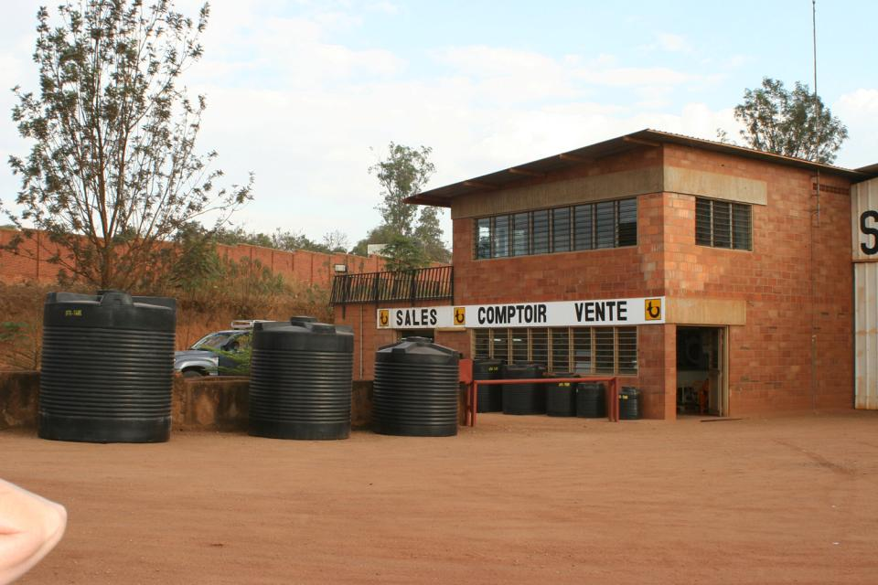

Slide 6
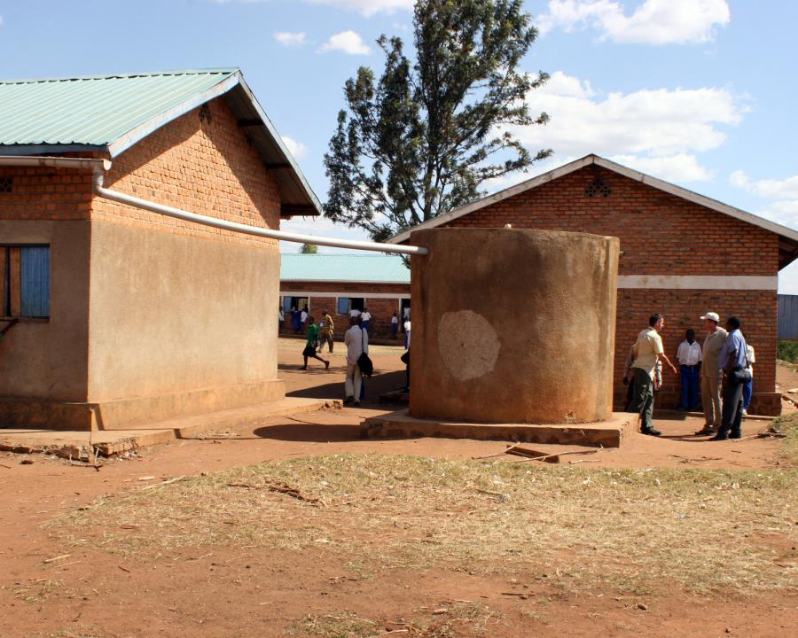

Slide 7
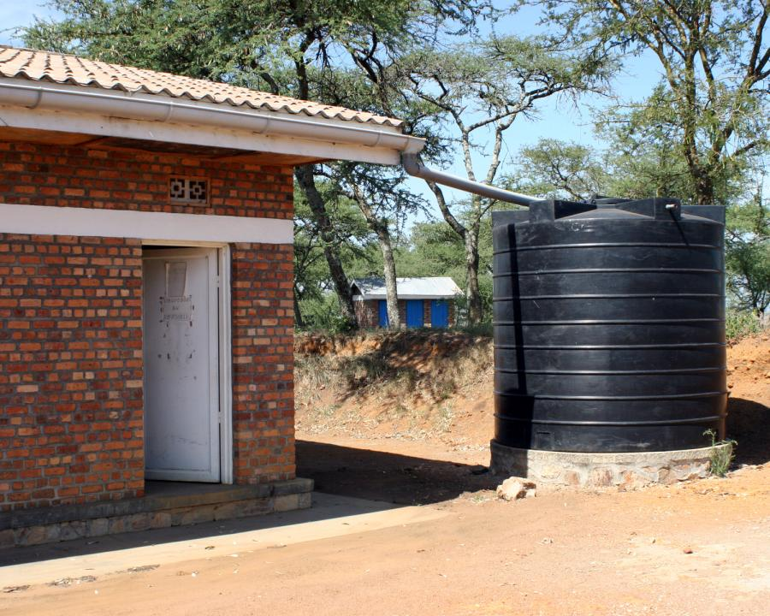

Slide 8
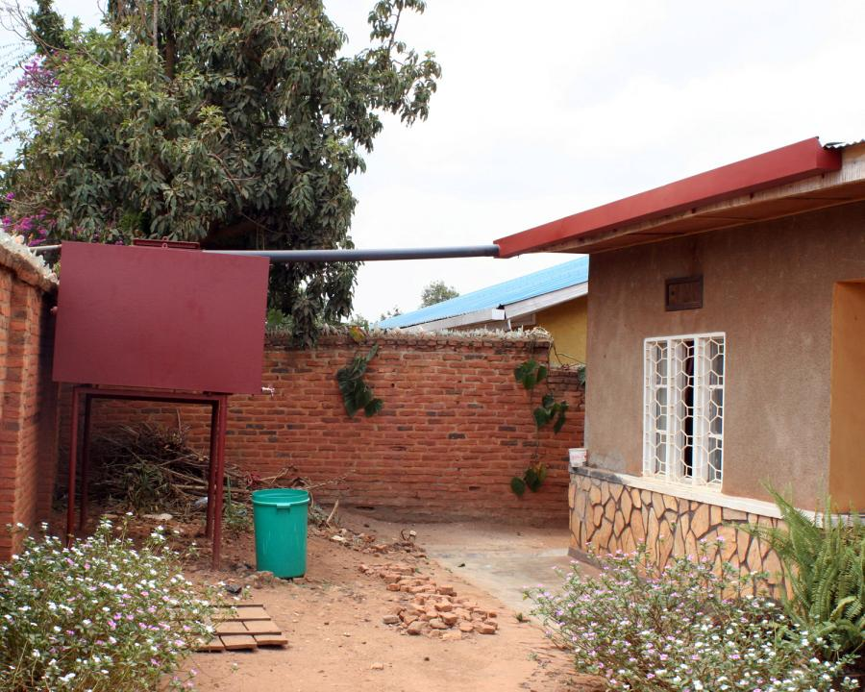
Notes:
Square shaped metal gutter with splashguard

Slide 9
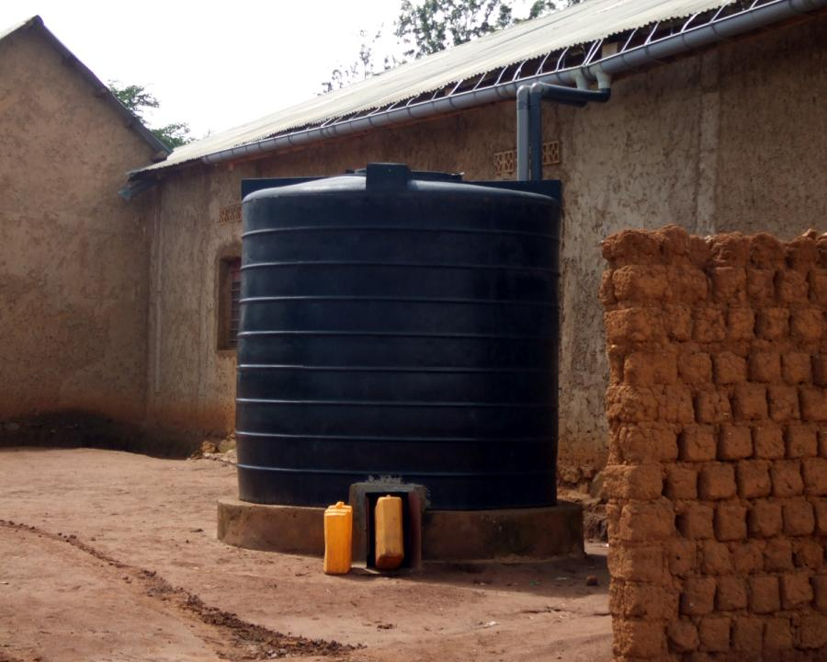
Notes:
Long roof run and so put tank in the middle.
Less run on the gutter makes it more stable.

Slide 10
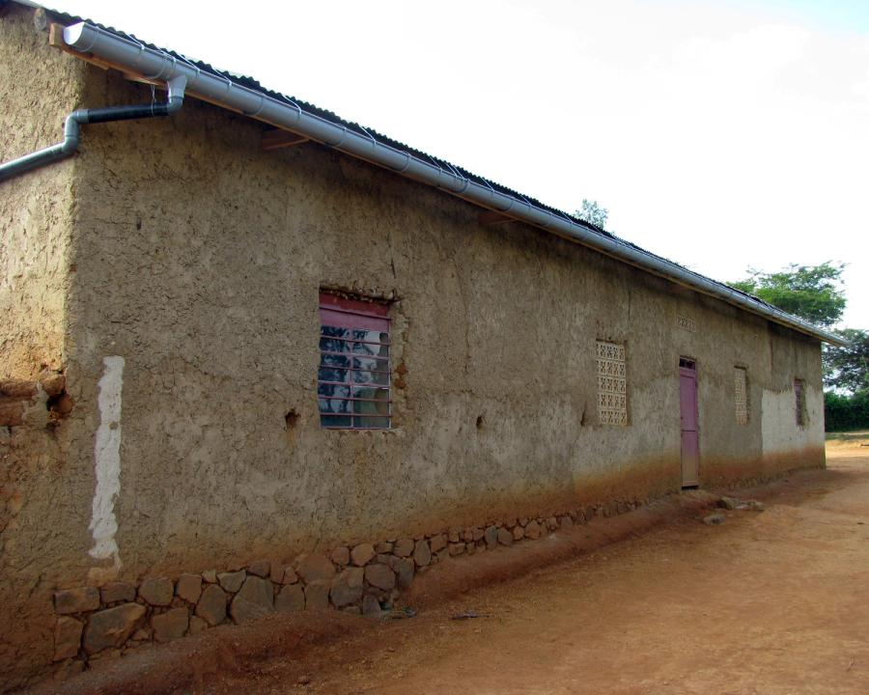

Slide 11
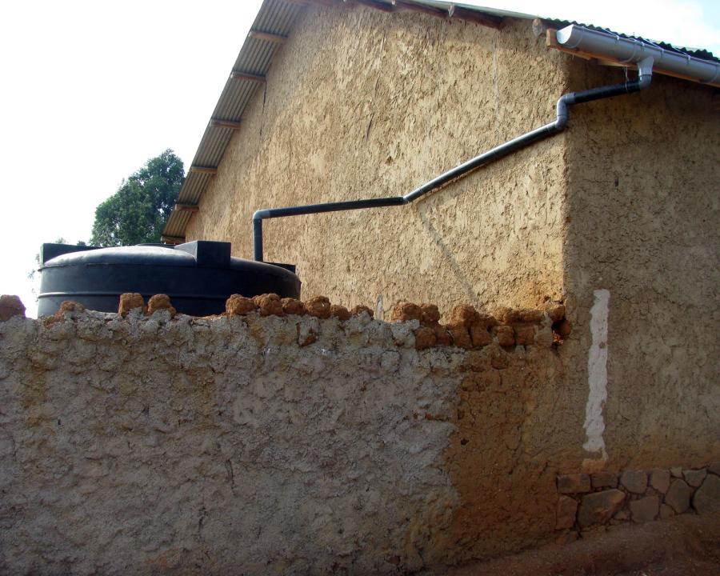
Notes:
Notice how the gutters are connected to the downspout and how it bends around the house.

Slide 12
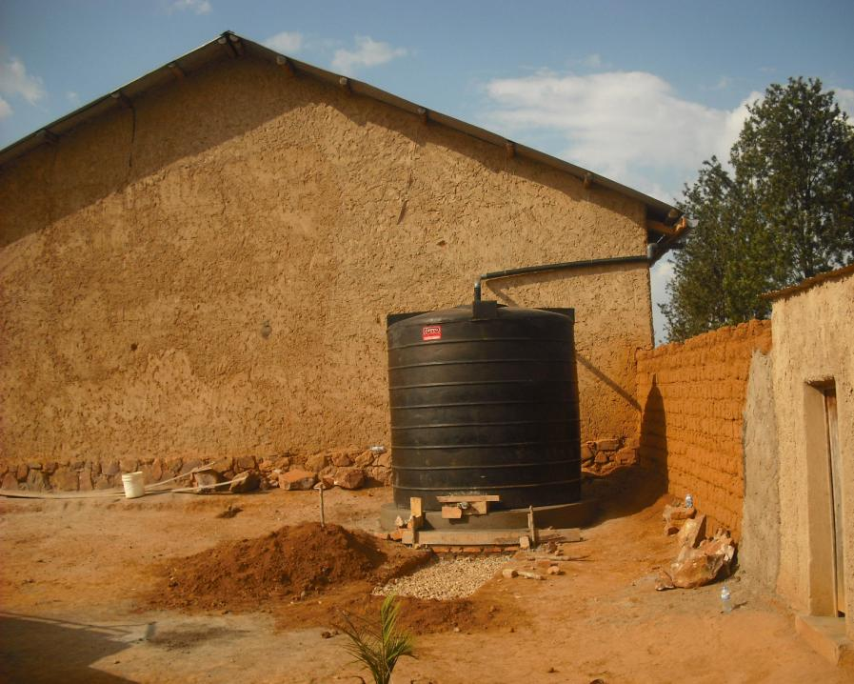

Slide 13
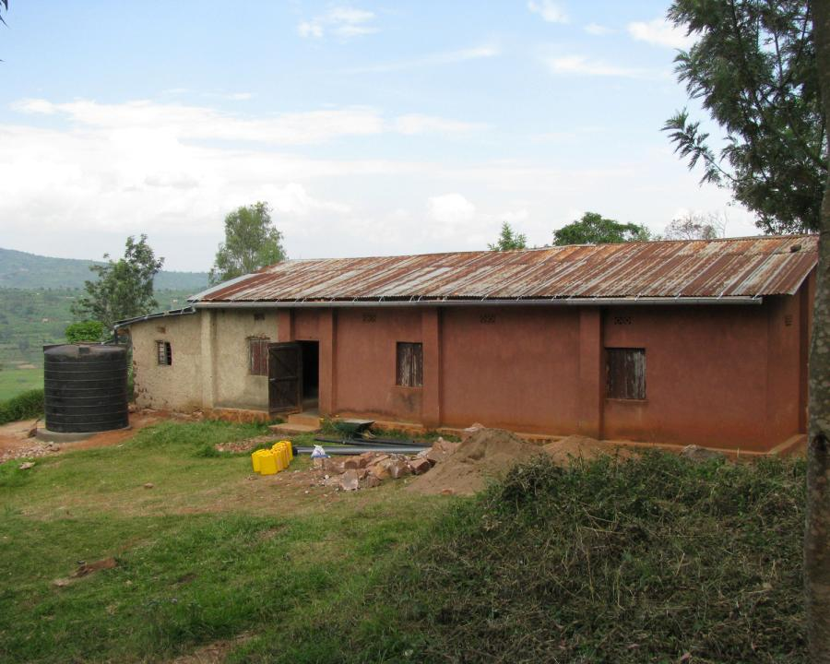

Slide 14
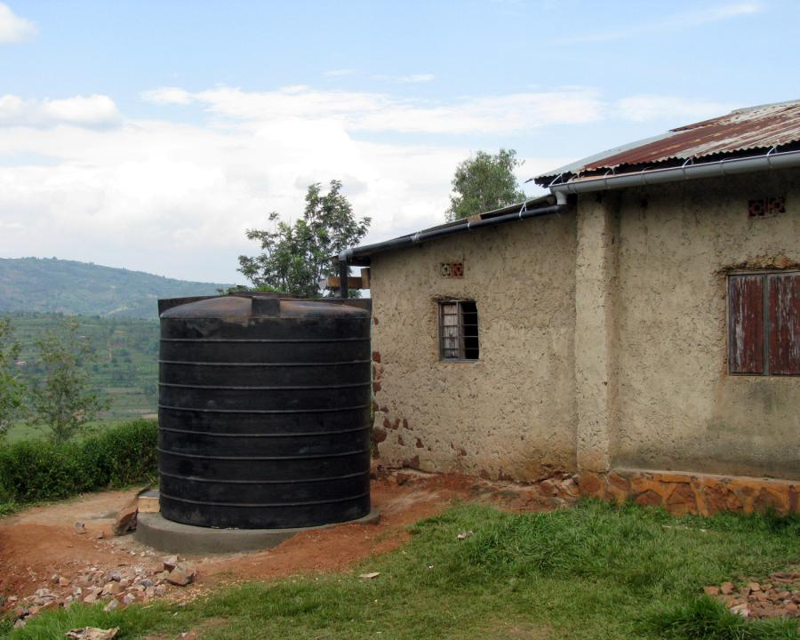

Slide 15
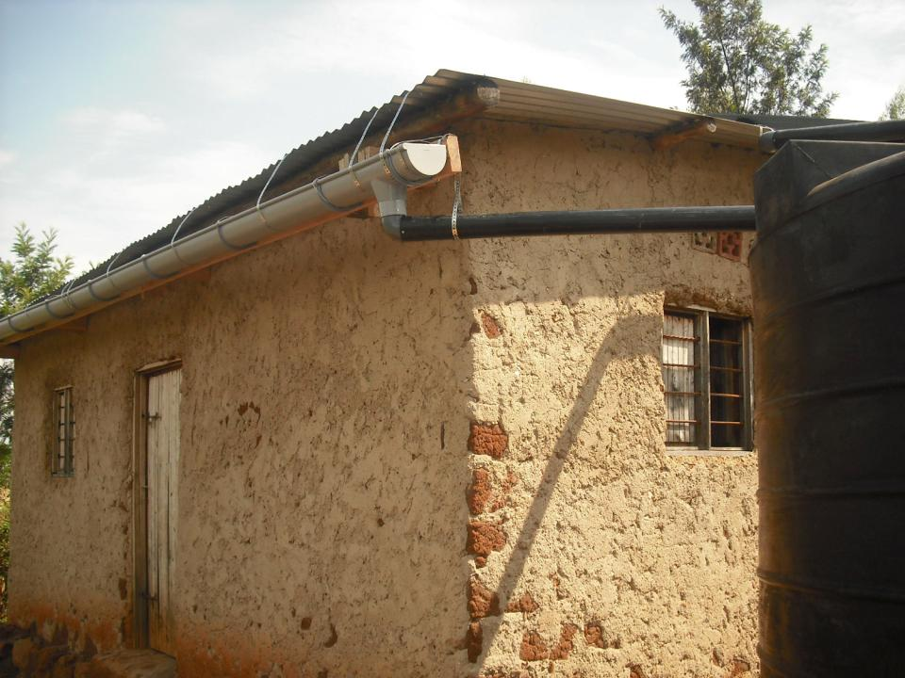
Notes:
Fascia board hung
Gutter attached to fascia
Held in place by brackets
Supported by straps

Slide 16
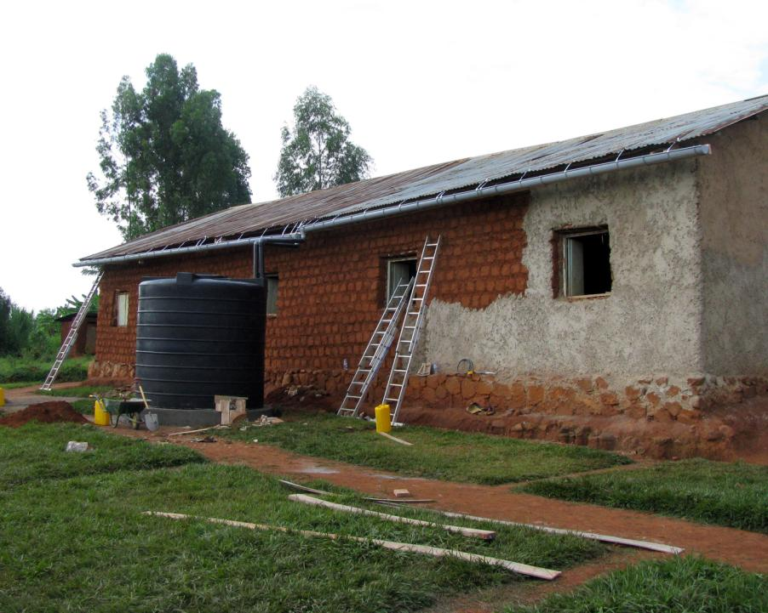

Slide 17
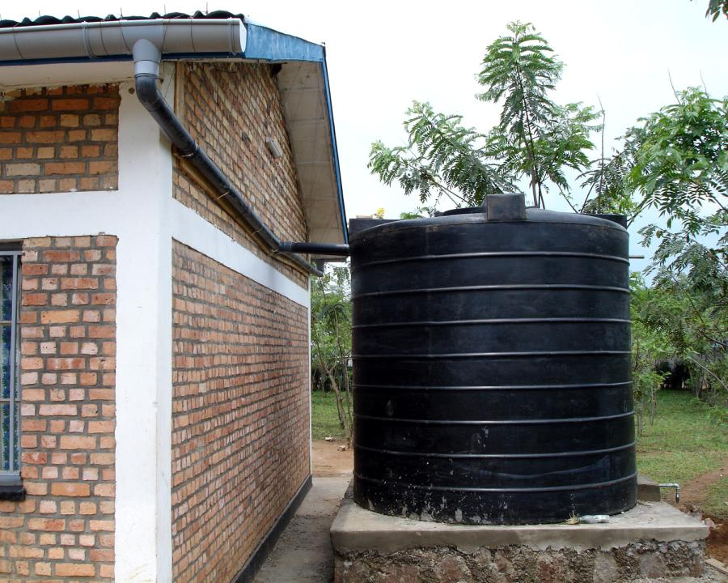

Slide 18
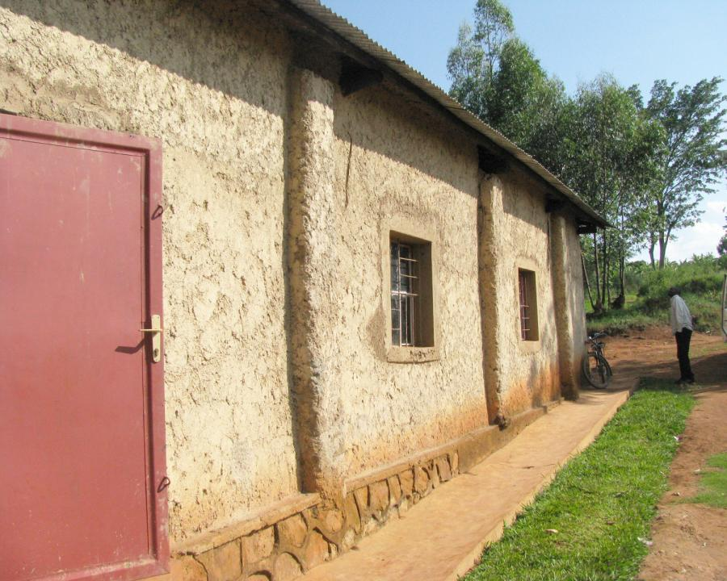

Slide 19
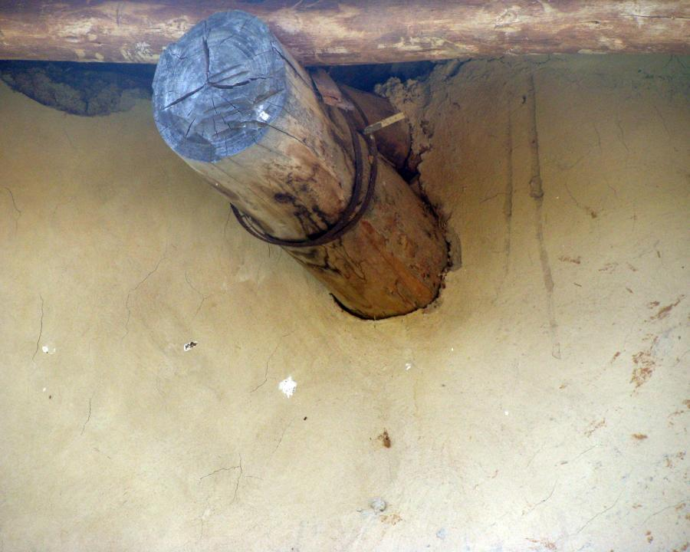
Notes:
This is where fascia can be mounted

Slide 20
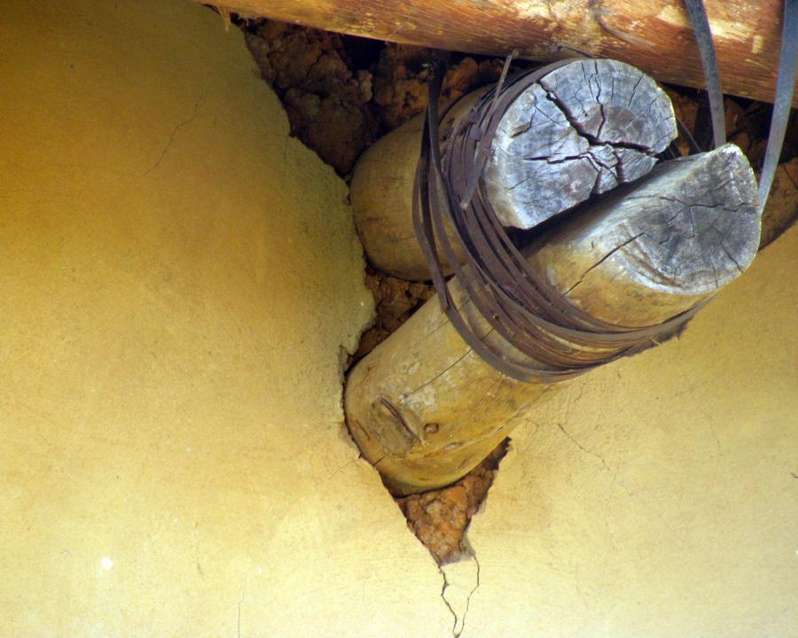

Slide 21
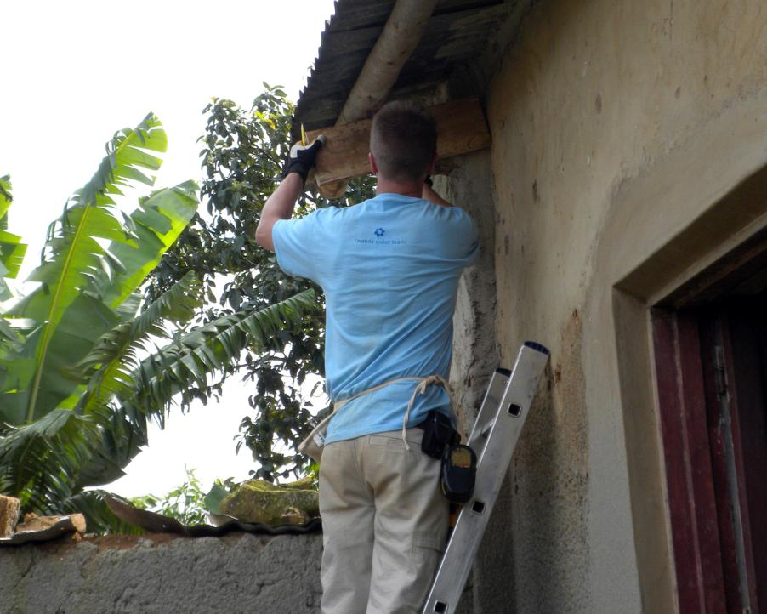

Slide 22
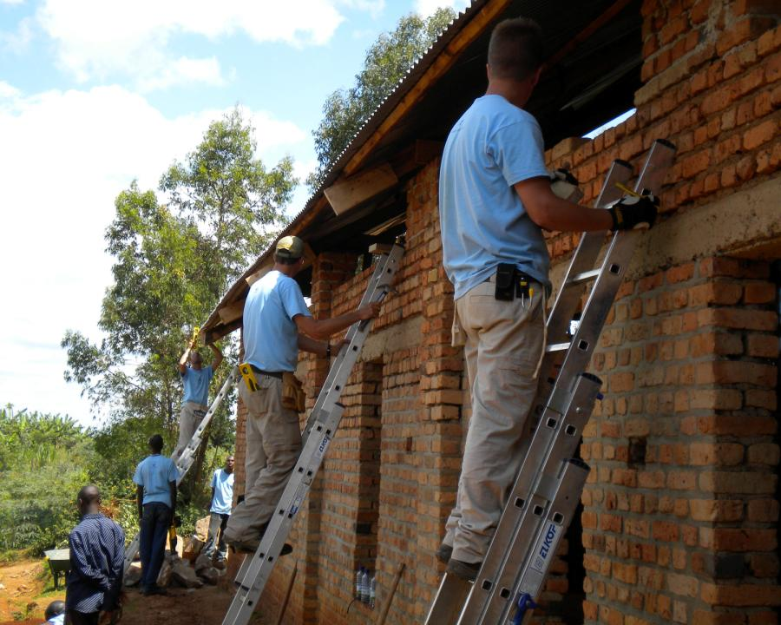

Slide 23
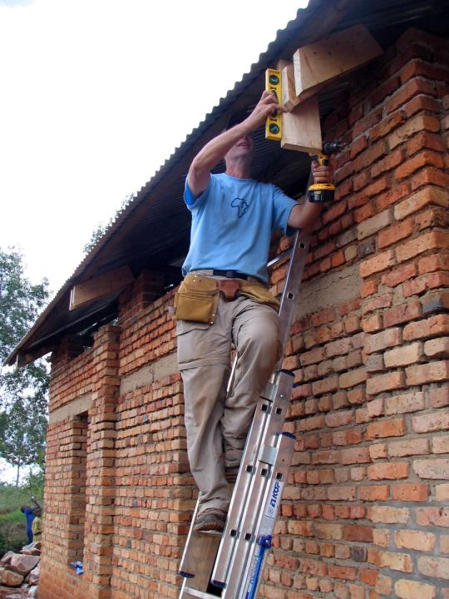

Slide 24
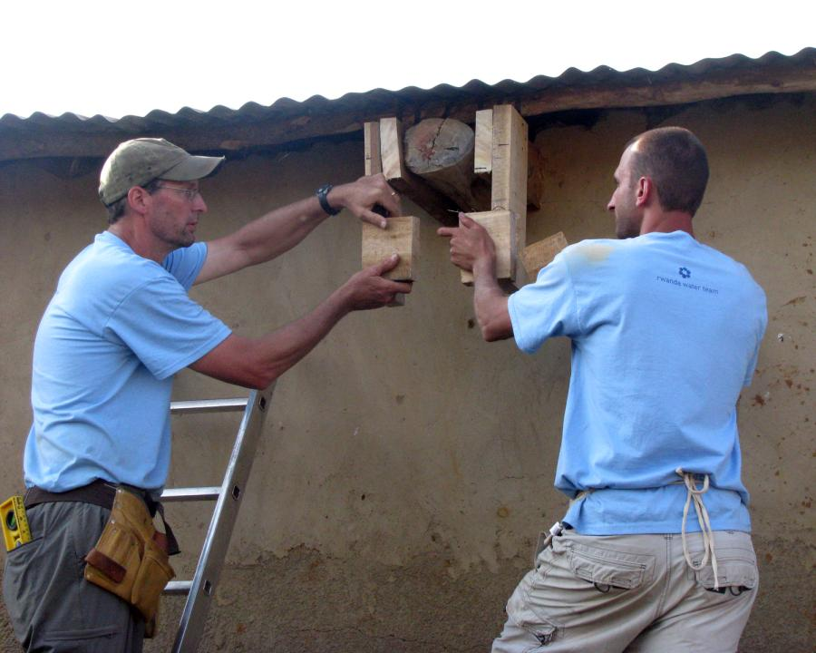

Slide 25
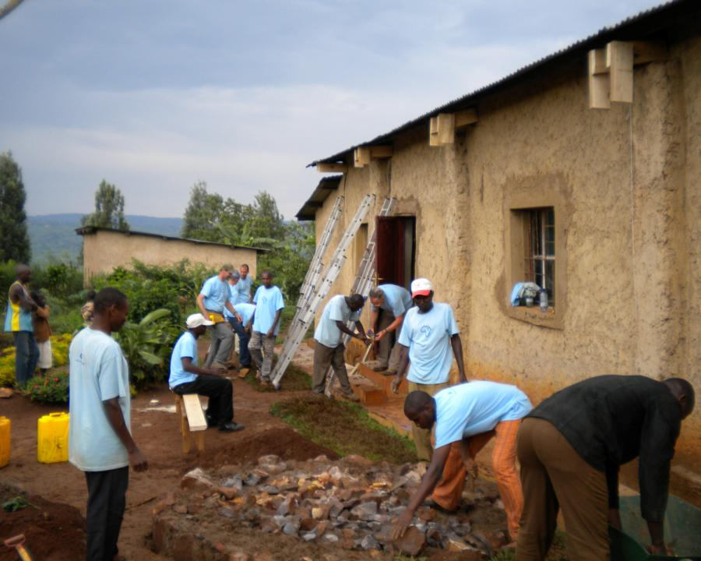

Slide 26
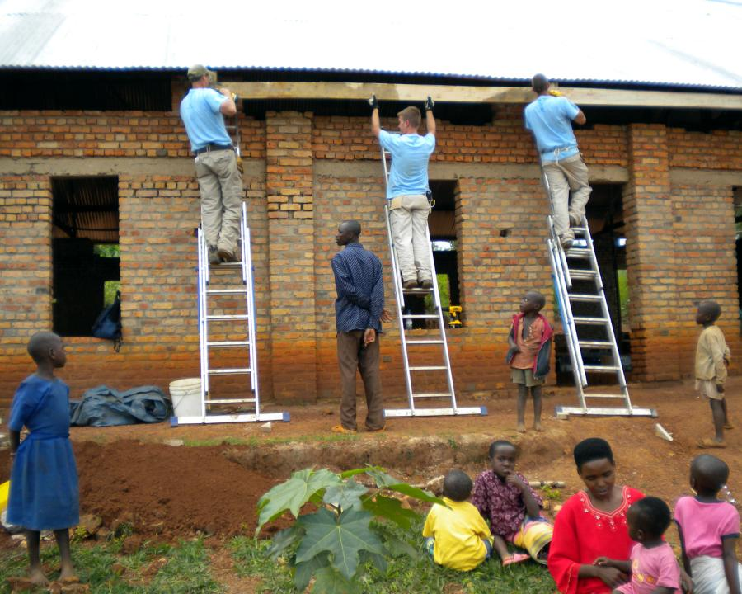

Slide 27
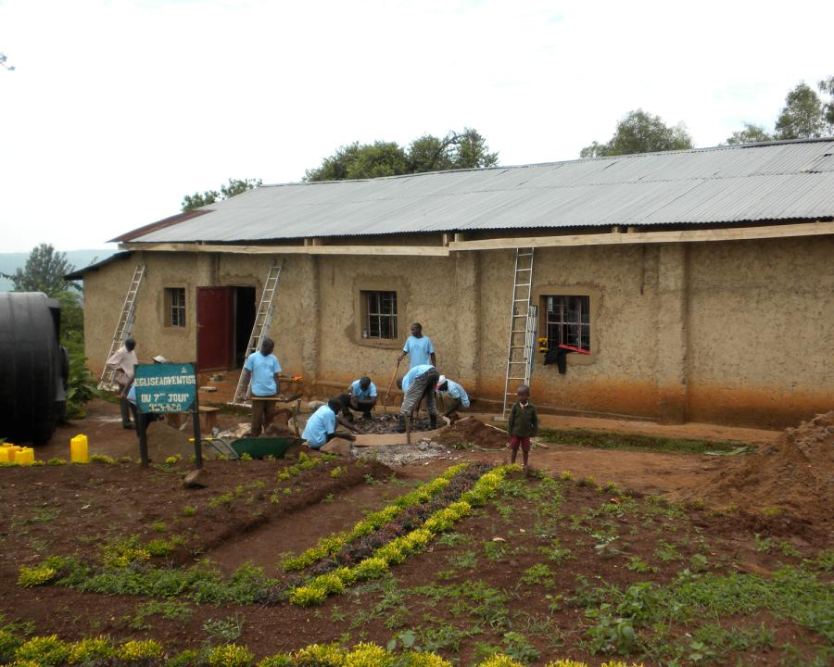

Slide 28
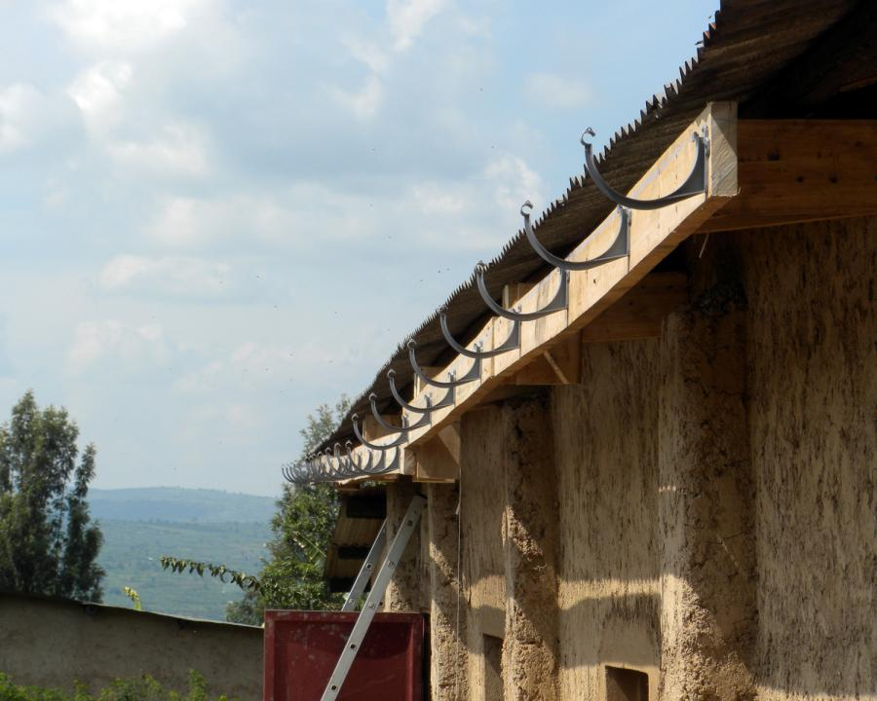

Slide 29
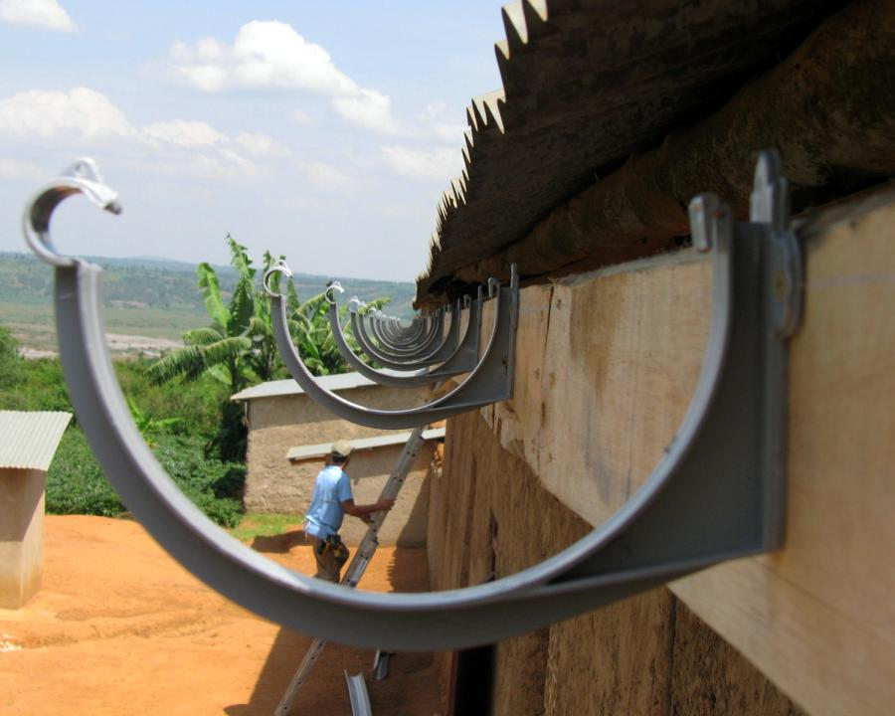

Slide 30
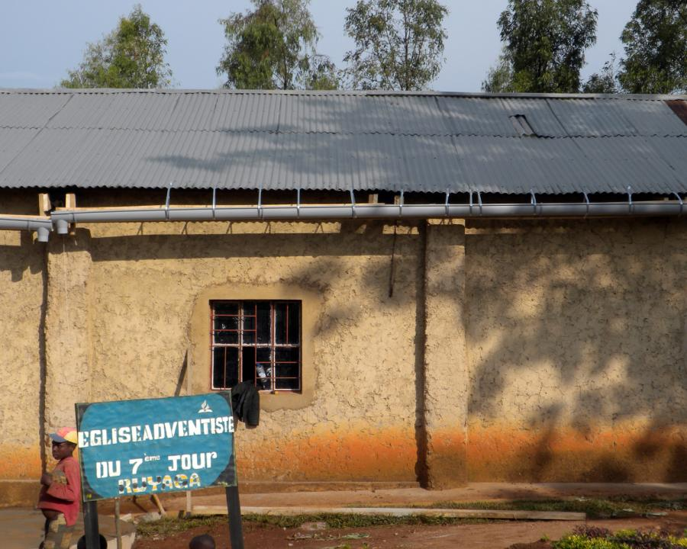

Slide 31
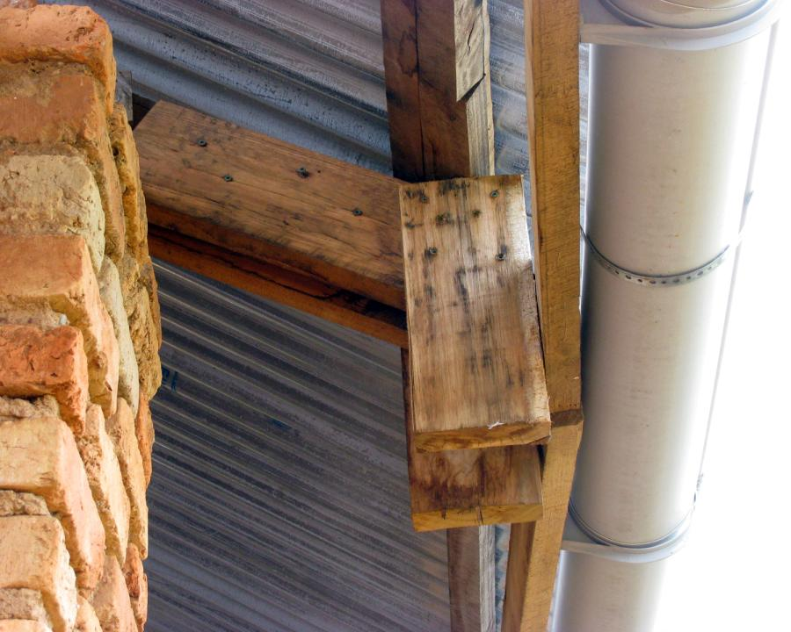

Slide 32
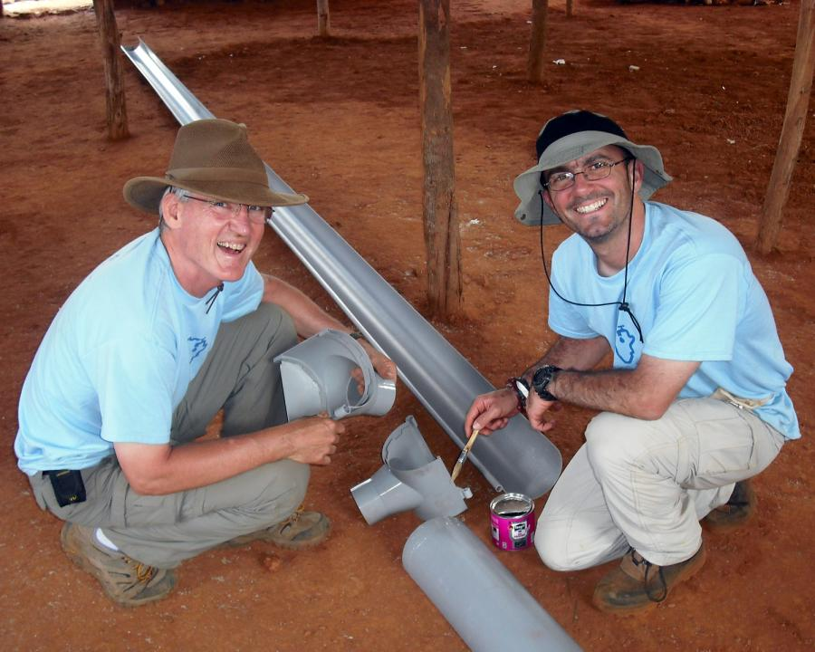

Slide 33
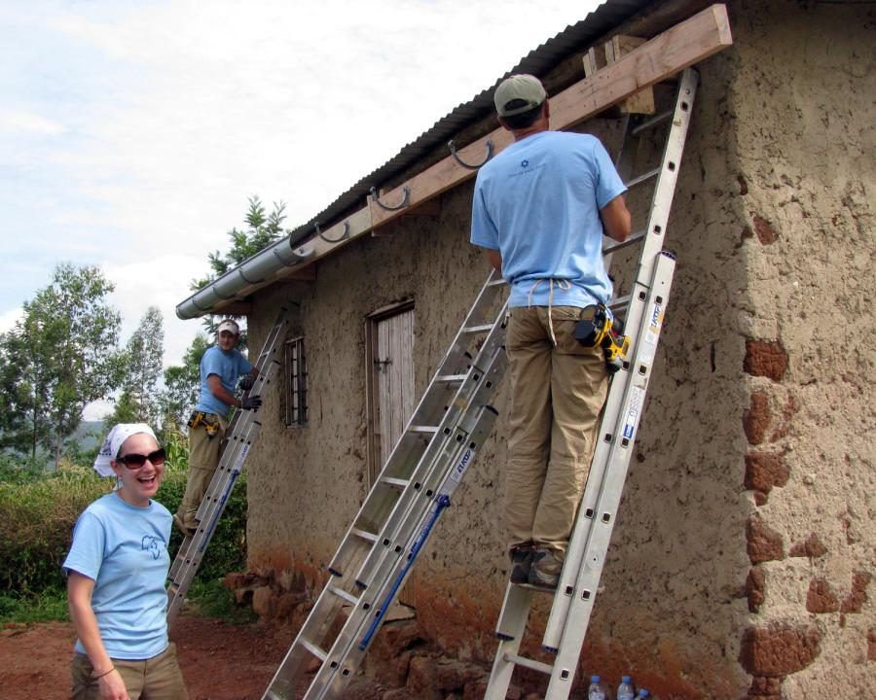

Slide 34
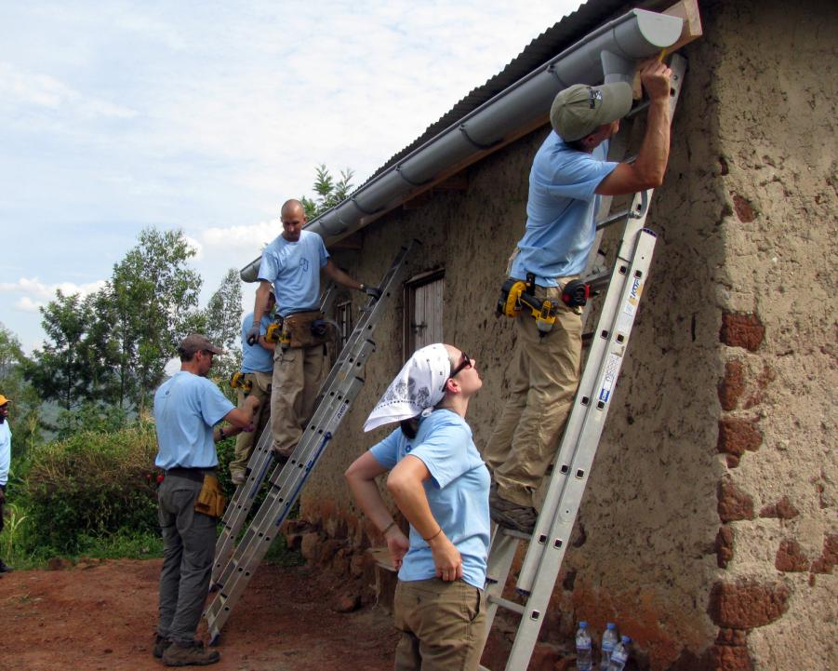

Slide 35
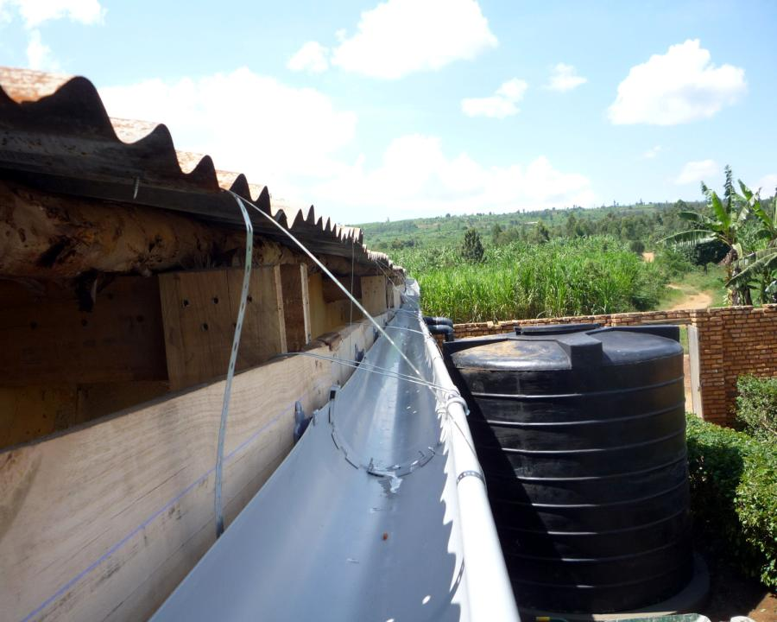

Slide 36
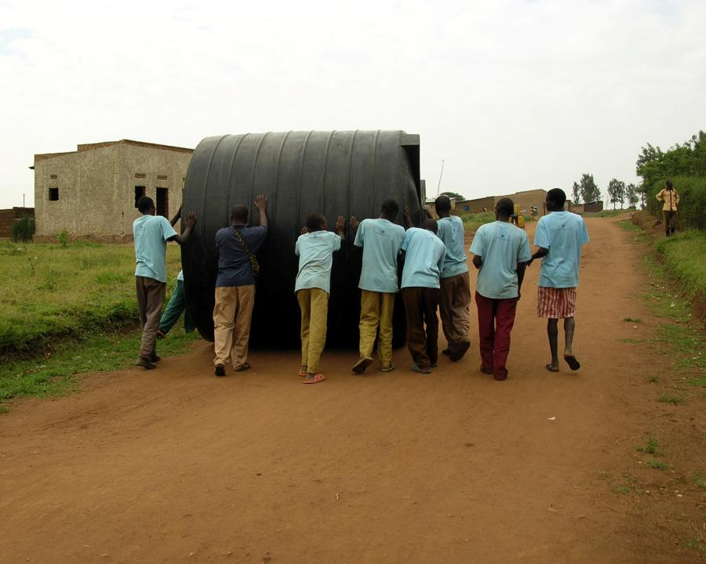

Slide 37
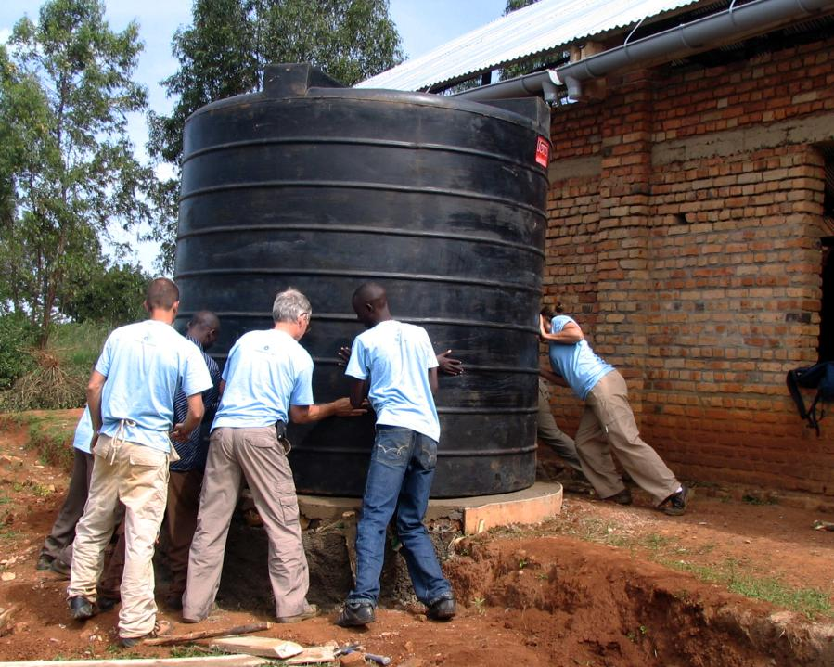

Slide 38
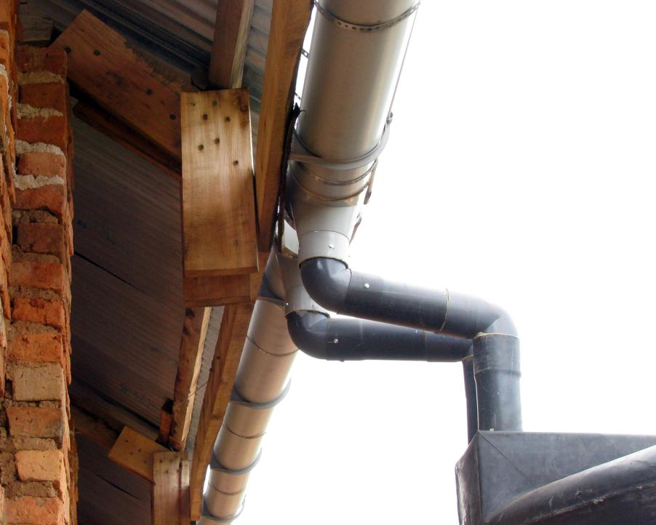

Slide 39
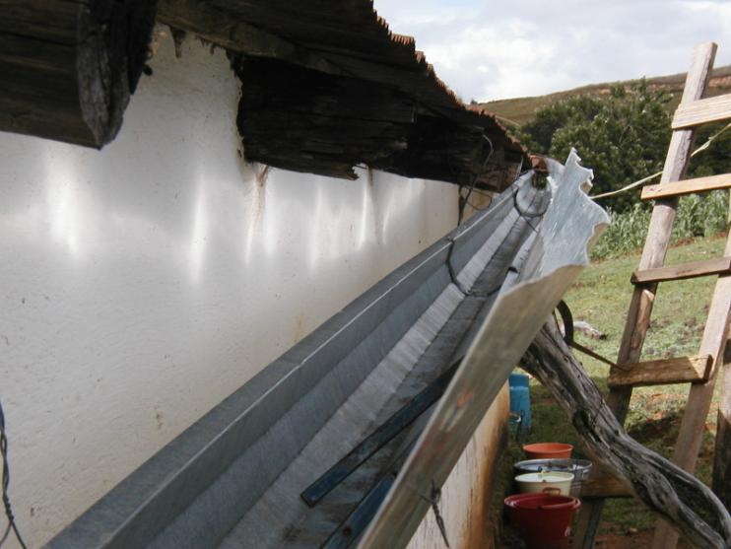
Gutter with Splash Shield - Mexico

Slide 40
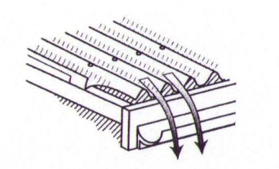
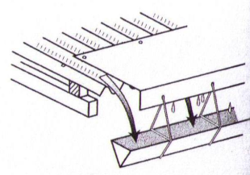
Splash Guards
Prevent runoff from overshooting the gutter and spilling onto the ground
Over shooting
Splash guard
(Gould and Nissen-Peterson, 1999)

Slide 41
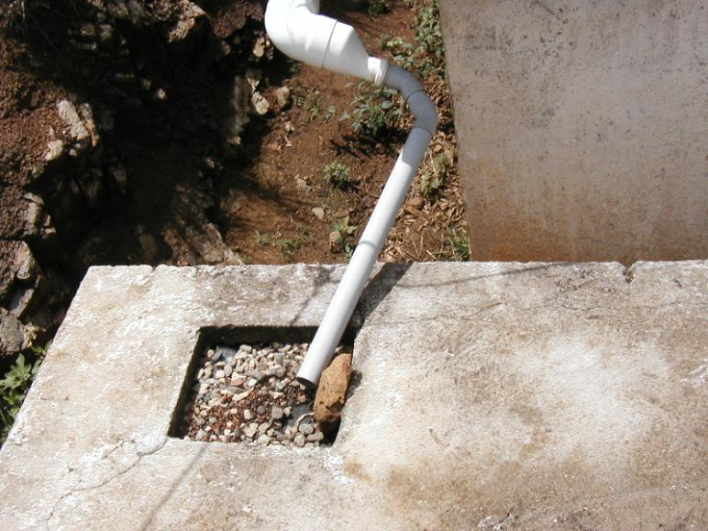
Filter on tank - Mexico

Slide 42

First Flush
Small drain hole at 9:00 o’clock position

