Slide 1
Gender:Concept and its terminologies
Resource Person

Slide 2
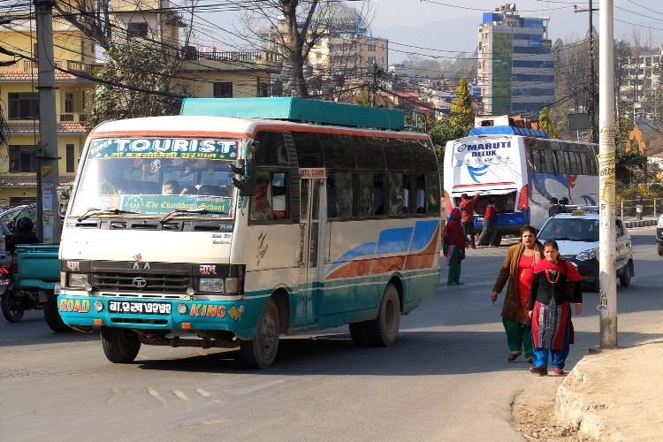
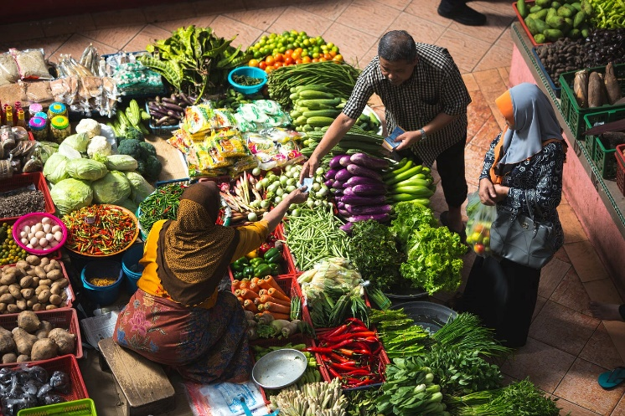
Introduction
What kind of work is expected from a male and female while travelling as a couple?
Who will pay your bills/ or the bill is presented to whom while doing grocery or sitting in a restaurant as a couple?
Notes:
Possible answer: Carrying luggage, buy ticket (heavy work or financial part) as a male partner and waiting for a male partner (looking after the luggage while male partner buy ticket) as a female partner)
Point 2- Possible answer: male partner
Linking with their answer, inform participants that basically, any heavy work or the payment related issues are directly pointed to male partners rather than other way out. Although, there is no such rule where male partners are to subjected for such activities. However, the society has formed and passed on such ideas through generations, relating to activities that a specific gender is entitled to.

Slide 3
Learning Outcome
Clarify the concept of gender
Describe gender related terminologies
Elaborate the concept of Gender Equality, Disability and Social Inclusion (GEDSI)

Slide 4
Presentation Outline
Concept of gender
Terminologies related to gender
Gender Equality, Disability and Social Inclusion (GEDSI)

Slide 5
Training Structure
1
2
3
4
5
6
7
Training Opening
Gender: Concept and its terminologies
Gender Mainstreaming
Laws and Policies for gender mainstreaming
Gender Perspective in WASH
Mainstreaming Gender in Project Cycle
Training
Closing
Notes:
This training includes

Slide 6
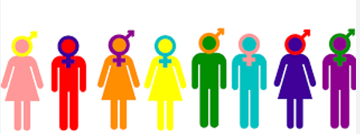
Gender
Gender refers to socially constructed roles, behaviours, expression and identities of girls, women, boys, men and gender diverse people.

Slide 7
Gender
Gender diverse people have been included – a community which is popularly called as LGBTIQA+
Lesbian, Gay, Bisexual, Transgender, Intersex, Queer, Asexual and other sexually or gender diverse (LGBTIQA+)
One people helps to ensure that services and organisations are inclusive and respectful

Slide 8
Sex and Gender
The physical state of being either male, female, or intersex
Sex generally refers to the biological differences that vary little over time and across cultures
Gender generally refers to socially constructed differences that can vary across time, societies, and cultures (and can be changed more easily).
Notes:
Summarize the SG activity with the content in slides

Slide 9
Sex (S)/Gender (G) Activity – SG Activity
Women give birth to babies, men don’t .
Sex
Girls are gentle, boys are rough.
Gender
Most long-distance truck drivers are men.
Gender
Women are fragile whereas men are protectors.
Gender
Women are only responsible for doing household chores.
Gender
Women are weak, incompetent and emotional in comparison to men.
Gender
Men are better leaders and administrators than women.
Gender
Women can breastfeed babies.
Sex
Men and women are born with different genitals.
Sex
Women have uterus whereas men don’t.
Sex
Notes:
After the Sex and Gender Activity.
Discussion on what differences between women and men are socially constructed and termed under gender, and what differences are biological and termed under sex.

Slide 10
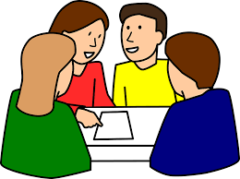
Gender terminologies - Group work
4 Groups
10 minutes
Notes:
Group Activity: ‘Match the appropriate terminologies’
3 terminologies in a group
Provide cut piece of terminologies and definition to match after group discussion and discuss about an example of that term in sanitation.

Slide 11
Gender terminologies
Gender identity | It is how someone feels about their own gender. It's about how you see yourself inside, not what others think you should be. In short, it is about how you feel inside regardless of external factors.
Example: Girls and women are generally expected to dress in typically feminine ways and be polite, accommodating, and nurturing.
Notes:
Gender identity is how someone feels about their own gender. It's about how you see yourself inside, not what others think you should be.
It can be:
A woman
A man
Both
Neither
Something else entirely
Important to remember:
Everyone's gender identity is different.
It doesn't always match the sex you were assigned at birth.
In short, gender identity is about how you feel inside.

Slide 12
Gender terminologies
Gender norms | They are the rules society sets about how men and women should behave, dress, and act. They're like unspoken guidelines about what's "normal" for boys and girls. These rules can be different in different places and change over time
Example: It's inappropriate or unsafe for women to be outside of their homes after dark
Notes:
Gender norms are the rules society sets about how men and women should behave, dress, and act.
They're like unspoken guidelines about what's "normal" for boys and girls. For example, the idea that girls should like pink and dolls, while boys should like blue and trucks, is a gender norm.
These rules can be different in different places and change over time
Note: Example of gender norms can be linked with access to WASH facilities and services to women and men. Gender norms in some communities might dictate that it's inappropriate or unsafe for women to be outside of their homes after dark. This can impact women's and girls' access to sanitation facilities, especially if they need to use a toilet or washroom during the night. Such norms can lead to women and girls waiting until dark for privacy, which can have health implications.

Slide 13
Gender terminologies
Gender roles | They are behaviour, attitudes, and actions that society feels are appropriate or inappropriate for a man or woman, boy or girl, according to cultural and traditions.
Example: Maintenance tasks, especially those requiring physical strength or technical aspect (like ﬁxing a handpump), are often designated as "men's work" due to societal gender roles.

Slide 14
Gender terminologies
Gender Equality | It means that everyone, no matter if they are a girl, boy, woman, man, or something else, has the same rights, chances, and responsibilities. It's about being fair to everyone, no matter what their gender is.
Example: A sanitation facility is being constructed where both women and men are included in planning and decision making process. This ensures preferences and views of both of the gender leading to widely accepted sanitation facility by entire community.

Slide 15
Gender terminologies
Gender Equity | Provision of fairness and justice in the distribution of benefits and responsibilities between women, men and others.
Example: A women are primarily responsible for fetching water in some communities, water points can be designed to consider the physical stature and strength of women. This might involve making handpumps easier to operate or piped-line water with tap connection in the kitchen.

Slide 16
Gender terminologies
Gender role stereotyping | A portrayal, in media or books or conversations, of socially assigned gender roles as "normal" and "natural."
Example: Society considered women to be weak, incompetent and only made for household chores, and men are considered to be strong, competent and work outside and manages household finances

Slide 17
Gender terminologies
Gender Mainstreaming | It is a process aimed at integrating a gender perspective into all aspects of projects, activities, and organizational processes. This process ensures that women and men have equal access to and control over resources, development benefits, and decision-making at all stages of the development process.
Example: To data collection to understand the existing gender gaps, inequalities, speciﬁc needs, challenges, and to implementation of policies, projects that ensures developmental benefit of development process integrating all gender.

Slide 18
Gender terminologies
Social Inclusion | Improving the lives of disadvantaged people by giving them more opportunities, resources, and a voice.
Example, in relieving poverty or sickness or the needs of old age, an organisation might concentrate on building the capacity of people in poverty (or people who are sick or old) to enable them to be included in society as a means of relieving their needs and promoting social inclusion.

Slide 19
Gender terminologies
Social Exclusion | A state in which individuals are unable to participate fully in economic, social, political and cultural life, as well as the process leading to and sustaining such a state.
Example, people belonging to certain castes are excluded from equal opportunities.

Slide 20
Gender terminologies
Data: Sex or Gender Disaggregated | Information differentiated on the basis of what pertains to women and their roles and to men and their roles. More correctly termed sex-disaggregated when collected and analyzed for men and women
Example, Data collected and tabulated separately for women and men. Data to gain insights into the specific needs and experiences of different groups within a community.

Slide 21
Gender terminologies
Gender Analysis | Critical examination of how differences in gender roles, activities, needs, opportunities and rights/entitlements affect women, men, girls and boys in a given policy area, situation or context.
Example, Identify the speciﬁc needs, roles, and challenges of both men and women in the target community. This analysis will serve as the foundation for project design.

Slide 22
Gender terminologies
Gender Equality, Disability, and Social Inclusion (GEDSI) | It's about making sure everyone, regardless of their background, has equal access to opportunities, while also understanding that some people face extra challenges that need to be addressed.
Notes:
It aims to ensure everyone has equal access to resources, services, and decision-making, while also respecting their diverse backgrounds and needs. It acknowledges that certain groups, like women, people with disabilities, and marginalized communities, face barriers and discrimination that limit their full participation in society.

Slide 23
Gender Equality, Disability and Social Inclusion (GEDSI)

Slide 24
Concept of GEDSI
Gender Equality, Disability and Social Inclusion (GEDSI) aims to promote the fundamental principles of equal access of all individuals (while valuing and addressing their diverse backgrounds and needs) to:
resources
services
decision-making processes
GEDSI is previously called GESI
Notes:
Gender Equality, Disability, Social Inclusion (GEDSI) aims to promote the fundamental principles of equal access to resources, services, and decision-making processes for all individuals while valuing and addressing their diverse backgrounds and needs

Slide 25
Gender Equality, Disability and Social Inclusion (GEDSI)
Gender Equality is the state or condition that affords women and girls, men and boys, equal enjoyment of human rights, socially valued goods, opportunities, and resources.
It includes expanding freedoms and voice, improving power dynamics and relations, transforming gender roles and enhancing overall quality of life so that women and men could achieve their full potential.
(WorldVision, 2023)

Slide 26
Gender Equality, Disability and Social Inclusion (GEDSI)
Social inclusion seeks to address inequality and/or exclusion of vulnerable populations by improving terms of participation in society and enhancing opportunities, access to resources, voice and respect for human rights.
It seeks to promote empowerment and advance peaceful and inclusive societies and institutions.
(WorldVision, 2023)

Slide 27
Gender Equality, Disability and Social Inclusion (GEDSI)
Disability inclusion is part of our overall gender equality and social inclusion approach, as a vital part of social inclusion programming.
Our work on disability inclusion also considers how intersectionality, gender and other social norms impact the situation for persons, children with disabilities.
(WorldVision, 2023)

Slide 28
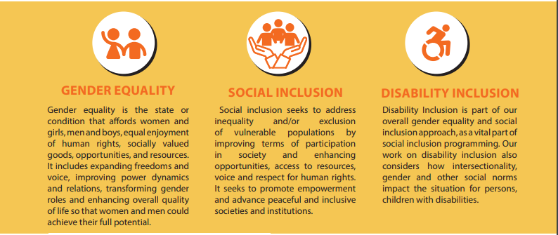
Gender Equality, Disability and Social Inclusion (GEDSI)
(WorldVision, 2023)

Slide 29
Concept of GEDSI
GEDSI identifies obstacles and forms of discrimination to women, individuals with disabilities, marginalized communities
Identifies the hinderness for full participation in and integration into society and development
Notes:
GEDSI recognizes that certain segments of the population, including
women,
individuals with disabilities, and
marginalized communities,
and encounter various obstacles and forms of discrimination that hinder their full participation in and integration into society and development.

Slide 30
Concept of GEDSI
highlights the complex interactions between
social,
cultural,
economic,
and environmental elements
that influence equity and inclusion
It aims to identify the underlying structures, institutions, and norms

Slide 31
Importance of GEDSI- Group work
4 Groups
10 minutes
Notes:
to have access in urban sanitation and facilities by all (marginalized group, disable people, LGBTIQA+ community members, male and female), mentioned in the constitution of Nepal as a basic human rights, etc.

Slide 32
Importance of GEDSI
Human rights
Gender integration has mentioned in Constitution of Nepal
Contribution in achieving Sustainable Development Goal (SDG)
Promotes inclusive policies on increasing the power of excluded, women and poor
Notes:
Trainers’ Note: to have access in urban sanitation and facilities by all (marginalized group, disable people, LGBTIQA+ community members, male and female), mentioned in the constitution of Nepal as a basic human rights, etc.
GEDSI is a about human rights and the health and well –being of individual
Gender integration has mentioned in Constitution of Nepal (The Constitution of Nepal, 2015 lays a strong and comprehensive foundation for GEDSI in Nepal, with a clear vision of an inclusive state that guarantees the right to equality for all its citizens)
Contribution in achieving Sustainable Development Goal (SDG)
Promotes inclusive policies on increasing the power of excluded, women and poor

Slide 33
Importance of GEDSI
Eliminate existing barriers
Support in development and implementation of gender transformative developmental programs, policies, and services
Sustainable and inclusive development
Ensure respectful, safe and fair working environment at all level
Notes:
Trainers Note
Eliminate existing barriers in order to increase access, enable decisions making and participation of marginalized populations.
GEDSI supports in development and implementation of gender transformative developmental programs, policies, and services.
Sustainable and inclusive development – realizing full potential to contribute to national, economic, political, social and cultural development
Ensure respectful, safe and fair working environment at all level

Slide 34
Review
Pair discussion
Why the concept of GEDSI is important in sanitation?
Allow 2-3 pairs to share

