Slide 1
424 Aviation Road NE
Calgary, Alberta, T2E 8H6, Canada
Phone: + 1 (403) 243-3285, Fax: + 1 (403) 243-6199
E-mail: resources@cawst.org, Website: www.cawst.org
CAWST, the Centre for Affordable Water and Sanitation Technology, is a nonprofit organization that provides training and consulting to organizations working directly with populations in developing countries who lack access to clean water and basic sanitation.
One of CAWST’s core strategies is to make knowledge about water common knowledge. This is achieved, in part, by developing and freely distributing education materials with the intent of increasing the availability of information to those who need it most.
This document is open content and licensed under the Creative Commons Attribution Works 3.0 Unported License. To view a copy of this license, visit http://creativecommons.org/licenses/by/3.0 or send a letter to Creative Commons, 171 Second Street, Suite 300, San Francisco, California 94105, USA.
You are free to:
Share – to copy, distribute and transmit this document
Remix – to adapt this document
Under the following conditions:
Attribution. You must give credit to CAWST as the original source of the document. Please include our website: www.cawst.org
CAWST will produce updated versions of this document periodically. For this reason, we do not recommend hosting this document to download from your website.
CAWST and its directors, employees, contractors, and volunteers do not assume any responsibility for and make no warranty with respect to the results that may be obtained from the use of the information provided.
Stay up-to-date and get support:
Latest updates to this document
Other workshop & training related resources
Support on using this document in your work
CAWST provides mentorship and
coaching on the use of its education
and training resources.

Slide 2
This presentation is used with Lesson Plan 3: Introduction to Environmental Sanitation in the Introduction to Environmental Sanitation Trainer Manual.
Available at www.cawst.org/resources

Slide 3
What is Environmental Sanitation?

Slide 4
Learning Outcomes
Identify the different aspects of environmental sanitation.
Explain the difference between sanitation and environmental sanitation.

Slide 5
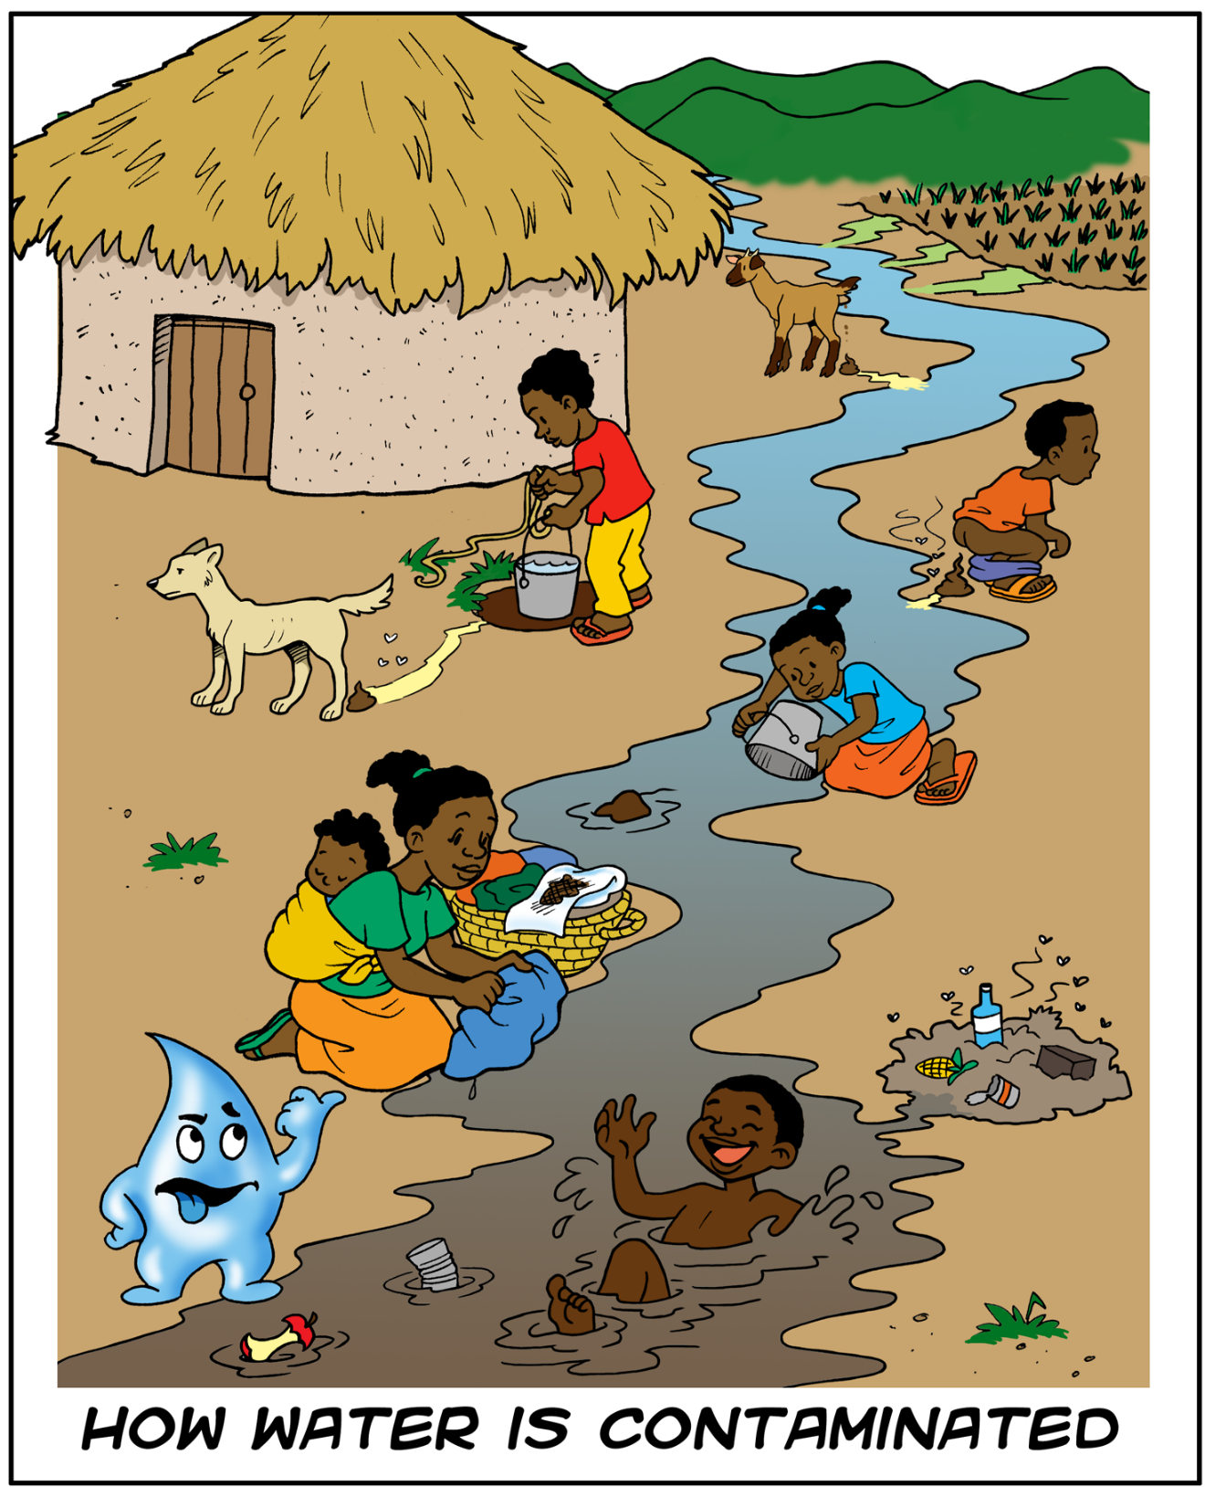
Notes:
Africa

Slide 6
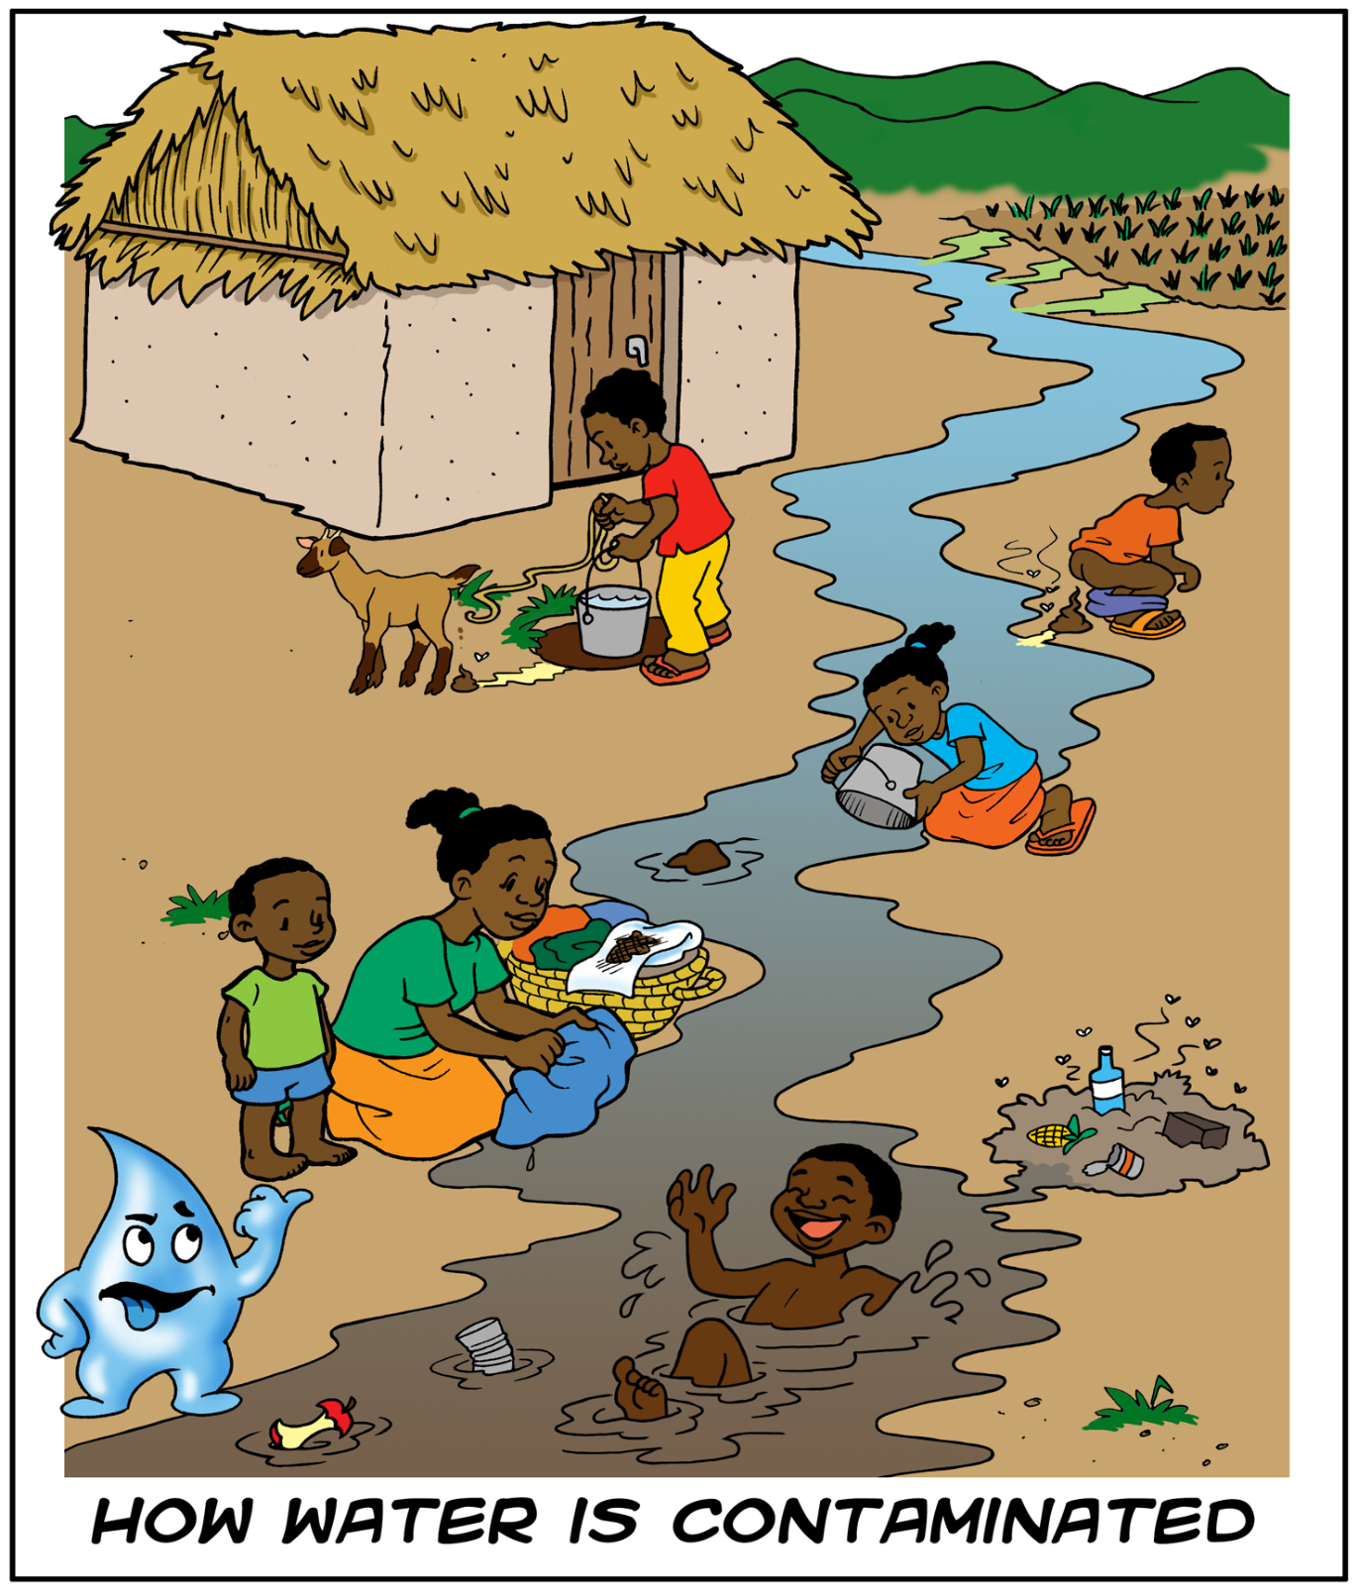
Notes:
Caribbean - Haiti

Slide 7
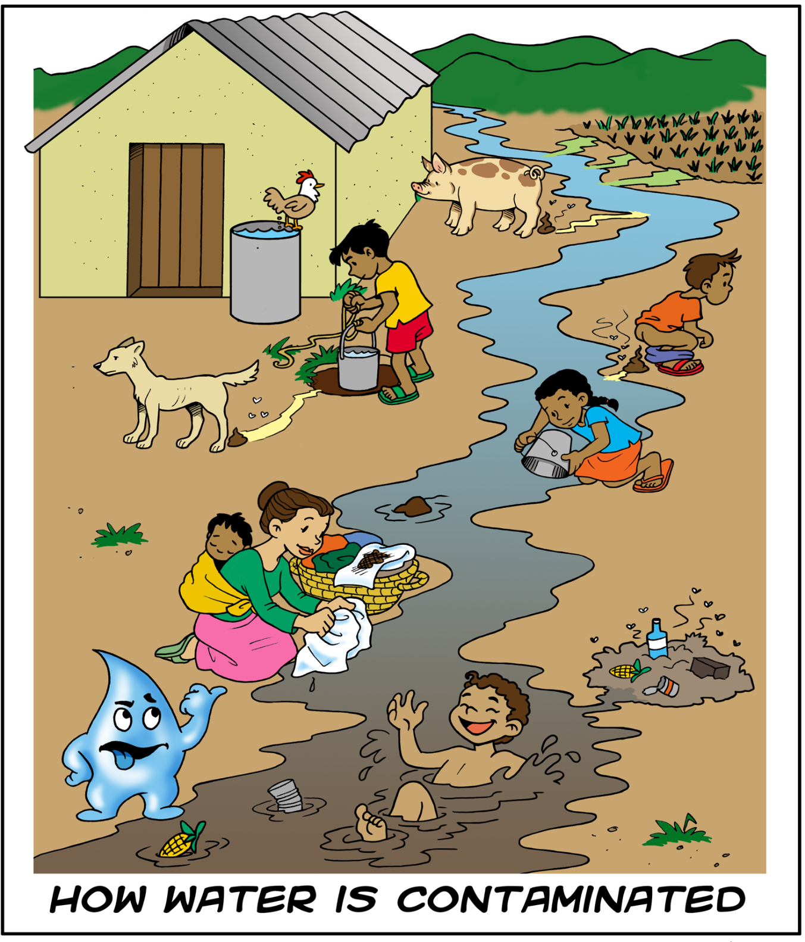
Notes:
Latin America

Slide 8
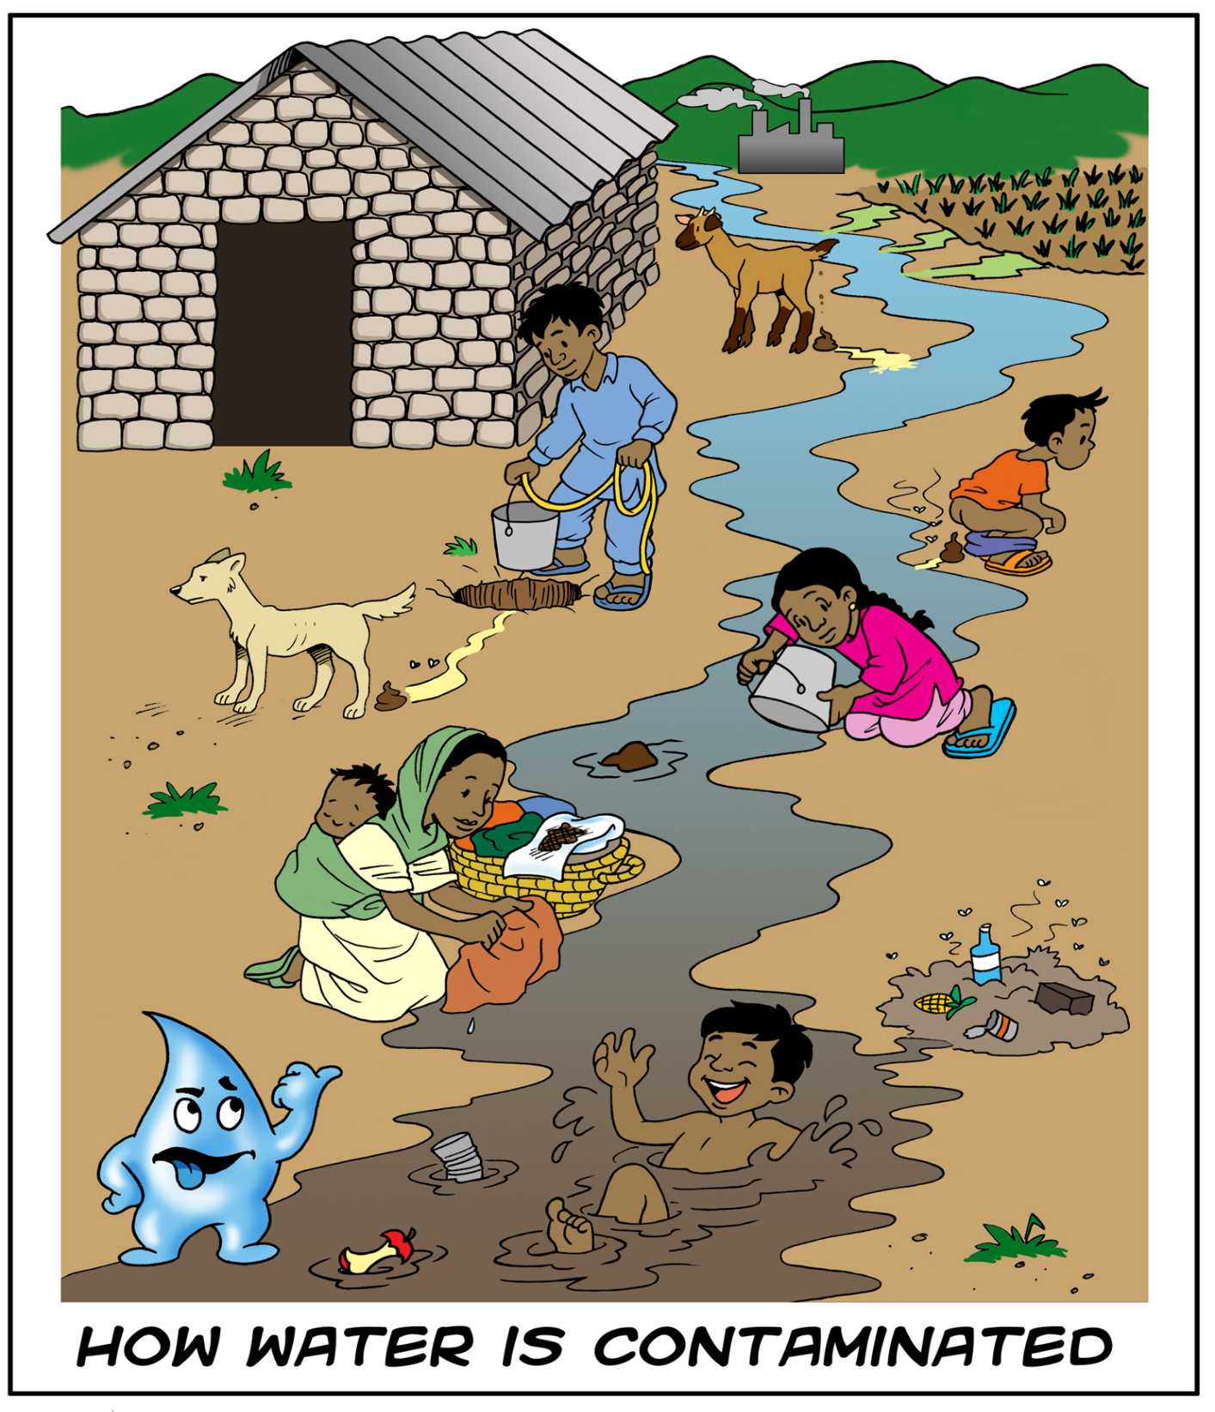
Notes:
South Asia

Slide 9
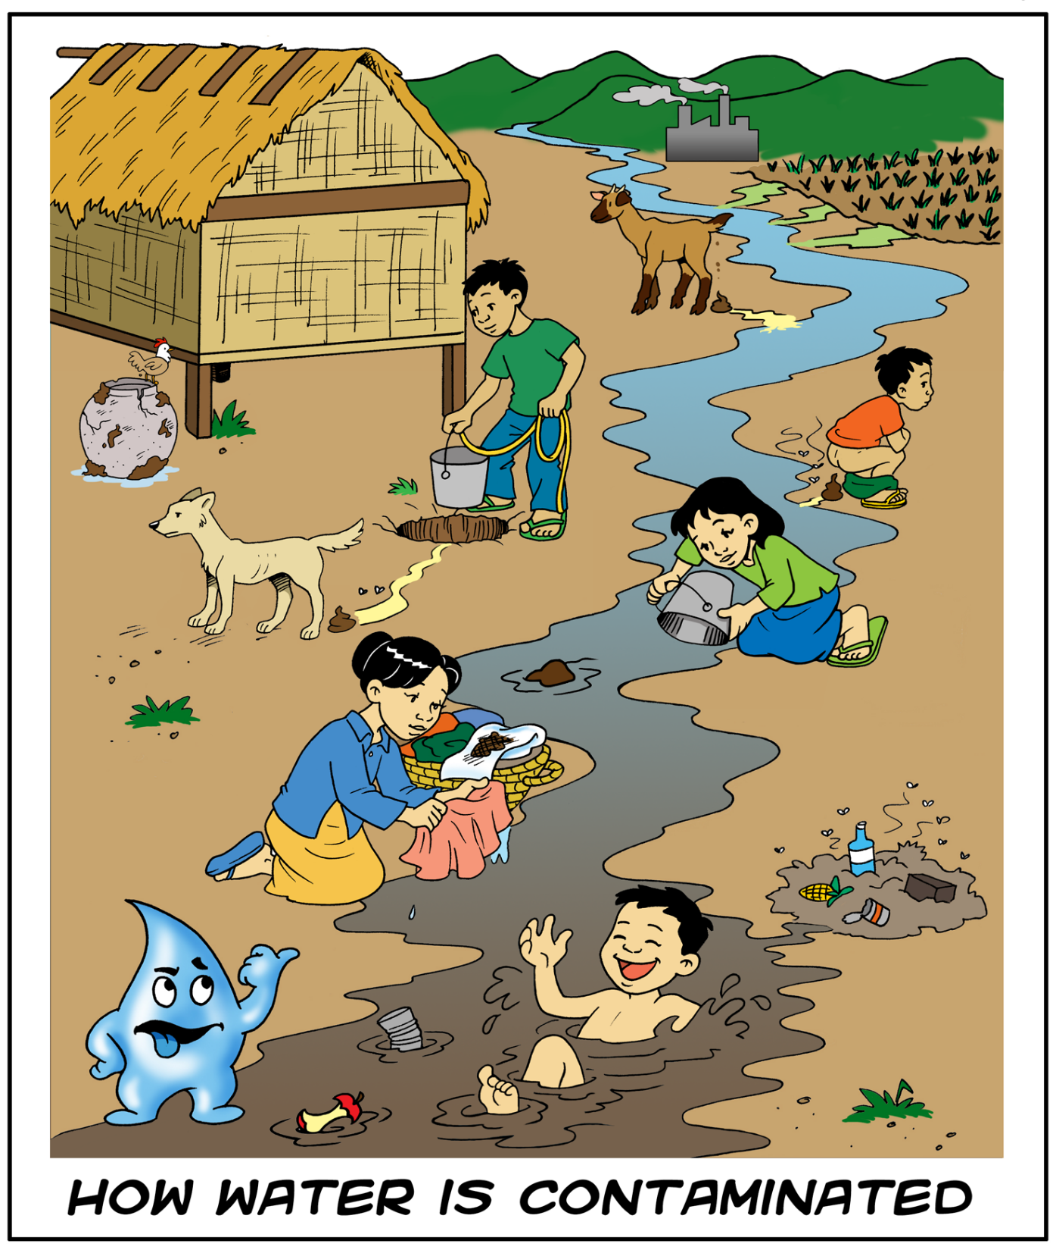
Notes:
South East Asia

Slide 10
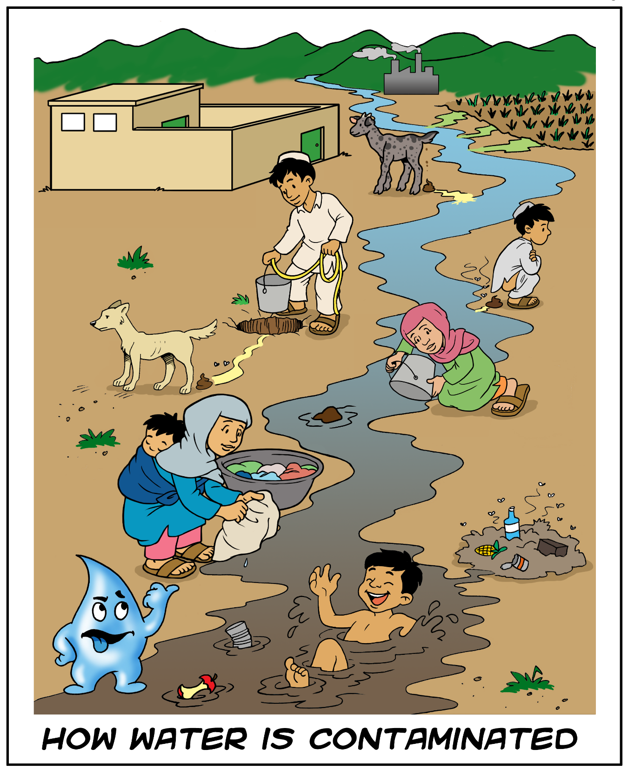
Notes:
South West Asia

Slide 11
What is Environmental Sanitation?
Human and animal excreta (feces and urine) management
Household wastewater management
Solid waste management
Vector control
Stormwater drainage
Notes:
Ask the participants to look at one of the Contamination Posters in the previous slides for a few minutes.
Discuss the issues they see with sanitation and identify as well as any issues that are not illustrated in the poster
Show the definition of environmental sanitation after the discussion.

Slide 12
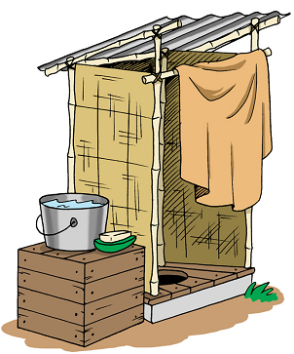
What is Sanitation?
Human excreta (feces and urine) management
Notes:
Ask participants what is the difference between sanitation and environmental sanitation?
Sanitation is specifically the management of human excreta, and usually means latrines.
Environmental sanitation is a broader definition of sanitation and tries to include all aspects which may affect human health and well-being.

Slide 13
Review
Discuss with a partner whether or not you agree with the definitions of sanitation and environmental sanitation.
Notes:
With a partner, ask the participants to discuss whether or not they agree with the definitions of sanitation and environmental sanitation. Ask participants to explain why or why not.

