Slide 1
12, 2916 – 5th Avenue
Calgary, Alberta, T2A 6K4, Canada
Phone: + 1 (403) 243-3285, Fax: + 1 (403) 243-6199
E-mail: cawst@cawst.org, Website: www.cawst.org
CAWST, the Centre for Affordable Water and Sanitation Technology, is a nonprofit organization that provides training and consulting to organizations working directly with populations in developing countries who lack access to clean water and basic sanitation.
One of CAWST’s core strategies is to make knowledge about water common knowledge. This is achieved, in part, by developing and freely distributing education materials with the intent of increasing the availability of information to those who need it most.
This document is open content and licensed under the Creative Commons Attribution Works 3.0 Unported License. To view a copy of this license, visit http://creativecommons.org/licenses/by/3.0 or send a letter to Creative Commons, 171 Second Street, Suite 300, San Francisco, California 94105, USA.
You are free to:
Share – to copy, distribute and transmit this document
Remix – to adapt this document
Under the following conditions:
Attribution. You must give credit to CAWST as the original source of the document. Please include our website: www.cawst.org
CAWST will produce updated versions of this document periodically. For this reason, we do not recommend hosting this document to download from your website.
CAWST and its directors, employees, contractors, and volunteers do not assume any responsibility for and make no warranty with respect to the results that may be obtained from the use of the information provided.
Stay up-to-date and get support:
Latest updates to this document
Other workshop & training related resources
Support on using this document in your work
CAWST provides mentorship and
coaching on the use of its education
and training resources.

Slide 2
This presentation is used with Lesson Plan 38: HWTS Implementation Framework in the Biosand Filter for Project Implementers Trainer Manual.
Available at www.cawst.org/resources

Slide 3
Implementation of Household Water Treatment and Safe Storage

Slide 4
Learning Expectations
List the 5 components of the implementation framework.
Apply the framework to a HWTS implementation scenario.

Slide 5
Why is Some HWTS Implementation Failing to Reach its Potential?
Notes:
Point out the biosand filter that is not being used to treat water, rather it is a plant holder! Why is this?

Slide 6
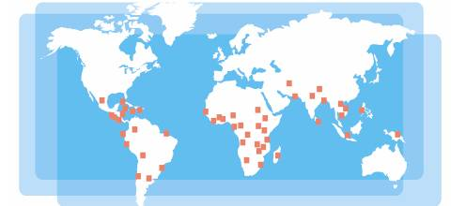
Look for the Bright Lights
Review of CAWST’s 392 clients in 63 countries
Notes:
A CAWST review of current implementation practices coupled with years of experience working with implementers worldwide has shown that HWT implementation is being successfully carried out by a wide variety of organizations, using different HWT options and a diverse range of programs, from emergency response to long term development.

Slide 7
What Have We Learnt?
HWTS implementation :
Is carried out by a wide variety of Implementers
Uses different HWTS options
Uses different implementation approaches
Have a diverse range of overall objectives
No standard implementation model!
Notes:
Implementers include: Local entrepreneurs, service clubs, local NGO’s, National NGO’s, private companies, international NGO’s, governments and multilateral organizations
HWTS Options include: Straining, Coagulants, Biosand filters, ceramic filters, membrane filtiers, boiling, SODIS, chlorine, UV
Implementation methods include: Community construction, free distribution, full subsidies, commercial approaches, entrepreneur approaches, microcredit, women's groups, schools
Objectives include: Emergency response, long term development, health, economic development, women's empowerment
A review of the diversity of implementation programs worldwide shows that there is no standard approach for getting HWTS into people’s home.

Slide 8
Implementation Framework
Program Financing
Building Human Capacity
Creating Demand
Supplying Products & Services
Monitoring
& Improvement
Notes:
Although there is a wide variety of implementing organizations using different approaches, many of the most successful programs have carefully considered and addressed the following components:
1. Creating demand for HWTS
2. Supplying the required HWTS products and services to meet the demand
3. Monitoring and continuous improvement of program implementation
The framework also integrates two support components which are essential for the successful planning and implementation of the program elements:
4. Building human capacity
5. Ensuring sustained program financing

Slide 9
Creating and Sustaining Demand
Ceramic Pot Filters in Myanmar (Credit: ThirstAid)
Notes:
Why: Essential for long term adoption of new behaviour.
Creating demand requires awareness and education to convince households of the need and benefits of HWTS so that it is desired and sought after. Demand exists when people need and want HWTS and have the opportunity and ability to bring it into their homes. It is critical that households actually want and value HWTS; this ensures it will be used over the long term.
Ultimately all implementation programs want to make a change – an increase in the number of people who have safe drinking water. For anything to change, one has to start acting differently, such as treating water in their home. The challenge of changing people’s behaviour, and subsequently creating demand for HWTS, is significant for implementers – requiring time, sustained investment, and a range of strategies.
How: Pilot -> understand changes in the population -> use results to create further demand and support users
Case Study: Thirst Aid Myanmar
Key Points:
They use a marketing campaign that targets the population that can afford ceramic filters.
There are two filter models, one for the middle class and one for the working poor.
Thirst-Aid staff conducts awareness raising and education with a variety of target audiences, including women's groups, schools, monasteries, orphanages, community based organizations, NGOs and international NGOs. They meet and follow up with the different groups as often as necessary.
Their staff use a variety of education tools and communication methods, including billboards, posters, games, flip charts, hands on practice and videos. Thirst-Aid created most of their education materials, with contributions from UNICEF. The government supports the program by approving their education materials before use.
Thirst-Aid provides the currency for community buy-in by issuing Certificates of Knowledge upon successful completion of their educational program. These certificates serve as legal tender that can be later used for the purchase of household water treatment technologies.
Thirst-Aid emphasizes that in order to create demand, the filters should not be viewed as a give-away product for the poor. They should be marketed as a desirable, easy to use and effective product for everyone who needs improved water.

Slide 10
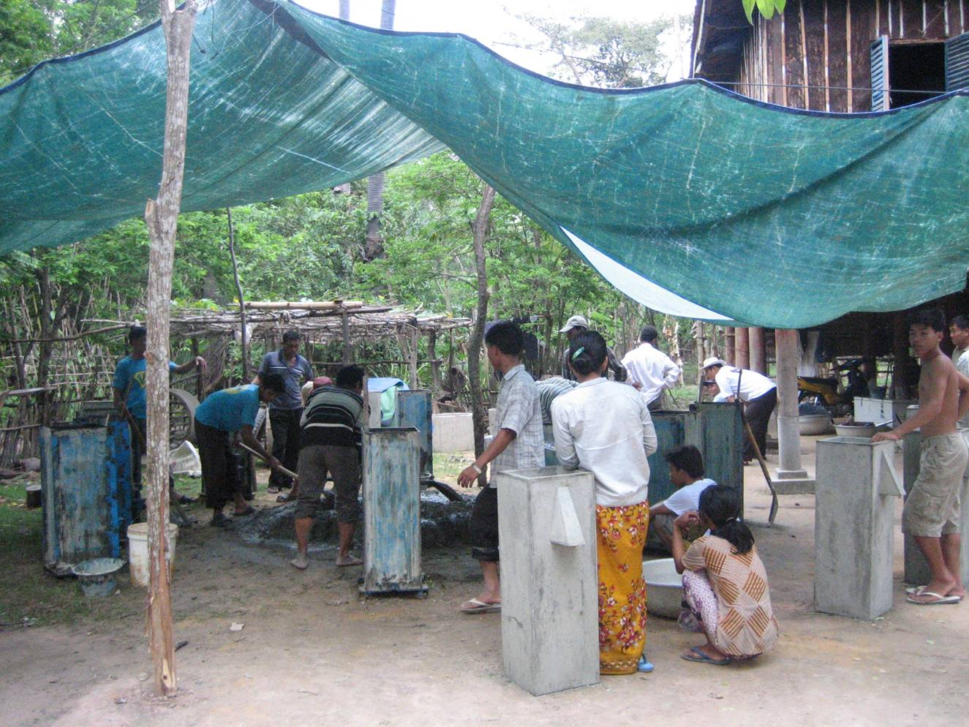
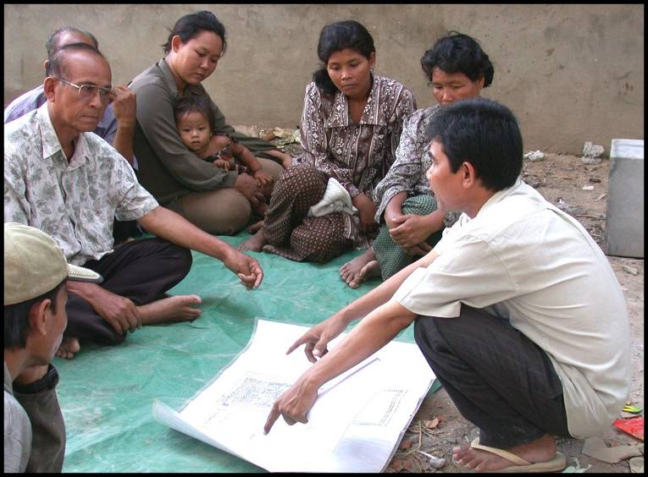
Supplying Products and Services
Learning about Biosand Filters
(Credit: Clear Cambodia)
Building Biosand Filters
(Credit: Clear Cambodia)
Notes:
Why:
Households need both the HWTS product and support services to ensure its proper and consistent use over the long term. Households need a contact point for follow up service, purchase of replacement parts, and queries.
This requires significantly more effort on the service component or “software” than has traditionally been the case in the water and sanitation sector.
How:
Determine demand for durables, consumables and services
Work out how existing systems and networks can be utilized
Set up new systems if necessary
Many organizations choose to do a small pilot project to establish their processes, learn from experience and ensure quality control of product and service before scaling up their program.
Case Study: Clear Cambodia
Key Points:
Clear employs Cambodian staff to manufacture and distribute biosand filters.
They use travelling teams that transport the molds and tools required to build the filters at temporary work sites in each village. The team includes staff to supervise construction and conduct the community outreach and health education. They will spend several weeks in the village until the demand has been satisfied before moving onto the next.
Most construction materials are found locally, however filtration sand is transported by truck from a centralized source in one province to ensure quality control.

Slide 11
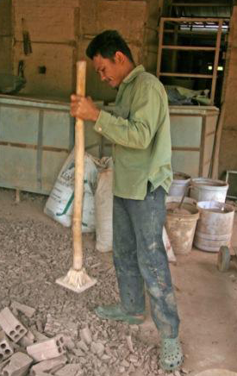
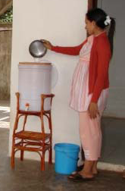
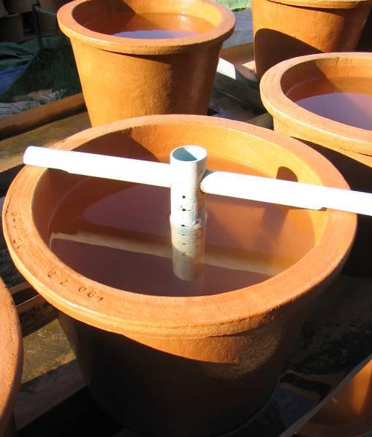
Monitoring and Improvement
Process
Impact
Product
Ceramic Pot Filters in Cambodia (Credit: RDI Cambodia)
Notes:
Why: Feedback loop is needed for on-going program improvement. Important to measure the impact success of a program, especially before scaling up
How:
Monitor Process, Product and Impacts
Ensure that information gathered gets processed and leads to change
Case Study: RDI, Cambodia
RDI has a monitoring program to ensure that they manufacture high quality filters. Flow rate tests are carried out on every filter to ensure it is within the tolerance range. The filter elements are also examined for cracks and other defects at every production step, and removed from the process if they do not meet requirements. Each filter is stamped with a with a date, serial number and manufacture’s name.
RDI also tracks the filters sold, and periodically goes back to the community and runs tests on the filters to verify that they are still functioning properly.
Their manufacturing and education method has been developed over 3 years and is continually reviewed and improved.

Slide 12
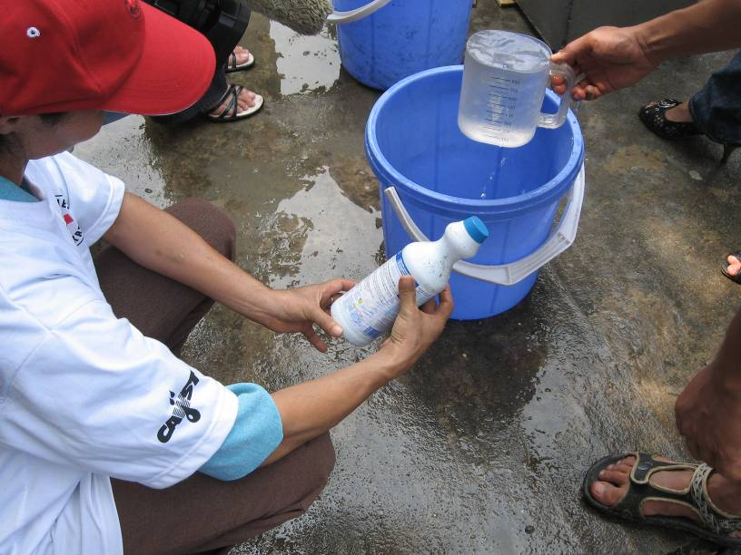
Capacity Building
Build the capacity of local populations to meet their own needs
Learning is incremental and takes time
Various roles:
Program Implementer
Community Health Promoters
Product Manufacturer
Trainer
Other Stakeholders (Donors, Government, Researchers)
Training in Vietnam (Credit: CAWST)
Notes:
Developing individual people’s knowledge and skills is part of building the overall organizational capacity required for implementation. A capacity building process with competency validation can be used to increase both individual and organizational capacity. The ultimate objective of HWTS programs should be to build the capability of local populations to meet their own needs.
A variety of roles are needed to implement HWTS programs. The following roles may be carried out within one organization or across multiple organizations:
Program Implementers: Individual or organization who plans and implements a HWTS program.
Community Health Promoters: Raise awareness and educate households about the need for safe water and HWTS solutions.
Product Manufacturers: Construct and distribute the HWTS product.
Trainers: Provide training and consulting to support implementers.
Other Stakeholders: Donors, government, universities and education institutions

Slide 13
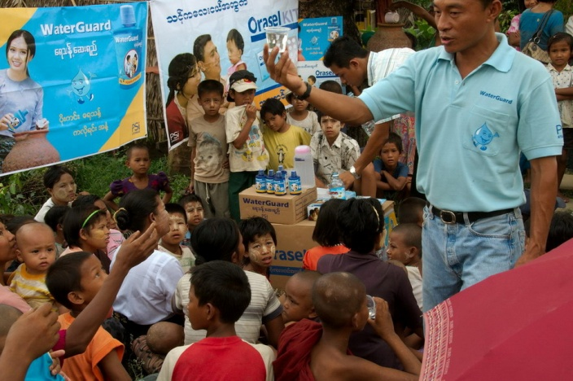
Program Financing
WaterGuard Chlorine in Myanmar (Credit: PSI Myanmar)
Notes:
Why: Long term financing helps secure long term adoption
How:
Determine program costs include planning, awareness and education, product manufacturing and distribution, monitoring and evaluation
Determine how much individuals are able and willing to pay
Determine the gap between that and actual costs
Develop strategy to enable sustained access of finance, different funders can be used to cover the different costs
Case Study: WaterGuard, PSI Myanmar
Key Points:
Households pay for 70% of product cost in rural areas and 100% in urban and peri-urban areas
International donor funding subsidizes: Manufacturing, Distribution, Retailing, Promotion and education
Government provides lower rates for WaterGuard television commercials

Slide 14
Putting It All Together
Program Financing
Building Human Capacity
Creating Demand
Supplying Products & Services
Monitoring
& Improvement

Slide 15
Review
What is one aspect of the framework that is new or interesting to you?
Notes:
Ask partners to discuss one aspect of the framework that was new or most interesting to them and why.
Summary of key messages: The approach an implementer uses needs to be well thought out. HWTS implementation is a complex process in which the effectiveness of a particular strategy can be highly dependent on the other choices that are made. Sometimes, strategies chosen by implementers may complement and reinforce one another, producing a highly effective program. Other times, the chosen strategies may contradict or cancel one another out, leading to ineffective implementation.
Review the learning expectations with the entire group. Ask participants whether or not the expectations have been met. If not, give options for participants to find the information they were looking for or identify next steps for follow up.

