Slide 1
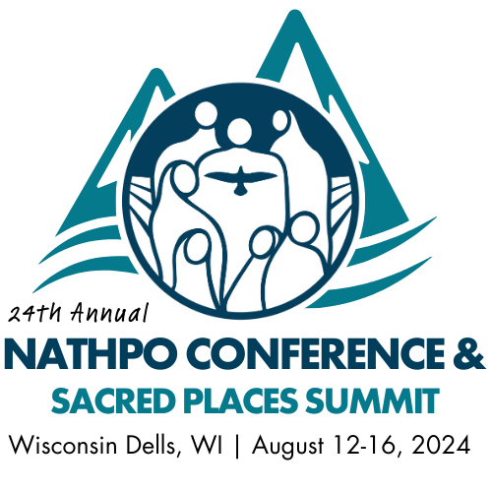
Tribal Historic Preservation Officers
Valerie J. Grussing, PhD
Nathpo Executive Director
valerie@nathpo.org
Shasta C. Gaughen, PhD
Nathpo Board Chair
sgaughen@palatribe.com

Slide 2
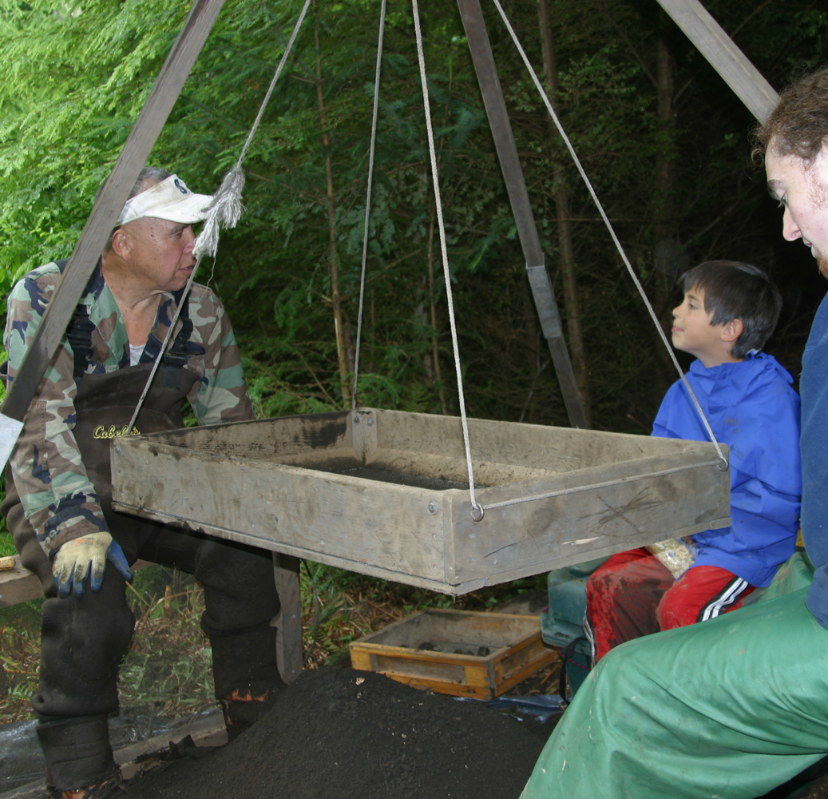
Where They Come From
NHPA
With approved NPS application, assume SHPO duties on Tribal land
Sovereignty & self-determination
Historic Preservation Fund
NPS manages program & grants

Slide 3
What They Do
Sacred & foundational work
Wear many hats:
Review federal projects
National Register of Historic Places
Inventories of Tribal cultural resources & places
Revitalization of cultural traditions & languages
Repatriation & NAGPRA duties
Natural resources & ecosystem conservation
Tribal museums, cultural centers, oral history programs

Slide 4
What are some of the main Tribal cultural resource management issues you face?

Slide 5
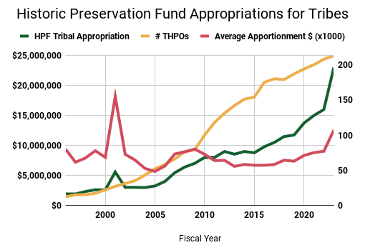
HPF Tribal Appropriation
# THPOs
Average apportionment (x1000)
Number of THPOs = 222
HPF Tribal Appropriation = $23 mil
Average THPO apportionment = $104,000
The number of THPOs increases each year. For the average apportionment per THPO
to actually increase, the HPF Tribal appropriation must begin to keep pace.

Slide 6
FY 2025 & HPF Reauthorization
$34 million for THPO line of HPF
44% increase in FY23 brings it up to 11% of total HPF
221 THPOs (would avg $154k)
Increasing reviews for infrastructure, energy, broadband
20% minimum set aside & NPS report on increasing # of THPOs

Slide 7
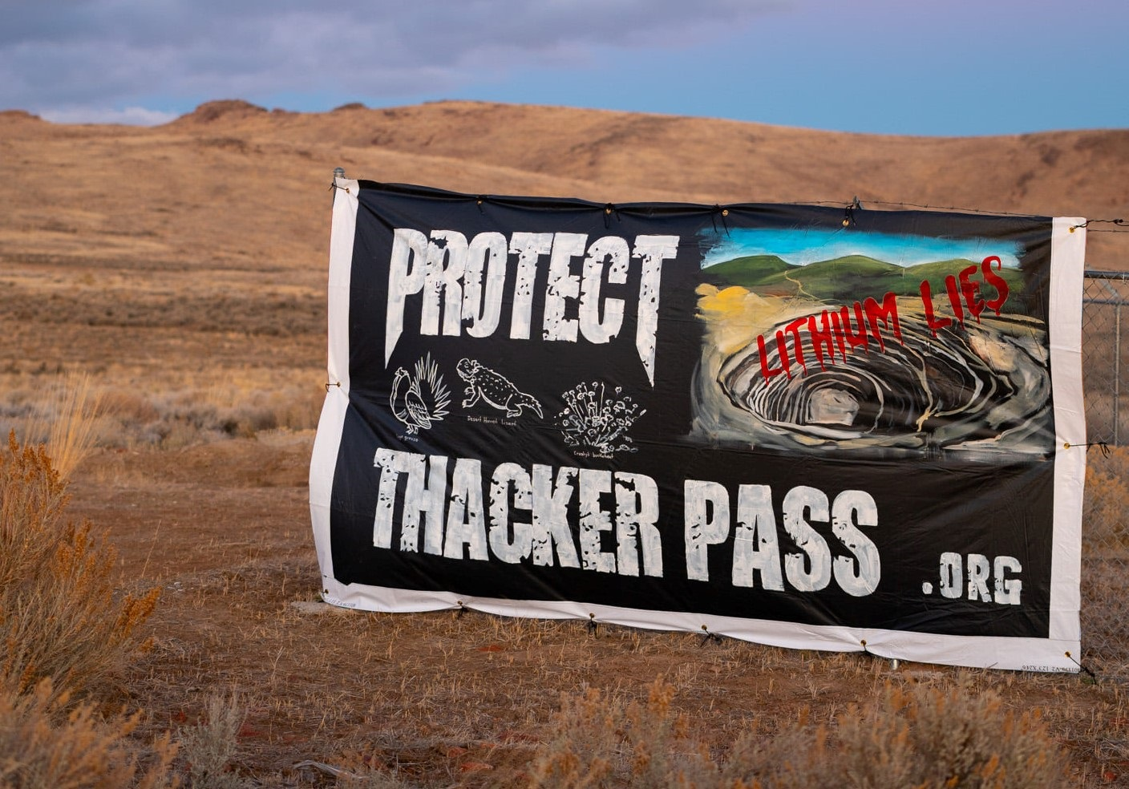
Consultation
Requirements vs best practices & good faith
Making meaningful mean something
Strengthening nation-to-nation relationship has two parts
Rebuilding foundations of culture
Healing, power balance & consent

Slide 8
A Seat at the Table
Same language, definitions & cultural understandings?
Grown-up table – complete with meal and utensils.
Which tribes, where & how?
Tribal capacity:
Funding/staffing
Knowledge/tools

Slide 9
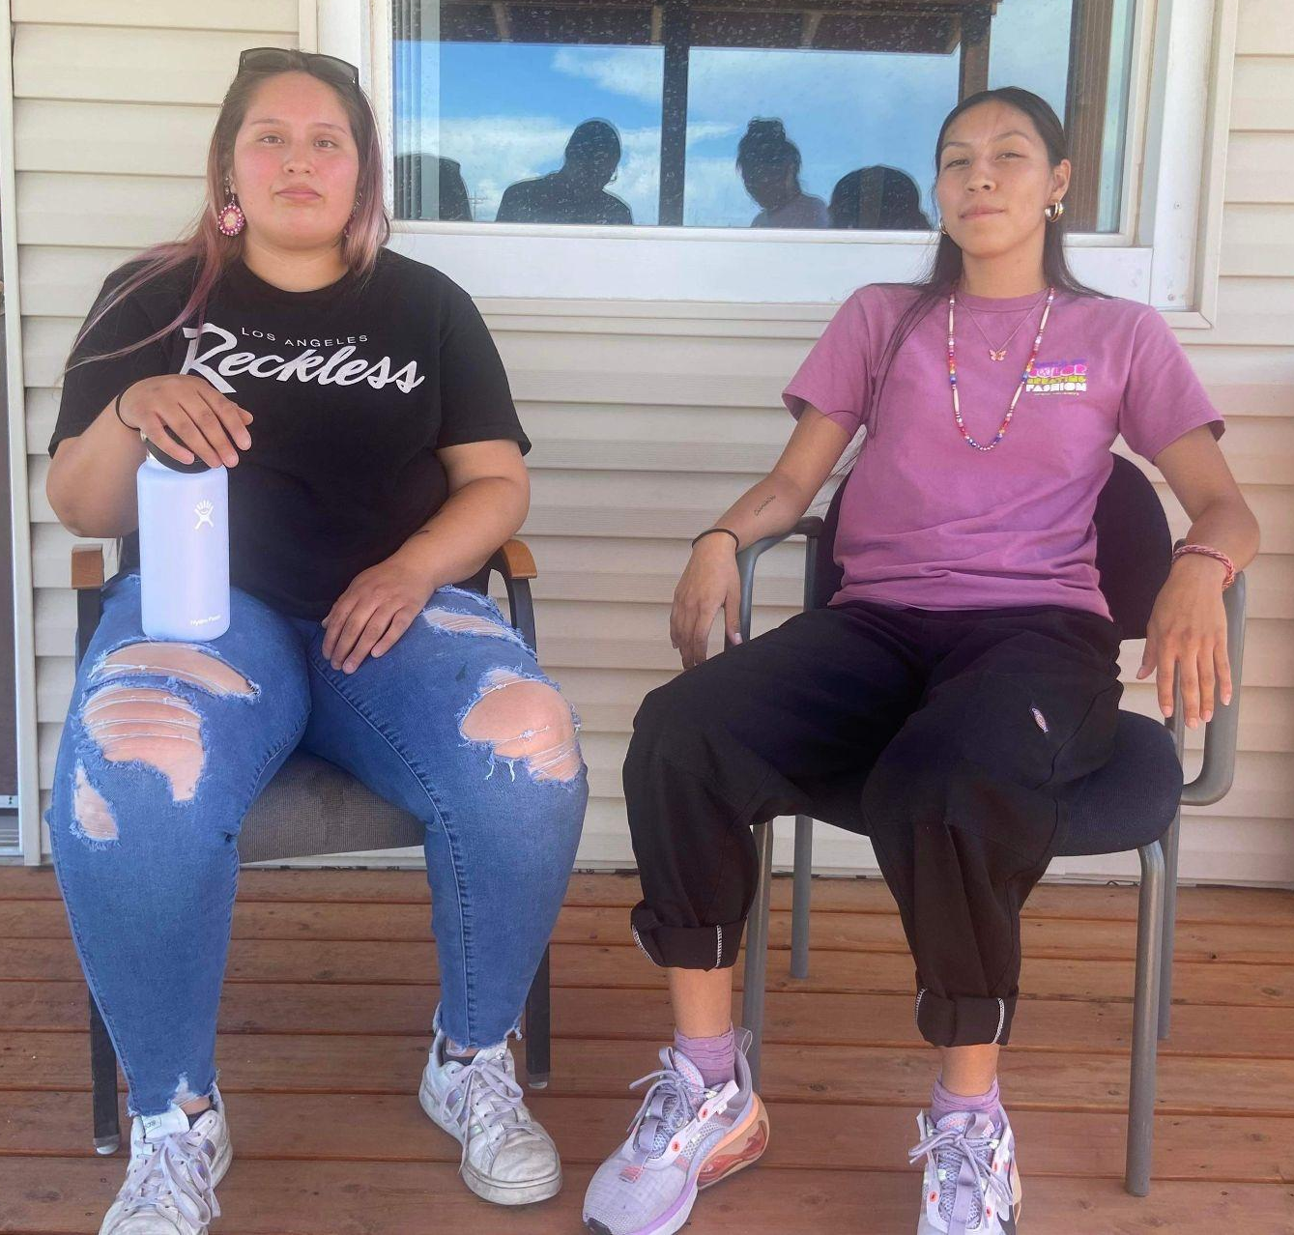
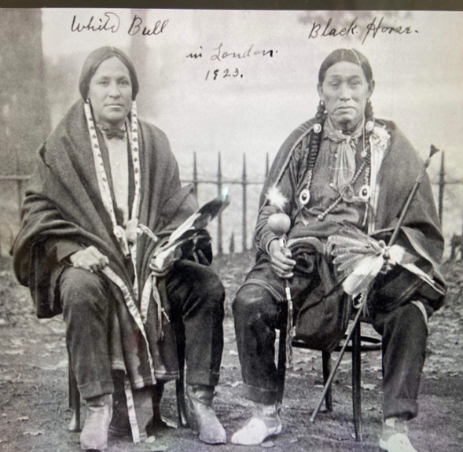
Structural Issues Recap
Requirements for federal recognition & Tribal/trust land
Duties beyond NHPA
Placement of program in NPS
Funding from HPF + source
Amount of ancestral area on which they consult
Systemic challenges with Section 106 (ACHP’s purview)
Lack of protection for places & resources

