Slide 1
Tribal-Interior Budget Council
Education Subcommittee Update
Sharon Pinto, Deputy Bureau Director
Doug Ward, Supervisory Budget Officer
Tulsa, Oklahoma
August 4, 2025

Slide 2
Overview
Per Pupil Spending
BIE Overview
Budget Status
Tribal Grant Support Cost
TCS Pay Actuals
WebET 2.0 Student Transportation Reporting Program
Expanding Educational Opportunities

Slide 3
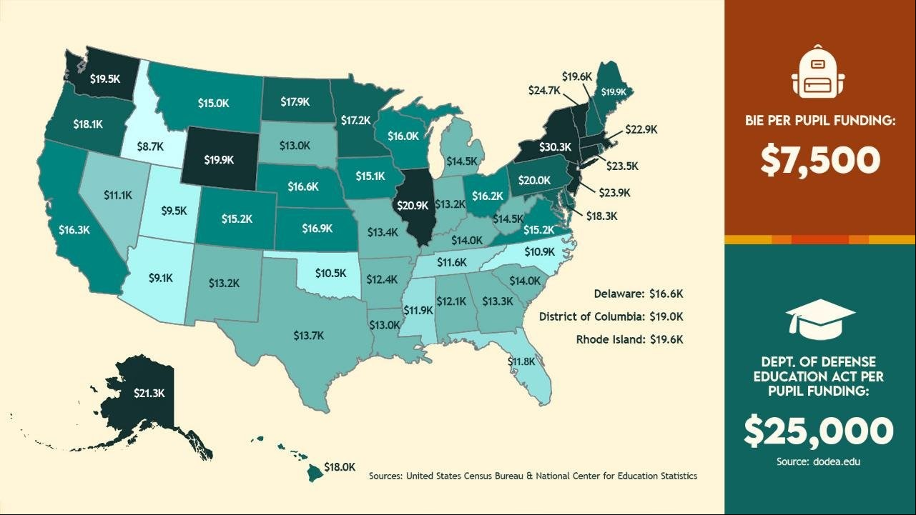

Slide 4
Bureau of Indian Education Overview
The Bureau of Indian Education (BIE) provides elementary and secondary education services (K-12) to approximately 40,000 students in 23 States.
Currently 128 or approximately 70 percent of BIE-funded schools are Tribally controlled and operate under the direction of Tribal governments.
BIE provides funding to 33 Tribal Colleges and Universities (TCUs). These colleges are primarily located on reservations in States and serve American Indian communities with limited access to other post-secondary institutions.
BIE annually records approximately 13 million miles in transporting (school bus routes) students to and from 169 schools across Indian Country.
73% of all BIE forward funding allocated is provided pursuant to formulas outlined in 25 CFR Part 39.

Slide 5
Budget Status – FY2021 - Present
Operation of Indian Education Programs (OIEP)
BIE OIEP funding has remained flat since FY 2023
Fixed Costs were applied to the FY 2023 enacted budget

Slide 6
Current Budget Status
Operation of Indian Education Programs (OIEP)
Full-Year Continuing Resolution for FY 2025
$1,131,617,000
BIE forward funds are available 01 July (2025) approximately $833 million
2025-2026 funds successfully distributed to schools via July 01 allocation.
Priority is focused on processing all allocations
8

Slide 7
BIE Core Funding Methodologies
Elementary and Secondary Programs
Key Budget Lines | 2024 Enacted | Allocation Funding Factors | Formula
ISEP Formula Funds | $ 481,636,000 | Student Counts | Yes
Tribal Grant Support Costs | $ 95,822,000 | School Funds Managed | Yes
Facilities Operations | $ 80,888,000 | Actual facilities & conditions by location | Yes
Facilities Maintenance | $ 73,544,000 | Facility Real Assets,. etc. | Yes
Student Transportation | $ 70,007,000 | Mileage & Commercial Transportation | Yes
Total Funding | $ 801,897,000
Post Secondary Programs
Key Budget Lines | 2024 Enacted | Allocation Funding Factors | Formula
Tribal Colleges and Universities | $87,926,000 | Student Count | Yes
Scholarships and Adult Education | $43,549,000 | Applicants | Application
Haskell and SIPI | $30,325,000 | Historical | Yes
Tribal Technical Colleges | $9,156,000 | Student Count | Yes
Science Post Graduate Scholarships | $6,450,000 | Applicants | Application
Special Higher Ed Scholarships | $4,992,000 | Applicants | Application
TCU Supplements | $1,220,000 | Historical | Yes
Total Funding | $183,618,000

Slide 8
Bureau of Indian Education
OIEP Summary

Slide 9
Bureau of Indian Education
Education Construction

Slide 10
Bureau of Indian Education
FY 2026 House vs Senate
ACCOUNT ACTIVITY |  | 2025 NOTIONAL |  | 2026 HOUSE Markup |  | 2026 SENATE Markup
BUREAU OF INDIAN EDUCATION, TOTAL |  | $ 1,366,342 |  | $ 1,530,883 |  | $ 1,366,342
OPERATION OF INDIAN EDUCATION PROGRAMS |  | $ 1,131,617 |  | $ 1,235,516 |  | $ 1,131,617
EDUCATION CONSTRUCTION |  | $ 234,725 |  | $ 295,367 |  | $ 234,725
FY2026 appropriation language reflects forward funded budget lines being available on June 1st instead of July 1st

Slide 11
Tribal Grant Support Costs (TGSC)
TGSC increased +10% 2021-2025
Future need estimates based on BIE Budget requests
Increased funds managed = Increased TGSC resources

Slide 12
Bureau of Indian Education
TCS Salary and Benefits Pay Actuals
FY 2024 Employee Pay Actuals
(1 October 2023 to 30 September 2024)
 | Submitted | Not Received | Total | Participation Rate
 | 63 | 66 | 129 | 49%
Tribally Controlled Schools | 44 | 51 | 95 | 34%
Tribally Controlled Schools -Navajo | 19 | 15 | 34 | 15%
Pay Parity for Tribally Controlled Schools

Slide 13
What is WebET 2.0?
ISEP Student Transportation Reporting
A web-based reporting program for BIE ISEP Student Transportation
Became available for all Bureau Operated and Tribally Controlled Schools in Fall, 2025
Used to submit two required reports:
  Count Week Report: ISEP Student Transportation Funding 09/22/2025 – 09/26/2025 (to and from school)
  Annual Report: Collect actual expense data incurred by schools for all types of student transport activity due August 1st

Slide 14
Expanding Educational Opportunities
Executive Order 14191
Flexible Funding
Reserved $1.3M from ESEA Sec. 1003A to support direct student services—advanced courses, tutoring, CTE, dual enrollment, etc.
Tribal Authority
Supporting Tribes exercising authority with technical assistance for transition planning.
TED Expansion
Increasing Tribal Education Department (TED) grants ahead of SY 2025–26 to boost local control of education.

Slide 15
Questions and Answers

