Slide 1


Division of Facilities Management & Construction & Bureau of Indian Education
U.S. DEPARTMENT OF THE INTERIOR
August 4, 2025
Gary Mosesman
Division Chief, DFMC

Slide 2
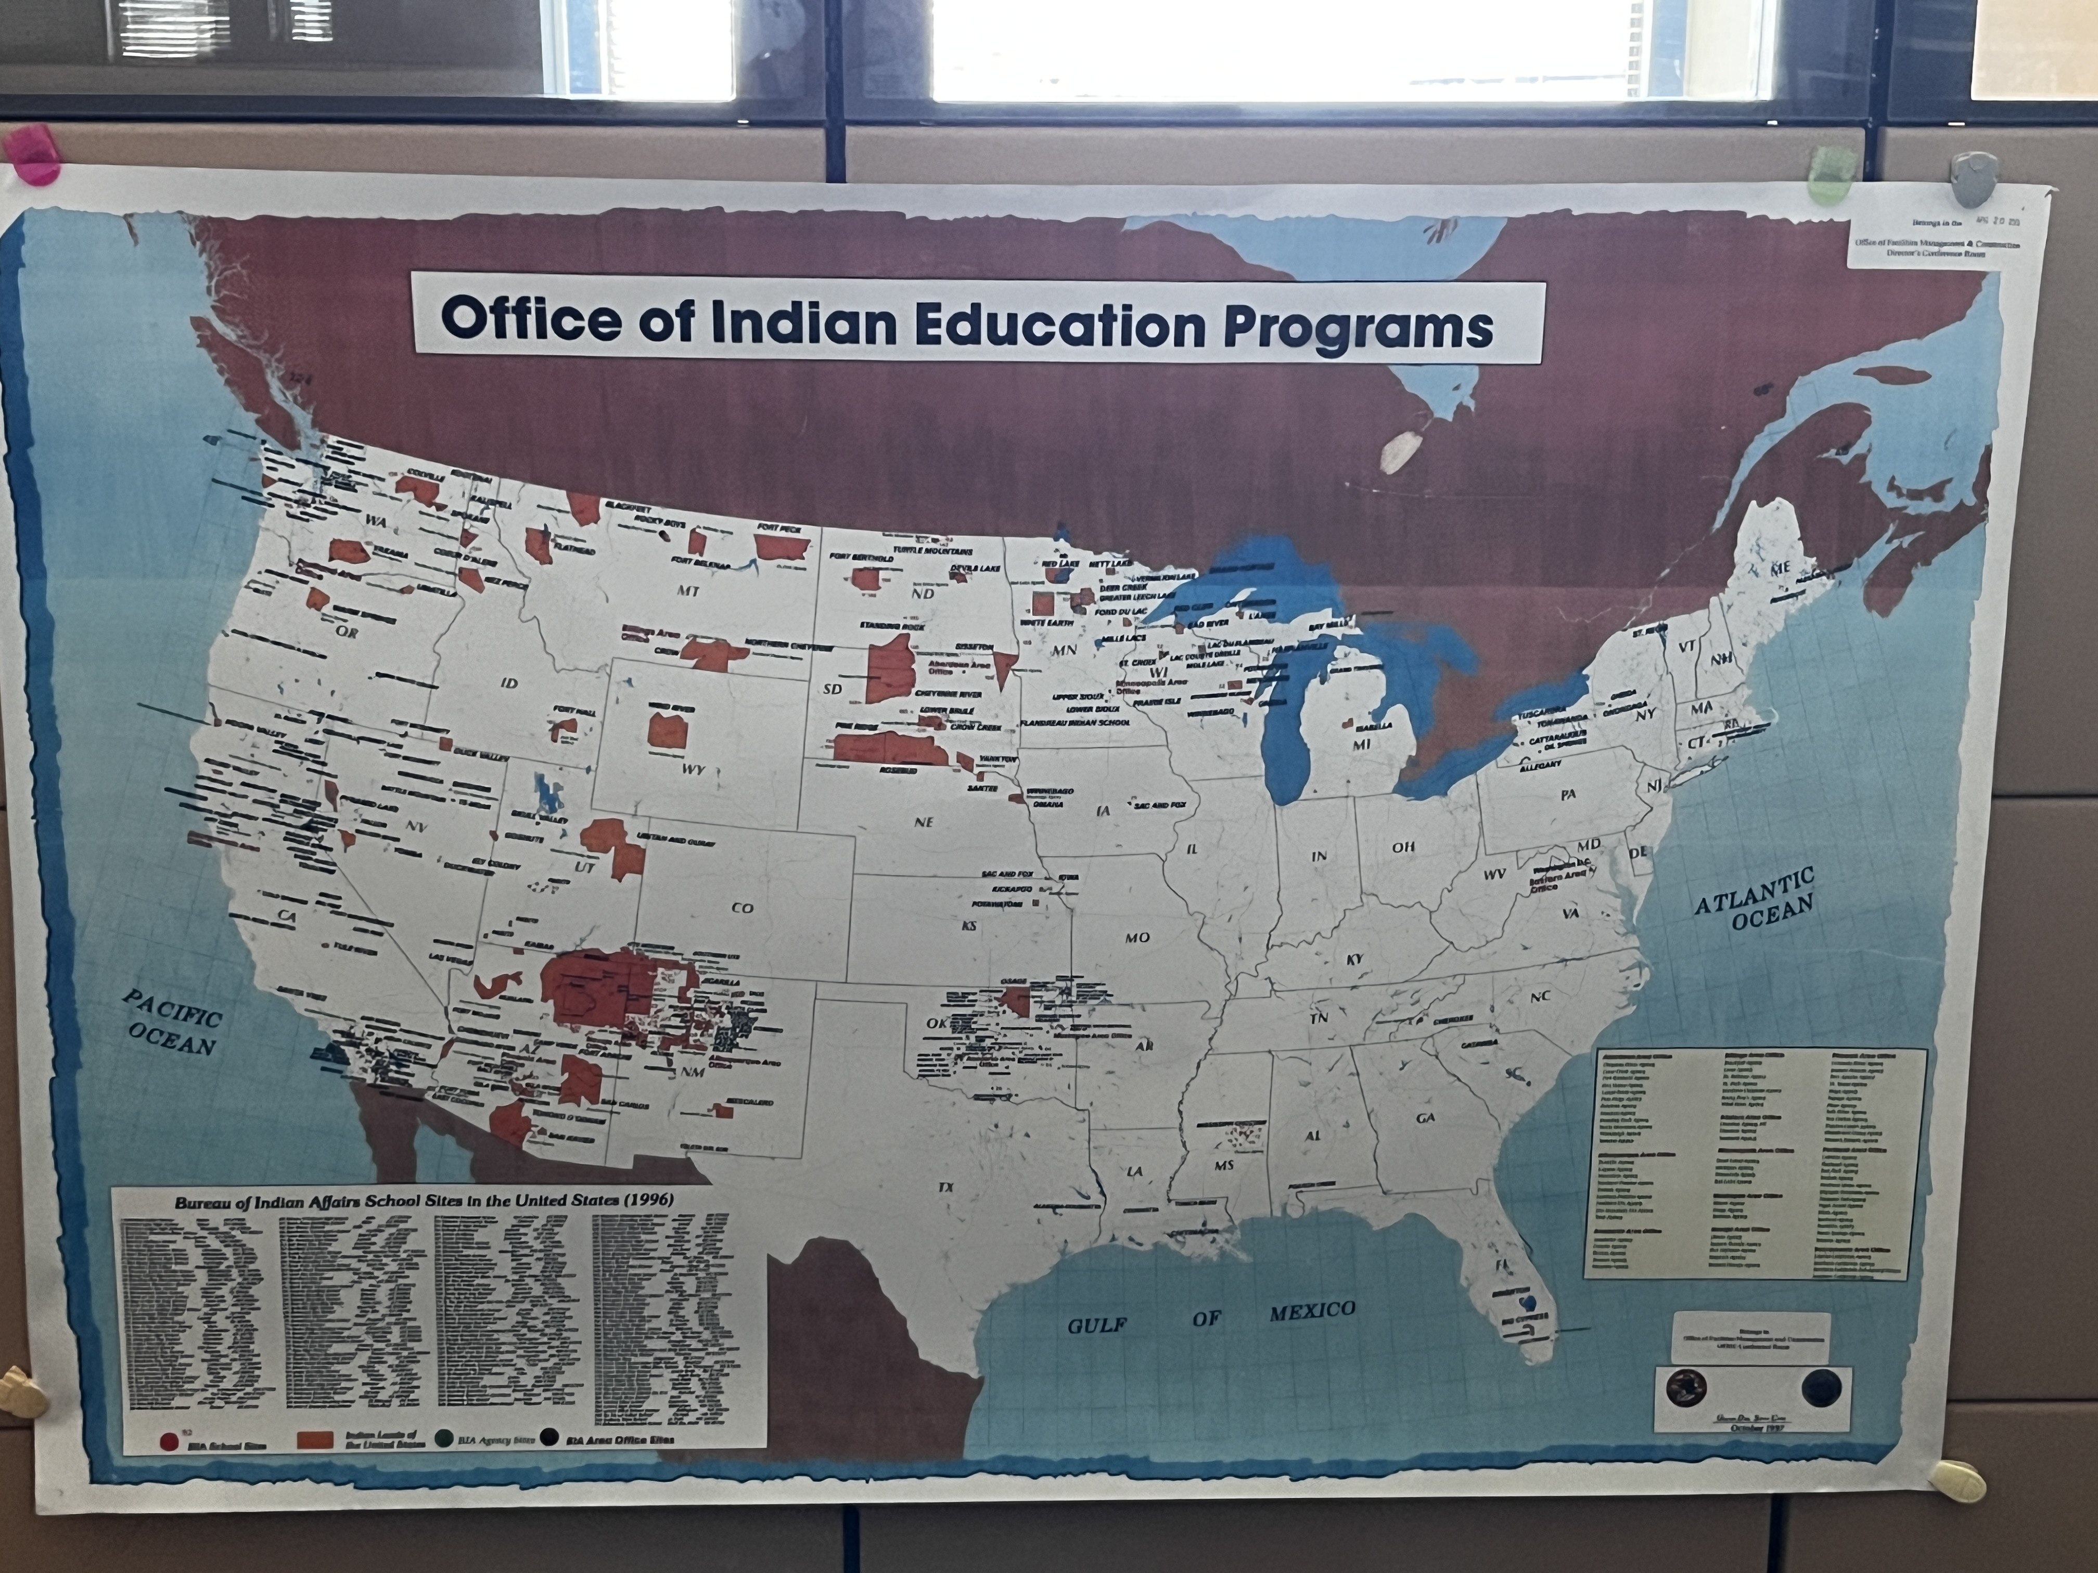
Division of Facilities Management and Construction (DFMC)
Professional Engineers, Architects, Asset Management staff
Provide policy advice and technical oversight for BIA, BIE, OJS
  Services all BIE run schools, quarters, office, and OJS detention centers
Manage planning, construction, renovations, operations, maintenance and improvements of IA properties
  Set prioritization for projects
  Planning & formulation of annual program budgets
  Evaluate buildings and set allocations for FI&R
DFMC portfolio includes: 4,924 buildings
Located in Albuquerque, NM

Slide 3
DFMC Offices & Programs
Branch of Asset Management – O&M funding, Maximo and facility assessments
Contact: William (Bill) Kehoe, Branch Chief - william.kehoe@bia.gov
Branch of Planning and Design - School-centered planning, design code compliance, stakeholder coordination.
Contact: Brian Johns, (Acting)Branch Chief - brian.johns@bia.gov
Branch of Education New Construction – Construction delivery for new educational facilities, design-build focus.
Contact: Ahmed Zaki, (Acting) Branch Chief - Ahmed.Zaki@bia.gov
Branch of Education Facilities Improvement and Repair (FI&R) - Major repair and code compliance upgrades across IA educational facilities
Contact: Daniel Benitz, Branch Chief - daniel.benitez@bia.gov
Great American Outdoors Act
Contact: Laura Rovero, Program Manager- laura.rovero@bia.gov
Additional programs managed by DFMC:
Facilities Management and Construction
Demolition Program
Emergency Repair Program
Facilities Improvement and Repair
IA Facilities Management System (MAXIMO)
Operations and Maintenance
Quarters Management Program
Replacement School Construction
Education/PS&J Site Assessment Capital Investment Program
GAOA

Slide 4
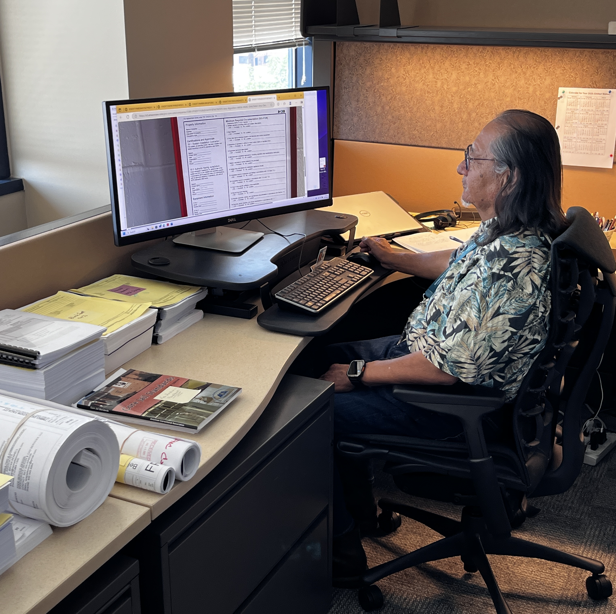
DFMC Support of BIE Facilities
Lead
Lead projects over $5M from planning through construction and turnover.
Conduct
Conduct facility condition assessments on a 3-year cycle.
Provide
Provide policy and operational oversight of the Maximo system.
Assist
Assist with project scoping, cost estimating, and emergency repair response.
Allocate & Manage
Allocate and manage Facility Improvement and Repair (FI&R) funds aligned with school safety and educational mission
Coordinate
Coordinate with BIE and schools to prioritize and execute facility improvements.

Slide 5
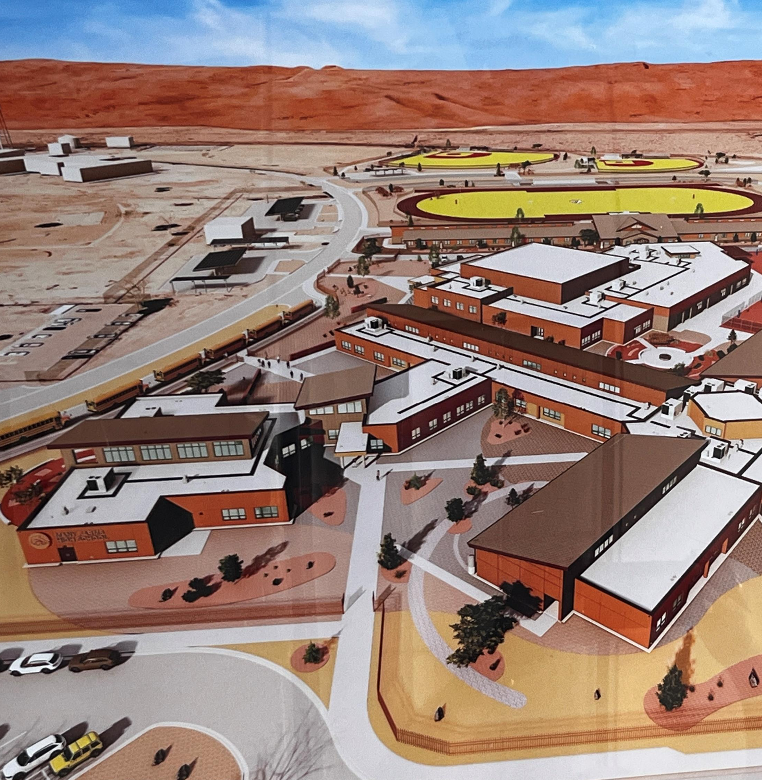
Collaboration with BIE
DFMC serves as the facilities technical and policy resource to support BIE's education mission.
We provide design standards, project delivery methods, and facility support.
Our team supports schools with Maximo training and troubleshooting.
While BIE manages local needs and projects under $5M, DFMC ensures alignment with national priorities.
Together, we work to ensure school facilities support safe and successful learning environments.

Slide 6
Role and Dependencies: DFMC / BIE
Function / Activity | DFMC | BIE Facilities
Manage Projects > $5M | Lead | Support
Manage Projects < $5M | Support | Lead
Facility Condition Assessments | Lead | Provide Input
Maximo System Oversight | Oversight & Policy | Enter & Close Tasks
Work Order Execution | Support | Execute Locally
Emergency Repairs | Support | Initiate Requests
Design Standards | Develop Standards | Implement Locally
Facility Technical Support | Technical Advisor | Execute Work
FI&R Budgeting | Allocate Funds | Implement Projects
Facility Training | Lead | Local Coordination
Space Requests | Review & Advise | Initiate Request
Quarters Oversight | Policy Oversight | Manage Locally
O&M Fund Distribution | Calculate & Distribute to BIE | Distribute to Schools

Slide 7

QUESTIONS ?
Dan Galvan
Deputy Assistant Secretary - Management (Acting)
Gabriel Draper
Acting Director OFPSM
Michael Wischnewski
Deputy Director OFPSM
Gary Mosesman
Division Chief DFMC

