Slide 1

Decentralized Finance & Pending Crypto Legislation
Amanda Fischer
Policy Director & COO
Better Markets
May 28, 2026
Disclaimer: Better Markets does not support or oppose any legislation discussed in this presentation. This slide deck is for informational purposes only. Nothing in this slide deck constitutes legal advice.

Slide 2
Background
Better Markets is a non-profit, non-partisan, and independent organization founded in the wake of the 2008 financial crisis to promote the public interest in the financial markets, support the financial reform of Wall Street, and make our financial system work for all Americans again.
Amanda Fischer is Policy Director & COO of Better Markets. Before joining the organization, she was Chief of Staff and Senior Counselor to the Chair at the Securities and Exchange Commission (SEC) and served as an advisor to members of the House of Representatives and Senate for over a dozen years.

Slide 3
Agenda
What is the CLARITY Act?
What is the concept of “DeFi” as understood in the crypto community?
How does the CLARITY Act approach “DeFi?”
How could prediction markets organize themselves as “DeFi?”
Bottom Line & Moving Forward
Questions/Discussion

Slide 4
What is the CLARITY Act?
Relates to the regulation of cryptocurrency (Bitcoin, Ethereum, memecoins, etc.)
Removes crypto from the jurisdiction of the SEC and moves authority to the Commodity Futures Trading Commission (includes jurisdiction over the assets and over the exchanges that enable trading in the assets)
Generally prohibits regulation of activities that meet the definition of “DeFi” (encompassed over several definitions in the legislation)
Straddles the jurisdiction of the House Financial Services/Senate Banking Committees and the House/Senate Agriculture Committees
Currently needs to pass the full Senate and, if that happens, be reconciled with the House version of the legislation

Slide 5
What is “DeFi” as a Crypto Market Concept?
DeFi stands for “decentralized finance”
DeFi entities argue that they are autonomous, decentralized entities that enable economic activity between individuals via open source software code, hard-wired into a blockchain.
They have argued that coding is protected First Amendment speech and that it therefore can’t be regulated. They are seeking permanent legal protection in legislation to mitigate the chance of future enforcement actions.

Slide 6
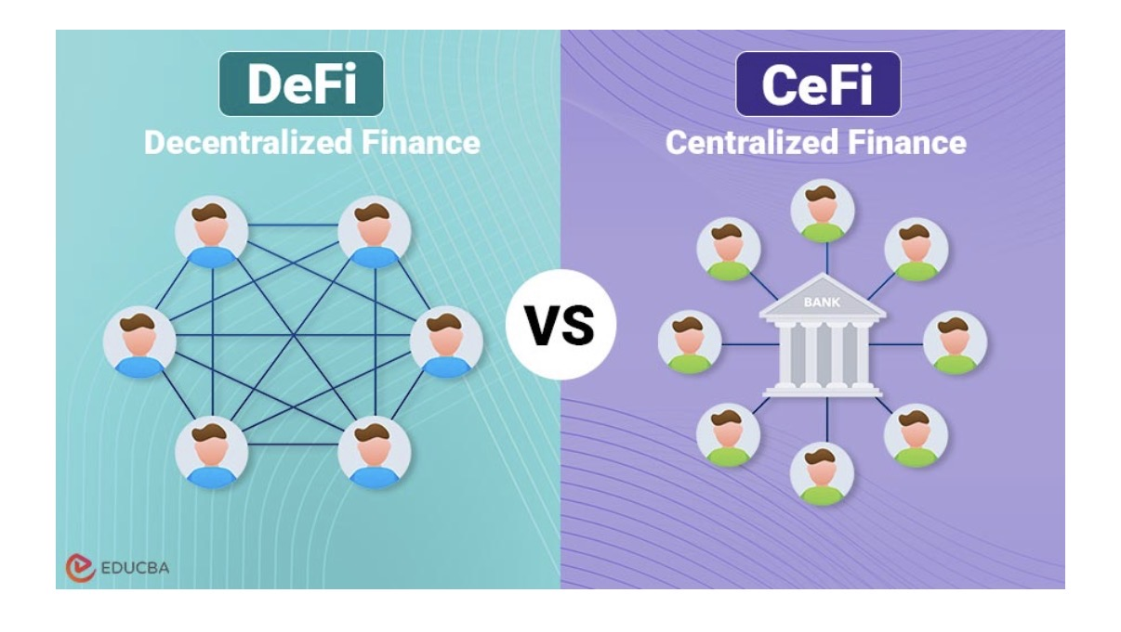
What is “DeFi” as a Crypto Market Concept?

Slide 7
What is “DeFi” as a Crypto Market Concept? (cont’d)
Past enforcement activity in the Biden Administration:
  SEC investigated so-called “DeFi” platforms for being securities exchanges in disguise
  CFTC successfully brought charges against a “DeFi” platform for acting as an unregistered commodity futures exchange to allow leveraged trading in crypto (CFTC v. Ooki DAO, U.S. District Court for the Northern District of California, 2023)
  Treasury Department attempted to apply sanctions to a platform called “Tornado Cash” – which allowed crypto users to deposit funds, have those funds electronically scrambled, and then sent back to the original holder. This was essentially blockchain-based money laundering.

Slide 8
How Does the CLARITY Act Approach DeFi?
Legislation defines “decentralized” entities like trading protocols operated according to “decentralized governance” (shorthand is “DEX”)
Platforms that meet these definitions are exempt from registration requirements, regulation of the underlying trading or from requirements like conducting KYC, registering as a money transmitter, etc. Preserves certain anti-fraud enforcement authority.
Therefore platforms that operate in this “DeFi” manner won’t have to register with the CFTC as a Designated Contract Market (DCM), the current structure used by Kalshi, etc. for their exchanges enabling trading in prediction markets.
Directs the SEC to conduct a rulemaking to clarify when the securities laws apply to decentralized finance trading protocols if they are engaging in activities directly involving securities.

Slide 9
How Could Prediction Markets Platforms Benefit?
  Platforms could argue:
  We are “DeFi” because we don’t act as the bookmaker but just match yes/no bets on a neutral platform where users trade amongst themselves
  Payouts are “automatic” and hard-wired via code and provided via a blockchain
  Disputes are settled via a decentralized “oracle” of crypto token holders (i.e., if the rules aren’t clear about what happens if there’s a tie at the Oscars, the holders of the token vote to determine yes/no)
  Platform doesn’t custody users’ funds and therefore isn’t a money transmitter

Slide 10
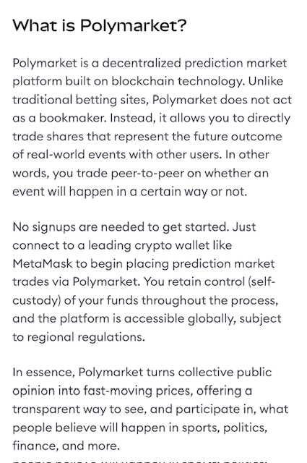

How Could Prediction Markets Platforms Benefit? (con’t)

Slide 11
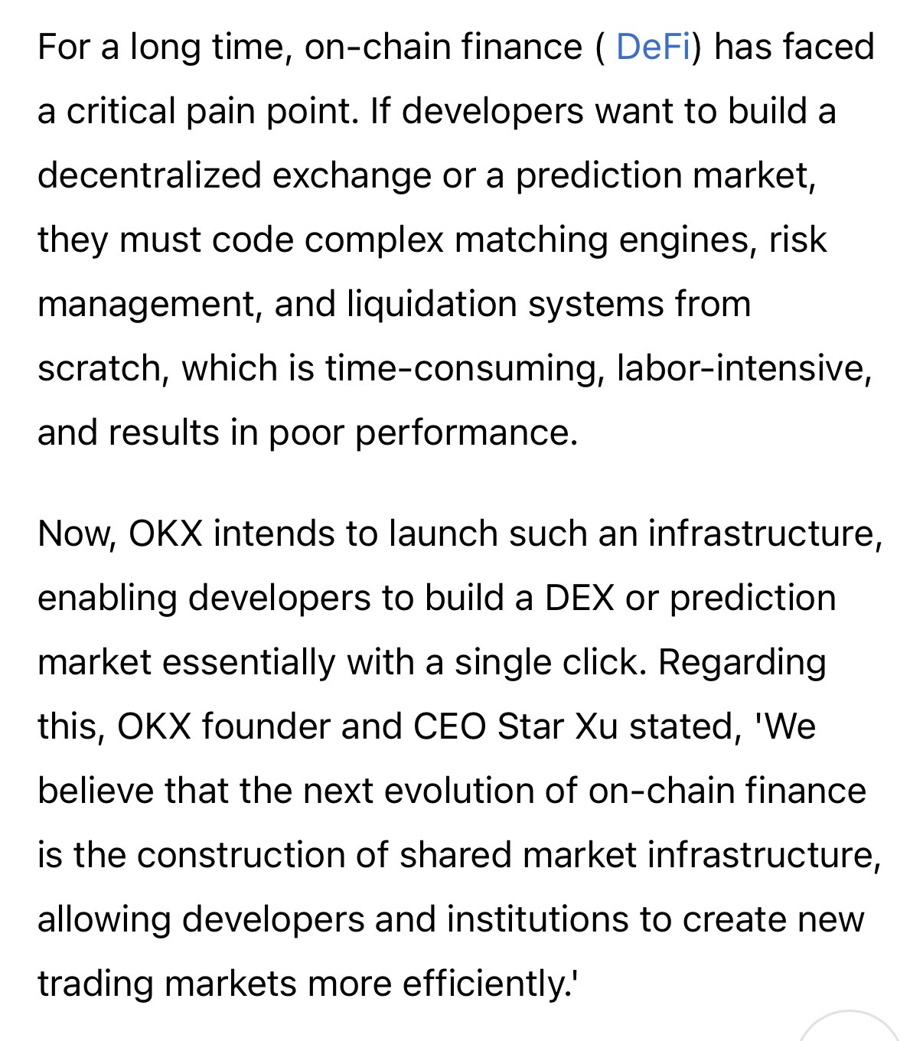
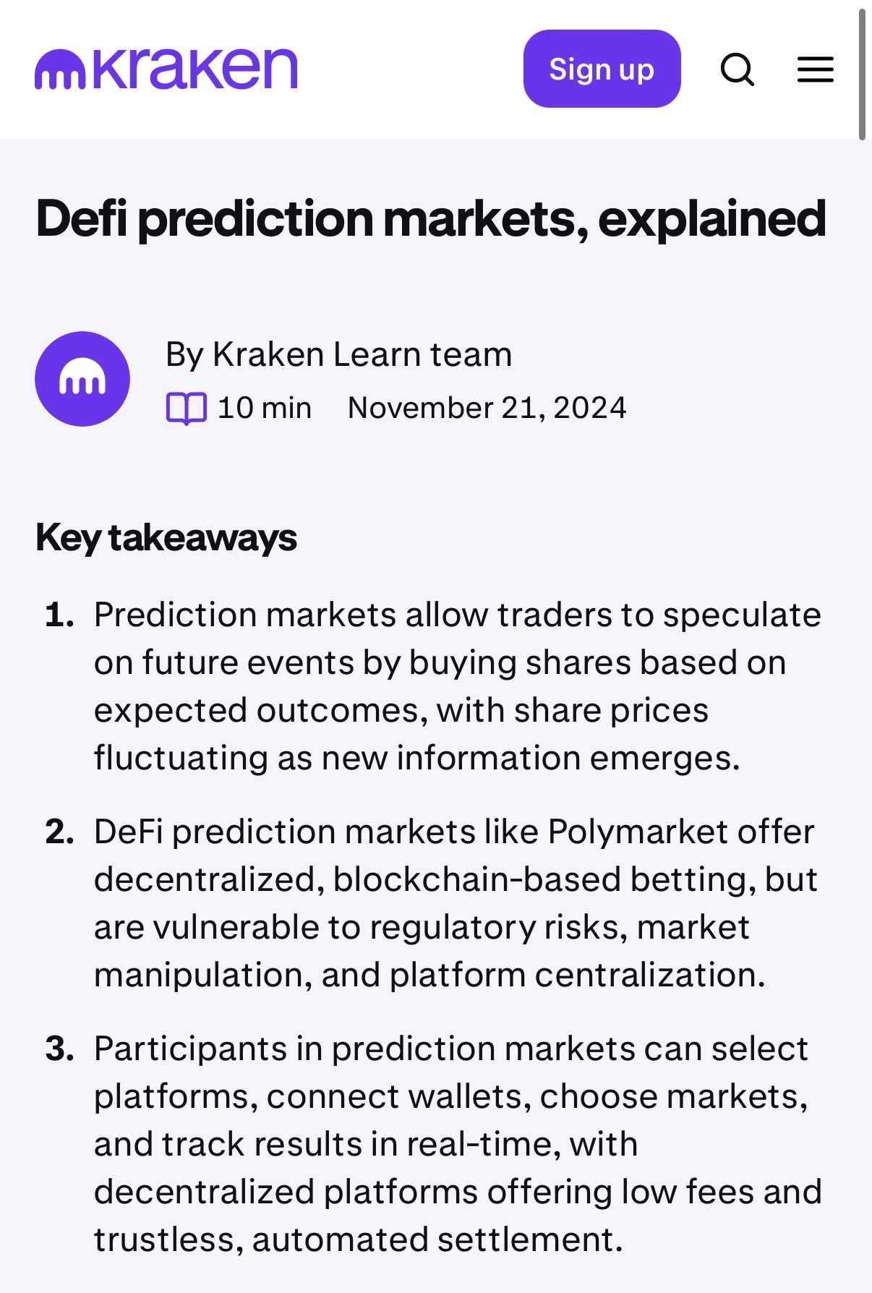

How Could Prediction Markets Platforms Benefit? (con’t)

Slide 12
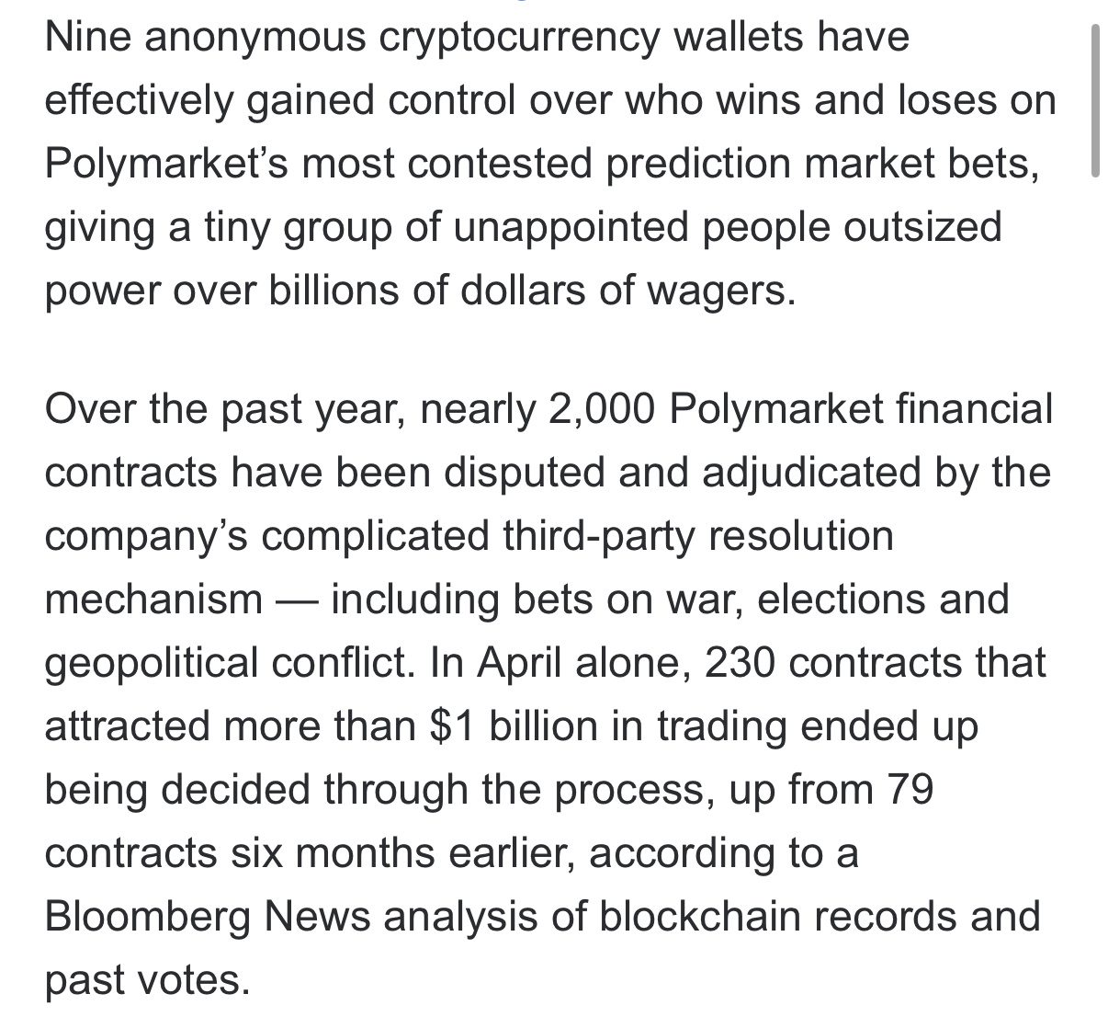
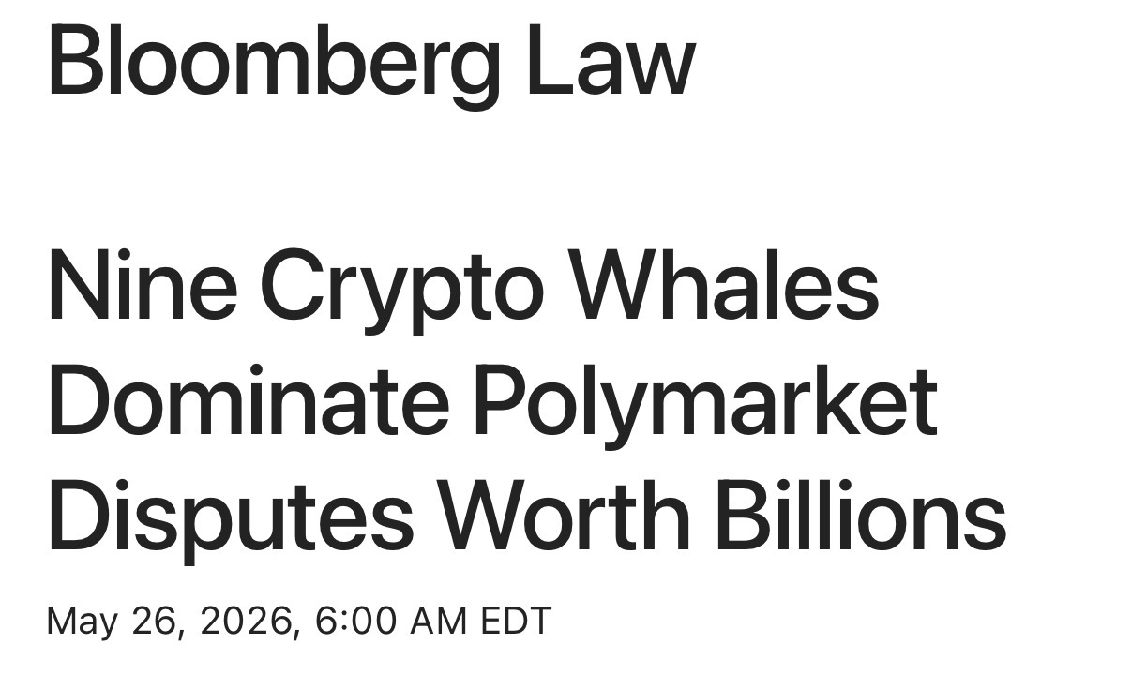
How Could Prediction Markets Platforms Benefit? (con’t)

Slide 13
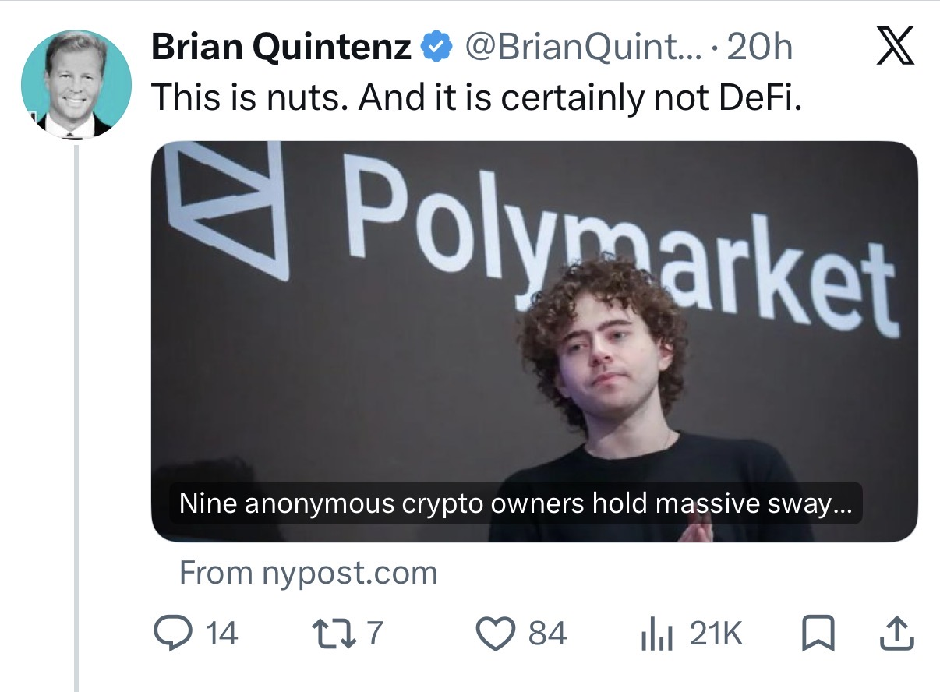
How Could Prediction Markets Platforms Benefit? (con’t)

Slide 14
Bottom Line & Moving Forward
  Bottom line:
    Restructuring their businesses as “DeFi” (which has a permissive definition in the CLARITY Act) could allow prediction market firms to avoid CFTC registration as a DCM.
    This could be a workaround from future adverse court rulings that side with states/tribes over prediction markets/CFTC.
  Moving forward:
    Arguably legislation should close the sports/casino-style gaming loophole in the Commodity Exchange Act
    At a minimum, there should be a savings clause to clarify that the DeFi language does not pre-empt state or tribal gaming authority

Slide 15
Questions/Discussion

