Slide 1
Defining Data TIBC Data Management Subcommittee Meeting July 30, 2024

Slide 2
Definitions
Data: recorded information, regardless of form or the media on which the data is recorded. (Source: 44 USC § 3502[16]).

Slide 3
Definitions
Data Asset: a collection of data elements or data sets that may be grouped together. (Source: 44 U.S.C§ 3502[17])

Slide 4
Foundations for Evidence-Based Policymaking Act of 2018
“Evidence Act of 2018” (P.L. 115-435) establishes processes for the federal government to modernize data management practices, evidence-building, and statistical efficiency.
Title I – Federal Evidence-Building Activities.
Requires agencies to develop and implement evidence-based policies and programs.
Data the agency intends to collect, use, or acquire to facilitate the use of evidence for policymaking
Evaluation Officer and Statistical Official

Slide 5
Foundations for Evidence-Based Policymaking Act of 2018
(P.L. 115-435, Title II) – OPEN Government Data Act requires government data to be open by default unless restricted by law.
Establishes role of Chief Data Officer and CDOC
Best practices, data sharing agreements, producing evidence for policymaking.
Comprehensive Data Inventory

Slide 6
Foundations for Evidence-Based Policymaking Act of 2018
(P.L. 115-435, Title III) – Confidential Information Protection and Statistical Efficiency Act
Modernizes and streamlines the legal framework for protecting confidential statistical information, and establishes new safeguards to protect the privacy of individuals and organizations that provide data to federal statistical agencies.

Slide 7
Foundations for Evidence-Based Policymaking Act of 2018
Evaluation Officer
Statistical Official
Chief Data Officer

Slide 8
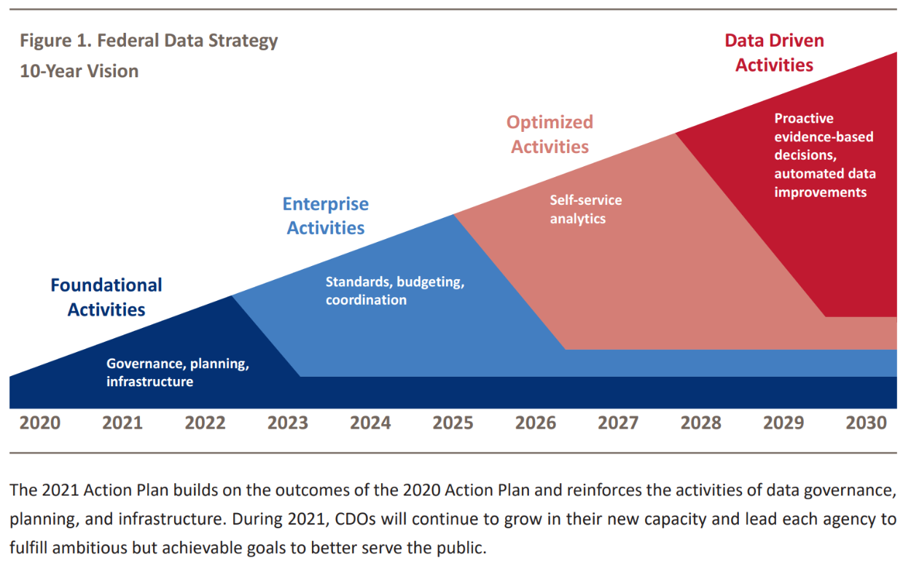
Federal Data Strategy

Slide 9
DOI Data Strategic Plan – Information Management and Technology Strategic Plan (Goal 5)
5.1) Align data collections to the achievement of shared mission outcomes across business functions.
5.2) DOI employees can easily find priority DOI data assets that help inform their decisions. Measures and information are provided as required in the DOI Strategic Plan.
5.3) Lower barriers to effectively use DOI data assets
5.4) DOI employees have data literacy, AI, and evidence-based decision-making skills for their roles and responsibilities.
5.5) Increase transparency and public trust by publishing priority DOI data for the benefit of all as defined by the Evidence Act.
https://www.doi.gov/sites/default/files/documents/2024-01/imt-strategic-plan-508-compliant-final-final.pdf

Slide 10
Data Updates Across Indian Affairs
Established an Internal IA Data Governance Body
People, Policies, Processes, and Technology
IA Programs are focusing on Evidence Building Activities
Articulating key mission objectives and goals
Tracking progress and identifying performance measures
Aligning and integrating data collections to mission outcomes

Slide 11
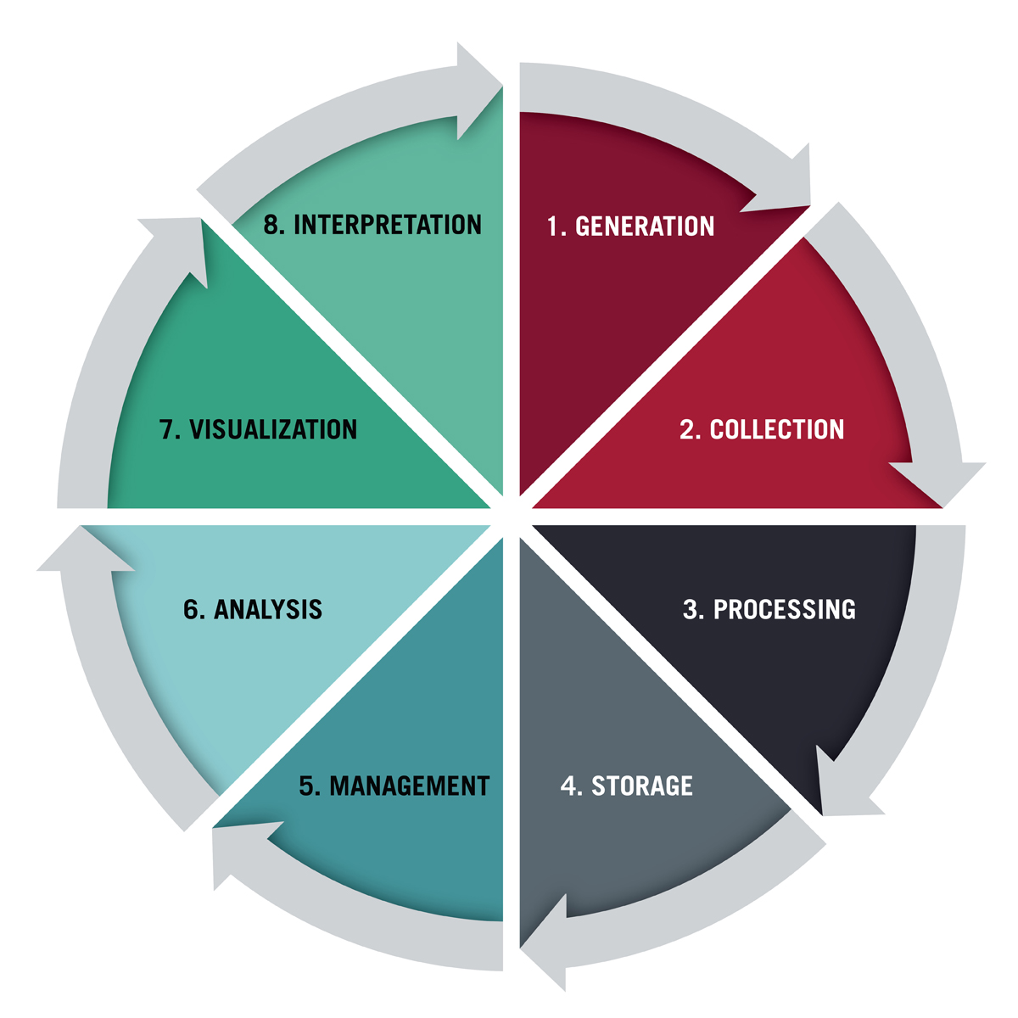
Data Lifecycle
Data Use

Slide 12
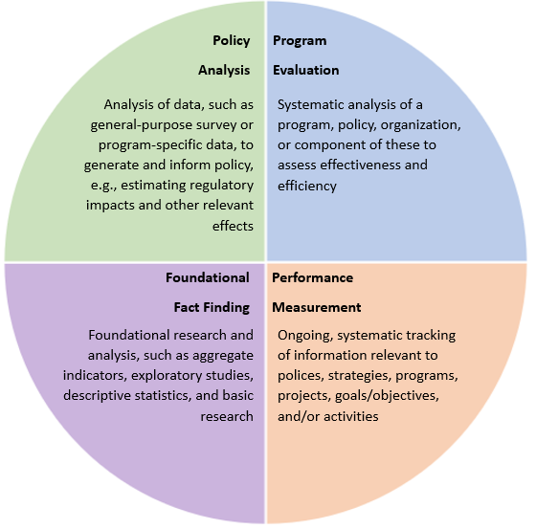
Evidence Building
https://www.whitehouse.gov/wp-content/uploads/2019/07/m-19-23.pdf

Slide 13
Questions?
Veronica Lane, Ph.D.
Chief Data Officer
Office of Budget and Performance Management
Office of the Assistant Secretary for Indian Affairs
veronica.lane@bia.gov
Ahéhee’
(Thank you!)

