Slide 1
Tribal Interior Budget Council (TIBC) Public Safety & Justice Subcommittee
BIE School Resource Officer Requirements
Sharon Pinto, Deputy Bureau Director Travis Clark, Chief of Staff
Larry Palmer, Budget Officer
Pala, CA
July 29th – August 3rd

Slide 2
Agenda
BIE Indian Country Mission Areas
BIE Day, Residential, and Boarding School Requirements
Tribal Colleges and Universities (TCUs)
School Resource Officer Costing Overview
Serving Our Student and Employee Populations
Questions and Answers
2

Slide 3
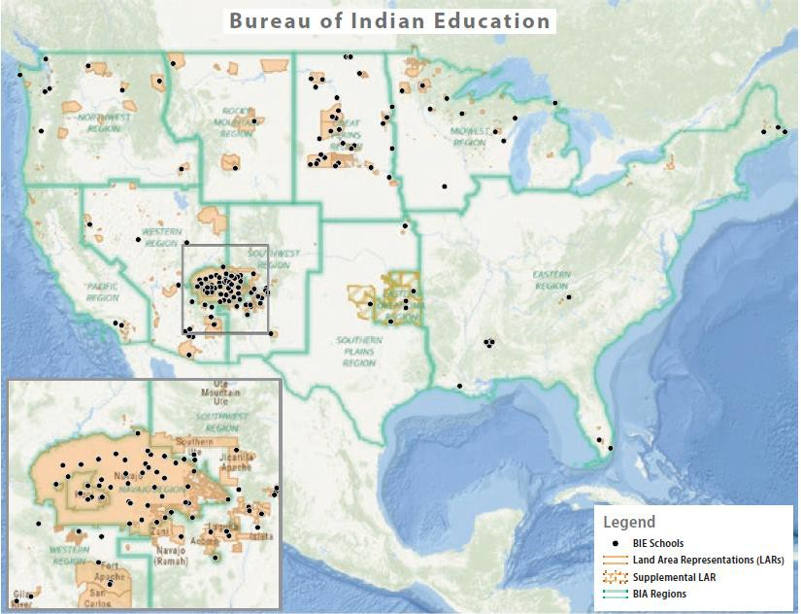
BIE Schools
BIE-funded schools include 183 elementary and secondary schools – serving students in 23 States.
3

Slide 4
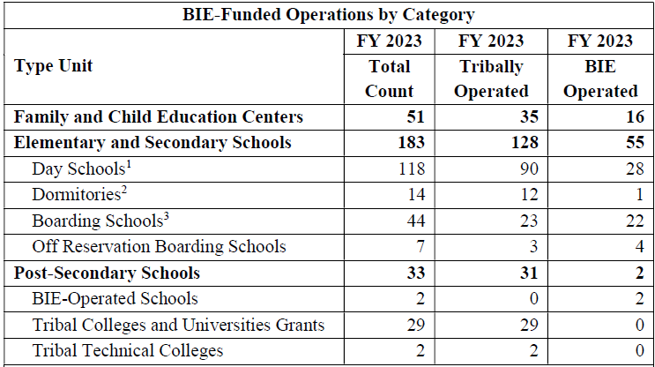
BIE’s Unique School Categories
BIE’s
Day Schools, Residential and Boarding Schools vary significantly from public schools
BIE’s
mission includes 24/7 services at various locations
4

Slide 5
Tribal Colleges and Universities
BIE-funded TCUs operate in over 15 states
TCUs | State
Ilisagvik College | AK
Tohono O'odham Community College | AZ
Dine College | AZ
Haskell Indian Nations University | KS
Bay Mills Community College | MI
Keweenaw Bay Ojibwa Comm. College | MI
Saginaw Chippewa Tribal College | MI
Leech Lake Tribal College | MN
Red Lake Nation College | MN
White Earth Tribal & Comm. College | MN
Aaniiih Nakoda College | MT
Blackfeet Community College | MT
Chief Dull Knife College | MT
Fort Peck Community College | MT
Little Big Horn Community College | MT
Salish Kootenai College | MT
TCUs | State
Stone Child College | MT
Cankdeska Cikana Comm. College | ND
Nueta Hidatsa Sahnish College | ND
Sitting Bull College | ND
Turtle Mountain Community College | ND
United Tribes Technical College (UTTC) | ND
Little Priest Tribal College | NE
Nebraska Indian Community College | NE
Southwestern Indian Polytechnic College | NM
Navajo Technical University (NTU) | NM
College of the Muscogee Nation | OK
Oglala Lakota Community College | SD
Sinte Gleska University | SD
Sisseton Wahpeton College | SD
Northwest Indian College | WA
College of Menominee Nation | WI
Lac Courte Oreilles Community College | WI
5

Slide 6
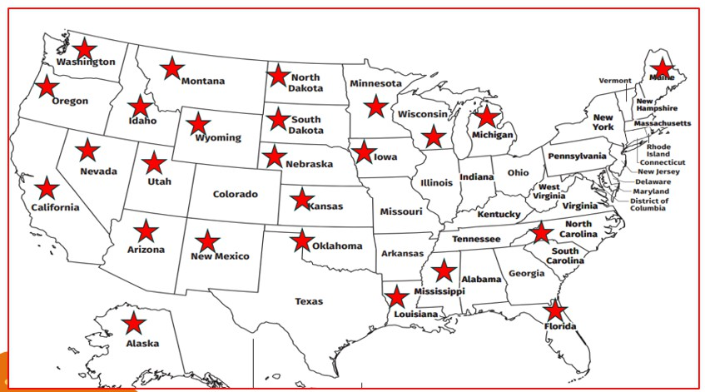
BIE-funded Schools and TCUs
Safety Coverage Includes A Large Geographic Area
6

Slide 7
BIE School Resource Officer Needs - 412
Elementary and Secondary Schools
Description | Count | SRO | SROs
Day Schools | 118 | 1 EACH | 118
Dormitories | 14 | 3 EACH | 42
Residential Schools | 44 | 3 EACH | 132
Off-Reservation Boarding Schools | 7 | 3 EACH | 21
Elementary and Secondary SROs |  |  | 313
Post Secondary
Description | Count | SRO | SROs
BIE- Operated Post-Secondary | 2 | 3 EACH | 6
Tribal Colleges and Universities | 29 | 3 EACH | 87
Tribal Technical Colleges | 2 | 3 EACH | 6
Post-Secondary SROs |  |  | 99
Total Requirement
Total BIE School Resource Officers Request | 412
7

Slide 8
School Resource Officer Cost Overview
Grade Benchmark | Police Officer Series |  | Location – Pay Examples | OPM Salary Data Source |  |  | Law Enforcement Benefits |  | Total
GS-11-12 | 1801 Series |  | New Mexico | $ 114,237 |  |  | $ 45,695 |  | $ 159,932
 |  |  | Arizona | $ 118,079 |  |  | $ 47,232 |  | $ 165,311
 |  |  | California | $ 128,752 |  |  | $ 51,501 |  | $ 180,253
 |  |  | Rest of United States | $ 113,047 |  |  | $ 45,219 |  | $ 158,266
Estimated Average Salary and Benefits Per SRO |  |  |  | $ 118,529 |  |  | $ 47,412 |  | $ 165,940
Summary of Salary and Benefits for SROs
Estimated Average Salary and Benefits |  |  |  |  | Average |  |  | # SROs | Total
Cost of Salary and Benefits |  |  |  |  | $ 165,940 |  |  | 412 | $ 68,367,280
Estimated Law Enforcement Availability Pay - Overtime |  |  |  |  |  |  |  |  | $ 7,632,720
Total Estimated Salary and Benefits |  |  |  |  |  |  |  |  | $ 76,000,000
Non-Pay Operational Costs
Description |  | SRO |  |  |  | SRO Operational Costs
Fleet Vehicle - Lease/Buy |  | 300 Vehicles |  |  |  | $8,500 Per Vehicle |  |  | $2,550,000
IT Costs Per FTE – Standup |  | 412 |  |  |  | $4,617 IT Costs Per FTE |  |  | $2,000,000
Mandatory Training/Travel |  | 412 SROs - 10% of Base Salary |  |  |  | 10%*Salary*SROs Rounded |  |  | $7,185,213
SRO Reporting Systems, Equipment, Administrative Support Contracts |  |  |  |  |  |  |  |  | $5,264,787
Total Non-Pay |  |  |  |  |  |  |  |  | $17,000,000
Total SRO Requirement (Salary, Benefits, and Non-Pay)
$93,000,000
8

Slide 9
Serving Students and Employees
Ensuring A Safe Environment
Post-Secondary TCUs
Over 25,000
academic year students
Secondary High Schools
Elementary Schools
Early Childhood (FACE Programs)
Over 9,000
9-12
students
Over 28,000 K-8
students
Over 2,500
Children & Adults
Estimated BIE and TCS Employees Serving BIE-funded schools
Over 9,000 Federal and Tribal Employees
9

Slide 10
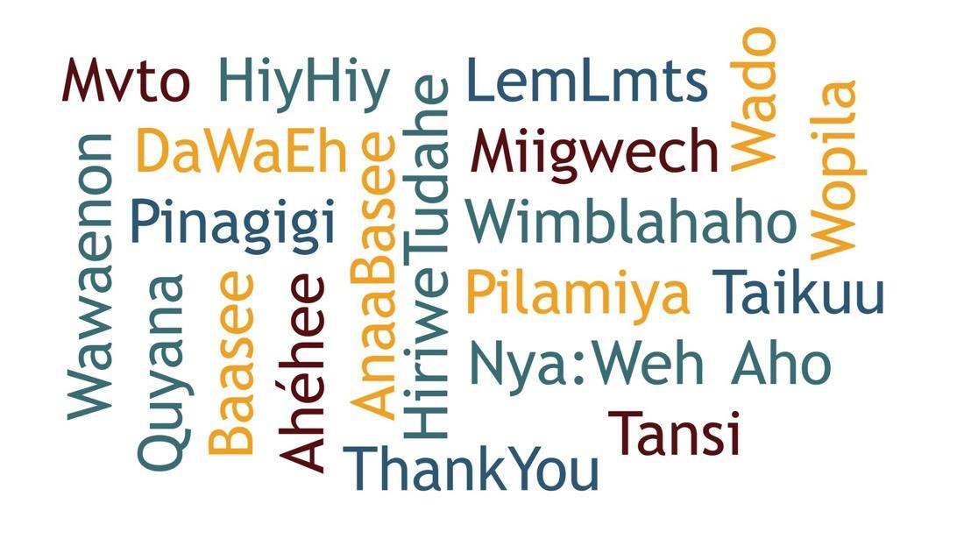
Questions and Answers

