Slide 1
Budget Strategy
Dani McQuillen
Principal Deputy Bureau Director, Trust Operations Management
August 2, 2024

Slide 2
Meet Danelle “Dani” McQuillen
Onieda Nation of Wisconsin; grew up on Pine Ridge Reservation
Joined BTFA on detail in 2021; permanent since 2022
Key member of the Boarding School Initiative team
Currently Principal Deputy Bureau Director, Trust Operations Management; most recently acting as Deputy Bureau Director for Trust - Field Operations
Transferred from BIA Great Plains Region, Deputy Regional Director for Indian Services

Slide 3
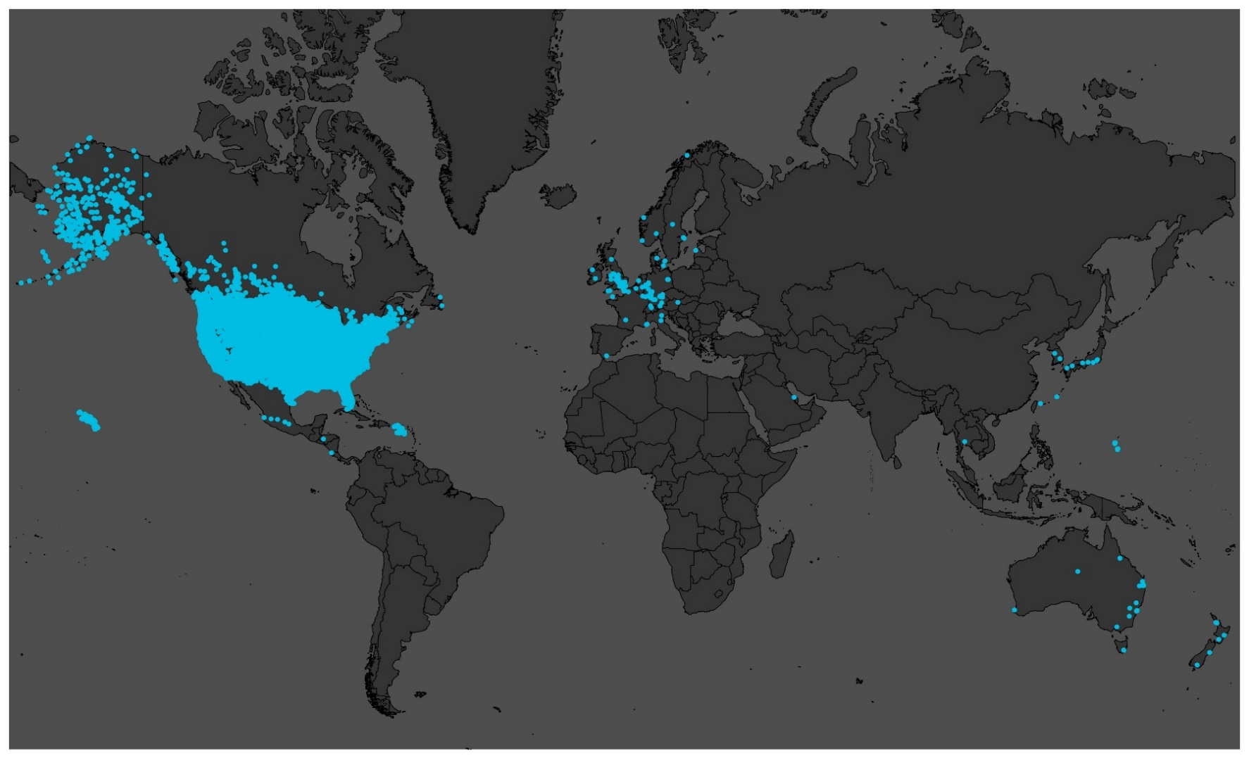
Beneficiaries
$8.8 billion under management
411,000+ IIM accounts
4,200+ Tribal accounts
*Audited figures as of September 30, 2023

Slide 4
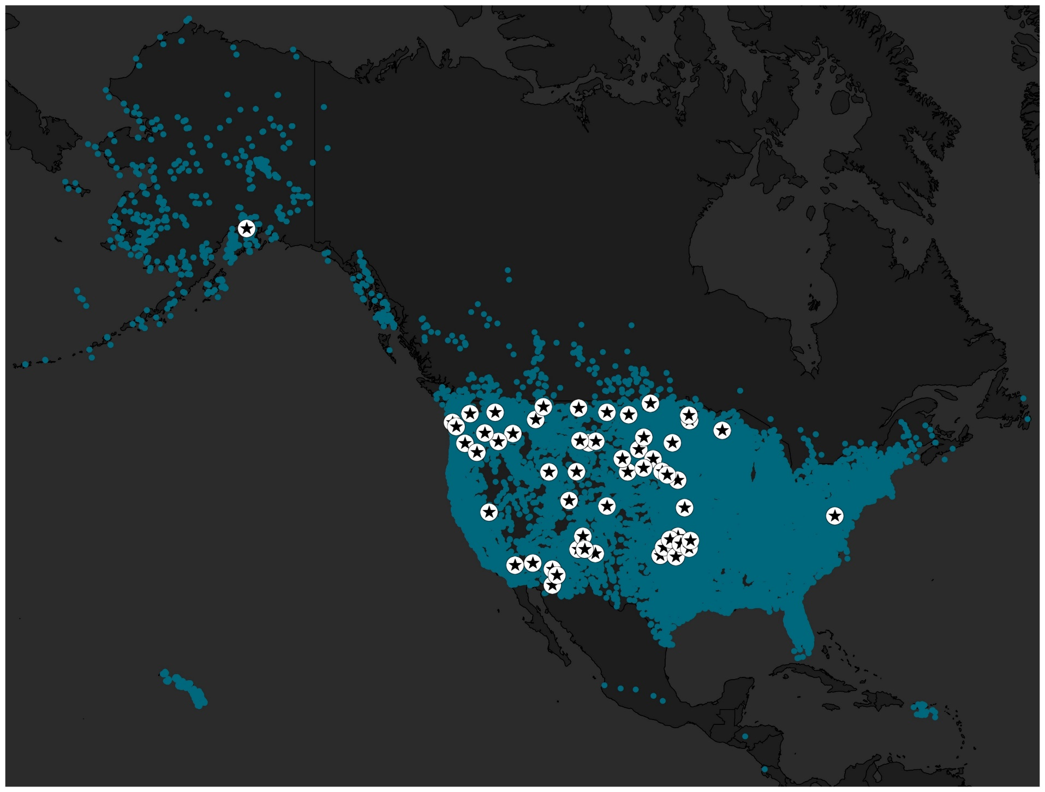
Staff
423 Federal Employees
120 Contractors
57 Field Offices

Slide 5
Bureau Status FY2025
The House Appropriation Sub-Committee released its initial 2025 proposed mark up for the Bureau of Trust Funds Administration, $105,227,000
Providing $105.2 million, which is -$6.0 million (-5.4%) below the request and $5.2 million (+5.3%) above 2024 Enacted
The Senate Mark up for the Bureau of Trust Funds Administration, $100,472,000
Providing $100.4 million, which is –$10,805 million (-10%) below the request and +$463,000 (0%) above the 2024 Enacted

Slide 6
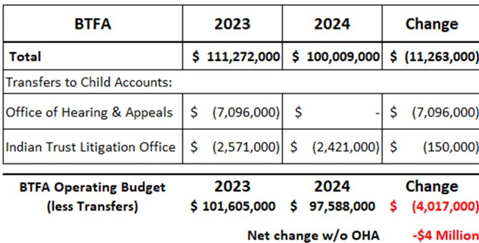
Bureau Status FY2024
Reduced operating budget by $4 Million due to budget cuts

Slide 7
Managing a $4 Million Cut
Most vacancies will remain unfilled
Fund some expenses with rollover/carryover
Restrict travel
Reduce office space
Reduce hours at Trust Beneficiary Call Center

Slide 8
Current Modernization Efforts
As a High Impact Service Provider, BTFA must meet the requirements of Section 7 of the December 13, 2021 Executive Order requiring agencies to:
(e) improve the digital customer experience for their respective agencies’ customers by modernizing agency websites, using human-centered design methodologies, digitizing agency services and forms, modernizing records management, updating network infrastructure and mobility capabilities, and accelerating the use of electronic signatures when aligned with policy priorities, as required by … (44 U.S.C. 3501)
BTFA is currently undergoing four major modernization efforts to fulfill these requirements:
Cloud Customer Service Management System
Online Account Access
Electronic Records Management Project
Virtual Call Center and Interactive Voice Response

Slide 9
Modernization Project Updates
Cloud Customer Service Management
Launched July 2024
Tracks all beneficiary contacts and requests
Improved case management from creation to resolution
Online account access
View account balance/statements, download account transaction activity
2024 piloting with 6 tribes (Crow, Chickasaw, Choctaw, CSKT, Fort Berthold/MHA/TAT, Rosebud)
Access to all beneficiaries – in FY2025
Electronic Records Management
Digitizing the collection at the American Indian Records Repository, transitioning from paper-based records management to electronic
V24 hour voice response at Call Center (via Cloud Based Virtual Call Center launched August 2023)
Currently piloting; launching Aug. 2024 – self-service balance and last distribution information

Slide 10
Future Expenses
Trust Fund Accounting System – FY2028
Increased leasing costs for records storage
Digitization of trust records – Ongoing
Discovery requests in Tribal litigation – Ongoing
Beneficiary Services Improvements – Ongoing

Slide 11
Thank you.
Danelle "Dani" McQuillen
Deputy Bureau Director
605-850-4158
danelle_mcquillen@btfa.gov

