Slide 1
DOI - Probate Strike Team
TIBC August 4, 2025

Slide 2
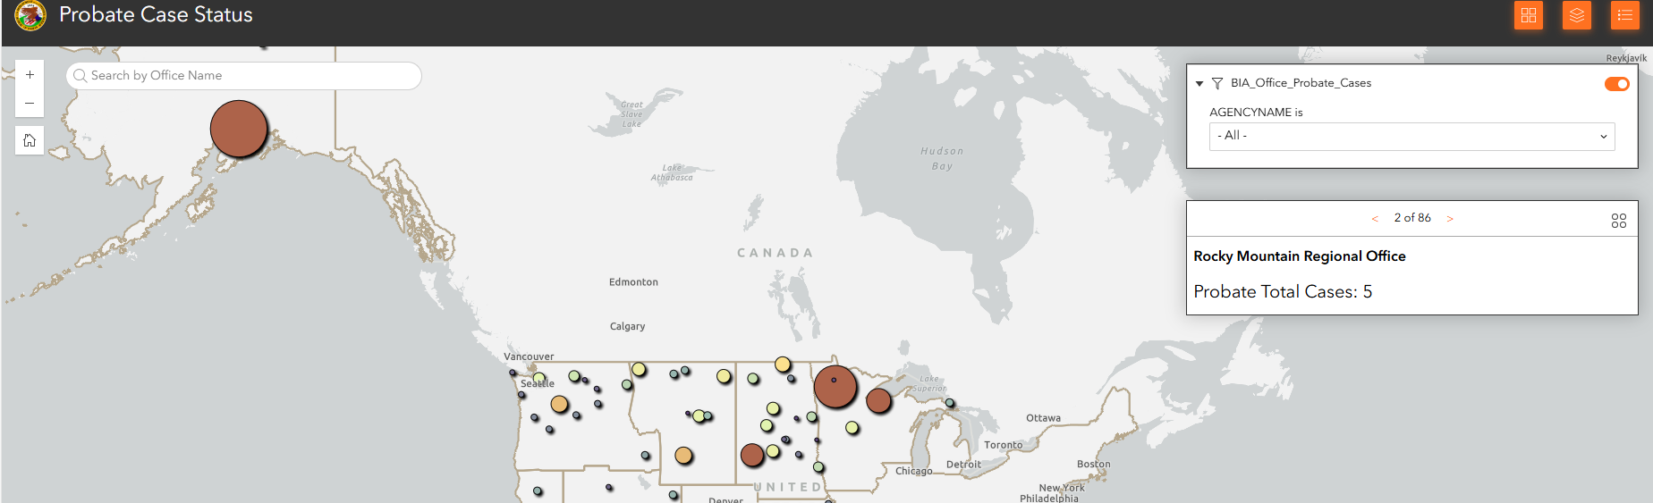
Probate Backlog: A Crisis Years in the Making
The Department of the Interior (DOI) is entrusted with a sacred fiduciary duty to uphold and protect the trust assets and interests of Tribal Nations and Individual Indian allottees. The current backlog of over 48,000 probate cases impedes our service to Indian County delaying asset transfers, undermining land consolidation and eroding the trust in federal probate systems. This project represents not merely an operational challenge, but a moral obligation to correct systemic delays and deliver enduring reform.

Slide 3
Initial Vision of Probate Project
Vision -
The Probate Backlog Reduction and Efficiencies Project will serve as a BIA model of accountable, transparent, and culturally competent estate processing—one that:
Closes aged probate cases through scalable, data-driven intervention;
Establishes repeatable business processes and internal controls;
Delivers results to Native communities by preserving the value of land, titles, and trust accounts through timely resolution;
Honors Tribal sovereignty through direct engagement, co-designed solutions, and shared capacity.

Slide 4
Initial Guiding Principles
Accountability:
  Measure progress through developing tools with today’s technology to better service Tribal Communities interacting in the Probate Process.
Transparency:
  Maintain open lines of communication with Tribes, internal DOI stakeholders, by conducting Tribal Listening Sessions.
Cultural Sensitivity:
  Recognize and respect the unique legal, social, and cultural contexts in which Indian probate matters occur. Ensure language, outreach, and solutions are informed.
Agility:
  Adapt to field conditions by using developing feedback loops with BIA Agency’s and Tribes along with phased scaling. Identify and address bottlenecks—whether systemic, technological, or policy-based.

Slide 5
Point of Contact(s)
Kelly Rael
U.S. Department of the Interior
Office of the Assistant Secretary - Indian Affairs
Email: Kelly_Rael@ios.doi.gov
Eric J. Rodriguez
Acting Senior Advisor to the Director BIA
Email: Eric.Rodriguez@bia.gov

