Slide 1
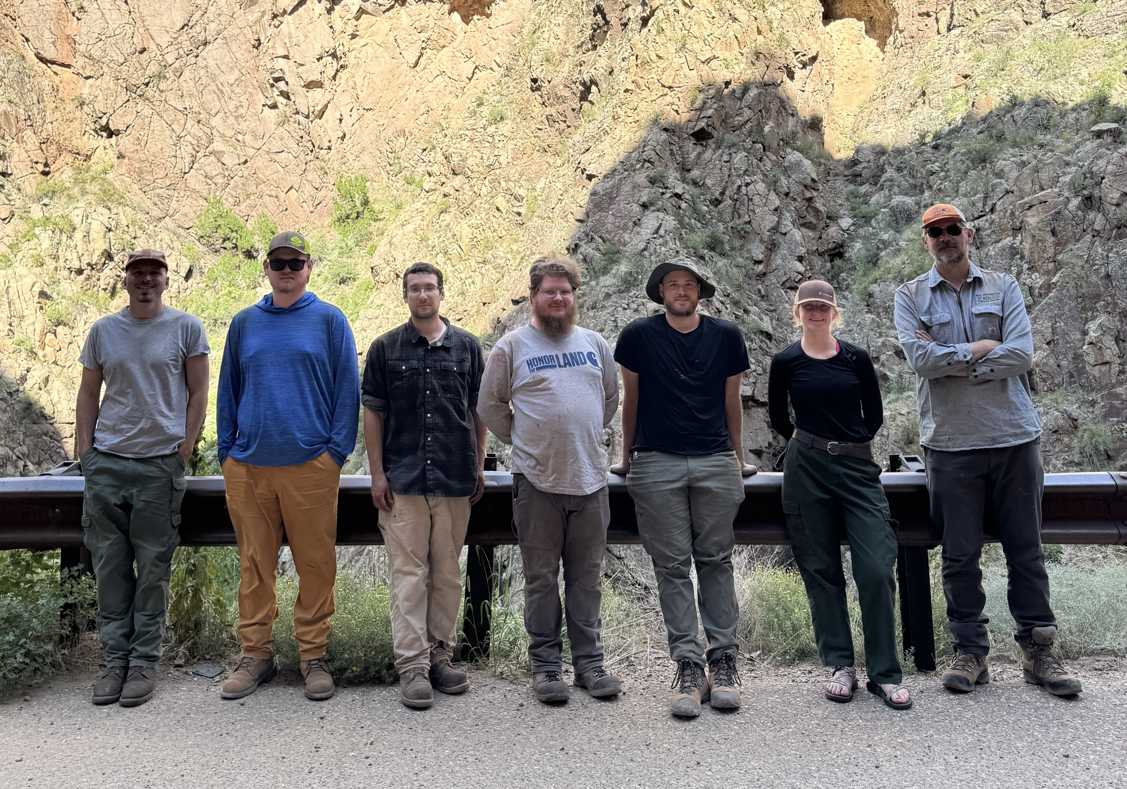
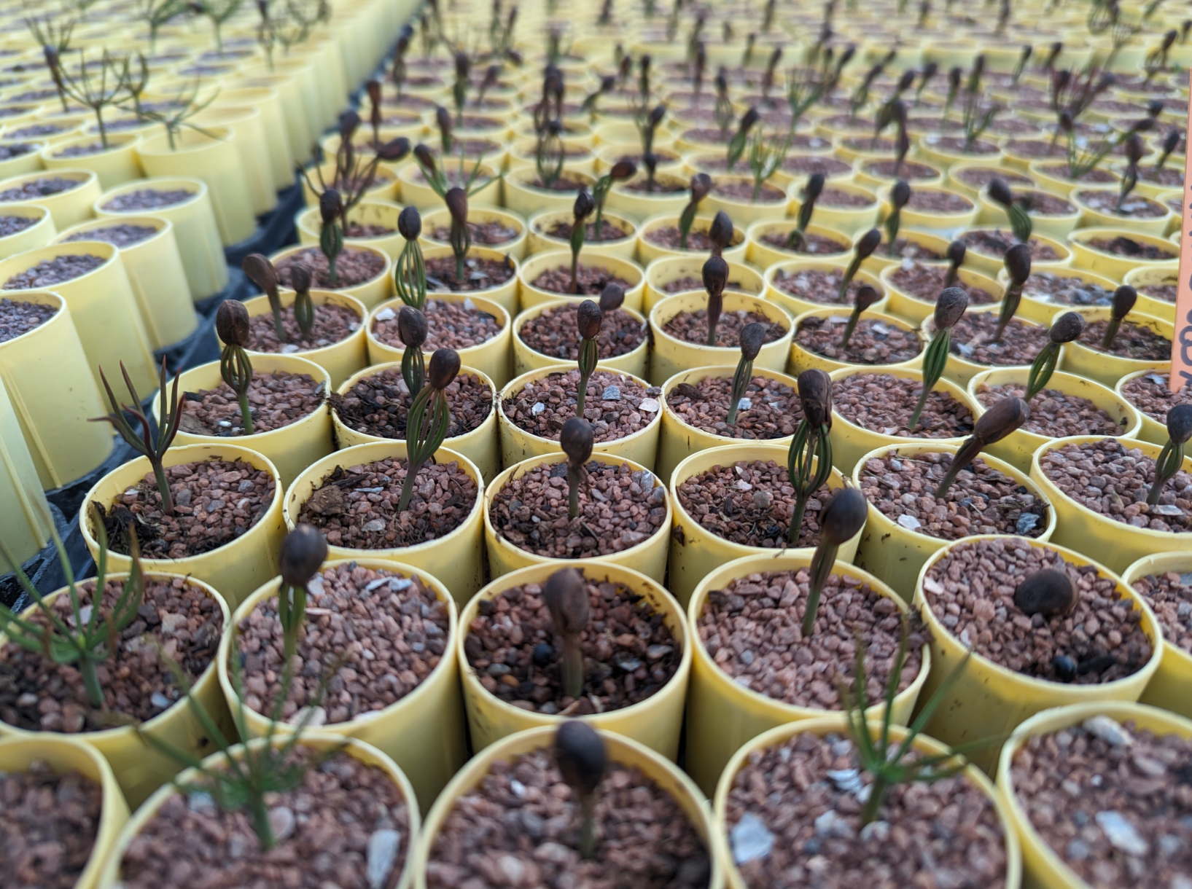
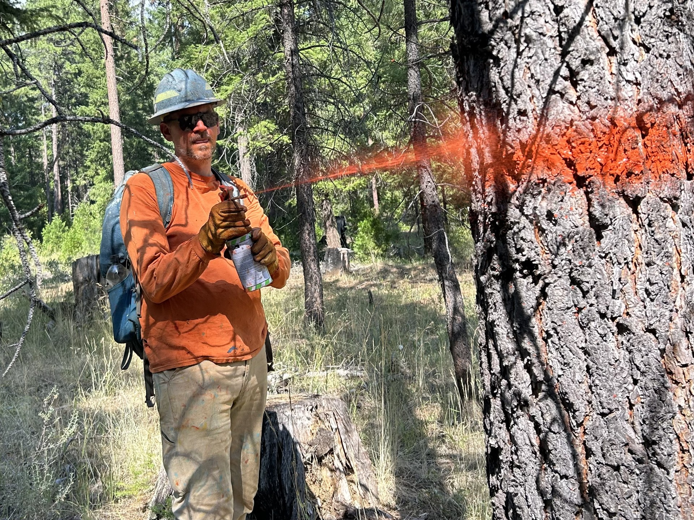
BIA - Division of Forestry
Caleb Cain

Slide 2
Timber Team Accomplishments
Work Overview May 2024 - 2025
Travel Overview May 2024 – May 2025
Weeks Traveled: 24
Tribes/Agencies Served: 14
States Visited: Arizona, Montana, Washington, Oregon, Oklahoma, North Carolina, New Mexico, and Alaska
Remaining FY 25 Schedule: Uintah and Ouray, Metlakatla, Wind River, Yakama, Navajo Nation, & Quinault
84 CFI plots measured
311 stand exams completed
123 Cruise Plots taken
3,128 acres of timber sale units prepped (layout, marking, GPS)
2,037 woodland species inventoried
154,525 GIS acres of Forest Cover Types updated

Slide 3
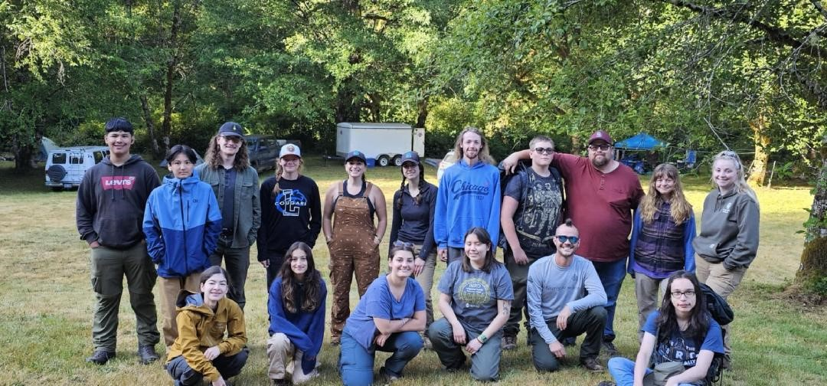
Tribal Forestry Summer Youth Camps – 2024 & 2025
$812,423 supporting 24 camps
Over 600 students participating
Inspiring the next generation of Tribal Foresters!
2024 CTCLUSI Forestry Field Camp participants

Slide 4
Opportunities
Co-Management
Demonstration Projects
GNA
FOFA
TFPA
Draft Bills
Nurseries/Seed Banks
Restoration
White Oak (5 pilot projects)
Biomass
Biochar
Tribal Sawmill
EO-14225 Immediate Expansion of American Timber Production
Wood For Life
NASP
Youth Camps
AI
Portable/Small Infrastructure

