Slide 1
Technology Modernization Fund TIBC Brief – July 2024
School Website Installation and Maintenance Services
Modernizing Bureau of Indian Education funded school websites to a 21st Century IDEA digital experience

Slide 2
The Problem
Many BIE funded school websites are archaic, often ill- managed and do not offer up to date, relevant information to school communities. Most do not adhere to GWDS or Section 508 Requirements
As anchor institutions, BIE schools support the BIE’s mission to provide quality education to Tribal communities. Outreach and communication is critical to success of each student in the school system.
Schools have used a variety of platforms and services in an uncoordinated manner. Facebook sites are commonly used.
2

Slide 3
The Solution
Provide a common hosting platform for all BIE Schools,
adhering to common core standards – GWDS, Section 508
Provide for Cybersecurity capabilities across all websites
School access to manage and update content
Solution builds upon existing capability, in line with the
BIE Director’s Strategic Transformation of Education Plan
3

Slide 4
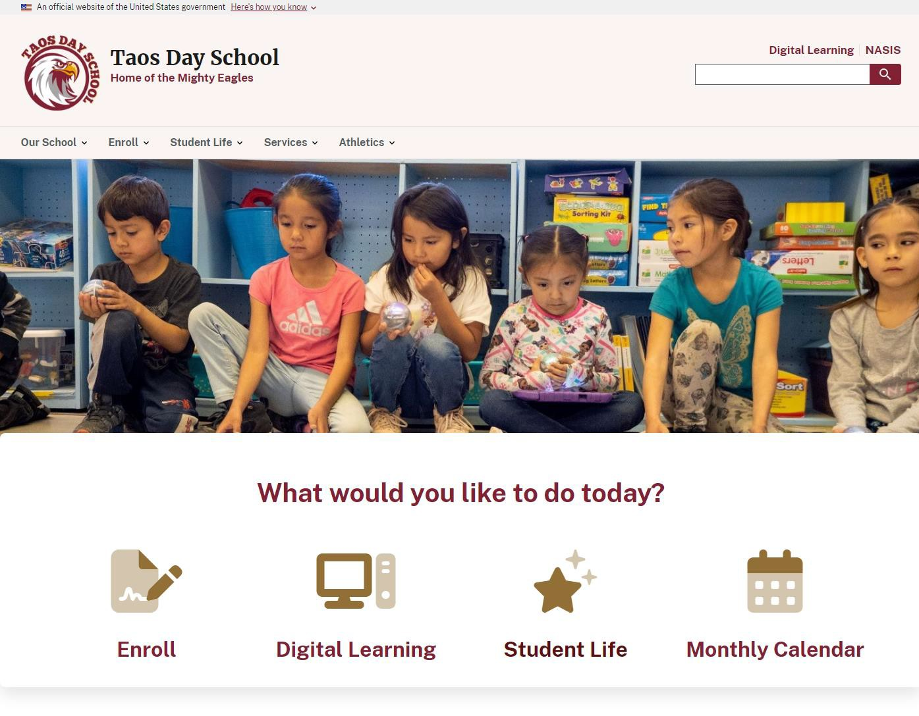
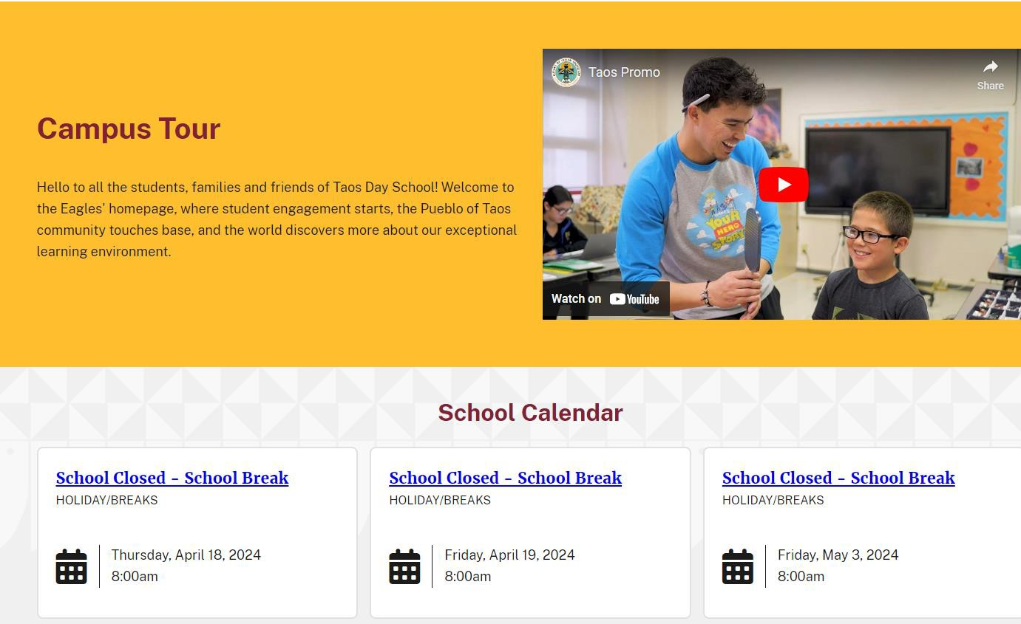
Taos Day School – tds.bie.edu
4

Slide 5
Community Facing Impact
Schools will be able to communicate and maintain continuity for school activities and information to tribal community members, including school staff, parents, guardians, and students.
Contact Us
School History
Enrollment
Learning Mgmt Systems Linkage
NASIS Linkage
After School Programs
Athletics
Special Education Services
5

Slide 6
Overall TMF Investment
 |  |  | Current (Baseline) |  | Projected |  | Actual (Future)
Total Combined Investment |  |  | $ 1,522,000 |  | $ 5,868,000 |  | $ -
Agency Investment |  |  | $ 1,522,000 |  | $ - |  | $ -
TMF Investment |  |  |  |  | $ 5,868,000 |  | $ -
Savings (Cost Increase) from Baseline |  |  |  |  | $ (4,346,000) |  | $ 1,522,000
Return on Investment (ROI) |  |  |  |  | - 74% |  | 0%
Net Present Value (NPV – 7% Discount Rate, per OMB A-94) |  |  |  |  | $ (3,335,896.07) |  | $ 1,422,429.91
Internal Rate of Return (IRR) |  |  |  |  | $ 1 |  | No IRR
Repayment Schedule at 50% of Investment
FY 2025 Q3 | FY 2026 Q3 | FY 2027 Q3 |  | FY 2028 Q3 |  | FY 2029 Q3 |  | Total
$ 586,800 | $ 586,800 | $ 586,800 |  | $ 586,800 |  | $ 586,800 |  | $ 2,934,000
6

Slide 7
Tribal School Opportunities
Tribally Controlled Schools can request Website Services at no cost to include:
Drupal Hosting and Environment Setup
Content Support and Custom Branding and Design Services
100% control and management of school content within the SiteFactory Framework
Website Security Services across all sites
24 BOS Schools have completed with 8 more scheduled to launch
7

Slide 8
The Team
Technical Unit – Stuart Ott, Senior Sponsor (OIT)
Content Unit – Jennifer Bell, Senior Sponsor (BIE)
Name | Title / Role
George ‘Tony’ Morris | Acting Supervisory IT Specialist (Inet)
Fermin Aguilar | Web Developer (Contractor - Goldbelt Hawk)
Melinda Hardin | Web Developer (Contractor - Goldbelt Hawk)
TCeharmistsopahreer iAnllepnlace | toWmebaDkeeveploropegrress quickly – additional
Name | Title / Role
Susann Konkus | Web Content Manager (Contractor)
Glen Perry | Creative Communications Manager – STEP (Contractor)
Rhonelle Shallow | Senior Web Manager (Contractor)
Krysten Bevilaqua | Senior Graphic Designer/Illustrator (Contractor)
Kendra Long | Digital Asset Manager
William ‘Billy’ Person | Creative Content Writer (Contractor)
Additional Personnel (To be Recruited) | 2x Content Manager Communications Manager Graphic Designer Digital Asset Manager Creative Writer Social Media Manager 8
BIE Content team members may be recruited through existing IDIQ contract or a new vehicle, as required.

Slide 9
Contact for more information
Technical | Content
stuart.ott@bia.gov | jennifer.bell@bie.edu
703-909-3065 | 202-941-0789
9

Slide 10
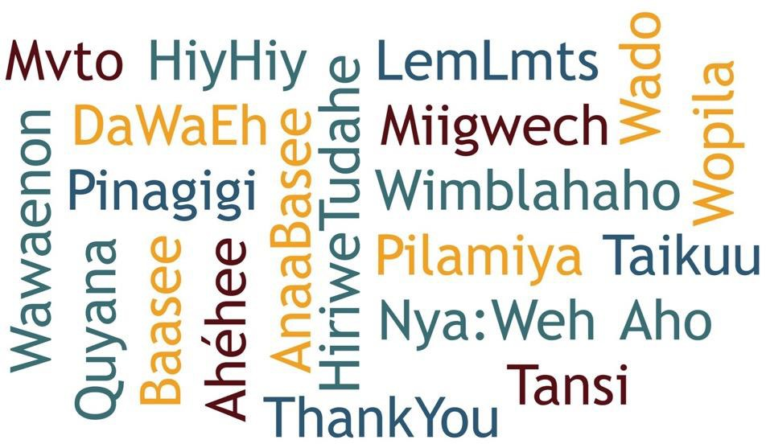
Questions and Discussion Topics

