Slide 1
Technical Assistance for Tribes on Cost of Federal Programs
November 2024

Slide 2
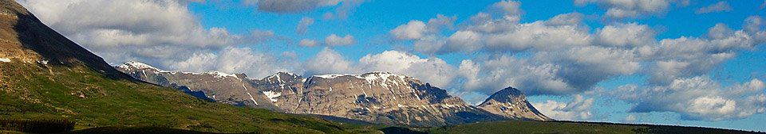

Probate Case Log
Key Funding Needs and Solutions:
  Alaska Region: $6 million annually for 52 FTEs to reduce the backlog to a 2–3-year timeframe.
  Nationally: An additional $35 million and 134 FTEs would enable a 2–3-year resolution timeline. Achieving a <1-year backlog requires significantly more resources.
  Office of Hearings and Appeals: (OHA): $7.3 million and 60 FTEs to increase annual case processing from 3,000 to 7,000
  Bureau of Trust Funds Administration (BTFA): $4.8 million and 26 FTEs to handle 2,000 more cases annually and enhance efficiency through automation.
Opportunities for Improvement:
  Centralized teams for death notice management and urban outreach to expedite documentation collection.
  Streamlined data entry into the Trust Asset Accounting Management System (TAAMS) to enhance case preparation and adjudication.
  Estate planning services remain underfunded, with an estimated need of $32 million to support wills and planning tools, through this will not necessarily reduce probate timelines
National Goal:
  $30 million annually over 10 years is needed to process 500 probate cases per region, reducing the backlog effectively and improving trust asset distribution.
* Estimate include $260M O&M waiver.

Slide 3
Workforce Planning
Self-Determination (Regional):
  Alaska Region: Manages 229 tribes with only 3 awarding officials and 4 vacancies, averaging 1,171 actions annually.
  Eastern Region: Oversees 35 tribes, with 4 vacancies, managing 632 actions annually
  Other Regions (Eastern Oklahoma, Great Plains, Midwest, etc.) Varying workloads with notable vacancies and under-resourced staffing levels, highlighting a need for funding to fill positions and meet operational needs.
Estimated Unmet Need Funding: the total estimated funding need across all regions is approximately $20.7 million, factoring in costs to fill 59 vacant positions, hire 80 additional staff, and support operational expenses.
Opportunities for Improvement:
  Increase Staffing Levels: Achieving a mid-term goal of 153 FTEs would reduce the average workload to 47 transactions per specialist, significantly improving work conditions.
  Long-term Workforce Planning: An optimal workforce size of 200 FTEs would further align with sister agency workloads and enhance critical functions like technical assistance, contract oversight, and workforce development.

Slide 4
Workforce Planning – cont’d
Overall Business Operations Need: To support program delivery, investments in HR, IT, finance, procurement, facilities, and safety management are necessary. The estimated additional funding across these areas include:
  HR: $6.75 million for 50 FTEs
  IT: $12.92 million for 75 FTEs and infrastructure
  Finance: $4.05 million for 30 FTEs
  Procurement: $3.38 million for 25 FTEs
  Facilities: $20.4 million for 20 FTEs and equipment
  Safety: $10.7 million for 20 FTEs and equipment

Slide 5
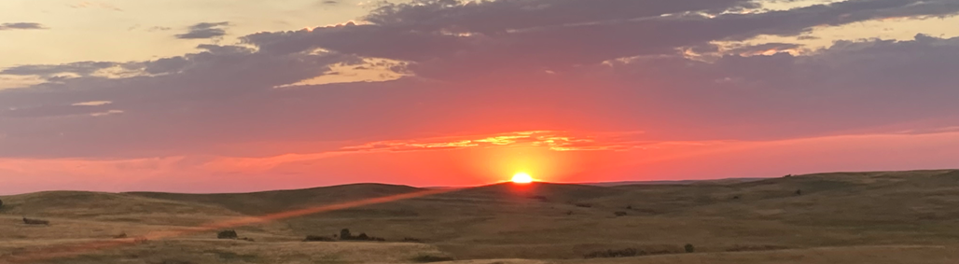
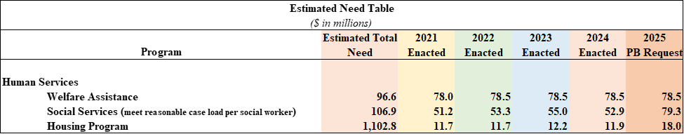
Human Services
Welfare Assistance: The total estimated need for Welfare Assistance is $106.9 million. This estimate is based on 2022 reported need for welfare services from tribes that filled out the BIA Financial Assistance and Social Services Report.
Social Services: The estimated funding requirement is $106.9 million, based on recommendations from the Child Welfare League of America, which advises limiting caseloads to 12-15 children per social worker and 12 or fewer cases for family centered casework
Housing Improvement Program: the estimated need of $1.1028 billion is based on unfunded eligible Tribal applications submitted to BIA regions.

Slide 6

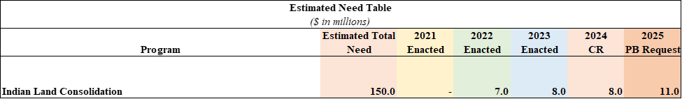
Indian Land Consolidation
Indian Land Consolidation: An estimated $150 million annually is required to sustain land consolidation, based on experiences from the Buy-Back Program.
[1]
TCR
BIL = $216M, $43,200 x 5yrs
IRA = $220M

Slide 7
Natural Resources
Tribal Climate Resilience in Alaska: The total estimated need for Tribal Climate Resilience totals $9.14 billion. In Alaska, $4.3 billion over the next 50 years is needed to protect 144 Alaska Native villages from flooding, erosion, and permafrost degradation, with an additional $833 million for hub communities. In the Lower 48, $4.84 billion is required, including $1.6 for unmet needs, with $372.3 million for relocation planning. These figures are based on analysis by Indian Affairs and the Institute of Tribal Environmental Professionals.
An additional $96 million is needed for Forestry programs, as identified in the IFMAT IV report. For FY2024, BIA Forestry received $52.8 million for 306 programs, falling short due to inflation, stagnant funding and a growing gap compared to federal forest management.
TCR
BIL = $216M, $43,200 x 5yrs
IRA = $220M

Slide 8
Natural Resources Cont’d
Tribal Climate Resilience in the Lower 48: The total estimated need for Tribal Climate Resilience in the Lower 48 States is $1.365 billion. Approximately $1.909 Billion is required for planning and implementation costs for infrastructure estimated needs in Tribal Communities across the Contiguous 48 States.
  This value consists of planning costs of approximately $463 million and implementation costs of approximately $1.446 billion.
  Roughly $543 million in annually funded programs was already identified as available resources for all Tribes in the U.S. (including Alaska). The estimated need ($1.365 billion) is the difference between Total Need ($1.909 billion) and Existing Support ($543 million)
  Note that the $543 million value of available multi-program Existing Support is an estimation of overall program availability and includes funding that is also available to Alaska Communities, not just the communities in the lower 48, so it is actually an overestimation of funding.

Slide 9
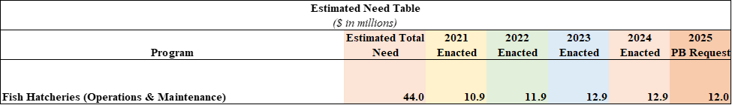
Fish Hatcheries – Operations & Maintenance
Currently, 65 hatcheries lack operational funding, with an estimated $400 million required per hatchery to meet basic needs (staff, utilities, fish food). Maintenance funding, currently at $7 million annually, needs to be increased to $14 million. Large-scale renovations or replacements range from $2 to 10 million per project, with an additional $4 million proposed for these upgrades.

Slide 10
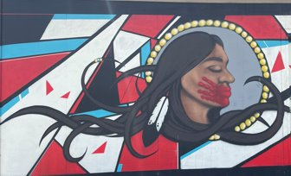
Office of Justice Services – Tribal Law and Order Act
Law Enforcement: Based on the FY2021 TLOA report, costs range from $856,000 for tribes with fewer than 600 residents to $7.5 million for tribes with service populations between 16,251 and 19,500. A standard law enforcement program includes officers, dispatchers, administrative services, and supplies and equipment.
Tribal Court Costs: Scaled by population, costs range from $818, 000 for part-time courts serving small tribes to $6.8 million for larger tribes with service populations of 16,251 to 19,500.
Detention/Correction Costs: Based on facility-specific staffing and operational needs estimated at $284.2 million, which apply to existing BIA-funded centers only.

Slide 11
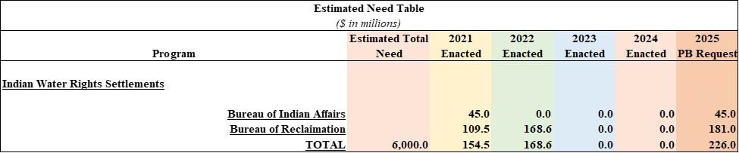
Indian Water Rights Settlements
Federal contributions for Indian Water Rights Settlements are estimated at $6 billion, including allocations from the Bipartisan Infrastructure Law ($2.5 billion) and the Reclamation Water Settlements Fund ($1.2 billion). However, these funds are insufficient to meet the financial obligations of existing and future settlements. Since 2021, additional settlements have been enacted, and several more are under congressional review. To address funding gaps, the Department of the Interior proposed a mandatory fund for recent and future IWRS obligations, but this proposal has not been enacted.
* Estimate include $260M O&M waiver.

Slide 12
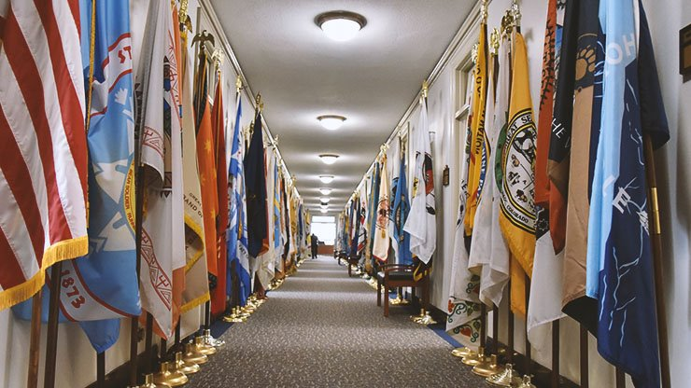
Bureau of Indian Education
Indian Student Equalization Program (ISEP) Funding per Student: BIE’s per-pupil expenditure is $16, 021, which exceeds some state spending but is significantly lower than Department of Defense Education Agency (DODEA) expenditures. Funding includes Indian School Equalization Program (ISEP) and additional support for transportation, and Tribal Grant Costs. Residential settings also increase BIE costs.
Notes:
Weighted Student Unit (WSU)
The measure of student membership adjusted bu the weight or ratios used as factors in the Indian School Equalization Formula; and
The factor used to adjust the weighted student count at any school as the result of the adjustments made under this part.
Based on the average per pupil funding in public schools, multiplied by the total WSU and accounts for 15 contingency fund. (Larry Palmer, BIE Budget Analyst)

Slide 13
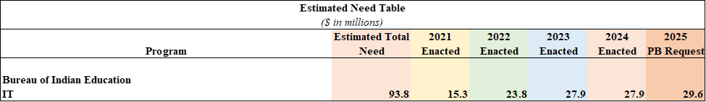
Bureau of Indian Education – IT Staff & Modernization
IT Staff & Modernization: The per capita cost is $2,369 for 11,771 users across 55 BIE-operated schools with 50% allocated to telecommunications infrastructure, 26% to IT staffing, 22% to equipment and services, and 2% to administrative costs. Compared to broader education IT spending, BIE focuses heavily on basic connectivity, with limited resources for advanced IT services like cyber security
Notes:
Weighted Student Unit (WSU)
The measure of student membership adjusted bu the weight or ratios used as factors in the Indian School Equalization Formula; and
The factor used to adjust the weighted student count at any school as the result of the adjustments made under this part.
Based on the average per pupil funding in public schools, multiplied by the total WSU and accounts for 15 contingency fund. (Larry Palmer, BIE Budget Analyst)

Slide 14
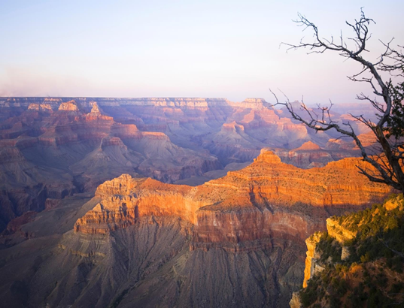
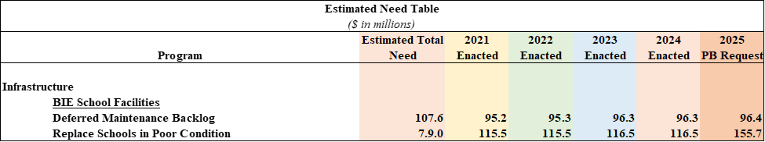
Infrastructure
Bureau of Indian Education School Facilities
Deferred Maintenance Backlog: Deferred maintenance costs and school replacements are estimated based on recent project data, averaging $1,200 per square foot for comprehensive construction costs, totaling $107 billion. Replacing 94 schools in poor condition would require $7.9 billion.

Slide 15
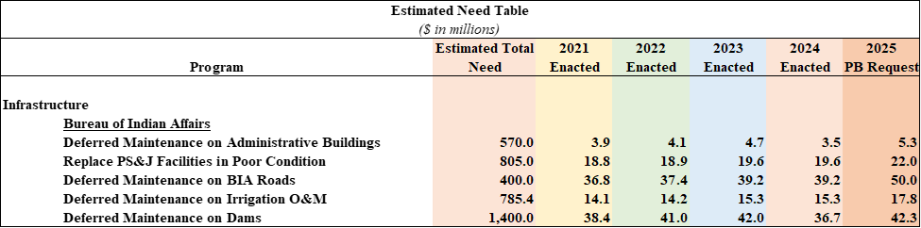
Infrastructure
Bureau of Indian Affairs
Administrative Buildings & Quarters: Total estimated need of $570 million, including deferred maintenance for 91 facilities and 1, 000 quarter units.
PS&J Facilities: $805 million needed for replacement/construction, with deferred maintenance for 65 sites totaling $64.7 million.
Road Maintenance: An unmet need of $400 million for maintaining 29,100 miles of roads and 1,070 bridges.
Irrigation Systems & Dams: Estimated deferred maintenance needs are $2.2 billion and $1.4 billion.

Slide 16
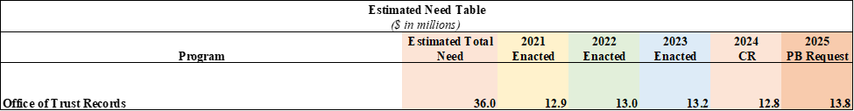
Bureau of Trust Funds Administration (BTFA)
Electronic Records Management Program (ERMP): To comply with federal mandates from the Office of Management and Budget & National Archives and Record Administration for electronic records, BTFA has requested $36.1 million for the first year to implement an ERMP. This transition involves digitizing extensive IA records, including historical documents from the 1700s, to streamline management and ensure long-term preservation.

Slide 17
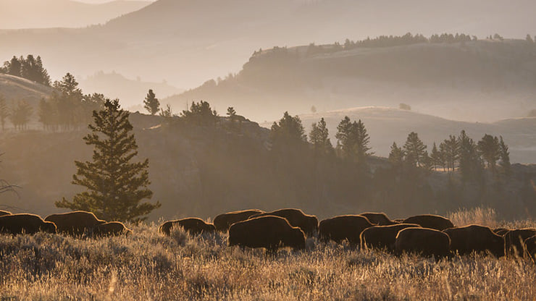
Office of Tribal Leases
Challenges and Current Resources: The current budget allocates $2.2 million for salary and benefits, supporting only 28 staff members, which strains the workforce. Staff also face significant travel demands, with $117,271 allocated to travel expenses.
Opportunities for Improvement: Expanding the workforce would distribute responsibilities more equitably, reduce travel burdens, and enhance operational efficiency. Additional personnel would allow the office to optimize resources, improve service delivery, and ensure program sustainability without significantly increasing the budget.

Slide 18
THANK YOU!

