Slide 1
Prepared by the TAAMS Operations Group Bureau of Indian Affairs Office of Trust Services
US Department Of The Interior
Bureau of Indian Affairs
Branch of Probate Services
Presented by:
Charlene Toledo, Chief, Division of Trust Asset Ownership and Title
Albuquerque, N.M.

Slide 2
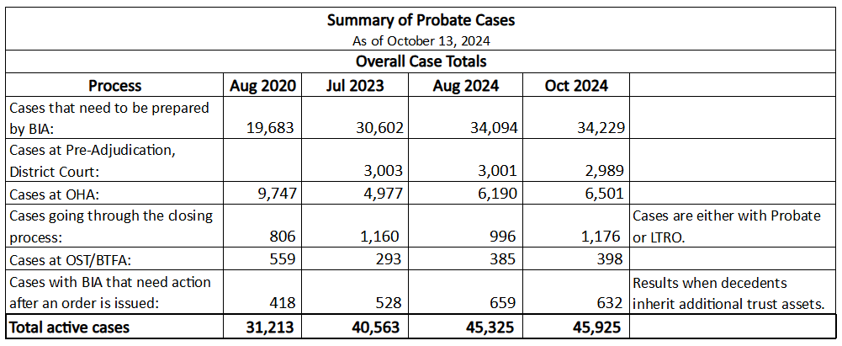
Probate Caseload

Slide 3
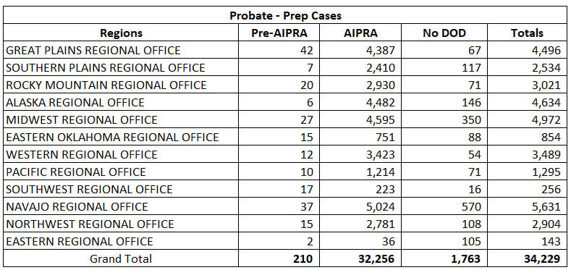
Probate Caseload

Slide 4
Future Endeavors
Add Probate closing process for BTFA
Decrease closing time from more than 6 months to 30 days
Develop application to receive probate documents via public facing application.
Partner with Bureau of Trust Administration on a Beneficiary Discovery Project

Slide 5
Legislative Amendments
Co-ownership inheritance – When a decedent has not errors and no tribe has jurisdiction
Possibility of Transfer upon death for cash only estates
Remedy for estates less than $1.00 – 3,000 cases
Notes:
Provide a good email address

Slide 6
Questions??

