Slide 1
Outer Continental Shelf (OCS) Renewable Energy
Tribal/Interior Budget Council (TIBC)
Land, Water & Natural Resources Subcommittee Meeting
July 29, 2024
Richard Yarde, Pacific Region

Slide 2
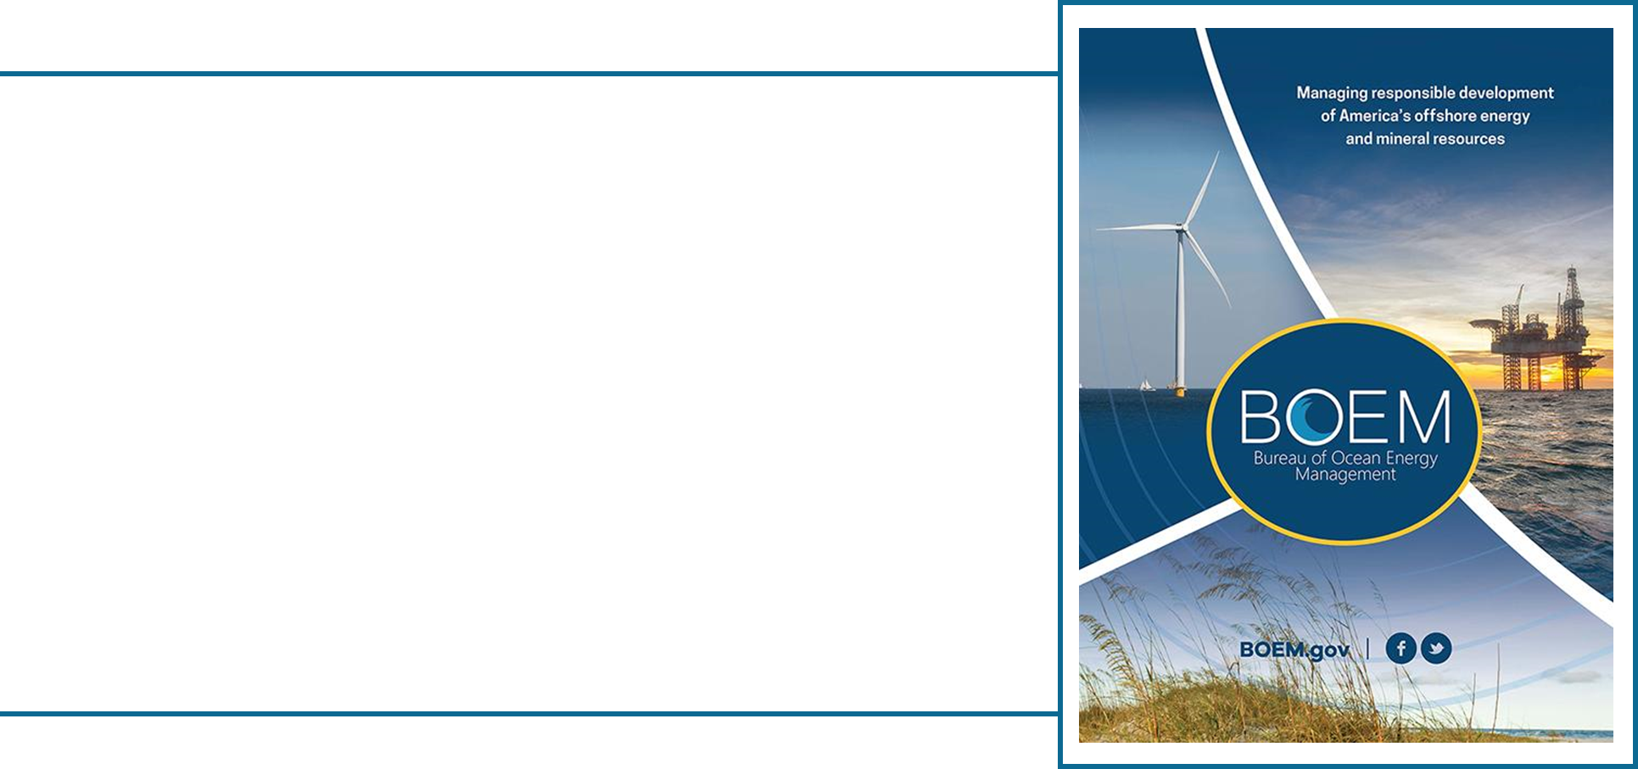
BOEM Mission
To manage the development of
U.S. Outer Continental Shelf (OCS) energy, mineral, and geological resources in an environmentally and economically responsible way.
BOEM manages almost 3.2 billion acres of the U.S. Outer Continental Shelf.
2
Notes:
The Bureau of Ocean Energy Management promotes energy independence, environmental protection, and economic development by managing offshore energy resources.

Slide 3
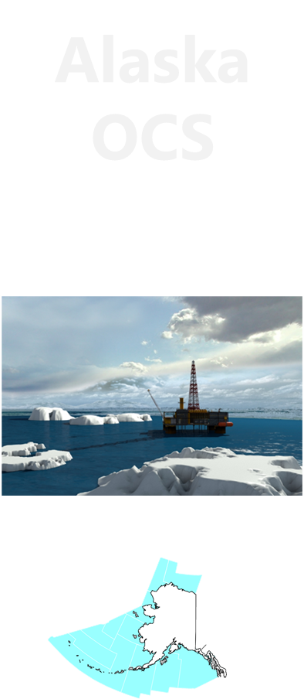


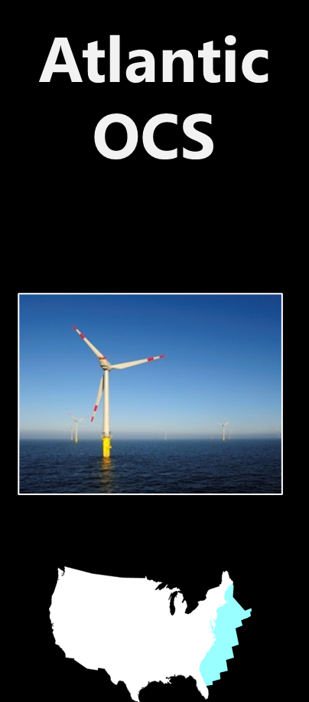
Authorities
OCS Lands Act: “… vital national resource … expeditious and orderly development … environmental safeguards”
Energy Policy Act of 2005: “… energy from sources other than oil and gas …”
The Inflation Reduction Act (IRA) of 2022 “provides DOI with the authority to issue leases, easements and rights-of-way offshore US territories…”

Slide 4
Authorities
OCS Lands Act: “… vital national resource … expeditious and orderly development … environmental safeguards”
Energy Policy Act of 2005: “… energy from sources other than oil and gas …”
The Inflation Reduction Act (IRA) “provides DOI with the authority to issue leases, easements and rights-of-way offshore US territories…”
Notes:
For those of you who aren’t familiar with BOEM, we are the bureau within the Department of the Interior that oversees the development of our energy and mineral resources on almost 2.5 billion acres of the nation’s Outer Continental Shelf, or OCS. The OCS extends from the 3-mile line of state jurisdiction out to the full extent of the EEZ or exclusive economic zone approximately 200 miles offshore. slightly larger than total land mass of the United States
We at BOEM are responsible for the expeditious and orderly development of the energy resources of the OCS including renewables like wind. It’s our job to ensure this development is done in an environmentally and economically responsible way.
Energy policy act of 2005 regs 2009

Slide 5




BOEM Renewable Energy Program Mission
To facilitate the development of renewable energy resources in Federal waters through conscientious planning, stakeholder engagement, comprehensive environmental analysis, and sound technical review.
Wind
Wave
Ocean Current
Transmission
5

Slide 6
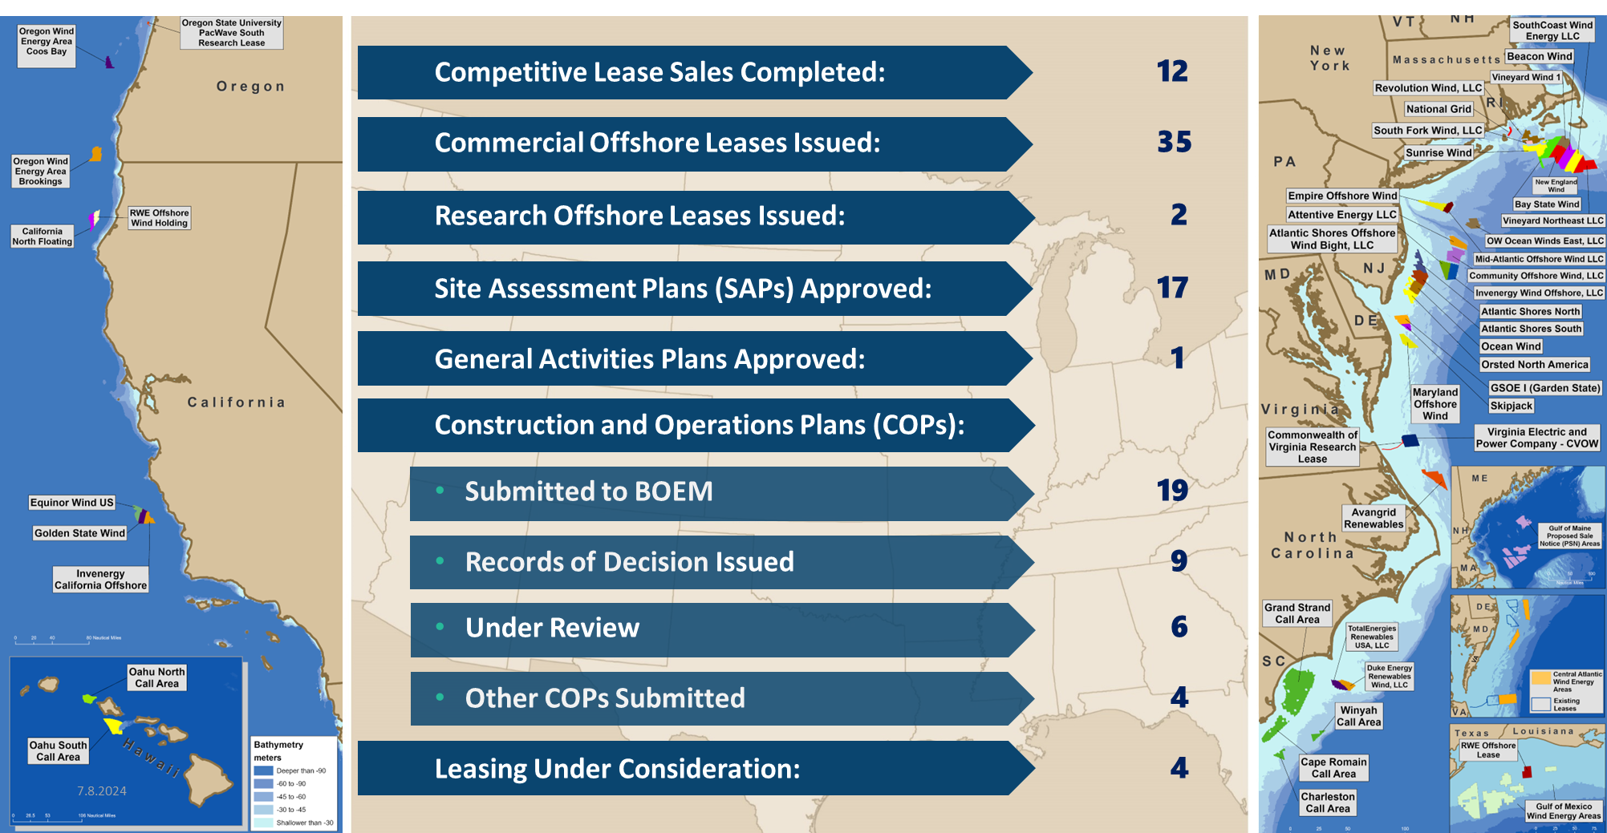
Renewable Energy Program by the Numbers

Slide 7
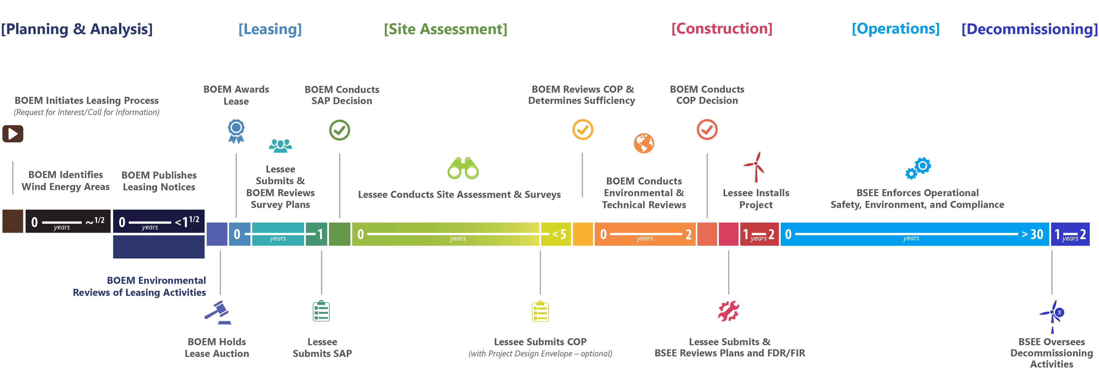
Renewable Energy Leasing Process:
Timeline of Operations
This timeline does not reflect the Modernization Rule Publication
7

Slide 8

Renewable Energy Modernization Rule Publication
Incorporate lessons learned since BOEM first published the offshore renewable energy regulations over 15 years ago.
Further the Biden-Harris climate agenda and success in achieving 30GW by 2030.
Enhance regulatory certainty and efficiency.
Expected to result in cost savings of roughly $1.9 billion to the offshore wind industry.
Reduce the need for departures from the regulations, thereby reducing the associated administrative burden on BOEM and the regulated community.
Published in the Federal Register on May 15, 2024, expected final effective date of July 15, 2024.
federalregister.gov renewable-energy-modernization-rule
8
Notes:
Cite as: Renewable Energy Modernization Rule, 89 Fed. Reg. 42,602 (May 15, 2024).

Slide 9
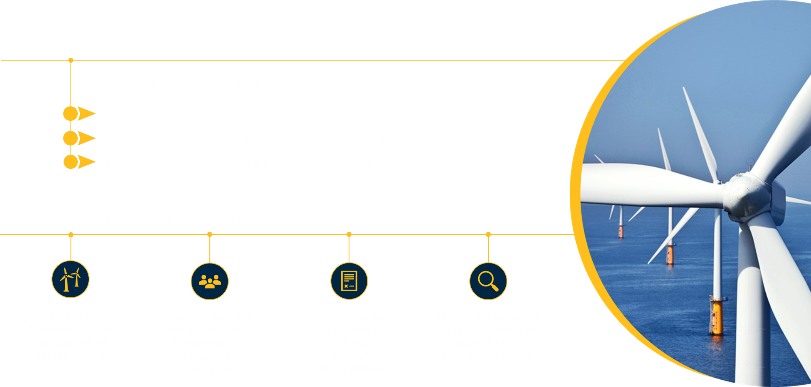
Offshore Wind Outlook
9

Slide 10
Richard Yarde, Richard.Yarde@boem.gov

