Slide 1
IA Budget Update
August 1, 2024

Slide 2
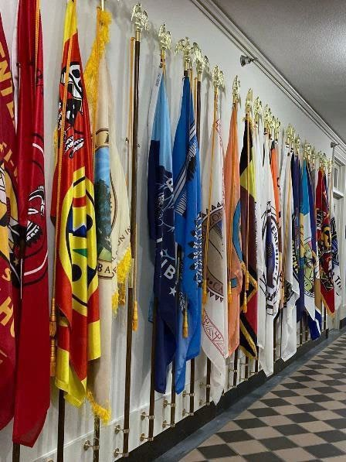
Agenda
FY 2025 Update
FY 2026 Schedule
FY 2027 Ranking Tool
2

Slide 3
FY 2025 Appropriations Actions
House and Senate released 2025 proposed allocations
House Markup – Bill released June 27, full committee report released July 9
Senate Markup – Bill and full committee report released July 25
BUREAU ACCOUNT | 2024 Enacted | 2025 President's Budget Request | 2025 HOUSE | $ Change from 2024 Enacted | % Change from 2024 Enacted | $ Change from 2025 Request | % Change from 2025 Request | 2025 SENATE | $ Change from 2024 Enacted | % Change from 2024 Enacted | $ Change from 2025 Request | % Change from 2025 Request
TOTAL, INDIAN PROGRAMS | 3,922,986 | 4,452,746 | 4,387,069 | +464,083 | +12% | -65,677 | -1% | 4,115,994 | +193,008 | +5% | -336,752 | -8%
Tribal programs across Indian Affairs are collectively funded at:
HOUSE: $4.4B
SENATE: $4.1B
❖ +$464.1M above FY 2024 Enacted level.
-$65.7M below the President’s budget.
➢ +$193M above FY 2024 Enacted level.
-$336.8M below the President’s budget.

Slide 4
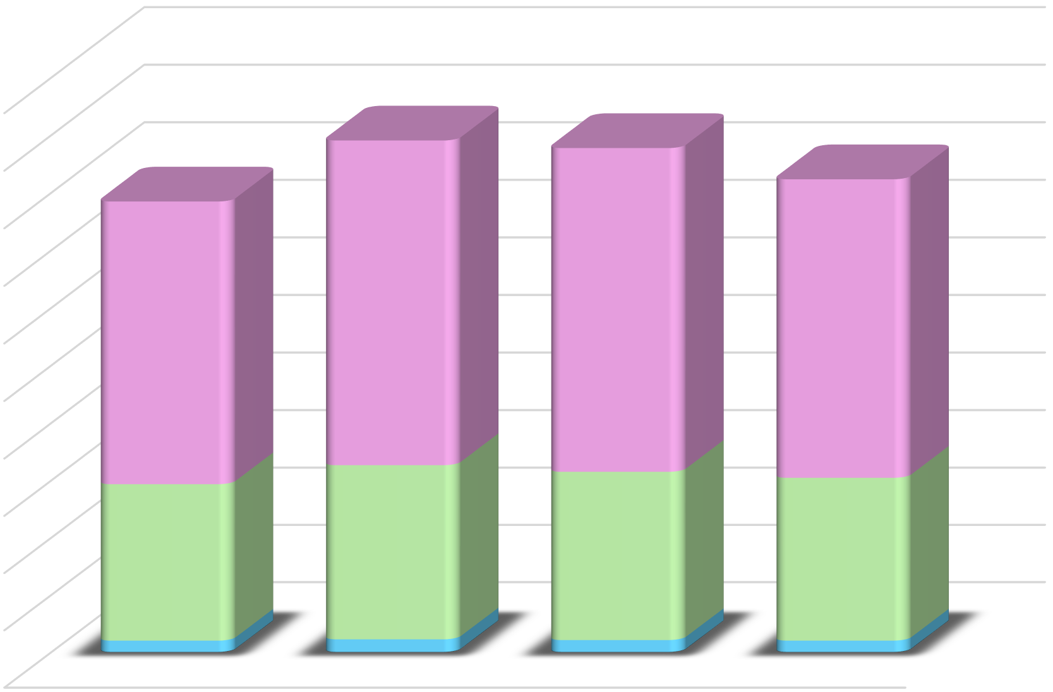
Indian Affairs Budget Overview
 |  | Indian Affairs Budget
 |  | 4,452,746
 | 5,000,000 |  |  |  | 4,387,069 | 4,115,994
 |  | 3,922,986
 | 4,500,000
 | 4,000,000
 | 3,500,000 | 2,820,543 |  |  | 2,812,709
 | 3,000,000 | 2,456,635 |  |  |  | 2,593,894
 | 2,500,000
 | 2,000,000
 | 1,500,000
 | 1,000,000 | _{1,366,342} 1,520,926 |  |  | 1,469,083 | 1,421,628
 | 500,000 | 100,009 111,277 |  |  | 105,277 | 100,472
 | - | 2024 | 2025 | 2025 |  | 2025
 |  | Enacted | President's Budget | HOUSE |  | SENATE
 |  |  | Request
 | TOTAL, IA | 3,922,986 | 4,452,746 | 4,387,069 |  | 4,115,994
 | BUREAU OF INDIAN AFFAIRS | 2,456,635 | 2,820,543 | 2,812,709 |  | 2,593,894
 | BUREAU OF INDIAN EDUCATION | 1,366,342 | 1,520,926 | 1,469,083 |  | 1,421,628
 | BUREAU OF TRUST FUNDS ADMINISTRATION | 100,009 | 111,277 | 105,277 |  | 100,472
House Mark is $464.1M (+12%) above FY 2024 Enacted and Senate is $193.1M (+5%) above FY 2024, Indian Affairs came out relatively well.
BIA
House +$356.1M above FY 2024
Senate +$137.3M above FY 2024
BIE
House +$102.7M above FY 2024
Senate +$55.3M above FY 2024
BTFA
House +5.3M above FY 2024
Senate +0.5M above FY 2024
Dollars in Thousands
^{1/} 2023-24 Enacted reflects current CSC & 105(l) Actuals

Slide 5
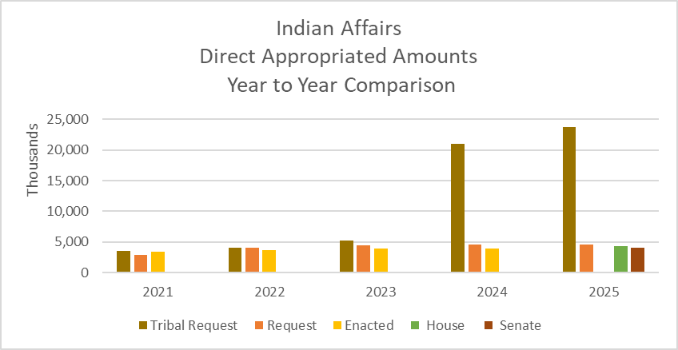
Tribal Request vs PB Request vs Enacted
.

Slide 6
BIA Committee Mark Overview
BUREAU ACCOUNT | 2024 Enacted | 2025 President's Budget Request | 2025 HOUSE | $ Change from 2024 Enacted | % Change from 2024 Enacted | $ Change from 2025 Request | % Change from 2025 Request | 2025 SENATE | $ Change from 2024 Enacted | % Change from 2024 Enacted | $ Change from 2025 Request | % Change from 2025 Request
BUREAU OF INDIAN AFFAIRS | 2,456,635 | 2,820,543 | 2,812,709 | +356,074 | +14% | -7,834 | -0% | 2,593,894 | +137,259 | +6% | -226,649 | -8%
OPERATION of INDIAN PROGRAMS | 1,898,550 | 2,169,386 | 2,189,150 | +290,600 | +15% | +19,764 | +1% | 1,959,359 | +60,809 | +3% | -210,027 | -10%
CONTRACT SUPPORT COSTS ACCOUNT | 342,000 | 356,000 | 356,000 | +14,000 | +4% | - | - | 356,000 | +14,000 | +4% | - | -
PAYMENTS for TRIBAL LEASES | 64,000 | 69,000 | 69,000 | +5,000 | +8% | - | - | 69,000 | +5,000 | +8% | - | -
INDIAN LAND CONSOLIDATION | 4,000 | 11,000 | - | -4,000 | -100% | -11,000 | -100% | 4,000 | - | - | -7,000 | -64%
LWCF TRIBAL LAND ACQUISITION | - | - | - | - |  | - |  | - | - |  | -
CONSTRUCTION | 133,780 | 154,771 | 146,296 | +12,516 | +9% | -8,475 | -5% | 146,022 | +12,242 | +9% | -8,749 | -6%
SETTLEMENTS | 976 | 45,897 | 32,263 | +31,287 | +3,206% | -13,634 | -0,030% | 45,897 | +44,921 | +4,603% | - | -
INDIAN GUARANTEED LOAN PROGRAM | 13,329 | 14,489 | 20,000 | +6,671 | +50% | +5,511 | +38% | 13,616 | +287 | +2% | -873 | -6%
Operation of Indian Programs
House is $2.2B
❖ +$290.6M above FY 2024 Enacted.
❖ +$19.8M above the President’s budget.
Senate is $1.96B
❖ +$60.8M above FY 2023 Enacted.
-$210M below the President’s budget.
BIA Construction
House and Senate is $146M

Slide 7
BIA Committee Mark Overview
HOUSE
Highlights –
➢ +$1M for Small Tribes Supplement.
➢ +$2M for Road Maintenance to improve and maintain roads and bridges.
➢ +$5M for Social Services for Tribes that have not been able to receive BIA social services activities pursuant to a self-determination contract or self-governance compact. Tiwahe requested increase not funded.
➢ +$1M for Welfare Assistance.
➢ +$1M for ICWA off-reservation grants.
➢ +$2M for Housing Program to support housing unit applicants.

Slide 8
BIA Committee Mark Overview
HOUSE
Highlights –
➢ +$1M for Natural Resources TPA to support co-management activities.
➢ +$1M for Irrigation O&M.
➢ +$1M for Rights Protection Implementation to support Pacific Salmon Treaty.
➢ +$5M for Tribal Management/Development Program of which $2.5m is to support Inter-Tribal Buffalo Council and the remaining general increase.
➢ +$1M for Water Mgmt., Planning & PreDevelopment to ensure protection and management of Tribal water resources.
➢ +$905K for Energy and Minerals Projects.
➢ +$1M for EQ Projects for NAGPRA support and coordinate expedited repatriation and disposition of Tribal ancestors and cultural property.
➢ + $2.1M Central Oversight for Indigenous Communication and Technology [+500K], user-friendly public-facing portal providing the status of probate actions for Tribes [+1.2m], and NAGPRA Coordinator [+$400K].

Slide 9
BIA Committee Mark Overview
HOUSE
Highlights –
▪ +$164.2M for Law Enforcement programs.
➢ +$130.6M for Criminal Investigations and Police Services
❖ +$1m increase above the enacted level for the National School Resource Officer Program.
$5m to support expanding the Agency’s Opioid Reduction Task Force.
❖ +$68m increase ($130m total) to Tribes affected by the McGirt v. Oklahoma decision to ensure parity of percentage of total need funded for police and investigative activities.
Fully funds the request for additional operational capacity / boots on the ground adding additional officers.
Funds the requested increase for the professional standards directorate to improve internal processes, policy and program reviews, equipment and technology procurement, standardization, and training.

Slide 10
BIA Committee Mark Overview
HOUSE
Highlights –
➢ +$13.1M for Detentions/Corrections.
➢ +$924K for Inspections/Internal Affairs.
➢ +14.7M for Law Enforcement Special Initiatives of which +$13.5m supports Missing and Murdered Indigenous Women Initiative.
➢ +$3M for Tribal Justice Support to fund Healing to Wellness courts.
➢ +1.8M for Facilities O&M.
➢ +$9M for Tribal Courts (TPA).

Slide 11
BIA Committee Mark Overview
HOUSE
Highlights –
➢ +$2M for Economic Development Projects to fund business incubators. Requested increase for Native Language was not funded and maintains 2024 enacted level.
Executive Direction maintained at the 2024 enacted level and does not include requested increases for: Office of Strategic Partnerships ($300K); Secretary’s Tribal Advisory Committee ($350K); White House Council on Native American Affairs ($500K); Tribal Experience Effort ($200K); Executive Order 14112 Implementation ($1.5m); 105(l) Leasing & Realty Staff/Budget Support Staff ($2.2m); and Human Resources ($340K)
Transfers $11.1M for Office of Subsistence Management from the Office of the Secretary.
➢ +$32.3M for Indian Land and Water Claim Settlements and Miscellaneous Payments to Indians and provides $31.4M for the initial payment for the Hualapai Tribe Water Rights Settlement Act of 2022.

Slide 12
BIA Committee Mark Overview
HOUSE
Highlights –
Does not fund Indian Land Consolidation, -$4M below enacted and -$11M below the request.
Recommends an indefinite appropriation for Payments to Tribal Leases estimated to be
$69M.
Construction includes increases above enacted for:
PS&J Construction - Employee Housing (+$1M); Facilities Improvement & Repair (+$3M); and Fire Protection (+$1M).
Resources Management Construction - Safety of Dams (+$2M); and Dam Maintenance (+$3M).
Other Program Construction - +$2M for Telecommunications Improvement & Repair.
$20M for the Indian Guaranteed Loan Program Account, an increase of +$6.7M above 2024 enacted level. The House assumes an estimated loan ceiling of $399.1M.

Slide 13
BIA Committee Mark Overview
SENATE
Highlights –
➢ +$8.7M to raise the minimum funding level for eligible Small Tribes.
➢ +$1M for emergency road maintenance and critical repairs.
➢ +$1M for additional awarding officials.
➢ +$1M for Social Services (TPA) to support child protection and child abuse treatment activities.
+$1.5M for ICWA grants off reservation.

Slide 14
BIA Committee Mark Overview
SENATE
Highlights –
➢ +1M for Indian Youth Service Corps.
➢ +$500K Rights Protection Implementation general program increase.
➢ +$250K for Tribal Management Development Program to expand capacity for Tribal participation.
➢ +$3M Tribal Climate Resilience for adaptation and relocation grants.
➢ +$2M to address the spread of invasive European Green Crab.
+$500K Forestry Projects.
+$1M for O&M of fish hatcheries.
➢ +$750K Probate TPA to help reduce the probate backlog.
+$2M for Real Estate Services Oversight to help process lands records, rights of way, and other real estate functions.

Slide 15
BIA Committee Mark Overview
SENATE
Highlights –
+$11.5M for Law Enforcement programs.
➢ +$6M for additional boots on the ground.
➢ +$4M for Detentions/Corrections additional personnel, equipment, and technology needs
➢ +$750K for LE Special Initiatives, including $250K for Missing and Murdered indigenous persons
➢ +$700K for Tribal Justice Support
➢ +$1M for Economic Development Projects, $500K each to support Native Act and Native Languages
➢ +$5.8M Special Initiatives
+$12.1M for Construction

Slide 16
Bill Language Overview
HOUSE and SENATE:
Does not address the Administration’s proposal to reclassify Contract Support Costs and Payments for Tribal Leases as mandatory funding
Does not address proposed amendments to the Indian Reorganization Act to clarify the eligibility of federally recognized Tribes for the purposes of taking land into Trust. (ref: Carcieri vs Salazar).
HOUSE
On decisions made in consultation with Tribes, the Committee directs agencies funded in this bill to publish decision rationale in the context of and in reasonable detail to the Tribal input received during consultation.
SENATE
Continues language that allows IA to contract for services in support of the management, operation, and maintenance of the Power Division of the San Carlos Irrigation Project.

Slide 17
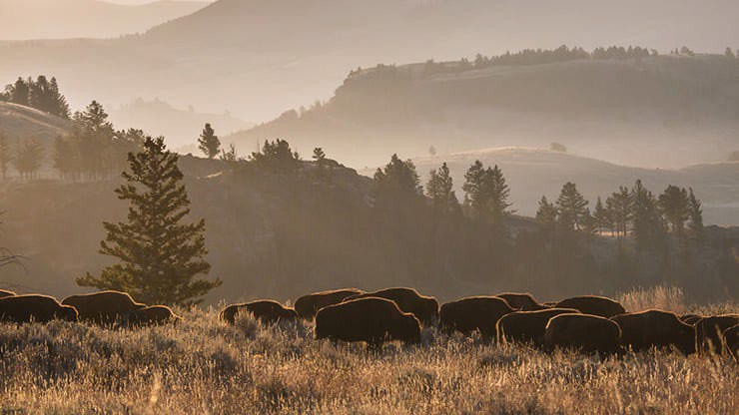
BIE Committee Mark Overview
BUREAU ACCOUNT | 2024 Enacted | 2025 President's Budget Request | 2025 HOUSE | $ Change from 2024 Enacted | % Change from 2024 Enacted | $ Change from 2025 Request | % Change from 2025 Request | 2025 SENATE | $ Change from 2024 Enacted | % Change from 2024 Enacted | $ Change from 2025 Request | % Change from 2025 Request
BUREAU OF INDIAN EDUCATION | 1,366,342 | 1,520,926 | 1,469,083 | +102,741 | +8% | -51,843 | -3% | 1,421,628 | +55,286 | +4% | -99,298 | -7%
OPERATION OF INDIAN EDUCATION PROGRAMS | 1,131,617 | 1,210,690 | 1,198,216 | +66,599 | +6% | -12,474 | -1% | 1,156,853 | +25,236 | +2% | -53,837 | -4%
EDUCATION CONSTRUCTION | 234,725 | 310,236 | 270,867 | +36,142 | +15% | -39,369 | -13% | 264,775 | +30,050 | +13% | -45,461 | -15%
Operation of Indian Education Programs
Education Construction
House is $1.198B
➢ +$66.6M above FY 2024 Enacted.
-$12.5M below the President’s budget.
Senate is $1.156B
➢ +25.2M above FY 2024 Enacted.
-$53.8M below the President’s budget.
House is $270.9M
➢ +$36.1M above FY 2024 Enacted.
-$39.4M below the President’s Budget.
Senate is $264.8M
➢ +$30.1M above FY 2024 Enacted.
-$45.5M below the President’s budget.
17

Slide 18
BIE Committee Mark Overview
HOUSE Highlights –
➢ +$3M for ISEP fixed costs only.
➢ +$1M for Tribal Grant Support Costs.
➢ +$5M JOM
➢ +$7M TCUs
➢ +$343K Scholarships & Adult Ed.
➢ +$7.6M Education Program Management.
-$44.1M Replacement School Construction.
➢ +$1.3M Replacement Facility Construction.
➢ +$1M Employee Housing Construction.
➢ +$14.7M Employee Housing Repair.
➢ +$60.1M each to FI&R.
➢ +$3M Tribal College FI&R.

Slide 19
BIE Committee Mark Overview
SENATE Highlights –
➢ +$5M for ISEP.
➢ +$1 Tribal Grant Support Costs
+$1M JOM
➢ +$750K Tribal Colleges and Universities
➢ +$493K Scholarships & Adult Ed
-$13.7M Replacement School Construction
➢ +$9.7M Employee Housing and Repair
+$55.1M to FI&R
-$2M Tribal College FI&R

Slide 20
Bill Language Overview
HOUSE and SENATE:
The bill includes language shifting the availability of forward funded appropriations from July 1 to June 1.

Slide 21
BTFA Committee Mark-Up Overview
 |  | 2025 |  | $ | % | $ | % |  | $ | % | $ | %
BUREAU | 2024 | President's | 2025 | Change from | Change from | Change from | Change from | 2025 | Change from | Change from | Change from | Change from
ACCOUNT | Enacted | Budget | HOUSE | 2024 | 2024 | 2025 | 2025 | SENATE | 2024 | 2024 | 2025 | 2025
 |  | Request |  | Enacted | Enacted | Request | Request |  | Enacted | Enacted | Request | Request
BUREAU OF TRUST FUNDS ADMINISTRATION 100,009 111,277 105,277 +5,268 +5.27% -6,000 -5.39% 100,472 +463 +0.46% -10,805 -9.71%
The House bill funds Bureau of Trust Funds Administration at $105.3M, +$5.3M above 2024 Enacted and -$6M below the President’s budget.
Senate funds BTFA at $100.5M

Slide 22
FY 2026 Budget Formulation
Internal Indian Affairs’ budget proposals were developed using input from the Ranking Tool priorities, TIBC budget submission, School, Regional and CO input and Leadership priorities were submitted to DOI budget office.
DOI Passback is tentatively scheduled week of July 29, 2024.
2026 budget submission due to OMB in early September 2024.
OMB passback is usually in early December.
President’s Budget is usually released in early February.

Slide 23
FY 2027 Budget Formulation and Tribal Priority Ranking Tool
Tentative Schedule:
July – August 2024:
Aug – Sept:
Mid-October:
Collect and review Tribal priority ranking tool feedback. Update ranking tool.
Kick-off meeting to release tool and commence FY 2027 budget formulation.
Regional Budget Officers meet with Tribes to provide training on the ranking tool, encourage participation, and to rank regional priorities.
Tribal ranking tool due to regional budget officers and central office. Release FY 2027 Tribal Priority Ranking results at Spring TIBC.
Nov – Jan 2025:
February 2025:
March 2025:

Slide 24
FY 2027 Budget Formulation and Tribal Priority Ranking Tool
FY 2025 Preferred Program Tribal Submissions Regional Summary
Great Plains Region - Tribal Submissions
Southern Plains Region - Tribal Submissions
Rocky Mountain Region - Tribal Submissions
Alaska Region - Tribal Submissions
Increase Participation
Regional Budget Officers and Regional Directors
Review FY25 participation rate
Outreach to Tribes that did not participate last time
Provide training on the tool
Emphasize rankings are used to inform IA leadership when making budget decisions
Provide examples of positive outcomes
Increased funding to Tribal Courts O&M, Tiwahe
35%
58%
100%
7%
Eastern Region - Tribal Submissions
Midwest Region - Tribal Submissions
42%
100%
Eastern Oklahoma Region
- Tribal Submissions
Northwest Region - Tribal Submissions
60%
100
%
Navajo Region - Tribal Submissions
Southwest Region - Tribal Submissions
Pacific Region - Tribal Submissions
Western Region - Tribal Submissions
100%
64%
14%
33%

Slide 25
FY 2027 Budget Formulation and Tribal Priority Ranking Tool
Regional Directors and Regional Budget Staff are required to provide ongoing support at the regional level, ensuring input from all Tribes within their region, including Self-Governance Tribes, and from BIE school representatives.
Regions will solicit the active participation of Indian Tribes and organizations in the formulation of the IA budget request through the use of the Preferred Program Ranking Tool and by holding two formulation meetings with their Tribes.
Regions will solicit the active participation of the BIE schools by reaching out to the BIE Deputy Director and the BIE Budget Formulation staff notifying them in advance of the date and time for their regional/Tribal budget formulation sessions.

Slide 26
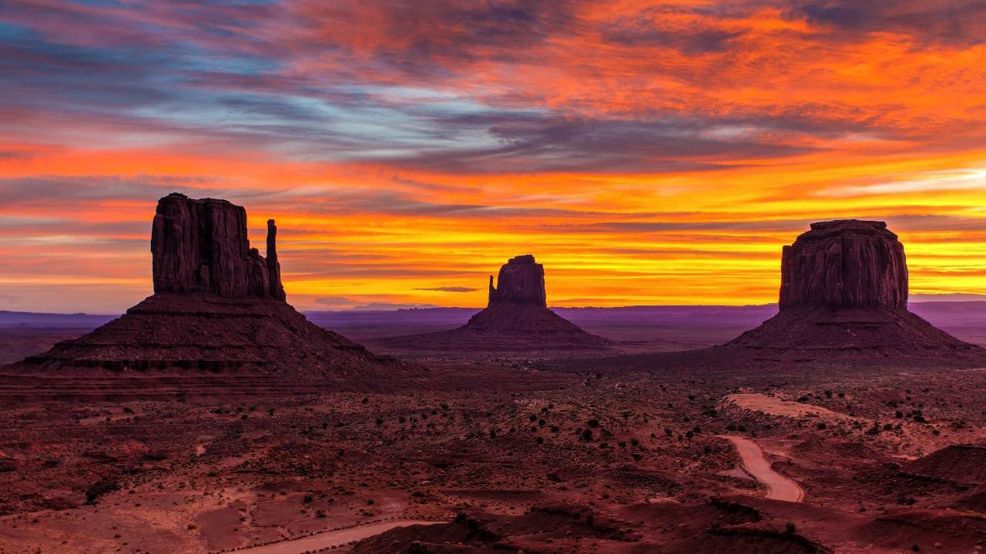
Questions?

Slide 27
THANK YOU!

