Slide 1


FY 2026 Interior Approps
The House Bill includes $1.53 billion for the Bureau of Indian Education (BIE)—a $165 million increase over FY 2025. The Senate bill includes $1.37 billion—flat funding from FY 2025.
HOUSE INTERIOR BILL
$1.24 billion for Operation of Indian Education Programs, an increase of $104 million over FY 2025.
$295 million for Education Construction, an increase of $61 million over FY 2025.
$27.6 million for Johnson O’Malley, an increase of $7 million over FY 2025.
Notably, while the White House’s FY 2026 budget request proposed an 80% cut to the Education Construction account, the House bill provides a 25% increase instead.
SENATE INTERIOR BILL
All individual accounts under the BIE are flat-funded from FY 2025.
Also includes direction for the BIE to explore pay-parity with Department of Defense schools and extending Federal Employees Retirement System (FERS) benefits to Tribally Controlled Schools.
Both the House and Senate Reports direct the BIE to explore the potential impacts of a federal charter for Haskell Indian Nations University.

Slide 2

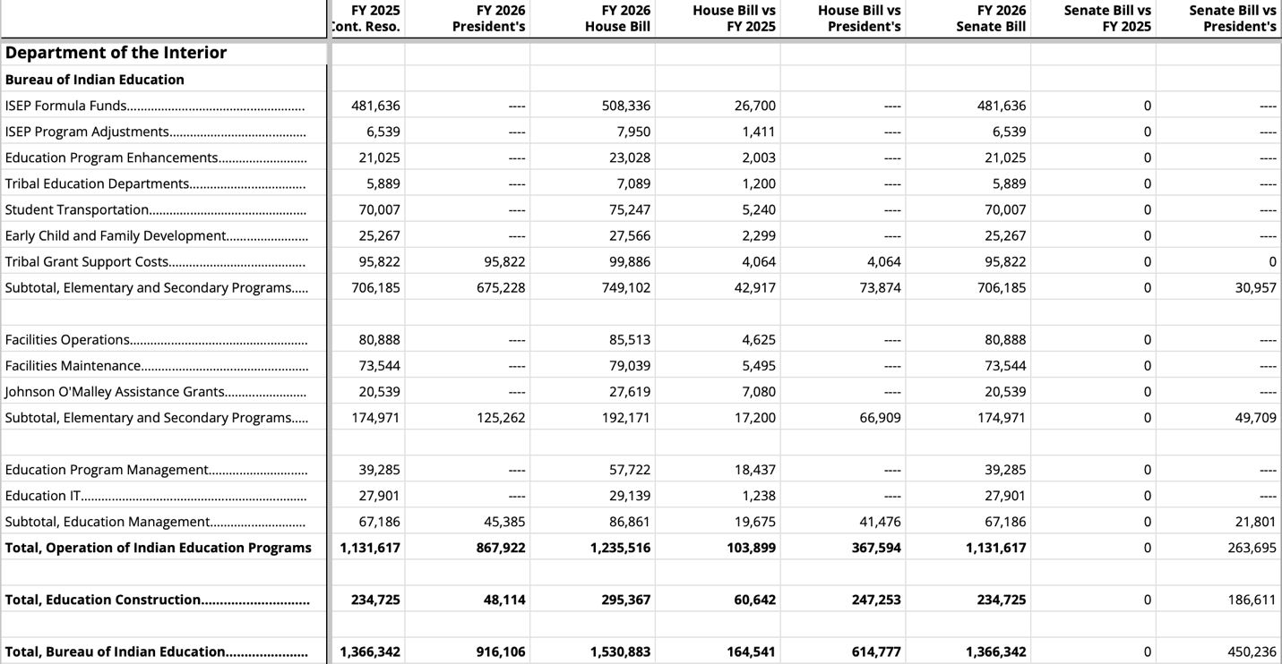
BIE APPROPRIATIONS

Slide 3
FY 2026 HHS-ED Approps
Only the Senate has considered its funding bill for Labor, HHS, Education and Related Agencies. The House is expected to pick up its bill early in September following the August Recess.
Administration for Children and Families
Department of Education
$60.5 million for Native American Programs at the Administration for Native Americans (ANA), flat-funded from FY 2025
$12.357 billion for Head Start nationwide, an increase of $85 million over FY 2025
$8.831 billion for Child Care Development Block Grants nationwide, an increase of $85.4 million over FY 2025
Also includes direction to HHS-ACF to justify the closure of regional offices and the plan to reallocate grantee support to new regional offices within 60 days.
directs HHS-ACF to explore technical assistance to potential Native Hawaiian Head Start, including language immersion, in acknowledgement of the trust responsibility to the Native Hawaiian Community. HHS-ACF would be required to brief Congress within 180 days of enactment.
The Senate bill includes flat-funding for every Department of Education (ED) account for Native education.
$194.7 million for Indian Education at ED
$45.9 million for Education for Native Hawaiians
$45 million for Alaska Native Education Equity
$1.625 billion for Impact Aid nationwide

Slide 4
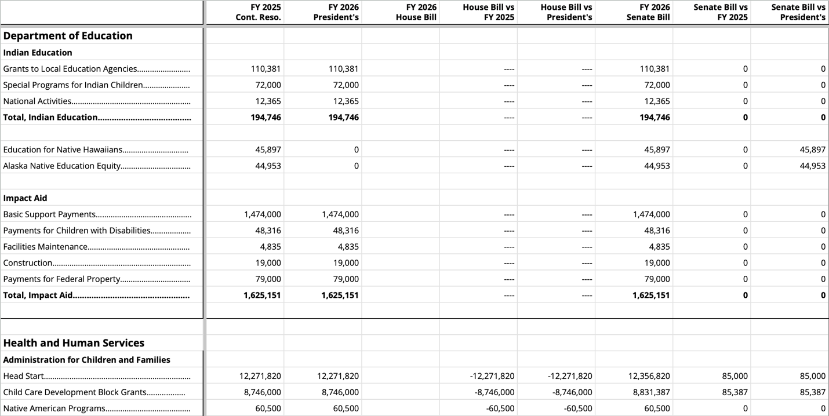
DEPARTMENT OF ED APPROPRIATIONS

