Slide 1
Budget Strategy
Janel Perry, Regional Trust Director
August 2025

Slide 2
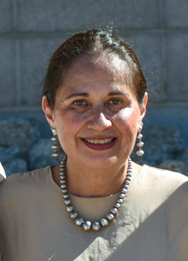
Margaret Williams
Acting Director
Previous Role: Senior Advisor to the BTFA Director since August 2018.
Federal Career: Began in 1992, Accountant for the Branch of Investment
Accounting within the Office of Trust Funds Management. 30+ years in
federal service; with BTFA since its inception.
Areas of Expertise: Risk management; Trust operations; Regulatory drafting and
implementation; Project management
Awards: Distinguished Service Award and Service to Citizens Award, 2023
Cultural Background: Enrolled member of Sisseton-Wahpeton Oyate in South Dakota; raised in Arizona on the Navajo Reservation; affiliated with the Keweenaw Bay Indian Community. IIM account holder.
Family: Proud mother of three and grandmother of one

Slide 3
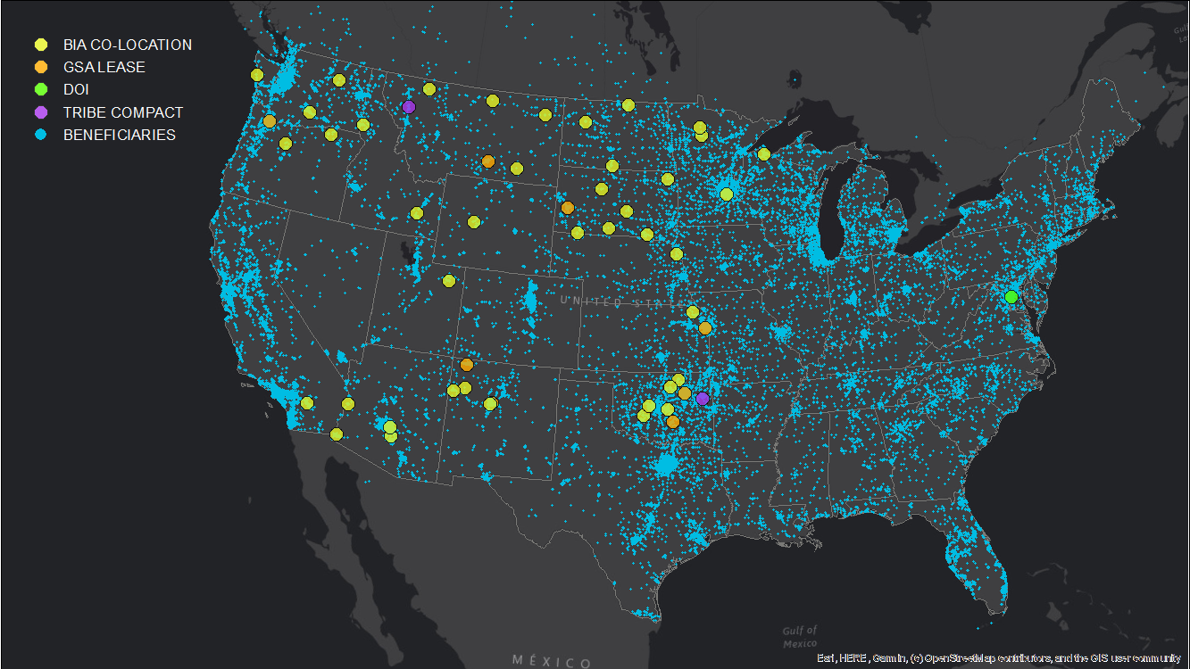
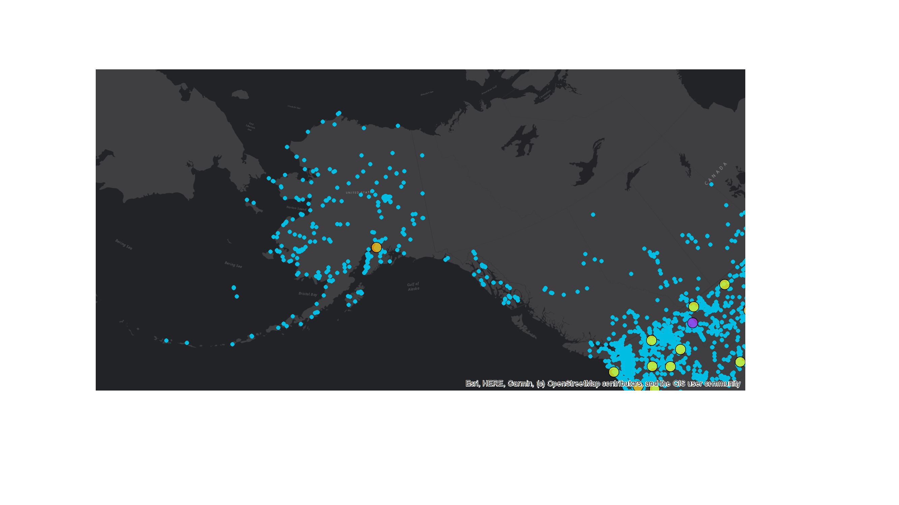
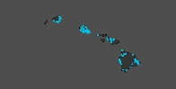
Bureau Snapshot - August 2025
Support 395K Unique Beneficiaries
  Across 50 States
  3 U.S. Territories
  27 Countries
67K Whereabouts Unknown
BTFA OFFICES

Slide 4

BTFA Budget Overview
 | 2025 Enacted | 2026 President's Budget | 2026 House Mark | 2026 Senate Mark | 2026 House Mark vs. 2026 Request | 2026 Senate Mark vs. 2026 Request
BTFA | $100,009 | $100,009 | $108,077 | $100,009 | $8,068 | $ 0

Slide 5
Accounting Operations
IIM and Tribal Receipts - $1.07B
January – July 2025

Slide 6
Accounting Operations
IIM and Tribal Disbursements - $813M
January – July 2025
Type | $ Disbursements |  |  | # Disbursements
CHECK | $66 M | 8% |  | 136,805 | 36%
ACH | $447 M | 55% |  | 247,541 | 64%
WIRE | $299 M | 37% |  | 156 | 0.04%
Total | $813 M | 100% |  | 384,502 | 100%

Slide 7

Beneficiary Experience
Trust Beneficiary Call Center
41,681 Calls Managed
January – July 2025
5,200
CALLS PER MONTH
93% First Line Resolution Rate

Slide 8
Beneficiary Experience
Technology Modernization Fund (TMF) Pilot Program
  Interviewed beneficiaries and federal staff
  Sent online survey >13K beneficiaries; received 1,640 responses

Slide 9
Modernization Updates
Call center launch of 24/7, self-service: www.doi.gov/ost/self-service
  33,111 interactions with beneficiaries since January 2025
Online Account Access
  Testing with 6 Tribes; anticipate rolling out to all Tribes by FY26
Trust Information Analysis and Reporting Tool (TIART):
  Integrated, enterprise technology solution for securely indexing, organizing, locating, viewing, analyzing, reporting on, and producing trust-related records (data and digitized documents)
  Piloting AI technology to address Department of Justice document production requirements for litigation
Digitization: Transition to electronic records management within Indian Affairs

Slide 10

Thank you
Margaret Williams, Acting Bureau Director
margaret_williams@btfa.gov
Janel Perry, Regional Trust Director
janel_perry@btfa.gov
www.btfa.gov​
Facebook.com/IATrustFunds​
x.com/IATrustFunds​

