Slide 1
Fee-to-trust division of real estate services (DRES) November 2024

Slide 2
Fee-to-trust
The Restoration of Tribal Homelands has been a priority to the DOI and BIA by fee-to-trust, land transfers and proclamations.
The Department asked BIA to review and simplify authorities, policies, and procedures governing the acquisition of land by the United States in trust status for individual Indians and Tribes.
This Photo by Unknown Author is licensed under CC BY

Slide 3
Reducing FTT timelines
25 CFR Part 151 Land Acquisitions effective date January 11, 2024
The final rule intends to make the FTT process less burdensome and more cost-efficient
In 2021, processing started at 1263 days, currently at 756 days to issue NOD
Identifying 20+ internal timeframes for processing
Created FTT and Geodata Examination & Validation (GDEV) Strike Teams
Average days to review legal descriptions by GDEV team = 19 days
GDEV ongoing coordination with BILS

Slide 4
FTT Accomplishments CY 2023 – CY 2024
Notice of Decisions – 544
Full-time FTT positions at DRES as of August 25, 2024
Ongoing TAAMS enhancements on utilization, tracking & monitoring
Ongoing TAAMS Data Clean-up coordination with field staff
Creating an online FTT Portal for applicants (Tribal & Individual)
DOI/BIA hosting upcoming Tribal Consultation on "Proposed Procedures for Evaluating Environmental Risk before Acquiring Real Property and Land in Trust"
Fri, Nov 22, 2024 - 1:00 PM Eastern (ET)
Notes:
Discussions on developing mitigation steps on how to ensure internal timeframes regarding Environmental Compliance Reviews, specifically National Environmental Policy Act (NEPA), 602 DM 2, Land Acquisitions: Hazardous Substances Determinations

Slide 5
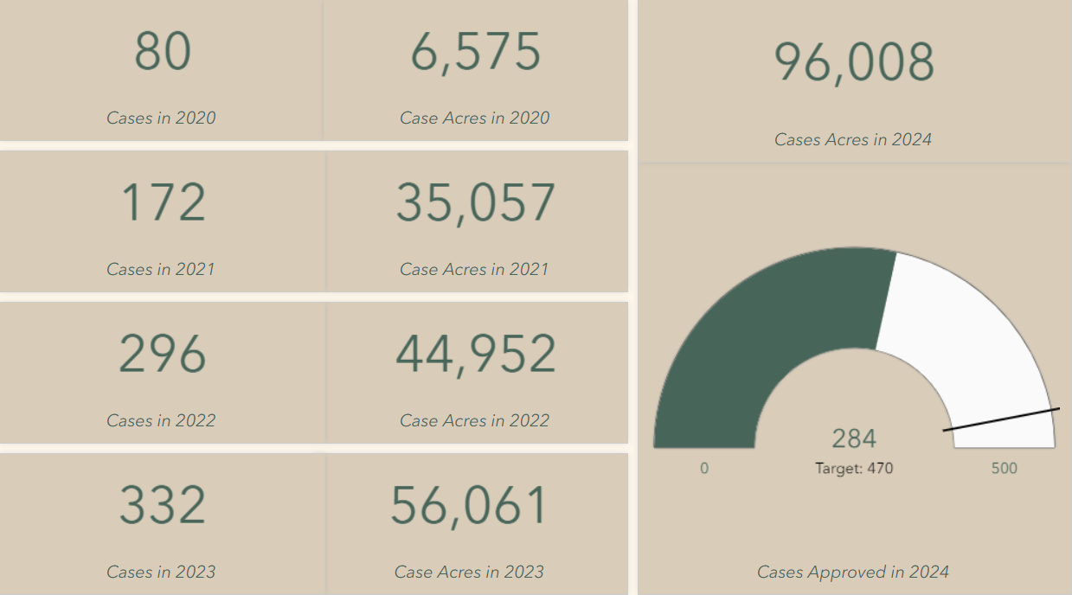
AOC Ftt statistics 20-24
Notes:
These numbers show the FTT Statistics from 202 to current. FTT Cases are counted at the Acceptance of Conveyance stage

Slide 6
Reservation Proclamations
12 Tribes from 6 different Regions completed Reservation Proclamations
17,159.55 acres have been Proclaimed Reservation Land
FY21 = 725.33 acres
FY22 = 9,302.93 acres
FY23 = 274.42 acres
FY24 = 6,131.54 acres

Slide 7
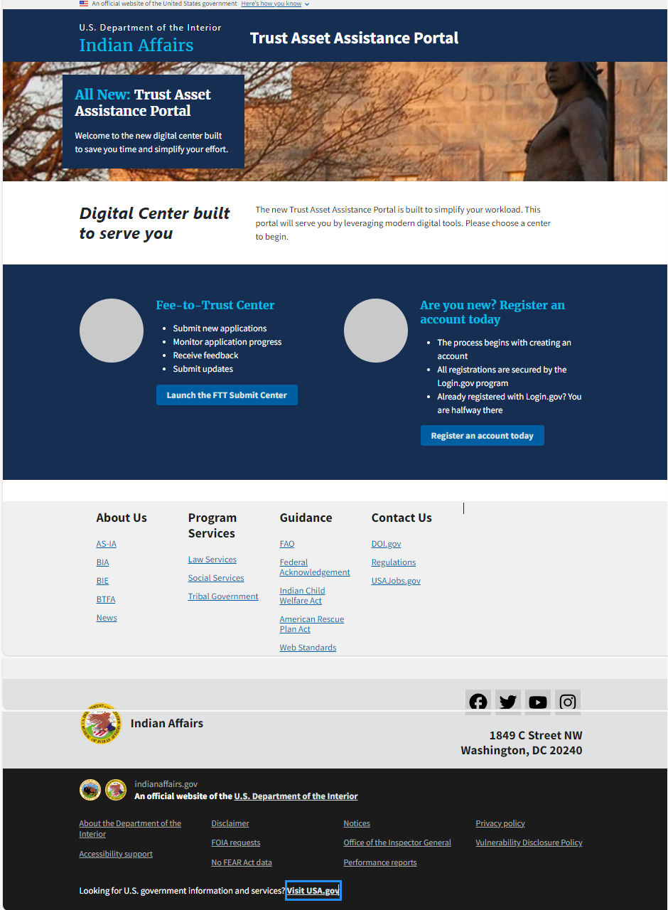
FTT portal home page
Notes:
Users can click on the “Launch FTT Submit Center” button to Access the Portal.
Clicking on that button will take user to the log-in page. (next slide)

Slide 8
Sign in with Login.gov
Notes:
Users who have existing Login.gov will be able to sign in with their Login.gov to create their FTT profile.
Clicking on “Sign in with Login.gov” button will redirect users to the Trust Asset Application Portal (Shown in the next slide)
Request module they need (FTT, HEARTH, Mortgages, etc)
Accounts will be monitored by DRES CO

Slide 9
Profile Setup
Notes:
Step 2 requires user to select one of the five roles:
Individual
Tribal attorney
Tribal leader
Tribal land office
BIA realty office

Slide 10
Portal Dashboard
My Dashboard -
First Time User
Notes:
As a first time user, user will have no applications to view. They can get started by clicking on the “Create a new application” button.

Slide 11
My Dashboard –
Re-occurring User
Notes:
As a reoccurring user, their dashboard will consist of several applications in different statuses. There are 6 different status an application can be depending on the progress of the application.
There is a brief description on the side to help user understand what each status is about.
Users can also look at their application dashboard for a detailed view of what is going on with their application. (next couple slides)

Slide 12
Application Process –
Parcel - Land Description
Notes:
Users who want to provide would have to provide a land area description or a parcel description and select yes for Question #1
User who do not want to include either can select no (shown in the next slide)

Slide 13
Application Process –
Single document Upload
Notes:
Users are required to upload a single document if they selected “single document” and confirm the following documents ( written request, map, evidence of eligible Indian status, title evidence/title insurance, ownership) have been include in the uploaded file.

Slide 14
Application Process –
Multiple document Upload
Notes:
Users are required to upload multiple documents if they selected “multiple document” and confirm the following documents; written request, map, evidence of eligible Indian status, title evidence/title insurance, ownership have been uploaded.

Slide 15
Application Dashboard
At a glance
Notes:
Application dashboard is specific to the application. Gives the user information on what is required, what messages they have received, and a progress tracker that helps with tracking the steps they need to take to complete the application.
Application panel (next slide)

Slide 16
Application Dashboard – Required Actions Panel
Notes:
Required Actions Panel shows user what they need to get done so that their application can be completed. Having any incomplete letters will show up here. Users can click on “Provide additional documents” to upload the needed documents.
Screen shot on the left is how it looks on the dashboard. Clicking on “Go to Required Actions” button will display the screen shot on the right

Slide 17
Application Dashboard – Messages
Notes:
Messages allows users to send and receive messages to a BIA member
Screen shot on the left is how it looks on the dashboard (like an overview). Clicking on “Go to Messages” button will allow users to create new messages, see which ones they have sent and see their unread messages (shown on the right)

Slide 18
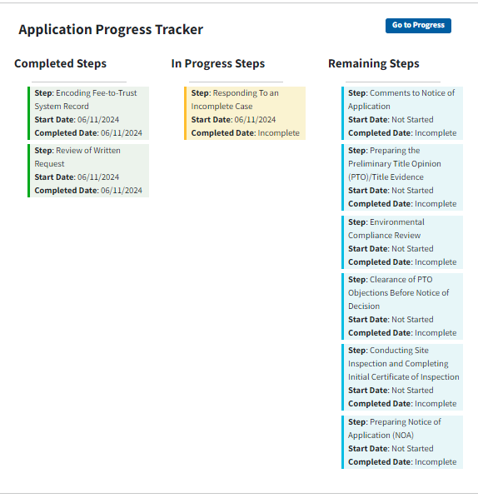
Application Dashboard – Application Progress Tracker
Notes:
Application Progress Tracker helps user keep track on what steps they have completed and what steps they need to get done.
Screen shot on the left is how it looks on the dashboard. Clicking on “Go to Progress” button will display the screen shot on the right
Next is Application Steps

Slide 19
FTT Portal implementation
Tentative implementation date of the FTT Portal is April 2025
Training for BIA and Contract/Compact Staff training
Training for Applicants (Tribal and Individual)

Slide 20
THANK YOU
Carla H. Clark
Division Chief
Division of Real Estate Services
Office of Trust Services
Bureau of Indian Affairs
carla.clark@bia.gov
This Photo by Unknown Author is licensed under CC BY

