Slide 1
Tribal Interior Budget Council (TIBC)
BIE Director Update
Tony Dearman, Director
Sharon Pinto, Deputy Bureau Director
Larry Palmer, Budget Officer
Pala, CA
July 29th – August 3rd

Slide 2
BIE Agenda
BIE Budget Update
BIE Support of Executive Order 14112
BIE Funding Distributions By Budget Line
BIE Ranking Update Recommendations
Questions and Answers
2

Slide 3
BIE 2024 Funding Summary
BIE Funding Snapshot | FY2024 Enacted | FY2025 Request | FY2025 Change
Operation of Indian Education Programs | $1,131,617 | $1,210,690 | $79,073
Education Construction | $234,725 | $310,236 | $75,511
BIE Direct Appropriations | $1,366,342 | $1,520,926 | $154,584
Department of Education Funding* | $246,550 | $246,550 | $0
Total BIE Funding | $1,612,892 | $1,767,476 | $154,584
* Department of Education transfer funds – most recent estimated transfer funds
Overall, BIE’s 2025 Budget Request is a 9% increase over 2024
4 Continuing Resolutions (CRs)were passed from Oct 23 to Mar 24
A delayed full-year appropriation and CRs are expected in 2025
3

Slide 4
BIE 2025 Congressional Action
Congressional Action Funding Snapshot | FY2024 Enacted | FY2025 Request | FY2025 House Mark | House Mark VS 2025 Request | House Mark VS 2024 Enacted
Operation of Education Programs | $1,131,617 | $1,210,690 | $1,198,216 | -$12,474 | $66,599
Education Construction | $234,725 | $310,236 | $270,867 | -$39,369 | $36,142
BIE Direct Appropriations | $1,366,342 | $1,520,926 | $1,469,083 | -$51,843 | $102,741
Department of Education Funding* | $246,550 | $246,550 | $216,550 | -$30,000 | -$30,000
Total BIE Funding | $1,612,892 | $1,767,476 | $1,685,633 | -$81,843 | $72,741
* Department of Education – Title I, Part A proposed reduction, Title II A, Elimination
BIE’s 2024 appropriation did not include bureau fixed costs
BIE’s 2025 request includes several key BIE initiatives and proposals
4

Slide 5
Key BIE 2025 Budget Initiatives
Continuing funding priority and increases in BIE’s Native Language Immersion grant program under Education Program Enhancements.
Expansion of BIE’s Family and Child Education (FACE) programs under Early Childhood and Family Development program funding.
Tribal Grant Support Costs rise to over $100 million for Tribally Controlled Schools, promoting educational self-determination for Tribal communities that operate and manage BIE-funded schools.
Under Education Construction, requested investments in repair and improvement of employee quarters and school facilities support BIE school leader and teacher recruitment and retention.
5

Slide 6
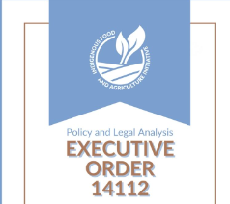
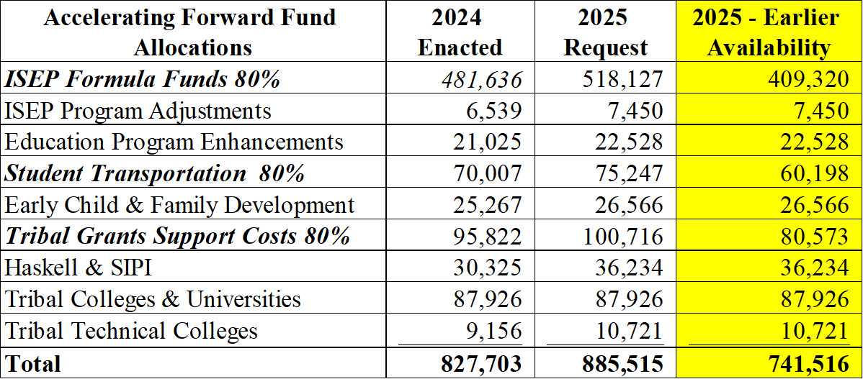
BIE Support Initiatives
2025 Proposed Appropriation Language Releases Forward Funds Faster
Provides Tribal Controlled Schools with funds 1 June vs 1 July
Accelerates funding of over $740 million in these key budget lines:
6

Slide 7
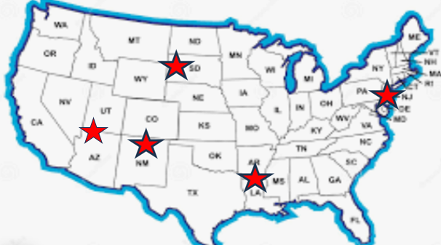
BIE Support Initiatives
FY 2024 Listening Sessions were held on funding formula changes to Indian School Equalization Program (ISEP) and ISEP Transportation
These 2 programs support over $550 million in annual school funding
Listening Funding Formula Listening Sessions | 2024 Enacted | 2025 Request
ISEP Formula Funds | $ 481,636,000 | $ 518,127,000
Student Transportation | $ 70,007,000 | $ 75,247,000
Total | $ 551,643,000 | $ 593,374,000
2024 Listening Sessions were held this year in Arizona, New Mexico, South Dakota, Louisiana, Washington D.C.
7

Slide 8
BIE Support Initiatives
Federal Employees Retirement System (FERS) Benefits
BIE recognizes disparities between BIE teacher and administrative salaries and public teacher and administrative salaries may lead to difficulty recruiting and retaining
Forward Funding of Key Education Budget Lines
Operations and Maintenance
Scholarships
Johnson O’Malley Program
8

Slide 9
BIE Support Initiatives
BIE supports pay parity and for all BIE-funded school employees
Requesting across-the-board funding of annual pay raises supports equity for both federal and non-federal Tribal employees
Presently all fixed costs for elementary and secondary programs are are allocated among all BIE-funded schools
The 2024 BIE Enacted Budget did not fund requested fixed costs
Annual Tribal data collection recommendations on TCS staffing costs support annual budget justifications
9

Slide 10
BIE Support Initiatives
Modernize BIE Native American Student Information System
Support Wide Area Network and Internet Service Delivery
Update Enterprise Software including MS Azure Active Directory
Technology Modernization Fund - TCS website services at no cost to include Drupal Hosting and Setup​ Content Support, Custom Branding and Design Services,​ 100% control and management of school content and website security across all sites​
10

Slide 11
Tribal Grant Support Costs Outlook
10% percent increase in TGSC funding 2021-2024
TGSC funding formula is based on managed federal dollars
2025 Request at $100.7 million is the high-mark for TGSC funding
Overall funding set by BIE Congressional appropriations
13

Slide 12
Tribal Ranking Tool Recommendations
BIE-funded schools continue to rank its programs separately from BIA
Do not include BIE-funded schools rankings in BIA’s Consolidated National Ranking for education and education construction categories
BIE will add the following budget line items in the construction category:
Tribal Colleges and Universities FI&R
Replacement/New Employee Housing
BIE will add key sub-programs in budget lines items for clarification
School Resource Officers (SROs) – ISEP Program Adjustments
Native Language Programs – Education Program Enhancements
Behavioral Health and Wellness – ISEP Program Adjustments
Improve School Leader and Tribal Engagement/Collaboration on BIE Ranking
14

Slide 13
Questions and Discussion Topics

