Slide 1
Tribal Self-Governance
Changes to the Automated Standard Application for Payments (ASAP) system

Slide 2
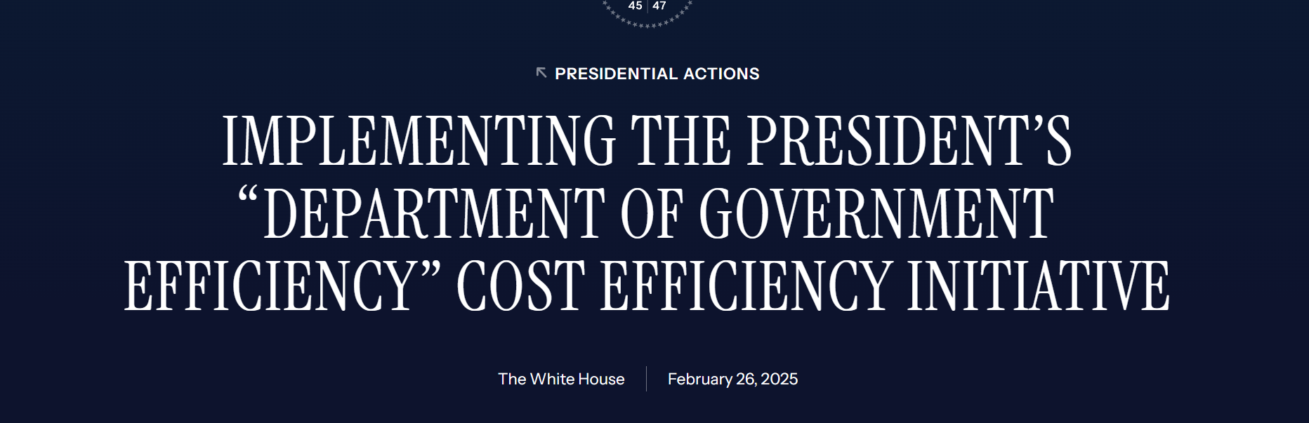
EO 14222

Slide 3
Sec. 3. Cutting Costs to Save Taxpayers Money. (a) Contract and Grant Justification. Each Agency Head shall, with assistance as requested from the agency’s DOGE Team Lead, build a centralized technological system within the agency to seamlessly record every payment issued by the agency pursuant to each of the agency’s covered contracts and grants, along with a brief, written justification for each payment submitted by the agency employee who approved the payment. This system shall include a mechanism for the Agency Head to pause and rapidly review any payment for which the approving employee has not submitted a brief, written justification within the technological system.
(i) Once the system described in subsection (a) of this section is in place, the Agency Head shall issue guidance, in consultation with the agency’s DOGE Team Lead, to require that the relevant agency employee promptly submit a brief, written justification prior to that employee’s approval of a payment under covered contracts and grants, subject to any exceptions the Agency Head deems appropriate.
(ii) To the maximum extent permitted by law, and to the maximum extent deemed practicable by the Agency Head, the payment justifications described in subsection (a)(i) of this section shall be posted publicly.

Slide 4

In response to Executive Order 14222,
The Department of Treasury added a new payment justification feature to its ASAP fund distribution system.
ASAP is the system that DOI uses to transfer ISDEAA funds to Tribal governments.
ASAP is a government-wide system that several federal agencies use – primarily for reimbursable grants.
The new feature was made systemwide and Treasury does not have the option to exclude the field for a subset of recipients.

Slide 5
Payment Justification Feature
Starting Monday, May 19, 2025, all payment requests submitted in ASAP.gov will require a brief written justification for each payment.
This field is mandatory, limited to 300 characters, and will be required in the first step of the payment request process.
If you have several payment justifications, please enter the requests separately, (i.e., individual payments).

Slide 6
Concerns with the payment justification requirement
Under ISDEAA, once funds are awarded to a Tribe, the government is required to transfer those funds expeditiously and fully. Any delay or withholding is tightly constrained by statute.
ISDEAA expressly provides that the Secretary may only suspend, withhold, or delay the payment of funds to a Tribe under an ISDEAA agreement in very narrow circumstances not present here. A blanket policy that pauses payments simply because a justification field is deemed insufficient (or not provided) does not fit these narrow exceptions and procedural safeguards.
Imposing these new conditions undercuts the very intent of Self-Governance, which affirms the right of Tribal governments to assume control over programs without unnecessary federal interference or bureaucratic delay.
ISDEAA agreements are legally binding documents, negotiated on a government-to-government basis, which outline the conditions and funding amounts for Tribal programs. Our agreements do not contain a requirement for payment-by-payment justifications as a condition of receiving funds.

Slide 7
In response to the addition of the new requirement in the ASAP system, the Self-Governance Communication and Education Tribal Consortium (SGCETC) requested that DOI change its process for the transfer of ISDEAA funding. Instead of using ASAP (a reimbursement based financial distribution system), we request DOI move to a direct wire transfer process.

Slide 8
The direct wire transfer process is already used at Indian Health Service and the Department of Transportation for transferring ISDEAA funds.
In response to our request,
We met with Treasury officials who expressed support but noted it is up to DOI to decide how it transfers funds.
DOI is evaluating the request and has identified a short-term work around. The work around is to identify a term for all Tribes to enter in the ASAP justification field—such as “pursuant to ISDEAA agreement”—that will be accepted by DOI and Treasury as meeting the intent of the new justification requirement.
DOI has also asked for an exemption from the Administration.
We appreciate the work around option but hope it is a short-term fix.

Slide 9
This presents an opportunity to address a long-standing management challenge at DOI.
Interior’s ability to disburse funds in a timely manner has been a long-standing management challenge.
“Interior’s process to disburse funds associated with the tribes’ self-determination contracts and self-governance compacts is a factor that hinders expansion of self-determination contracts or self-governance compacts.” (GAO-19-87)
“Interior officials told us that the agency’s financial data management system is used for all of Interior and is not equipped for the unique aspects of self-determination contracts and self-governance compacts..” (GAO-19-87)

