Slide 1
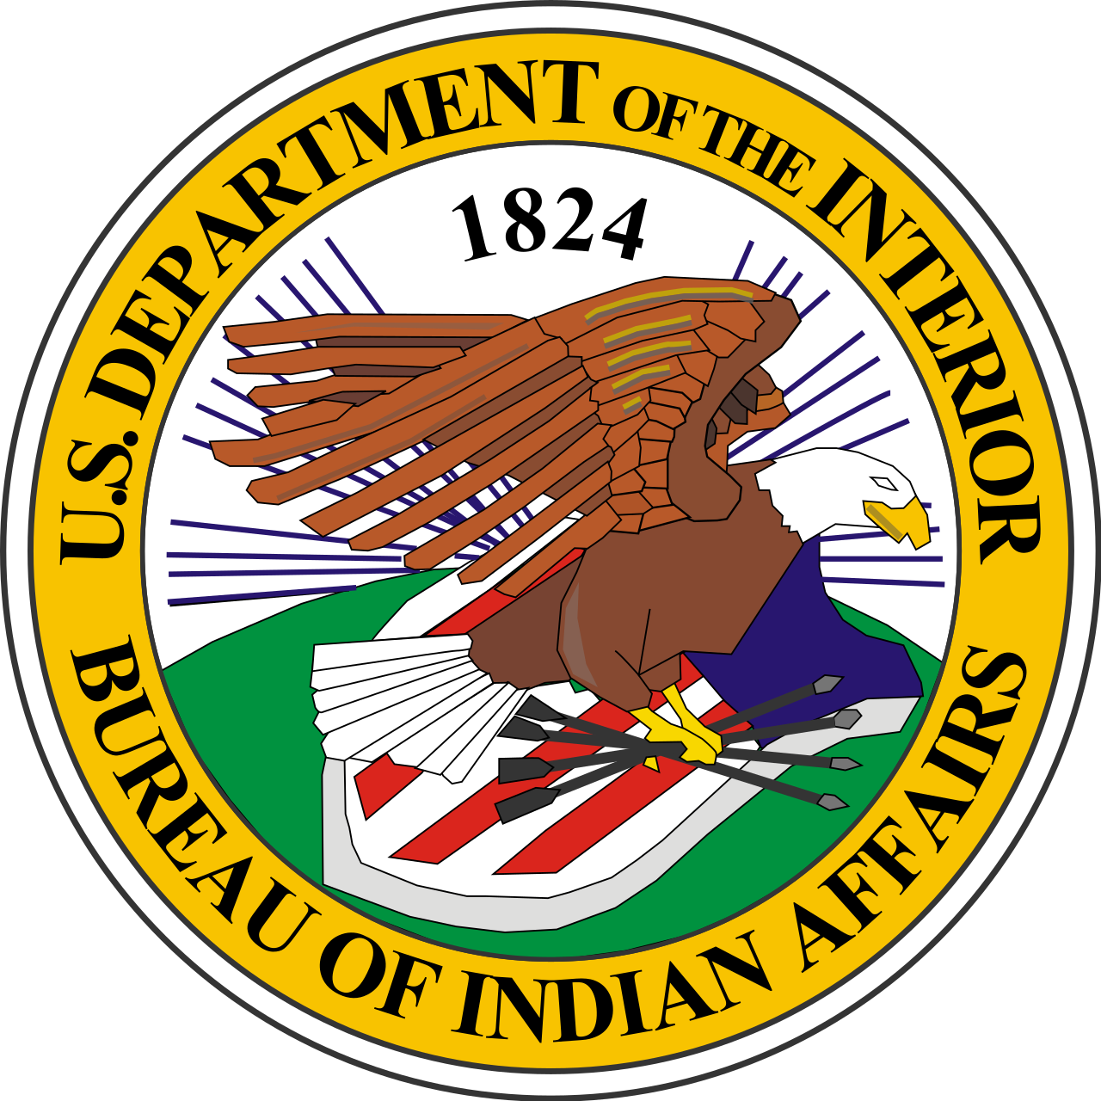
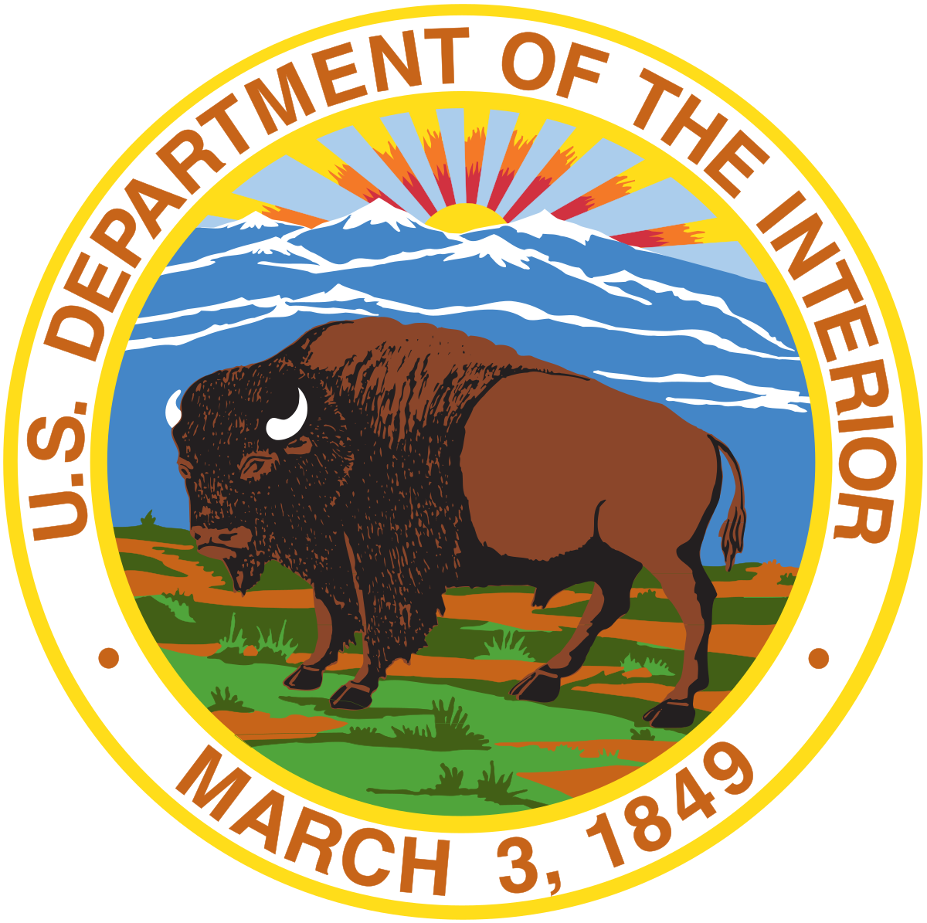
DOI Initiatives and Updates
Trina Locke, Associate Deputy Bureau Director, Environmental and Natural Resources Directorate

Slide 2
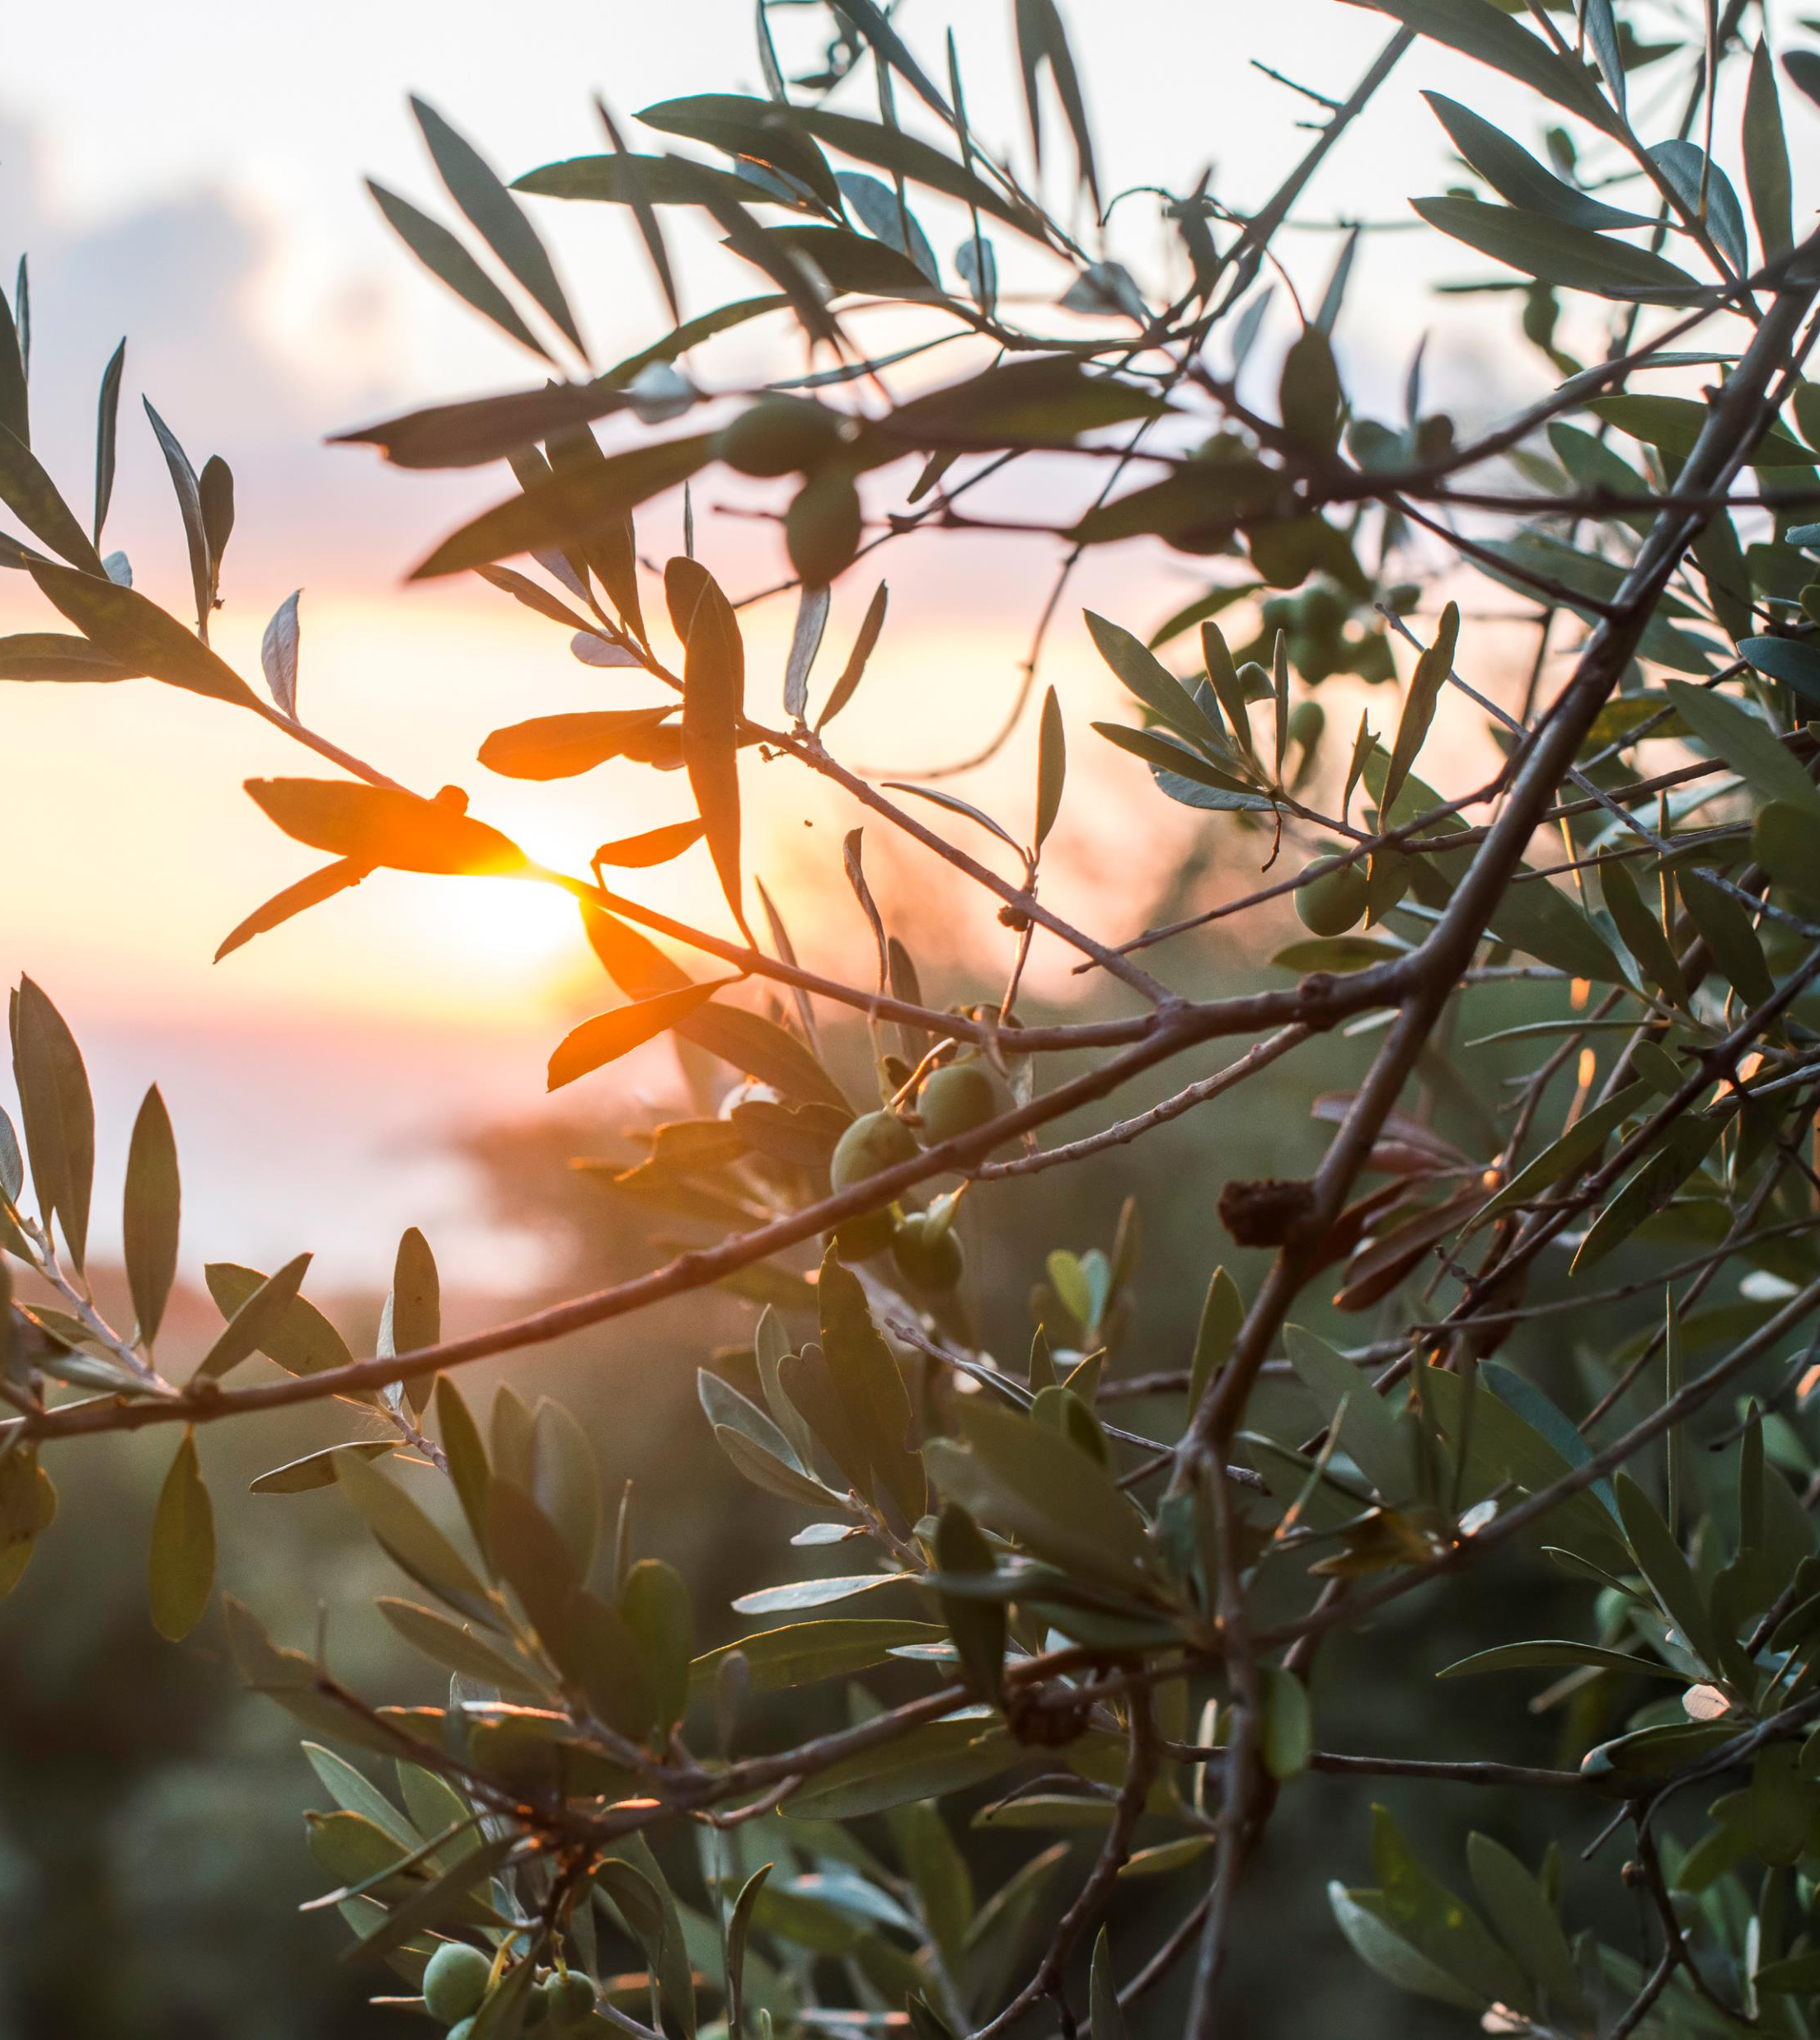
Bipartisan Infrastructure Law
President Biden’s Bipartisan Infrastructure Investment and Jobs Act (IIJA), commonly referred to as the Bipartisan Infrastructure Law (BIL) provided a historic $13 billion directly in Tribal communities across the country and makes Tribal communities eligible for billions more. These resources go to tackle the climate crisis, advance environmental justice, and invest in Tribal communities often left behind.
The Office of Trust Services (OTS) is providing $2.966 billion in BIL funding directly to tribal communities and coordinate with other lead DOI programs on the release of an additional $170.8 earmarked for ecosystem restoration projects, wildfire drought coordination, orphaned well site plugging, remediation and restoration on trust and restricted lands.

Slide 3
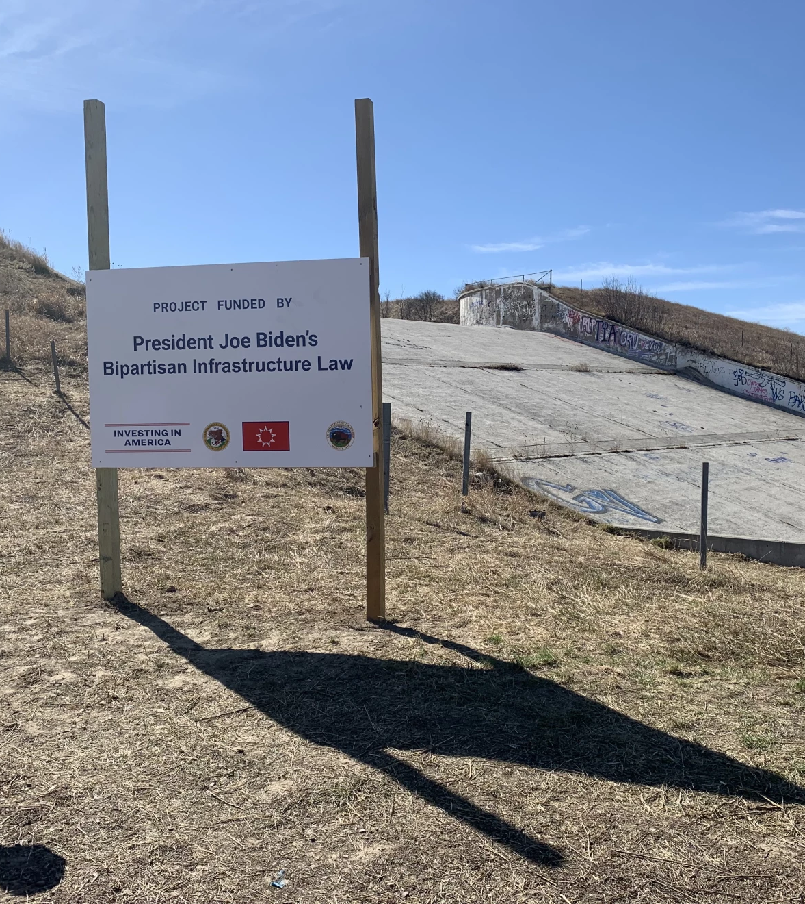
Dam Safety
Safety of Dams projects accelerate rehabilitation activities using a prioritization methodology based on inspections and analysis of all high-hazard program dams to understand the risk each structure presents to downstream residents.
The mission is to reduce the potential loss of human life and property damage caused by dam failure by making dams under the administration of BIA as safe as practically possible
Oglala Dam - Design and Construction
The reservoir formed by Oglala Dam was drained in 2019 to protect downstream communities and property following flood damage that compromised the spillway and outlet works
In September 2023, IA awarded a $58 million Indian small business economic enterprise (ISBEE) construction contract to address damages and restore an important local water resource for the Pine Ridge community

Slide 4
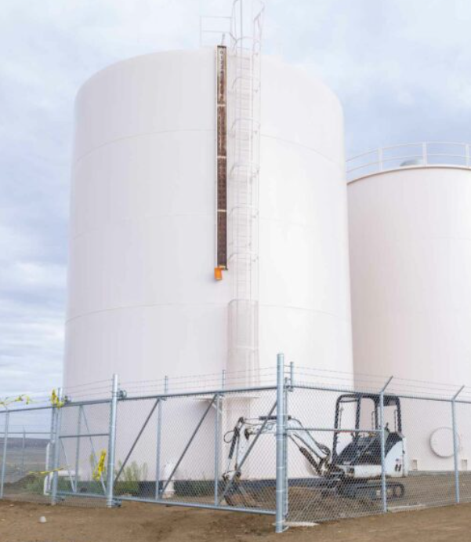
Water Sanitation
Water Sanitation projects prioritize addressing Environmental Protection Agency notice of violations, contamination issues, critical risks of system failure, and system upgrades.
Hopi Arsenic Mitigation Project (HAMP)
Arsenic contamination was previously 2-3x the Federal maximum
$15.4 million in BIL funding is being used to improve the operation and capacity of the HAMP, to reduce concentrations of arsenic and eliminate health risks for Keams Canyon residents, schools, and businesses

Slide 5
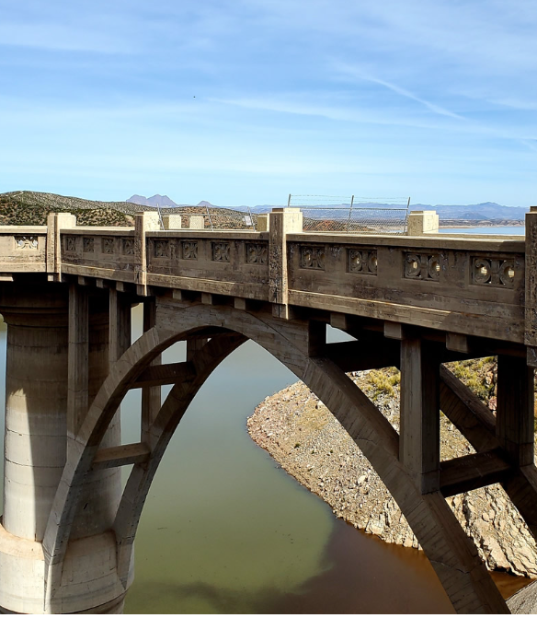
Tribal Irrigation and Power Systems
Tribal Irrigation and Power Systems funds address deficiencies identified in condition assessments and opportunities to modernize the irrigation and power projects. BIA is focusing on projects that reduce the risk of failure, reduce deferred maintenance, and align with Condition Assessments and Modernization Studies to rehabilitate aging irrigation and power infrastructure.

Slide 6
Tribal Climate Resilience Adaptation Awards
Climate Adaptation awards can be used to support: training and workshops, adaptation planning, habitat restoration, youth engagement, implementation, travel, and capacity building
For both categories, Tribal proposals are considered based on factors such as overall quality of design, potential for implementation, and incorporation of science features; capacity-building features; and strength of budget proposal and supplemental factors such as breadth of benefits and leveraging of funds

Slide 7
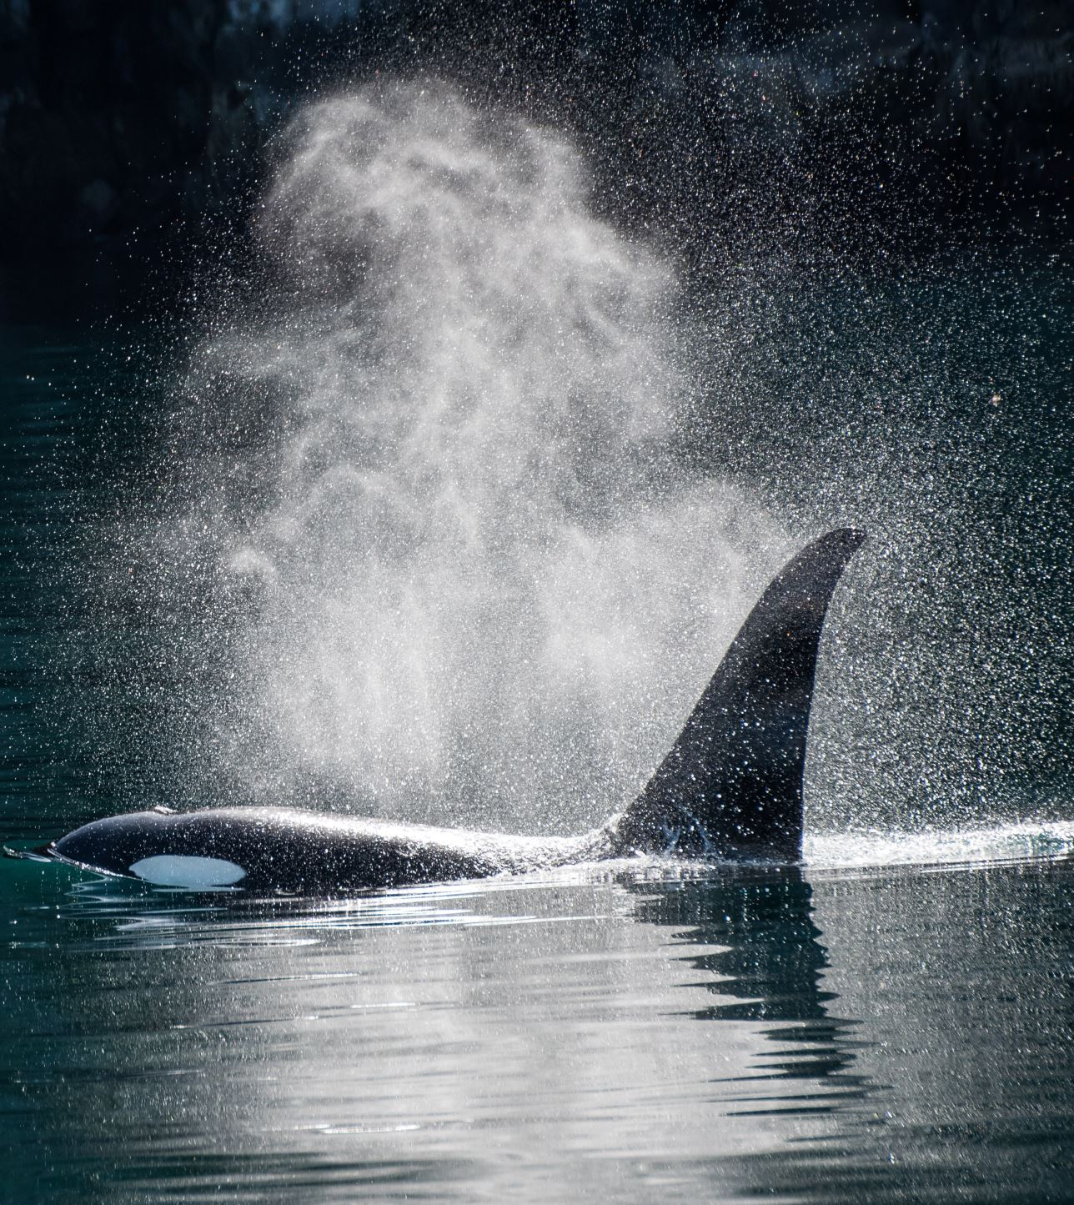
Voluntary Community-Driven Relocation
Community Relocation awards can be used to support: (1) risk assessment, (2) planning, (3) implementation, and (4) capacity building
Eleven demonstration projects were chosen. Tribes were selected based on factors such as risk level, community-readiness, existing plans or designs, and potential to yield lessons-learned for other Tribes facing similar issues

Slide 8
Community Driven Relocation Accomplishments
Announced three CDR demonstration implementation projects:
Newtok Village (Alaska)
Native Village of Napakiak (Alaska)
Quinault Indian Nation (Washington)
All three CDR demonstration implementation projects received an initial $250 thousand to hire staff that manage project activities and prepare plans to access remaining funds.
Announced eight CDR demonstration planning and preparation projects:
Native Village of Point Lay (Alaska)
Huslia Village (Alaska)
Native Village of Fort Yukon (Alaska)
Native Village of Nelson Lagoon (Alaska)
Havasupai Tribe (Arizona)
Yurok Tribe (California)
Chitimacha Tribe (Louisiana)
Passamaquoddy Indian Tribe (Maine)
Provided initial allocations of $250 thousand to the eight CDR demonstration planning and preparation projects to hire staff that manage project activities and prepare plans to access remaining funds. Remaining funding allocations for these eight projects ($5 million) will be funded through other funding sources.
Several CDR demonstration projects hired coordinators and are actively working on developing budgets to access their remaining allotment of CDR funds.
Extended the RMP cohort training program, which was originally designed to increase technical capacity for Tribal RMP coordinators has been extended to the CDR demonstration project communities to participate and utilize these relevant training resources as well.

Slide 9
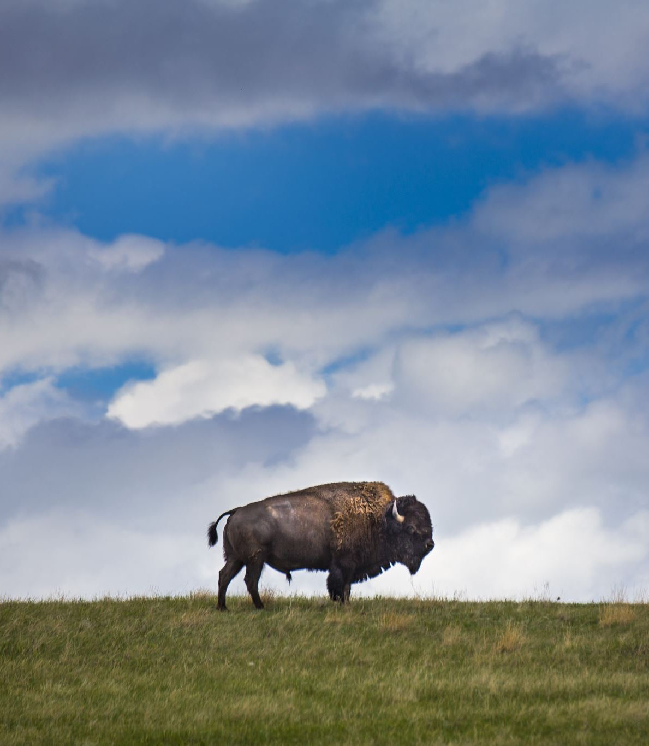
Ecosystem Restoration
BIL provided $40M to enhance Tribal recreation, reduce the risk of resources and loss to environmental factors, restore habitat connectivity and advance habitat restoration, conservation of at-risk and listed species with benefits to significant ecosystems and support for grasslands restoration and greenhouses for forest health.

Slide 10
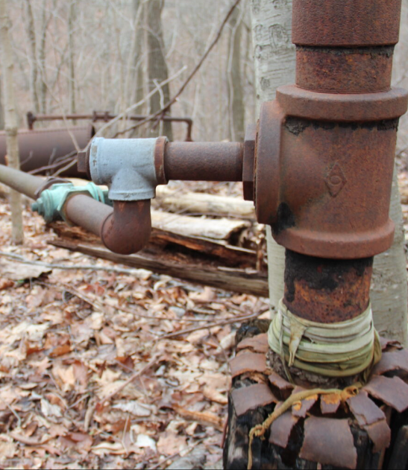
Orphaned Well Plugging
$150 Million was provided from BIL for Orphaned Well plugging and reclamation as well as development of Tribal Orphaned well program on Tribal lands.
There are three phases of funding available to Tribes, Phase 1 resulted in the funding of $40 Million to 11 Tribes for program development and implementation efforts.
Phase 2 $50M has concluded and is in the process of award. The requests for both Phases exceeded available funds and were well over $120 Million in needed projects.
The Phase 3 $50 Million opportunity is expected to be available in the fall of 2024.

Slide 11
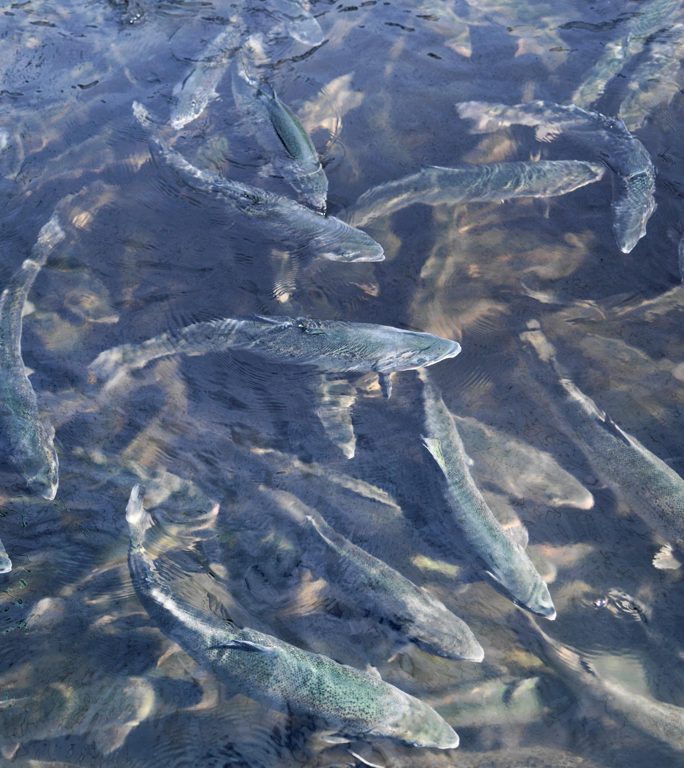
Fish Hatchery O&M and Minor Improvement and Repair
The IRA Fish Hatchery program supports the expansion of the existing hatchery maintenance program, allowing BIA to address outdated, undersized, inefficient hatchery systems that require new construction or upgrades due to changing environmental restrictions. It includes construction of brand-new hatcheries as well as retrofits that are not funded through annual appropriations.
The $10M in Inflation Reduction Act (IRA) Fish Hatchery funding provided for 11 critically needed Tribal Fish Hatchery facilities projects.

Slide 12
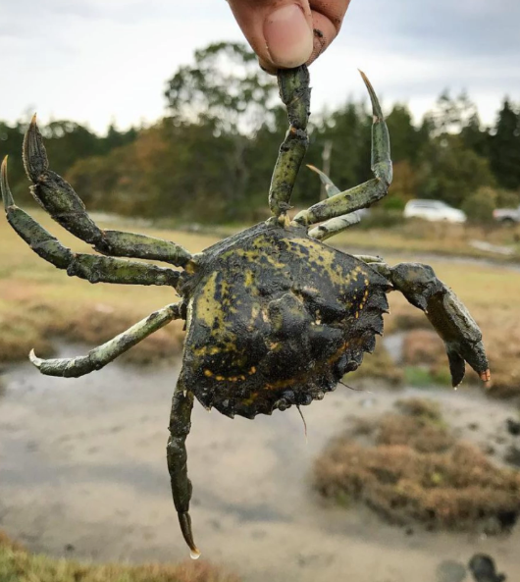
Habitat Restoration
IRA provided $50M for habitat restoration.
$7M for Buffalo restoration and herd expansion. It also provided $1m for a Bison Management Apprenticeship Program to develop a pipeline of talent and build capacity within Tribal communities as Tribes work to expand their bison herds and enter into co-stewardship agreements for bison management. The apprenticeship program will include opportunities for Tribal youth to work at Fish and Wildlife Service and National Park Service units. Program development will include Tribal engagement.
It provided close to $5M for European Green Crab eradication efforts to improve native species diversity and reduce the threat of dispersal.
In addition, it added a set aside to the Tribal Climate Adaptation for projects in support of habitat and watershed restoration especially after fire, flood, drought, climate, and other at-risk landscapes such as forests and grasslands under the annual awards program.

