Slide 1
Tribal-Interior Budget Council
Tony L. Dearman, Director
Sharon Pinto, Deputy Bureau Director, School Operations
Travis Clark, Associate Deputy Director - Strategic Education Programs

Slide 2

Mission
In partnership with Indian Nations, the BIE promotes a culturally based, comprehensive education that prepares and empowers students to be healthy and successful.
Vision
Excellence in Student-Centered, Indian Education.

Slide 3
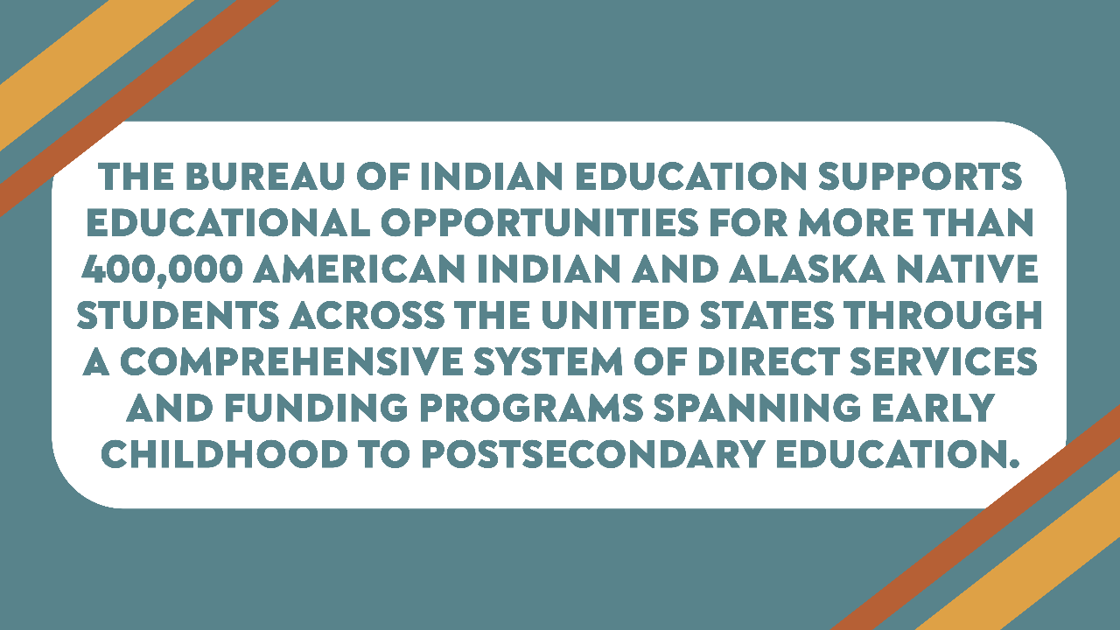

Slide 4
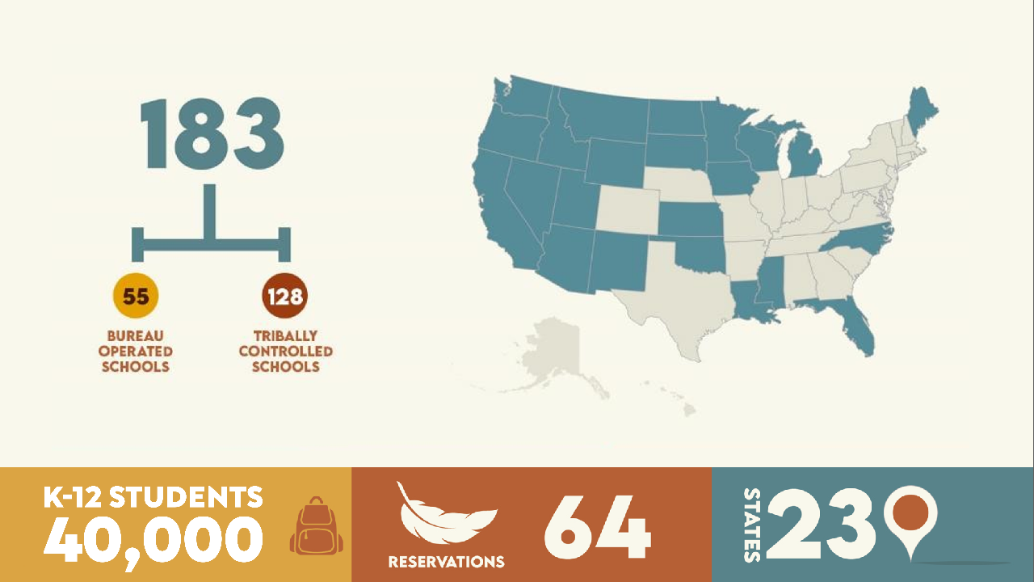

Slide 5


Slide 6
BIE BUDGET

Slide 7
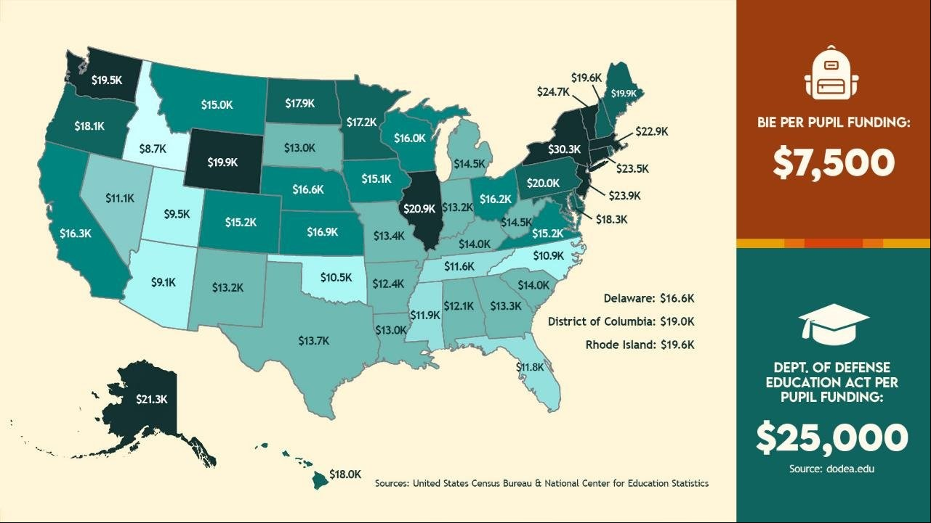

Slide 8
Bureau of Indian Education Overview
The Bureau of Indian Education (BIE) provides elementary and secondary education services (K-12) to approximately 40,000 students in 23 States.
Currently 128 or approximately 70 percent of BIE-funded schools are Tribally controlled and operate under the direction of Tribal governments.
BIE provides funding to 33 Tribal Colleges and Universities (TCUs). These colleges are primarily located on reservations in States and serve American Indian communities with limited access to other post-secondary institutions.
BIE annually records approximately 13 million miles in transporting (school bus routes) students to and from 169 schools across Indian Country.
73% of all BIE forward funding allocated is provided pursuant to formulas outlined in 25 CFR Part 39.

Slide 9
Budget Status – FY2021 - Present
Operation of Indian Education Programs (OIEP)
BIE OIEP funding has remained flat since FY 2023
Fixed Costs were applied to the FY 2023 enacted budget

Slide 10
Bureau of Indian Education
FY 2026 House vs Senate
ACCOUNT ACTIVITY |  | 2025 NOTIONAL |  | 2026 HOUSE Markup |  | 2026 SENATE Markup
BUREAU OF INDIAN EDUCATION, TOTAL |  | $ 1,366,342 |  | $ 1,530,883 |  | $ 1,366,342
OPERATION OF INDIAN EDUCATION PROGRAMS |  | $ 1,131,617 |  | $ 1,235,516 |  | $ 1,131,617
EDUCATION CONSTRUCTION |  | $ 234,725 |  | $ 295,367 |  | $ 234,725
FY2026 appropriation language reflects forward funded budget lines being available on June 1st instead of July 1st

Slide 11
Bureau of Indian Education
OIEP Summary

Slide 12
Bureau of Indian Education
Education Construction

Slide 13
WORKFORCE EFFICIENCY

Slide 14
BIE Workforce Efficiency Strategies
Putting Students First
BIE prioritizes frontline educators and staff to ensure every student has access to a high-quality education.
Aligning with National Priorities
BIE’s workforce efforts reflect key directives from the President and Administration to deliver choice and better outcomes for BIE students and families.
Making Smart, Data-Informed Decisions
We’re using data to drive continuous improvement and better serve our schools and communities.
Streamlining Government Services
By coordinating with the Department of the Interior, BIE is modernizing operations and reducing duplication.
Planning for the Future
BIE is investing in sustainable workforce strategies to support long-term success.

Slide 15
JOHNSON O’MALLEY

Slide 16

The Johnson-O’Malley program provides supplemental academic and cultural support services to meet the unique educational needs of eligible American Indian and Alaska Native students in public schools.

Slide 17
Johnson O’Malley Funding
FY25 will be the first year the JOM funding will be distributed under the JOM distribution formula, which utilizes actual JOM student count numbers as the primary data point to calculate the per-pupil amount. Beginning in FY25 and every fiscal year thereafter, the JOM funding will cease to be distributed on a historical TPA amount instead of the actual JOM student count from the previous school year.

Slide 18
EXPANDING EDUCATIONAL OPPORTUNITIES

Slide 19
Executive Order 14191 Tribal Consultation Summary
BIE held five consultation sessions on EO 14191, which directed the review of federal funding mechanisms for BIE-eligible students.
Over 50 Tribal governments, schools, and organizations participated. Most Tribal leaders and stakeholders opposed any diversion of funds from BIE schools, including via vouchers.
Feedback will inform expanded TED grants, technical assistance, and postsecondary pathway planning for SY 2025–26.

Slide 20
Expanding Educational Opportunities: Proposed Mechanisms
Flexible Funding
Reserved $1.3M from ESEA Sec. 1003A to support direct student services—advanced courses, tutoring, CTE, dual enrollment, etc.
Tribal Authority
Supporting Tribes exercising authority with technical assistance for transition planning.
TED Expansion
Increasing Tribal Education Department (TED) grants ahead of SY 2025–26 to boost local control of education.

Slide 21
BUREAU OF INDIAN EDUCATION AND DEPARTMENT OF EDUCATION MOU

Slide 22
The Bureau of Indian Education and the U.S. Department of Education held a tribal consultation on July 1, 2025, to review a draft Memorandum of Understanding required under the Elementary and Secondary Education Act and the Every Student Succeeds Act.
The agreement outlines how ED transfers federal education funds to BIE for programs such as Title I, II, IV, V, VI, Comprehensive Literacy, and McKinney-Vento support for homeless youth. Under the MOU, BIE functions as the State Educational Agency for BIE-funded schools, assuming responsibility for program oversight, fiscal management, compliance, and reporting.
ED retains monitoring authority and supports implementation through training and technical assistance. This is the first update to the MOU since 2012 and reflects a renewed commitment to interagency coordination and tribal engagement in the administration of federal education programs.

