Slide 1
IA Budget Update
August 6, 2025

Slide 2
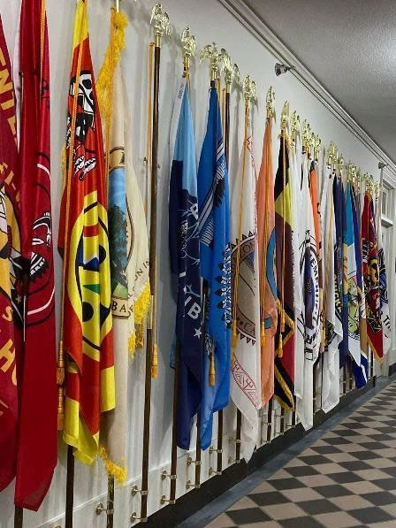

Agenda
FY 2025 Status of Distributions
FY 2026 Budget Request
FY 2027 Budget Formulation
FY 2028 Tribal Ranking Priorities

Slide 3
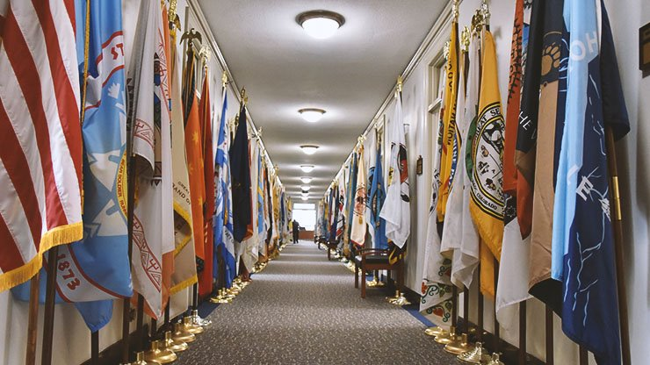
FY 2025 Distribution of Funds
Full Year Continuing Resolution (CR) through September 30, 2025.
  OMB approved apportionments and Treasury issued warrants.
  IA programs distributing funds.
Notes:
CR includes disaster supplemental BIA $17m storms in the west and maine; BIE school $153m

Slide 4
FY 2026 Budget Request by IA Bureaus
BUREAU ACCOUNT | 2024 Enacted | 2025 Notional^{/1} | 2026 President's Budget Request | 2026 HOUSE | 2026 SENATE
TOTAL, INDIAN PROGRAMS | 3,922,986 | 3,962,225 | 2,728,560 | 4,543,207 | 3,942,648
BUREAU OF INDIAN AFFAIRS | 2,456,635 | 2,495,874 | 1,714,445 | 2,904,247 | 2,476,297
BUREAU OF INDIAN EDUCATION | 1,366,342 | 1,366,342 | 914,106 | 1,530,883 | 1,366,342
BUREAU OF TRUST FUNDS ADMINISTRATION | 100,009 | 100,009 | 100,009 | 108,077 | 100,009
Overall, 2026 House and Senate marks support Indian Affairs programs close to or above 2024 and 2025 spendings levels.
  Strong support to fully fund IA and fulfill treaty obligations.
^{1/}Resource levels included are estimates. The President reserves his authority under the “Full-Year Continuing Appropriations and Extensions Act, 2025” (P.L. 119-4) to revise spending within the amounts provided by Congress.
Notes:
+15.8% House; +1% Senate above 2024 enacted; +14.7% House, -1% below 2025

Slide 5
FY 2026 Budget Request by IA Bureaus
BUREAU ACCOUNT | 2024 Enacted | 2025 Notional^{/1} | 2026 President's Budget Request | 2026 HOUSE | 2026 SENATE
TOTAL, INDIAN PROGRAMS | 3,922,986 | 3,962,225 | 2,728,560 | 4,543,207 | 3,942,648
BUREAU OF INDIAN AFFAIRS | 2,456,635 | 2,495,874 | 1,714,445 | 2,904,247 | 2,476,297
OPERATION of INDIAN PROGRAMS | 1,898,550 | 1,897,709 | 1,217,383 | 2,250,254 | 1,918,712
INDIAN LAND CONSOLIDATION | 4,000 | 4,000 | - | - | 4,000
CONSTRUCTION | 133,780 | 133,780 | 93,423 | 167,096 | 136,280
SETTLEMENTS | 976 | 976 | 58,897 | 58,897 | 976
INDIAN GUARANTEED LOAN PROGRAM | 13,329 | 13,329 | 1,000 | 25,000 | 13,329
CONTRACT SUPPORT COSTS ACCOUNT | 342,000 | 342,080 | 205,418 | 350,000 | 350,000
PAYMENTS for TRIBAL LEASES | 64,000 | 104,000 | 138,324 | 53,000 | 53,000
BUREAU OF INDIAN EDUCATION | 1,366,342 | 1,366,342 | 914,106 | 1,530,883 | 1,366,342
OPERATION of INDIAN EDUCATION PROGRAMS | 1,131,617 | 1,131,617 | 865,992 | 1,235,516 | 1,131,617
EDUCATION CONSTRUCTION | 234,725 | 234,725 | 48,114 | 295,367 | 234,725
BUREAU OF TRUST FUNDS ADMINISTRATION | 100,009 | 100,009 | 100,009 | 108,077 | 100,009
^{1/}Resource levels included are estimates. The President reserves his authority under the “Full-Year Continuing Appropriations and Extensions Act, 2025” (P.L. 119-4) to revise spending within the amounts provided by Congress.
Notes:
+15.8% House; +1% Senate above 2024 enacted; +14.7% House, -1% below 2025

Slide 6
FY 2026 House and Senate Mark Highlights
BIA
  House recommends for Operation of Indian Programs funding of +$352.5m above 2025 (+18.5%) and Senate recommends +$21m above 2025.
  House accepts the President’s Budget Request to eliminate funding for the Indian Land Consolidation Program.
  House supports an additional +$23.8m for construction of detention and corrections facilities.
  Senate did not include funding for the Hualapai Water Settlement.
  House recommends $25m for Indian Guaranteed Loan Program, nearly double the 2025 level and +$24m more than the Request.
  Both House and Senate provide $53m for 105(l) leases, -$85.3m below the Request, and -$51m below 2025.
BIE
  House and Senate reject proposed eliminations in the 2026 Request.
^{1/}Resource levels included are estimates. The President reserves his authority under the “Full-Year Continuing Appropriations and Extensions Act, 2025” (P.L. 119-4) to revise spending within the amounts provided by Congress.
Notes:
+12% House; +5% Senate above 2024 enacted

Slide 7

Tribal Request vs PB Request vs Enacted
.

Slide 8
2026 Markup
.
 | 2024 | 2025 | 2026
ACCOUNT ACTIVITY Sub Activity | 2024 Enacted | 2025 Notional^{1/} | 2026 President's Budget Request | 2026 HOUSE MARK | 2026 SENATE MARK
TRIBAL GOVERNMENT | 398,987 | 401,296 | 252,988 | 442,571 | 398,987
Aid to Tribal Government (TPA) | 28,923 |  |  | 36,024 | 28,923
Consolidated Tribal Gov't Program (TPA) | 83,415 |  |  | 92,499 | 83,415
Self Governance Compacts (TPA) | 230,008 |  |  | 257,158 | 230,008
New Tribes (TPA)
Small Tribes Supplement (TPA) | 7,002 |  |  | 1,502 | 7,002
Road Maintenance (TPA) | 39,190 |  |  | 43,814 | 39,190
Tribal Government Program Oversight | 10,449 |  |  | 11,574 | 10,449
^{1/}Resource levels included are estimates. The President reserves his authority under the “Full-Year Continuing Appropriations and Extensions Act, 2025” (P.L. 119-4) to revise 2025 spending within the amounts provided by Congress.

Slide 9
2026 Markup
.
 | 2024 | 2025 | 2026
ACCOUNT ACTIVITY Sub Activity | 2024 Enacted | 2025 Notional^{1/} | 2026 President's Budget Request | 2026 HOUSE MARK | 2026 SENATE MARK
HUMAN SERVICES | 163,747 | 163,453 | 65,640 | 183,172 | 163,747
Social Services (TPA) | 52,954 |  |  | 62,032 | 52,954
Welfare Assistance (TPA) | 78,494 |  |  | 80,494 | 78,494
Indian Child Welfare Act (TPA) | 16,903 |  |  | 20,230 | 16,903
Housing Program (TPA) | 11,939 |  |  | 15,981 | 11,939
Human Services Tribal Design (TPA) | 218 |  |  | 645 | 218
Human Services Program Oversight | 3,239 |  |  | 3,790 | 3,239
House and Senate continues support for Tiwahe.
^{1/}Resource levels included are estimates. The President reserves his authority under the “Full-Year Continuing Appropriations and Extensions Act, 2025” (P.L. 119-4) to revise 2025 spending within the amounts provided by Congress.

Slide 10
2026 Markup
.
 | 2024 | 2025 | 2026
ACCOUNT ACTIVITY Sub Activity | 2024 Enacted | 2025 Notional^{1/} | 2026 President's Budget Request | 2026 HOUSE MARK | 2026 SENATE MARK
TRUST - NATURAL RESOURCES MANAGEMENT | 322,349 | 320,369 | 101,196 | 352,037 | 326,608
Natural Resources (TPA) | 12,985 |  |  | 15,148 | 12,985
Irrigation Operations & Maintenance | 15,269 |  |  | 17,011 | 15,269
Rights Protection Implementation | 49,200 |  |  | 51,290 | 51,459
Tribal Management/Development Program | 18,544 |  |  | 25,696 | 18,544
Endangered Species | 5,993 |  |  | 6,130 | 5,993
Tribal Climate Resilience | 34,291 |  |  | 34,291 | 34,291
Integrated Resource Info Program | 2,954 |  |  | 3,410 | 2,954
Agriculture & Range | 39,438 |  |  | 42,005 | 41,438
Forestry | 62,887 |  |  | 65,986 | 62,887
Water Resources | 18,005 |  |  | 21,312 | 18,005
Fish, Wildlife & Parks | 23,751 |  |  | 25,019 | 23,751
Energy & Minerals | 30,814 |  |  | 35,342 | 30,814
Resource Management Program Oversight | 8,218 |  |  | 9,397 | 8,218
^{1/}Resource levels included are estimates. The President reserves his authority under the “Full-Year Continuing Appropriations and Extensions Act, 2025” (P.L. 119-4) to revise 2025 spending within the amounts provided by Congress.

Slide 11
2026 Markup
.
 | 2024 | 2025 | 2026
ACCOUNT ACTIVITY | 2024 Enacted | 2025 Notional^{1/} | 2026 President's Budget Request | 2026 HOUSE MARK | 2026 SENATE MARK
TRUST - REAL ESTATE SERVICES | 165,887 | 170,008 | 86,284 | 178,925 | 170,387
^{1/}Resource levels included are estimates. The President reserves his authority under the “Full-Year Continuing Appropriations and Extensions Act, 2025” (P.L. 119-4) to revise 2025 spending within the amounts provided by Congress.

Slide 12
2026 Markup
 | 2024 | 2025 | 2026
ACCOUNT ACTIVITY Sub Activity Program Element | 2024 Enacted | 2025 Notional^{1/} | 2026 President's Budget Request | 2026 HOUSE MARK | 2026 SENATE MARK
PUBLIC SAFETY & JUSTICE | 555,559 | 560,263 | 476,078 | 771,836 | 558,812
Law Enforcement | 506,845 |  |  | 711,533 | 510,098
Criminal Investigations & Police Services | 274,152 |  |  | 425,478 | 274,152
Detention/Corrections | 136,879 |  |  | 158,463 | 136,879
Inspections/Internal Affairs | 3,751 |  |  | 5,891 | 3,751
Law Enforcement Special Initiatives | 25,094 |  |  | 42,441 | 27,847
Indian Police Academy | 5,163 |  |  | 6,532 | 5,663
Tribal Justice Support | 34,836 |  |  | 39,869 | 34,836
Law Enforcement Program Management | 7,391 |  |  | 8,965 | 7,391
Facilities Operations & Maintenance | 19,579 |  |  | 23,894 | 19,579
Tribal Courts (TPA) | 47,101 |  |  | 57,713 | 47,101
Fire Protection (TPA) | 1,613 |  |  | 2,590 | 1,613
.
House recommends +38% increase over the FY 2025 enacted level.
  Includes an additional $68m, for a total of $130m, to Oklahoma Tribes that were impacted by the McGirt vs. Oklahoma decision.
  Funding for the Missing and Murdered Indigenous Persons activities is increased by $14.5m, from $16.5m in 2025 to $31.0m.
^{1/}Resource levels included are estimates. The President reserves his authority under the “Full-Year Continuing Appropriations and Extensions Act, 2025” (P.L. 119-4) to revise 2025 spending within the amounts provided by Congress.

Slide 13
2026 Markup
.
 | 2024 | 2025 | 2026
ACCOUNT ACTIVITY | 2024 Enacted | 2025 Notional^{1/} | 2026 President's Budget Request | 2026 HOUSE MARK | 2026 SENATE MARK
COMMUNITY & ECONOMIC DEVELOPMENT | 30,546 | 30,524 | 9,764 | 38,542 | 31,046
House recommends +$5m for Business Incubators.
^{1/}Resource levels included are estimates. The President reserves his authority under the “Full-Year Continuing Appropriations and Extensions Act, 2025” (P.L. 119-4) to revise 2025 spending within the amounts provided by Congress.

Slide 14

2026 Markup
.
 | 2024 | 2025 | 2026
ACCOUNT ACTIVITY | 2024 Enacted | 2025 Notional^{1/} | 2026 President's Budget Request | 2026 HOUSE MARK | 2026 SENATE MARK
EXECUTIVE DIRECTION & ADMINISTRATIVE SERVICES | 260,634 | 251,796 | 225,433 | 282,709 | 260,634
^{1/}Resource levels included are estimates. The President reserves his authority under the “Full-Year Continuing Appropriations and Extensions Act, 2025” (P.L. 119-4) to revise 2025 spending within the amounts provided by Congress.

Slide 15
2026 Markup
.
 | 2024 | 2025 | 2026
ACCOUNT ACTIVITY Sub Activity | 2024 Enacted | 2025 Notional^{1/} | 2026 President's Budget Request | 2026 HOUSE MARK | 2026 SENATE MARK
SPECIAL INITIATIVES | 841 |  |  |  | 8,491
CITC for Commission on Native Children Recommendation Dissemination |  |  |  |  | 500
Robert Aqqaluk Newlin Sr Memorial Trust for Uqapiaqta Inupiatun Adult Fluency Program |  |  |  |  | 241
NATIFS for MN Native American Economic Empowerment |  |  |  |  | 2,000
ENIPC for Caja del Rio Ethno graphic Study |  |  |  |  | 500
CRITFC for Columbia River In-Lieu/Treaty Fishing Access Site Construction |  |  |  |  | 5,250
AK Native Heritage Center | 631
APIA, Inc. Living Languages | 210
^{1/}Resource levels included are estimates. The President reserves his authority under the “Full-Year Continuing Appropriations and Extensions Act, 2025” (P.L. 119-4) to revise 2025 spending within the amounts provided by Congress.

Slide 16
2026 Markup
.
 | 2024 | 2025 | 2026
ACCOUNT ACTIVITY | 2024 Enacted | 2025 Notional^{1/} | 2026 President's Budget Request | 2026 HOUSE MARK | 2026 SENATE MARK
INDIAN LAND CONSOLIDATION | 4,000 | 4,000 |  |  | 4,000
CONSTRUCTION | 133,780 | 133,780 | 93,423 | 167,096 | 136,280
PUBLIC SAFETY & JUSTICE CONSTRUCTION | 45,791 | 45,791 | 45,791 | 69,591 | 48,291
RESOURCES MANAGEMENT CONSTRUCTION | 65,694 | 65,694 | 38,186 | 72,046 | 65,694
OTHER PROGRAM CONSTRUCTION | 22,295 | 22,295 | 9,446 | 25,459 | 22,295
^{1/}Resource levels included are estimates. The President reserves his authority under the “Full-Year Continuing Appropriations and Extensions Act, 2025” (P.L. 119-4) to revise 2025 spending within the amounts provided by Congress.

Slide 17
2026 Markup
.
 | 2024 | 2025 | 2026
ACCOUNT ACTIVITY | 2024 Enacted | 2025 Notional^{1/} | 2026 President's Budget Request | 2026 HOUSE MARK | 2026 SENATE MARK
INDIAN LAND & WATER CLAIM SETTLEMENTS & MISCELLANEOUS PAYMENTS TO INDIANS | 976 | 976 | 58,897 | 58,897 | 976
UNALLOCATED | 976 |  |  | 58,897 | 976
INDIAN GUARANTEED LOAN PROGRAM | 13,329 | 13,329 | 1,000 | 25,000 | 13,329
CONTRACT SUPPORT COSTS ACCOUNT | 342,000 | 342,080 | 205,418 | 350,000 | 350,000
CONTRACT SUPPORT | 337,000 | 337,080 | 200,418 | 345,000 | 345,000
INDIAN SELF-DETERMINATION FUND | 5,000 | 5,000 | 5,000 | 5,000 | 5,000
PAYMENTS for TRIBAL LEASES | 64,000 | 104,000 | 138,324 | 53,000 | 53,000
^{1/}Resource levels included are estimates. The President reserves his authority under the “Full-Year Continuing Appropriations and Extensions Act, 2025” (P.L. 119-4) to revise 2025 spending within the amounts provided by Congress.

Slide 18
FY 2027 Budget Formulation
  Tribes
    Submitted the Tribal Priority Ranking Tool.
  Regional Offices and Agencies
    Facilitated two budget formulation working group sessions and submitted consolidated tribal priority rankings.
    Identify regional office budget priorities.
  Central Office
    Departmental budget formulation kickoff – Summer 2025.

Slide 19
FY 2027 Budget Request
  2027 budget proposal usually due to OMB in September.
  OMB passback – late November/early December.
  President’s Budget Request – February 2026.

Slide 20
FY 2028 Tribal Priority Program Ranking
  Tribal Priority Program Ranking Tool is a biennial process.
  2027 National Tribal Rankings will be used for 2028 budget formulation.
    https://www.ncai.org/initiatives/bia-tribal-budget-advisory-council/meeting-materials
  Tribes may submit an updated ranking tool for 2028 to their respective IA regional office and to central office. IA will recalculate the regional and national ranking and update the results if needed.
    Submit to IA no later than January 31, 2026.
    https://www.bia.gov/as-ia/obpm/budget-formulation-guides

Slide 21
2027
Tribal Priority Program Ranking Results

Slide 22
Agenda
Participation
National and Regional Tribal Ranking by Category
National Tribal Ranking by Program
Education Ranking - Tribal vs Schools

Slide 24
FY 2027 National Tribal Ranking by Category

Slide 26
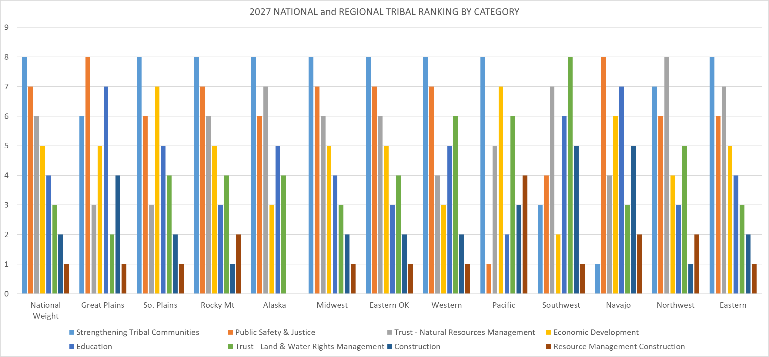

Slide 27
Additional Materials (Separate Handouts)
Individual Regional versus National Ranking Charts
National Tribal Ranking by Category + Programs (Detailed)
Education Ranking –
  TCS, BOS
  Tribal versus Schools

Slide 28
THANK YOU!

