Slide 1

Legislative Updates

Slide 2
ADMINISTRATIVE/LEGISLATIVE UPDATE
Overview
H.R.1 - One Big Beautiful Bill (OBBB)
Rescission(s) Package
Administrative Update
FY 2026 Appropriations
House & Senate

Slide 3
LEGISLATIVE UPDATE: H.R.1 - OBBB
H.R. 1 - One Big Beautiful Bill
Tribal Specific Provisions
Sec. 10102. Modifications to SNAP Work Requirements for Able-Bodied Adults
  Exempts Indians, urban Indians, and California Indians
Sec. 50301. Mandatory Disposal of Bureau of Land Management for Housing
  The Secretary shall consult with applicable tribes
Sec. 50402(b)(2)(D). Repeals; Recissions
  Repeals unobligated funds of the Tribal Energy Loan Program
Sec. 70204. Trump Accounts and Contribution Pilot Program
  A "general funding contribution" does include contributions from Tribal governments
Sec. 70403. Recognizing Indian Tribal Governments for Purposes of Determining Whether a Child Has Special Needs for Purposes of the Adoption Credit
  Effective for taxable years beginning after December 31, 2024
Sec. 71121. Requirement for States to Establish Medicaid for States to Establish Medicaid Community Engagement Requirements for Certain Individuals
  "Specified excluded individual" includes Indians, urban Indians, California Indians, and individuals eligible to receive Indian Health Services (IHS) services
Sec. 90005. State and Local Assistance
  Funds authorized to enhance Tribal (and others) security through grants

Slide 4
LEGISLATIVE UPDATE: H.R.1 - OBBB
H.R. 1 - One Big Beautiful Bill
Alaska Native Specific Provisions
Sec. 70429. Adjustment of charitable deduction for certain expenses incurred in support of Native Alaskan subsistence whaling.
  Increases the charitable deduction from $10,000 to $50,000 to support costs incurred by Alaska Native whaling captains
Sec. 10101. Re-evaluation of Thrifty Food Plan
  Authorizes the Secretary of Agriculture to make cost adjustments to the Thrifty Food Plan to account for the high costs of food in urban and rural parts of Hawaii and Alaska
Sec. 71401. Rural Health Transformation Program
  Pluses up the program to be a $50 billion fund
Environmental Provisions
Sec. 50203. Leases for Known Recoverable Coal Resources.
  Opens four million additional acres of Federal land to mining, without accounting for retained rights by tribal members to hunt, fish, gather, and stand in ceremony on certain lands
Sec. 10201. Rescission of amounts for forestry.
  Rescinds the balance of over $2 billion already appropriated for forestry-related NEPA reviews, the protection of old-growth forests, climate change mitigation, and forestry replanting
Sec. 50301. Timber sales and long-term contracting for the Forest Service and the Bureau of Land Management.
  Section 50301 continues to direct the mandatory disposal of millions of acres of public lands, despite public outcry. Tribal Nations are excluded from a right of first refusal to reclaim their own land, which was frequently lost to them by duress or fraud, and does not compensate them for the loss of access to land they continue to use. The language does not clarify whether existing tribal rights to use Federal land are “existing rights” for purposes of excluding land from sale, and it also does not give nearly enough guidance for a Secretary to determine which “applicable” Indian tribe should be consulted.
Sec. 50104. Alaska oil and gas leasing
  Requires not fewer than four lease sales area-wide under the oil and gas program by not later than 10 years after the date of enactment of this Act
Sec. 50105. National Petroleum Reserve-Alaska
  Restores the NPR-A Oil and Gas Leasing Program
  70 percent of the revenue from the lease sales goes to the state of Alaska, the remainder goes to the U.S. Treasury

Slide 5
LEGISLATIVE UPDATE: Rescission(s) Bill
Congressional Rescissions Package
Definition: A formal legislative process where Congress passes a bill to cancel previously appropriated funds.
Key Process Steps:
President submits a rescission proposal to Congress
Congress must pass legislation within 45 days to approve
Requires only a simple majority vote in both House and Senate
Subject to regular legislative procedures (Approps committee review, amendments)
President signs the rescission bill into law
Legal Status: Fully legal and constitutional under the Congressional Budget and Impoundment Control Act of 1974

Slide 6
LEGISLATIVE UPDATE: Rescission(s) Bill
Pocket Rescissions
Definition: The executive branch's practice of asking Congress to rescind previously appropriated funding close to the end of the fiscal year so that the funds will expire before Congress is legally obligated to act.
Key Process Characteristics:
Most funds expire at the end of the fiscal year or appropriation period, and are required to be spent under the Impoundment Control Act of 1974 (ICA)
According to a 2018 GAO report, pocket rescissions are considered illegal impoundment under the ICA - the only legal withholding under law is the 45 day period from the President sending the proposed message for rescissions
Bypasses Congressional oversight entirely - Constitutionally, Congress holds the power of the purse
Legal Status: Open question on the legality of pocket recessions

Slide 7
LEGISLATIVE UPDATE: Rescission(s) Bill
Aspect | Congressional Rescissions | Pocket Rescissions
Congressional Role | Must actively approve | Bypassed entirely
Transparency | Public legislative process | Often done quietly
Legal Authority | Explicitly authorized by law | Legally uncertain/questionable
Time Frame | 45-day Congressional review | Can extend throughout fiscal year
Political Liability | Shared between branches | Falls on executive branch
Precedent | Established, accepted practice | Historically controversial
Notes:
GAO in 2018 reported this as illegal
OMB Director has stated that Pocket rescissions are allowable

Slide 8
LEGISLATIVE UPDATE: Rescission(s) Bill
Constitutional Significance
The Core Issue
The distinction reflects the fundamental tension between:
Congressional power of the purse
Executive spending authority
Key Implications
Pocket rescissions allow the executive to:
Achieve same result as formal rescissions
Avoid required legislative process
Circumvent Constitutional requirements

Slide 9
LEGISLATIVE UPDATE: Rescission(s) Bill
Timeline and Legislative Process - H.R. 4 - Rescissions Act of 2025
June 3, 2025: President Trump sent the rescission request to Congress - the first such request in over 25 years.
June 12, 2025: The House initially passed the legislation in a close 214-212 vote
July 15, 2025 (Procedural Votes): The vote was 51-50, with Vice President JD Vance breaking a tie after three Senate Republicans broke with their party and voted with Democrats.
July 15-17, 2025: The Senate considered the bill through an extensive "vote-a-rama" (a process where members could offer unlimited amendments.)
July 17, 2025: The Senate narrowly passed, 51-48, two Senate Republicans broke rank and joined democrats in a vote against the legislation. $9 billion foreign aid and public media rescissions package.
July 18, 2025: A little after midnight Friday morning, the House passed the Rescissions Act of 2025 (H.R. 4) in a 216-213 vote. Two Republican members joined Democrats in voting against the bill.
July 24, 2025: This bill was enacted after being signed by the President.

Slide 10
LEGISLATIVE UPDATE: Administrative Updates
The consultation activities since March 2025 demonstrate significant federal engagement with tribal nations across multiple policy areas, particularly focusing on government efficiency, educational choice, energy development, and ongoing trust responsibilities.
Executive Order Consultations
Workforce Efficiency Initiative (EO 14210): Following President Trump's February 11, 2025 Executive Order establishing the "Department of Government Efficiency" Workforce Optimization Initiative, Indian Affairs conducted extensive tribal consultations. The Department conducted six hybrid, one in-person, and one virtual tribal consultation sessions, plus a separate session for Bureau of Indian Education stakeholders. These sessions were scheduled for May 2025, with written comment periods extending through July 7, 2025.
Educational Freedom Executive Order (EO 14191): On January 29, 2025, President Trump issued an executive order directing the Secretary of the Interior to review mechanisms for families of Bureau of Indian Education students to use federal funding for educational options including private, faith-based, or public charter schools. The Bureau of Indian Education conducted two virtual tribal and education stakeholder consultation sessions on March 14, 2025, with written comments accepted through July 25, 2025.

Slide 11
LEGISLATIVE UPDATE: Administrative Updates
Emergency Energy Permitting Consultations
In response to President Trump's declaration of a National Energy Emergency on April 23, 2025, Indian Affairs included discussions about emergency permitting procedures in their tribal consultations Indian Affairs Workforce Efficiency and Productivity (EO 14210) and Emergency Permitting Procedures to Strengthen Domestic Energy Supply. These procedures aim to significantly reduce energy project approval timelines from months or years to just weeks using emergency authorities under NEPA, the Endangered Species Act, and the National Historic Preservation Act.

Slide 12
LEGISLATIVE UPDATE: Administrative Updates
DOI Strategic Plan Consultation FY 2026-2030
The Department of the Interior is preparing to release its Fiscal Year (FY) 2026–2030 Strategic Plan in October 2025, which outlines the Department's strategic goals, objectives, and strategies for the next four years. This strategic plan will be more streamlined in length and presented at a very high level, reflecting the Administration's goal of providing clear and concise documents to the American public.
To support collaboration with Tribal Nations, the Department hosted a series of virtual consultation sessions from June 16-26, 2025.
The consultation represents Interior’s commitment to working in partnership with Tribal Nations to ensure the outcomes in the plan are meaningful and valuable to Tribal communities. These sessions provided Tribal leaders the opportunity to offer input on the strategic goals and objectives, and to recommend performance measures.
A preview draft framework was made available during the consultation period.
The consultation process demonstrates the Department's ongoing commitment to government-to-government relationships with Tribal Nations, ensuring that Indigenous communities have meaningful input into federal strategic planning that affects their communities and trust obligations.

Slide 13
LEGISLATIVE UPDATE: Administrative Updates
Assistant Secretary of Indian Affairs (AS-IA) Nomination Hearing
A nomination hearing was held on July 17, 2025, where the Senate Committee on Indian Affairs examined President Trump's nominee William "Billy" Kirkland for the position of Assistant Secretary for Indian Affairs within the Department of the Interior.
Chairman Murkowski emphasized the critical role in upholding the trust responsibility and strengthening federal-tribal partnerships.

Slide 14
LEGISLATIVE UPDATE: FY 2026 Appropriations
Appropriations Bill | House Status | Senate Status
Agriculture, Rural Development, FDA | Committee Approval (6/23/25) | Initial Passage (8/1/25) H.R. 3944
Commerce, Justice, Science (CJS) | Subcommittee Approval (7/15/25) | Committee Approval (7/17/25)
Defense | Initial Passage (7/18/25) | Committee Approval (7/31/25)
Energy & Water Development | Committee Approval (7/17/25) | TBD
Financial Services & General Government | Subcommittee Approval (7/21/25) | TBD
Homeland Security | Committee Approval (6/24/25) | TBD
Interior & Environment | Committee Approval (7/22/25) | Committee Approval (7/24/25)
Labor, HHS, Education | TBD | Committee Approval (7/31/25)
Legislative Branch | Committee Approval (6/26/25) | Initial Passage (8/1/25)
Military Construction, Veterans Affairs | Initial Passage (6/25/25) | Initial Passage (8/1/25)
National Security, Department of State | Committee Approval (7/23/25) | TBD
Transportation, HUD | Committee Approval (7/17/25) | Committee Approval (7/24/25)

Slide 15
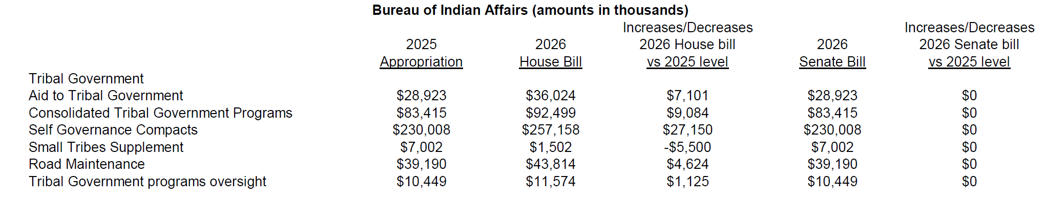
LEGISLATIVE UPDATE: FY 2026 Appropriations

Slide 16
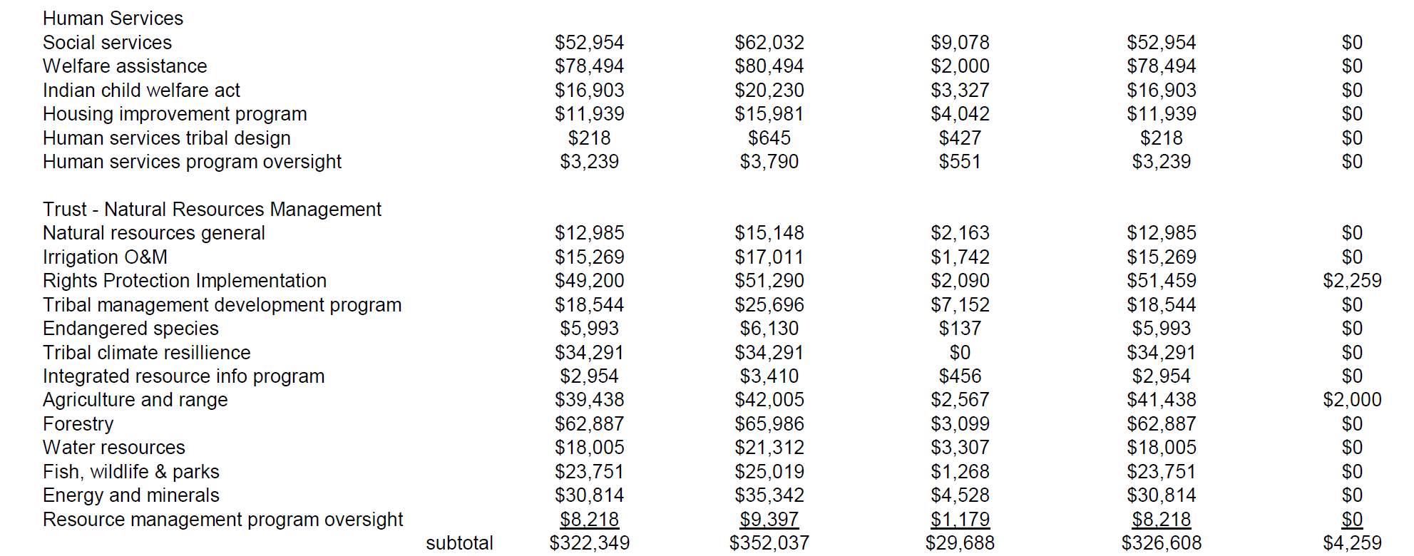
LEGISLATIVE UPDATE: FY 2026 Appropriations

Slide 17
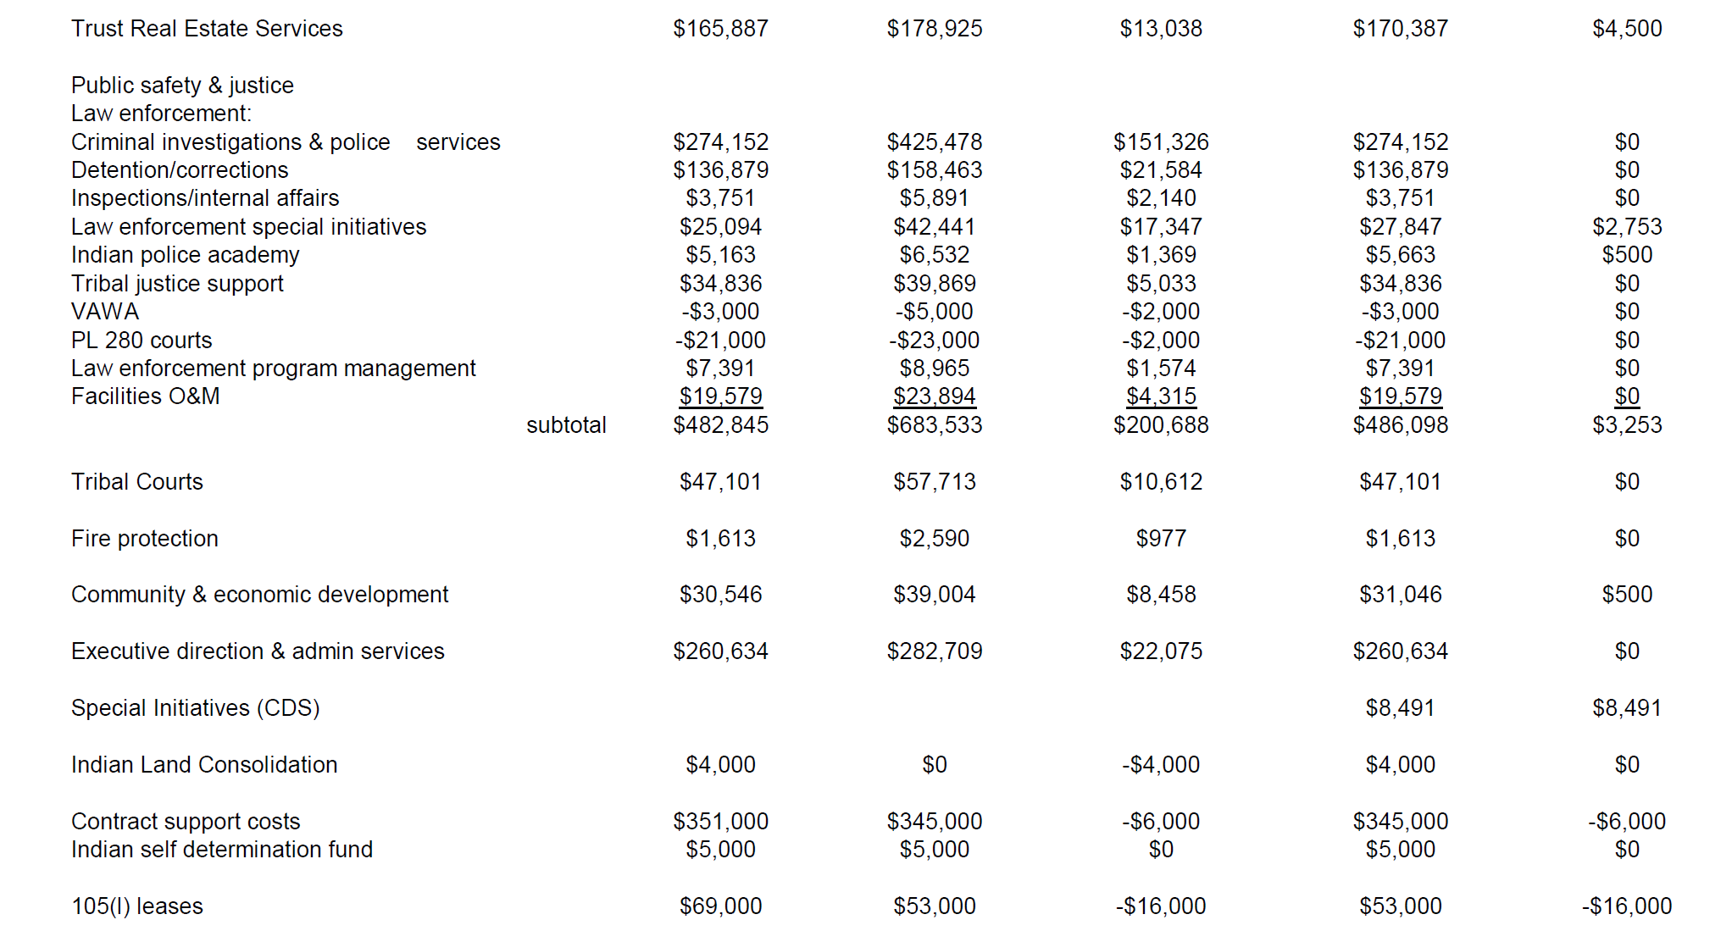
LEGISLATIVE UPDATE: FY 2026 Appropriations

Slide 18
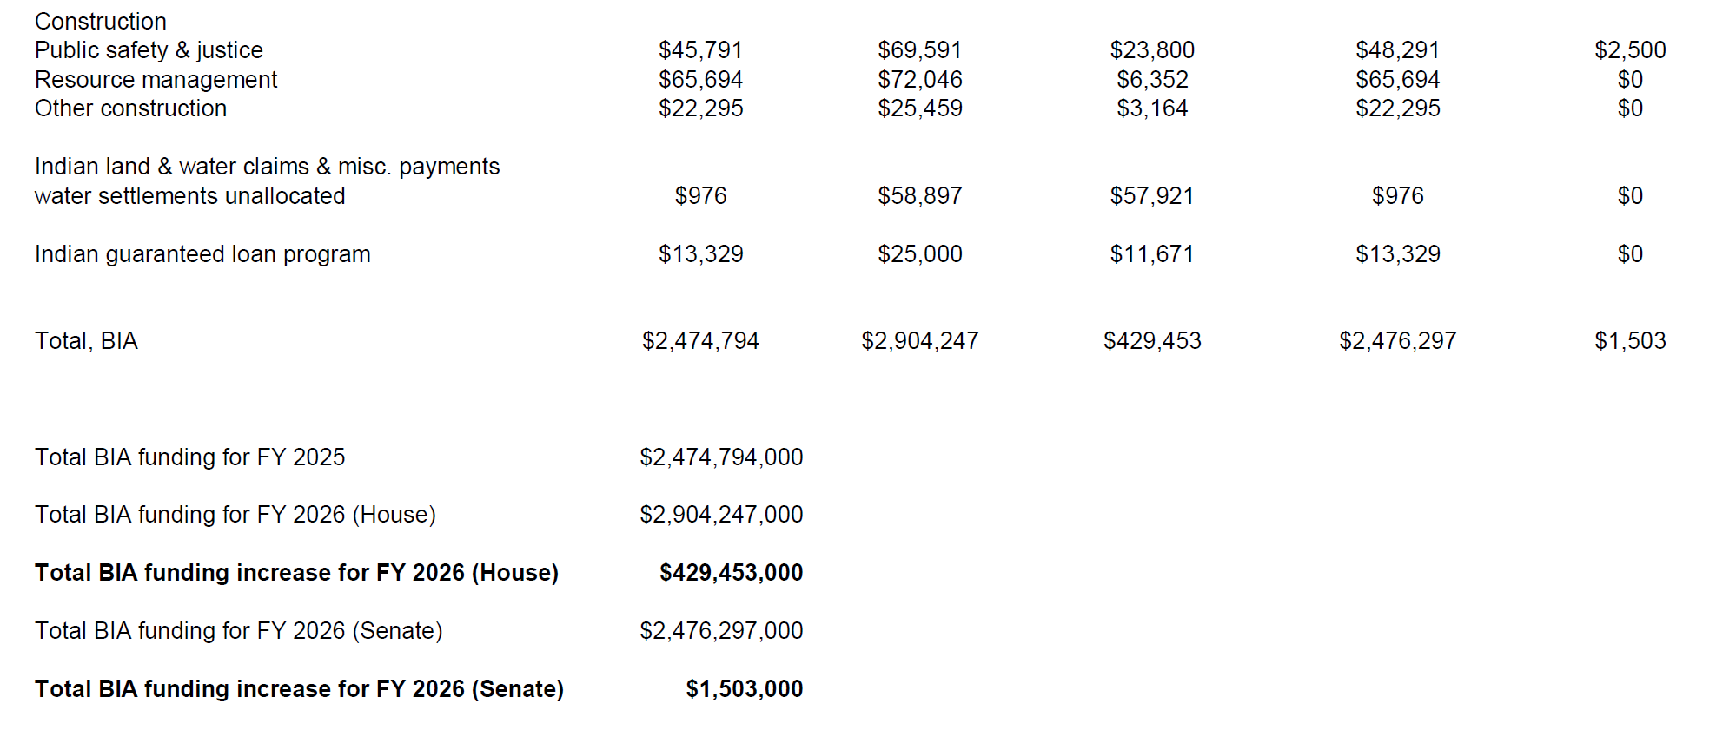
LEGISLATIVE UPDATE: FY 2026 Appropriations

Slide 19
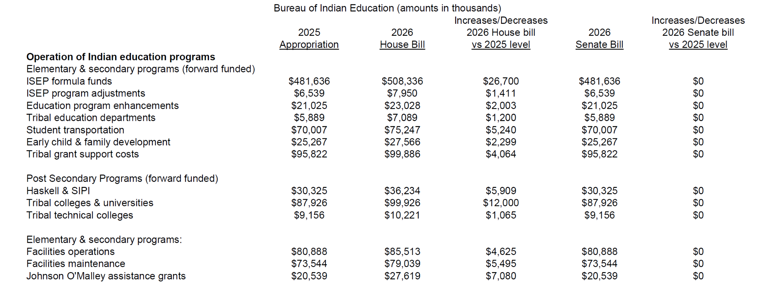
LEGISLATIVE UPDATE: FY 2026 Appropriations

Slide 20
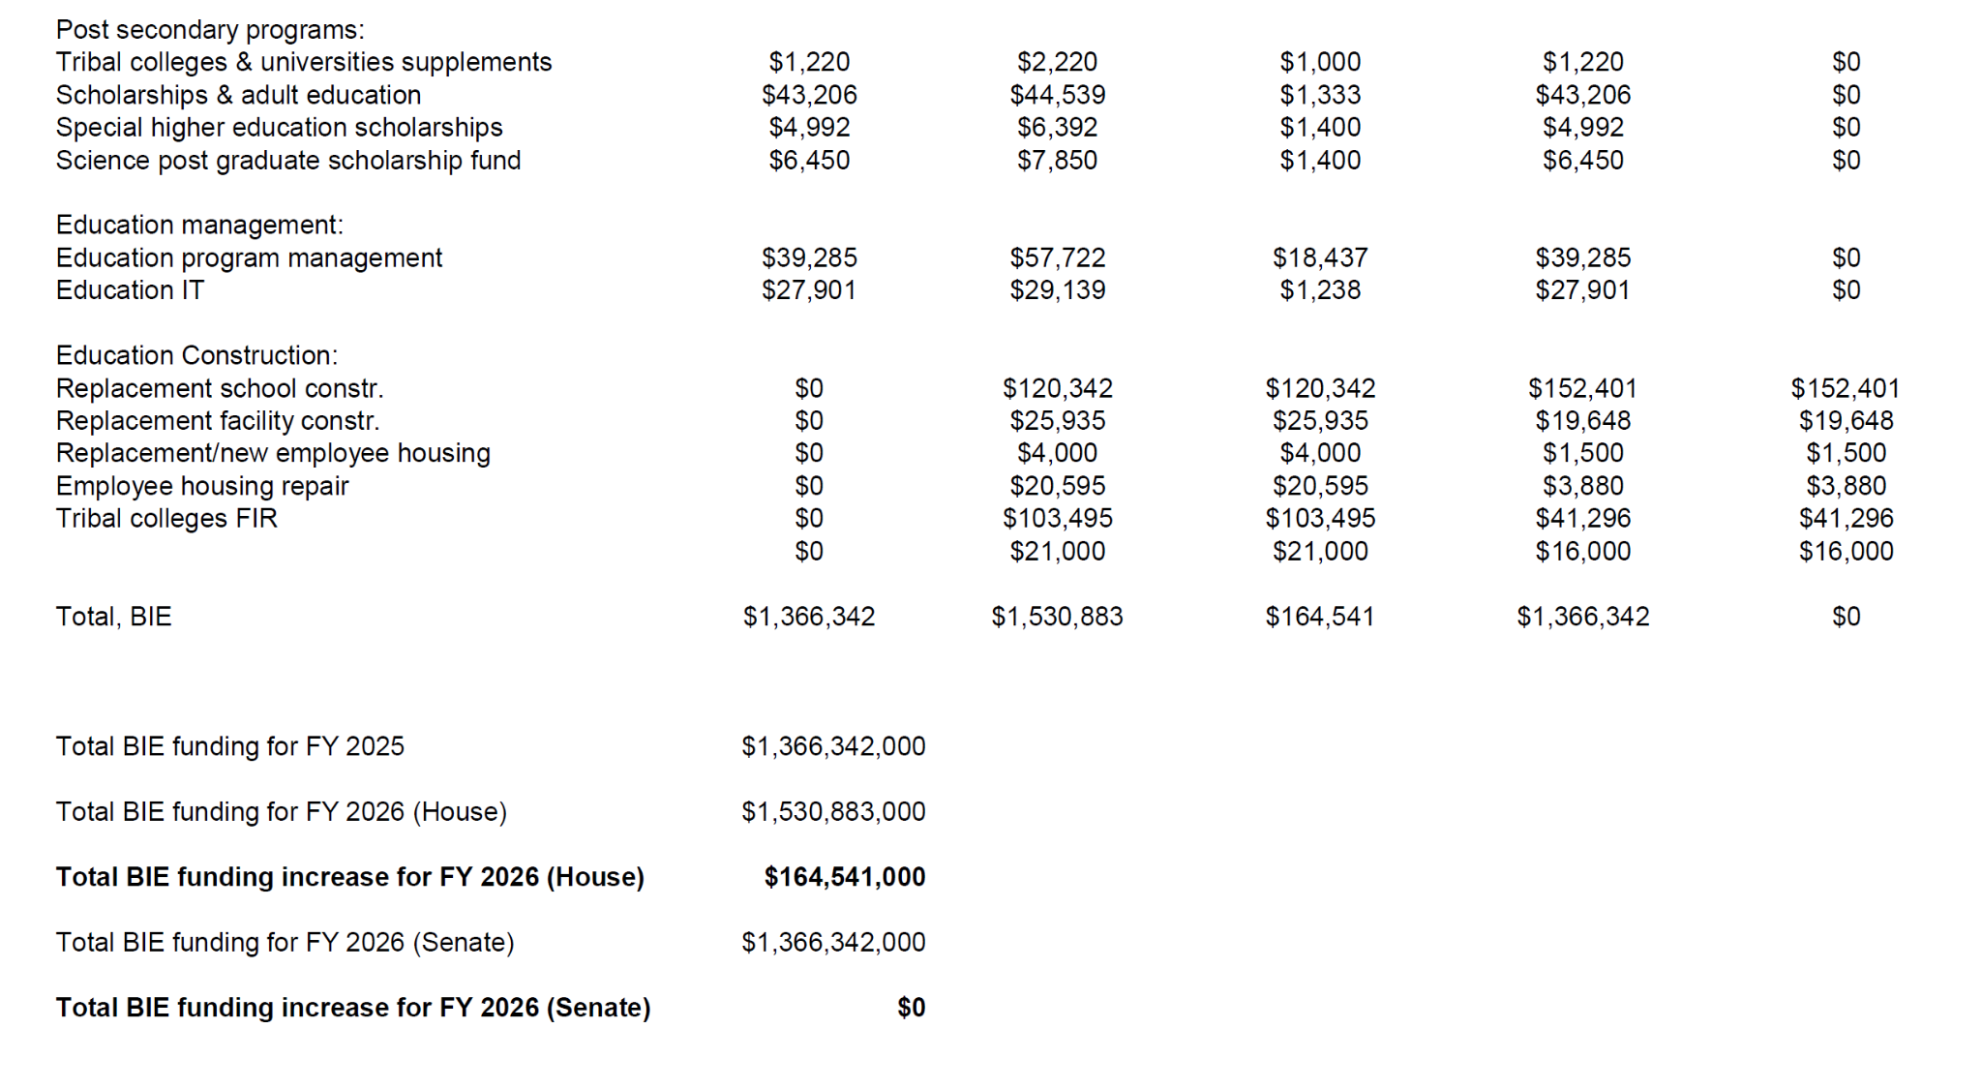
LEGISLATIVE UPDATE: FY 2026 Appropriations

Slide 21
LEGISLATIVE UPDATE: FY 2026 Appropriations
Senate Report Language: Highlights
Bureau of Indian Affairs Reductions in Force [RIF] Oversight and Service Transition Plan.
Congress requires the Bureau of Indian Affairs to submit a report within 90 days covering:
1. Office Operations Before Changes
Number and location of BIA offices that were operating on January 19, 2025
2. Current Office Count
How many BIA offices exist today
3. Public Input
What feedback did BIA get from the communities they served before closing offices?
4. Service Transition Plans
How is BIA still providing required services after closing offices?
5. Performance Tracking
How does BIA measure if they're doing their job well in each region?
6. New Hires Since January 20, 2025
How many new political appointees and career staff were hired?
7. Staffing Levels Before Changes
How many employees worked in Arizona and other states on January 19, 2025?
8. Current Staffing Levels
How many employees work in Arizona and other states now?
9. Service Disruptions
What problems or delays have communities experienced since January 20, 2025?
10. Monitoring and Problem-Solving
What is BIA doing to track service quality and fix problems in areas where offices closed?

Slide 22
LEGISLATIVE UPDATE: FY 2026 Appropriations
Senate Report Language: Highlights
Tribal Community Resilience (TCR)
Within 30 days of enactment of this act, and monthly thereafter, BIA is directed to provide the Committee a status update on all current TCR frozen grants, including the reason(s) why funding has not yet been awarded, who is responsible for approving the unfreezing, how long they have been frozen, when it is expected that there will be a final decision on the funding, and when the funding will be distributed.
Agriculture and Range
The Committee provides $2,000,000 to address the spread of invasive European Green Crab in the Puget Sound region. The Committee directs the Bureau to coordinate with the U.S. Fish and Wildlife Service and the National Oceanic and Atmospheric Administration to ensure a comprehensive Federal approach to addressing the threat posed by European green crab, mitigate harm, and protect native crab and other shellfish populations. Further, the Bureau and its Federal partners are directed to jointly brief the Committee no later than 90 days after enactment of this act on their collective efforts to address European Green Crab.

Slide 23
LEGISLATIVE UPDATE: FY 2026 Appropriations
Senate Report Language: Highlights
Rights Protection Implementation
Within the funding provided for Rights Protection Implementation, an additional $500,000 is provided in a general program increase to benefit the off-reservation hunting, fishing, and gathering rights supported by this program, an additional $759,000 is provided for Columbia River In-Lieu and Treaty Fishing Access Sites construction in accordance with the assessment conducted under Public Law 116–99, and an additional $1,000,000 is to aid in the implementation of the U.S. Canada Pacific Salmon Treaty.
Johnson O’Malley
The Committee remains concerned about the distribution methodology of the Johnson O’Malley [JOM] assistance grants and is aware that Congress enacted the Johnson O’Malley Modernization Act (Public Law 115–404) in 2018. In addition to requesting a report detailing the Bureau’s compliance with the act, the Committee once again requests that the Department include estimates of necessary appropriations levels to provide per pupil funding levels equal to the fiscal year 2018 level per pupil levels for all newly reported eligible students.

Slide 24
LEGISLATIVE UPDATE: FY 2026 Appropriations
House Report Language: Highlights
Road Maintenance
The Committee remains concerned about the poor condition of many roads on Tribal lands, which creates substantial safety hazards and barriers to economic development. The recommendation includes $43,814,000 for road maintenance to improve and maintain roads and bridges.
Public Safety and Justice
The Committee remains concerned about the Tribal law enforcement and courts needs of Tribal governments in Public Law 83–280 States and previously directed BIA to conduct consultations with Tribes located in these States to determine budgetary needs of Tribal law enforcement. The Committee is concerned that there are Tribes subject to Public Law 83–280 that are currently providing law enforcement services without any funding from BIA. The Committee directs BIA to provide a briefing not later than 180 days following the enactment of this Act on the identified needs. The Committee notes that to address the challenges these Tribal governments face, any funding received for law enforcement and courts needs may be used to enter into agreements with local or State authorities to provide eligible services.

Slide 25
LEGISLATIVE UPDATE: FY 2026 Appropriations
House Report Language: Highlights
Criminal Investigations and Police Services.—
The Committee recognizes that additional resources are needed to ensure safe Tribal communities. The recommendation provides $425,478,000 for Criminal Investigations and Police Services, including support for the Office of Justice Services and Tribal Police Offices.
The Committee recognizes that there is a significant outstanding need to implement public safety changes resulting from the McGirt v. Oklahoma decision, creating an immediate and severe shortage of police and investigative personnel in the expanded Tribal criminal jurisdiction areas. The recommendation provides $130,000,000 for these activities. With the additional resources provided for McGirt, the Committee encourages BIA to consult with impacted Tribes regarding the distribution of funds.

Slide 26
LEGISLATIVE UPDATE: FY 2026 Appropriations
House Report Language: Highlights
Elementary and Secondary Programs (Forward Funded).
The recommendation includes $733,602,000 for forward funded Elementary and Secondary Programs, $27,417,000 above the fiscal year 2024 enacted level. The recommendation includes $502,036,000 for Indian School Equalization Program (ISEP) formula funds, $20,400,000 above the fiscal year 2024 enacted level.
The Committee understands that fixed costs continue to rise and flat funding results in a cut to programmatic dollars. Consistent with Bureau of Indian Education Operation of Indian Programs the recommendation provides the Agency’s requested baseline capacity, which covers fixed costs from fiscal year 2024, and for fiscal year 2025.
Education Construction.
The recommendation provides $270,867,000 for Education Construction, $36,142,000 above the fiscal year 2024 enacted level. The recommendation includes $108,342,000 for Replacement School Construction and $19,000,000 for Tribal Colleges Facilities Improvement and Repair.

Slide 27
LEGISLATIVE UPDATE: FY 2026 Appropriations
FY 2026 Appropriations Forecast?
Continuing Resolution
Minibus
Government Shutdown

Slide 28

NCAI Updates

Slide 29
Contact Information:
Matthew Vogel
Policy Lead
National Congress of American Indians
mvogel@ncai.org

