Slide 1
Empowering Early Careerists: Navigating the Path to Success in Nursing Informatics
HIMSS Nursing Informatics Community Webinar
June 21, 2023

Slide 2

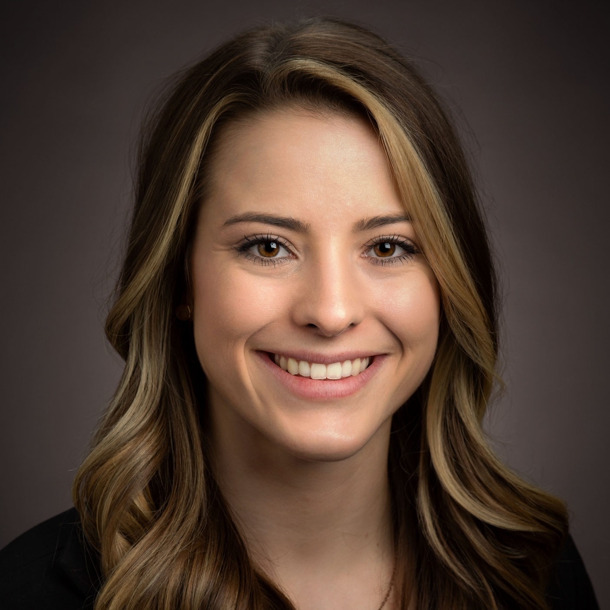
Welcome
Cait Obenauf, MBA
Program Manager, Clinical Informatics, HIMSS

Slide 3







Join the HIMSS Nursing Informatics Community
Apply for the HIMSS Nursing Informatics Committee
https://www.himss.org/membership-participation/nursing-informatics-community
https://www.himss.org/membership-participation/nursing-informatics-committee
Ways to get involved at HIMSS
as an informatics nurse
Submit a manuscript to the Online Journal of Nursing Informatics
Join the HIMSS Nursing Informatics Education & Networking Task Force
https://www.himss.org/resources/online-journal-nursing-informatics
Email us at nursinginformatics@himss.org
Attend an upcoming webinar or coffee chat
Get involved with your local HIMSS Chapter
https://www.himss.org/events
https://www.himss.org/membership-participation-chapters

Slide 4
Agenda
Meet the Speakers
Learning Objectives
Speaker Discussion
Audience Q&A

Slide 5

Learning Objectives
Understanding the landscape of nursing informatics: Learn about the evolving role of nursing informatics and how it aligns with the broader healthcare landscape.
Building a foundation: Discover essential skills and competencies needed to excel in nursing informatics positions, including the use of technology and data analysis.
Networking and mentorship: Gain insights on how to develop meaningful connections within the nursing informatics community and find mentors who can guide you in your early career.
Professional growth opportunities: Explore continuing education, certifications, and additional resources that can enhance your knowledge and propel your career in nursing informatics.
Overcoming challenges: Hear from our panelists about the common obstacles faced by early careerists in nursing informatics and strategies to overcome them.

Slide 6
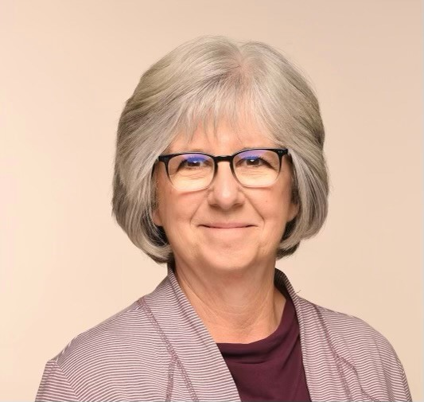
Meet the Moderator
Lisa Lyon, MSN, RN-BC
Sr. Clinical Informatics Coordinator, Cherokee Nation

Slide 7
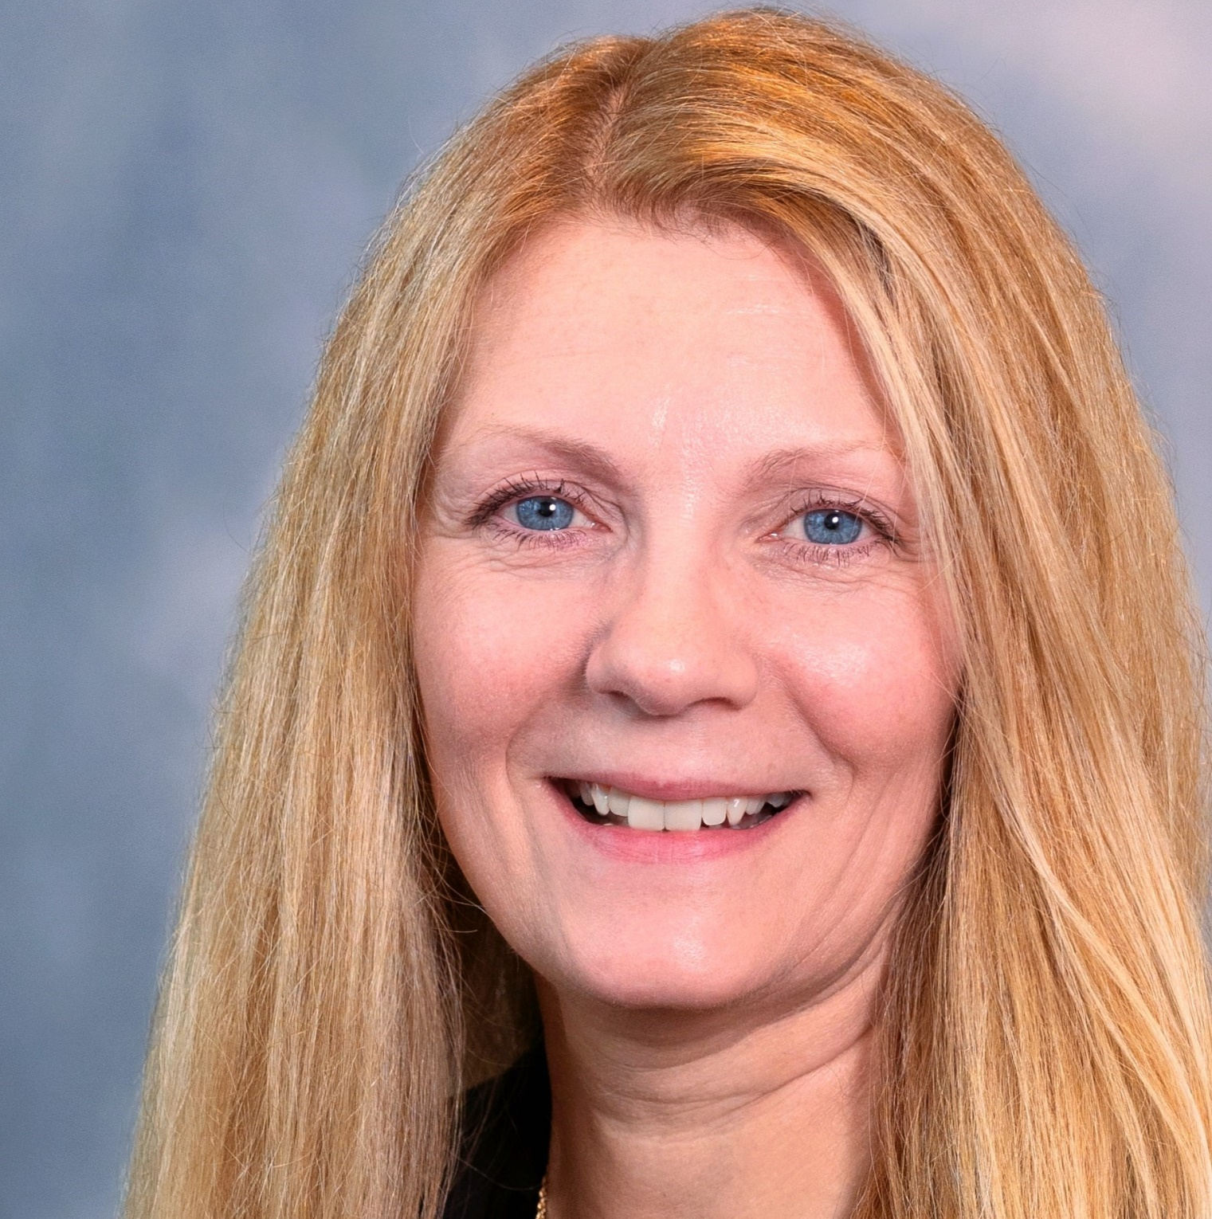
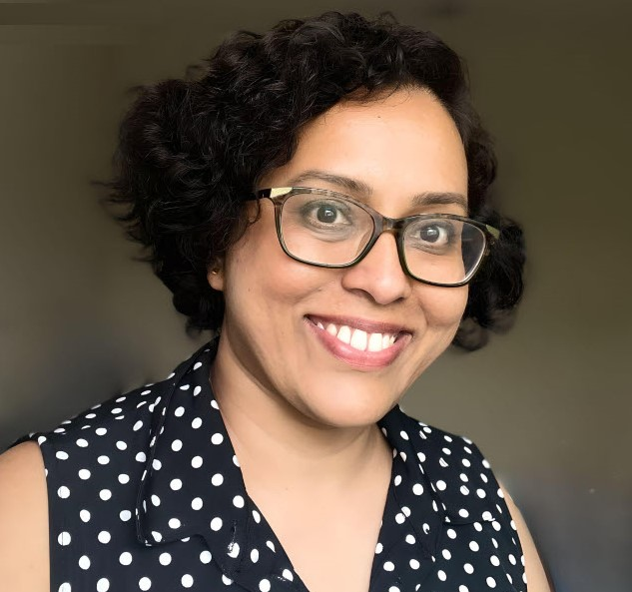
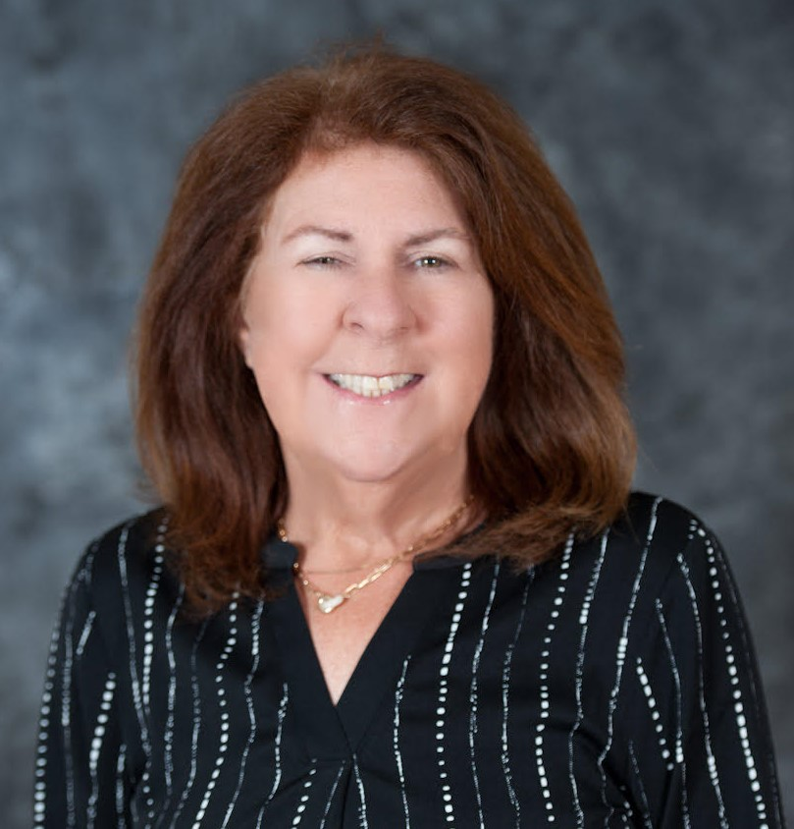
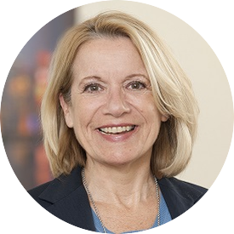
Meet the Speakers
Karen Iapoce, RN-BC, MS, CMAC, CPHQ, LSSBB
Surya Shenoy, MSN, CCRN, RN-BC
Cindy Drake, MSN, RN-BC, CPHIMS
MaryAnn Connor, CPHIMS, MSN, RN, RN-BC
Senior Director of Government Products and Programs, ZeOmega
Clinical Informatics Consultant, Kaiser Permanente
Informatics Program Specialist, Sharp HealthCare
Director, Nursing Informatics, Memorial Sloan Kettering Cancer Center

Slide 8

Webinar | June 21st Empowering Early Careerists: Navigating the Path to Success in Nursing Informatics
Karen Iapoce, RN-BC, MS, CMAC, CPHQ, LSSBB
Lisa Lyon, MSN, RN-BC
Surya Shenoy, MSN, CCRN, RN-BC
Cindy Drake, MSN, RN-BC, CPHIMS
MaryAnn Connor, CPHIMS, MSN, RN, RN-BC
Sr. Clinical Informatics Coordinator, Cherokee Nation
Clinical Informatics Consultant, Kaiser Permanente
Informatics Program Specialist, Sharp HealthCare
Director, Nursing Informatics, Memorial Sloan Kettering Cancer Center
Senior Director of Government Products and Programs, ZeOmega

Slide 9
Panel Discussion

Slide 10
Questions?

Slide 11

Questions? Contact us!
Cait Obenauf, MBA
Program Manager, Clinical Informatics, HIMSS
cait.obenauf@himss.org

Slide 12
Thank you for joining!

