Slide 1
Definitions for top 10 Emerging Technologies of 2024
Brought to you by the HIMSS Nursing Informatics Community
This content reflects the expertise and perspective of volunteer author(s) and does not represent the official position of HIMSS.
Last update: February 2025

Slide 2

Predictive Model
HIMSS Nursing Innovation Advisory Workgroup
Definition/ Description
Healthcare predictive models are transformative tools that leverage data analytics to anticipate future scenarios and improve decision-making. By enabling early interventions, optimizing operations, and supporting personalized care, these models help healthcare organizations deliver better outcomes while enhancing efficiency and cost-effectiveness (Dixon et al., 2024)
Implementation Settings
Hospitals and Clinics, Pharmacies, Public Health Management , Telehealth, Health Insurance providers , Rural and underserve settings, Academic Settings
Considerations
Data Quality and Availability
Privacy and Security
Organizational Change and Workflow Integration
Model Transparency and Interpretability
Ethical Considerations
Model monitoring and maintenance
Cost and Resource Allocation
Scalability
Impact Evaluation
Notes:
Dixon, D., Sattar, H., Moros, N., Kesireddy, S. R., Ahsan, H., Lakkimsetti, M., Fatima, M., Doshi, D., Sadhu, K., & Hassan, M. J. (2024). Unveiling the Influence of AI Predictive analytics on patient Outcomes: A Comprehensive Narrative review. Cureus. https://doi.org/10.7759/cureus.59954

Slide 3
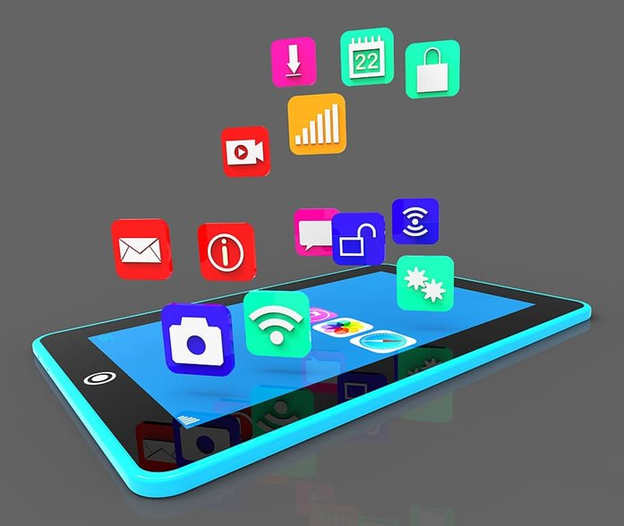
Mobile Application Management (MAM)
HIMSS Nursing Innovation Advisory Workgroup
Definition/ Description
MAM refers to the processes, equipment, and guidelines used in the healthcare industry to protect, manage, and maximize the use of mobile applications in medical settings.
It permits doctors and administrators to safely access vital healthcare data while guaranteeing that mobile apps tailored to the healthcare industry are used effectively, adhere to legal requirements, and safeguard private patient data (Arumugam et al., 2021)
Implementation Settings
  Inpatient, Ambulatory, Remote monitoring, Patient Homes, Education Centers, Skilled Facilities
Considerations
Data Security and Privacy
Device APP Management .
User Training and Support: Healthcare providers and patients need adequate training to effectively use mobile applications. MAM solutions should include support resources to address any technical issues that arise.
Monitoring and Analytics
Scalability and Customization
Compliance and Regulatory Requirements: MAM solutions must ensure that mobile applications adhere to all relevant healthcare regulations and standards, including data protection and patient privacy laws.
  Cost and Resource Management : Budget allocation, ROI assessment, vendor selection
Notes:
Arumugam, N., Ramulu, J. S., Muniandy, S., Peter, A. B., & Razak, M. I. (2021). Acceptance of integrated mobile healthcare app to bridge medical ersonnel and patients. International Journal of Academic Research in Business and Social Sciences, 11(9). https://doi.org/10.6007/ijarbss/v11-i9/11026

Slide 4
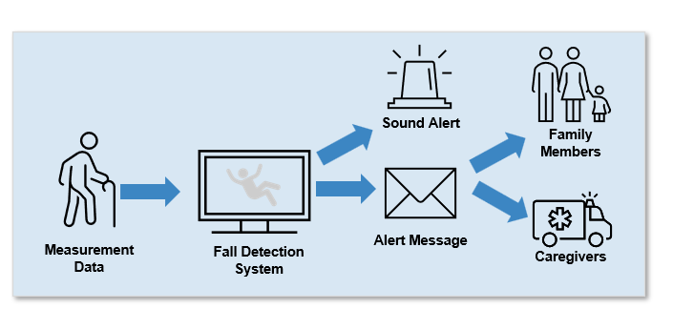
Falls Surveillance
HIMSS Nursing Innovation Advisory Workgroup
Definition/ Description
The use of sophisticated artificial intelligence models that can produce, condense, and interpret natural language to improve clinical documentation, decision support, and workflow efficiency is known as generative AI (GenAI) in Electronic Health Records (EHRs) (Reddy, 2024).
To enhance the accessibility and functionality of EHRs, AI models—which are frequently driven by large language models (LLMs)—interact with healthcare systems and providers (Reddy, 2024).
Implementation Settings
  Inpatient, Ambulatory, Corporate & Occupational Health Settings, Patient Centered-Home based care , Emergency and Disaster Response
Considerations
  Accuracy and Reliability
  Patient Interaction and Trust
  Workflow alignment
  Ethical and legal issues
  Integration and Interoperability
  Security and Privacy
Notes:
Reddy, S. (2024). Generative AI in healthcare: an implementation science informed translational path on application, integration and governance. Implementation Science, 19(1). https://doi.org/10.1186/s13012-024-01357-9

Slide 5





Staffing Workload Predictions
HIMSS Nursing Innovation Advisory Workgroup
Definition/ Description
          Step 1
Set Strategic Direction
Staffing workload predictions involve estimating the necessary workforce requirements to meet the demands of a given workload within a specific time frame. These predictions leverage data analytics, forecasting models, and organizational trends to determine the number, type, and skill level of staff needed to efficiently and effectively manage tasks, ensuring optimal resource allocation without overburdening employees (Griffiths et al., 2019).
In healthcare, for instance, accurate staffing workload predictions are critical for ensuring patient safety, meeting regulatory standards, and maintaining staff morale amidst varying levels of demand.
          Step 2
Analyze Skill Gaps, and Conduct Workforce Analysis
01
05
02
          Step 5
Monitor, Evaluate and Revise
WORKFORCE
PLANNING
Implementation Settings
  Inpatient, Nursing Homes, Pharmacies, Public Health, Telehealth Services, Outpatient
          Step 3
Develop Action Plan
04
03
Considerations
          Step 4
Implement Action Plan
Data Quality and Availability
Technological Infrastructure
Regulatory Compliance
Human Factors
Evaluation and Continuous Improvement
Ethical and Quality Considerations

Slide 6
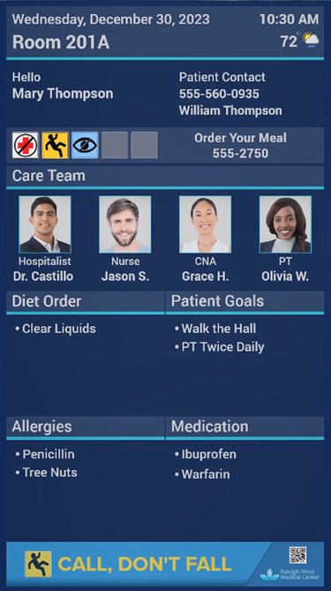
Smart Whiteboards
HIMSS Nursing Innovation Advisory Workgroup
Definition/ Description
A hospital digital whiteboard is an interactive display system used in healthcare settings to support coordination of care by augmenting visibility and availability of clinical information. (Gjære & Lillebo, 2014)
Unlike traditional dry-erase whiteboards seen in patient rooms, these digital versions often feature touchscreen capabilities and can integrate with hospital information systems, such as the electronic health record (EHR) and Nurse Call ~ RTLS systems.
Implementation Settings
  Inpatient, ED’s, Nursing Homes, Rehabilitation Centers
Considerations
Integration with Electronic Health Records
Data Security and Patient Privacy
User Training and Adaptation
Cost and Maintenance
Customization and Flexibility
Technical Support
Notes:
Gjære, E. A., & Lillebo, B. (2014). Designing privacy-friendly digital whiteboards for mediation of clinical progress. BMC Medical Informatics and Decision Making, 14(1). https://doi.org/10.1186/1472-6947-14-27

Slide 7
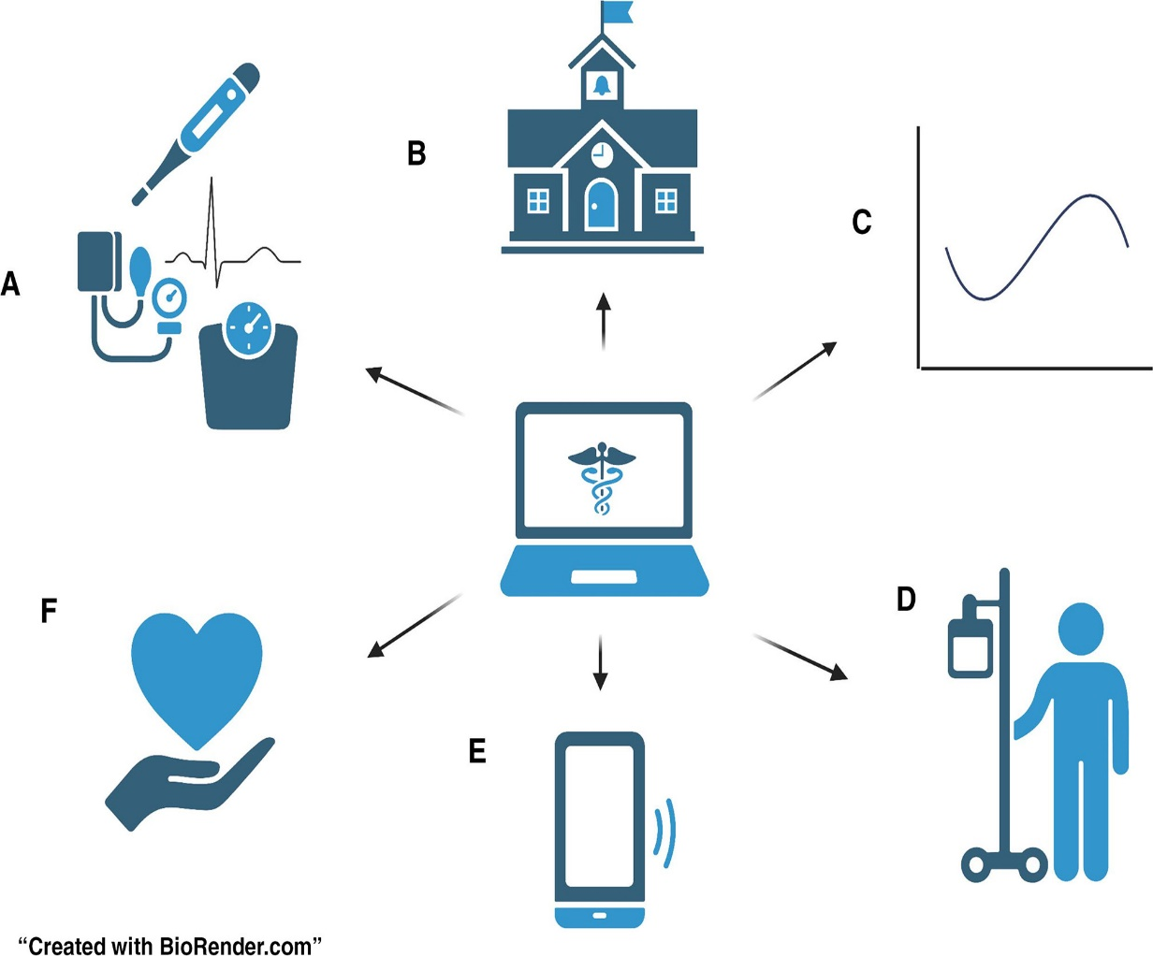
Remote Monitoring
HIMSS Nursing Innovation Advisory Workgroup
Definition/ Description
Remote patient monitoring (RPM), or telemonitoring, offers ways for health care practitioners to gather real-time information on the physiological conditions of patients (Serrano et al., 2023).
This allows healthcare professionals to continuously monitor and assess patient health data, make timely diagnoses, and deliver necessary treatments without requiring the patient to be physically present in a clinic or hospital.
Key technologies in RPM include wearable devices, sensors, and mobile apps that provide real-time health data by tracking vitals and enabling patients to monitor and manage their health remotely.
Implementation Settings
  Inpatient, Ambulatory, Home based Settings, Community Centers, Mobile Clinics
Considerations
Legal and Jurisdiction : licensure and Jurisdiction , Documentation Standards, HIPPA compliance
Integration with Existing Systems: Remote monitoring solutions should seamlessly integrate with electronic health records (EHR) and other healthcare IT systems to ensure continuity of care and efficient data sharing.
Technical Consideration : Device Selection, Integration and Data Security:
Clinical: Care team coordination, data integration, patient suitability
Patient Related: Accessibility, education and support and Adherence
Notes:
Serrano, L. P., Maita, K. C., Avila, F. R., Torres-Guzman, R. A., Garcia, J. P., Eldaly, A. S., Haider, C. R., Felton, C. L., Paulson, M. R., Maniaci, M. J., & Forte, A. J. (2023). Benefits and Challenges of remote patient monitoring as perceived by health care practitioners: A Systematic review. The Permanente Journal, 27(4), 100–111. https://doi.org/10.7812/tpp/23.022

Slide 8
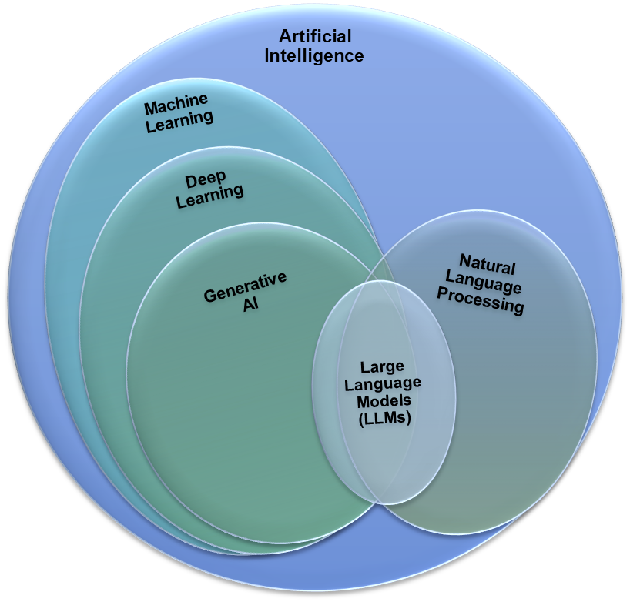
GenAI use in EHR
HIMSS Nursing Innovation Advisory Workgroup
Definition/ Description
Fall surveillance is the methodical use of technology, clinical evaluations, and data-driven strategies to monitor, identify, and prevent patient falls (Woltsche et al., 2022).
In order to improve patient safety and lower the number of fall-related injuries, this procedure seeks to identify those who are at risk, recognize fall episodes in real-time, and apply treatments.
Fall surveillance can involve manual reporting, automated monitoring systems, or a combination of both to track falls in various care environments (Woltsche et al., 2022)
Implementation Settings
  Hospitals and Acute settings, Outpatient and Ambulatory Care, Rehabilitation Centers, Home Health and Remote monitoring
Considerations
          Technology Selection
          Privacy and Security
          Training and User engagement
          Cost and Resource allocation
          Integration with existing EHR systems
Notes:
Dixon, D., Sattar, H., Moros, N., Kesireddy, S. R., Ahsan, H., Lakkimsetti, M., Fatima, M., Doshi, D., Sadhu, K., & Hassan, M. J. (2024). Unveiling the Influence of AI Predictive analytics on patient Outcomes: A Comprehensive Narrative review. Cureus. https://doi.org/10.7759/cureus.59954

Slide 9
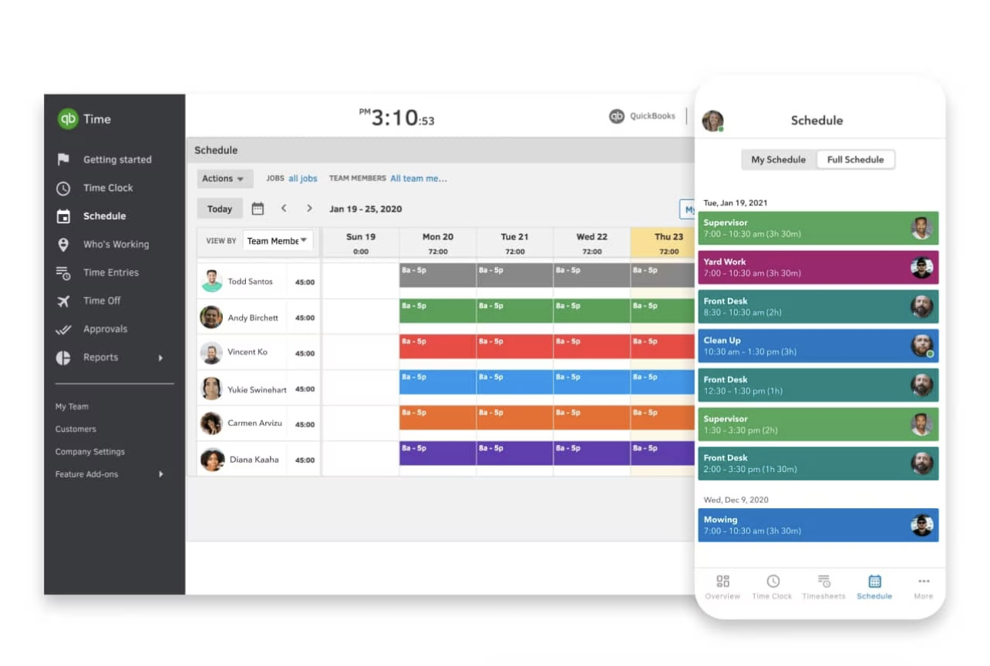
Staffing Scheduling
HIMSS Nursing Innovation Advisory Workgroup
Definition/ Description
Healthcare staff scheduling solutions are tools, systems, or methodologies designed to create and manage staff schedules in healthcare settings.
Healthcare staff scheduling solutions are essential for maintaining the balance between operational efficiency, staff well-being, and patient care quality. By leveraging technology and data-driven approaches, these solutions streamline scheduling processes, adapt to dynamic healthcare environments, and support the continuity of care (Abdalkareem et al., 2021).
Implementation Settings
  Inpatient, Ambulatory, Rehabilitation Centers, Home Healthcare, Emergency Medical Services
Considerations
Data Security and Privacy
Financial
Staff Centric
Flexibility and Customization
Operational
Evaluation and Continuous Improvement
Regulatory and Compliance
Organizational and Workflow
Notes:
Abdalkareem, Z. A., Amir, A., Al-Betar, M. A., Ekhan, P., & Hammouri, A. I. (2021). Healthcare scheduling in optimization context: a review. Health and Technology, 11(3), 445–469. https://doi.org/10.1007/s12553-021-00547-5

Slide 10
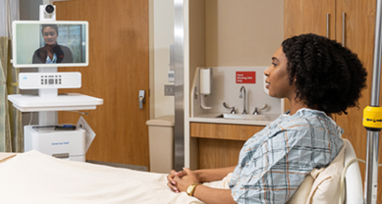
Virtual Nursing
HIMSS Nursing Innovation Advisory Workgroup
Definition/ Description
A revolutionary strategy that uses cutting-edge technology to improve patient care and maximize healthcare services is virtual nursing.
Virtual nursing enhances continuity of care by facilitating frequent check-ins and ongoing connection between nurses and patients through the integration of digital platforms and communications (Baalharith & Aboshaiqah, 2024)
Implementation Settings
  Inpatient, Home Care, or other remote facilities in the health system
Consideration
Technology Infrastructure
Data Security and Privacy
Quality and Outcomes
Clinical Workflow Integration
Patient Experience and Engagement
Financial and Operational costs.
Equity and Access
Ethical and Professional Issues
Notes:
Baalharith, I. M. A., & Aboshaiqah, A. E. (2024). Virtual Healthcare Revolution: Understanding nurse competencies and roles. SAGE Open Nursing, 10. https://doi.org/10.1177/23779608241271703

Slide 11

Alert/Alarm Communications
HIMSS Nursing Innovation Advisory Workgroup
Definition/ Description
Alarms are signals intended to capture and direct human attention to a potential issue that may require monitoring, assessment, or intervention and play a critical safety role in high-risk situations (Pruitt et al., 2023)
These notifications are typically generated by medical devices, monitoring systems, or software and are categorized by their urgency and purpose.
Promote workflow efficiency by ensuring staff are notified of clinically relevant events without being overwhelmed by irrelevant noise (alarm fatigue).
Implementation Settings
  Inpatient, Nursing Homes, Rehabilitation Centers, Home based care
Considerations
Alarm Fatigue: Human factors
Workflow Integration
Technology and Device Management
Patient Safety and experience
Compliance and Standards
Monitoring and Continuous improvement
Clinical Relevance
Notes:
Pruitt, Z., Bocknek, L., Busog, D., Spaar, P., Milicia, A., Howe, J., Franklin, E., Krevat, S., Jones, R., & Ratwani, R. (2023). Informing Healthcare Alarm Design and Use: A Human Factors Cross-Industry Perspective. Patient Safety, 6–14. https://doi.org/10.33940/med/2023.3.1

