Slide 1

Physician EHR Inbox Workflow Training
Reducing Burden Beyond the Note:
Admin Practice Improvement
Notes:
(Image Source: OpenAI. (2024). ChatGPT [Large language model]. /g/g-2fkFE8rbu-dall-e)

Slide 2

Agenda
Background
Pre-pandemic Message Data
5 Simple Changes
Foundational Principles
Training and Prioritization
  Team Approach
  Physician/Nurse Focus
Scope and Budget
General Risk
(Image Source: OpenAI. (2024). ChatGPT [Large language model]. /g/g-2fkFE8rbu-dall-e)

Slide 3
Background
Physicians’ Inbox Messages Exponential Growth*
The use of EHR has profoundly changed the practice of medicine.
  It is both a blessing and a burden to clinicians.
The EHR significantly contributes to physician burnout.
  Individual healthcare professionals cannot independently address this challenge.
  Organizations must enact effective system-level policies
  Organizations must actively respond to feedback to see ongoing improvement at the systemic level.
Access options to healthcare professionals are available 24/7/365
  The pandemic underscored awareness of this availability.
  Inbox messages surged.
*This presentation focuses on provider related messages and results, not patient generated messages.
*This presentation was developed from a large academic institution.
*The recommended workflows discussed are meant only as guidelines. We recognize that resources and practices vary depending upon department size, practice specialty, and patient care setting.
Notes:
Took away a lot of words… Is this still clear? Tried to avoid passive tense.
Not sure we need the first bullet point- could start with The EHR contributes to physician burnout.
*This presentation focuses on provider related messages and results, not patient generated messages

Slide 4

Pre-pandemic
Data for Message Volume
Message volume had been growing pre-pandemic, but at a slower rate.
(Image Source: OpenAI. (2024). ChatGPT [Large language model]. /g/g-2fkFE8rbu-dall-e)

Slide 5
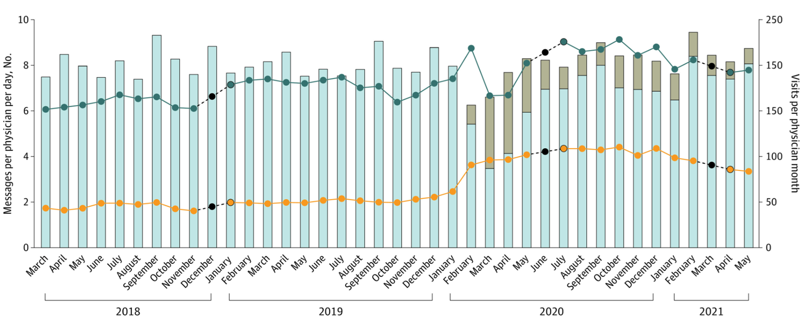
Primary Care
Raw Trends in Patient Medical Advice Requests and Patient Call Messages (Weighted Average, per Physician, per Day) by Specialty, Ambulatory Visit Volume, and Type, March 2018 to June 2021
Data source: Trends in Electronic Health Record Inbox Messaging During the COVID-19 Pandemic in an Ambulatory Practice Network in New England - PMC (nih.gov)
Notes:
Is there a way to make the title “Primary Care” bigger? DONE
I had to flip back to be sure the slides weren’t duplicates.

Slide 6
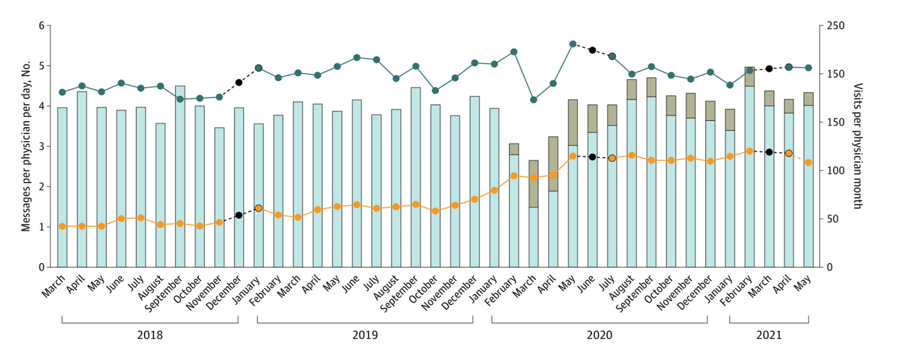
Medical Specialties
Raw Trends in Patient Medical Advice Requests and Patient Call Messages (Weighted Average, per Physician, per Day) by Specialty, Ambulatory Visit Volume, and Type, March 2018 to June 2021
Data source: Trends in Electronic Health Record Inbox Messaging During the COVID-19 Pandemic in an Ambulatory Practice Network in New England - PMC (nih.gov)

Slide 7
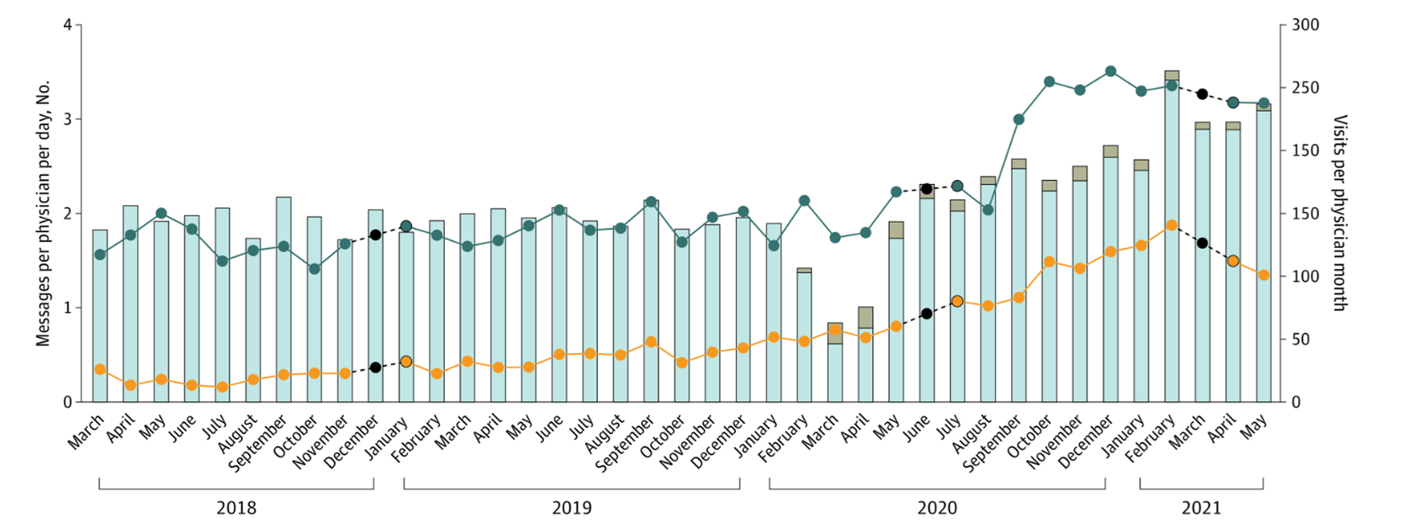
Surgical Specialties
Raw Trends in Patient Medical Advice Requests and Patient Call Messages (Weighted Average, per Physician, per Day) by Specialty, Ambulatory Visit Volume, and Type, March 2018 to June 2021
Data source: Trends in Electronic Health Record Inbox Messaging During the COVID-19 Pandemic in an Ambulatory Practice Network in New England - PMC (nih.gov)

Slide 8

5 Simple Changes to Help Cut Physician’s EHR Burden
Eliminate unnecessary work
Work with compliance department
Use indication prescribing
Replace shorthand writing
Incorporate team documentation
Implement training and support programs
(Image Source: OpenAI. (2024). ChatGPT [Large language model]. /g/g-2fkFE8rbu-dall-e)
*The recommended workflows discussed are meant only as guidelines. We recognize that resources and practices vary depending upon department size, practice specialty, and patient care setting.
Notes:
Only the last bullet is missing a verb. Create training and support programs? Deploy training and support programs? IMPLEMENT!

Slide 9
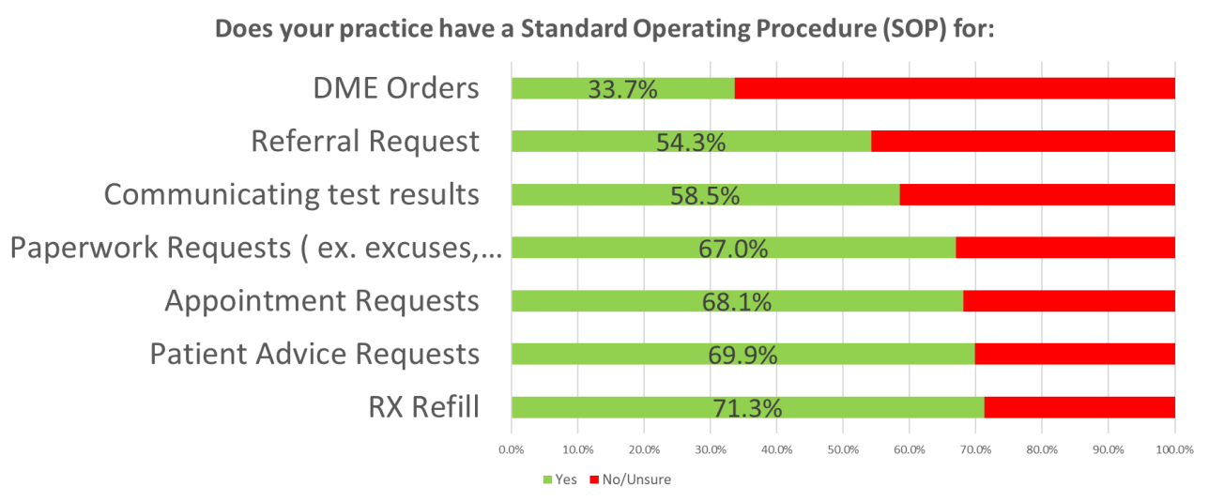
Message Types to Consider an SOP
The information on this graph is specific for a particular intuition, this is an example.
*May vary based on state and scope of practice laws

Slide 10
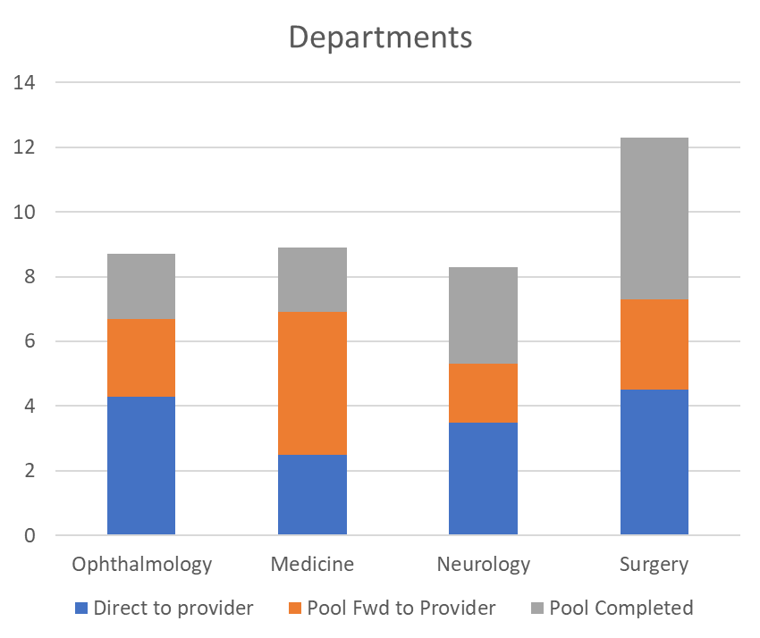
Identify the Department’s Message Volume
Evaluate use of message pools
Staff usage to “top of license”
Identify departments where the onus of messages fall on the provider
Ask leaders to self-assess.

Slide 11
Foundational Principles
Ambulatory care extends beyond the provider-patient interaction necessitating comprehensive resources to provide clinical care safely, efficiently, and effectively.
Efficient and effective care involves the patient engagement through use of patient messaging systems (Inbox).
It is recommended that organizations utilize a HITECH certified messaging system to communicate between patients, their proxies, and healthcare practices.
Practice staff must operate within the defined scope of practice.
Practices should have clear accountability with defined accountability for managing clinical workflow tasks.
Clinical team members should be proficient in the use of their EHR system's tools and shortcuts to effectively manage workflow tasks.
Practices should establish workflows to promptly address patient messages, aligning with professional standards and policies.
Practices should regularly review and prioritize patient messages throughout the day to prevent delays in patient care.
There should be established procedures for handling clinical tasks during provider absences, ensuring continuity of care.
The organization should monitor operational, quality, safety, and patient satisfaction metrics as it relates to patient messaging practices.
Consult with your legal team for Inbox processes to assure all regulations are met.
Notes:
Is there a source for this or did this come from the team? Should probably cite if needed.

Slide 12

Prioritize Training Workflows
1. Lab results workflow
2. Referral request workflow
3. Patient clinical question (Phone/Patient Portal)
4. Scheduling request workflow
5. Prescription refill workflow
6. Medical supplies request workflow
7. Paperwork request workflow
8. Mobile
(Image Source: OpenAI. (2024). ChatGPT [Large language model]. /g/g-2fkFE8rbu-dall-e)

Slide 13
Utilizing Accepted Scope of Practice
In Basket/Work queue Item | Registered Nurse | Medical Assistant | Administrative Assistant
Communicate Normal results to patient | With protocol in place, prior to provider review | Communicate normal results per protocol or after provider review/instructions | No
Communicate abnormal results to patient | With protocol in place, after provider review | Communicate abnormal results if directed by provider (low impact) | No
Refill Rx existing in med list | Can pend medication order for provider to sign; Can approve medication with nurse-initiated protocol | Can pend medication order for provider signature | Can pend medication order for provider signature
Refill Rx, medication not in med list | Can pend medication order for provider to sign | No | No
Failed Electronic Prescription | Can call medication order to pharmacy if medication order fails to transmit | Same as RN | Same as RN
Communicate Normal results to patient | With protocol in place, prior to provider review | Communicate normal results per protocol or after provider review/instructions | No
Referral renewal | Can update the referred to provider, department or location, extend expiration date | Same as RN | Same as RN
New referral request | Can create a new referral with a nurse-initiated protocol | Same as RN | Same as RN
Labs or imaging order as requested by provider | Can pend order for provider signature. Can create a new order with nurse-initiated protocol | Same as RN | Can pend order for provider signature
DME orders, new & existing | Can pend order for provider signature | Same as RN | Same as RN
Prior authorization request for medications and DME | Can pend prior authorization request for provider signature | Same as RN | Same as RN
Form completion request | Complete and send if provider review not needed. Complete and route to provider if review/signature needed | Same as RN | Same as RN
Notes:
This slides empowers staff and documents the process to eliminate any accountability concerns. This should be reviewed and signed off by members of your practice.

Slide 14

Prioritization and Training Initiative for Ambulatory Practices Transformation
(Image Source: OpenAI. (2024). ChatGPT [Large language model]. /g/g-2fkFE8rbu-dall-e)
This initiative aims to transform ambulatory practices through a phased approach.
Focusing on immediate, mid-term, and long-term priorities.
The strategy involves targeted training for different groups over a 12-month timeline, with ongoing reinforcement and support.

Slide 15
Prioritization Utilizing a Team Approach
Immediate (0-6 months):
  Target: All ambulatory practices
  Duration: 4 hours of training per practice
  Approach: Uniform training for all practices to establish a baseline competency.
Mid-term (6-12 months):
  Target: Practices with greater needs
  Duration: Additional 1 to 2 weeks of training per practice
  Approach: Identify specific needs and tailor training to address them, ensuring a more comprehensive skill set.
Long Term (12+ months):
  Target: New faculty, providers, staff, and leaders
  Approach: Incorporate education into onboarding processes to integrate new members seamlessly into the transformed practices.

Slide 16

Physician Focus Training
1 Hour of in-person or virtual training
  Virtual training scheduled ahead of time at a convenient time for the provider
  A recording of the training should be available in a resource center.
Strongly recommend after-hours (investigate 24/7/365) On-Demand support offered after completing initial training.
  Offered through a staffed MS Teams channel, Zoom, Slack, etc. or using a Platform and Service to provide instant on-demand support.
  Easily accessible from within the training environment and live patient environment.
Workflow Data Analysis
  Capture questions asked during training and support.
  Improve training content based on data collected.
  Improve EMR configuration based on data collected (including order sets, EMR build, etc.)
(Image Source: OpenAI. (2024). ChatGPT [Large language model]. /g/g-2fkFE8rbu-dall-e)

Slide 17

Nurse Focus Training
7-Module Approach
  Understanding the 8 Workflows in Messaging System Optimization Initiatives
  Messaging Systems Navigation and Prioritization
  Effective Communication and Collaboration
  Utilizing Technology for Messaging Systems Optimization
  Time Management and Efficiency Strategies
  Quality Improvement and Feedback
  Patient Safety and Advocacy
(Image Source: OpenAI. (2024). ChatGPT [Large language model]. /g/g-2fkFE8rbu-dall-e)
  *See appendix for detailed information on each module | Authors: V. Payne, K. Owen

Slide 18
Suggested Training Schedule by Role
Learner Groups
(Staff, Faculty & Clinicians, Practice Administrative Leadership)
  Staff: 1-1.5 hours per group training at flexible timings (beginning, middle, or end of the day)
  Faculty & Clinicians: 1-hour group training during faculty practice meetings
  Practice Administrative Leadership: 1-hour group training
  Timeline: 6 months of training followed by six months of reinforcement and support

Slide 19

General Scope and Budget
(Image Source: OpenAI. (2024). ChatGPT [Large language model]. /g/g-2fkFE8rbu-dall-e)
Scope:
  All ambulatory practices
  All specialties
  All campuses
Budget:
  Cost includes time spent in training for all staff, providers, and administrative leadership in ambulatory practices
  Consideration of resources required for targeted training and reinforcement efforts

Slide 20

General Risks
(Image Source: OpenAI. (2024). ChatGPT [Large language model]. /g/g-2fkFE8rbu-dall-e)
Project Size:
  Mitigation: Phased approach and ongoing assessment of progress to address challenges incrementally.
Culture Changes:
  Mitigation: Team based, collaborative approach, working to top of license.
  Mitigation: Communication strategies to manage expectations and foster a positive attitude towards change.
Staffing and Turnover:
  Mitigation: Develop strategies for knowledge transfer and contingency plans to address potential staffing issues.

Slide 21

Summary
This initiative recognizes the challenges of implementing significant cultural changes but aims to create a more resilient and adaptable ambulatory practice environment through systematic and targeted training efforts.
(Image Source: OpenAI. (2024). ChatGPT [Large language model]. /g/g-2fkFE8rbu-dall-e)

