Slide 1
Unlocking Large Language Models in Healthcare- Understanding their prowess, identify prospects and the prudence needed
August 17, 2023

Slide 2





Vision
Mission
To realize the full health
potential of every human, everywhere.
Reform the global health ecosystem through the power of information and technology.

Slide 3
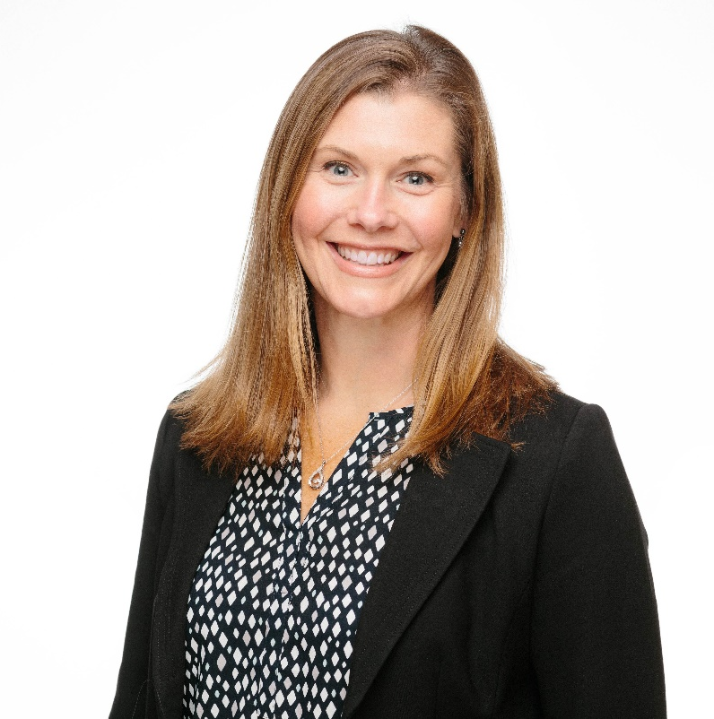
Welcome
Gwynne Jelbaoui
Program Manager
Clinical Informatics HIMSS
Gwynne.Jelbaoui@himss.org

Slide 4






Opportunities
https://www.himss.org/membership-participation/physician-community
Education
Community
Present webinars on topics such as: telehealth, medical informatics, AI, Interoperability, and best use of EHR systems
Volunteer and show leadership through CMIO Roundtable and Workgroups
Thought Leadership
Public Policy
Physician Community
Gain insight into current policy updates and affect change in healthcare systems and planning
Physician Executive subject matter expertise; Interview with HIMSS Media; contribute to preconference forum planning
Education Task Force
Drive education and content for the community
Physician Resources
Access career profiles, education, articles, and news items
Strategic Partners
Collaborate with high profile Physician Societies such as AMDIS, EHRA, and AMIA

Slide 5
Unlocking Large Language Models in Healthcare- Understanding their prowess, identify prospects and the prudence needed
Learning Objectives
Gain a better understanding, from industry leaders, on the technical evolution of generative AI, and what is it setting the foundation for?
Acquire a better understanding of the benefits and opportunities Generative AI, specifically LLM, have relating to healthcare.
Receive information on how you, teams, and organizations as a whole, can prepare from a technical, governance and risk management perspective.

Slide 6
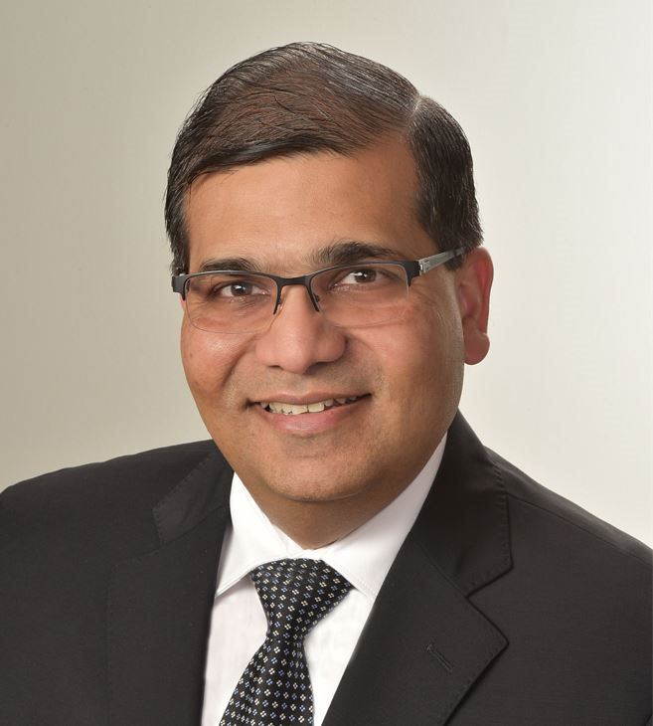
Ash Goel, MD, MBA
Senior Vice President, CIO at Bronson Healthcare
Moderator

Slide 7
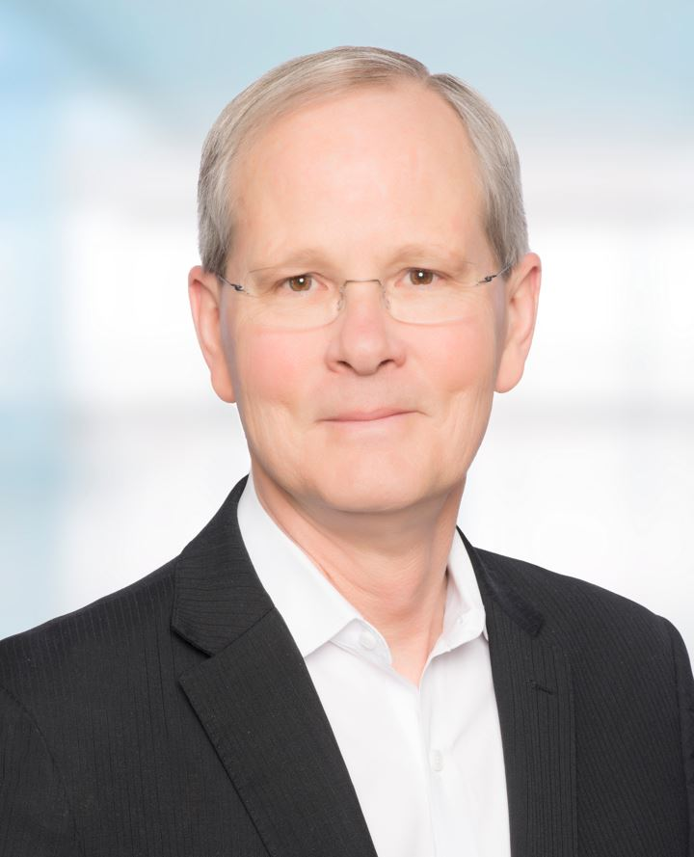
John Glaser, PhD
Executive-in-Residence at the Harvard Medical School
John is a former senior vice president of population health, at Cerner Corporation. Previously he was chief executive officer of Siemens Heath Services. Prior to Siemens, John was chief information officer at Partners HealthCare.
John was the founding chair of the College of Healthcare Information Management Executives (CHIME) and the past-president of the Healthcare Information and Management Systems Society (HIMSS). He is a former chair of the board of the American Telemedicine Association and a former Chair of the Global Agenda Council on Digital Health, World Economic Forum. He was a Senior Advisor to the US Office of the National Coordinator for Health Information Technology, federal department of Health and Human Services.
John serves on the boards of Carlton Willard Village, the Scottsdale Institute, National Committee for Quality Assurance, Lumeon, Wellsheet, and Relatient.
John has received numerous industry awards including the John P. Glaser Innovation Award (established by the School of Biomedical Informatics, University of Texas Health Sciences Center), William B. Stead Thought Leadership Award (American Medical Informatics Association) and the Lifetime Achievement Award (CHIME).
John received his Ph.D. from the University of Minnesota. He has written over 200 articles and four books on the strategic application of IT in health care. He is on the faculty of the UTHealth School of Biomedical Informatics and the Harvard School of Public Health. He was previously on the faculty of the Wharton School at the University of Pennsylvania.

Slide 8
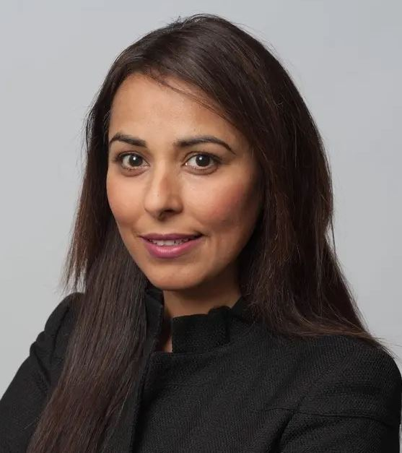
Aashima Gupta
Global Director, Global Healthcare Solutions, Google Cloud at Google
Ms. Gupta is a Transformational Healthcare and Financial Services Executive with over 19 years of extensive experience in complex large-scale enterprise environments. In her current role at Google Cloud, she is accountable for driving healthcare strategy and solutions. She is instrumental in accelerating digital transformation in the Healthcare Industry through the use of Cloud, Artificial Intelligence, APIs and Mobile solutions.
She is a passionate visionary with expertise in driving architecture, digital technologies, Big Data Analytics and APIs. She is articulate and a persuasive communicator. She brings to the table high energy, a strong intellect and the courage to be a force for change while being able to deal with ambiguity. With her broad skills she is able to drive for results across multiple initiatives, technologies and business areas.
Ms. Gupta also serves on the HIMSS Board of Advisors and has been a member for 19 years.

Slide 9
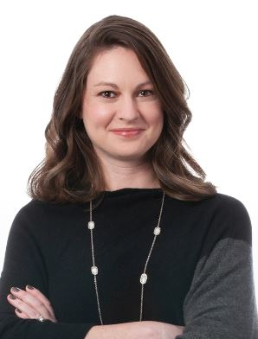
Jessica Lamb
Partner, McKinsey & Company
Jessica joined McKinsey in 2008 and has served clients across the healthcare industry including pharmaceuticals, payers and providers, and healthcare services companies. Her work has primarily been targeted to create healthcare value and leverage analytics to improve performance and outcomes. As the leader of McKinsey’s advanced analytics center of excellence within the Healthcare Practice. she focuses on helping clients leverage advanced analytics techniques, such as machine learning and artificial intelligence, to achieve these goals.
Before joining McKinsey, Jessica conducted laboratory research in nanoparticle hyperthermia for cancer treatment at Dartmouth-Hitchcock Medical Center. Jessica holds a BA in Engineering and Economics and a BE in Biomedical Engineering from Dartmouth College.

Slide 10


Panel Discussion

Slide 11
Questions from the attendees?

Slide 12




Thank you, Speakers!!
Ash Goel, MD, MBA
Moderator
Senior Vice President, CIO at Bronson Healthcare
John Glaser, Ph.D.
Executive in Residence at Harvard Medical School
Aashima Gupta
Global Director, Global Healthcare Solutions, Google Cloud at Google
Jessica Lamb
Partner, McKinsey & Company

Slide 13


Thank you!
Contact email:
Gwynne Jelbaoui
Gwynne.Jelbaoui@himss.org

