Slide 1
How to Use This Presentation
Target Audience
Content covered
Why of interest
Notes:
This presentation, titled "Artificial Intelligence: A Primer for Nurses," is designed for nurse leaders and nurse informaticists to educate bedside care nurses and students on Artificial Intelligence.
It covers a comprehensive agenda that includes an introduction to artificial intelligence (AI), understanding AI, types of AI, AI in healthcare, AI and nursing, AI's impact on critical thinking and AI challenges.
The deck is of particular interest to nurses and healthcare professionals because it highlights the significant role nurses play in AI development and implementation. It emphasizes the importance of leveraging nurses' insights in AI development, including them in the design process, and using their knowledge to enhance machine learning for clinical decision-making. Additionally, it discusses the impact of emerging technologies on nursing practice, aiming to automate low-value tasks and allow nurses to focus on high-value activities, ultimately improving patient engagement and satisfaction.
By understanding the applications and implications of AI in healthcare, nurses can better navigate the evolving landscape of healthcare technology and contribute to the development of effective AI solutions that enhance patient care and safety.

Slide 2
Artificial Intelligence:
A Primer for Nurses
HIMSS Nursing Innovation Advisory Workgroup
This content reflects the expertise and perspective of volunteer author(s) and does not represent the official position of HIMSS.
Last update: January 2025

Slide 3
Agenda
Nurses Role in Artificial Intelligence (AI)
Introduction to Artificial Intelligence
Understanding AI
What is and AI Is Not
Types of AI
AI in Healthcare
AI and Nursing
AI, the Nursing Process and Critical Thinking
AI Challenges and Considerations
Exploring Generative AI

Slide 4
Nurses' Role in AI Development & Design
Nurses' Insight
  Leverage knowledge of patient care and administrative needs
  Recognize best use cases for AI in clinical settings
  Assess the effectiveness of AI Models by evaluating their accuracy, reliability, and ethical considerations in delivering healthcare solutions.
Notes:
Nurses play a crucial role in the development and design of AI technologies in healthcare. Their firsthand experience with patient care and administrative processes allows them to provide valuable insights into how AI can be effectively integrated into clinical settings. By identifying the best use cases for AI, nurses can help ensure that these technologies address real-world challenges. Additionally, their involvement in assessing AI models is vital; they can evaluate not only the accuracy and reliability of these systems but also their ethical implications. This ensures that AI solutions are not only effective but also align with the core values of patient care and safety.
______

Slide 5
Nurses' Role in AI Development & Design
Nurse Inclusion
  Understand voices of patients, nurses, clinicians, and administrators
  Include nurses early in design and development
  Nurses as knowledge bearers of evidence-based care delivery
  Provide feedback to developers to improve the accuracy and relevance of AI in clinical practice.
Notes:
Incorporating nurses into the AI development process is crucial for creating effective healthcare solutions. Nurses bring invaluable insights from their direct interactions with patients and their understanding of clinical workflows. By including them early in the design phase, we can ensure that the technology aligns with real-world needs. Their expertise in evidence-based care delivery allows them to provide critical feedback, which can enhance the accuracy and relevance of AI applications in clinical settings. This collaboration not only improves the technology but also fosters a sense of ownership among nursing professionals, ultimately leading to better patient outcomes.
______

Slide 6
AI: Leveraging the expertise of nurses
Nursing Data is Essential to AI:
  Knowledge derived from nurse data helps machines apply “wisdom” for making suggesting clinical decisions which often become faster, and more accurate and precise.
  As the collection of data grows, machines become smarter and better able to assist nurses when using human judgement and critical thinking to provide the most appropriate care.
  Improved data-driven clinical-decision making will improve nursing contribution to practice in all clinical settings.
Notes:
The integration of nursing knowledge into machine learning systems is revolutionizing clinical decision-making. By leveraging the expertise of nurses, these systems can provide suggestions that enhance the speed and accuracy of care. As we accumulate more data, the algorithms will refine their capabilities, allowing for more nuanced support in patient care. This synergy between human judgment and machine intelligence not only streamlines processes but also elevates the role of nurses within the healthcare framework. Ultimately, improved decision-making leads to better patient outcomes and reinforces the critical value nurses bring to the system.
______

Slide 7
Emerging technologies
In nursing practice, the end goal of emerging technologies such as assistive intelligence is to decrease the low-value tasks that can be automated by smart machines to allow more high-value activities and best use of nurses’ essential skill to give more time with patients to improve their experience engagement and satisfaction.
AI, together with critical thinking and human judgment, significantly impacts all phases of the nursing process by increasing the speed and accuracy of evaluation, anticipation, and knowledge synthesis generation.
Notes:
Emerging technologies, particularly assistive intelligence, are transforming nursing practice by automating low-value tasks. This shift allows nurses to focus on high-value activities, enhancing patient engagement and satisfaction. By freeing up time, nurses can dedicate more attention to their patients, which is crucial for improving overall care quality. Additionally, the integration of AI into nursing processes enhances critical thinking and human judgment. It accelerates evaluation, anticipation, and knowledge synthesis, leading to more accurate and timely decision-making. This synergy between technology and human expertise is vital for advancing nursing practice and ultimately improving patient outcomes.
______

Slide 8
AI in Nursing: Patient-Centeredness and Safety
Maximizing Value and Safety and with AI
  Automating low-value tasks to focus on high-value activities
  Decreasing chances of drug-drug interactions
  Reducing duplicative treatments
  Identifying risks for hospital-acquired infections and conditions
  Determining the most appropriate staffing levels
Notes:
Artificial Intelligence is transforming nursing by enhancing patient-centered care and safety. By integrating emerging technologies like precision and assistive intelligence, we can automate routine tasks, allowing nurses to concentrate on more critical, high-value activities. This shift not only maximizes safety but also improves clinical decision-making.
Enhanced AI tools can significantly reduce the risk of drug-drug interactions and prevent duplicative treatments, which are crucial for patient safety. Additionally, AI can help identify risks associated with hospital-acquired infections and optimize staffing levels, ensuring that the right number of nurses are available to meet patient needs. Ultimately, these advancements will elevate the role of nurses within the healthcare system, highlighting their value in delivering quality care.
______

Slide 9
AI used in tandem with critical thinking strengthens nurses to generate new knowledge, look beyond the obvious of what is happening with the patient, and challenge traditional ways of thinking used in practice historically (Paul & Heaslip, 1995 ).
The fluid process of reasoning is enhanced by AI; the use of smart machines is balanced with nurses’ unique skill sets and solid clinical knowledge, using human judgment throughout the process (Carroll , 2019a ).
Notes:
The integration of AI in nursing is a game changer, as it empowers nurses to not only gather data but also to interpret it critically. This synergy between AI and human expertise allows for a deeper understanding of patient needs, moving beyond surface-level observations. By leveraging AI, nurses can challenge long-standing practices and innovate care strategies that are more effective.
The quotes highlight the importance of maintaining human judgment in this process, ensuring that technology complements rather than replaces the invaluable skills that nurses bring to patient care. This balance is crucial for fostering an environment where new knowledge can flourish.
_____

Slide 10
Definition of AI
“AI is an area of computer science that emphasizes the creation of machines that work and react like humans. This means a system that can depict or mimic human brain functions including learning, speech (recognition and generation); problem-solving, vision, and knowledge generation.”
Lawry, T. (2020). AI in Health: A Leader's Guide to Winning in the New Age of Intelligent Health Systems. New York: HIMSS Publishing.
Notes:
Lawry, T. (2020). AI in Health: A Leader's Guide to Winning in the New Age of Intelligent Health Systems. New York: HIMSS Publishing. ISBN: 9780367333713.

Slide 11
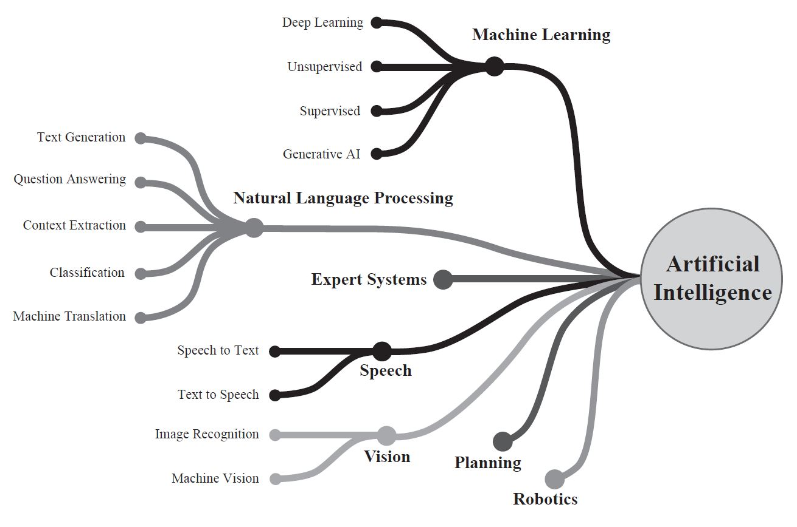
Artificial Intelligence Domains
Permission received by author to use.
Notes:
Artificial Intelligence encompasses a variety of domains, each with its unique applications and implications. These domains include machine learning, natural language processing, computer vision, and robotics, among others. Understanding these areas is crucial as they represent the foundational technologies driving innovation across industries. For instance, machine learning enables systems to learn from data and improve over time, while natural language processing allows for more intuitive human-computer interactions. As we explore these domains, consider how they can be leveraged to enhance our operations and create value for our customers.
______

Slide 12
Understanding AI and Its Technologies
Definition of Artificial Intelligence (AI)
Aptitude exhibited by smart machines
Includes perceiving, thinking, planning, learning, speech recognition, and manipulating objects
Examples include:
Machine Learning (ML)
National Language Processing (NLP)
Computer Vision
Real-life Applications to enhance intelligence
Commonplace in daily lives
Enhances human judgement and efficiency
Examples: e-commerce, financial transactions, search engines, social media, smart communications
Notes:
Artificial Intelligence, or AI, represents a significant leap in technology, enabling machines to perform tasks that typically require human intelligence. This includes capabilities such as perception, reasoning, and learning. Key technologies within AI include Machine Learning, which allows systems to learn from data; Computer Vision, enabling machines to interpret visual information; and Natural Language Processing, which helps in understanding and generating human language. AI is not just a futuristic concept; it is integrated into our daily lives, enhancing decision-making and efficiency across various sectors. For instance, in e-commerce, AI personalizes shopping experiences, while in finance, it streamlines transactions and fraud detection. Understanding these applications is crucial as they shape our interactions with technology.
______

Slide 13
AI Algorithms
Sequential Instructions
Step-by-step guidance for task completion
Self-Learning Algorithms
Algorithms adapt when encountering a trigger
Triggers are events or behaviors from intermeshed algorithms
Form the backbone of AI
Layering of Algorithm Groups
Multiple algorithms transform and create new ones
Respond to learned inputs and data
Not limited to initial designed triggers
Notes:
AI algorithms are essential for driving intelligent behavior in systems. They can be categorized into sequential instructions, which provide step-by-step guidance for completing tasks, and self-learning algorithms that adapt based on triggers—specific events or behaviors that prompt a response. This adaptability is crucial as it allows algorithms to evolve and improve over time. Additionally, the layering of algorithm groups enables multiple algorithms to work together, transforming and creating new outputs based on learned inputs and data. This interconnectedness is not confined to the original triggers, showcasing the dynamic nature of AI and its potential to enhance decision-making and efficiency across various applications.
______

Slide 14
What AI Is Not
AI Algorithms and Machines
Not standalone; require data to learn and evolve
Built from more than just wires and chips
Role of Smart Machine Outputs
Should act as supportive tools to enhance human judgment, not automatic doers
Assist and augment human reasoning
AI and Empathy
Not programmed to be empathetic
Cannot replace critical thinking and judgment of clinicians
Notes:
Understanding what AI is not is crucial for setting realistic expectations. AI algorithms and machines are not standalone entities; they rely heavily on data to learn and improve. It's important to recognize that these systems are built from more than just hardware; they require a robust framework of data and algorithms to function effectively. Additionally, while AI can produce outputs, these should be viewed as tools that support and enhance human decision-making rather than replacing it. AI lacks the ability to empathize and cannot replicate the critical thinking and judgment that professionals, such as clinicians, bring to their work. This distinction is vital in ensuring that we use AI responsibly and effectively.
______

Slide 15
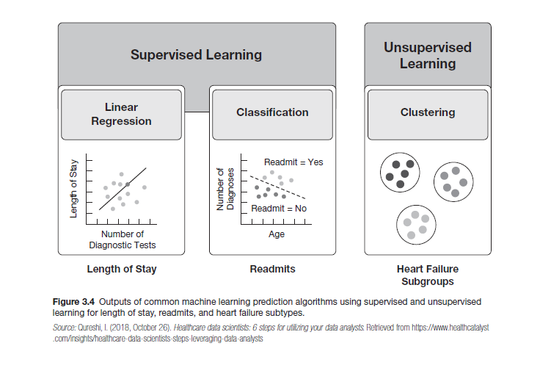
Machine Learning (ML)
Definition of Machine Learning
  Study of computer algorithms improving through experience
  Focuses on predictive analytics and algorithm performance
Supervised Learning
  Uses known input and output data to train models
  Generates predictions for new data
Unsupervised Learning
  Draws inferences from input data without labeled responses
  Determines structure and patterns in unlabeled data
Reinforcement Learning
  Agent learns through feedback from actions and experiences
  Uses feedback from actions and experiences
Deep Learning (DL)
  Processes big data inputs through hidden layers
  Develops responses based on pattern recognition
Permission received by author to use.
Notes:
Machine Learning is a transformative field that focuses on how computers can learn from data and improve their performance over time. It encompasses various approaches, including Supervised Learning, where models are trained on labeled data to make predictions, and Unsupervised Learning, which identifies patterns in data without predefined labels. Reinforcement Learning introduces a dynamic element, allowing agents to learn from the consequences of their actions. Additionally, Deep Learning leverages complex neural networks to process vast amounts of data, enhancing pattern recognition capabilities.
It's important to note how Machine Learning differs from traditional statistics; it prioritizes predictive accuracy and algorithm performance, making it a powerful tool for modern analytics.
______

Slide 16
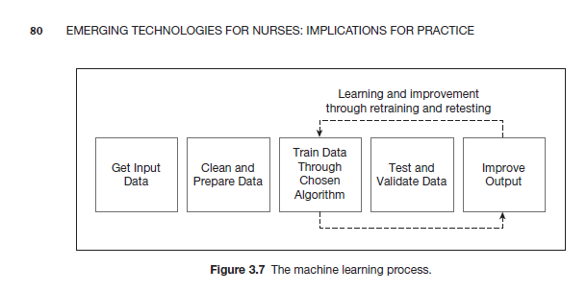
Five-Step Process for ML
Data Collection
Cleaning
Training
Testing
Validation
Permission received by author to use.
Notes:
The five-step process for machine learning is crucial for developing effective models. It begins with data collection, where we gather relevant datasets that will inform our model. Next, we move to data cleaning, which involves removing inaccuracies and ensuring the data is in a usable format. Training is the third step, where we use the cleaned data to teach the model to recognize patterns. Following that, we conduct testing to evaluate the model's performance on unseen data, ensuring it generalizes well. Finally, validation is essential to confirm that the model meets the desired accuracy and reliability standards before deployment. Each of these steps is interconnected and vital for the success of any machine learning initiative.
______

Slide 17
Predictive Analytics:
A mathematic approach that uses statistical computations to analyze historical data from multiple sources to predict future events.
Predictive Data Strategy
Provides valuable insights
Helps in understanding future events
Anticipation of Interventions
Determines necessary actions
Ensures desired outcomes
Proactive Decision Making
Enables proactive decisions
Prevents undesired events
Notes:
Predictive analytics is a powerful tool that leverages statistical methods to analyze historical data, allowing us to forecast future events with greater accuracy. This approach not only provides valuable insights but also enhances our understanding of potential future scenarios. By anticipating interventions, we can determine the necessary actions to ensure desired outcomes. This proactive decision-making process is crucial in preventing undesired events and optimizing our strategies. The visual elements on this slide, including the smart art, highlight the integration of advanced analytics and human clinical heuristics, emphasizing the importance of reliability and organization in clinical decision-making. This combination ultimately leads to improved outcomes in our initiatives.
______

Slide 18
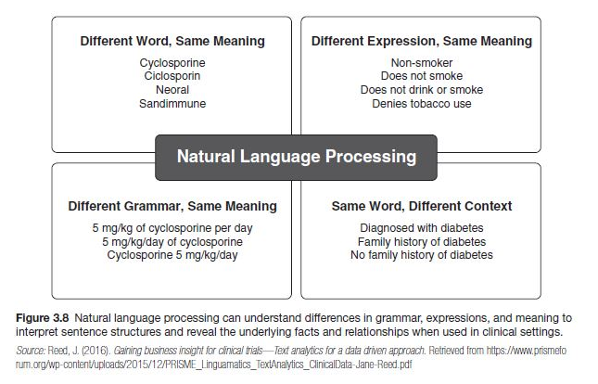
Natural Language Processing (NLP)
Definition of NLP
  Automatic manipulation of natural, unstructured language
  Includes text and speech
  Achieved through algorithmic programming
Purpose of NLP
  Allows computers to analyze and understand human language
  Derives meaning in a cost-efficient and useful manner
  Based on machine learning algorithms
Applications in Healthcare
  Enhances clinical documentation
  Provides insights from unstructured data in EHRs
Permission received by author to use.
Notes:
Natural Language Processing, or NLP, is a fascinating field that focuses on enabling computers to understand and interpret human language. This involves both text and speech, allowing for a wide range of applications. The core of NLP lies in its algorithmic programming, which processes unstructured language data. One of the primary goals is to derive meaningful insights in a way that is both efficient and practical. In healthcare, for instance, NLP plays a crucial role by enhancing clinical documentation and extracting valuable insights from electronic health records. This capability not only streamlines workflows but also improves patient care by making sense of vast amounts of unstructured data.
______

Slide 19
Data is Fundamental to Analytics
Foundation for Insights
Informed Decision-Making
Predictive Capabilities
Operational Efficiency
Risk Management
Customer Insights
Notes:
1. Foundation for Insights: Data provides the necessary information to identify patterns, trends, and correlations. Without data, analytics would have no basis for generating insights.
Informed Decision-Making: Analytics transforms data into actionable insights, enabling organizations to make informed decisions. This can lead to improved efficiency, cost savings, and competitive advantages.
Predictive Capabilities: By analyzing historical data, organizations can predict future trends and behaviors. This is crucial for proactive decision-making and strategic planning.
Operational Efficiency: Data-driven analytics helps in optimizing operations by identifying inefficiencies and areas for improvement. This can lead to reduced downtime, lower maintenance costs, and streamlined processes.
Risk Management: Analytics can identify potential risks and fraud by analyzing data patterns. This helps organizations to mitigate risks and protect their assets.
Customer Insights: Data analytics provides a deeper understanding of customer behavior and preferences, allowing organizations to tailor their products and services to meet customer needs better.
Data serves as the cornerstone of effective analytics, enabling organizations to uncover valuable insights. By examining data, we can identify significant patterns and trends that inform our decision-making processes. This transformation of raw data into actionable insights not only enhances operational efficiency but also leads to cost savings.
In healthcare, analyzing patient data can reveal trends in disease outbreaks, allowing for timely interventions and resource allocation. Leveraging historical data allows us to forecast future trends, which is essential for strategic planning. For example, predicting patient admission rates can help hospitals manage staffing and bed availability more effectively.
Analytics also plays a critical role in risk management by detecting potential threats and fraud through data pattern analysis. In healthcare, this could mean identifying unusual billing patterns that may indicate fraudulent activities. Additionally, understanding patient behavior through data analytics enables us to tailor our offerings to better meet their needs, such as personalized treatment plans based on individual health data.
In essence, data is indispensable for driving both strategic and operational advancements in healthcare, leading to improved patient outcomes and more efficient healthcare delivery.
______

Slide 20

Types of Analytics in AI
Predictive Operational Insights
AI predicts potential issues and tracks safety metrics.
Equipment Health Monitoring
Continuous monitoring of equipment condition.
Supply Chain Integrity
AI ensures the supply chain remains uncompromised.
Fraud Detection
Identification and prevention of fraudulent activities.
Operational Improvements
Enhanced documentation coding for efficient claims processing.
Revenue Cycle Management
AI-driven platforms auto-adjust claims for optimal reimbursement.
20
Notes:
As mentioned on the previous slide, data is the backbone of analytics, enabling organizations to extract valuable insights that drive strategic and operational improvements.
This slide highlights various types of analytics powered by AI, emphasizing their importance in enhancing business processes. Predictive operational insights allow organizations to foresee potential issues, which is crucial for proactive decision-making. Continuous equipment health monitoring ensures that machinery operates efficiently, reducing downtime and maintenance costs. The integrity of the supply chain is vital, and AI plays a key role in safeguarding it against disruptions. Fraud detection mechanisms are essential for identifying and preventing fraudulent activities, protecting the organization’s assets. Additionally, operational improvements through better documentation coding streamline claims processing, while AI-driven revenue cycle management optimizes reimbursement processes. Each of these elements showcases how integrating AI into operational analytics can lead to significant improvements in efficiency and effectiveness.
______

Slide 21
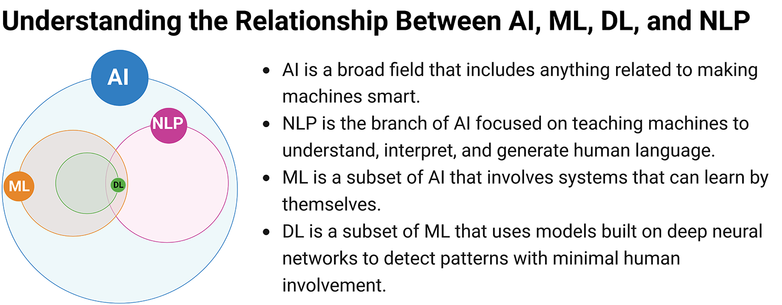
NLP – Natural Language Processing
ML – Machine Learning
DL – Deep Learning
Figure 1,Alowais, S.A., Alghamdi, S.S., Alsuhebany, N. et al. Revolutionizing healthcare: the role of artificial intelligence in clinical practice. BMC Med Educ 23, 689 (2023). https://doi.org/10.1186/s12909-023-04698-z, Creative Commons
Notes:
Here’s a simple everyday example of these:
•AI system – Siri you ask Siri for today weather
•NLP (Natural Language Processing): processes your words and understanding your intent
•ML (Machine Learning): Learns from he last time you asked about the weather to better understand your preferences
•DL (Deep Learning): recognized your voice and generate natural-sounding responses.
•AI (Artificial Intelligence): The smart assistant as a whole is an AI system, designed to simulate human-like interactions and assist you with various tasks.
•NLP (Natural Language Processing): When you speak to the assistant, NLP processes your spoken language, converting it into text and understanding your intent, 3.ML (Machine Learning): The assistant uses machine learning to improve over time. For example, it learns from previous interactions to better understand your preferences, such as commonly requested reminders or preferred phrasing, making its responses more accurate and personalized.
•DL (Deep Learning): Deep learning models are used for the voice recognition part, allowing the assistant to accurately transcribe your spoken words into text and understand complex speech patterns. Deep learning also powers the assistant’s ability to generate natural-sounding responses.

Slide 22
AI Applications in Healthcare
AI's Role in Patient Care
Nurses should understand AI's growing presence in healthcare settings.
Transformational Uses of AI
Accelerates innovation and improves decision making.
Automates processes and contributes to cost savings.
AI as a Solution for Medical Data Growth
Handles the increasing volume and complexity of medical data.
Current AI Usage Among End Users
Only a small percentage (15-20%) utilize AI to transform healthcare delivery.
22
Notes:
AI is increasingly becoming a vital component in healthcare, enhancing patient care and operational efficiency. It's essential for nurses and healthcare professionals to recognize the growing role of AI in their daily practices. The transformational uses of AI not only accelerate innovation but also significantly improve decision-making processes. Moreover, AI automates various tasks, leading to substantial cost savings for healthcare institutions. As we face an explosion of medical data, AI provides a robust solution to manage this complexity effectively. However, it's important to note that current adoption rates are relatively low, with only 15-20% of end users leveraging AI to enhance healthcare delivery. This presents both a challenge and an opportunity for the industry to embrace AI more fully.
______

Slide 23
AI: Clinical Applications & Implications
Robotic Surgery and Radiology Image Recognition
Enhances precision and efficiency in surgical procedures
Improves accuracy in diagnosing medical conditions
EHR Clinical Decision Support for Early Warning Systems (EWSs)
Provides timely alerts for potential health issues
Supports proactive patient care
Speech and Text Recognition for Communication
Facilitates better communication among care teams
Reduces errors in information exchange
Continuous Adaptation of EHRs to User Preferences
Improves clinical outcomes and clinician well-being
Notes:
Artificial Intelligence is transforming clinical applications in several impactful ways. For instance, robotic surgery enhances precision and efficiency, significantly improving surgical outcomes. In radiology, AI-driven image recognition boosts diagnostic accuracy, allowing for earlier detection of medical conditions. The integration of Electronic Health Records (EHR) with Clinical Decision Support systems plays a crucial role in Early Warning Systems, providing timely alerts that enable proactive patient care. Additionally, advancements in speech and text recognition facilitate seamless communication among healthcare teams, minimizing errors in information exchange. Finally, the continuous adaptation of EHRs to user preferences not only enhances clinical outcomes but also contributes to clinician well-being, making their work more efficient and less stressful.
______

Slide 24
AI’s Clinical Purpose:
Patient Experience and Outcomes
Automation and Computation for Improved Outcomes
Extension of right patient, right treatment, and right time
Enhances the healthcare’s Quintuple Aim
  Improves the patient experience
  Heightening patient engagement and satisfaction
  Improves the nurse's experience by the reduction of human factors while providing care
  Increases human interaction through EHR optimization allowing for more time with patients.
Notes:
This slide emphasizes the critical role of AI in enhancing patient experience and outcomes within healthcare. By automating processes and leveraging computational tools, we can ensure that patients receive the right treatment at the right time. This approach not only aligns with the healthcare's Quintuple Aim but also significantly improves patient engagement and satisfaction. Additionally, it alleviates some of the burdens on nurses by minimizing human error, allowing them to focus more on patient care. The optimization of Electronic Health Records (EHR) is particularly noteworthy, as it fosters increased human interaction, ultimately leading to a more personalized and effective healthcare experience.
______

Slide 25

AI Considerations
Factors Driving AI Advancement
  Availability of big data
  Improved machine learning approaches and algorithms
  Capabilities of more powerful computers
Essential Criteria for AI Technology
  Addressing significant clinical needs
  Performing as well as existing standards
  Considering policy and ethics
  Addressing bias and equity
  Ensuring regulation and governance
Notes:
AI is rapidly evolving, driven by several key factors. The availability of vast amounts of big data allows for more effective training of algorithms, while advancements in machine learning techniques enhance AI's capabilities. Additionally, the power of modern computing hardware enables more complex models to be developed and deployed. When considering AI technology, it's crucial to address significant clinical needs and ensure that AI performs at least as well as existing standards. We must also take into account policy and ethical considerations, particularly regarding bias and equity. Finally, establishing robust regulation and governance frameworks is essential to ensure that AI technologies are implemented responsibly and effectively.
______

Slide 26
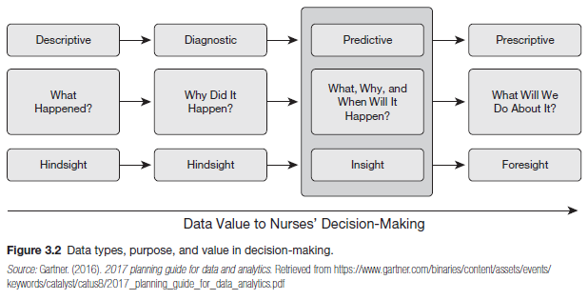
Data and AI: Types, Value, and Uses
Types of Data Used in Healthcare
  Descriptive Data: Simple data used for basic understanding
  Diagnostic Data: Identifies causes of issues
  Predictive Data: Forecasts future outcomes
  Prescriptive Data: Suggests actions to achieve desired outcomes
Value of Data Types for Nurses
  Increases from descriptive to prescriptive data
  Higher complexity data provides greater decision-making value
  Enhanced accuracy and speed in which action can be taken
Uses:
  Predict who will get sick and when
  How nurses will treat patients
  Support organizational processes that impact nursing care
Permission received by author to use.
Notes:
Predictive analytics is revolutionizing healthcare by integrating advanced algorithms with clinical expertise. This combination not only accelerates decision-making but also enhances its reliability and organization. The types of data utilized in healthcare analytics are crucial; descriptive data provides foundational insights, while diagnostic data helps identify underlying issues. Predictive data is particularly powerful as it forecasts potential health outcomes, and prescriptive data guides healthcare professionals on the best actions to take. For nurses, the value of data escalates from descriptive to prescriptive, as more complex data translates into improved decision-making capabilities. This approach enables nurses to anticipate patient illnesses and tailor treatments accordingly, ultimately supporting organizational processes that enhance nursing care.
______

Slide 27
AI Impact on Nursing

Slide 28

Impact on Nursing Process
AI Enhances Nursing Process
  Increases speed and accuracy
  Improves evaluation and anticipation
  Enhances knowledge synthesis generation
Critical Thinking and Human Judgment
  AI complements these skills
  Leads to better decision-making
Notes:
Artificial Intelligence is revolutionizing the nursing process by significantly enhancing both speed and accuracy in patient care. With AI tools, nurses can evaluate patient data more effectively and anticipate potential issues before they arise. This technology also aids in synthesizing vast amounts of knowledge, allowing for improved critical thinking and human judgment. Rather than replacing these essential skills, AI serves as a powerful complement, enabling nurses to make more informed decisions. As we embrace these advancements, we can expect a transformation in how care is delivered, ultimately leading to better patient outcomes.
______

Slide 29
AI Role in the Nursing Process
AI+ Critical Thinking+ Human Judgement impacts all phases of the nursing process by increasing speed and accuracy.
Assessment
Processes data input
Diagnosis
Customized Care
Intervention
Inform actionable, patient-specific recommendations
Intelligent data extraction
Intervention determination
Evaluation
Refine Priorities
Ongoing data collection
Plan
Develop a plan
Customized goals and interventions
Notes:
Artificial Intelligence is transforming the nursing process by enhancing critical thinking and human judgment at every stage. The integration of AI allows for more efficient data processing and intelligent extraction, which significantly improves the assessment phase. As we move through the nursing process—from diagnosis to intervention—AI provides tailored, patient-specific recommendations that empower nurses to make informed decisions. This not only streamlines care but also ensures that interventions are more precise and effective. The ongoing evaluation and refinement of priorities, supported by continuous data collection, further enhance the quality of care. Emphasizing the synergy between AI and human expertise is crucial, as it leads to better patient outcomes and a more responsive healthcare system.
______

Slide 30

Impact on Critical Thinking
AI's Influence on Human Factors and Organized Thinking
  AI impacts the practice environment
  Enhances nurse's critical thinking
Critical Thinking Enhancement
  Fluid reasoning process improved by AI
  Smart machines complement nurses' skills
  Leads to better decision-making
  Human judgment remains crucial
Notes:
Artificial Intelligence is reshaping how we approach critical thinking in healthcare. It enhances the practice environment by providing tools that support nurses in their decision-making processes. With AI, nurses can experience an improvement in their fluid reasoning, allowing them to analyze complex situations more effectively. Smart machines act as valuable partners, complementing the skills of healthcare professionals rather than replacing them. However, it's essential to remember that while AI can provide insights and data, human judgment remains a vital component in the decision-making process. This synergy between AI and human expertise leads to better outcomes for patients and the healthcare system as a whole.
______

Slide 31
Considerations
Importance of standardized data collection
Addressing bias and equity in AI algorithms
  biased outcomes mean one group of people get better medical treatment than another based on characteristics of gender or race, language, skin type, genealogy, or lifestyle, age
  AI developers, clinicians, and patients must be prudent about subjectivity and inclusivity in the data being used to make life-altering healthcare decisions ( Stanford Medicine, 2019 ).
  Datasets that contain patient-specific data are only as good as those populations that we extract data from for AI algorithm building
  Recognizing and mitigating bias in AI systems is essential to building trust between humans and machines that learn
Should address a significant, identified clinical need, and must perform at least as well as the existing standard approach.
substantial clinical testing needs to verify the performance of the new technology under the wide range of clinical situations (The MITRE Corporation, 2017 ).
Notes:
Standardized data collection is crucial in ensuring that AI algorithms are fair and equitable. When we consider the potential biases in healthcare, it's important to recognize that certain groups may receive better treatment based on characteristics like gender, race, or age. This highlights the need for AI developers, clinicians, and patients to be vigilant about the inclusivity of the data used in decision-making processes. The quality of datasets directly impacts the effectiveness of AI algorithms, making it essential to address any biases to foster trust in these systems. Furthermore, any new technology must not only meet a significant clinical need but also undergo rigorous testing to ensure it performs effectively across diverse clinical scenarios. This approach is vital for integrating AI into healthcare responsibly.
______

Slide 32

Key Ethical Considerations for using AI
Patient Privacy and Confidentiality
Informed Consent
Bias and Fairness
Accountability
Transparency
Notes:
1. Patient Privacy and Confidentiality: Ensuring that AI systems comply with privacy laws and regulations to protect patient data.
Informed Consent: Patients should be informed about the use of AI in their care and provide consent.
Bias and Fairness: Addressing potential biases in AI algorithms to ensure fair and equitable treatment for all patients.
Accountability: Clarifying who is responsible for decisions made by AI systems and ensuring that nurses remain accountable for patient care.
Transparency: Maintaining transparency about how AI systems work and how decisions are made.
As we delve into ethical considerations, it's crucial to address three key areas: privacy, job displacement, and decision-making transparency. Privacy is paramount in today's digital landscape, where data protection is not just a legal requirement but a moral obligation. We must ensure that our practices respect individual privacy rights. Job displacement is another significant concern; as technology evolves, we need to proactively manage the impact on employment and provide support for workforce transitions. Lastly, decision-making transparency is essential for building trust. Stakeholders should understand how decisions are made, especially when they involve AI and automation. By focusing on these areas, we can navigate the ethical landscape responsibly.
______

Slide 33
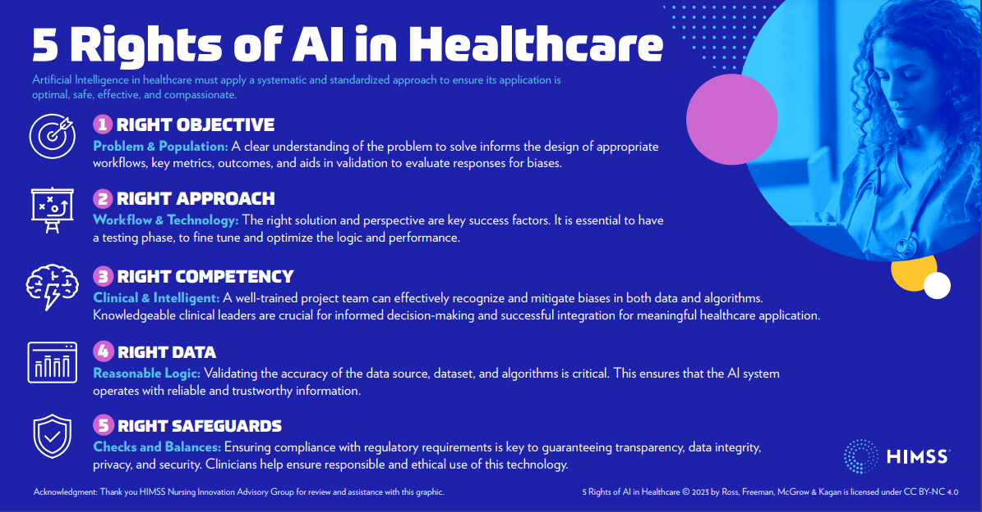
Notes:
•To prevent these types of Bias and promote safe practices in AI, the Healthcare Information and Management Systems Society, Nursing Innovation Advisory Group developed – The concept of the "Five Rights of AI" draws inspiration from the "Five Rights of Medication," a concept with roots in nursing practices to guide nurses toward safe and accurate medication administration to enhance patient safety and advancing quality improvement.
•The adaptation of these rights for AI takes into account the recommendations of the WHO recommendations for ethical and safe use of AI for health and the White House AI Bill of Rights and aims to provide a clear and practical framework for applying and managing Artificial Intelligence (AI) in healthcare settings
• Let’s review the rights:

Slide 34
Challenges in Implementing AI
AI Democratization Impact
AI usage expected in most organizations by 2025
Data Estate Maturity
Challenges with siloed, unstructured healthcare data
Importance of operational databases, data warehouses, and lakes
Skills Transformation for AI
Need for significant skills development in AI technologies
Continuous AI Innovation
Healthcare leaders must adapt to rapidly changing AI tech
AI Integration in Healthcare
Technical teams to bring AI to applications
Expansion of AI to business and clinical processes
34
34
Notes:
Implementing AI in healthcare presents several challenges that organizations must navigate. One significant hurdle is the democratization of AI, which requires widespread adoption across various departments. By 2020, it was anticipated that most organizations would utilize AI, yet many still struggle with siloed and unstructured data, particularly in healthcare. This emphasizes the need for robust operational databases, data warehouses, and lakes to manage and analyze this information effectively. Additionally, there's a pressing need for skills transformation; healthcare professionals must develop competencies in AI technologies to leverage these tools fully. Continuous innovation in AI is crucial, as healthcare leaders must stay ahead of rapidly evolving technologies. Finally, integrating AI into both business and clinical processes necessitates collaboration between technical teams and healthcare practitioners to ensure successful application.
______
Redwan Bin Abdul Baten, How are US hospitals adopting artificial intelligence? Early evidence from 2022, Health Affairs Scholar, Volume 2, Issue 10, October 2024, qxae123, https://doi.org/10.1093/haschl/qxae123

Slide 35
AI: The Essential to Explain and Interpret
Understanding AI in Organizations
Organizations may not fully grasp AI algorithmic processes and decisions
Importance in Healthcare
Need to comprehend algorithmic models for explanation
Realize actual performance and interpret outputs
Essential for practice, research, and education
Deep Learning Methods
Interpretable or explainable models not always possible
Clarity by developers and users is crucial for healthcare decision-making
Must be understandable and conveyed in plain language
Human Interpretability of AI Solutions
End user interpretability is paramount
Notes:
Understanding AI's role in organizations is crucial, especially in sectors like healthcare where decisions can significantly impact lives. It's important to recognize that many organizations may not fully understand how AI algorithms function or the rationale behind their decisions. This lack of comprehension can hinder effective implementation and trust in AI systems. In healthcare, comprehending algorithmic models is vital for accurate interpretation of outputs, which directly affects practice, research, and education. While deep learning methods can be complex and not always interpretable, it's essential for developers to communicate their workings in clear, accessible language. Ultimately, ensuring that end users can interpret AI solutions is key to fostering trust and facilitating informed decision-making.
______

Slide 36
Exploring Generative AI

Slide 37
Understanding AI and Generative AI
Artificial Intelligence (AI)
Computer systems performing tasks needing human intelligence
Capabilities include seeing, listening, reasoning, translating
Foundation Models
Large AI models trained on extensive data
Base for specific AI tools, using deep-learning 'Transformer' architectures
Generative AI (GenAI)
Systems generating content like text, images, media
Based on patterns and structure from large input data
Large Language Models (LLMs)
Type of GenAI for language data patterns and relationships
Applications in natural language processing, summarization, translation
37
Notes:
Artificial Intelligence, or AI, encompasses computer systems that can perform tasks typically requiring human intelligence, such as visual perception, speech recognition, reasoning, and translation. At the core of AI are Foundation Models, which are large-scale models trained on vast datasets, serving as the backbone for various AI applications. These models utilize deep-learning architectures, particularly the 'Transformer' model, to process and understand complex data. Generative AI, a subset of AI, focuses on creating new content—be it text, images, or other media—by recognizing patterns and structures from the input data. A prominent example of generative AI is Large Language Models (LLMs), which excel in natural language processing tasks, including summarization and translation. Understanding these concepts is crucial as they form the basis for many innovative applications in today's technology landscape.
______

Slide 38
What is a large language model?
Large Language Models: Power & Potential
Capacity to understand, generate, and interact using natural language
Trained on diverse datasets
Used for tasks like content creation, coding assistance, customer service automation, and more
A machine learning model trained on a massive amount of text, that can be used to generate text
Notes:
Large language models, or LLMs, represent a significant advancement in machine learning, leveraging vast amounts of text data to generate coherent and contextually relevant text. Their power lies in their ability to understand and produce human-like language, making them versatile tools across various applications. For instance, they can assist in content creation, provide coding support, and automate customer service interactions. The training on diverse datasets enhances their capability to engage in natural language processing tasks effectively. As we explore their potential, it's essential to consider both the opportunities they present and the ethical implications of their use.
______

Slide 39
Some prominent large language models
GPT
CLAUDE
LLaMA
Palm-2
Notes:
Generated by Copilot
In this slide, we highlight some of the leading large language models currently shaping the AI landscape. Each model, including GPT, CLAUDE, LLaMA, and Palm-2, brings unique capabilities and innovations to the table. For instance, GPT has been widely recognized for its versatility in generating human-like text, while CLAUDE focuses on conversational AI. LLaMA is known for its efficiency in training, and Palm-2 emphasizes understanding context in language. Understanding these models is crucial as they represent the forefront of AI technology, influencing various applications across industries. As we explore their functionalities, consider how they can be leveraged to enhance our own projects and initiatives.
______

Slide 40

Generative AI
Generative AI in a Nutshell Video
https://youtu.be/2IK3DFHRFfw?si=kGx3-rDjAjTHr_H3
Notes:
Create QR code and let them go out and watch the video and add to appendix

Slide 41
LLM Issues
Hallucinations
Confabulations
Math
Expensive
Understanding vs mimicking
Privacy violations
Adherence to legal and moral standards
Ethical implications
Over-reliance on LLMs
Regular evaluation of LLM performance.
41
Notes:
Large Language Models (LLMs) present a range of challenges that we must navigate carefully. Hallucinations and confabulations can lead to misinformation, which undermines trust in these systems. Additionally, while LLMs can perform complex calculations, they are not infallible and can produce errors in math. The cost of deploying these models can be significant, raising questions about their economic viability. It's crucial to distinguish between understanding and mere mimicking of language, as this impacts the quality of interactions. Privacy violations are a serious concern, especially when sensitive data is involved. We must also consider adherence to legal and moral standards, as well as the ethical implications of over-reliance on these technologies. Regular evaluation of LLM performance is essential to ensure they meet our expectations and standards.
______
Hallucinations in AI: Makes stuff up
In AI, hallucinations refer to the generation of data or responses that do not accurately reflect the input or the real world.
This can occur in machine learning models when they generate nonsensical or irrelevant outputs.
Confabulations in AI: Fill in the gaps
AI systems may produce confabulated outputs, similar to fabricated memories, especially in response generation tasks where the AI fills gaps with plausible but incorrect information.
Math in AI:
AI heavily relies on mathematical foundations, including statistics, probability, and algebra, to build models that can learn from data.
Math is essential for designing algorithms and understanding their behavior.
Expensive in AI:
Developing, training, and deploying AI systems can be expensive due to computational costs and the need for large datasets.
The term also applies to the economic impact of AI, which can be significant in terms of investment and potential returns.
Understanding vs Mimicking in AI:
AI systems, particularly those based on machine learning, often mimic human behavior without true understanding.
The challenge is to develop AI that can genuinely understand contexts and concepts, moving beyond mere pattern recognition.
Privacy Violations in AI:
AI systems can inadvertently violate privacy by exposing personal data through their outputs or by being susceptible to attacks that reveal sensitive information.
Ensuring privacy in AI involves careful data handling and the implementation of privacy-preserving techniques.
Adherence to Legal and Moral Standards in AI:
AI must comply with legal regulations and moral standards to ensure its applications do not cause harm and are fair and unbiased.
This includes considerations around transparency, accountability, and ethical decision-making.
Ethical Implications in AI:
The use of AI raises ethical questions about autonomy, job displacement, bias, and the potential for misuse.
It’s crucial to consider the ethical implications of AI systems in their design and deployment.
Over-reliance on LLMs (Large Language Models) in AI:
Over-reliance on AI, such as LLMs, can lead to a lack of critical thinking and an overestimation of the AI’s capabilities.
It’s important to maintain a balance and ensure that AI complements human skills rather than replacing them.
Regular Evaluation of LLM Performance in AI:
Continuous evaluation of AI systems, like LLMs, is necessary to monitor their performance, fairness, and alignment with human values.
Regular assessments help identify biases and errors, ensuring AI systems remain reliable and trustworthy.

Slide 42
Key Takeaways / Actions
Nurses play a crucial role in the development and design of AI by leveraging their knowledge of patient care and administrative needs
AI maximizes value and safety by automating low-value tasks
Predictive analytics combines predictive algorithms with human clinical heuristics to enhance speed, reliability, and organization in decision-making
AI enhances the nursing process by increasing speed and accuracy, improving evaluation and anticipation, and enhancing knowledge synthesis generation. It complements critical thinking and human judgment, leading to better decision-making
Implementing AI in healthcare involves challenges such as data estate maturity, skills transformation, continuous AI innovation, and AI integration in healthcare. Addressing these challenges is crucial for the successful adoption of AI technologies.
Notes:
Nurses' Role in AI Development & Design:
Nurses play a crucial role in the development and design of AI by leveraging their knowledge of patient care and administrative needs. They help recognize the best use cases for AI in clinical settings and assess the effectiveness of AI models by evaluating their accuracy, reliability, and ethical considerations.
AI in Nursing: Patient-Centeredness and Safety:
AI maximizes value and safety by automating low-value tasks, reducing duplicative treatments, identifying risks for hospital-acquired infections, and determining the most appropriate staffing levels.
Predictive Analytics in Healthcare:
Predictive analytics combines predictive algorithms with human clinical heuristics to enhance speed, reliability, and organization in decision-making. It uses various types of data, including descriptive, diagnostic, predictive, and prescriptive data, to support organizational processes that impact nursing care.
Impact on Nursing Process:
AI enhances the nursing process by increasing speed and accuracy, improving evaluation and anticipation, and enhancing knowledge synthesis generation. It complements critical thinking and human judgment, leading to better decision-making.
Challenges in Implementing AI:
Implementing AI in healthcare involves challenges such as data estate maturity, skills transformation, continuous AI innovation, and AI integration in healthcare. Addressing these challenges is crucial for the successful adoption of AI technologies.

Slide 43



Thank you

Slide 44
Appendix

Slide 45
Artificial Intelligence Glossary

Slide 46
Artificial general intelligence, or AGI | A concept that suggests a more advanced version of AI than we know today, one that can perform tasks much better than humans while also teaching and advancing its own capabilities.
AI ethics | Principles aimed at preventing AI from harming humans, achieved through means like determining how AI systems should collect data or deal with bias.
AI safety | An interdisciplinary field that's concerned with the long-term impacts of AI and how it could progress suddenly to a super intelligence that could be hostile to humans.
Algorithm | A series of instructions that allows a computer program to learn and analyze data in a particular way, such as recognizing patterns, to then learn from it and accomplish tasks on its own.
Alignment | Tweaking an AI to better produce the desired outcome. This can refer to anything from moderating content to maintaining positive interactions toward humans.

Slide 47
Anthropomorphism | When humans tend to give nonhuman objects humanlike characteristics. In AI, this can include believing a chatbot is more humanlike and aware than it actually is, like believing it's happy, sad or even sentient altogether.
Artificial intelligence, or AI | The use of technology to simulate human intelligence, either in computer programs or robotics. A field in computer science that aims to build systems that can perform human tasks.
Bias | In regards to large language models, errors resulting from the training data. This can result in falsely attributing certain characteristics to certain races or groups based on stereotypes.
Chatbot | A program that communicates with humans through text that simulates human language.
ChatGPT | An AI chatbot developed by OpenAI that uses large language model technology.
Cognitive computing | Another term for artificial intelligence.
Data augmentation | Remixing existing data or adding a more diverse set of data to train an AI.

Slide 48
Deep learning | A method of AI, and a subfield of machine learning, that uses multiple parameters to recognize complex patterns in pictures, sound and text. The process is inspired by the human brain and uses artificial neural networks to create patterns.
Diffusion | A method of machine learning that takes an existing piece of data, like a photo, and adds random noise. Diffusion models train their networks to re-engineer or recover that photo.
Emergent behavior | When an AI model exhibits unintended abilities.
End-to-end learning, or E2E | A deep learning process in which a model is instructed to perform a task from start to finish. It's not trained to accomplish a task sequentially but instead learns from the inputs and solves it all at once.
Ethical considerations | An awareness of the ethical implications of AI and issues related to privacy, data usage, fairness, misuse and other safety issues.
Expert Systems | A technique that uses advanced computer programs to imitate the knowledge and reasoning capabilities of an expert in a particular discipline, with the endpoint being a tool that a layman can use to solve difficult or vague problems.

Slide 49
Foom | Also known as fast takeoff or hard takeoff. The concept that if someone builds an AGI that it might already be too late to save humanity.
Generative adversarial networks, or GANs | A generative AI model composed of two neural networks to generate new data: a generator and a discriminator. The generator creates new content, and the discriminator checks to see if it’s authentic.
Generative AI | A content-generating technology that uses AI to create text, video, computer code or images. The AI is fed large amounts of training data, finds patterns to generate its own novel responses, which can sometimes be similar to the source material.
Google Bard | An AI chatbot by Google that functions similarly to ChatGPT but pulls information from the current web, whereas ChatGPT is limited to data until 2021 and isn't connected to the internet.
Guardrails | Policies and restrictions placed on AI models to ensure data is handled responsibly and that the model doesn't create disturbing content.
Large language model, or LLM | An AI model trained on mass amounts of text data to understand language and generate novel content in human-like language.

Slide 50
Hallucination | An incorrect response from AI. Can include generative AI producing answers that are incorrect but stated with confidence as if correct. The reasons for this aren't entirely known. For example, when asking an AI chatbot, "When did Leonardo da Vinci paint the Mona Lisa?" it may respond with an incorrect statement saying, "Leonardo da Vinci painted the Mona Lisain 1815," which is 300 years after it was actually painted.
Machine learning, or ML | A component in AI that allows computers to learn and make better predictive outcomes without explicit programming. Can be coupled with training sets to generate new content.
Microsoft Bing | A search engine by Microsoft that can now use the technology powering ChatGPT to give AI-powered search results. It's similar to Google Bard in being connected to the internet.
Multimodal AI | A type of AI that can process multiple types of inputs, including text, images, videos and speech.
Natural language processing | A branch of AI that uses machine learning and deep learning to give computers the ability to understand human language, often using learning algorithms, statistical models and linguistic rules.
Overfitting | Error in machine learning where it functions too closely to the training data and may only be able to identify specific examples in said data but not new data.

Slide 51
Neural network | A computational model that resembles the human brain's structure and is meant to recognize patterns in data. Consists of interconnected nodes, or neurons, that can recognize patterns and learn over time.
Parameters | Numerical values that give LLMs structure and behavior, enabling it to make predictions.
Predictive Analytics | A mathematic approach that uses statistical computations to analyze historical data from multiple sources to predict future events.
Prompt chaining | An ability of AI to use information from previous interactions to color future responses.
Reinforcement Learning | A type of behavioral model of machine learning technique that enables an agent to learn in an interactive environment by using feedback from its actions and experiences.
Stochastic parrot | An analogy of LLMs that illustrates that the software doesn't have a larger understanding of meaning behind language or the world around it, regardless of how convincing the output sounds. The phrase refers to how a parrot can mimic human words without understanding the meaning behind them.

Slide 52
Style transfer | The ability to adapt the style of one image to the content of another, allowing an AI to interpret the visual attributes of one image and use it on another. For example, taking the self-portrait of Rembrandt and re-creating it in the style of Picasso. A branch of AI that uses machine learning and deep learning to give computers the ability to understand human language, often using learning algorithms, statistical models and linguistic rules.
Supervised Learning | An algorithm that takes a known set of input data and known responses to the output data training model to generate reasonable predictions for the answers to new data.
Temperature | Parameters set to control how random a language model’s output is. A higher temperature means the model takes more risks
Text-to-image generation | Creating images based on textual descriptions
Training data | The datasets used to help AI models learn, including text, images, code or data.
Transformer model | A neural network architecture and deep learning model that learns context by tracking relationships in data, like in sentences or parts of images. So, instead of analyzing a sentence one word at a time, it can look at the whole sentence and understand the context

Slide 53
Turing test | Named after famed mathematician and computer scientist Alan Turing, it tests a machine's ability to behave like a human. The machine passes if a human can't distinguish the machine's response from another human.
Unsupervised Learning | An algorithm used to draw inferences from datasets consisting of input data only, without labeled responses to determine structure and patterns and uncover unobserved factors in unlabeled data.
Weak AI, aka narrow AI | AI that's focused on a particular task and can't learn beyond its skill set. Most of today's AI is weak AI.
Zero-shot learning | A test in which a model must complete a task without being given the requisite training data. An example would be recognizing a lion while only being trained on tigers.

Slide 54
REFERENCES
Carroll, W. M. (2021). (ed.). Emerging Technologies for Nurses: Implications for Practice (1st Ed.). Springer Publishing: Company: NYC.
Cato, K. D., McGrow, K., & Rossetti, S. C. (2020). Transforming clinical data into wisdom. Nursing Management, 51(11), 24–30. https://doi.org/10.1097/01.NUMA.0000719396.83518.d6
Gartner (2016). 2017 planning guide for data and analytics.
Lawry, T. (2020). AI in Health: A Leader's Guide to Winning in the New Age of Intelligent Health Systems. New York: HIMSS Publishing. ISBN: 9780367333713
Ourchesh, I. (2018, October 26). Early readmission: Machine data scientists & six steps for utilizing your data analytics. Retrieved from Health Catalyst.
Redwan Bin Abdul Baten, How are US hospitals adopting artificial intelligence? Early evidence from 2022, Health Affairs Scholar, Volume 2, Issue 10, October 2024, qxae123, https://doi.org/10.1093/haschl/qxae123
Reed, J. (2016). "Natural language processing can understand differences in grammar, expressions, and meaning to interpret sentence structures and reveal the underlying facts and relationships when used in clinical settings." Retrieved from AHIMA Foundation.
Ross, A., Freeman, R., McGrow, K., & Kagan, O. (2024). Implications of artificial intelligence for nurse managers. Nursing Management, 55(7), 14–23. https://doi.org/10.1097/nmg.0000000000000143
Ross, A., McGrow, K., Zhi, D., & Rasmy, L. (2024). Foundation Models, Generative AI, and Large Language Models. CIN: Computers, Informatics, Nursing, 42(5), 377–387. https://doi.org/10.1097/CIN.0000000000001149

