Slide 1

Biosimilar and Interchangeable Biological Products: An Overview of Scientific Concepts and Practical Resources
Pharmacy Informatics Town Hall
August 25, 2022

Slide 2



As a mission-driven non-profit, HIMSS offers a unique depth and breadth of expertise in health innovation, public policy, workforce development, research and analytics to advise global leaders, stakeholders and influencers on best practices in health information and technology.
HIMSS is a global advisor and thought leader supporting the transformation of the health ecosystem through information and technology.
With more than 350 employees, HIMSS has operations in:
North America | Asia Pacific | Europe | Latin America | Middle East | United Kingdom

Slide 3

About NCPDP
Founded in 1977, NCPDP is a not-for-profit, ANSI-accredited, Standards Development Organization with over 1,500 members representing virtually every sector of the pharmacy services industry.
NCPDP members have created standards such as the Telecommunication Standard and Batch Standard, the SCRIPT Standard for e-Prescribing, the Manufacturers Rebate Standard and more to improve communication within the pharmacy industry.
Our data products include dataQ®, a robust database of information on more than 80,000 pharmacies, HCIdea®, a database of continually updated information on more than 2.5 million prescribers, and resQ™, an industry pharmacy credentialing resource. NCPDP's RxReconn® is a legislative tracking product for real-time monitoring of pharmacy-related state and national legislative and regulatory activity.
www.ncpdp.org
3

Slide 4
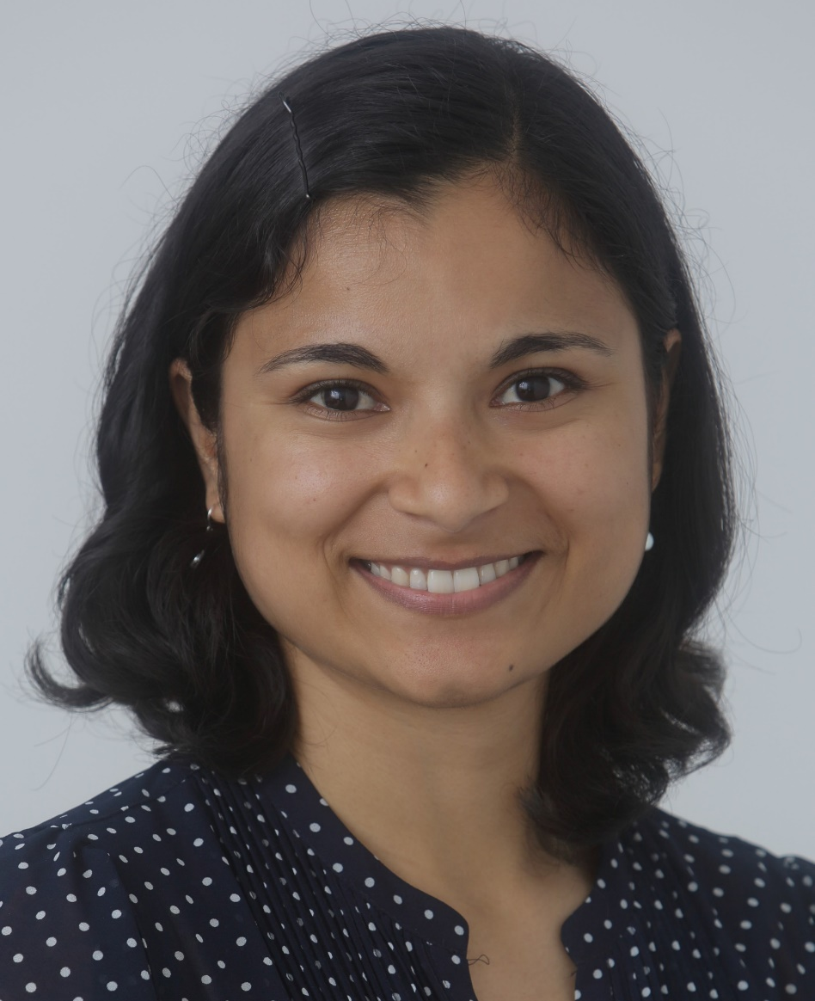


Nina Brahme, Ph.D., M.P.H.
Senior Clinical Analyst
Office of Therapeutic Biologics and Biosimilars (OTBB)
U.S. Food and Drug Administration (FDA)
Nina Brahme has worked with the Office of Therapeutic Biologics and Biosimilars (OTBB) at the U.S. Food and Drug Administration for over three years as part of an interdisciplinary team which supports communicating clear, consistent scientific advice for biosimilar and interchangeable product development. Previously, Nina was a product quality reviewer in FDA’s Office of Biotechnology Products (OBP). Nina received her Bachelors degree in Molecular and Cell Biology from University of California Berkeley and her PhD in Cell Biology from Yale University. As a National Cancer Institute Postdoctoral Fellow, she completed a Masters of Public Health from Harvard T.H. Chan School of Public Health.

Slide 5
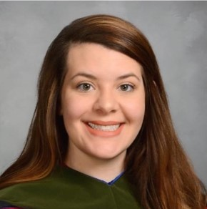
Shelley Skibinski, Pharm.D.
Project Coordinator
Office of Therapeutic Biologics and Biosimilars (OTBB)
U.S. Food and Drug Administration (FDA)
Shelley Skibinski is a Project Coordinator at the U.S. Food and Drug Administration (FDA) Office of Therapeutic Biologics and Biosimilars (OTBB). As a member of OTBB’s Policy Staff, Shelley works on policy and regulatory issues that impact biosimilar and interchangeable product development. She is also the lead for large-scale projects such as the Purple Book Database of Licensed Biological Products. Shelley graduated as a Doctor of Pharmacy from the Bernard J. Dunn School of Pharmacy at Shenandoah University. She joined FDA in January 2021 in her current role.

Slide 6
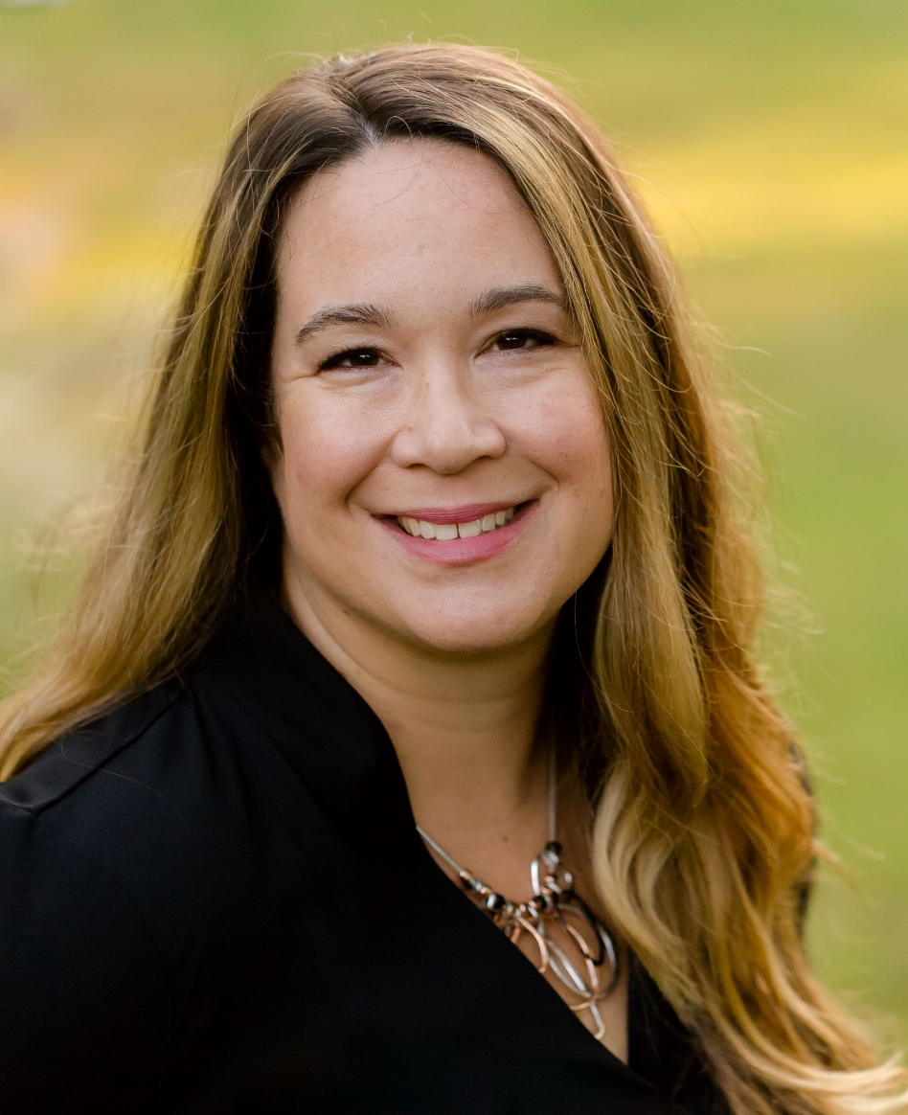
Sarah Ikenberry, M.A.
Senior Communication Advisor
Office of Therapeutic Biologics and Biosimilars (OTBB)
U.S. Food and Drug Administration (FDA)
Sarah Ikenberry is a Senior Communication Advisor at the Office of Therapeutic Biologics and Biosimilars (OTBB) in the Food and Drug Administration’s (FDA) Center for Drug Evaluation and Research (CDER). She provides communication advice and support to senior leaders and the agency about communicating strategic priorities, initiatives, and educational information about biosimilar and interchangeable products. Sarah received her Master of Arts in Communication from Johns Hopkins University.

Slide 7
Disclosures
Nina Brahme, Shelley Skibinski and Sarah Ikenberry have no relevant financial relationships to disclose.
7

Slide 8

Nina Brahme, Ph.D., M.P.H.
Biosimilar and Interchangeable Biological Products: An Overview of Scientific Concepts and Practical Resources

Slide 9
Learning Objectives
At the end of this presentation, learners will be able to:
Pharmacist –
1. Describe how biologics differ from small molecules (size, complexity, manufacturing) and explain why some biologics cannot be copied exactly.
2. Compare and contrast the development, statutory requirements, and approval process for new biologics and for biosimilars/interchangeables.
3. Compare and contrast the requirements for generics and biosimilars/interchangeables.
4. Describe the U.S. Food and Drug Administration's (FDA) educational resources available for healthcare providers to learn more about biosimilar and interchangeable products.
5. Explain how to use the Purple Book Database of Licensed Biological Products.
9

Slide 10
Learning Objectives continued
At the end of this presentation, learners will be able to:
Pharmacy Technician -
1. Describe how biologics differ from small molecules (size, complexity, manufacturing) and explain why some biologics cannot be copied exactly.
2. State the development, statutory requirements, and approval process for new biologics and for biosimilars/interchangeables.
3. State the requirements for generics and biosimilars/interchangeables.
4. Describe the U.S. Food and Drug Administration's (FDA) educational resources available for healthcare providers to learn more about biosimilar and interchangeable products.
5. Explain how to use the Purple Book Database of Licensed Biological Products
10

Slide 11
What are Biosimilars?
Biosimilars : Original Biologic Products Generics : Original Drug Products
11

Slide 12
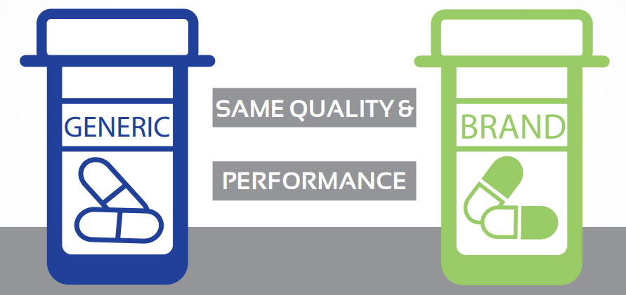



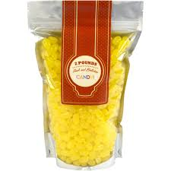
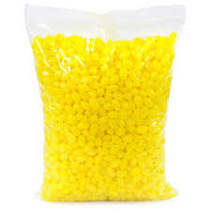
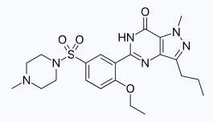
What are Generics?
Approved as Abbreviated
New Drug Applications (ANDA’s)
Approved as New
Drug Applications (NDA’s)
⬄
⬄
⬄
⬄
A molecule
A molecule
A pill
A pill
12

Slide 13
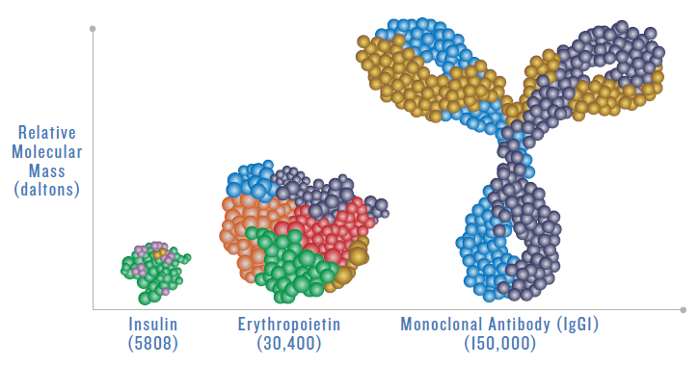
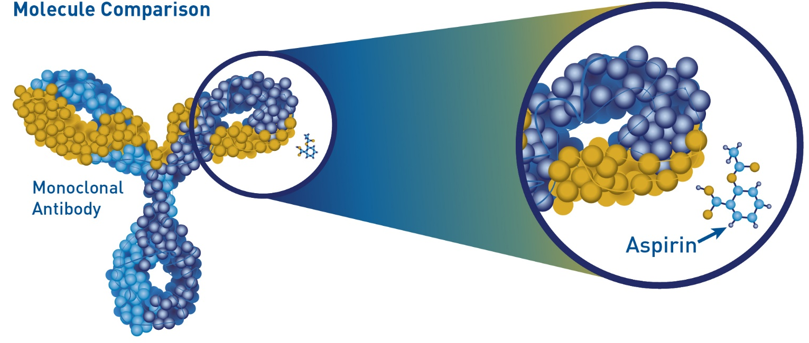
Biological Products
Biologics are generally large and produced from living systems such as a microorganisms (yeast or bacteria), or plant or animal cells
They range in size and complexity
Examples: therapeutic proteins (hormones, growth factors, monoclonal antibodies), vaccines, blood products
Modified from Mellstedt H, EJC Supplements II, 2013, 3, I - II
13

Slide 14
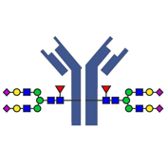
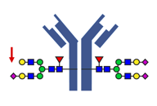
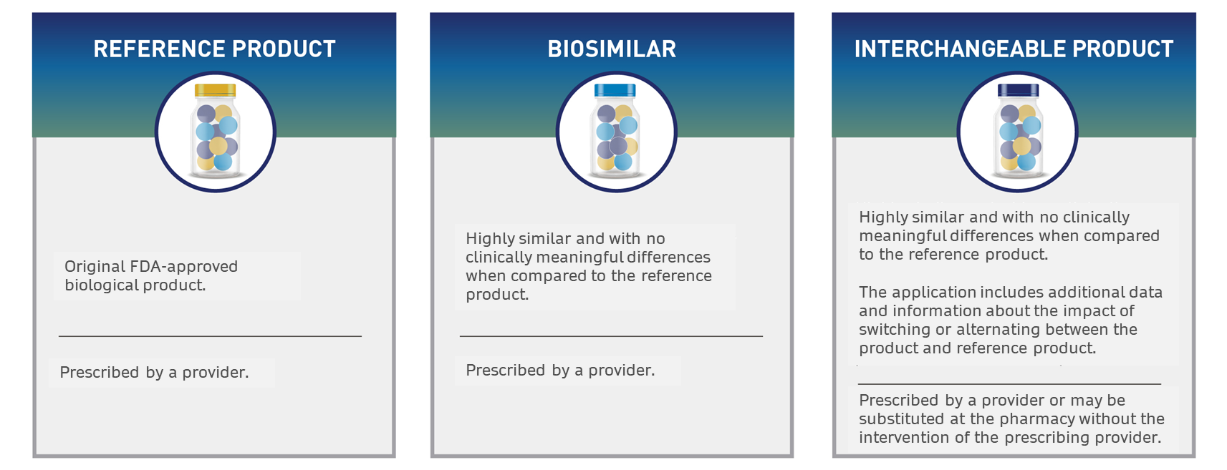
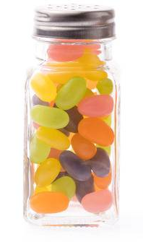
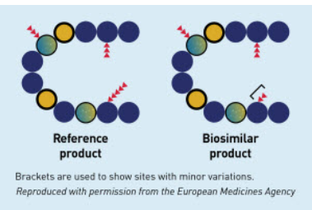
Therapeutic Proteins: Complexity
Add-ons and other post-translational changes create “variants”
A consistent mix of variants
exists in every sample/dose
Protein frame is an exact copy
Biosimilars Info Sheet Level 1: foundational concepts
14

Slide 15
Q: Why use the term “biosimilar” instead of “generic?”
A: Because, unlike chemical drugs, biologics can’t be copied exactly
Q: Why can’t a biologic be copied exactly?
A: Because biologics aren’t made up of identical versions of the same molecule. They are a mix of versions of a molecule.

Slide 16
How does FDA determine biosimilars to be acceptable for approval?
16

Slide 17
Biological Product Regulation
351(a) “stand alone” Biologics License Application (BLA): contains all information and data necessary to demonstrate that the proposed biological product is safe, pure and potent
The Biologics Price Competition and Innovation Act of 2009 (BPCI Act)
Created an abbreviated licensure pathway [351(k)] for biological products shown to be biosimilar to or interchangeable with an FDA-licensed reference product (originator 351(a)-licensed biological product)
17

Slide 18
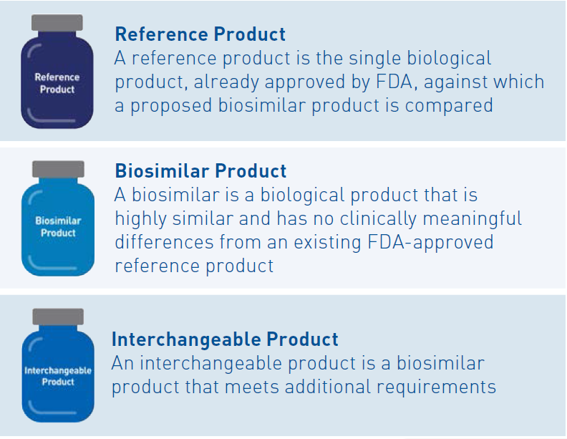

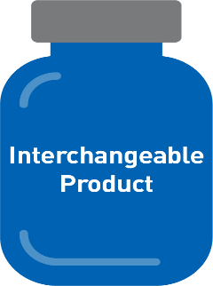
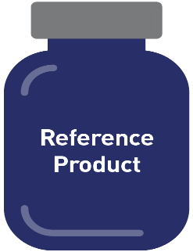
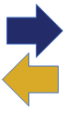
Key Definitions from the BPCI Act
Reference Product
Reference Product
A reference product is the single biological product, already approved by FDA, against which a proposed biosimilar product is compared
Biosimilar Product
Biosimilar Product
A biosimilar is a biological product that is highly similar to and has no clinically meaningful differences from an existing FDA-approved reference product
Biosimilar Product
Interchangeable Product
-Is a biosimilar
-Expected to produce the same clinical result as the reference product (RP) in any given patient
-Switching between the proposed product and the RP does not ↑safety risks or ↓effectiveness compared to using the RP without switching
Interchangeable Product
Reference Product
Interchangeable Product
Reference Product
18
18

Slide 19
Different Goals for “Stand-alone” vs. Biosimilar Development
“Stand-alone”: 351(a) BLA
Goal: To establish de novo safety and
efficacy of a new product
“Abbreviated”: 351(k) BLA
Goal: To demonstrate biosimilarity (or
interchangeability) to a reference product
based on comparative assessments
Clinical Safety & Efficacy Study for Each Indication
Clinical Pharmacology
Animal
Product Quality
Additional Clinical Studies
Clinical Pharmacology
Animal
Comparative Analytical Assessment
Product Quality
19

Slide 20
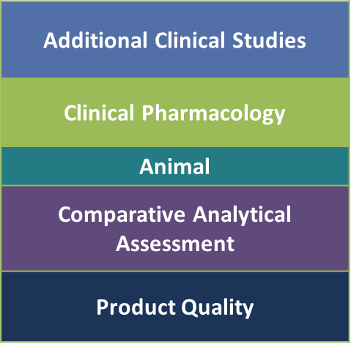
Comparative Analytical Assessment is the Foundation
Compare multiple physicochemical and biological attributes of each product
Analytical studies are generally more sensitive than clinical studies in detecting differences between products, should differences exist
A biosimilar product with highly similar structure and function to the reference product should behave like the reference product
Analyze multiple lots of the reference product and proposed biosimilar for product quality attributes, including:
Primary amino acid sequence
Higher order structure (protein folding)
Post-translational modifications (glycosylation, etc.)
Heterogeneity (charge, size, aggregates, etc.)
Biological activity - evaluation of attributes that affect the
known MoAs
20

Slide 21
Case Study of Interchangeable Biosimilar Semglee (insulin glargine-yfgn or MYL-1501D)
21

Slide 22
Semglee (insulin glargine-yfgn) vs US-Lantus: Quality Attributes Compared*
Other
Zinc content
Protein Concentration
Activity and concentration in U/mL
Aggregates/High molecular weight proteins
Isoelectric point
Primary structure
Amino acid sequence and mass
Higher order structure
Conformation
Tertiary and higher order structures
Hydrodynamic radius
Disulfide bonds
Secondary structure
Product Variants
Deamidation
Glycerol ester
Citric acid conjugate
Acetylation
Mitogenic Activity
IR-A phosphorylation
Mitogenic assay (Sao2 cells)
IR-A binding kinetics
IGF1R binding kinetics
Metabolic Activity
IR-B phosphorylation
Glucose uptake assay
IR long form receptor binding kinetics
IR autophosphorylation
Adipogenesis assay
Inhibition of stimulated lipolysis assay
*Not an exhaustive list; Information summarized and adapted from the Product Quality Review available on drugs@fda
22

Slide 23
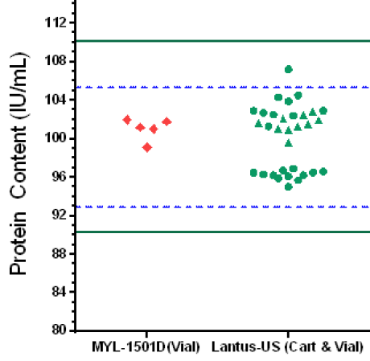
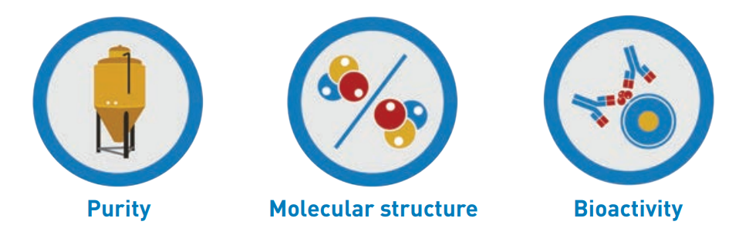
Case study MYL-1501D vs. US-Lantus Protein Concentration Example
These studies provide data to support the structural
and functional similarity of MYL-1501D to
US-Lantus and evaluate the impact of any
differences identified.
Protein Concentration IU/mL
Green lines represent the QR limits (mean ± 3SD of US-Lantus).
Additional MYL-1501D lots were analyzed for this assay and as part of the overall CAA
23
Adapted from the Product Quality Review available on drugs@fda

Slide 24
Role of Clinical Studies
As a scientific matter, FDA expects an adequate clinical PK, and PD if relevant, comparison between the proposed biosimilar product and reference product and a clinical immunogenicity assessment
Additional clinical studies are not considered “pivotal” in the way Phase 3 clinical trials are for standalone development
Add to the totality-of-the-evidence
that supports a demonstration of biosimilarity
24

Slide 25
Type of Clinical Data
Clinical Pharmacology Studies
PK and/or PD is generally considered more sensitive than clinical efficacy endpoints when assessing for differences between products, should they exist.
PK and PD similarity data support a demonstration of biosimilarity with the assumption that similar exposure (and pharmacodynamic response, if applicable) will provide similar efficacy and safety (i.e., an exposure-response relationship exists).
Use of a single scientifically appropriate PD biomarker or a composite of more than one relevant PD biomarker to demonstrate PD similarity can reduce residual uncertainty.
At least 1 clinical study that includes a comparison of the immunogenicity of the proposed and reference product generally will be expected.
A comparative clinical study is considered necessary if there are residual uncertainties about whether there are clinically meaningful differences between the proposed product and reference product based on structural and functional characterization, animal testing, human PK and PD data, and clinical immunogenicity assessment.
25

Slide 26
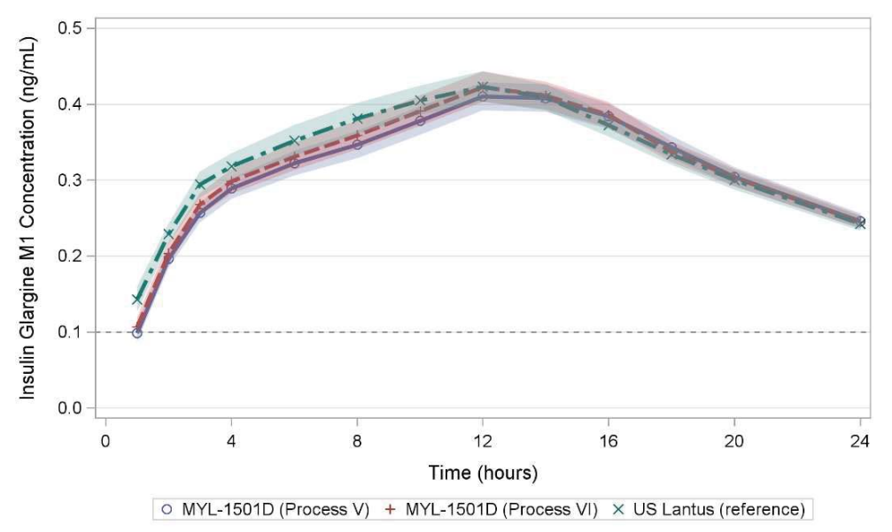
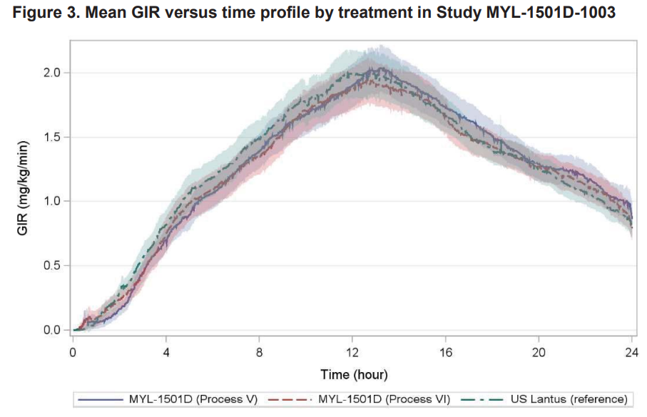

Semglee (insulin glargine-yfgn) vs US-Lantus: PK/PD Compared
PK/PD Similarity Study
Euglycemic clamp study in healthy subjects
 | Parameter | GMR (%) | 90% CI
PK similarity | AUC0-24h | 99.08 | 95.11 – 103.22
 | Cmax | 99.63 | 94.94 – 104.55
PD similarity | GIR AUC0-24h | 94.92 | 86.95 – 103.62
 | GIRmax | 96.44 | 89.33 – 104.11
Similar Exposure
Similar Efficacy
Similar Safety
26
Adapted from the Multi-Discipline Review available on drugs@FDA

Slide 27




Case Study – Summary for Biosimilarity
Comparative analytical data demonstrate that MYL-1501D and US-Lantus are highly similar, notwithstanding minor differences in clinically inactive components
PK/PD similarity data in healthy subjects support the demonstration of no clinically meaningful differences in safety, purity, and potency
The totality of the data support the Applicant’s claim that MYL-1501D is biosimilar to US-Lantus
Analytical studies
Animal studies
A clinical study or studies
FDA Review
Totality of the evidence
27

Slide 28
Key Takeaways: Biosimilarity
Biological products are generally large molecules that range in size and complexity.
Small variations in biologics, whether they are reference products, biosimilars or interchangeable biosimilars, can be expected within each lot (dose) or between lots (doses). The manufacturing process for biologics is carefully controlled and monitored to keep the variations within acceptable limits.
Comparative analytical data are the foundation of a biosimilarity assessment; a biosimilar is shown to be highly similar by extensive analytical comparisons of structure and function.
A biosimilar manufacturer must also demonstrate that the product has no clinically meaningful differences from the reference product. This may be demonstrated through human pharmacokinetic (i.e., exposure) and pharmacodynamic (i.e., response) studies, an assessment of clinical immunogenicity, and, if needed, a comparative clinical study in patients.
28

Slide 29


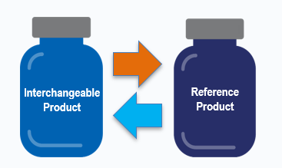
Why Seek Interchangeability?
An interchangeable biosimilar product can be substituted for the reference product at pharmacies without the intervention of the prescribing health care provider, subject to state pharmacy laws.
Pharmacy Substitution
Interchangeable Biological Products
29

Slide 30
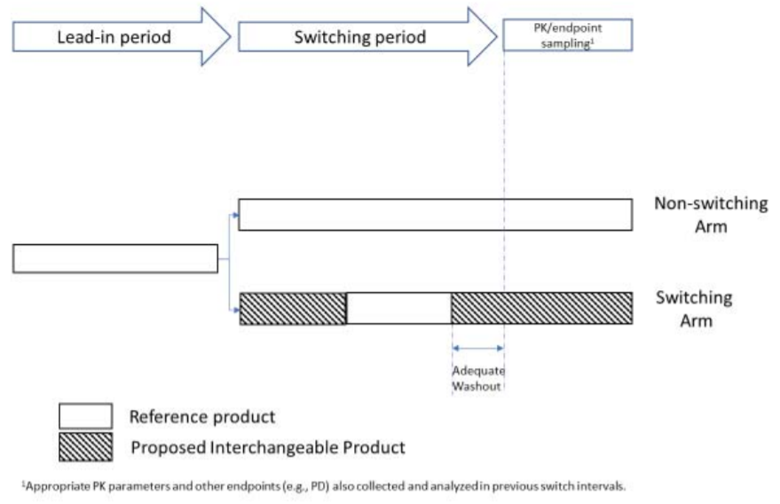
Interchangeable Product Examples: Cyltezo
The extent of additional data, including clinical data needed to support a demonstration of interchangeability will depend on factors, such as the product’s complexity or a product’s specific immunogenicity risk.
Cyltezo (adalimumab-adbm)
Cyltezo previously approved as biosimilar to US-Humira
Switching study designed as recommend in guidance*
*Considerations in Demonstrating Interchangeability With a Reference Product Guidance for Industry | FDA
30

Slide 31
Interchangeable Product Examples: Semglee
Semglee (insulin glargine-yfgn)
Comparative analytical assessment to support “highly similar” conclusion
Clinical pharmacology PK/PD similarity study
Immunogenicity assessment justification submitted, per guidance*
Switching study was determined to be unnecessary
Relatively small, structurally uncomplicated, well characterized
Minimal or no risk of clinical impact from immunogenicity
*Clinical Immunogenicity Considerations for Biosimilar and Interchangeable Insulin Products | FDA
31

Slide 32
Key Takeaways: Interchangeability
Interchangeable biosimilar products are pharmacy substitutable without intervention of the prescribing health care provider, subject to state laws.
FDA’s approval of an interchangeable biological product does not indicate a higher standard of biosimilarity. Different statutory criteria reflect scientific considerations related to the potential for substitution without the intervention of the prescriber.
Patients and healthcare providers do not need to wait for a biosimilar product to “become” an interchangeable product. Business considerations may influence applicants’ decisions about which type of licensure to seek.
32

Slide 33
Using Biosimilar and Interchangeable Products
33

Slide 34
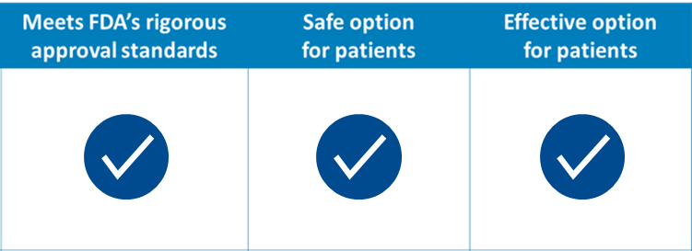
Using Reference, Biosimilar, and Interchangeable Products
Patients and healthcare providers can be confident in the safety and effectiveness of a biosimilar and interchangeable product and prescribe them by name, just as for the reference product.
Biosimilar and interchangeable biosimilar products can be used in patients who have previously been treated with the reference product (i.e., treatment-experienced), and in patients who have not previously been treated with the reference product (i.e., treatment-naïve).
Interchangeable biosimilars may be substituted
for the reference product without the intervention
of the prescribing health care provider,
subject to state laws.
Reference Product
34

Slide 35
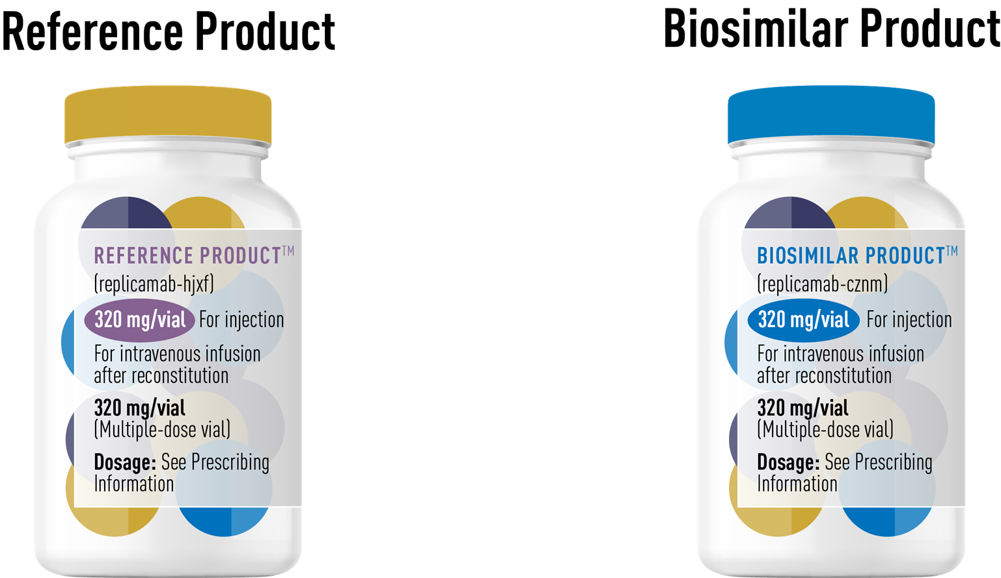
Biosimilar and Interchangeable Labeling
The labeling summarizes the scientific information health care practitioners need for safe and effective use of the product.
A biosimilar or interchangeable is not required to have the same labeling as its reference product (e.g., a it can be labeled for fewer than all indications or there may be differences in storage/preparation).
Health care professionals are advised to review the labeling (i.e., prescribing information) of the biosimilar or interchangeable to determine the conditions of use (e.g., indications, dosing regimens) and routes of administration for which the product is approved.
FDA recommends that Highlights of Prescribing Information contain a “Biosimilarity Statement” or an “Interchangeability Statement” describing the product’s relationship to its reference product.
35

Slide 36
Biosimilarity Statement
NEXSYMEO (replicamab-cznm) is biosimilar* to JUNEXANT (replicamab-hjxf).
*Biosimilar means that the biological product is approved based on data demonstrating that it is highly similar to an FDA-approved biological product, known as a reference product, and that there are no clinically meaningful differences between the biosimilar product and the reference product. Biosimilarity of NEXSYMEO as been demonstrated for the condition(s) of use (e.g., indication(s), dosing regimen(s)), strength(s), dosage form(s), and route(s) of administration described in its Full Prescribing Information.
36

Slide 37
Biological Product Naming Convention
Most biological products, including more recently approved originator biologics, biosimilar, and interchangeable products, are subject to FDA’s naming policy.
The naming convention for biological products is a proper name consisting of a core name and a unique 4-letter suffix.
The suffix will be attached with a hyphen to the core name of each product.
Core name: component shared among biological products that contain related drug substances (eg, filgrastim, epoetin alfa)
Suffix: four lowercase letters that are unique and devoid of meaning (eg, -cznm, -hixf)
Proper name: core name + suffix
For example, for hypothetical products sharing the fictitious core name replicamab, the proper names would include a unique suffix:
Originator biological product: replicamab-cznm
Related biological product: replicamab-rzbh
Biosimilar product: replicamab-hixf
Interchangeable biosimilar product: replicamab-tkpl
replicamab-cznm
Core name
Unique 4-letter suffix
37

Slide 38

Timeline of Biosimilar and Interchangeable Biosimilar Approvals
Biosimilars
05/15/18
Retacrit (epoetin alfa-epbx)
06/04/18
Fulphila (pegfilgrastim-jmdb)
07/20/18
Nivestym (filgrastim-aafi)
10/30/18
Hyrimoz (adalimumab-adaz)
11/02/18
Udenyca (pegfilgrastim-cbqv)
11/28/18
Truxima (rituximab-abbs)
12/14/18
Herzuma (trastuzumab-pkrb)
2015
2016
2017
2018
2019
2020
2021
2022
Interchangeable Biosimilars
02/2022
Relueko (filgrastim-ayow)
04/2022
Alymsys (bevacizumab-maly)
05/26/2022
Fylnetra (pegfilgrastim-pbbk)
04/05/16
Inflectra (Infliximab-dyyb)
08/30/16
Erelzi (etanercept-szzs)
09/23/16
Amjevita (adalimumab-atto)
06/10/20
Nyvepria (pegfilgrastim-apgf)
07/06/20
Hulio (adalimumab-fkjp)
12/17/20
Riabni (rituximab-arrx)
08/2/2022
Cimerli (ranibizumab-eqrn)
03/06/15
Zarxio (filgrastim-sndz)
04/21/17
Renflexis (Infliximab-abda)
08/25/17
Cyltezo (adalimumab-adbm)
09/14/17
Mvasi (bevacizumab-awwb)
12/01/17
Ogivri (trastuzumab-dkst)
12/13/17
Ixifi (infliximab-qbtx)
01/18/19
Ontruzant (trastuzumab-dttb)
03/11/19
Trazimera (trastuzumab-qyyp)
04/25/19
Eticovo (etanercept-ykro)
06/13/19
Kanjinti (trastuzumab-anns)
06/27/19
Zirabev (bevacizumab-bvzr)
07/23/19
Ruxience (rituximab-pvvr)
07/23/19
Hadlima (adalimumab-bwwd)
11/04/19
Ziextenzo (pegfilgrastim-bmez)
11/15/19
Abrilada (adalimumab-afzb)
12/6/19
Avsola (infliximab-axxq)
7/28/21
Semglee (insulin glargine-yfgn)
09/17/21
Byooviz (ranibizumab-nuna)
10/15/21
Cyltezo (adalimumab-adbm)
12/17/2021
Yusimry (adalimumab-aqvh)
Rezvoglar (insulin glargine-aglr)
37 Approved
>20 Currently marketed
https://www.fda.gov/drugs/biosimilars/biosimilar-product-information
38

Slide 39
Shelley Skibinski, Pharm.D.

Slide 40
FDA Resources and Education Materials
40

Slide 41
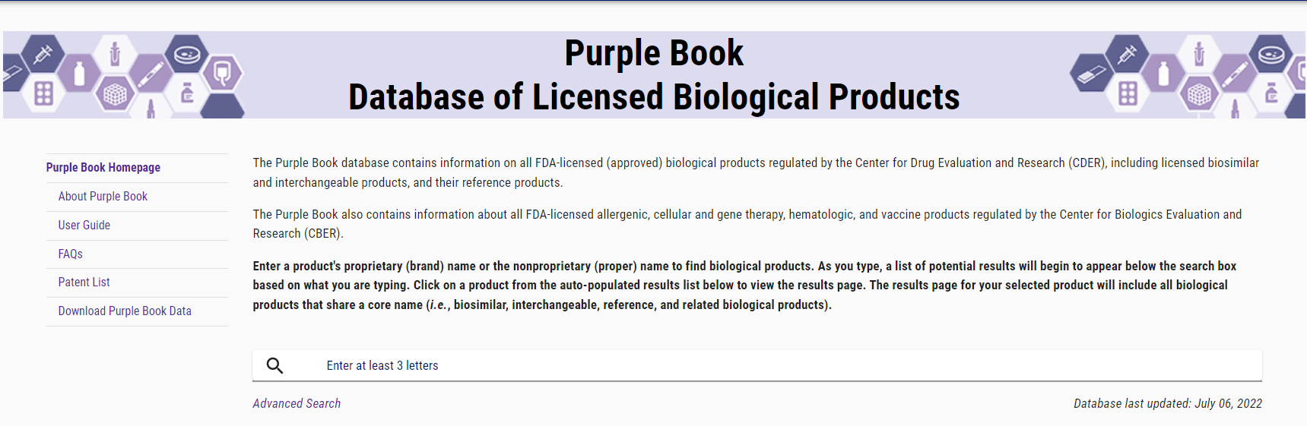
The Purple Book Database
The Purple Book Database contains information on all FDA-licensed (approved) biological products regulated by the Center for Drug Evaluation and Research (CDER), including licensed biosimilar and interchangeable products, and their reference products.
The Purple Book also contains information about all FDA-licensed allergenic, cellular and gene therapy, hematologic, and vaccine products regulated by the Center for Biologics Evaluation and Research (CBER).
The database can be found at PurpleBookSearch.fda.gov
41

Slide 42

Purple Book's Features
The database provides patients, payors, clinicians, and others with an accessible, easy-to-use online search engine with more information about FDA-approved biological products, including biosimilar and interchangeable biological products, and their reference products.
Features tailored to different user needs, including:
Simple Search and Advanced Search
User Guide with detailed instructions for site location functions
Auto-populated search results
Additional advanced search filters
Data download and export options
Product label links
Show/hide sortable data column options
Searchable glossary of terms
https://purplebooksearch.fda.gov
42

Slide 43
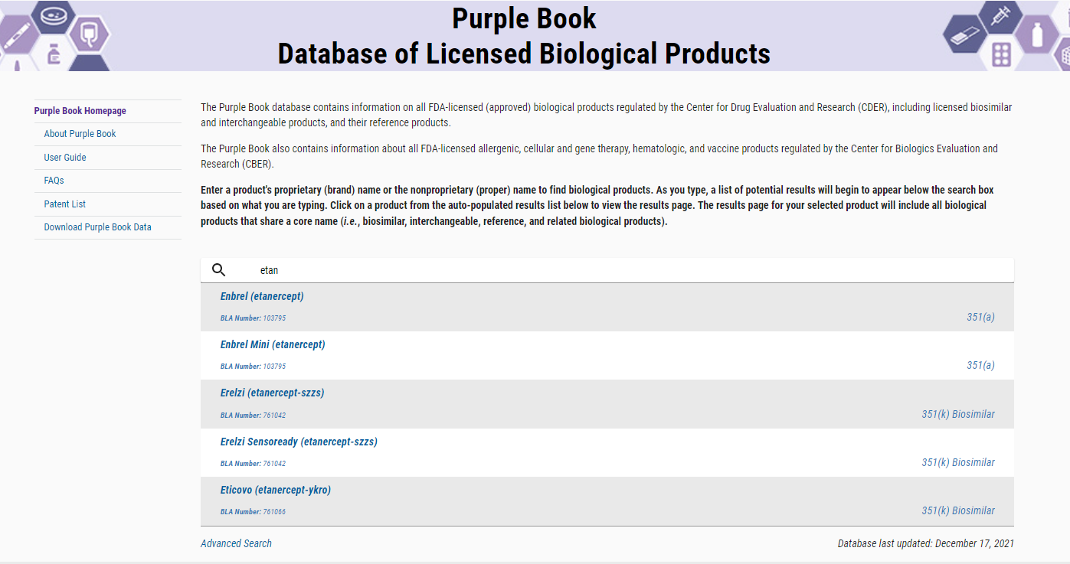

Homepage & Simple Search
https://purplebooksearch.fda.gov
43

Slide 44
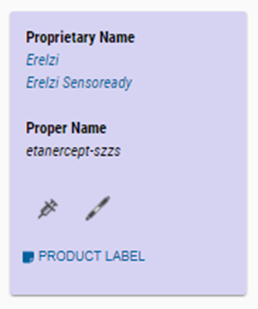

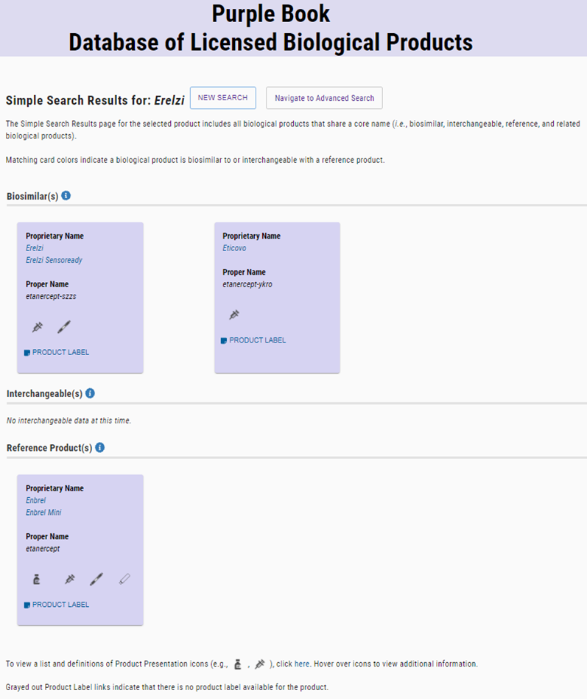
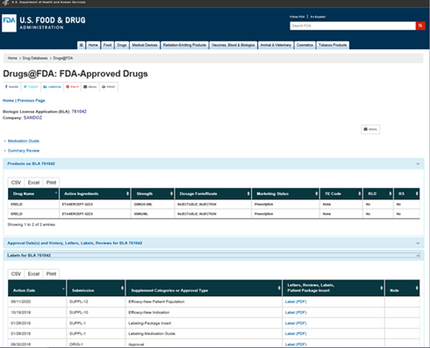
Simple Search Results
https://purplebooksearch.fda.gov
44

Slide 45
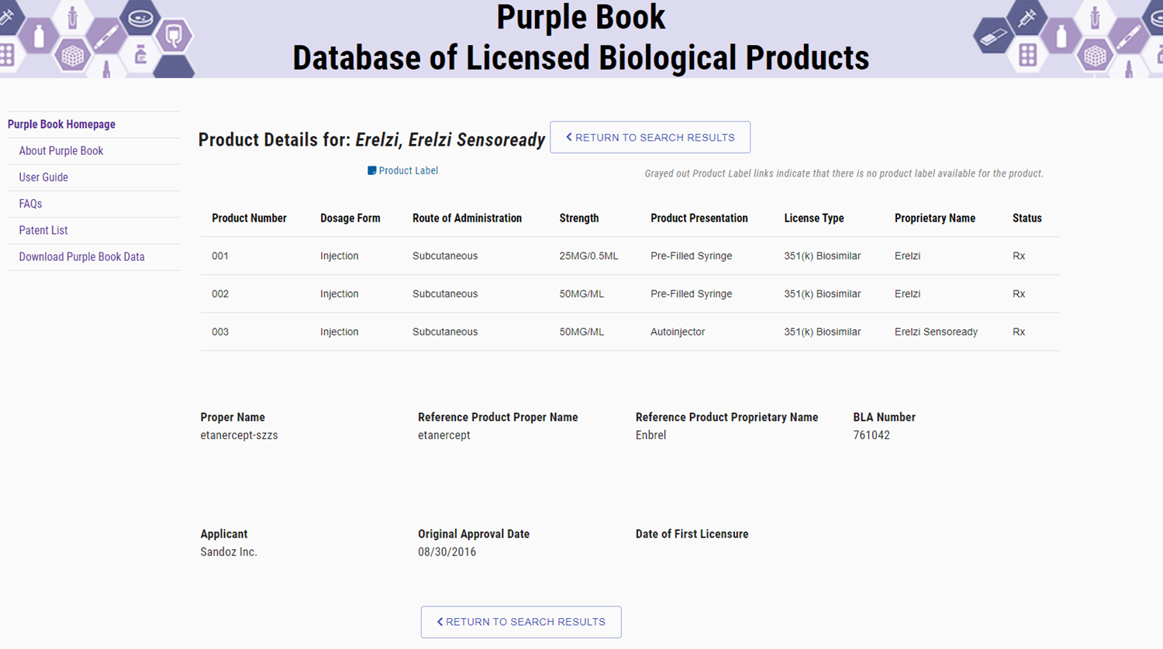
Product Details
https://purplebooksearch.fda.gov
45

Slide 46
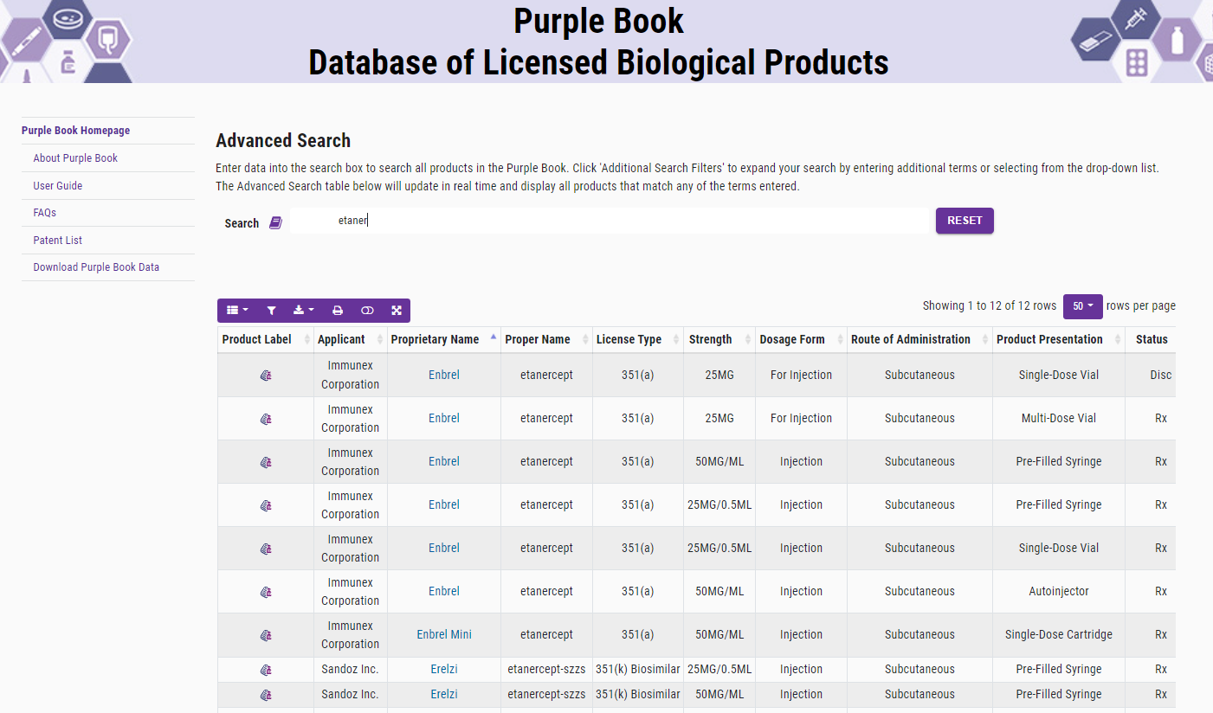
Advanced Search
https://purplebooksearch.fda.gov
46

Slide 47
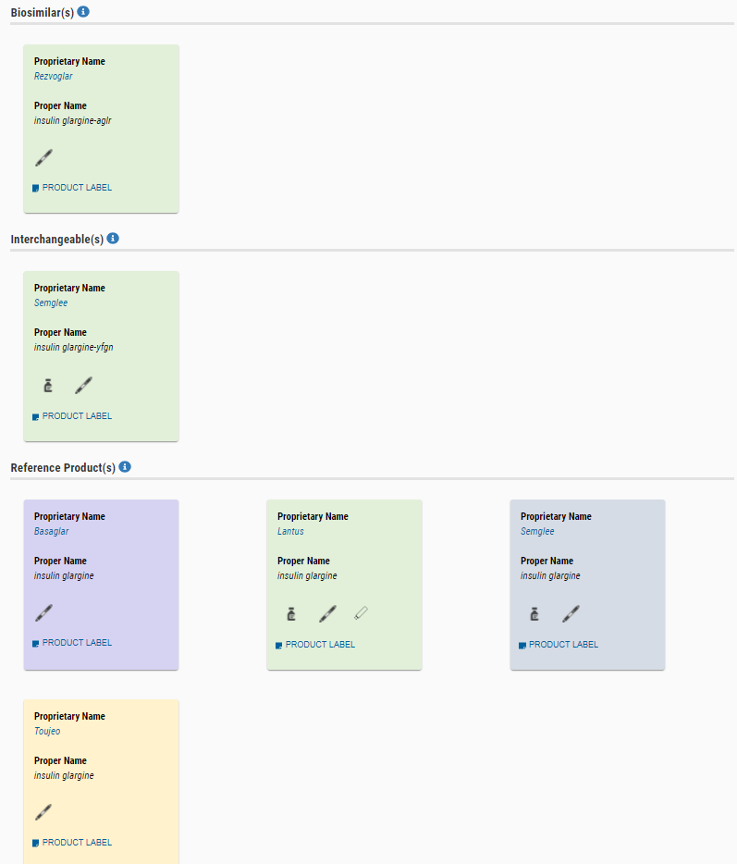
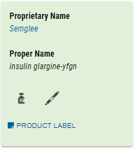
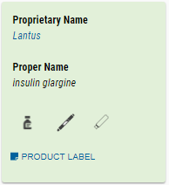
Interchangeable Products
https://purplebooksearch.fda.gov
47

Slide 48
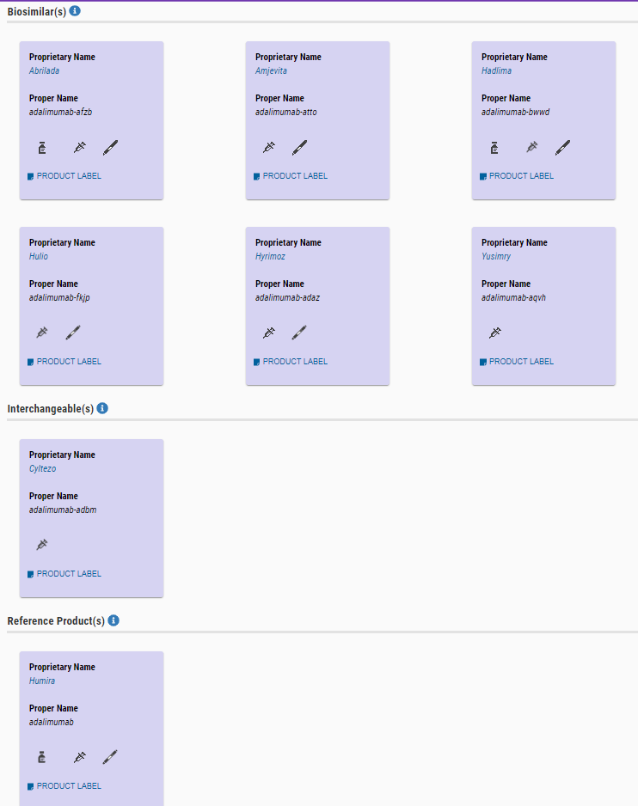
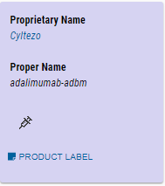
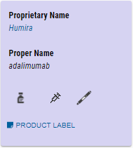
Interchangeable Products, Continued
https://purplebooksearch.fda.gov
48

Slide 49
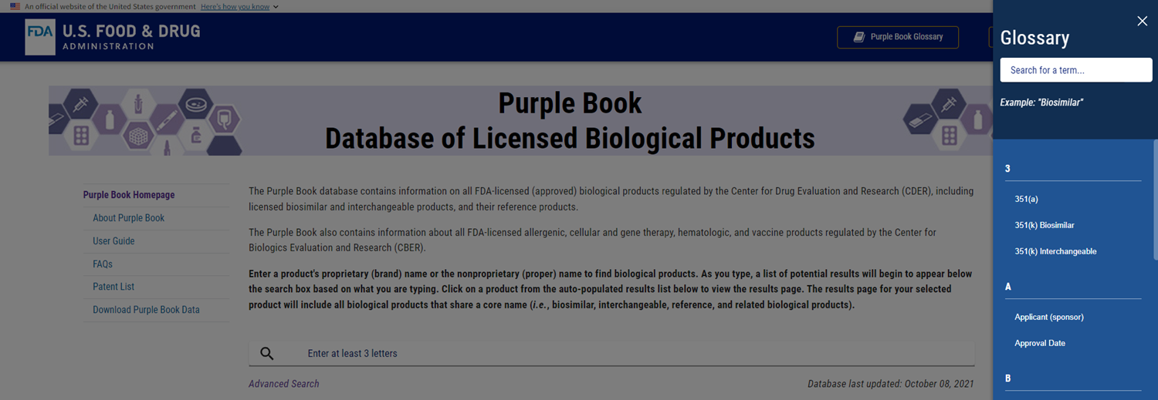
Glossary of Terms
https://purplebooksearch.fda.gov
49

Slide 50

Sarah Ikenberry, M.A.

Slide 51
Biosimilar Education and Outreach
FDA is committed to developing effective communications to improve understanding of biosimilars among patients, healthcare providers and payors
Engaging with healthcare professional and patient stakeholders
Developing educational materials for healthcare prescribers, pharmacists, and patients
Education is an undertaking that requires multi-stakeholder engagement
FDA is committed to fulfilling their important role as one of many stakeholders
51

Slide 52
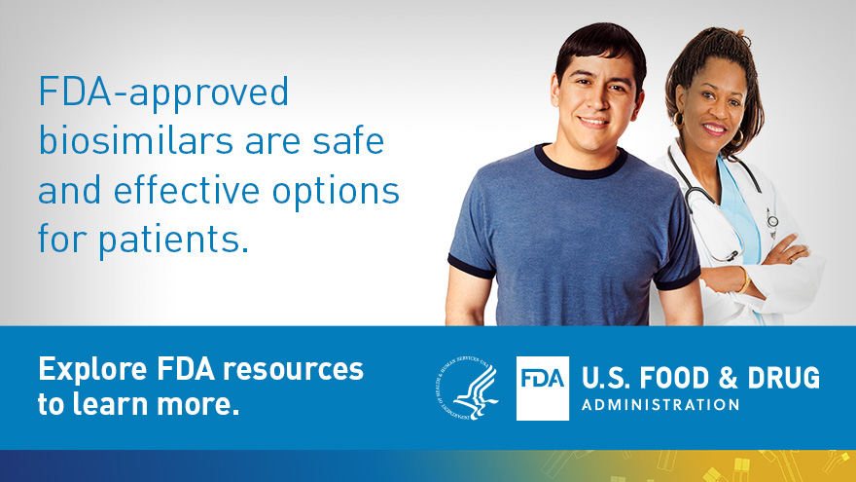
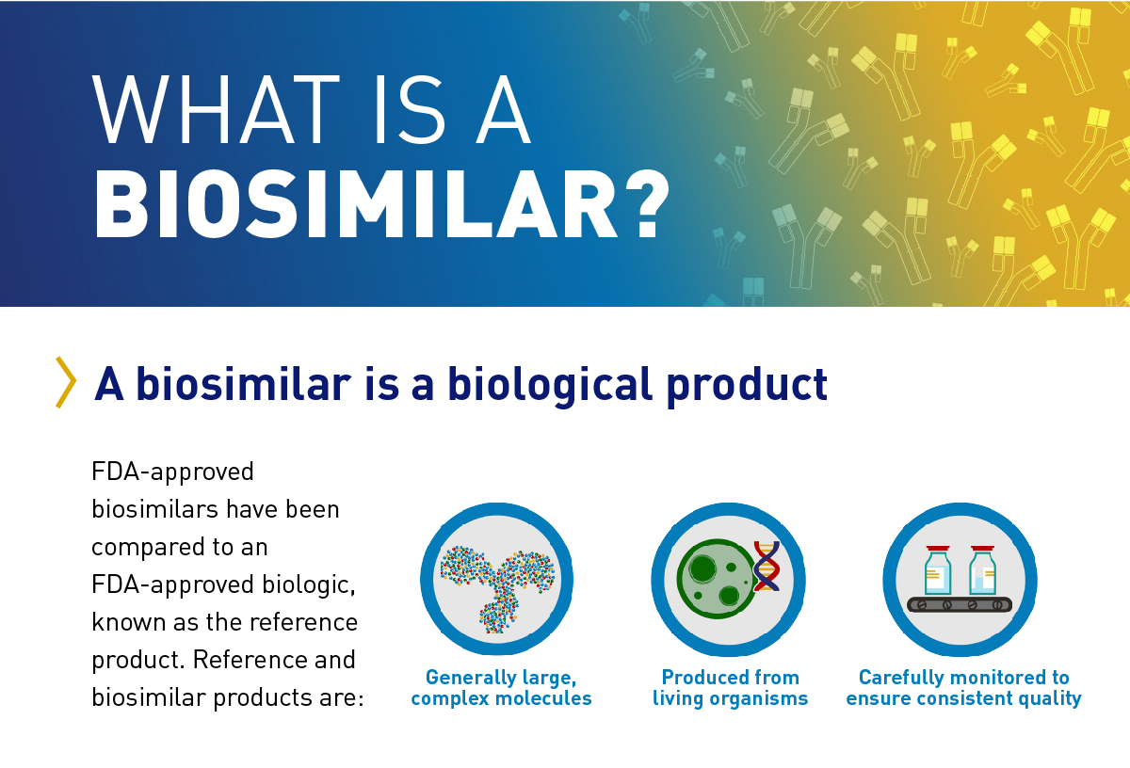
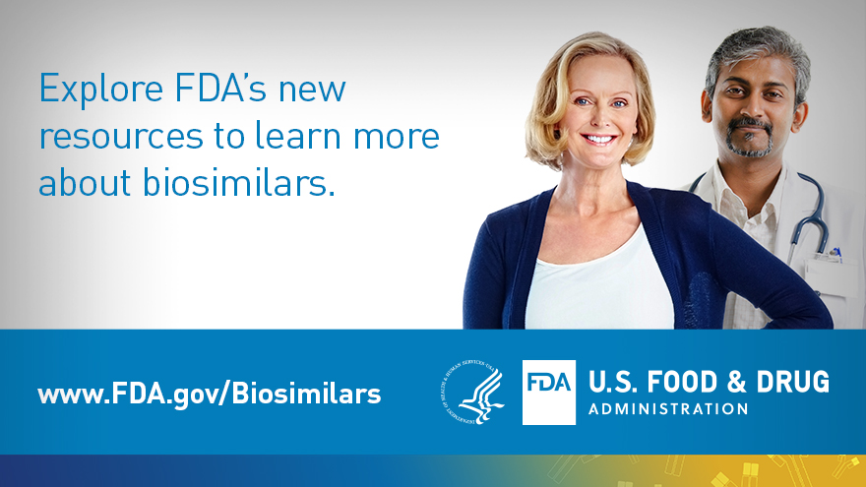

Healthcare Provider Materials
https://www.fda.gov/drugs/biosimilars/health-care-provider-materials
52

Slide 53
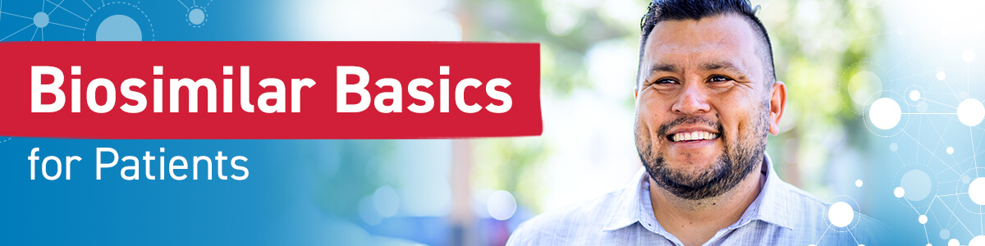
Web Content and Infographic:
Uses patient-friendly language and imagery
Addresses topics, concerns, and misconceptions shown to be most important to patients
Tested with patients treated with a biologic & patient advocacy organizations
https://www.fda.gov/drugs/biosimilars/patient-materials
53

Slide 54
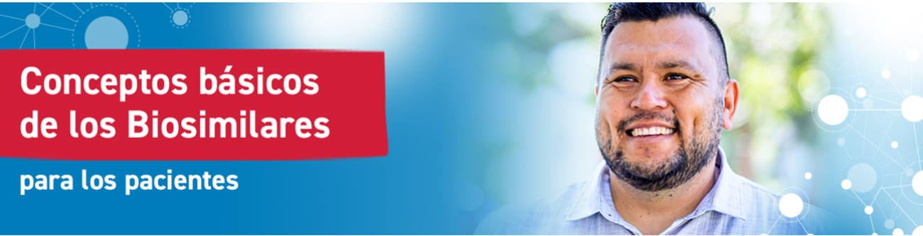
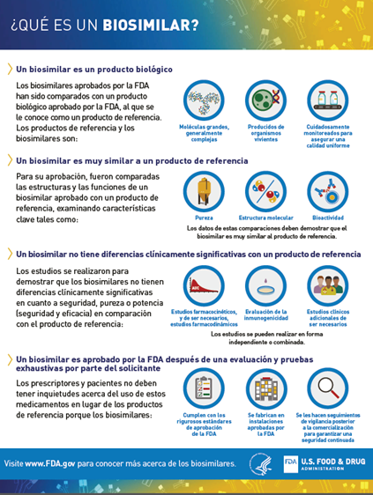
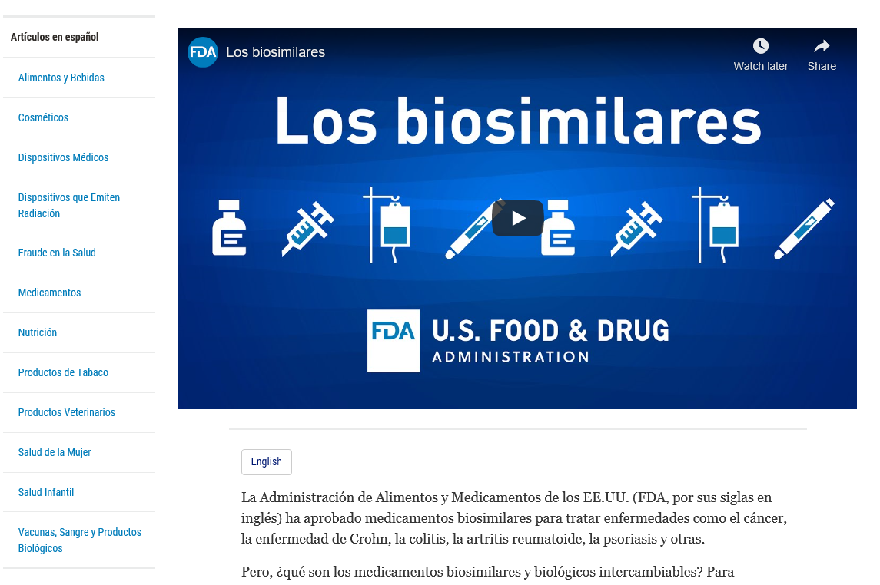
FDA Biosimilar Materials in Spanish
54

Slide 55
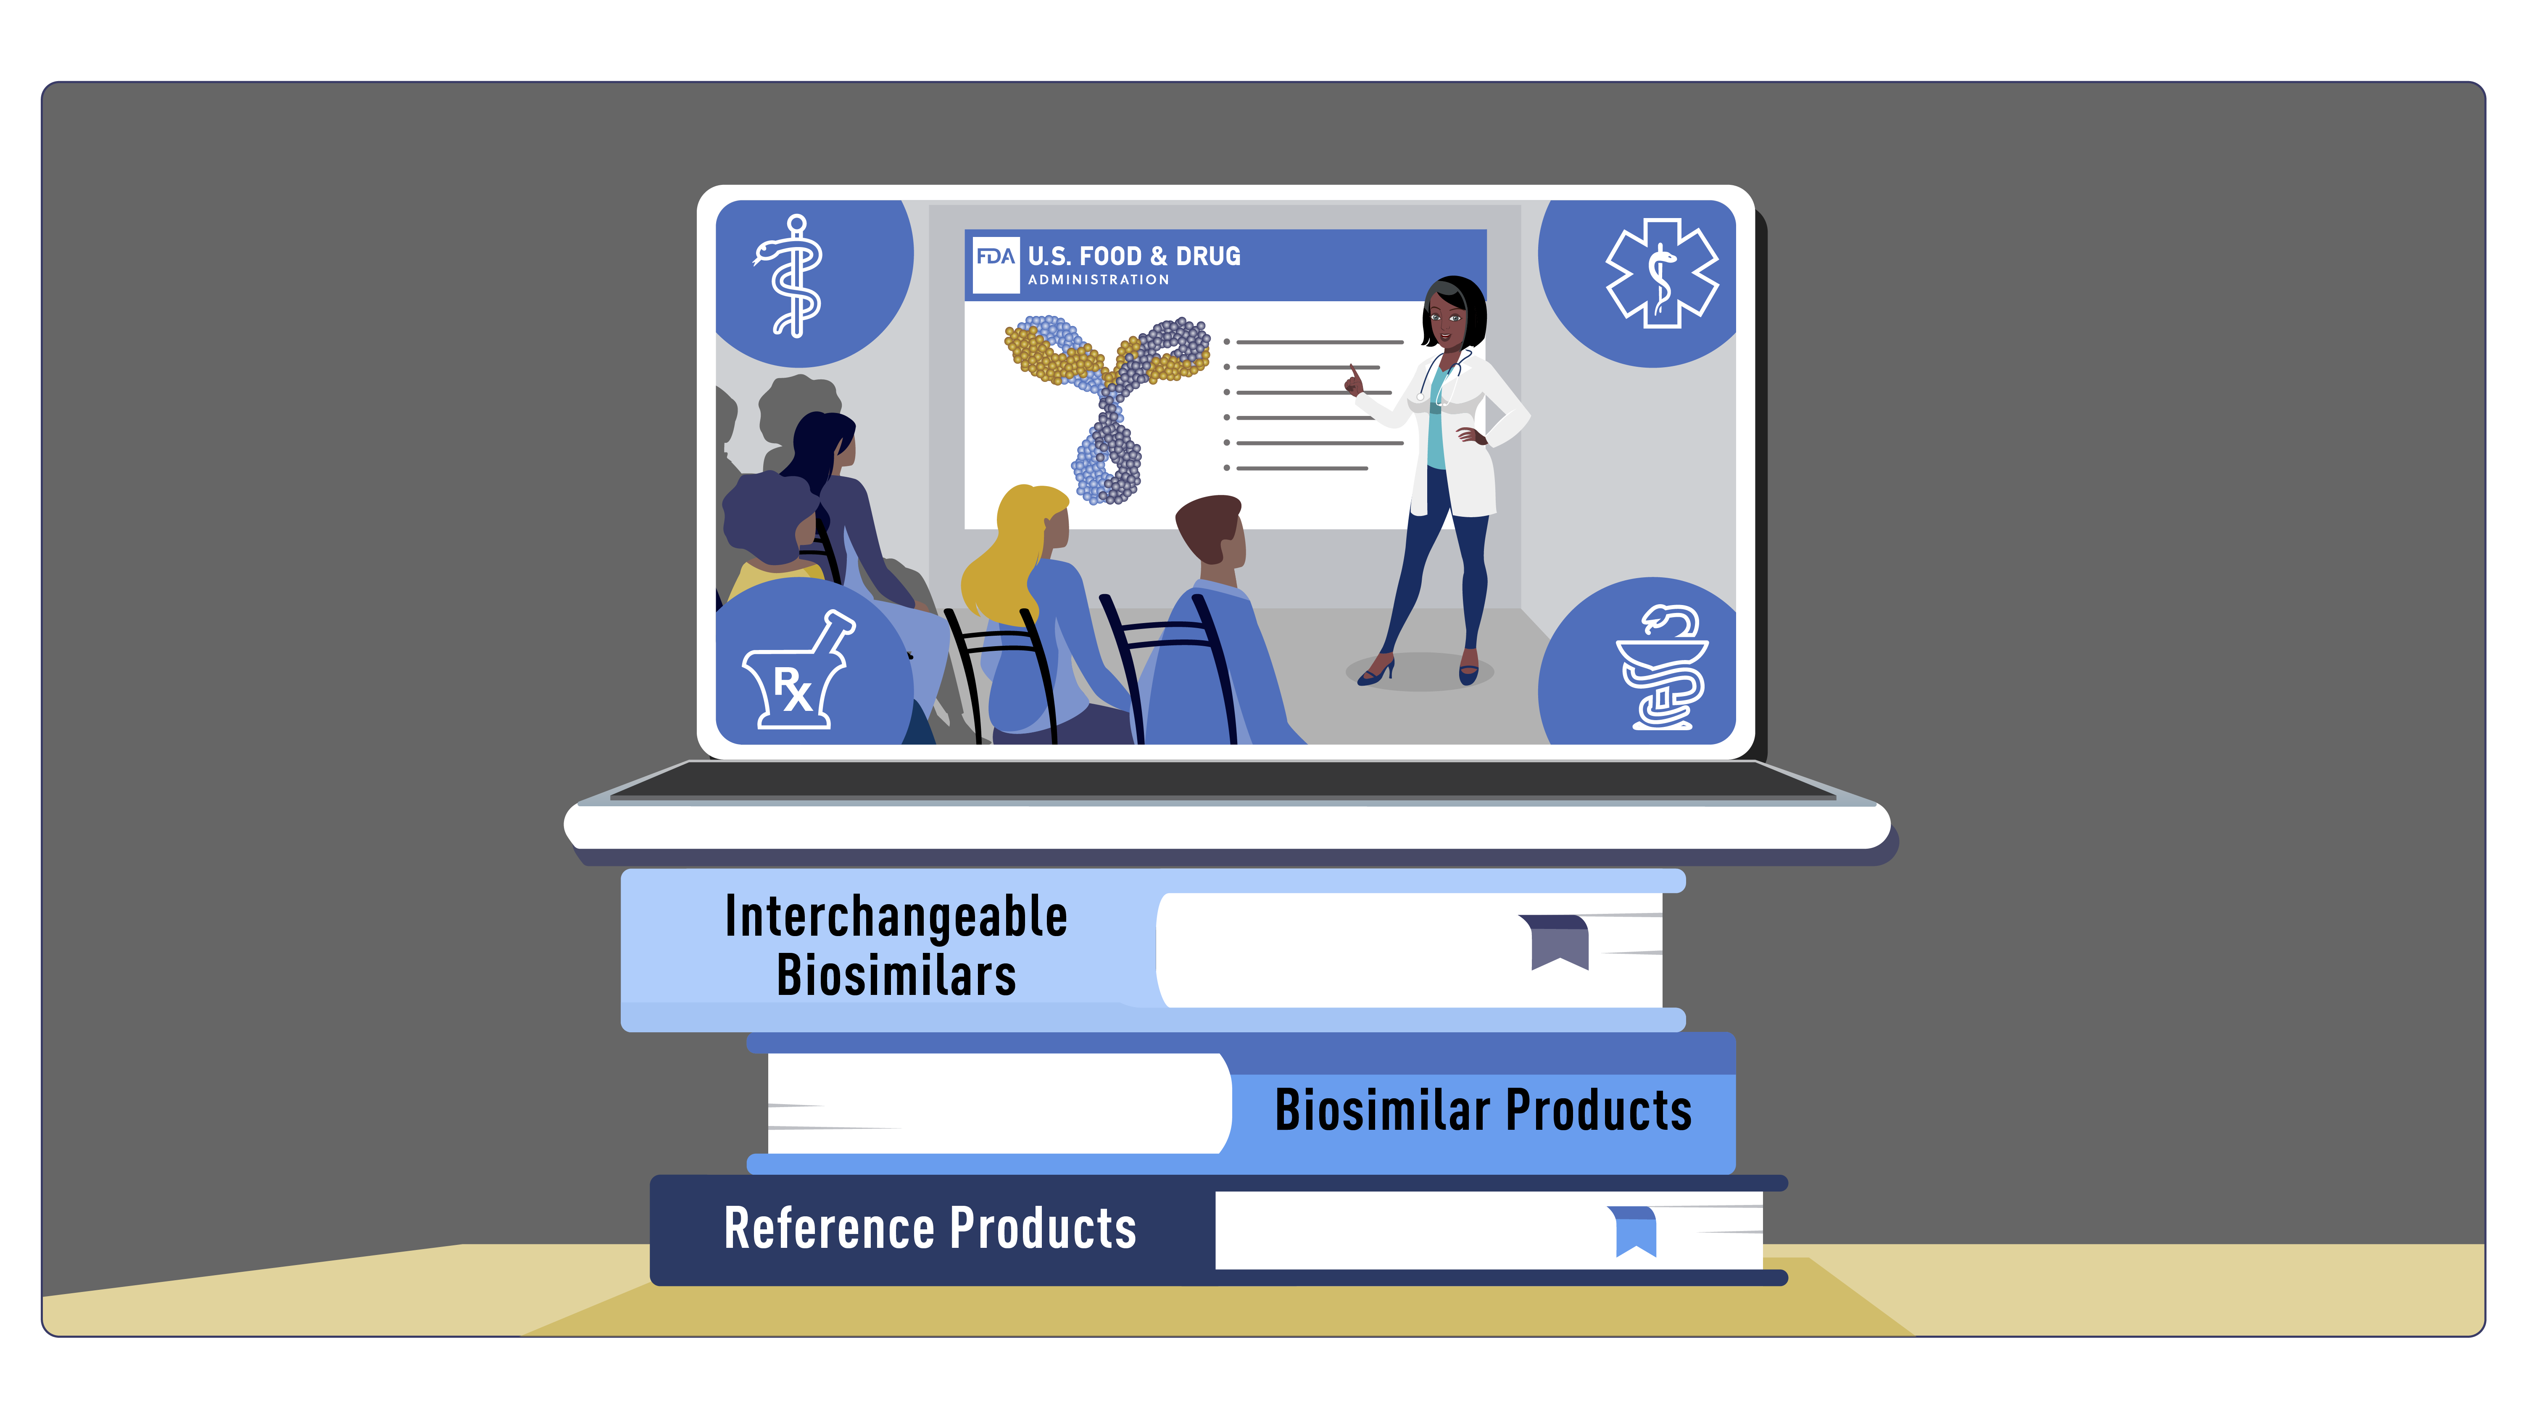
Curriculum for Healthcare Professional Programs
The Biosimilar Curriculum Toolkit contains multiple types of materials to help faculty integrate biosimilars and interchangeable products into the education and professional training of healthcare students.
Goal is to increase knowledge and real-world application of concepts among students in healthcare degree programs (Medicine, Nursing, Physician Asst./Assoc., and Pharmacy).
Materials are designed to meet a variety of needs and are divided into two (2) levels of content.
https://www.fda.gov/drugs/biosimilars/curriculum-materials-health-care-degree-programs-biosimilars
55

Slide 56
Curriculum for Healthcare Professional Programs, continued
Materials include a teaching guide, slide decks, videos, information sheets, case studies, discussion questions, exercises, and more.
Topics covered include:
Biologics, Biosimilars and Interchangeability
Approval pathways for biological products
Manufacturing and variation in biological products
Labeling and prescribing of biosimilar and interchangeable biosimilar products
https://www.fda.gov/drugs/biosimilars/curriculum-materials-health-care-degree-programs-biosimilars
56

Slide 57
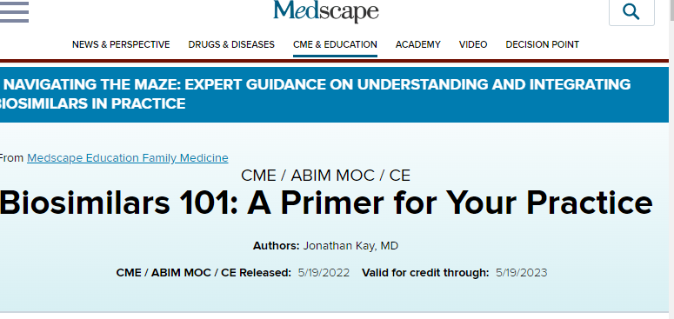
Medscape Continuing Education
Series of Continuing Education (CE) Courses through Medscape about biosimilar and interchangeable products
57

Slide 58
Future Education and Outreach Plans
Materials and resources for patients:
Videos
Additional infographics and graphics
Fact Sheets
Materials and resources for healthcare providers:
Videos
Continuing Education course options through Medscape - NOW AVAILABLE!
Updated Educational curriculum/teaching resources for HCP schools
58

Slide 59

Resources
Visit:
www.fda.gov/biosimilars for access to all the education materials and information about biosimilar and interchangeable products.
https://purplebooksearch.fda.gov/ The Purple Book: Database of Licensed Biological Products for information on biological products, including if products are biosimilar to a reference product.
www.fda.gov/drugsatfda (Drugs@FDA) for information on all FDA approved drug products, including labeling and review information.
Visit https://www.fda.gov/training-and-continuing-education/cderlearn-training-and-education (CDERLearn) for training and education opportunities
59

Slide 60
Available Educational Materials on FDA Webpages
Quality
Clinical Trial Evidence
Extrapolation
Interchangeability
Switching/Substitution
Biosimilar Regulatory Review and Approval
Patient Materials | FDA
Drugs@FDA: FDA-Approved Drugs
Biosimilar Development, Review, and Approval | FDA
Prescribing Biosimilar and Interchangeable Products | FDA
Interchangeable Biological Products
Webinars for CE
Product Information
Biosimilar and Interchangeable Biological Products: An Updated Review of Scientific Concepts and Practical Resources | FDA
The Purple Book: Database of Licensed Biological Products
60

Slide 61



CPE INSTRUCTIONS (LIVE VERSION): Biosimilar and Interchangeable Biological Products: An Overview of Scientific Concepts and Practical Resources
1
1
2
3
Redeem your credit online at
CEimpact.com
*If this is the first time you have utilized the CEimpact Learning Management System (LMS) you will need to create an account.
From the CEimpact.com Homepage – enter the code provided in the ‘Enter Code’ box and click SUBMIT.
Complete the Exam & Evaluation as prompted; click SUBMIT to send your information to CPE Monitor. Follow instructions to access your CPE Statement of Credit on CPE Monitor.
Pharmacist Code: ddusVV
Technician Code: 789F9F
The deadline for obtaining your CPE Credit is 9/24/2022.
The deadline is non-negotiable due to CPE Monitor reporting policies.
61

Slide 62
CPE INSTRUCTIONS (On-Demand Version): Biosimilar and Interchangeable Biological Products: An Overview of Scientific Concepts and Practical Resources
1
1
2
3
Redeem your credit online at
CEimpact.com
*If this is the first time you have utilized the CEimpact Learning Management System (LMS) you will need to create an account.
From the CEimpact.com Homepage – enter the code provided in the ‘Enter Code’ box and click SUBMIT.
Complete the Exam & Evaluation as prompted; click SUBMIT to send your information to CPE Monitor. Follow instructions to access your CPE Statement of Credit on CPE Monitor.
Click on My Courses. Then click on the Course Title in your Enrolled folder. Read the course instructions.
Pharmacist Code: vm5Wfm
Technician Code: eeaHvi
The deadline for obtaining your CPE Credit is 8/25/2025.
The deadline is non-negotiable due to CPE Monitor reporting policies.

Slide 63
Questions?

Slide 64
Thank you from www.fda.gov/biosimilars Email Questions or Comments to: CDER-BiologicsBiosimilarsInquiries@fda.hhs.gov or DRUGINFO@fda.hhs.gov
Thank You
64

Slide 65
Save the Date! Future HIMSS/NCPDP Townhall Sessions
September 27 @ 12:00pm ET – Topic: Pharmacy Standards for Value-based Arrangements
65

Slide 66

UPCOMING NCPDP WEBINARS:
NCPDP Pharmacy Standards – HIPAA Updates, Sept. 15 at 12 PM ET
Expanding Into Home-Based Services to Increase Revenue, Sept. 21 at 1PM ET
https://www.ncpdp.org/Webinars.aspx
66

Slide 67
SAVE THE DATE!
NCPDP’s 2022 Virtual Educational Summit
Telecommunication F6 & Related Standards: Prepare for Implementation
November 15-16, 2022
67

Slide 68


Call for Proposals for #NCPDP23, “The Great Race to Close Gaps in Care” is Now Open! View suggested topics and submit a proposal today: https://ncpdp.org/AC/call-for-proposals-info.aspx
68

Slide 69


SAVE THE DATE!
HIMSS23 Global Conference
April 17-21, 2023 | Chicago, IL
Call for Reviews is now open through August 29, 2022
https://www.himss.org/global-conference/call-reviewers
Call for Proposals is now open through September 12, 2022
https://www.himss.org/global-conference/call-proposals
Registration opens fall 2022

Slide 70

Thank you. Contact Gwynne Jelbaoui gwynne.jelbaoui@himss.org 312-638-9490

