Slide 1
The Power of Patient Engagement Starts Within
April 29, 2022

Slide 2





Vision
Mission
To realize the full health
potential of every human, everywhere.
Reform the global health ecosystem through the power of information and technology.

Slide 3
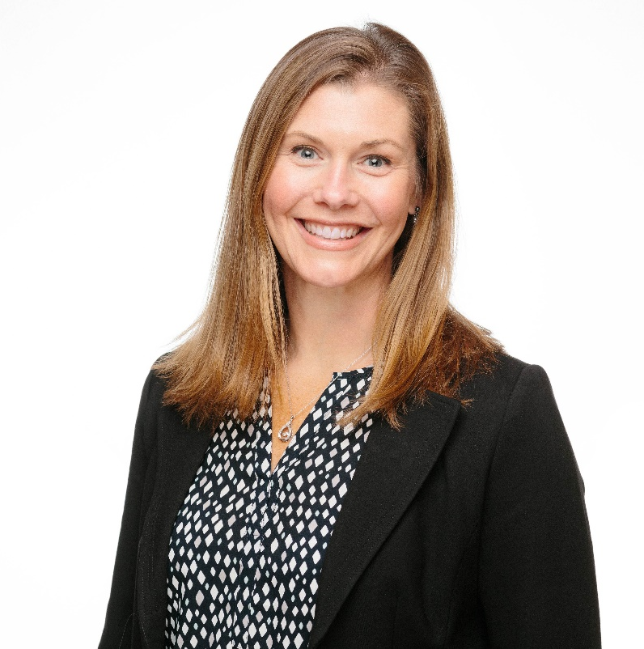
Welcome
Gwynne Jelbaoui
Program Manager
Clinical Informatics HIMSS
Gwynne.Jelbaoui@himss.org

Slide 4






Opportunities
https://www.himss.org/membership-participation/physician-community
Education
Community
Present webinars on topics such as: telehealth, medical informatics, AI, Interoperability and best use of EHR systems
Volunteer and show leadership through CMIO Roundtable and Workgroups
Thought Leadership
Public Policy
Physician Executive subject matter expertise; Interview with HIMSS Media; contribute to preconference symposium planning
Physician Community
Gain insight into current policy updates and affect change in healthcare systems and planning
Education Task Force
Drive education and content for the community
Physician Resources
Access career profiles, education, articles, and news items
Strategic Partners
Collaborate with high profile Physician Societies such as AMDIS, EHRA, and AMIA

Slide 5
The Power of Patient Engagement Starts Within
Learning Objectives
Gain insight on improving the workflow of patient appointment requests.
Allow for an improved patient experience through expanded access to internal resources.
Acquire an understanding of the challenges other organizations are facing in this area and the solutions they have developed.

Slide 6
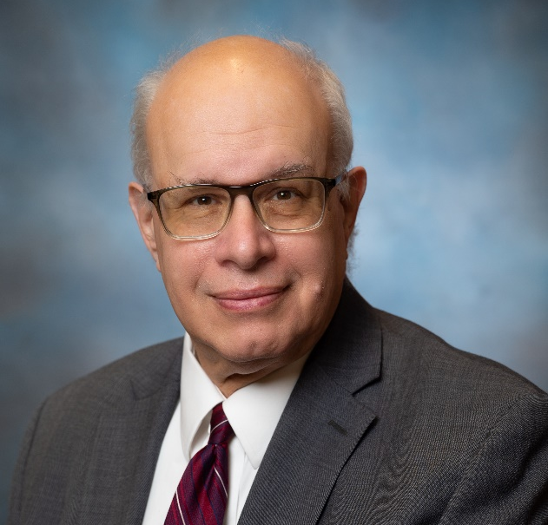
Jordan Tannenbaum, MD, MBA, MPH
Vice President, Chief Information Officer, Chief Medical Information Officer at
Saint Peter’s Healthcare System
Dr. Jordan Tannenbaum practiced pediatrics for 30 years while also pursuing his interests in healthcare computing. He became Chief Medical Information Officer for his hospital and oversaw the implementation of the inpatient and outpatient EMRs and supervised the hospital’s submissions for Stage I Meaningful Use in both the inpatient and outside areas. He retired from pediatrics after 30 years in practice and moved on to a consultant CMIO position at McKesson Corp. After four years at McKesson, he became CMIO of Saint Peter’s Healthcare System in New Brunswick, NJ, and was subsequently additionally appointed as Chief Information Officer. He currently continues to hold both roles.
During this time, he has overseen the implementation of the Paragon EMR, a predictive AI system for length of stay and readmissions and a physician communications tool among many other projects. He oversees all IT activities in the healthcare system.
Dr. Tannenbaum received an MD from the Dartmouth School of Medicine, an MBA, a post-graduate certificate in Health Informatics and a Masters of Public Health degree. He is board certified in Pediatrics and Clinical Informatics.
Dr. Tannenbaum is an active HIMSS Physician Committee Member.

Slide 7
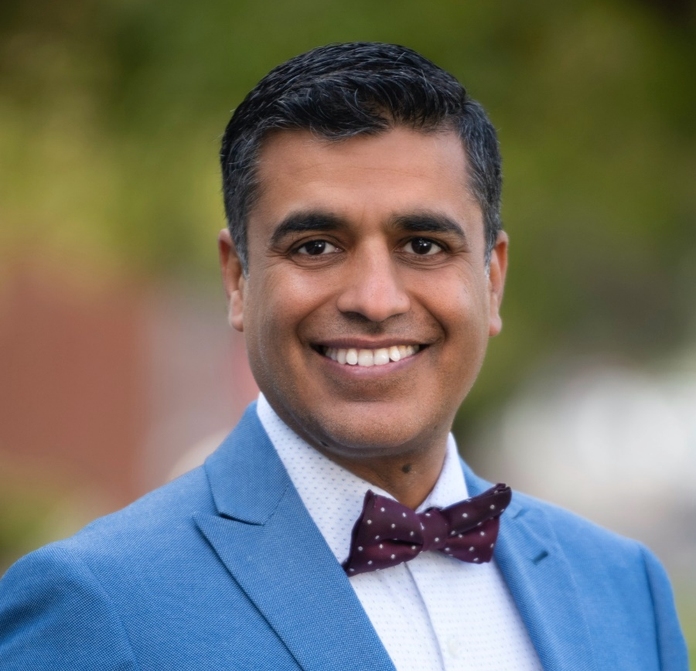
Ashish Atreja, MD, MPH
CIO and Chief Digital Health Officer at UC Davis Health
As CIO and Chief Digital Health Officer, Dr. Atreja, oversees IT, digital health and AI portfolios, bridging the gap between IT, academia, research, and innovation as “Digital Davis” becomes a global hub for digital health. Dr. Atreja has received formal training in public health and is board certified in gastroenterology, clinical informatics, and internal medicine. He launched the first digital health formulary in the health system and is often referred to as the "the App Doctor".
As an intrapreneur, Dr. Atreja has won innovation awards at Cleveland Clinic and Mount Sinai, successfully licensed technologies from academic centers and advises startups, accelerators and Fortune 500 companies in digital medicine. Dr Atreja coined the term "evidence-based digital medicine” and launched non-profit Association of Digital Medicine (NODE.Health) in 2018.
Dr. Atreja has received consecutive funding through NIH for the last 8 years and has published more than 80 papers in GI, digital health and AI. He was selected among Top 40 HealthCare Transformation People in 2017, Top 50 Future Healthcare leaders by HIMSS in 2020 and Top Chief Digital Officers in Health System in US in 2022.

Slide 8
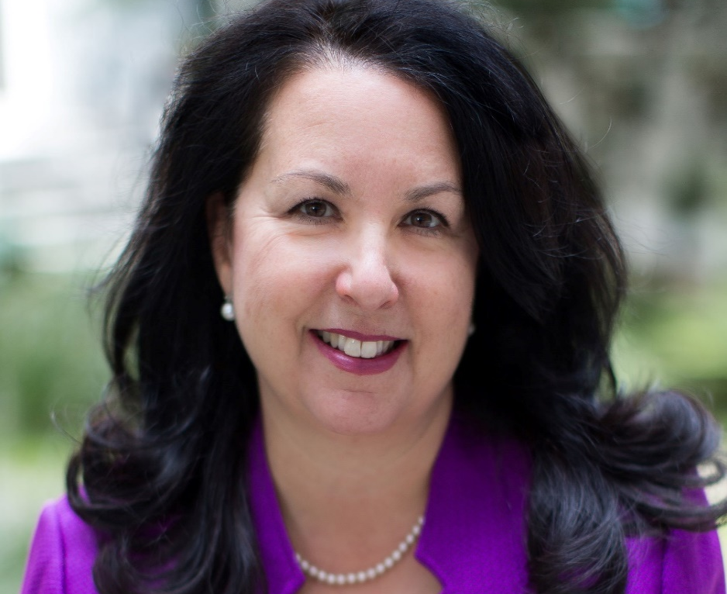
Marcee Chmait
Head of Business Development and Digital Partnerships at Providence
Marcee Chmait has served in multiple rolls within the health care industry for nearly 30 years. Her passion is to innovate, incubate and develop new businesses and to grow them into meaningful businesses. Marcee has spent her career at the brink of healthcare innovation, identifying opportunities to merge direct relationships between consumer and provider before consumer-centered healthcare was even a strategy.
Currently, Marcee leads digital partnerships and commercialization for the Providence Digital Innovation Group. Prior to joining Providence, Marcee has spent her career innovating on the payer side of the industry. At the same time, she also led and participated in three startups that had diverse exits.
Marcee’s work in healthcare innovation has afforded her a patent and three innovation awards: Gartner’s Cool Vendor, Fierce Health Award and the Bronze International Women in Business from the Stevie Awards.
Marcee is a graduate from the University of Minnesota with a degree in Marketing Communications.

Slide 9
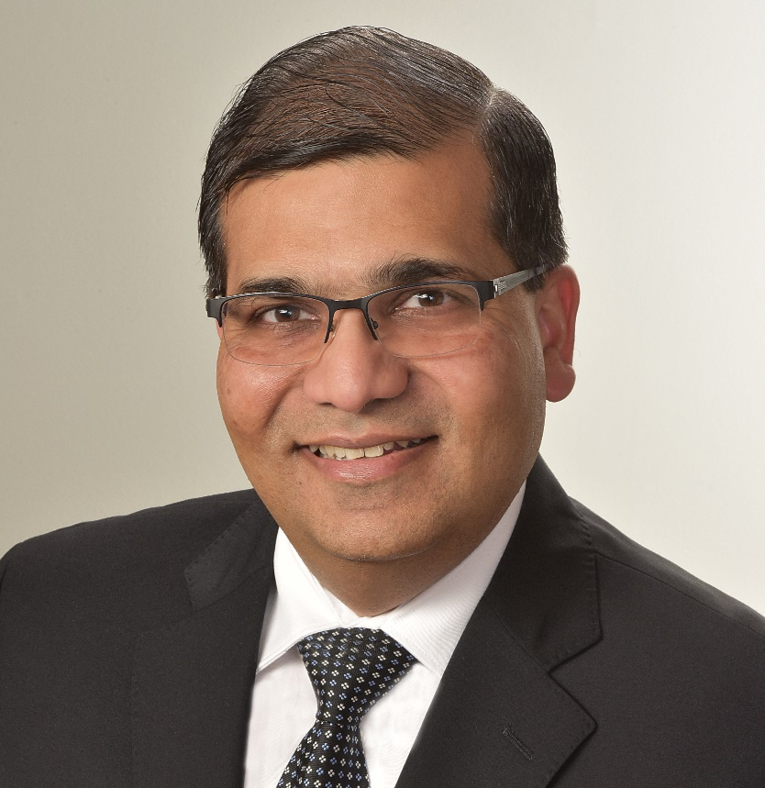
Ash Goel, MD, MS, MBA
Senior VP, Chief Information and Informatics Officer at Bronson Healthcare Group
Ash Goel, MD, MBA, is Senior Vice President, Chief Information Officer (CIO), for Bronson Healthcare. Dr. Goel oversees the broader IT strategy for the organization, enables the digital transformation journey, consumer focused growth, managing effective use of technology to further patient care, and developing and enhancing the use of data analytics throughout the health system to make informed decisions that support better clinical and business outcomes. In addition, he practices medicine as an adult hospitalist on a part-time basis.
Dr. Goel is an active HIMSS Physician Committee Member.

Slide 10


Panel Discussion

Slide 11
Questions from the attendees?

Slide 12
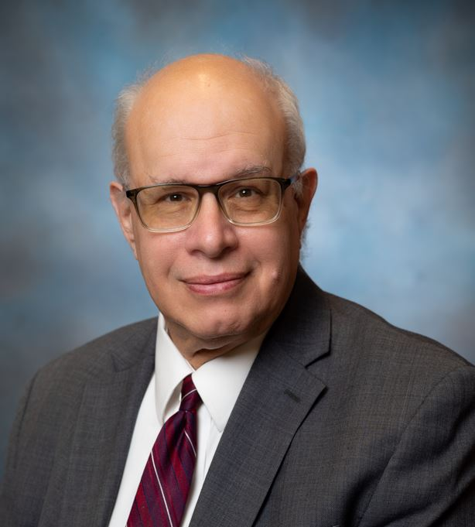


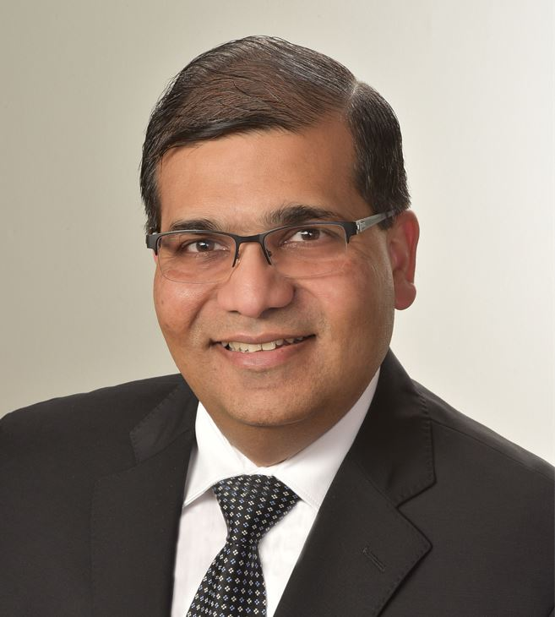
Thank you Speakers!!
Jordan Tannenbaum, MD, MBA, MPH
VP, CIO, CMIO
Saint Peter’s Healthcare System
Moderator
Ashish Atreja, MD, MPH
CIO and Chief Digital Health Officer
UC Davis Health
Marcee Chmait
Head of Business Development and Digital Partnerships Providence
Ash Goel, MD, MS, MBA
Senior VP, Chief Information and Informatics Officer
Bronson Healthcare Group

Slide 13
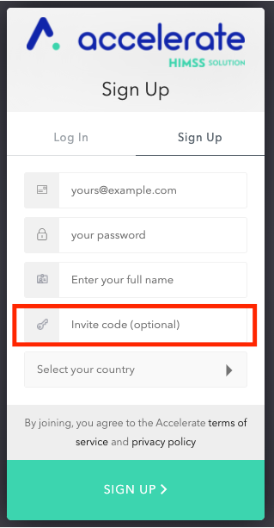
Join Accelerate and the Physician Community www.youraccelerate.com
Use PHYSCOM in the Invite code field
Accelerate is grounded in connecting our evolving community to provide opportunities for professional networking and development, thought leadership and research, and supporting digital transformation.

Slide 14

Thank you!
Contact emails:
Physician Community informatics@himss.org
Gwynne Jelbaoui
Gwynne.Jelbaoui@himss.org

