Slide 1
Navigating the Future of Healthcare: Virtual Nursing in the Digital Age
HIMSS Nursing Informatics Community Webinar
June 13, 2023

Slide 2


Welcome
Cait Obenauf, MBA
Program Manager, Clinical Informatics, HIMSS

Slide 3

Thank you to our sponsor

Slide 4







Join the HIMSS Nursing Informatics Community
Apply for the HIMSS Nursing Informatics Committee
https://www.himss.org/membership-participation/nursing-informatics-community
https://www.himss.org/membership-participation/nursing-informatics-committee
Ways to get involved at HIMSS
as an informatics nurse
Submit a manuscript to the Online Journal of Nursing Informatics
Join the HIMSS Nursing Informatics Education & Networking Task Force
https://www.himss.org/resources/online-journal-nursing-informatics
Reach out to Cait Michicich at cait.michicich@himss.org
Attend an upcoming webinar or coffee chat
Get involved with your local HIMSS Chapter
https://www.himss.org/events
https://www.himss.org/membership-participation-chapters

Slide 5
Agenda
Meet the Speakers
Learning Objectives
Overview of Telehealth
Virtual Nursing
Speaker Discussion
Audience Q&A

Slide 6

Learning Objectives
Provide an overview of virtual nursing, including its definition, benefits, challenges, and potential applications.
Discuss the different types of virtual nursing, such as remote monitoring, teleconsultation, and tele-triage.
Highlight the critical role of technology in enabling virtual nursing services.
Examine how virtual nursing can enhance the nursing profession by providing opportunities for nurses to develop new skills and work in innovative ways that transform the nursing profession and improve quality of care.

Slide 7
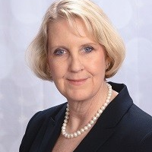

Meet the Moderator
Kathleen McGrow, DNP, MS, PMP, RN,
Chief Nursing Information Officer, Microsoft

Slide 8
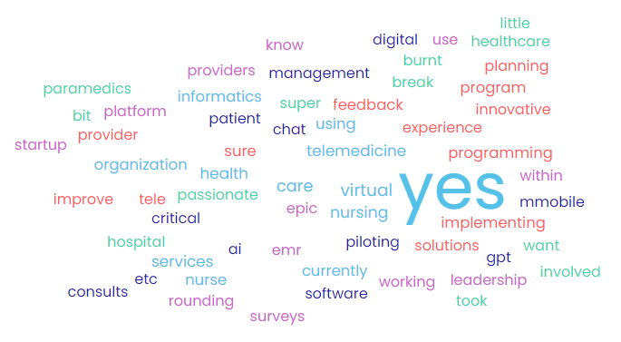
Is your organization using innovative solutions that improve the provider experience?

Slide 9
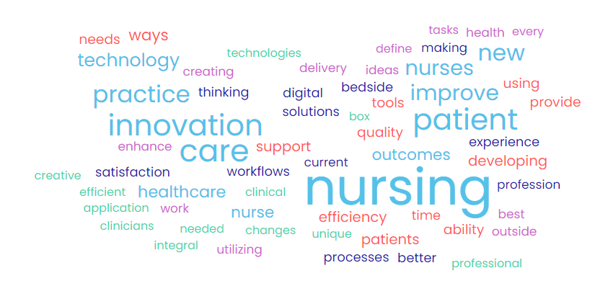
How would you define nursing innovation and its applicability to nursing practice?

Slide 10


Meet the Speakers
Murielle Beene, DNP, MBA, MPH, MS, PMP, RN-BC, FAMIA, FAAN
Kim Swafford, MHA
Healthcare Industry Executive, Americas, Microsoft
Senior Vice President and Chief Health Informatics Officer, Trinity Health

Slide 11

Kim Swafford, MHA Healthcare Industry Executive, Americas, Microsoft

Slide 12

Healthcare Labor Picture
Number of healthcare and social assistance workers who quit their jobs in August 2021 — the highest total going back to at least 2000, according to the U.S. Bureau of Labor Statistics
STATISTICS
534,000
Overall Healthcare Workers
Average Hospital turnover 19.5%
Average turnover of employees w/ <1 year 30.1%
Healthcare workers report not having adequate emotional support 39%
Healthcare providers considering retiring, quitting, changing jobs/careers 48%
Healthcare workers reporting exhaustion & burnout 76%
Physicians in Crisis
More than half of physicians surveyed reported at least one burnout manifestation
30% of primary care physicians age 35 to 39 plan to leave practice within 5 years
Only 1 in 10 physicians would recommend medicine as a career
Nurses In Crisis
63% of nurses report symptoms of burnout
RN vacancy rate March 2021 9.9%
44% worry patient care suffered because they were so tired
41% consider changing hospitals due to burnout
37,800-124,000
Range of the projected shortage of physicians by 2034, including up to 48,000 in primary care, according to the Association of American Medical Colleges
510,000
The pre-pandemic estimate of the nursing shortage in 2030, according to a 2017 study in the American Journal of Medical Quality
3.2 million
Projected shortage of support staff by 2026, according to Mercer, which examined “lower-wage healthcare occupations” such as medical assistants and home health aides
$40,000
Average cost of turnover for a bedside RN position, according to hospital survey responses
18.7%
The RN staff turnover rate in 2020, up from 15.9% in 2019
24.9%
The RN staff turnover rate in 2020 for hospitals in the Southeast, highest among five regions
13.2%
The RN staff turnover rate for hospitals in the Northeast, lowest among the five regions
Notes:
Kathleen make this real with examples.
The following data are from NSI Nursing Solutions, Inc., “2021 NSI National Health Care Retention & RN Staffing Report,” March 2021.
MD SOURCE : Research by Mayo Clinic
Kronos – need survey link
Source: “2021 NSI National Health Care Retention & RN Staffing Report,” NSI Nursing Solutions, Inc, March 2021; NSI_National_Health_Care_Retention_Report.pdf (nsinursingsolutions.com)
“Annual Turnover, Vacancy, and Premium Labor Benchmarks,” HR Advancement Center, Advisory Board, April 2019;
“Pandemic is taking a dangerous toll on the mental health of frontline workers,” Mental Health America, December 1, 2020; Lagasse J, COVID-19 pandemic is taking a toll on the mental health of frontline healthcare workers | Healthcare Finance News
“Healthcare workers experiencing burnout, stress due to COVID-19 pandemic,” Healthcare Finance, December 8, 2020. Healthcare workers experiencing burnout, stress due to COVID-19 pandemic | Healthcare Finance News
[Introduction tied to provocative statement]
Healthcare has consistently been a leading contributor to job market growth. Last year, COVID has not only amplified the mismatch between the supply and demand of labor, but, it has also stressed the industry and providers.
Other causal factors: Pandemic, Opioid Crisis, EHR/EMR documentation burden, Regulatory requirements that pile on and do not rescind: MACRA, ACA, HCAPS, etc. Violence in workplace, Reduce reimbursement, Mergers and Acquisition,
[Stimulating conclusion to invite more discussion]
The health care industry continues to be a cornerstone of our economy and must be ready to adapt to the changing landscape. The expanding healthcare roles, the aging population, the mandate on quality & safety, the squeeze in reimbursements, the competition for patient volume, the shift in the delivery of care, the shortage of physicians, nurses & allied professionals and a world-wide pandemic are all stressing the industry.
The value hospitals place on their people will have a direct correlation to their commitment, confidence and engagement. Enhancing culture and building programs to reinforce these values is critical to driving retention.
Focus on strategies that enhance culture and eliminate those that do not.
A quantifiable measure of the severity of a hospitals vacancy rate is contract labor and overtime usage. Trending turnover, based on historical data, is a leading indicator of future organizational pressure.
Management must identify contract labor costs and not view it as an “operating expense”, but rather as aggregated within the position control system. Inclusion within the payroll cost line, will provide greater insight into the actual direct cost of labor. To strengthen the bottom line, hospitals need to build retention capacity, manage vacancy rates, bolster recruitment initiatives and control labor expenses. Breaking through the myopic ways of hiring travel and agency staff to band-aid the issue or utilizing excessive overtime or premium pay which stresses the staff, the quality and the patient experience is a start. Building and retaining a quality workforce is paramount to navigate the shifting paradigm.

Slide 13
Microsoft Cloud for Healthcare Capabilities enabling better experiences, better insights, better care
Personalized care Build relationships through enhanced experiences
Care coordination Develop systems of care management with clinical intelligence and workflows
Improve clinical and
Operational insights
Empower health team
collaboration
Enhance patient
engagement
Security & compliance
Enhance clinician
experiences
Patient insights Transform data into prescriptive insights
Care collaboration Optimize resources and solve problems collectively
Data and AI
Virtual health Provide new avenues for care
Remote patient monitoring Combine IoT and analytics to optimize treatments
Clinical analytics Access and securely share actionable data insights
Ambient clinical intelligence Automatically document patient encounters
Operational analytics Gain insights to help optimize operational effectiveness
Clinical documentation Reduce administrative tasks and burnout
Diagnostic intelligence Empower radiologists to drive action, quality, and efficiency
HEALTHCARE INDUSTRY SPECIFIC
Data models
Connectors & APIs
Partner ecosystem
Notes:
Now let's take a closer look at the capabilities around the value chain and how Microsoft + Nuance can further transform their patient experiences and enhance clinician experiences
Each of these capabilities are composable, meaning they can be deployed one at a time or in groups. Customers can also leverage their existing investments in Microsoft Cloud technologies, by applying these capabilities to solutions already deployed in their environment.
All of this is built with the desired outcome of delivering better patient experience, delivering better insights that drive positive change, and overall better care—across the entire care continuum.
Microsoft Cloud for Healthcare will support accelerated health transformation into the future, with trusted cloud capabilities for customers and partners spanning the most important needs for healthcare organizations.
We start with Enhancing patient engagement and empowering health team collaboration.
First, we’ll start with Personalized care, which together with Nuance Patient Engagement Solutions, helps delight customers through conversational, automated experiences to personalize interactions. solve issues faster, remove friction, and enhance contact center team communication
Patient insights, we have a unified patient profile that allows healthcare organizations have a comprehensive view of the customer, which helps them tailor the customer experiences.
Next, virtual health, allows healthcare organizations to provide new avenues of care for patients, whether that ‘s through a virtual visit, or interacting with a health bot for chronic care management.
Up next, we empower health team collaboration through systems of care coordination and care collaboration that enables automation, collaboration, and communications to help organizations optimize their resources and solve problems collectively, minimize errors.
And now with the power of Nuance, we add additional support to enhance clinician experiences through the use of ambient clinical intelligence, clinical documentation and diagnostic intelligence. The addition of Nuance offers, will reduce time spent documenting patient encounters and alleviate provider burnout through AI-powered solutions that drive more personal and accessible healthcare.
Finally, Improving clinical and operational analytics will help to organizations provide the secure access and insights they need to optimize operational and clinical effectiveness.
As mentioned, these capabilities are built on a few key foundational elements that are tailored to the financial service industry. The first is our Data model and connectors. This is what enables the connection between our capabilities and your data and ensures interoperability of our solutions with your solutions and partner solutions.
The power of the Microsoft Cloud for healthcare doesn’t stop with our first-party technologies and solutions. Our extensive Partner ecosystem extends the cloud’s capabilities even further, ensuring customers can find a solution to fit their needs that builds on our technologies.
And beneath it all is the Microsoft Cloud. Organizations can depend on our trusted cloud services to power all these capabilities.
<click>
Transition: Let’s go a bit deeper into a couple of use cases and solutions.

Slide 14
TELEHEALTH
TELEMEDICINE
TELEPSYCH
VIRTUAL REHABILITATION
CLINICIAN
TELERADIOLOGY
VIRTUAL VISIT
TELESTROKE
VIRTUAL CARE
Virtual Health
connects clinicians, patients, families, care teams and health professionals to provide health services, promote professional collaboration, support self-management, and coordinate care across the care continuum
TELECONSULT
VISIT
RPM
TELEHEALTH
VIRTUAL
eICU
TELEPSYCH
KIOSKS
PATIENT
PHYSICIAN
CAREGIVER
VIRTUAL CARE
mHEALTH
REMOTE
VIRTUAL
VIRTUAL HOSPITAL
TELEMEDICINE
eICU
PATIENT
PATIENT
PHYSICIAN
VIRTUAL CARE
CLINICAL COMMUNICATIONS
KIOSKS
VIRTUAL VISIT
REMOTE PATIENT
MONITORING
TELESTROKE
RPM
Notes:
When it comes to the virtual health, there is no shortage of terminologies that are used (see word cloud for the more prominent ones).
Microsoft embraces the term “virtual health”, a broader definition that encapsulates the wide variety of technologies and services in the market today.
Virtual Health connects clinicians, patients, families, care teams and health professionals to provide health services, promote professional collaboration, support self-management, and coordinate care across the care continuum

Slide 15





What does virtual health mean to your organization?
Virtual Health Delivery Methods
Virtual Health Clients
Providers
Retail
Govt.
Life Sciences
Consumer Health
On Demand Triage
Virtual Physician Assistants
Kiosks
Remote MD/Nurse Care
Digital Front Doors for Health
Second opinions
Behavioral Health
Virtual Therapy and Counseling
Tele-Psychiatry
Substance Abuse/Addiction Remote Therapy
Digital Therapeutics
Facility-based Solutions
eICU
Teleradiology
TeleStroke
Virtual Rehabilitation
Virtual Clinical Trials
Hospital at Home
Source of Funding
Payor
Employer
Provider
Govt.
Self-pay
At Home Care
Sensors and wearables
Remote Patient Monitoring
Consumer devices
Personal Emergency Response Systems (PERS)
Targeted Conditions
Tele-Oncology
Tele-Dermatology
Diabetes
Cardiac
Sleep
Respiratory
Care Integration
Patient Engagement
Scheduling
Clinician Communications
Patient Navigation
Virtual Care Platforms
Pharmacy
Data Integration, Analytics, AI, SDoH analysis
Notes:
More than 50 million in person visits per year could be converted to virtual visits……per McKinsey
[Note: do not attempt to go through this slide in detail. Use the below notes to summarize the issue.]
When we assess the virtual health landscape , we see that solutions fall into 6 general categories that are uniquely focused on specific areas of need. While they all have some commonality - their program goals, how they are staffed, who derives benefit and the economic models that are driving them – can be quite different.
[Account Team] Gain understanding-Ask the customer:
Are they considering, or already have, some of the solutions mentioned above? If they have existing solutions, what are they and who manages the program (not the technology)? [Explore beyond a physician office visit.]
Who are the key decision makers and what are the key factors in this decision?
Is it an IT-only decision (technology)?
Are they concerned about the ability to manage and optimize the programs?
Is this a department-specific request versus corporate directive?
Is the decision being driven by patient demand? To reduce low-acuity patient load? Improve reimbursement versus cost?
Is the VP of Patient Experience involved since this so intimately impacts that area?

Slide 16

Murielle Beene, DNP, MBA, MPH, MS, PMP, RN-BC, FAMIA, FAAN Senior Vice President and Chief Health Informatics Officer, Trinity Health

Slide 17
Care Delivery Models of the Future: Virtual Connected CareTM
Presented by: Murielle Beene DNP, MBA, MPH, MS, PMP, RN-BC, FAMIA, FAAN
Date: June 13, 2023

Slide 18
Trinity Health is one of the largest Catholic health care systems in the nation
$21.5B
26
In Revenue
States
1.3M*
$1.4B*
Attributed Lives
Community Benefit Ministry
123K
8.3K
26.6K
Colleagues
Employed Physicians and Clinicians
Affiliated Physicians
88
17
135
24
136
Hospitals**
Clinically Integrated Networks
Continuing Care Locations**
PACE Center
Locations**
Urgent Care
Locations**
FY22 data recast to include MercyOne 9.1.2022 acquisition, unless noted. *Trinity Health FY22 data. **Owned, managed or in JOAs or JVs.
Version: 11.1.22
Notes:
Sources of Truth:
Revenue, Attributed Lives & Community Benefit Ministry | FINANCIAL REPORTING – Jenny Reed, confirmed
Number of States (& map) | STRATEGY – Bill Finateri, confirmed
Number of Colleagues | HR – Beth Slater, confirmed
Employed Physicians & Clinicians | MGPS – Arlita Moore, confirmed
Affiliated Physicians | UCO CENTER – Anne Wynne, confirmed
Number of Hospitals | STRATEGY – Linda Vanmeter, confirmed
Clinically Integrated Networks | CLINICAL INTEGRATION – Leslie Cribbs, confirmed
Continuing Care & PACE Center Locations | CONTINUING CARE – David DeFrain & Shelby Nakon, confirmed
Number of Urgent Care Locations | FINANCIAL OPS – Mike Prisby, confirmed

Slide 19





The organization is nationally recognized for quality care and experience
#14 Supply Chain Top 25 for 2021
#6 Top 25 large health systems with the best patient reviews for 2021
Internal use only.

Slide 20



Our world has changed, the instability and unpredictability of the workforce is not sustainable
People
Services
Value
Great Resignation
Workforce development
New roles & clinical care models
Wage and benefit inflation
Replace contract labor
Lower inpatient utilization rates
Lower volume in ED and SNF
Inpatient surgery shifted to outpatient
Growth in urgent care and virtual visits/home visits
Government and commercial payers reduce rates
Expanded responsibility for total cost of care
Patients/members expect more from us
* 1) We will not have our previous supply of RNs for at least a decade, 2) Unstable and unpredictable team composition and staffing of teams today is not sustainable

Slide 21

Our MOONSHOT
At Trinity Health, we know it will take more.
That’s why we’re changing how we work and think, and creating new ways to care for people.
It’s a BOLD VISION.
And together, our team is transforming care for people today — and generations to come.

Slide 22
Virtual Connected Care TM is a transformational model-We are solving for today and building for tomorrow…
Today’s Workforce
A Transformational Model
Today’s Unstable and Unpredictable Staffing is Not Sustainable
The national shortage for RNs will be as much as 1.1M by end of 2022***
It will take more than a decade to replenish the workforce
Impact: Feelings of isolation and instability
Impact: Shortage of mentors for early-career nurses
3-Person Care Team
Builds a pipeline of caregivers
Increases engagement and retention
Improves quality & safety of care, and patient & family experience
Decreases turnover and labor costs
Requires 20% fewer RNs* overall
Reduces labor cost/day by 8%**
* Step-down, Med/Surg and Telemetry units. **Assumes employed FTE base labor rates and benefits *** U.S. Bureau of Labor Statistics

Slide 23




At the core of this transformational model is a 3-person care team
Bedside RN
Patient/Member-Centered Care
Virtual RN
Provides direct patient care support
Gains experience
More time with patients and families
On-demand guidance
Coordinated, efficient care that
supports better outcomes, safety and an exceptional experience
Brings expert support and coordinates complex care
Ideal position for experienced RNs wanting a less physically demanding role and offers nurses nearing retirement an alternative
Practicing at top of license
More time mentoring
RN Partner
NA, CNA, or LPN/LVN
Partners with bedside RN to care for more patients
Path to career advancement

Slide 24
Considerations for health systems that want to begin this journey
Do not underestimate the change
Obtain leadership support, not just Nursing
Language matters
Measure along the way
Learn forward, revisit and apply the learnings

Slide 26
Questions?

Slide 27

Questions? Contact us!
Cait Obenauf, MBA
Program Manager, Clinical Informatics, HIMSS
cait.obenauf@himss.org

Slide 28
Thank you for joining!

