Slide 1
HIMSS TIGER Global Community meeting
September 30, 2025

Slide 2



Welcome

Slide 3





Vision
Mission
To realize the full health potential of every human, everywhere.
Reform the global health ecosystem through the power of information and technology.

Slide 4

Become a HIMSS TIGER Global Community Member Today!
Log in to your profile, select “Chapter & Community Participation,” then select the Technology Informatics Guiding Education Readiness (TIGER) Global Community from the Professional Communities dropdown menu.

Slide 5


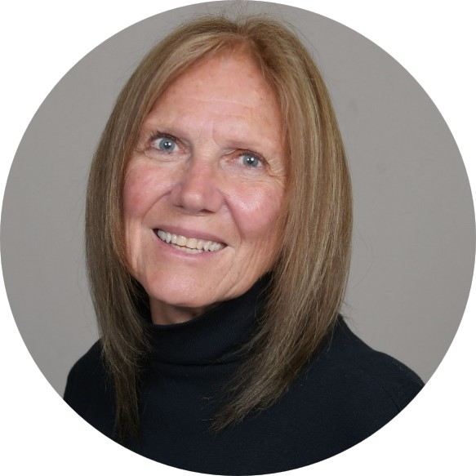
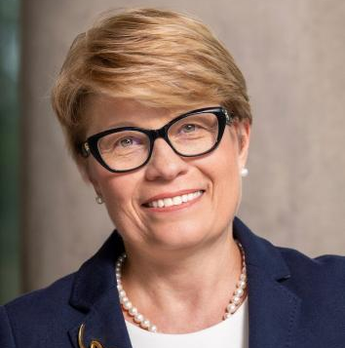
TIGER Co-Chairs
Gabriela Mustata Wilson, PhD MSc, FHIMSS
Patricia MacTaggart, MBA, MMA, CAHIMS

Slide 6

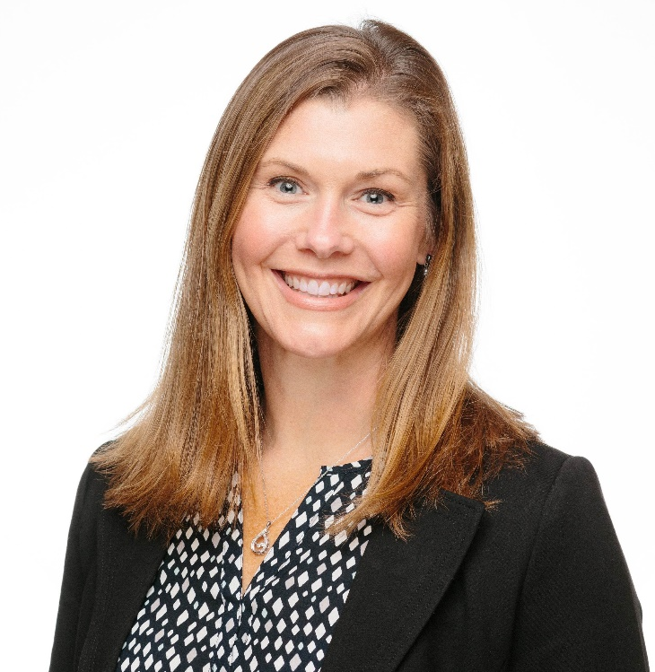

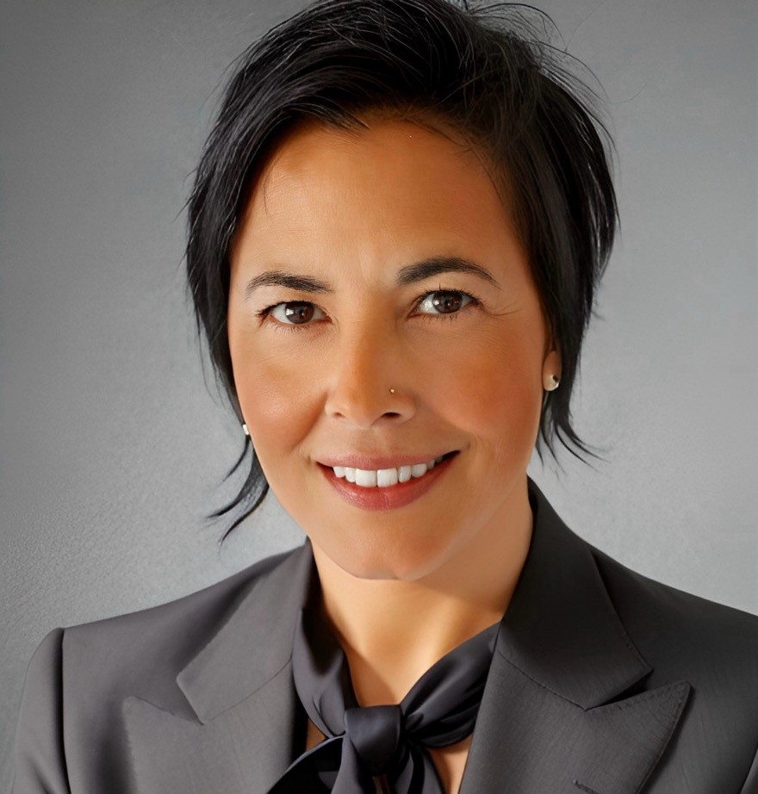
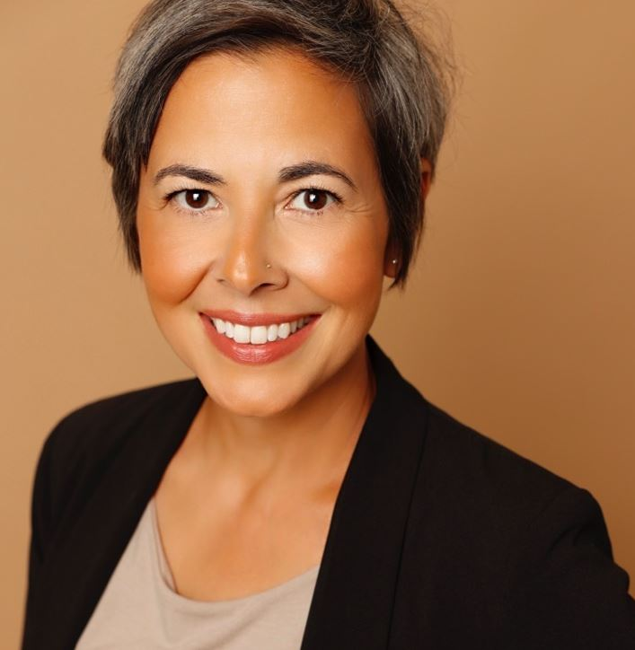
HIMSS Staff
Whende M. Carroll, MSN, RN, NI-BC, FHIMSS
Gwynne Jelbaoui, FHIMSS
Kelly Liput
Senior Program Manager
Information Specialist
HIMSS Clinical Advisor

Slide 7
Agenda
Word from our Co-Chairs (2 mins)
General Updates from Gwynne (2 mins)
Introduction from Marion J. Ball (10 mins)
Presentation from Valencia Payne (25 mins)
Update from the TIGER Liaisons (10 mins)
Next TIGER Global Committee meeting: October 30: from 10:00 AM-11:00 AM CST
Notes:
TIGER workgroups and the opportunity to contribute.
TIGER Global Health Informatics Competency Alignment Workgroup
HIMSS Early Careerist page
Support Full Funding for New Jersey's Community Colleges
Are you attending a HIMSS Global Event, Summit, Forum?
Please let us know which one in chat.
AI in Healthcare Forum | July 10-11 |New York
AI Leadership Strategy Summit | September 18-19 | Chicago, IL
Healthcare Cybersecurity Forum | October 9-10 |Houston, TX
Check out the new HIMSS Physician Committee global thought leadership paper
Areas you would like to hear more information on.

Slide 8
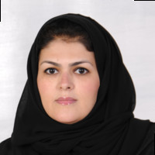
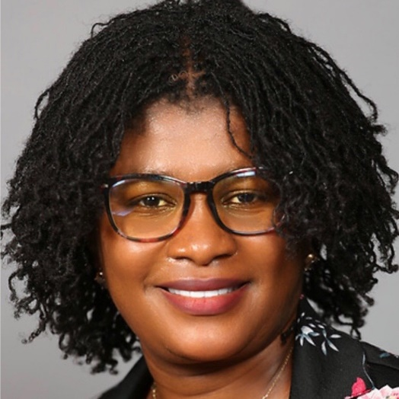
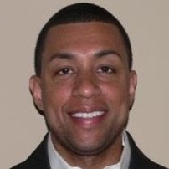
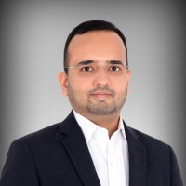
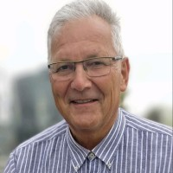
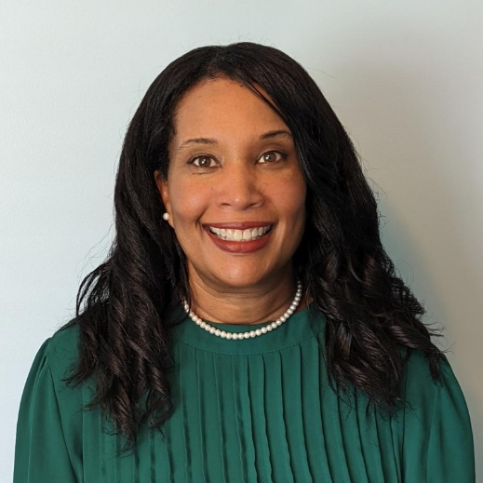
TIGER Liaisons
Shareefa Abdula
Mayfair Afiah Aboagyewah
Tony Black
Vibhor Mathur
Stephan Schug
Tiffiny Shockley

Slide 9
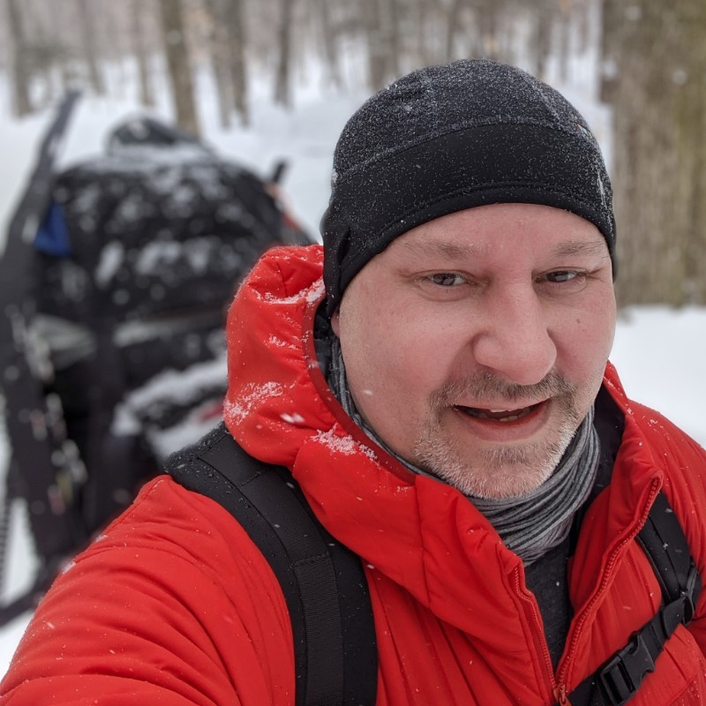
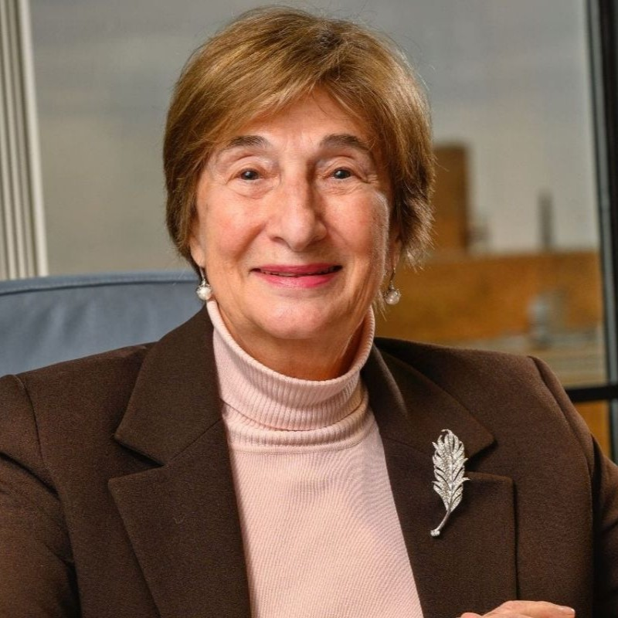
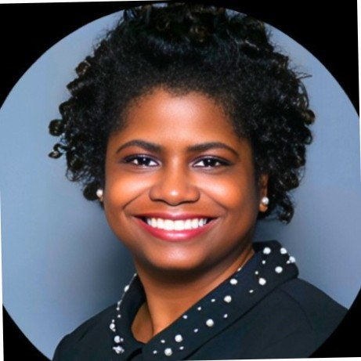
Presenters
Marion J. Ball
EdD, FACMI, FAAN, FIAHSI, FAHIMA, FMLA, FLHIMSS, FCHIME, FIMIA
Presidential Distinguished Professor and Executive Director Center for Innovation in Health Informatics (CIHI), University of Texas at Arlington
Valencia Annik Payne
MS Health Informatics/HA BSN RN
Owner/CEO RN4Students

Slide 10



History of the TIGER Initiative

Slide 11

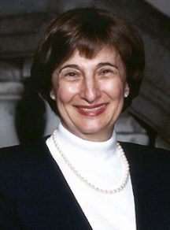
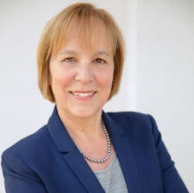
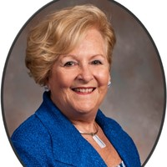
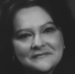

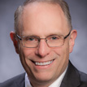
TIGER’s History:
Return to Main Menu
2004
2005
TIGER Pioneers include:
The National Mandate for Healthcare Informatics
Creation of the Forerunner of the Office of the National Coordinator (ONC) of Health Information Technology by U.S. President George W. Bush
Strategy: Electronic health record within a 10-year timeframe
Lack of nurse representation at the first ONC National Health IT conference.
Dr. David Brailer first director
The Birth of the TIGER Initiative
A group of leaders in nursing called the ‘TIGER Team’ for Technology Informatics Guiding Educational Reform began a grassroots effort to ensure nursing would be integrated into the nation’s healthcare delivery systems and academic programs with other key stakeholders/ advocates of health IT.
During my position at Johns Hopkins University
Marion J. Ball
Joyce Sensmeier
Patricia Hinton Walker
Diane Skiba
Michelle Troseth
Brian Gugerty
Notes:
Dr. Marion J. Ball https://www.amia.org/about-amia/leadership/acmi-fellow/marion-j-ball-edd-facmi
Joyce Sensmeier https://www.himss.org/resource-bio/joyce-sensmeier-rn-bc-ms-cphims-fhimss-faan
Patricia Hinton Walker https://www.linkedin.com/in/patricia-hinton-walker-phd-rn-faan-mcc-8181158/
Michelle Troseth https://www.linkedin.com/in/michelletroseth/
Brian Gugerty https://www.amia.org/about-amia/leadership/brian-gugerty-dns-rn
Diane Skiba https://www.amia.org/about-amia/leadership/acmi-fellow/diane-j-skiba-phd-facmi

Slide 12


TIGER’s History
Return to Main Menu
2006 - 2014
2009
2012
TIGER Summit 2006: Consensus on a 10-year vision and a 3-year action plan TIGER’s Recommendations for Integrating Technology to Transform Practice and Education]
Summary Report Identification of nine key “collaboratives” and publication of workgroups landmark reports, including:
Informatics Competencies
Usability & Clinical Application design.
Other highlights
Leadership, Consumer Empowerment. Personal Health Records, Education and Faculty development.
The TIGER initiative became established as the TIGER Foundation, with more than 1500 volunteers
Launch of the TIGER Virtual Learning Environment
Web-based education portal designed to expand health IT/informatics knowledge and skillset in a self-paced format
Courses tied to certificates of completion
Resource library
Webinar events archive
First major relaunch in 2015
Second major relaunch in 2019
International expansion
TIGER launches the TIGER International Committee to support the global health informatics workforce
Under the able leadership of Tori Shaw Markowski
The TIGER Summit & publication of landmark reports from collaborative workgroups

Slide 13
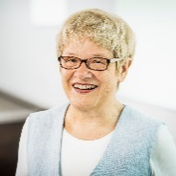
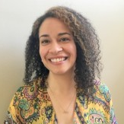

TIGER’s History
Return to Main Menu
2014
2015
TIGER transitions into HIMSS
TIGER transitioned into the Healthcare Information and Management Systems Society (HIMSS)
Refreshed TIGER focus: Interprofessional approach
TIGER International Competency Synthesis Project (ICSP)
TIGER launched the International Competency Synthesis Project (ICSP) focused on workforce competency
National Case Studies
Survey deployment
Publication of the Global Health Informatics Competency Recommendation Frameworks
Recommendation Framework 1.0: Nursing focus
Recommendation Framework 2.0: Interdisciplinary focus
Key Contributors:
See our project publications
Dr. Ursula Hübner and her research team at University of Applied Sciences Osnabrück Germany (FH OS)
Toria Shaw Morawski (HIMSS TIGER)

Slide 14
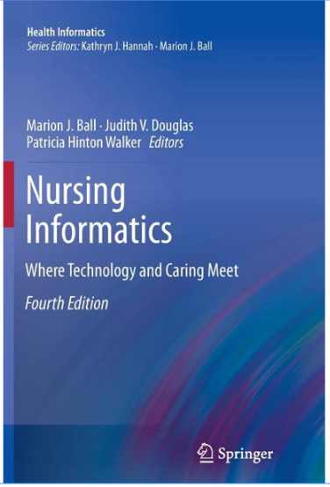
Nursing Informatics: Where Technology and Caring Meeting 4th edition
Return to Main Menu
The 4th edition of this book, Nursing Informatics: Where Care and Technology Meet, was published in 2011 and dedicated over 1,000 volunteers who have contributed to the TIGER cause since formalizing in 2005
This edition has gone on to sell over 80,000 copies and was translated into six languages
Post publication: Create mini courses and virtual/in-person learning workshops inspired by the textbook chapters
14

Slide 15
Relaunch in 2023
Relaunch in 2024
Notes:
Look through the lenes of HIMSS Informatics and HIMSS Committee engagement and expand the International Market

Slide 16

HIMSS TIGER Global Community
Leadership Council
Co-chairs: Gabriela Wilson & Patricia MacTaggart
Members are decision makers, scope, and action providers to the larger community.
Liaisons Members will represent TIGER in various HIMSS Communities. They will be on the Leadership Council and chair the relevant TIGER Workgroups.
HIMSS TIGER Global Community Members Existing members in TIGER committees and full community.
Formerly known as the ‘Global TIGER Network, TIGER Interprofessional Community, and TIGER International Taskforce'
Workgroups Liaisons will join HIMSS committees and lead Global Community members in developing collateral and content to support HIMSS projects and initiatives.
16
16

Slide 17


TIGER Liaisons
Shareefa Abdula
Mayfair Afiah Aboagyewah
Tony Black
Vibhor Mathur
Stephan Schug
Tiffiny Shockley

Slide 18
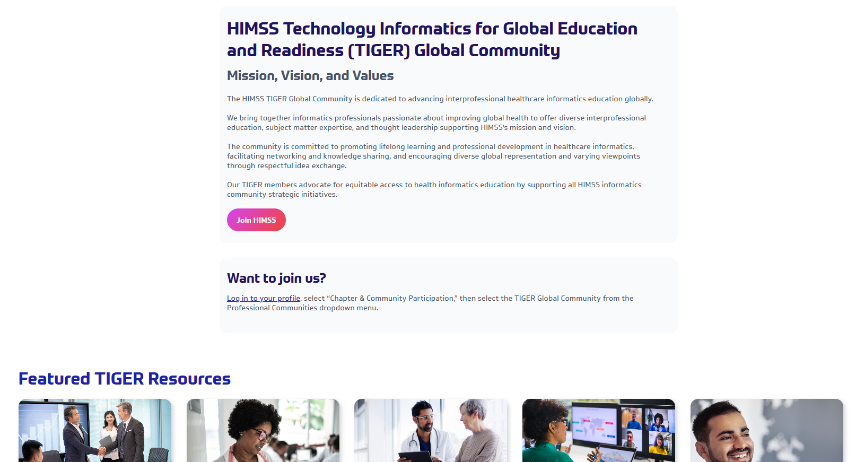

New TIGER Community HIMSS page
Easy access to TIGER resources
Publications from our Liaisons
Easy access to join the Community

Slide 19


The Connected Care
Revolution: Digital
2025
Transformation for a Smarter Healthcare
The Stage - Why Transformation is Non-Negotiable
19
VALENCIA ANNIK PAYNE
MS HEALTH INFORMATICS/HA
BSN RN, BS BIOLOGY,
CERT CYBERSECURITY,
CERT HEALTHCARE DATA ANALYTICS
19

Slide 20

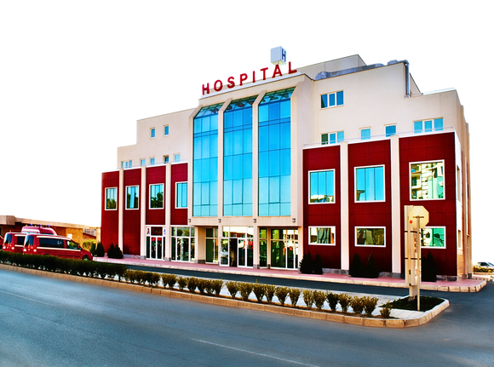
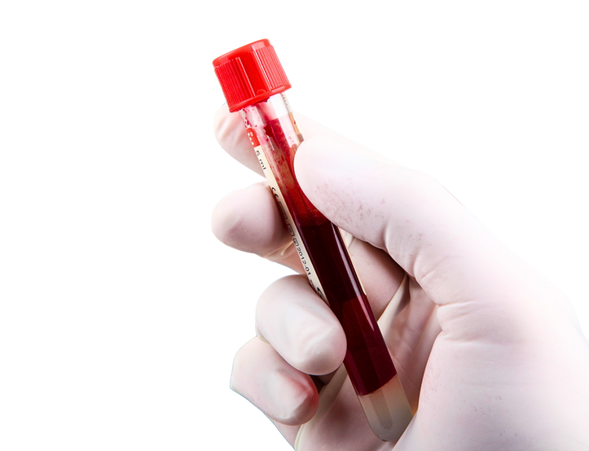
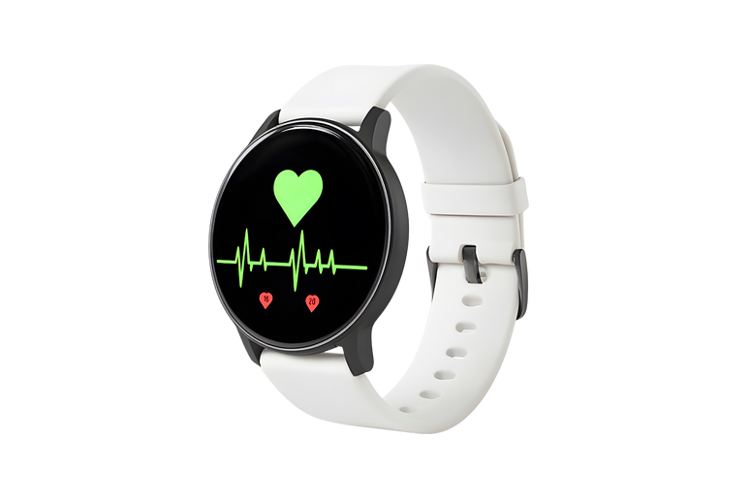

The Paradox of Modern Healthcare: Data-Rich, but Insight-Poor
THE DATA ISOLATION CRISIS IN HEALTHCARE
LABORATORY INFORMATION SYSTEM
HOSPITAL ELECTRONIC HEALTH RECORD (EHR)
Contains: Blood tests, pathology reports, genetic results.
Status: RESULTS READY but stuck in a separate portal.
Access: Requires logging into another system; delays alerts.
Contains: Patient history, progress notes, medication lists.
Status: ONLINE but isolated with the hospital’s own walls
Access: Available, but only what’s entered here
WEARABLES & REMOTE MONITORING
Contains: Real-time vitals, activity levels, sleep patterns, glucose trends.
Status: DATA STREAMING but invisible to clinical care.
Access: No integration. Patient must manually report (if they remember).
20

Slide 21



The Roadmap: Pillars of Digital Transformation
The Foundational & Connected Ecosystem (Now-Near Future)
The Cognitive & Transformative Ecosystem (Long-Term Future)
Focus:
Focus:
03
Simulation at Scale and Ubiquitous Computing
01
Data Unification and Basic Intelligence
Key Technology:
Interoperability:
Quantum Computing: Applied to complex problems like simulating molecular-level drug interactions.
Establishing secure, universal data standards (like FHIR) to break down silos. EHRs talk to each other,creating a holistic patient view
The Predictive & Personalized Ecosytem (Mid-Term Future)
TIGER Role:
TIGER Role:
Focus:
Prepares the workforce for a paradigm shift. Focuses on managing AI-quantum partnerships, the ethics of simulation-driven care, and leading in a fully digitally integrated environment
Proactive care and augmented decision-making
02
Focuses on building core informatics literacy among all healthcare professionals, ensuring they can work effectively within this connected data environment.
Key Technologies:
AI & NLP: AI models use the interoperable data to move into predictive analytics (id patients at high risk for diseases). NLP automates clinical documentation from voice notes.
AR: Guides surgeons with overlays during procedures or helps nurses locate for interactive, hands-free training simulations.
TIGER Role:
Shifts education to include data interpretation skills, ethical AI use, and competency in using AR/NLP tools as part of standard clinical workflow
21

Slide 22
The Roadmap: Pillars of Digital Transformation
The Foundational & Connected Ecosystem (Now-Near Future)
Focus:
01
Data Unification and Basic Intelligence
Interoperability:
Establishing secure, universal data standards (like FHIR) to break down silos. EHRs talk to each other, creating a holistic patient view
TIGER Role:
Focuses on building core informatics literacy among all healthcare professionals, ensuring they can work effectively within this connected data environment.
22

Slide 23
The Roadmap: Pillars of Digital Transformation
The Predictive & Personalized Ecosystem
(Mid-Term Future)
Focus:
Proactive care and augmented decision-making
02
Key Technologies:
AI & NLP: AI models use the interoperable data to move into predictive analytics (id patients at high risk for diseases). NLP automates clinical documentation from voice notes.
AR: Guides surgeons with overlays during procedures or helps nurses locate for interactive, hands-free training simulations.
TIGER Role:
Shifts education to include data interpretation skills, ethical AI use, and competency in using AR/NLP tools as part of standard clinical workflow
23

Slide 24
The Roadmap: Pillars of Digital Transformation
The Cognitive & Transformative Ecosystem (Long-Term Future)
Focus:
03
Simulation at Scale and Ubiquitous Computing
Key Technology:
Quantum Computing: Applied to complex problems like simulating molecular-level drug interactions.
TIGER Role:
Prepares the workforce for a paradigm shift. Focuses on managing AI-quantum partnerships, the ethics of simulation-driven care, and leading in a fully digitally integrated environment
24

Slide 25
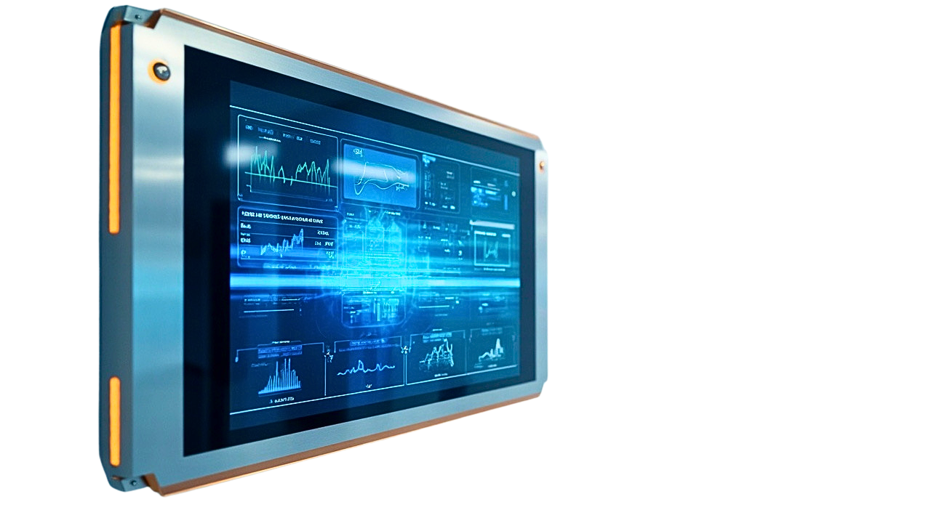
Part 2: The Pillars of Transformation
The Foundation: Interoperability & The FHIR Standard
Before we can be smart, we must be connected. Interoperability is the seamless, secure exchange of data between systems. The breakthrough has been the widespread adoption of the FHIR standard (Fast Healthcare Interoperability Resources).
25

Slide 26


The Translator: Natural Language Processing (NLP)
With data flowing, we face a new problem: 80% of it is unstructured text—clinician notes, discharge summaries, PDFs. This is where NLP comes in.
26
26

Slide 27

The Brain: Artificial Intelligence & Machine Learning
Now, with clean, structured, and connected data, we can deploy the brain: AI and Machine Learning. ML algorithms find patterns in this vast data ocean that humans simply cannot
27

Slide 28
The Translator: Natural Language Processing (NLP)
With data flowing, we face a new problem: 80% of it is unstructured text—clinician notes, discharge summaries, PDFs. This is where NLP comes in.

Slide 29
The Brain: Artificial Intelligence & Machine Learning
Now, with clean, structured, and connected data, we can deploy the brain: AI and Machine Learning. ML algorithms find patterns in this vast data ocean that humans simply cannot
29

Slide 30

The Frontiers: Quantum Computing & Augmented Reality
Looking further ahead, two technologies will redefine possibilities.
Quantum Computing
Augmented Reality

Slide 31
The Blueprint: Implementing a
Data-Driven Strategy
Technology is useless without strategy. Implementation is not a tech project; it's a change management project. The blueprint for success is consistent:

Slide 32

PART 3: THE CALL TO ACTION:
THE TIGER COMMUNITY'S ROLE
Our Moment: Opportunities for the TIGER Community
01
Educational Engine
02
Champion Global Standards
03
Foster Ethical Innovation
04
Bridge the Gaps
This transformation creates a massive skills and knowledge gap. This is where TIGER—with its mission of education, innovation, and global collaboration—can make its most profound impact. Our opportunities are clear

Slide 33
Conclusion
In conclusion, the future of healthcare is not a single technology. It is an orchestrated ecosystem built on interoperability, powered by intelligence, and designed for human connection.
The role of the TIGER community has never been more critical. We have the opportunity to ensure this transformation is guided by knowledge, ethics, and a unwavering focus on the human beings at the center of it all—our patients and our caregivers.
Let's get to work.

Slide 34

Get in touch
Web
VALENCIA ANNIK PAYNE
MS HEALTH INFORMATICS/HA
BSN RN, BS BIOLOGY,
CERT CYBERSECURITY,
CERT HEALTHCARE DATA ANALYTICS
Rn4studentsNanoSolutions.com
Email
rn4students@rn4studentsnanosolutions.com

Slide 35
Recently launched the HIMSS TIGER Competency Workgroup

Slide 36
HIMSS News You Need To Know
Pulse Check: Where are we with Social Determinants of Health (SDOH)? Virtual | Friday, October 24
Coffee with the HIMSS Nursing Informatics Task Force: Leadership & Governance Virtual |Tuesday, November 11
Check out your local HIMSS Chapter Events
HIMSS Experts to be Featured on PMI’s AI Today Podcast for a Series of Discussions on Artificial Intelligence in Healthcare Learn more
Register for the October HIMSS TIGER Global Meeting | Thursday, October 30th, with HIMSS’ Lee Kim sharing insights on cybersecurity
Find the recordings of the HIMSS TIGER Global Webinars on the HIMSS TIGER Community Page

