Slide 1
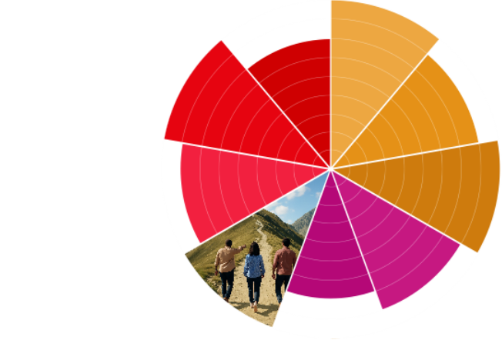

Communications Audit Template
Brand Architecture

Slide 2
Overview
Goals & Methodology
Preview of Findings
Detailed Analysis
  Channels
  Journey
Summary of Findings
Application

Slide 3
Goals & Methodology
Goal:
Channels Reviewed:
Process:
[who reviewed the channels]
[timeframe of communication samples analyzed]

Slide 4
Preview of Findings
Brand Structure:
[Main Finding]
Presentation of Brands:
[Main Finding]
Architecture Type:
[Main Finding]

Slide 5
Brand Structure
Use the next several slides to answer the following questions. Include screenshots and photos of communications that contributed to your conclusions.
What is my parent brand?
What are my sub-brands?
What are my products?
What are signposts rather than sub-brands?
What are the strengths & weakness of this architecture?

Slide 6
Presentation of Brands
Use the next several slides to answer the following questions. Include screenshots and photos of communications that contributed to your conclusions.
How is the messaging of the sub-brands similar to and different from the parent brand?
How are the sub-brands and products visually represented in comparison to the parent brand?
How are the sub-brands and products distributed across communication channels?
What is helpful and what is confusing about how the parent brand, sub-brands, and products are portrayed?

Slide 7
Architecture Type
Use the next several slides to answer the following questions. Include screenshots and photos of communications that contributed to your conclusions.
Does my architecture reflect a house of brands, branded house, or hybrid type?
Would a different type of architecture be more beneficial?

Slide 8
Summary of Findings
Brand Structure:
[Overall conclusion from findings]
Presentation of Brands:
[Overall conclusion from findings]
Architecture Type:
[Overall conclusion from findings]

Slide 9
Application
Use this slide to provide tangible next steps for improving your organisation’s brand architecture based on the findings from the audit.

