Slide 1
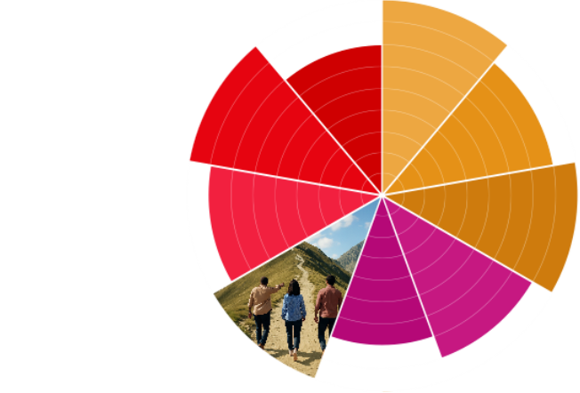

Organisation Audit Template
Audience Experience

Slide 2
Overview
Goals & Methodology
Organisations Reviewed
Preview of Findings
Detailed Analysis of Each Organisation
  Channels
  Journey
Summary of Findings
Application

Slide 3
Goals & Methodology
Goal:
Process:
[who reviewed the channels]
[timeframe of audit]
[number of organisations reviewed]

Slide 4
Organisations Reviewed
Use this slide to list the organisations reviewed with brief description of each.
It’s best to review 3-5 organisations similar to yours.
1
2
3
[Organisation 1]
[Organisation 2]
[Organisation 3]
[brief description]
[brief description]
[brief description]

Slide 5
Map of the Audience Experience : Organisation 1
For each organisation, create a summarized map that shows the steps the auditor took from first finding the organisation to becoming involved. A timeline view can be useful. For example, it could show that the auditor subscribed for emails, then 3 days later received the first email from the organisation.

Slide 6
Map of the Audience Experience : Organisation 2
For each organisation, create a summarized map that shows the steps the auditor took from first finding the organisation to becoming involved. A timeline view can be useful. For example, it could show that the auditor subscribed for emails, then 3 days later received the first email from the organisation.

Slide 7
Map of the Audience Experience : Organisation 3
For each organisation, create a summarized map that shows the steps the auditor took from first finding the organisation to becoming involved. A timeline view can be useful. For example, it could show that the auditor subscribed for emails, then 3 days later received the first email from the organisation.

Slide 8
Preview of Findings
Channels:
[Main Finding]
Journey:
[Main Finding]

Slide 9
Channels : Organisation 1
For each organisation, use a few slides to summarize your answers to the following questions. Include screenshots and photos of communications that contributed to your conclusions.
What channels is it using to communicate with its audience?
How is content integrated across channels?
How often does it communicate across channels?
How often does it communicate from each channel?
Are there certain visuals or messaging used that stand out?

Slide 10
Channels : Organisation 2
For each organisation, use a few slides to summarize your answers to the following questions. Include screenshots and photos of communications that contributed to your conclusions.
What channels is it using to communicate with its audience?
How is content integrated across channels?
How often does it communicate across channels?
How often does it communicate from each channel?
Are there certain visuals or messaging used that stand out?

Slide 11
Channels : Organisation 3
For each organisation, use a few slides to summarize your answers to the following questions. Include screenshots and photos of communications that contributed to your conclusions.
What channels is it using to communicate with its audience?
How is content integrated across channels?
How often does it communicate across channels?
How often does it communicate from each channel?
Are there certain visuals or messaging used that stand out?

Slide 12
Journey : Organisation 1
For each organisation, use a few slides to summarize your answers to the following questions. Include screenshots and photos of communications that contributed to your conclusions.
How easy it for their audience to go from discovering their organisation to getting involved with it? What communications would they see along the way?
How might they find that organisation for the first time?
Does it appear in Google results? What page of the website do the results link to? Is this helpful?
What journey does the website guide the audience through? What are they asked to do? Are there calls-to-action? Are they guided to another communication channel (social media, email, etc.)?
Do other communication channels have calls-to-action? Do they direct the audience to the website?
What communications does the audience receive while they are discovering the organisation and do these give the audience the information they’re looking for?

Slide 13
Journey : Organisation 2
For each organisation, use a few slides to summarize your answers to the following questions. Include screenshots and photos of communications that contributed to your conclusions.
How easy it for their audience to go from discovering their organisation to getting involved with it? What communications would they see along the way?
How might they find that organisation for the first time?
Does it appear in Google results? What page of the website do the results link to? Is this helpful?
What journey does the website guide the audience through? What are they asked to do? Are there calls-to-action? Are they guided to another communication channel (social media, email, etc.)?
Do other communication channels have calls-to-action? Do they direct the audience to the website?
What communications does the audience receive while they are discovering the organisation and do these give the audience the information they’re looking for?

Slide 14
Journey : Organisation 3
For each organisation, use a few slides to summarize your answers to the following questions. Include screenshots and photos of communications that contributed to your conclusions.
How easy it for their audience to go from discovering their organisation to getting involved with it? What communications would they see along the way?
How might they find that organisation for the first time?
Does it appear in Google results? What page of the website do the results link to? Is this helpful?
What journey does the website guide the audience through? What are they asked to do? Are there calls-to-action? Are they guided to another communication channel (social media, email, etc.)?
Do other communication channels have calls-to-action? Do they direct the audience to the website?
What communications does the audience receive while they are discovering the organisation and do these give the audience the information they’re looking for?

Slide 15
Summary of Findings
Channels:
[Overall conclusion from findings]
Journey:
[Overall conclusion from findings]

Slide 16
Application
Use this slide to provide tangible next steps for improving your audience’s experience with your organisation based on the findings from the audit.
Be sure to consider:
    How is my organisation similar or different?
    What can I apply from what these organisations are doing well?
    How can I set my organisation apart?

