Slide 1
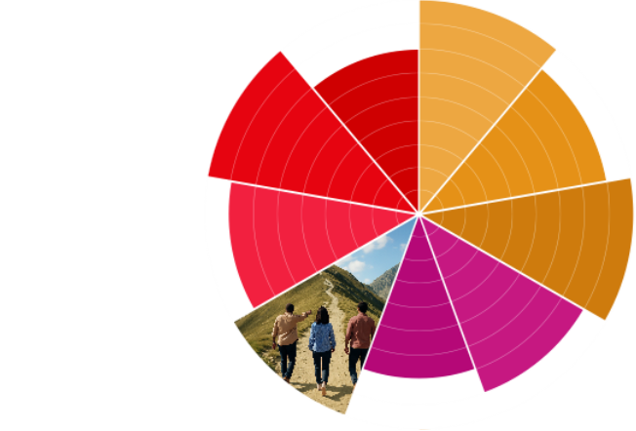

Communications Audit Template
Audience Experience

Slide 2
Overview
Goals & Methodology
Preview of Findings
Detailed Analysis
  Channels
  Journey
Summary of Findings
Application

Slide 3
Goals & Methodology
Goal:
Process:
[who reviewed the channels]
[timeframe of audit]

Slide 4
Map of the Audience Experience
Create a summarized map that shows the steps the auditor took from first finding the organisation to becoming involved. A timeline view can be useful. For example, it could show that the auditor subscribed for emails, then 3 days later received the first email from the organisation.

Slide 5
Preview of Findings
Channels:
[Main Finding]
Journey:
[Main Finding]

Slide 6
Channels
Use the next several slides to answer the following questions. Include screenshots and photos of communications that contributed to your conclusions.
What are all the channels used to communicate with my audience?
Do the channels I’m using appeal to my audience?
How is content integrated across channels?
How often does my audience hear from my organisation across channels?
How often do they receive communications from each channel?
Am I communicating with my audience too much or not often enough?
How does communication appear similar and different across channels?
Is the tone of voice consistent?
Are the communications visually interesting?

Slide 7
Journey
Use the next several slides to answer the following questions. Include screenshots and photos of communications that contributed to your conclusions.
How easy it for my audience to go from discovering my organisation to getting involved with it? What communications would they see along the way?
How might they find my organisation for the first time?
Does my organisation appear in Google results? If my audience clicks a Google result, what page of the website do they see?
Does the website guide them through the ideal journey? What are they asked to do? Are there calls-to-action? Are they guided to another communication channel (social media, email, etc.)?
Do other communication channels have calls-to-action? Do they direct my audience to the website?
Will the communications my audience receives as they discover my organisation give them the information they’re looking for?

Slide 8
Summary of Findings
Channels:
[Overall conclusion from findings]
Journey:
[Overall conclusion from findings]

Slide 9
Application
Use this slide to provide tangible next steps for improving your audience’s experience with your organisation based on the findings from the audit.

