Slide 1
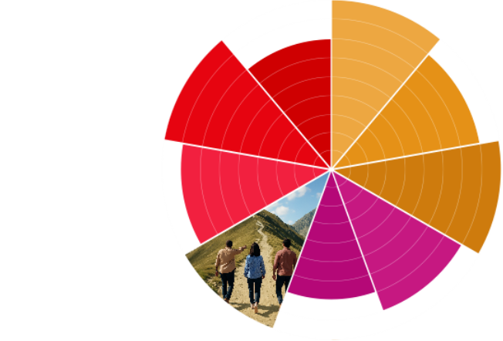

Organisation Audit Template
Brand Architecture

Slide 2
Overview
Goals & Methodology
Organisations Reviewed
Preview of Findings
Detailed Analysis of Each Organisation
  Brand Structure
  Presentation of Brands
  Architecture Type
Summary of Findings
Application

Slide 3
Goals & Methodology
Goal:
Channels Reviewed:
Process:
[who reviewed the channels]
[timeframe of communication samples analyzed]
[number of organisations reviewed]

Slide 4
Organisations Reviewed
Use this slide to list the organisations reviewed with brief description of each.
It’s best to review 3-5 organisations similar to yours.
1
2
3
[Organisation 1]
[Organisation 2]
[Organisation 3]
[brief description]
[brief description]
[brief description]

Slide 5
Preview of Findings
Brand Structure:
[Main Finding]
Presentation of Brands:
[Main Finding]
Architecture Type:
[Main Finding]

Slide 6
Organisation
1
For each organisation, use a few slides to summarize your answers to the following questions. Include screenshots and photos of communications that contributed to your conclusions.
Brand Structure:
What is its parent brand?
What are its sub-brands?
What are its products?
What signposts is it using?
What are the strengths & weakness of its architecture?
Presentation of Brands:
How is the messaging of the sub-brands similar to and different from the parent brand?
How are the sub-brands and products visually represented in comparison to the parent brand?
How are the sub-brands and products distributed across communication channels?
What is helpful and what is confusing about how the parent brand, sub-brands, and products are portrayed?
Architecture Type:
Does its architecture reflect a house of brands, branded house, or hybrid type?

Slide 7
Organisation
2
For each organisation, use a few slides to summarize your answers to the following questions. Include screenshots and photos of communications that contributed to your conclusions.
Brand Structure:
What is its parent brand?
What are its sub-brands?
What are its products?
What signposts is it using?
What are the strengths & weakness of its architecture?
Presentation of Brands:
How is the messaging of the sub-brands similar to and different from the parent brand?
How are the sub-brands and products visually represented in comparison to the parent brand?
How are the sub-brands and products distributed across communication channels?
What is helpful and what is confusing about how the parent brand, sub-brands, and products are portrayed?
Architecture Type:
Does its architecture reflect a house of brands, branded house, or hybrid type?

Slide 8
Organisation
3
For each organisation, use a few slides to summarize your answers to the following questions. Include screenshots and photos of communications that contributed to your conclusions.
Brand Structure:
What is its parent brand?
What are its sub-brands?
What are its products?
What signposts is it using?
What are the strengths & weakness of its architecture?
Presentation of Brands:
How is the messaging of the sub-brands similar to and different from the parent brand?
How are the sub-brands and products visually represented in comparison to the parent brand?
How are the sub-brands and products distributed across communication channels?
What is helpful and what is confusing about how the parent brand, sub-brands, and products are portrayed?
Architecture Type:
Does its architecture reflect a house of brands, branded house, or hybrid type?

Slide 9
Summary of Findings
Brand Structure:
[Overall conclusion from findings]
Presentation of Brands:
[Overall conclusion from findings]
Architecture Type:
[Overall conclusion from findings]

Slide 10
Application
Use this slide to provide tangible next steps for improving your audience’s experience with your organisation based on the findings from the audit.
Be sure to consider:
    How is my organisation similar or different?
    What can I apply from what these organisations are doing well?
    How can I set my organisation apart?

