Slide 1
An introduction to
Brand Architecture

Slide 2
What is Brand Architecture?
The grouping of an organisation’s offerings and services into strategic categories.
Parent brand:
The highest level of an organisation’s brand that could either exist on its own or contain sub-brands.
Sub-brand:
Segment of the parent brand that is owned by the parent brand, but speak to a unique audience and contain a specific offering.
Product:
The grouping of an
organisation’s offerings
and services into strategic
categories.
Signpost:
Ways of categorising and labelling products in communication materials to guide the way the audience experiences the organisation.

Slide 3
What is Brand Architecture?
Parent Brand
Sub-Brand
Toyota
Signpost
Product
Lexus
Toyota Trucks
Toyota SUVs/Vans
Toyota Cars
Toyota Tundra
Toyota Tacoma

Slide 4

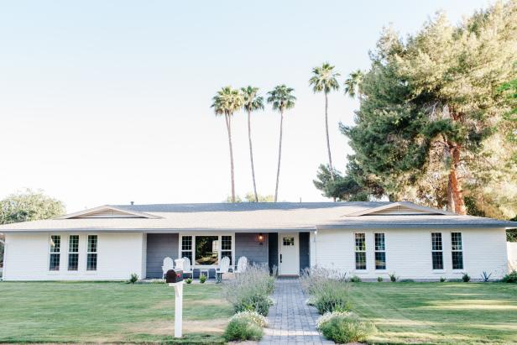
Types of Architecture
When looking at architectural styles of houses, you have many options that influence the appearance and functionality of the house. For example, in the United States, two different home architectures you might see are Craftsman and Ranch.
A Craftsman-style house is known for its front porch supported by columns, two stories, and a triangular roof. A Ranch style house is typically one story, wider, often “L-shaped”, with a somewhat flatter roof.
The layout and design of these houses affect where rooms are located, how they’re accessed, and who the house would best serve. For example, an elderly couple would likely prefer a Ranch style house over a Craftsman style one so they would not have to go up and down the stairs.
Likewise, the layout and design of your organisation affect how your products are accessed and who will most likely want to access them.
Craftsman Style House
Ranch Style House

Slide 5
Types of Brand Architecture?
3 main types of brand architecture:
1
2
3
Branded House
House of Brands
Hybrid
A parent brand contains sub-brands that are completely attached to it with few distinguishing characteristics.
A parent brand contains sub-brands that are distinct and unique from it.
A parent brand contains both attached and distinct sub-brands.

Slide 6
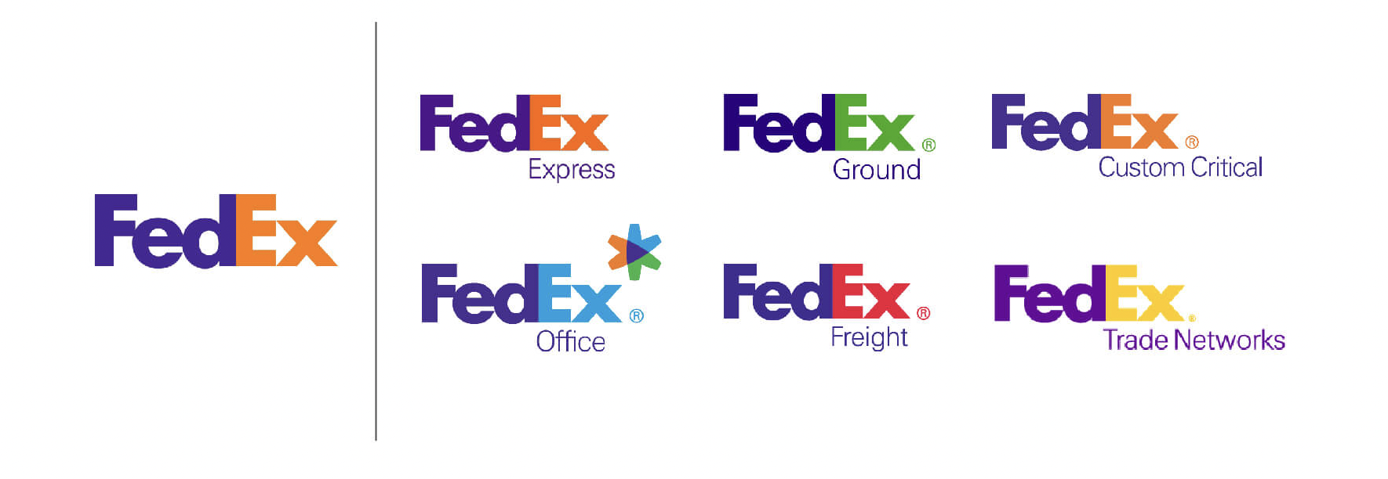
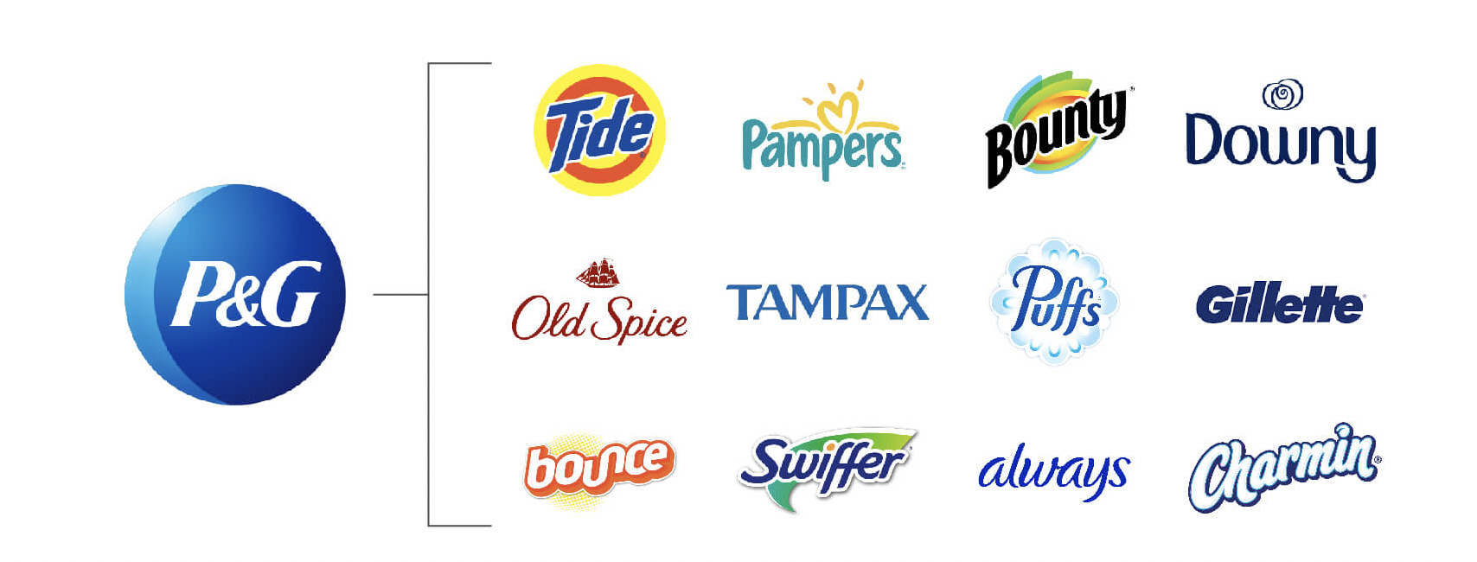
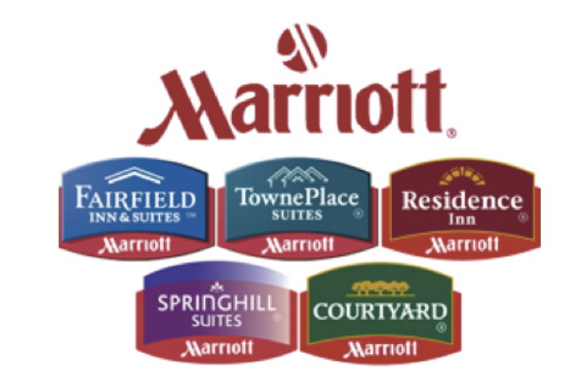
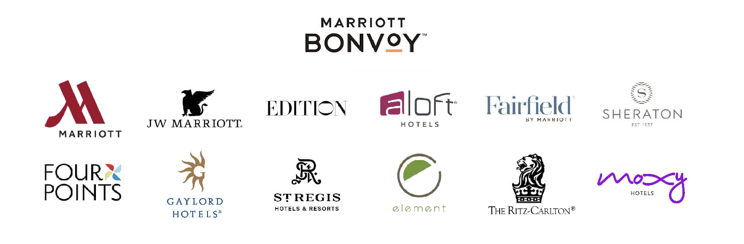
Examples of Brand Architecture?
Branded House: FedEx
House of Brands: P&G
Hybrid: Marriott Hotels

Slide 7
Introducing: Renew Ministries
To better exemplify how brand architecture might apply to your organisation, I’d like to introduce you to a fictional organisation - Renew Ministries.
Renew Ministries’ mission is to be the hands and feet of Jesus serving impoverished communities throughout Southeast Asia. It has a medical clinics offering free or discounted services to impoverished families. As its clinics grew, they split into offering two different services - one offers rehabilitation services for children with physical disabilities and the other offers prenatal and postnatal care for mothers.
To help raise money to fund the clinics, Renew Ministries also opened a thrift store called Like New, from which 50% of the profits go to the clinic.

Slide 8
Renew Ministries: Brand Architecture?
Renew Ministries follows a hybrid model of brand architecture.
Parent Brand
Sub-Brand
Signpost
Renew Ministries
Product
Renew Pediatrics
Renew
Maternal Care
Like New
Renew Pediatrics: South
Renew Pediatrics: East
Renew Maternal Care: South
Renew Maternal Care: East
Used Clothes
Used Homegoods
Rehabilitation Services
Prenatal & Postnatal Services

Slide 9
Renew Ministries: Brand Architecture?
Let’s break this down:
Renew Ministries is the parent brand. It is the name of the organisation that houses all of its endeavours. Even if one of the clinics closed or the thrift store shuts down, Renew Ministries would still exist.
Because Renew Ministries found the need to serve two different audiences each with unique needs, it created the sub-brands of Renew Pediatrics and Renew Maternal Care. They are supported by the parent brand and help fulfil the mission of Renew Ministries. Because they follow the same naming structure as Renew Ministries and have the same branding, they are following the branded house model.
Like New is also a sub-brand of Renew Ministries. It still fulfils the mission of Renew Ministries, but does so a bit differently than the clinics. It attracts a different audience and serves them in a different way – by providing discounted products rather than medical care. To ensure its audience knows it is a store and not a clinic, it follows a different naming structure and uses different visuals. This sub-brand follows the house of brands model.
The various locations of the Renew Pediatrics and Renew Maternal Care clinics are signposts. The experience at Renew Pediatrics: South and Renew Pediatrics: East is intended to be very similar, fulfilling the same need, just in a different place. They are simply listed on the website to guide the audience to the location closest to them.
Because Renew Ministries is blending a branded house and house of brands model, it’s a hybrid - and that seems to serve it well!

Slide 10
What are my sub-brands?
One of the most difficult tasks in establishing a brand architecture is often determining what is a sub-brand versus a product, or even just a signpost. Here are some useful criteria to determine if your organisation may have one or more sub-brands:
Are there people who would use one of my products/services but not the other(s)?
Are there parts of my products/services that fulfil a different part of my mission than the others?
Are there multiple locations of my organisation that are accomplishing different things or have a very
different look/feel?
Is my “sub-brand” really a product or a signpost?
Is it a fundraising campaign, newsletter, or event? This is a product.
Is it a podcast or video series that your ministry created for its typical audience to access? This is likely a product.
Is it a section or page of your website that helps your audience navigate but is not offering something unique to a unique audience (such as “Events”, “Blog”, or “Resources”)? This is a signpost.
Is it two or more locations offering the same service to similar audiences (just in different places)? This is likely a signpost.

Slide 11
Which Brand Architecture type is right for me?
The most important part of defining brand architecture is that you choose one to follow. When organisations start naming sub-brands and products without any strategy for doing so, it can lead to confusion quickly for their audience.
However, if you are able to map out your brand architecture and decide where your offerings fit, and future offerings might join, it keeps your organisation a lot more… well, organised! So, while choosing a house of brands, branded house, or hybrid model all have different pros and cons, the most important thing is that you choose one and stick with it.

Slide 12
What is Brand Architecture?
As you consider which model best fits your organisation, here are some helpful tips:
Branded House
1
House of Brands
2
Hybrid
3
Useful when less attachment to a parent brand is desired. However, many distinct sub-brands can quickly become confusing & stray from the parent brand.
Useful for keeping a brand with many sub-brands organised. However, there is less opportunity for sub-brands to separate themselves from the parent brand in ways that might serve their audiences.
Useful when either of the other two models feel too strict or limiting for your organisation and you have clear reasons why combining the two would best serve the audiences of your sub-brands.

