Slide 1
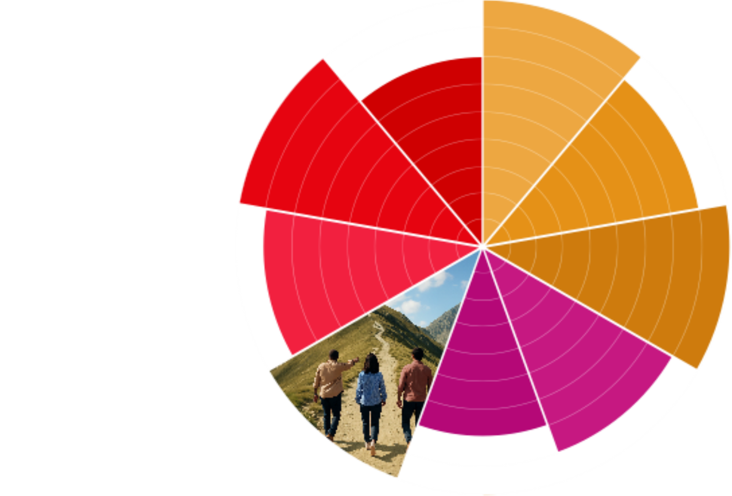

Organisation Audit Template
Brand Strategy

Slide 2
Overview
Goals & Methodology
Organisations Reviewed
Preview of Findings
Detailed Analysis of Each Organisation
  Messaging
  Visuals
  Channels
Summary of Findings
Application

Slide 3
Goals & Methodology
Goal:
Channels Reviewed:
Process:
[who reviewed the channels]
[timeframe of communication samples analyzed]
[number of organisations reviewed]

Slide 4
Organisations Reviewed
Use this slide to list the organisations reviewed with brief description of each.
It’s best to review 3-5 organisations similar to yours.
1
2
3
[Organisation 1]
[Organisation 2]
[Organisation 3]
[brief description]
[brief description]
[brief description]

Slide 5
Preview of Findings
Messaging:
[Main Finding]
Visuals:
[Main Finding]
Channels:
[Main Finding]

Slide 6
Organisation
1
For each organisation, use a few slides to summarize your answers to the following questions. Include screenshots and photos of communications that contributed to your conclusions.
Messaging:
From the communications analyzed, what does its brand promise appear to be? How does it communicate this across channels?
What are its emotional and functional benefits? How are these communicated across channels?
What is its personality? How is this communicated across channels?
What is the tone of voice? How is it communicated across channels?
What calls-to-action are used across channels?
Visuals:
What is the logo, colors, photography style, font, and icons/patterns?
How do its visuals appeal to its audience?
Channels:
What channels is it using to communicate?

Slide 7
Organisation
2
For each organisation, use a few slides to summarize your answers to the following questions. Include screenshots and photos of communications that contributed to your conclusions.
Messaging:
From the communications analyzed, what does its brand promise appear to be? How does it communicate this across channels?
What are its emotional and functional benefits? How are these communicated across channels?
What is its personality? How is this communicated across channels?
What is the tone of voice? How is it communicated across channels?
What calls-to-action are used across channels?
Visuals:
What is the logo, colors, photography style, font, and icons/patterns?
How do its visuals appeal to its audience?
Channels:
What channels is it using to communicate?

Slide 8
Organisation
3
For each organisation, use a few slides to summarize your answers to the following questions. Include screenshots and photos of communications that contributed to your conclusions.
Messaging:
From the communications analyzed, what does its brand promise appear to be? How does it communicate this across channels?
What are its emotional and functional benefits? How are these communicated across channels?
What is its personality? How is this communicated across channels?
What is the tone of voice? How is it communicated across channels?
What calls-to-action are used across channels?
Visuals:
What is the logo, colors, photography style, font, and icons/patterns?
How do its visuals appeal to its audience?
Channels:
What channels is it using to communicate?

Slide 9
Summary of Findings
Messaging:
[Overall conclusion from findings]
Visuals:
[Overall conclusion from findings]
Channels:
[Overall conclusion from findings]

Slide 10
Application
Use this slide to provide tangible next steps for improving your audience’s experience with your organisation based on the findings from the audit.
Be sure to consider:
    How is my organisation similar or different?
    What can I apply from what these organisations are doing well?
    How can I set my organisation apart?

