Slide 1

Agenda
Meet and greet – Networking
Introduction to Mall Location analytics & Shopper Profiles
Mall Experience Index (MEI)
Monetizing Mall Inventory with Moving Walls
Q&A

Slide 2


Mall Audience & Experience Index
Tea Time Talk
7th April

Slide 3
We believe …
A true customer-centric culture goes beyond being customer-first.
It not only prioritizes customer needs in decisions and trade-offs, but also embeds those needs into the organization’s systems, processes,
and most importantly People

Slide 4
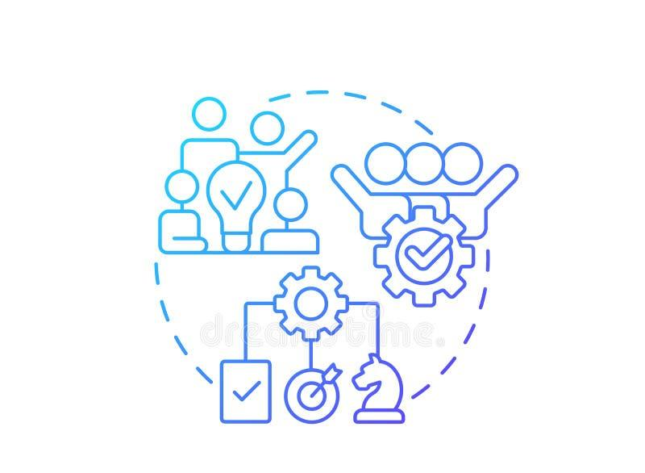


How CX is shaping up in the current scenario
EVOLVING CONSUMERS EVERY DAY
WIDE CHOICES | CONNECTED DIGITALLY | EVOLVING COMPETITION
EVERY INTERACTION MATTERS
PERSONALIZED | EASY | FAST
EXPERIENCE IS THE NEW BRAND
EVOLVING | COMPLEX & INTERLINKED

Slide 5



MULTIDIMENSIONAL DYNAMICS
Success happens when expectations, emotional cues, and consumption moments all align.
We can identify who these people really are, how they behave, what they choose, and the emotional cues shaping those choices?
This bridges claimed perception with real-world presence, giving brands visibility into consumers in the very moments that matter.

Slide 6
Power of looking through combined view
We combine REAL BEHAVIORAL mall intelligence with direct SHOPPER EXPERIENCE insights.
Passive Behaviour explains context → Shopper Survey explains motivations
Together they reveal growth opportunities
YOUR TITLE
Behavioral
– WHAT is happening
Shopper Experience
– WHY it happens
Footfall patterns (weekday vs weekend)
Audience profile (age, income, techies, students)
Visit frequency & movement trends
Brand interactions & category hotspots
Purpose of visit
Experience ratings (navigation, cleanliness, parking, ambience)
Tenant mix relevance
Emotional connection & loyalty drivers

Slide 7
Decoding Audience by locations

Slide 8
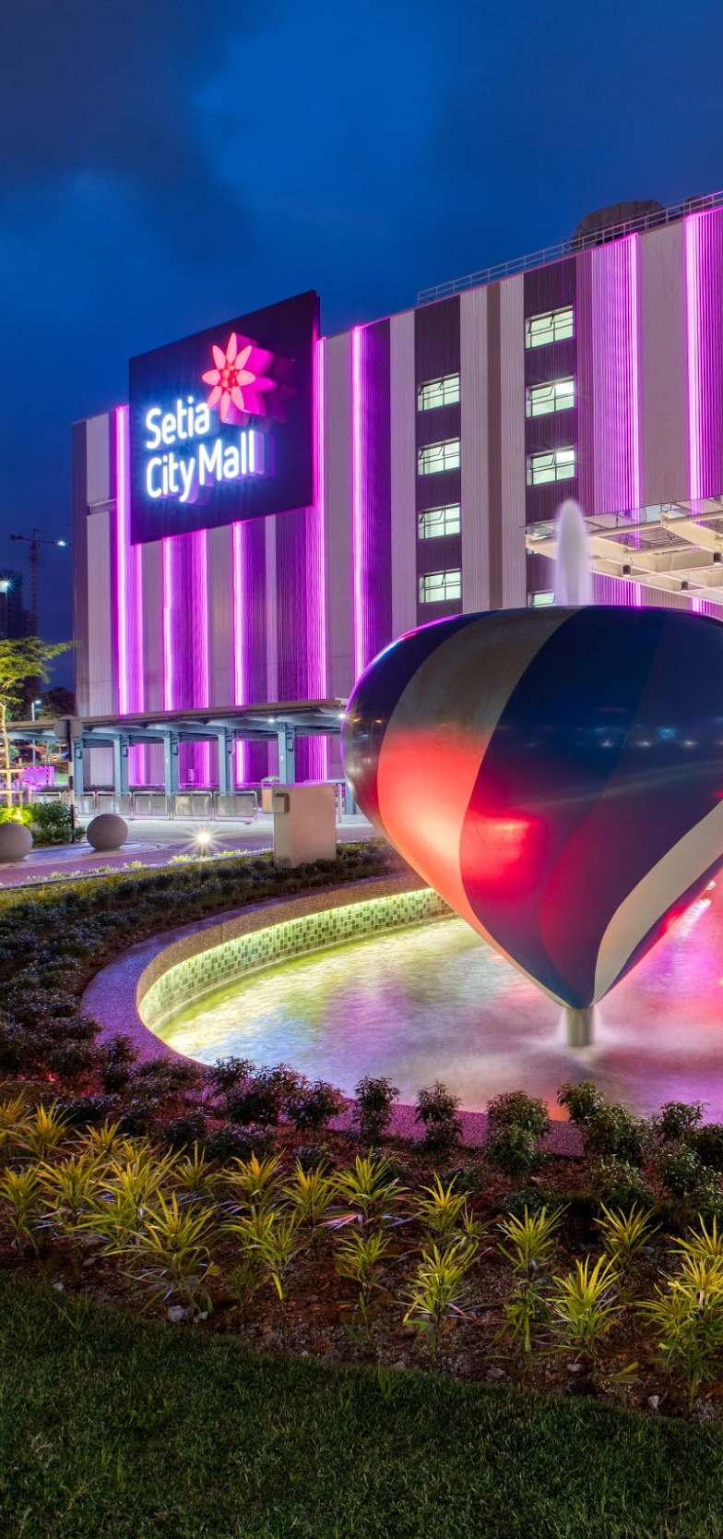
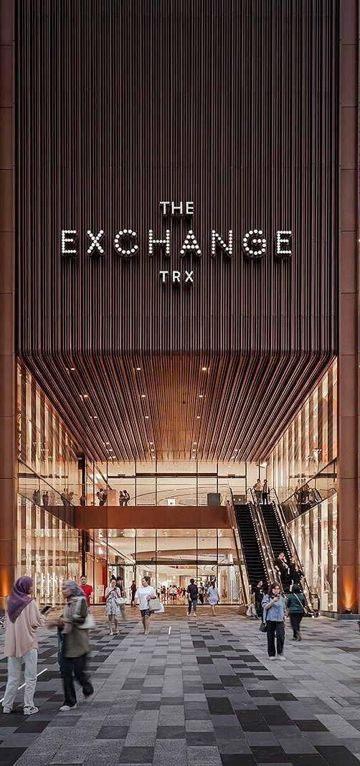
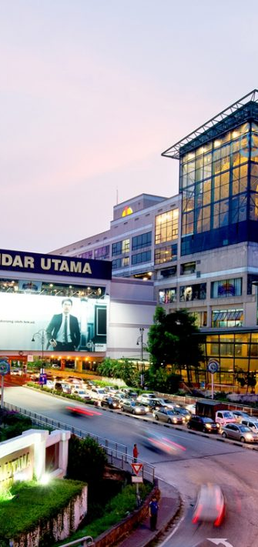
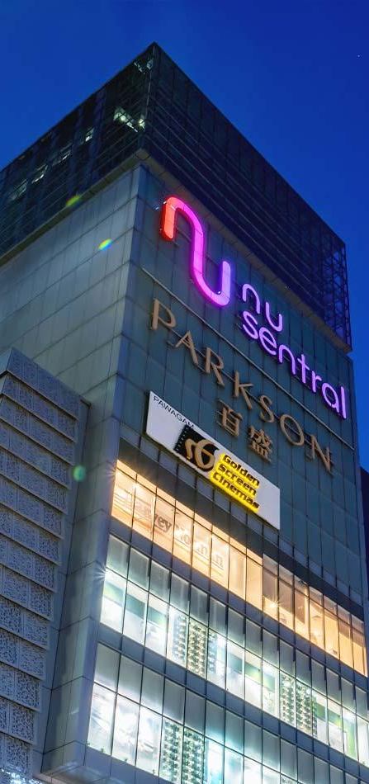
Community / Neighbourhood Malls | Luxury / Premium | Mega Lifestyle Destinations | Transit & Convenience Hubs

Slide 9
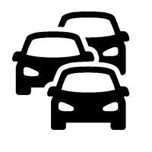
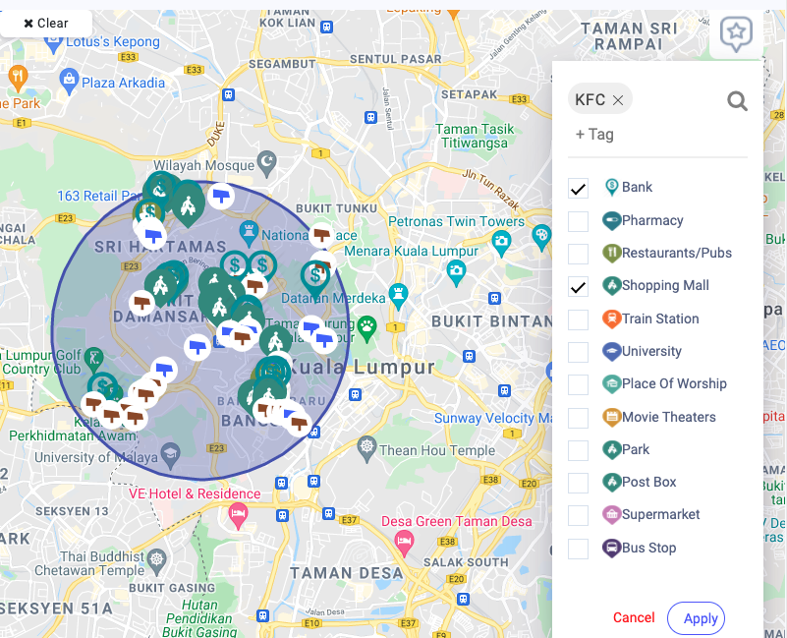
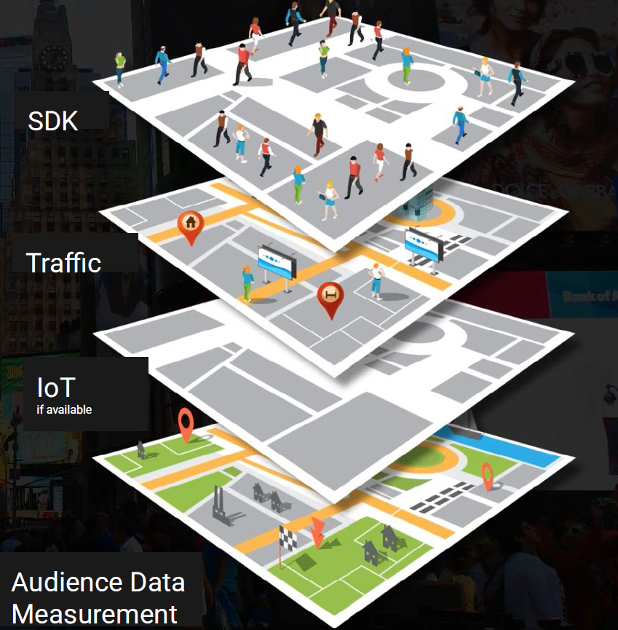






How do we do it ?
Multi-sources of the location footprints and calibration helps us gain knowledge about ….
Sources of audience movement data
TRAFFIC
Sports Enthusiasts
Affluent
Auto Enthusiasts
Biz Owners
Blue Collar
Commuters
Entertainment Seeker
Fashion
Fitness
Food Lovers
Gamers
Healthcare
Home Improvement
Mid-Income
Pet Lovers
Property Owners
Students
Tech Enthusiasts
Travellers
White Collar
Young Parents
Music Lovers
& Custom Segments
Knowledge of the audience – Demogs, Segment, volume / density
Residence & working areas of these audiences
Knowledge of the Location
Comparative analytics in terms of footfall, context and surroundings, peak/ off peak period
Incremental / overlap with other locations
MOBILE SDKs
IoT
(BT & WiFi)
VIDEO
DATA TRIGGERS

Slide 10
Average Footfall across mall types
Average Footfall a Day

Slide 11

Understand the power of organically attracted audience
WEEKDAY | WEEKEND
WEEKDAY | WEEKEND
WEEKDAY | WEEKEND
WEEKDAY | WEEKEND
Community / Neighbourhood Malls | Luxury / Premium | Mega Lifestyle Destinations | Transit & Convenience Hubs
WEEKDAY | WEEKEND
WEEKDAY | WEEKEND
WEEKDAY | WEEKEND
WEEKDAY | WEEKEND
Community / Neighbourhood Malls | Luxury / Premium | Mega Lifestyle Destinations | Transit & Convenience Hubs

Slide 12
Profiled based on Movement Patterns
Community / Neighbourhood Malls | Luxury / Premium | Lifestyle Destinations | Transit & Convenience Hubs

Slide 13
Power of Location analytics
Arrive at
Scaled solution
Tracks movement to mall and other locations to provide complete shopper journey
Day wise footfall
Segment it by key demogs
Decode profile of mall hoppers
Find overlap of your mall with others
Average dwelling time
Segment it belongs to
Shoppers – from where they come and where do they go post mall visit
Behavioral
– WHAT is happening
Footfall patterns (weekday vs weekend)
Audience profile (age, income, techies, students)
Visit frequency & movement trends
Brand interactions & category hotspots

Slide 14
Mall Experience Index

Slide 15
Mall Experience Index
Mall formats may differ in promise, but experience leadership is driven by how consistently that promise is delivered.
Very Good + Exception
Top 2 Box
52%
Considering all these aspects, how would you rate (_______ mall name) on your recent shopping experience
1 = Very Poor | 2 = Poor | 3 = Somewhat poor | 4 = Average/ neutral | 5 = Good | 6 = Very Good | 7 = Exceptional

Slide 16
Deep Diving Service Touch Points
Winning on experience is about playing to your strengths — not outperforming on every touchpoint
Transit leads on efficiency and digital, Luxury on service, Lifestyle on engagement, and Community on everyday convenience.

Slide 17
What aspect contributes in driving desired experience ?
Winning malls are not those that score highest across all touchpoints, but those that deliver strongest on the moments that matter most to their audience
 | Total | Community Neighbourhood Malls | Luxury/Premium Malls | Lifestyle Destinations | Transit & Convenience Hubs
Food Court / Dining Experience Overall | 22% | 15% | 42% | 19% | 9%
Retail Experience Overall | 19% | 20% | 5% | 26% | 26%
Navigation & Wayfinding | 13% | 8% | 30% | 9% | 7%
Events, Promotions & Marketing Activation overall | 12% | 5% | 5% | 14% | 26%
Arrival & Departure | 6% | 9% | 6% | 5% | 6%
Digital Experience Overall | 7% | 7% | 2% | 6% | 10%
Security & Safety Management Overall | 7% | 21% | 1% | 6% | 1%
Customer Service / Concierge | 6% | 7% | 5% | 4% | 9%
Housekeeping & hygiene | 4% | 4% | 1% | 9% | 3%
Accessibility & Inclusiveness Overall | 3% | 4% | 2% | 3% | 3%

Slide 18
Decoding performance against important aspects
Lifestyle Destinations
🚨 Fix Immediately
⭐ Leverage Strengths
I
MPORTANCE
💤 Relatively Lower Priority
⚖️ Optimise Investment
PERFORMANCE

Slide 19
Changing facets of Mall Experience
Experience gaps are not driven by low performance, but by where that performance is focused.
Winning malls are those that align execution with the highest-impact drivers of experience.
Mall experience in Malaysia has moved beyond infrastructure to delivering a seamless mix of convenience, engagement, and everyday relevance with different formats winning on different strengths.
While strong anchors like dining, retail mix, and accessibility are well established, the real opportunity lies in improving consistency across key touchpoints such as ease of movement and reducing efforts across the touch points and transactions
This raises a critical question : how does your mall truly perform on the moments that matter most to your shoppers?
Winning malls will be those that continuously measure, track, and optimise these experiences i.e. turning insight into sustained experience leadership.

Slide 20





Mall Experience Index (MEI)
Ready Output
Mall Performance Update
Shopper Insights & Profiles
Competitive Benchmarking
Benchmarking Across Mall Categories e.g.
– WHAT is happening
Actionable Recommendations
– WHAT is happening
Overall, MEI score and pillar-level performance
Trends by day, week, and month
Zone-level heatmaps and dwell analysis
Visitor origin, frequency, and loyalty
High-value vs casual visitors
Demographic and lifestyle segmentation
Performance vs comparable malls
Catchment overlap and leakage analysis
Strengths, gaps, and opportunity areas
  Premium malls Index
  Entertainment-led malls Index
  Outlet malls Index
  Concept malls Index
  Best in class entertainment category Index
  Best in retail / dining experience Index
  Best in loyalty / membership Index
Experience and layout optimisation
Event and activation effectiveness
Leasing and tenant mix insights

Slide 21
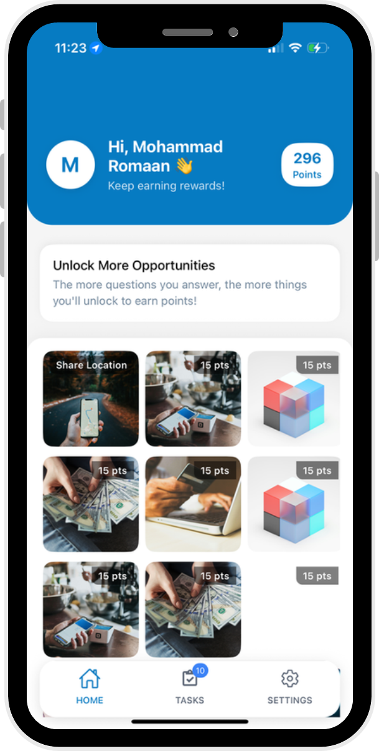
Research Methodology & Design
Experience Index
Shopper Experience Index is an always-on, app-based experience measurement platform designed to deliver fast, scalable, and benchmarked insights across mall locations across experience touchpoints.
Data Collection
Data is collected continuously via the proprietary mobile app, enabling high-frequency measurement with minimal respondent fatigue. Demographic and lifestyle attributes are pre-profiled, allowing surveys to remain concise while maintaining depth and quality.
Methodology
Combined Continuous data collection (Quartey refresh) and Standardized experience index metrics for comparability.
Demographic & Behavioural Controls:
  Age, Gender
  Ethnicity / Race
  Household income
  Life stage, solo vs accompanied shopping, spend during the visits etc
  Shopping context, weekday vs weekend, peak season vs non peak season,
  Malls visited ,Visit recency & engagement, Time spent, Visit frequency & purpose, Mall type preference

Slide 22
Measurement Base –
Rational for sample size
Sample Size Rational
Tier 1: Regional & destination giants (high gravity)
 | * % share of footfall | Expected reponses
1. 1 Utama | 15 | 1100-1200
2. Mid Valley Megamall | 12 | 900-1000
3. Sunway Pyramid | 10 | 700-900
4. Suria KLCC | 9 | 600-700
5. Pavilion KL | 7 | 500-650
6. IOI City Mall (Putrajaya) | 7 | 500-650
These 6 typically capture ~55-60%+ of visits among the top 20 due to scale, anchors, tourism, and event gravity.
Tier 2: Strong multi-catchment malls
7. The Gardens Mall | 4 | 300-400
8. MyTOWN + IKEA Cheras cluster | 4 | 300-400
9. Sunway Velocity | 3 | 200-300
10. NU Sentral | 5 | 400-500
11. Berjaya Times Square | 3 | 200-300
12. Paradigm Mall PJ | 3 | 200-300
Typically, ~18–24% of visits combined, driven by transit, office belts, youth/F&B pull, and regional families.
Tier 3: Large community & lifestyle anchors
13. Setia City Mall | 4 | 300-400
14. Central i-City (Shah Alam) | 3 | 200-300
15. Tropicana Gardens Mall | 2 | 150-200
16. The Curve / IPC cluster | 2 | 150-200
17. Quill City Mall | 2 | 150-200
Typically, ~10–14% of visits, dominated by defined local catchments + weekend skew.
Tier 4: Established but more localized
18. Sunway Putra Mall | 2 | 150-200
19. Empire Shopping Gallery | 2 | 150-200
20. Avenue K | 2 | 150-200
Typically, ~4–7% of visits, more weekday-driven and proximity-led.
2500 sample size per quarter
X
average 2 to 3 malls experience mapping per respondents allows to have a read of 7500 responses per quarter.
Hence for high footfall malls expected responses base could be in the range of 750-1200 responses and lowest footfall mall itself will have ~ 150-200 sample size per quarter
With 7500 responses base we are exposed to +/- 1.1 % margin of error which is best in class for statistical significance
* Based on predictive visitation share hypothesis with a model-based, indicative distribution built from how mall visitation is typically forecast

Slide 23
What each Individual Mall Can Expect as Outputs

Slide 24
MEI – Outputs
Baseline report (Single mall)
Industry benchmark – Consolidated index across all malls irrespective of the category.
Your mall : Single mall location for e.g. Mid-Valley only or KLCC only

Slide 25
MEI – Outputs
Baseline report (Single mall)

Slide 26
MEI – Outputs
Baseline report (Single mall)

Slide 27
Deep-dive Report | Core Experience Delivery Index

Slide 28
Deep-dive Report | | Retail, Dining & Offers Index

Slide 29
Deep-dive Report | Movement, Wayfinding & Access Index

Slide 30
Deep-dive Report | Customer Touchpoints & Digital Experience Index

Slide 31
Commercials

Slide 32
Solution which is agile and VFM
 |  | Quarterly | Annual
Baseline Report | SINGLE MALL CEX : AT TOTAL LEVEL Customer Experience Index Sub Indices Core Experience Delivery Index Retail, Dining & Experience Offerings Index Movement, Wayfinding & Access Index Customer Touchpoints & Digital Experience Index | 2,499 MYR | 9,996 MYR
Deep Dive Report | SINGLE MALL CEX : AT TOTAL LEVEL Under Each Indices – Detailed Scored by each attribute | 5000 MYR | 16,000 MYR
Competitive Analytics | If need data cuts by profile of the audience then investment to be discussed
 | Ad hoc cost to be discussed (based on # of malls / mall or specific mall in comparison

Slide 33
How can you use this in your day-to-day work
Understand consumer interests on an on-going basis
Benchmark by relevant peers
Get in-depth understanding of the footfall and profile of your own mall
What are the specific Experience feedback for your mall
Track for an on-going basis on what are the changes

Slide 34
Commercial Impact for Mall Owners
1
2
3
4
Better ROI on events, renovations, and promotions
Stronger monetisation of media and brand partnerships
Improved tenant retention and leasing leverage
Higher dwell time and repeat visitation

Slide 35
Monetizing Mall Inventory
Powering Smart Retail Environments with Media & Measurement

Slide 36
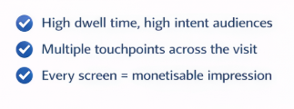
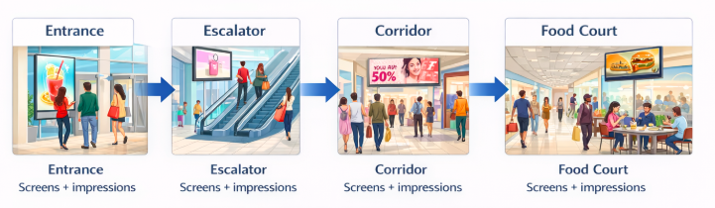
Turning Footfall into Media Value
Continuous exposure across the shopper jounrey

Slide 37
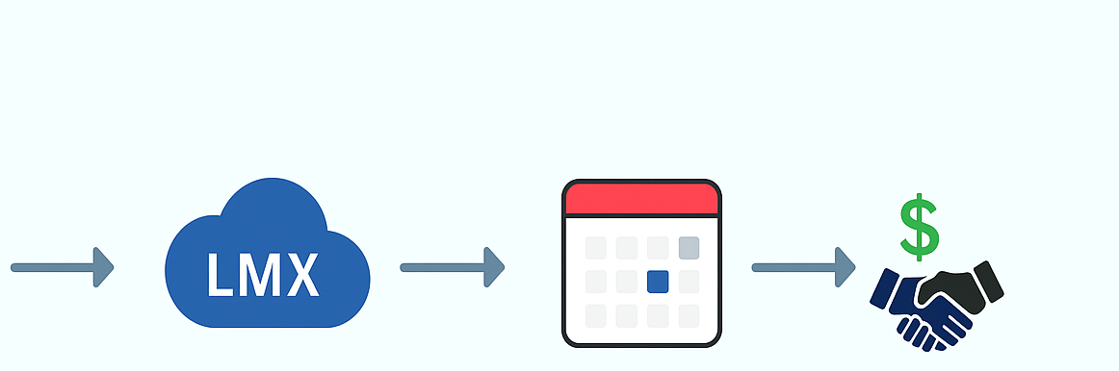

How Your Existing Screens Can Generate Revenue
Mall Screens (Existing Inventory)
LMX (Onboard Inventory)
Allocate
Ad Play (10% of Loop)
Revenue (External brand demand)
*Even allocating just 10% of loop time can start generating brand revenue

Slide 38
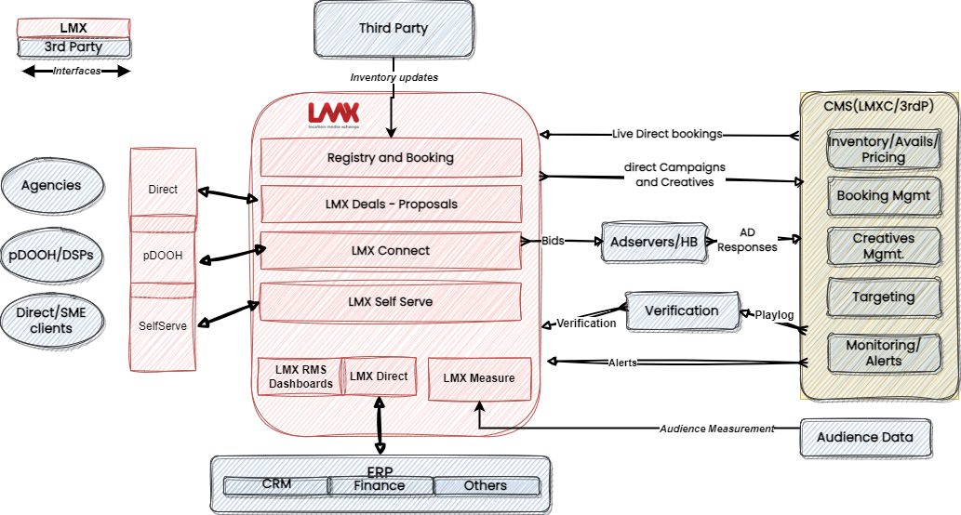
The LMX Platform – An Existing Technology Stack For Shopping Malls to Monetise

Slide 39
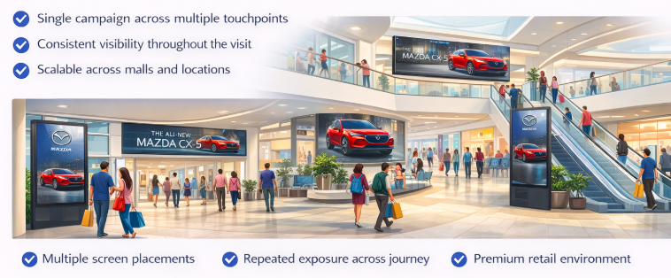
What this looks like in practice
Continuous exposure across the shopper jounrey

Slide 40
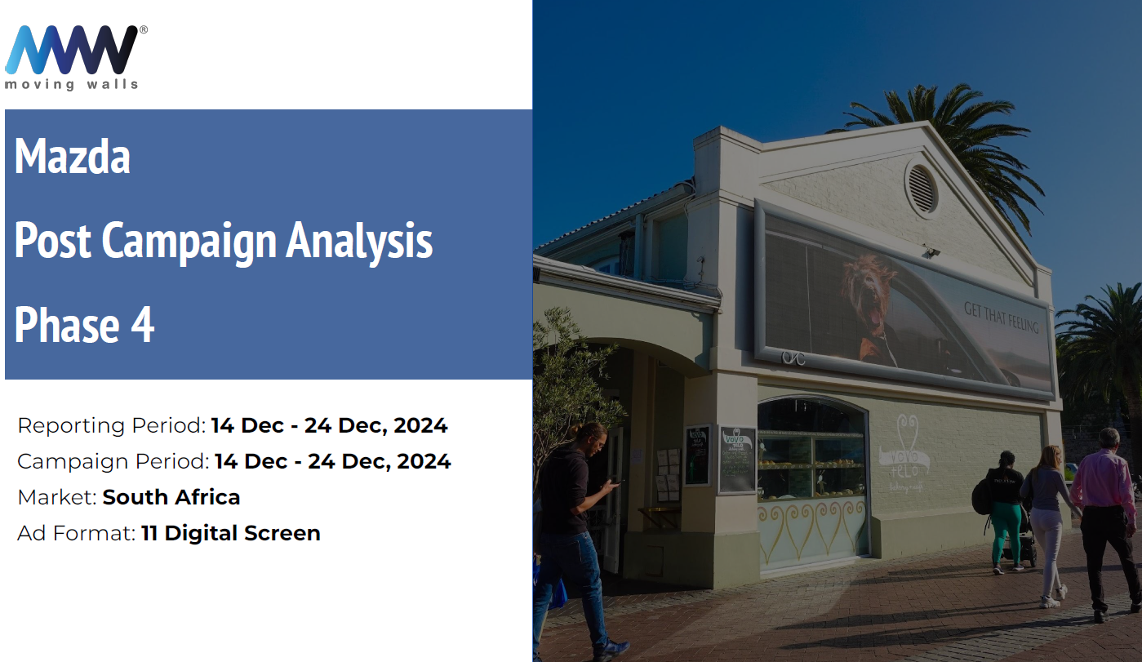
What does a campaign look like

Slide 41
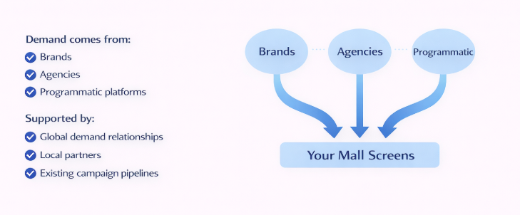
Unlocking Demand from your screens
You maintain full control!

Slide 42
Commercials
Platform Subscription CMS and Inventory Management Deployment Scope Single Mall / multi-location rollout Optional Modules Measure, Self-Serve | Commercial Model Monthly SaaS feed per site Scales with network size Flexible based on deployment scope
If required, commercial structure can be tailored based on mall size and rollout scope

Slide 43


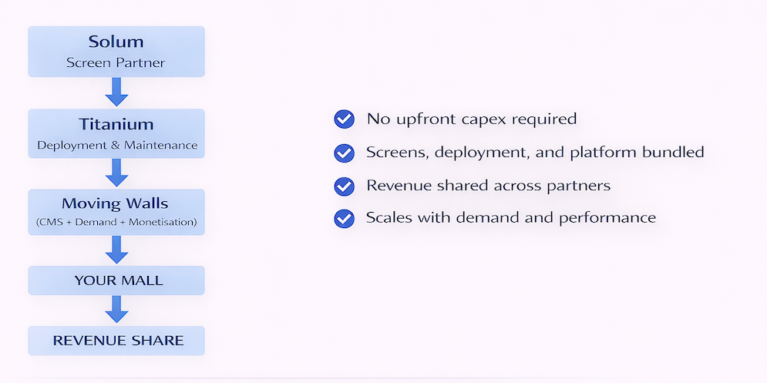
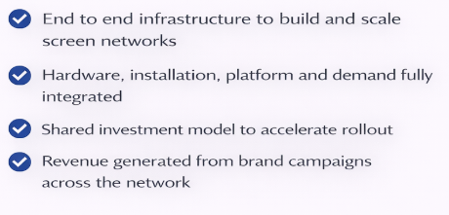
Build and Monetise Your Screen Network
Start with one site, expand based on revenue

Slide 44
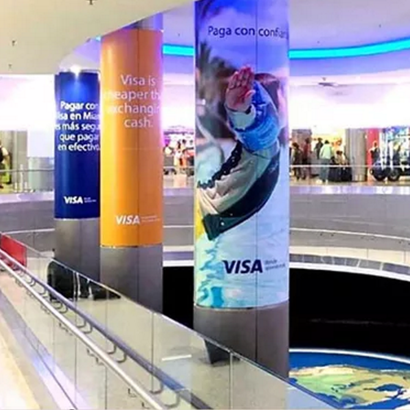

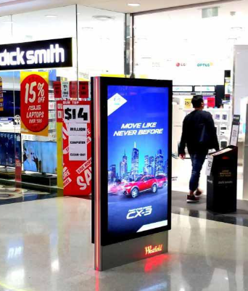
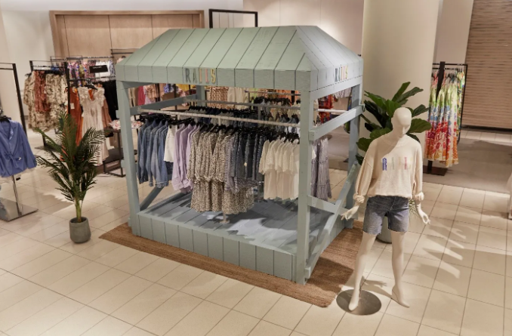
How can you use this in your day-to-day work
Inventory tracking
Proposal creation
Monitoring revenue
Advertising delivery
Advertising tracking
Static Inventory
Digital Inventory
Pop ups

Slide 45


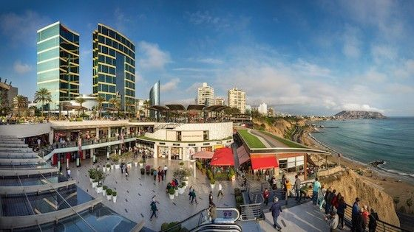
Proven in Key Markets
LATIN AMERICA
Strong agency-led demand across LATAM markets
Programmatic DOOH campaigns actively running in malls
Significant share of revenue from retail and indoor environments
Multi-market campaigns executed across mall networks

Slide 46

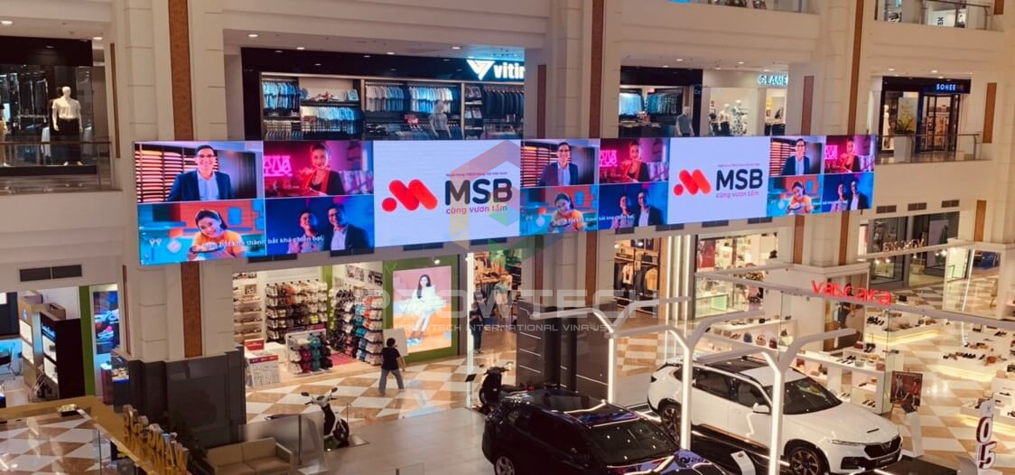
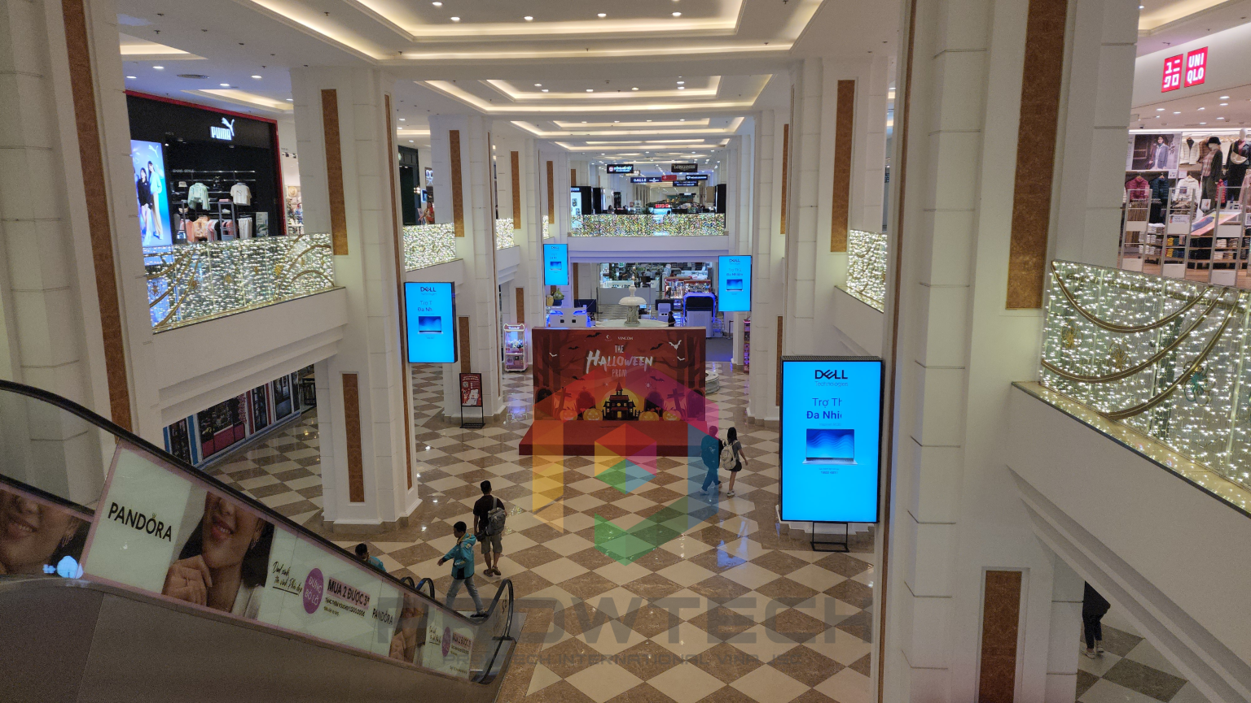
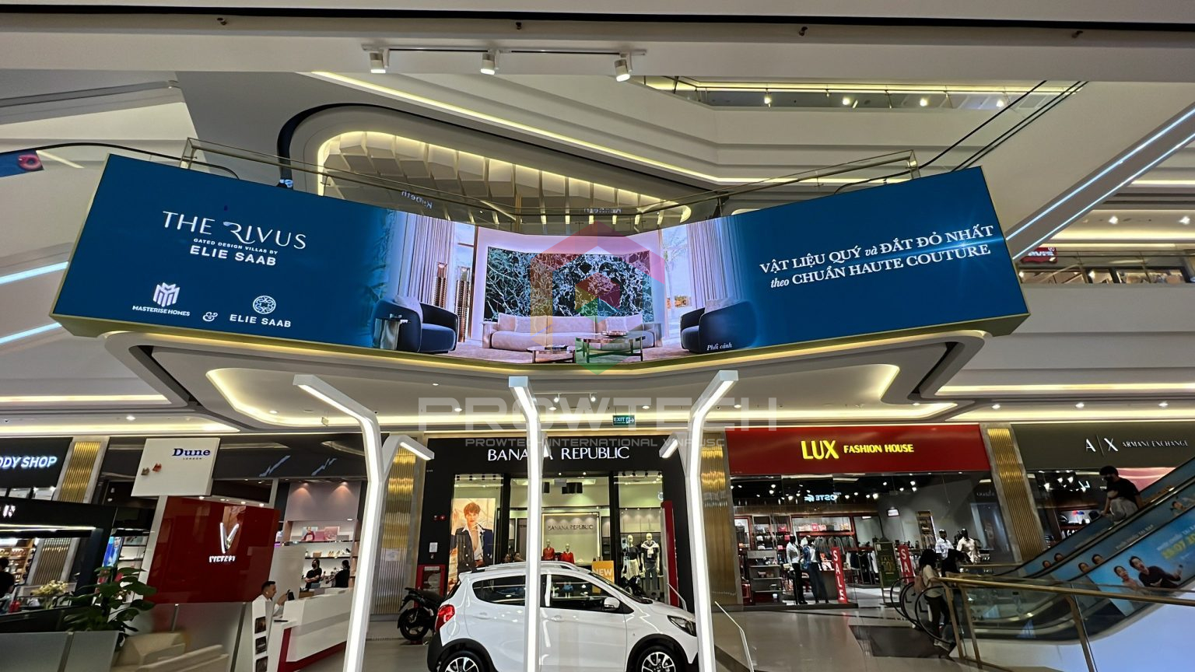
Proven in Key Markets
VIETNAM
Leading DOOH operator with extensive LED screen network across Vietnam
Active across retail, transit, and urban environments
Campaigns executed across multiple locations and formats
Driving advertiser demand into retail environments using Moving Walls platform

Slide 47
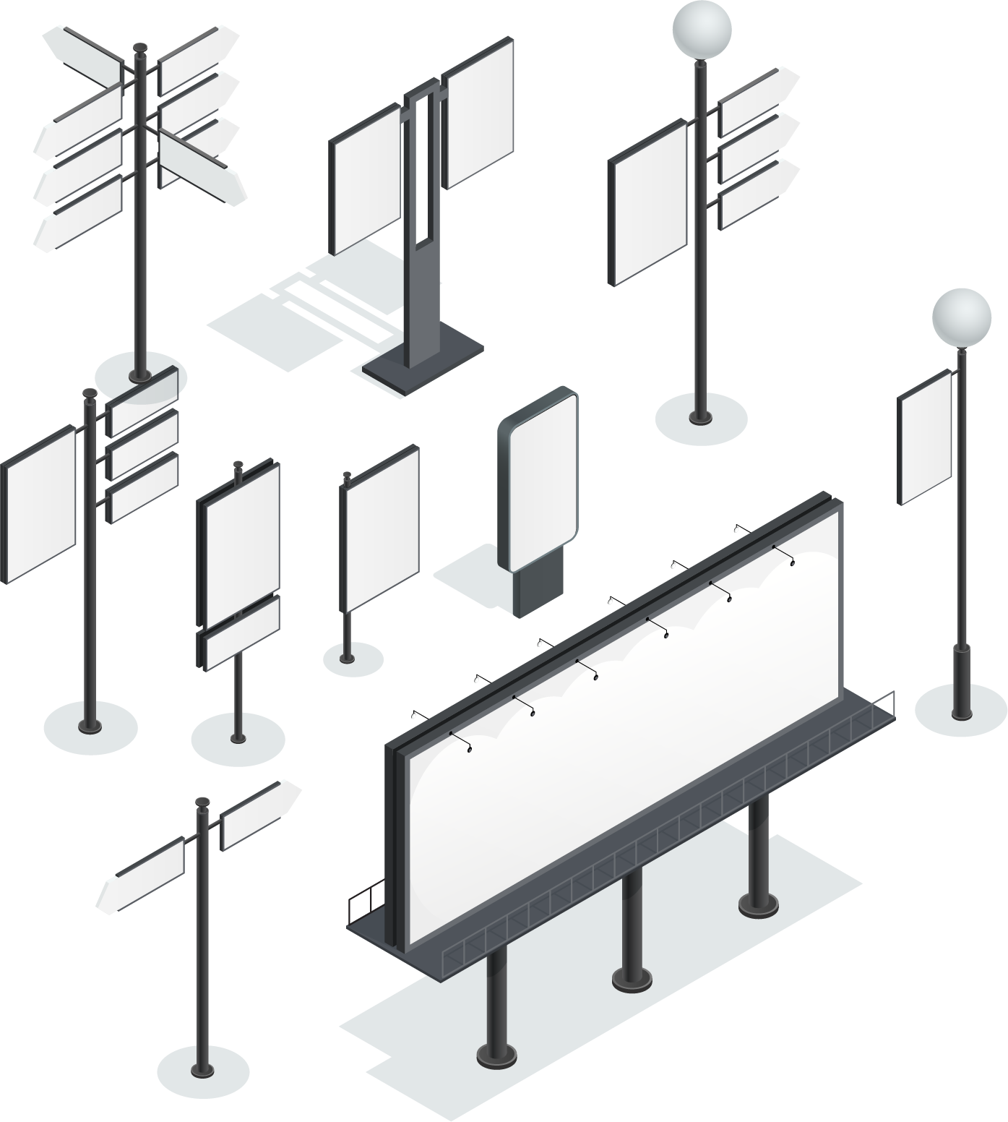





















Our Demand Partners Work With Regional Clients And Agency Media Buying Hubs

Slide 48

Operating at Global Scale
A monetization infrastructure already powering digital screen networks across regions
1M+ Screens Enabled
1B+ Monthly Audience Reach
500B+ Monthly Impressions
Multi-Region Operational Presence
20+ Markets Across APAC, MEA, Europe, and US
Core
Emerging
Frontier
Commercial and engineering presence across key OOH growth markets
Notes:
Use the script below as a guide, and feel free to adapt it based on your audience and presentation style.
We’re headquartered in Asia but support clients globally. Our engineering is in India and Malaysia, and our business teams are embedded across key markets. You’ll always have someone local to call.

Slide 49



Thank You

Slide 50
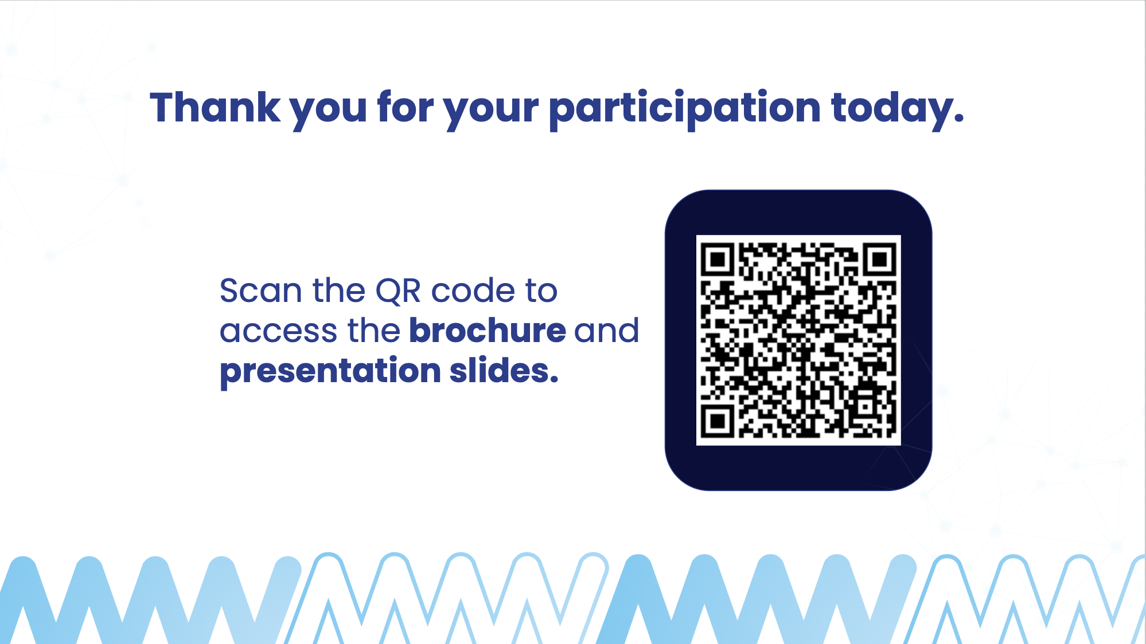


Slide 51
Thank you for your participation today.
Scan the QR code to access the brochure and presentation slides.

