Slide 1
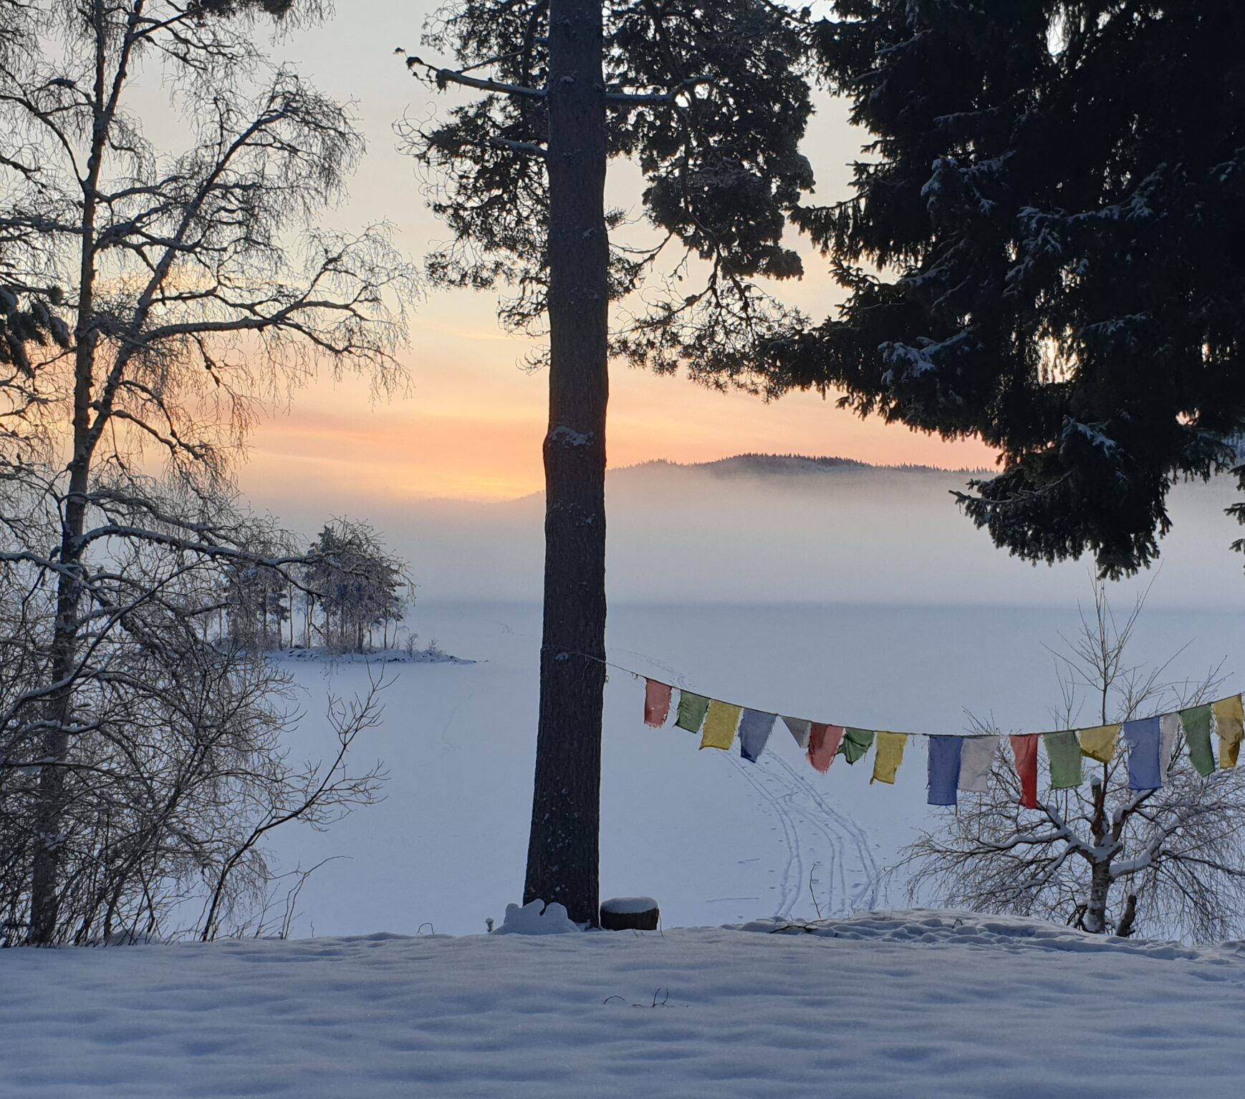
EcoDharma at the EBU AGM 2023
How to transform ourselves
and the world
to become more sustainable?

Slide 2
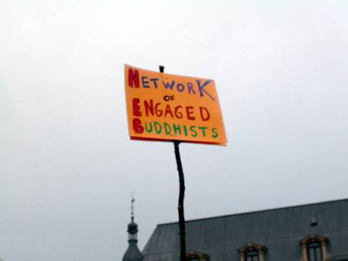
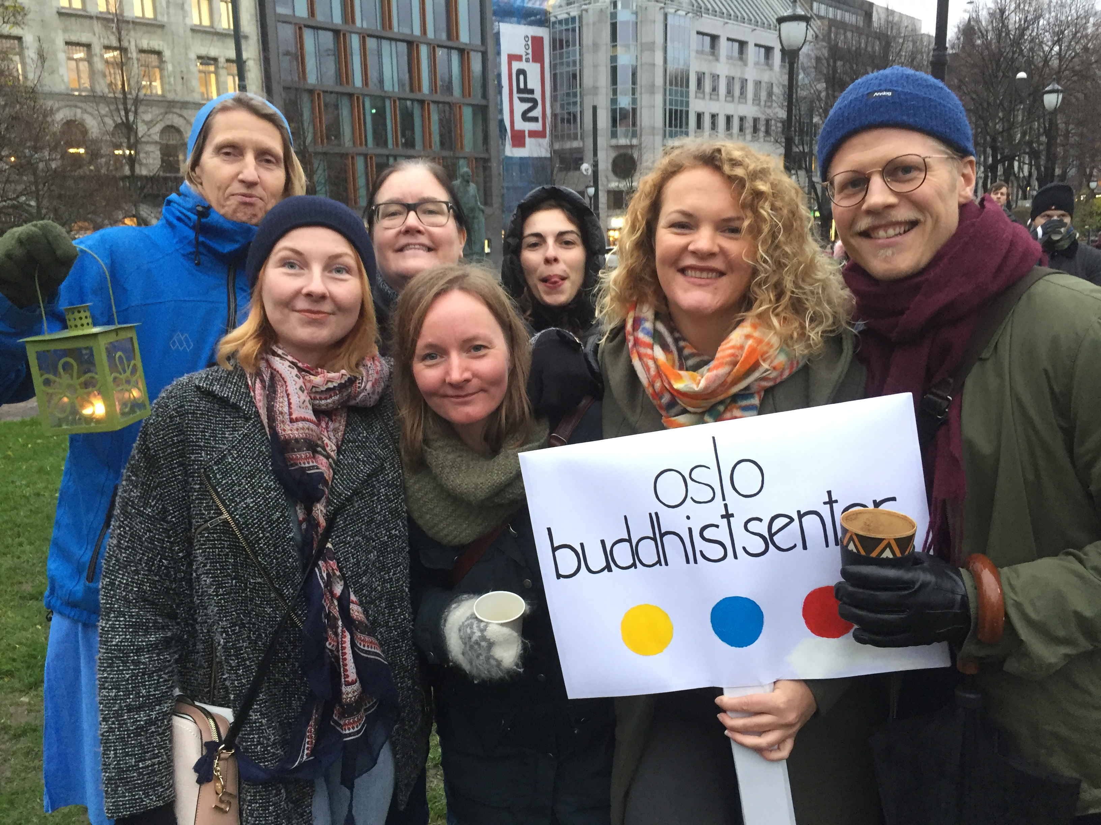
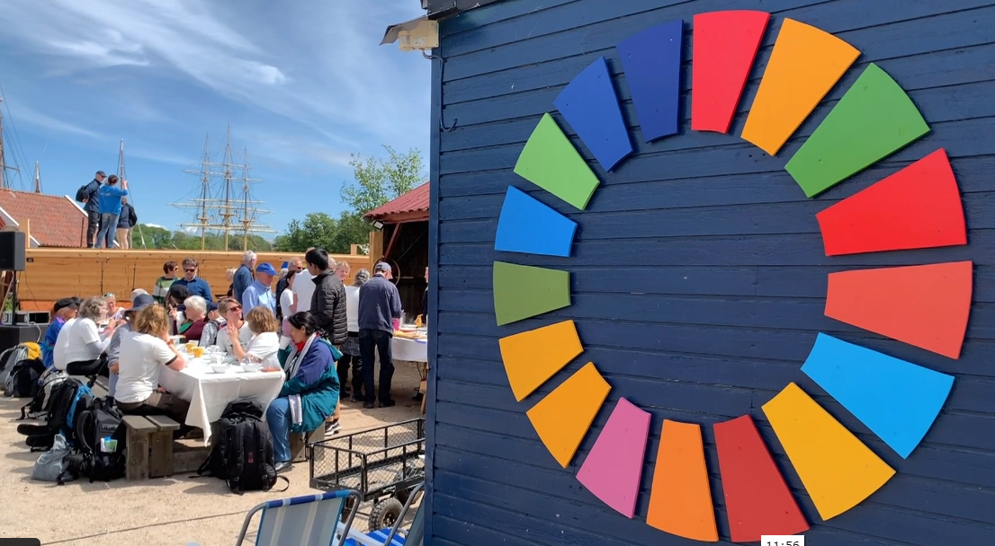
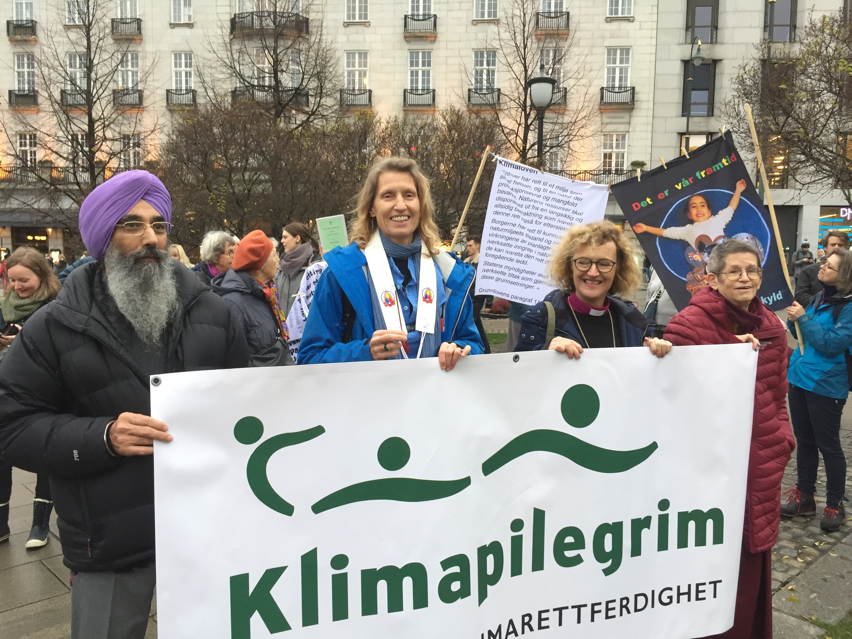
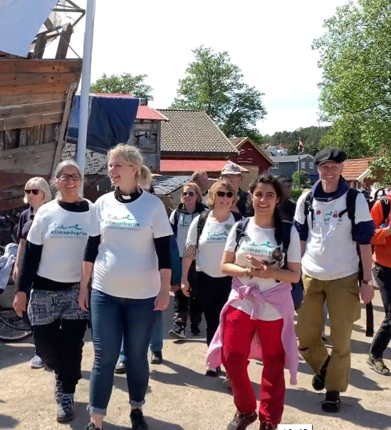
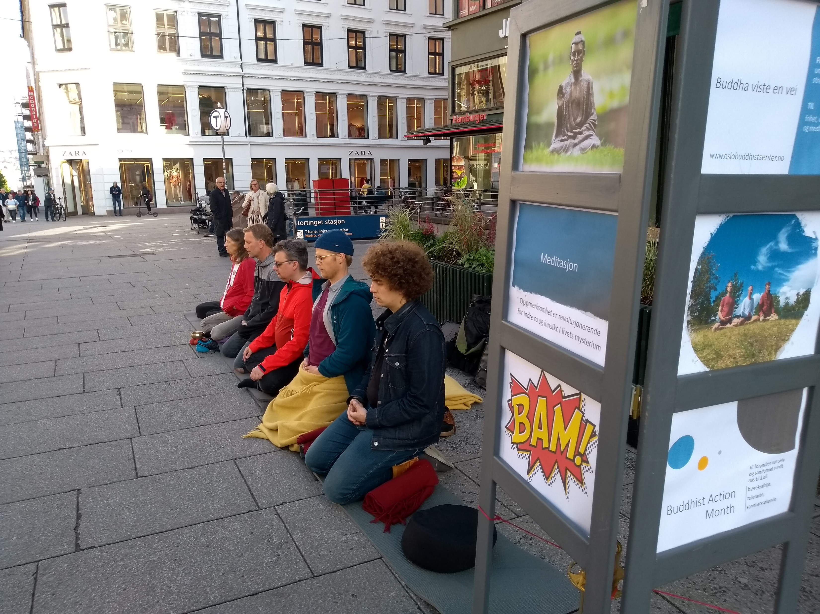
Notes:
Some highlights from activities in Norway
Sometimes just as buddhists with BAM
Meditated on the strees
Other times with others like several interreligious climat pilgrimages
demonstrations
Now we want to generate new energy and bring on more people, and we have made a new website

Slide 3
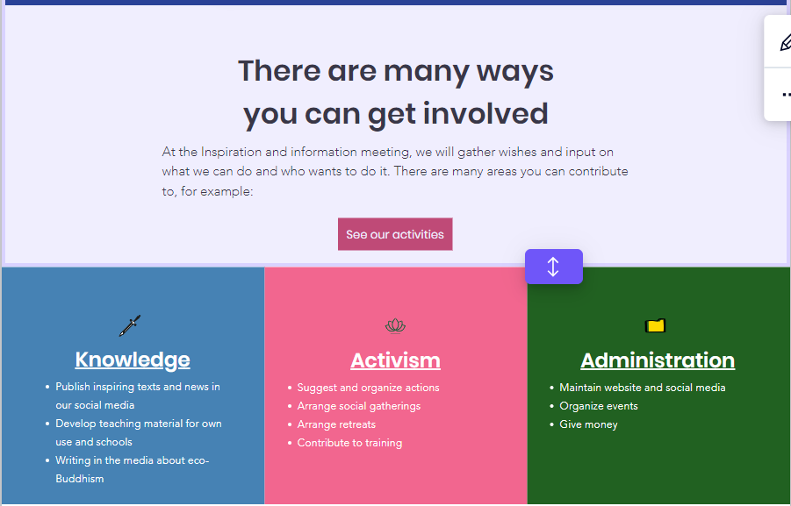
Notes:
But we can only do a little as one organisation
Fortunately we are many

Slide 4
Together we can be Avalokiteshvara
What do you want to do?

Slide 5
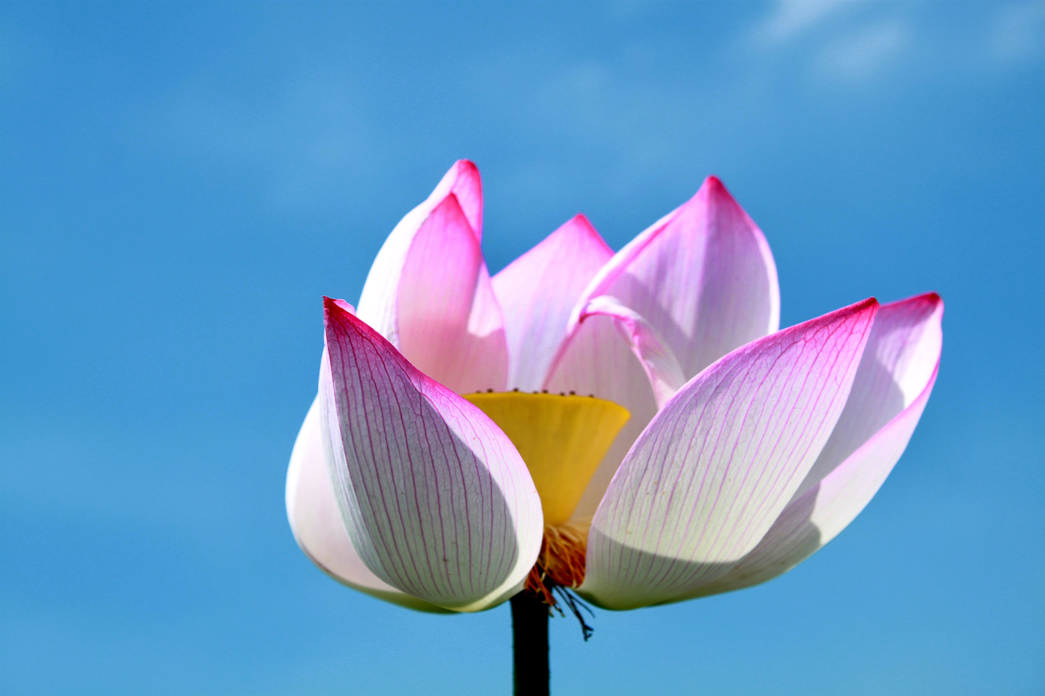
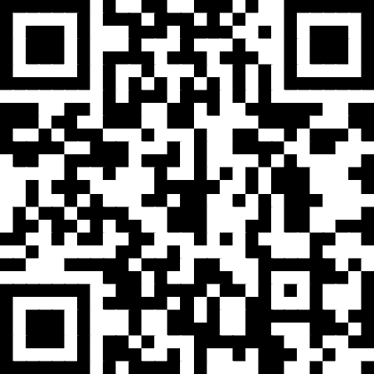
What would you like to do?
You can go to this address and fill in what you have done and what you would like to do.
You will also have the opportunity to fill in what you skills are
https://tinyurl.com/EBUEcodharma23
Notes:
https://tinyurl.com/EBUEcodharma23
This will stay open after the EBU to gather further information. You can respond several times.

