Slide 1

Edition 26.10
Make
We Sabi
Bitcoin
Guide for Person Wey Just Dey Start

Slide 2

Why Money Dey Important?
We dey use money every day, but we no dey too ask how e dey work.
Notes:
Source: My First Bitcoin, Introduction to Bitcoin, Guide for Beginners, edition 26.10. Dem adapt am under Creative Commons Attribution-ShareAlike 4.0 International; this slide deck dey use the same license. This slide deck na teaching aid wey educator go lead, and e follow the six questions wey dey inside the guide. Make una adjust the examples, the pace, and how una go present am to suit una community, but make una keep the meaning and the safety messages. E no mean say any fixed time dey for the session.

Slide 3

Most People No Dey Ever Take
Time Think About Money
No be to dey earn am, no be to dey spend am, but to dey think about wetin e be and how e dey work.
Make We Sabi Bitcoin · Why Money Dey Important?
Notes:
Start wit di picture: everybody around us dey use money without asking any question about am. Ask di group when be di last time wey dem think about where money dey come from.

Slide 4

Five Questions to Take Start
Why people need money?
Wetin dey make something be money?
Who fit create or control the money wey you dey use?
Why the money wey you dey use get value?
Your money still fit buy the same quantity of things as before?
Keep your answers
Write short answer for each question. You go come back to dem for the end.
Make We Sabi Bitcoin · Why Money Dey Important?
Notes:
Make una give learners small time to write. Make una no ask anybody to share their personal money matter. These answers go show again for the "Wetin Go Happen Next?" slide wey get the main lessons.

Slide 5

Na Fact Abi Na Opinion?
Fact: "Dem dey accept this money note to pay tax." Person fit check am.
Wetin person think: "Na this kind money good pass." E need standard wey dem go use judge am and evidence.
This guide na only to teach person. E no dey give advice about money matter, investment, law, or tax, and e no dey tell una to buy, sell, or keep anything.
Make We Sabi Bitcoin · Why Money Dey Important?
Notes:
Make una keep this difference in mind throughout the whole session. Anytime any claim come up, make una ask: we fit check am, or e need clear standards to judge am and evidence to back am up?

Slide 6

Wetin Be Money?
Money na tool wey people dey use take exchange things.

Slide 7

Trade by Barter and Wen Two People Want Wetin Each Other
Get
The two people must want wetin the other person get, for the same time and for quantity wey suit both of dem.
Make We Sabi Bitcoin · Wetin Be Money?
Notes:
Use di example wey dey di guide: una dey plant rice and una need shoes, but di shoemaker want cooking oil, no be rice. Economists dey call dis di way wetin two people want must match wetin each one get.

Slide 8
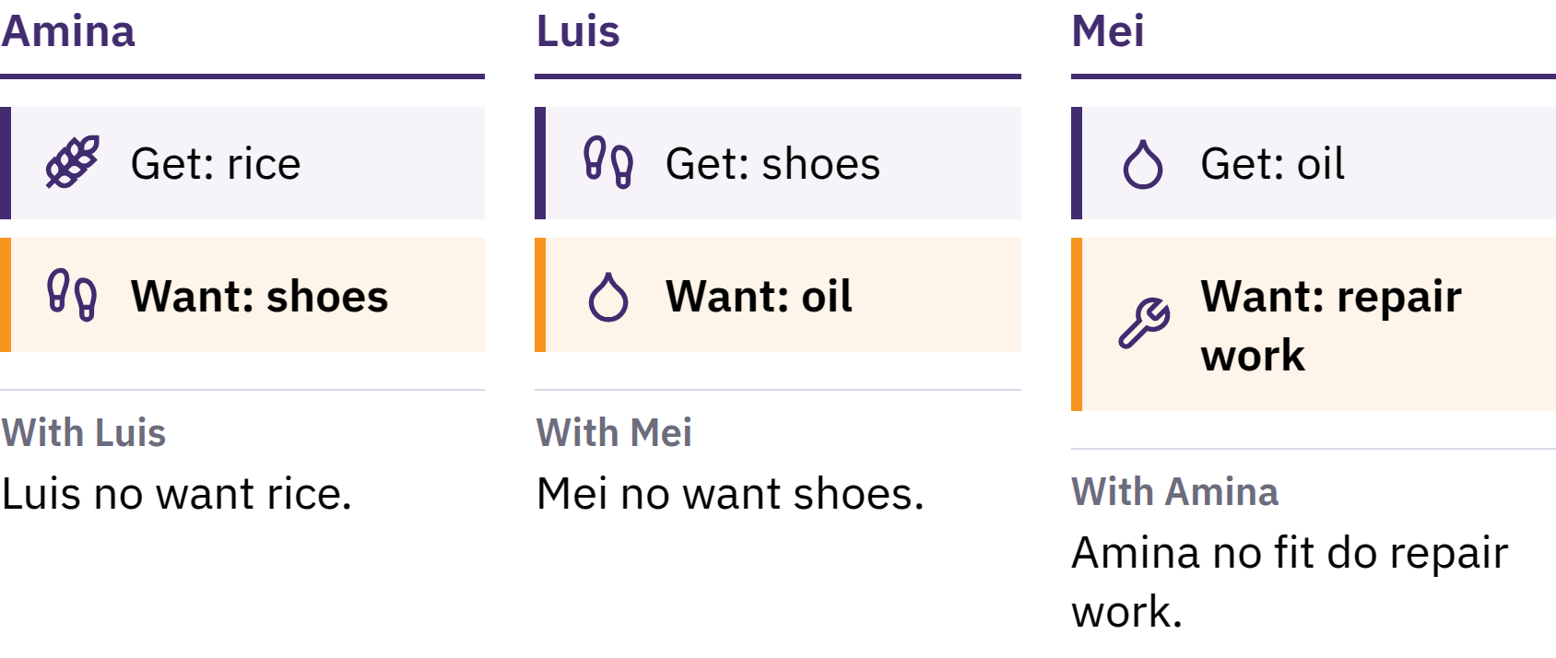
Trade by Barter and Wen Two People Want Wetin Each Other
Get
Di two people must want wetin di other person get, for di same time and for di right quantity.
Make We Sabi Bitcoin · Wetin Be Money?
Notes:
Use di example wey dey di guide: una dey plant rice and una need shoes, but di shoemaker want cooking oil, no be rice. Economists dey call dis di way wetin two people want must match wetin each one get.

Slide 9

Money Na Tool for Exchange
Nobody want money just to get am. Money dey useful because other people dey accept am, as dem dey expect say other people go accept am later.
Make We Sabi Bitcoin · Wetin Be Money?
Notes:
Banknote na just piece of paper. Money dey solve di problem of trade-by-barter by separating selling from buying: una fit sell una rice to one person, come buy shoes from another person. Na this dey make money different from trade-by-barter.

Slide 10

Three Things Wey Money Dey Do
Wetin dem dey use do exchange: people dey accept am as payment
Wetin dem dey use measure price: dem dey use am state price
Wetin dey preserve value: e dey carry value from today enter future
No money dey preserve value perfectly, but some kind money dey lose their power to buy things more slowly than others.
Make We Sabi Bitcoin · Wetin Be Money?

Slide 11

From Shell Dem Go Reach
Paper
Kauri, salt, beads, farm animals, kopa, silva, gold
Metals wey get high value: dem no plenty, dem dey last, people for plenty places dey accept dem
Paper wey give person right to collect the amount of metal wey dem write for am
Gold standards: system wey law tie one unit of currency to gold
The rules no be the same for every place and every time.
Make We Sabi Bitcoin · Wetin Be Money?

Slide 12
Fiat Moni
1971: United States stop the official arrangement wey allow foreign governments and central banks exchange dollars for gold
Today, most countries their currencies na fiat money: government authorise how dem dey issue am, but person no fit exchange am for gold or any other commodity
Fiat na Latin for "make e happen", wey people often understand as "by government order"
People accept am because people, businesses, banks, and governments dey use am; laws make am money wey dem recognise for payment and require people to use am pay tax
Make We Sabi Bitcoin · Wetin Be Money?

Slide 13

We don move from money wey
something dey back am, to
money wey trust wey we get for
somebody dey back am.
Make We Sabi Bitcoin · Wetin Be Money?

Slide 14

Wetin Dey Wrong With Our Money?
When people hear the word inflation, wetin dem dey usually think na say price of things dey go up.

Slide 15
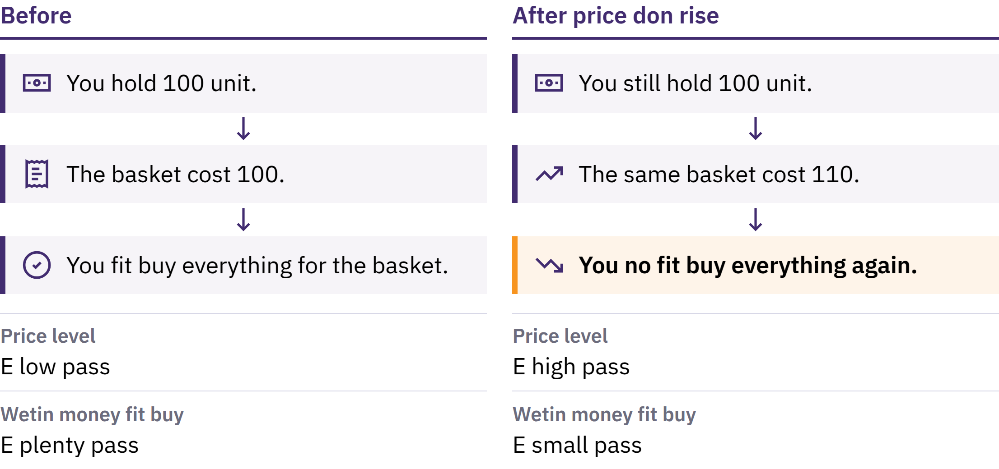
As Prices Dey Rise and Wetin Money Fit Buy
Make We Sabi Bitcoin · Wetin Dey Wrong With Our Money?
Notes:
Price inflation na when the general price level of goods and services dey continue to rise. The other side na purchasing power: how much goods and services one unit of money fit buy. If the price of one basket of basic goods rise from 100 units of currency to 110, the same 100 units no go fit buy the full basket again.

Slide 16

As Prices Dey Rise and Wetin Money Fit Buy
Make We Sabi Bitcoin · Wetin Dey Wrong With Our Money?
Notes:
Price inflation na when the general price level of goods and services dey continue to rise. The other side na purchasing power: how much goods and services one unit of money fit buy. If the price of one basket of basic goods rise from 100 units of currency to 110, the same 100 units no go fit buy the full basket again.

Slide 17

Plenty Reasons, One Choice
Increase for money and credit
Supply wey no dey flow well and changes for demand
Currency wey dey lose value, taxes, cost to produce things
One cause na deliberate choice, no be accident: for fiat system, small number of institutions fit increase di amount of money and credit wey dey available and change di rules wey dey guide am.
Make We Sabi Bitcoin · Wetin Dey Wrong With Our Money?
Notes:
Economists dey debate how much each cause matter. Make una focus on the one cause wey be deliberate decision, no be something wey happen by chance.

Slide 18
How E Scarce and Wetin E Worth
Di original Mona Lisa get value pass any copy: na only one dey
Scarcity alone no dey make something get value, but when people want something, how much of am dey available matter
When di amount of money wey dey available dey increase faster than di things wey e fit buy, each unit of di money dey tend to buy less
Make We Sabi Bitcoin · Wetin Dey Wrong With Our Money?

Slide 19
Inflation No Dey Affect Everybody the Same Way
Cash and money wey person save fit lose power to buy things
People wey own assets wey dia price dey rise fit get some protection
Wages and prices dey change at different speeds
Money wey dey your bank account different from cash wey dey your hand: na promise wey the bank make to pay you. Most times, the bank dey keep that promise, but e depend on the bank and the rules wey dey guide am.
Make We Sabi Bitcoin · Wetin Dey Wrong With Our Money?

Slide 20
Try Am: Check Wetin Your Money Fit Buy
Abeg, choose one everyday thing: bread, transport, or credit for phone
Abeg, write down how much e cost today
Abeg, ask person how much e cost some years ago, and check record wey person fit trust if una fit
Money wey people dey earn increase at the same rate? Wetin else fit explain the change?
Make We Sabi Bitcoin · Wetin Dey Wrong With Our Money?
Notes:
Dis one dey work without any device or internet. Make una compare answers across di group, and remind learners say di price of just one thing no be di full measure of inflation.

Slide 21
Fiat Money Dey Work, But E Get Risk
Payment wey easy, credit wey fit adjust, tools to take handle crisis
But the amount wey dey available and the rules fit change, and people wey dey use am no get much say
Na why people dey look for other options, and na why dem create Bitcoin.
Make We Sabi Bitcoin · Wetin Dey Wrong With Our Money?

Slide 22

Wetin be Bitcoin?
Digital money wey no get one central body wey dey control am, wey get limit for the total amount wey fit dey, and wey person fit send directly to another person without bank permission.

Slide 23
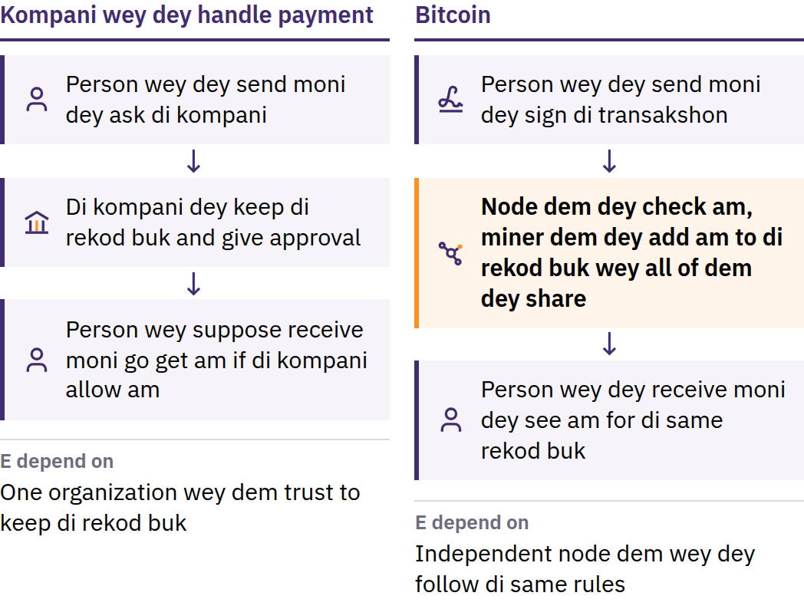
Di Problem of Spending di Same Money Two Times
31 October 2008: Satoshi Nakamoto publish Bitcoin: Elektronik Cash Sistem Wey Dey Work From Person to Person. January 2009: di network start.
Make We Sabi Bitcoin · Wetin be Bitcoin?
Notes:
Before Bitcoin come, to send money online always depend on organization wey people trust: bank or payment company wey dey keep record of transactions, approve accounts, and fit delay, block, or reverse payment. Digital information easy to copy: if person fit spend one digital coin twice, e no go fit work as money. Na this be the problem of spending the same money twice. Satoshi Nakamoto na one person or group wey dey use that name.

Slide 24
No Central Control · Supply Get Limit · Person to Person
E no get central control: no central office dey open account, change account balance, or approve who fit join
Supply get limit: bitcoin no go ever pass 21 million
Person to person: send to anybody, anywhere, without asking permission from any central authority
No company fit freeze bitcoin wey una dey control by unaself. The other side of that freedom na responsibility: normally, nobody fit reverse transaction wey follow the rules, and no help desk dey for the network.
Make We Sabi Bitcoin · Wetin be Bitcoin?
Notes:
Decentralized no mean say everybody get equal power to influence things. E mean say no single participant fit change the ledger or the money rules for everybody.

Slide 25
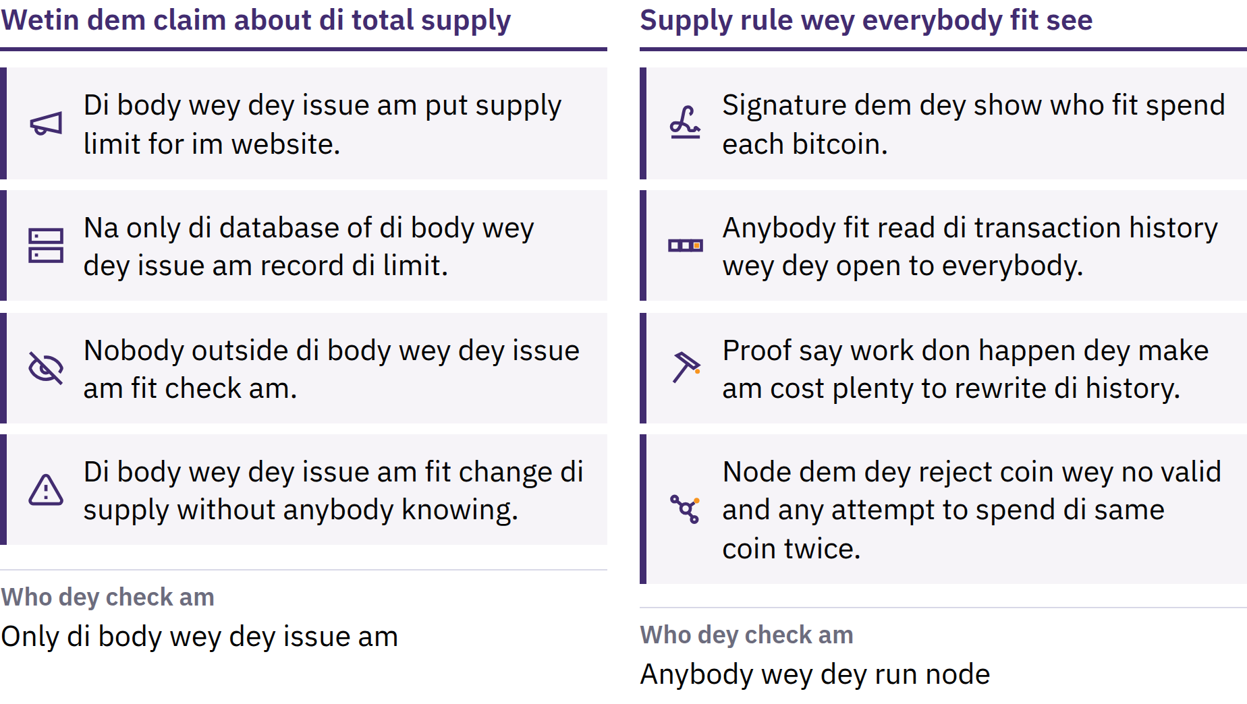
Limit Wey Anybody Fit Check
Make We Sabi Bitcoin · Wetin be Bitcoin?
Notes:
Dem dey release new bitcoin according to timetable wey everybody fit see, and independent computers wey dem dey call nodes dey reject any block wey break that rule. Anybody fit trust the limit because anybody fit check am. E no be law of nature: e dey hold because people wey dey take part continue to enforce am. Supply wey get limit no guarantee say price go rise; price depend on demand as well as supply.

Slide 26
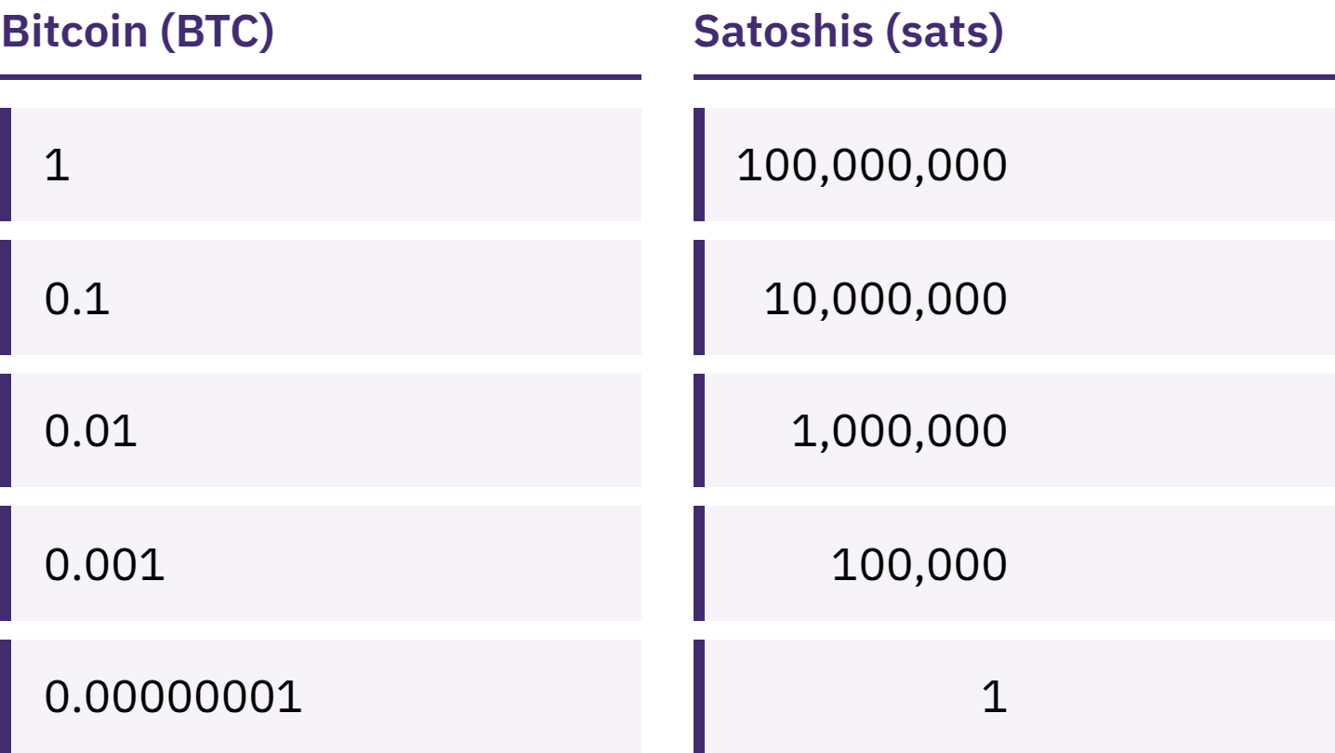
You No Need One Full Bitcoin
One bitcoin fit divide into 100,000,000 smaller units wey dem dey call satoshis, or sats.
Make We Sabi Bitcoin · Wetin be Bitcoin?
Notes:
To get 100,000 sats and to get 0.001 bitcoin na the same amount. Make una explain why e no correct to think say ordinary person no fit afford Bitcoin just because one bitcoin cost plenty.

Slide 27
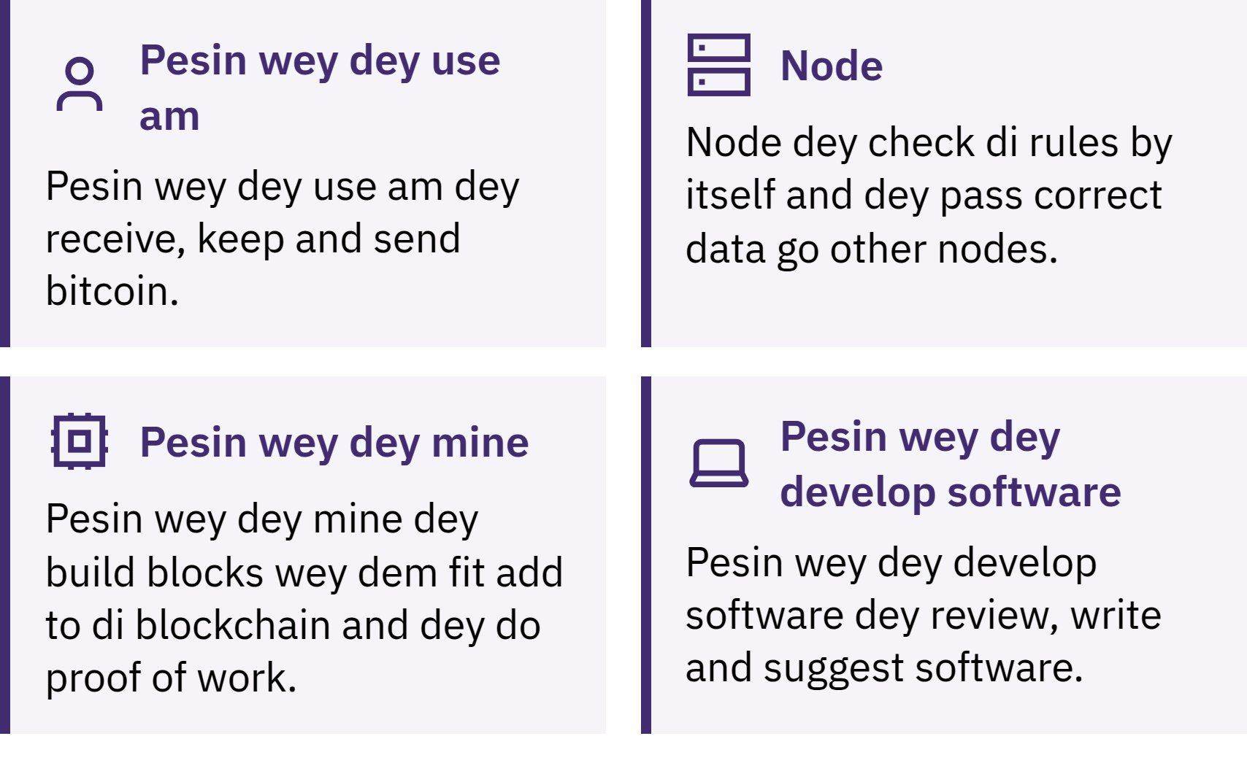
Who Dey Make Bitcoin Dey Work?
Make We Sabi Bitcoin · Wetin be Bitcoin?
Notes:
People wey dey use bitcoin dey send am, receive am, and keep am; nodes dey check every transaction and block to make sure say dem follow the rules; miners dey compete to add new block to the record about every ten minutes. That record, wey dem dey call blockchain, dey open for everybody to see, and to rewrite am go cost plenty well-well. Small note about spelling: Bitcoin wey start with capital B usually mean the network or the system; bitcoin wey start with small b mean the money itself.

Slide 28

Who Dey Make Bitcoin Dey Work?
Make We Sabi Bitcoin · Wetin be Bitcoin?
Notes:
People wey dey use bitcoin dey send am, receive am, and keep am; nodes dey check every transaction and block to make sure say dem follow the rules; miners dey compete to add new block to the record about every ten minutes. That record, wey dem dey call blockchain, dey open for everybody to see, and to rewrite am go cost plenty well-well. Small note about spelling: Bitcoin wey start with capital B usually mean the network or the system; bitcoin wey start with small b mean the money itself.

Slide 29
Bitcoin Get Im Own Advantages and Disadvantages
Im price fit change sharp sharp
Most times, mistake wey happen no fit reverse
For plenty places, people wey dey accept am still no plenty
To use am safely, person need learn some things
Bitcoin dey replace some trust wey people get for institutions with checking to confirm things and taking responsibility by yourself. E no remove risk.
Make We Sabi Bitcoin · Wetin be Bitcoin?

Slide 30

How You Go Take Use Bitcoin?
Di first question about any wallet na: who dey control di keys?

Slide 31
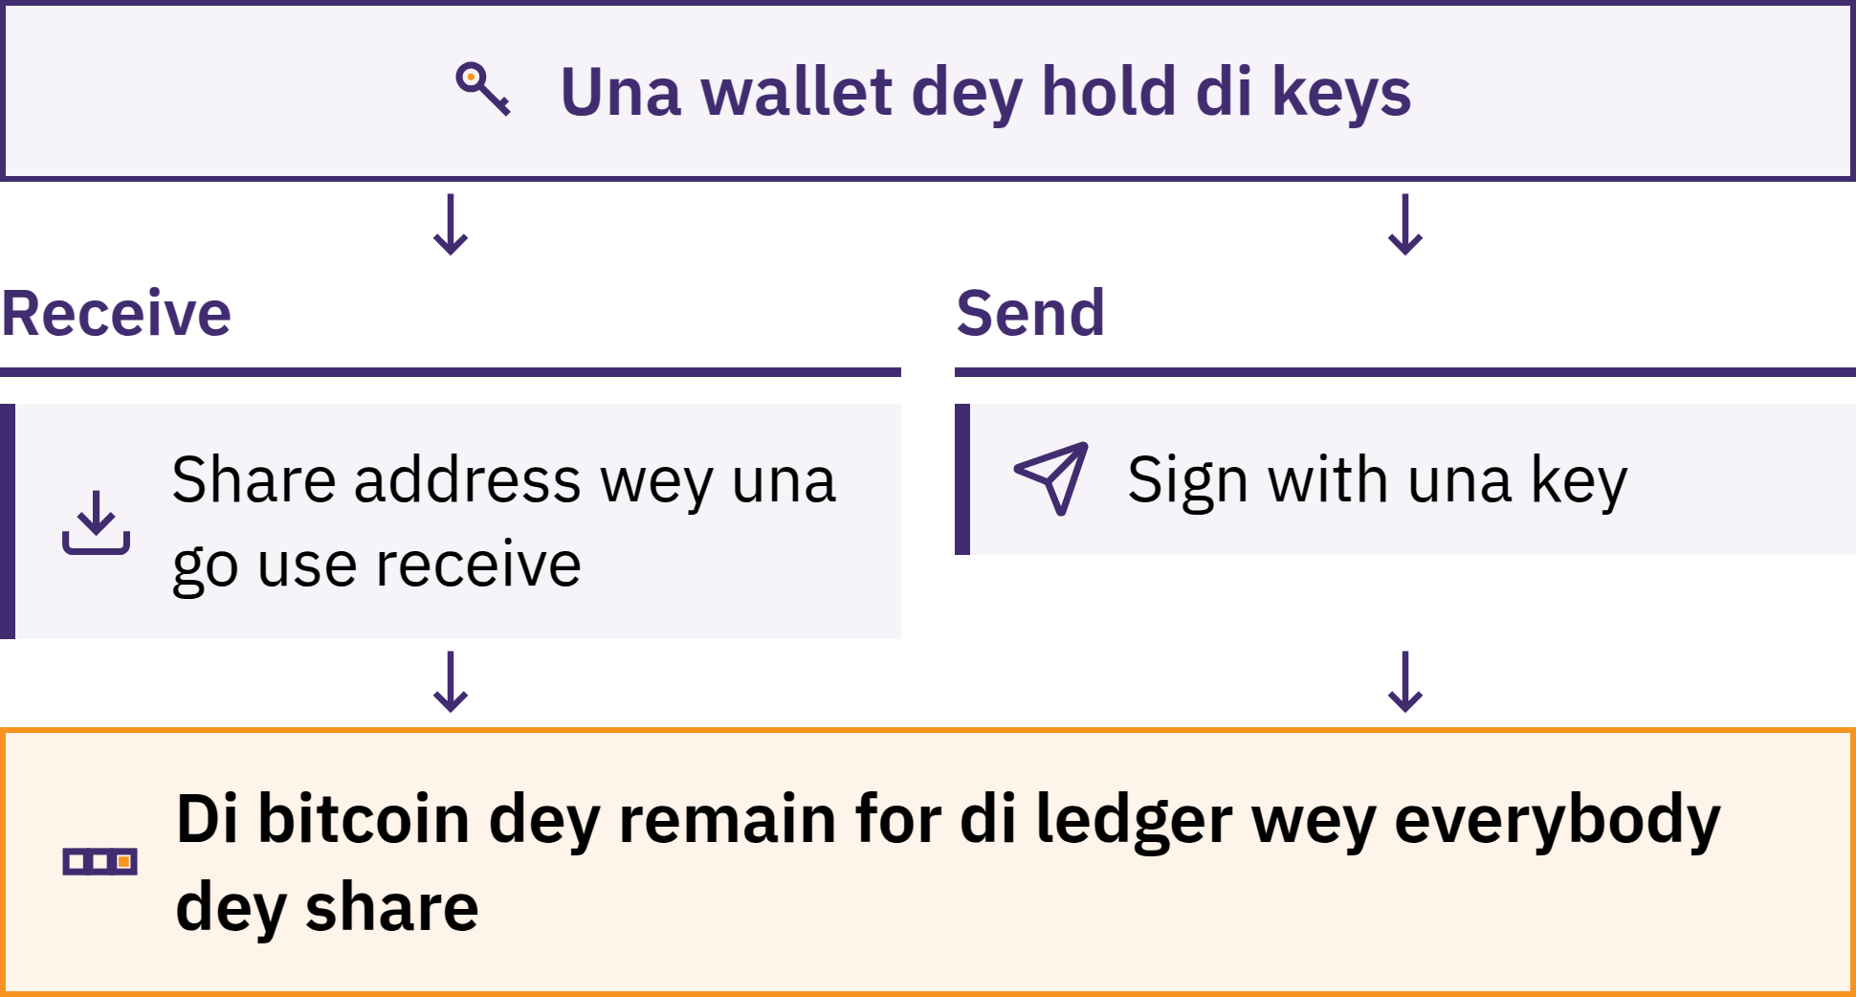
Wallet Dey Manage Key Dem
Make We Sabi Bitcoin · How You Go Take Use Bitcoin?
Notes:
Bitcoin wallet na tool, wey most times be app, wey dey allow una receive, check, and send bitcoin. Una bitcoin no dey stored inside una phone: na for blockchain dem record am. Di wallet dey manage di keys wey una fit use prove say di bitcoin na una own and give permission for payment.

Slide 32
Na Who Really Dey Hold Your Bitcoin?
Una dey keep am by unaself: na una dey control di key dem
Nobody fit recover una bitcoin for una if una lose di recovery word dem and di device
Company dey keep am for una: one company dey hold di key dem, small like bank
Di balance wey una get na di company promise to pay una; e fit limit how much una fit withdraw, freeze account, suffer hacker attack, or close down
To choose who go keep una bitcoin no be test of una value. Wetin matter na to know which kind una dey use and wetin una dey put trust for.
Make We Sabi Bitcoin · How You Go Take Use Bitcoin?

Slide 33

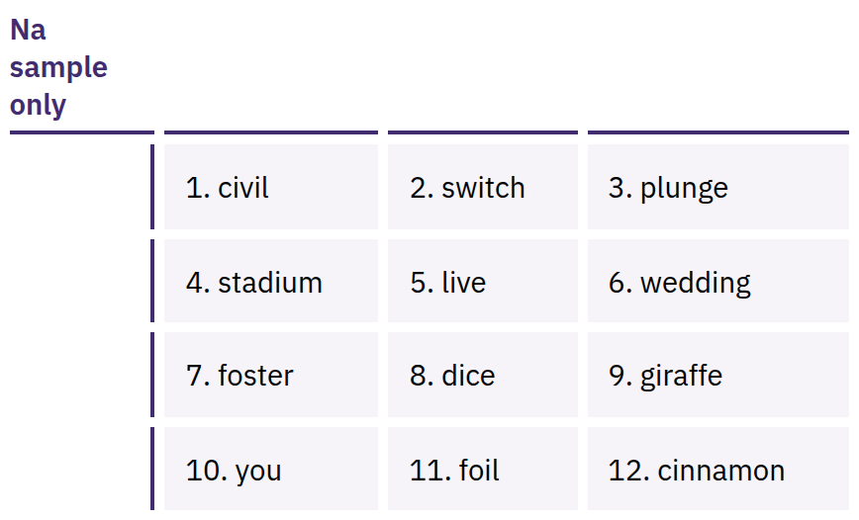
Your Seed Phrase Na Full
Access
List of words wey dey arranged in order, wey often be 12 or 24 words, wey fit recreate your keys. Anybody wey get am fit take your bitcoin.
Make We Sabi Bitcoin · How You Go Take Use Bitcoin?
Notes:
Seed phrase no be only backup: na wetin dey give full access. Abeg, write am correctly for paper when una create di wallet; keep am offline, keep am private, and put am for where e no go lost or spoil. No ever snap am, send am by email, save am for cloud notes, send am for message, or type am inside any website. Di words wey dem show na only example; no ever show or collect anybody real seed phrase.

Slide 34

If di keys no be your own, di
coins no be your own.
Make We Sabi Bitcoin · How You Go Take Use Bitcoin?

Slide 35

Before Una Use Any Wallet
Keys: na una dey control dem, abi na company?
Recovery: wetin go happen if una phone lost or di company disappear?
Where e come from: na di official website or di app wey dey app store, no be link wey person send una?
Code: e dey open for everybody to check, and dem still dey maintain am well? (Dis one alone no prove say e safe.)
Charges: how much dem dey charge to send, receive, or withdraw?
Payments: na for blockchain, Lightning, abi both?
Make We Sabi Bitcoin · How You Go Take Use Bitcoin?
Notes:
My First Bitcoin no dey recommend any particular wallet. Tools, fees, and who own dem dey change, and wetin fit one community fit no fit another. Make una direct learners to one teacher for their area wey dem fit trust.

Slide 36
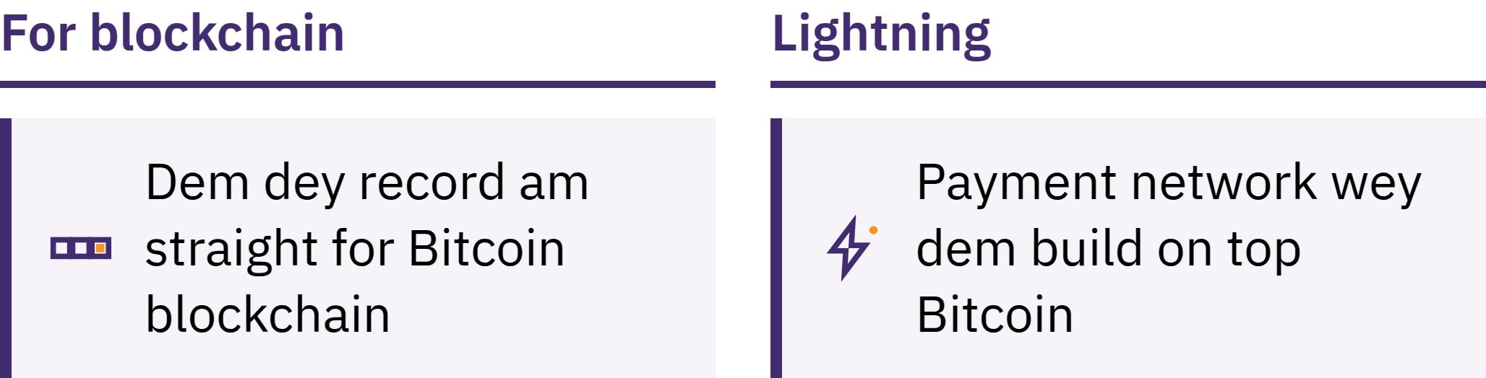
For Blockchain and Lightning
On-chain: dem record am directly inside di blockchain
Lightning: na payment network wey dem build on top Bitcoin for small payments wey dey happen fast and often, like to buy coffee
Lightning wallet fit also be one wey another person dey keep di keys, or one wey di owner dey keep di keys by demself
Make We Sabi Bitcoin · How You Go Take Use Bitcoin?

Slide 37
Three Rules as Una Dey Learn
Learn first. No take action because of excitement, fear, or pressure.
Start small. Use amount wey una fit afford to lose take try tools wey una never sabi.
No Just Trust, Verify. Check the person, the payment method, the address, and the amount.
Share information for receiving payment, no ever share secrets
Una fit share address or payment request. Una no suppose ever share seed phrase or private key. No genuine teacher, wallet company, or support worker go ever ask una for am.
Make We Sabi Bitcoin · How You Go Take Use Bitcoin?

Slide 38

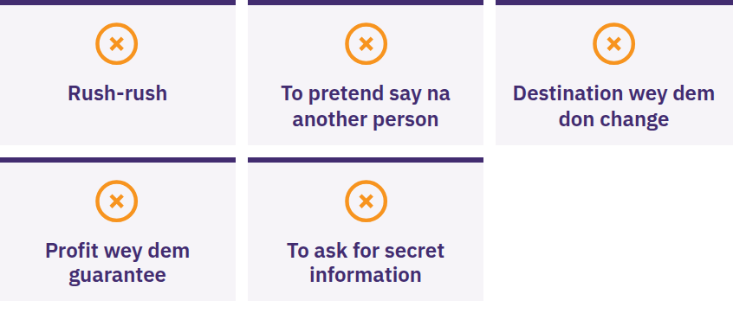
Stop, No Share Anything, No
Send Anything
Make una stop if person dey rush una or tell una to keep am secret, promise say una go surely make profit, ask una to send bitcoin first, or ask for una seed phrase. Make una pause. No share anything. No send anything. Then confirm am through source wey una already know.
Make We Sabi Bitcoin · How You Go Take Use Bitcoin?

Slide 39

Wetin Be Next?
Na just the beginning be this.

Slide 40
Four Main Points to Hold for Mind
Money dey depend on rules and trust. Na small number of institutions dey set the amount of fiat money wey go dey and the rules.
Bitcoin get different rules. The amount wey go dey get limit and dey open for everybody to see, anybody fit use am, and una fit check am instead of just to trust am.
Safety na first. Make una learn first, start small, check everything well, and no ever share una seed phrase.
Na just the beginning be this. Just one safe next step don do.
Small time to think am well
Make una go back to the five questions for the beginning. Wetin una go answer now?
Make We Sabi Bitcoin · Wetin Be Next?

Slide 41

Di Bitcoin Diploma
Di next step. Di four modules wey e get go carry una go further:
To understand money
How Bitcoin dey work
To use Bitcoin in safe way
Bitcoin for una community
Make una continue to dey find out new things, dey ask questions, and learn more for myfirstbitcoin.org.
We dey look forward to see una for our next group of learners.
Make We Sabi Bitcoin · Wetin Be Next?

Slide 42


