Slide 1

Uhlelo 26.10
Isingeniso
nge-Bitcoin
Umhlahlandlela Wabaqalayo

Slide 2

Kungani Imali Ibalulekile?
Sisebenzisa imali nsuku zonke, kodwa asivamile ukuzibuza ukuthi isebenza kanjani.
Notes:
Umthombo: My First Bitcoin, Isingeniso se-Bitcoin, Umhlahlandlela Wabaqalayo, uhlelo 26.10. Kulungiswe ngaphansi kwelayisensi ye-Creative Commons Attribution-ShareAlike 4.0 International; lawa maslayidi asebenzisa ilayisensi efanayo. Lawa maslayidi ayinsiza yokwethula eqondiswa uthisha, esekelwe emibuzweni eyisithupha yomhlahlandlela. Sicela nivumelanise izibonelo, ijubane lokufundisa nendlela yokwethula nomphakathi wenu, nibe nigcina incazelo nemiyalezo yokuphepha. Akushiwo ukuthi isikhathi sesifundo sinqunyiwe.

Slide 3

Abantu Abaningi Abalokothi
Bame Bacabange Ngemali
Hhayi ukuyizuza, hhayi ukuyisebenzisa, kodwa ukucabanga ngokuthi iyini nokuthi isebenza kanjani.
Isingeniso nge-Bitcoin · Kungani Imali Ibalulekile?
Notes:
Qalani ngesithombe: wonke umuntu osizungezile usebenzisa imali ngaphandle kokuzibuza imibuzo ngayo. Buzani iqembu ukuthi lagcina nini ukucabanga ngokuthi imali ivelaphi.

Slide 4

Imibuzo Emihlanu Yokuqala
Kungani abantu bedinga imali?
Yini eyenza into ibe yimali?
Ubani ongadala noma alawule imali eniyisebenzisayo?
Kungani imali eniyisebenzisayo inenani?
Ingabe imali yenu isathenga inani elifanayo lezinto njengakuqala?
Gcinani izimpendulo zenu
Bhalani impendulo emfushane yombuzo ngamunye. Nizobuyela kuzo ekugcineni.
Isingeniso nge-Bitcoin · Kungani Imali Ibalulekile?
Notes:
Nikeza abafundi imizuzu embalwa yokubhala. Ungaceli muntu ukuba abelane ngemininingwane yakhe yezezimali. Lezi zimpendulo zizophinde zivele kusilayidi samaphuzu abalulekile esithi “Yini Elandelayo?”

Slide 5

Iqiniso noma Umbono?
Iqiniso: "Leli phepha lemali liyamukelwa ekukhokheni izintela." Lokhu kungaqinisekiswa.
Umbono: "Lolu uhlobo lwemali olungcono kunazo zonke." Lokhu kudinga izindlela zokuhlola nobufakazi.
Lo mhlahlandlela ngowokufundisa kuphela. Awunikezi izeluleko zezezimali, zokutshala izimali, zezomthetho noma zentela, futhi awunitsheli ukuthi nithenge, nithengise noma nigcine noma yini.
Isingeniso nge-Bitcoin · Kungani Imali Ibalulekile?
Notes:
Gcinani lo mehluko kuso sonke isikhathi sesifundo. Lapho kuvela isimangalo, buzani: singasihlola yini, noma sidinga imibandela nobufakazi?

Slide 6

Iyini Imali?
Imali iyithuluzi lokushintshiselana.

Slide 7

Ukuhwebelana Ngempahla Nokuqondana Okukabili
Kwezidingo
Bobabili abantu kufanele bafune lokho omunye anakho, ngesikhathi esifanayo nangamanani afanele.
Isingeniso nge-Bitcoin · Iyini Imali?
Notes:
Sebenzisani isibonelo esisemhlahlandleleni: nitshala irayisi futhi nidinga izicathulo, kodwa umenzi wezicathulo ufuna amafutha okupheka, hhayi irayisi. Izazi zezomnotho zibiza lokhu ngokuthi ukuqondana okukabili kwezidingo.

Slide 8
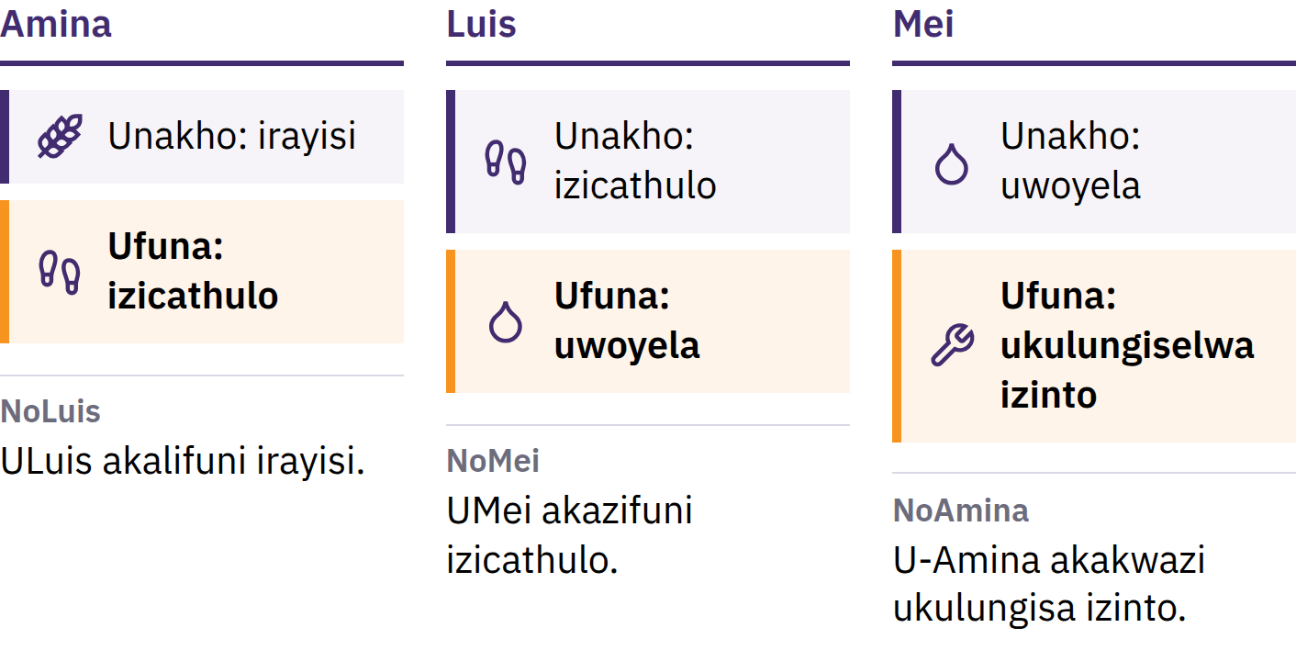
Ukuhwebelana Ngempahla Nokuqondana Okukabili
Kwezidingo
Bobabili abantu kufanele bafune lokho omunye anakho, ngesikhathi esifanayo nangamanani afanele.
Isingeniso nge-Bitcoin · Iyini Imali?
Notes:
Sebenzisani isibonelo esisemhlahlandleleni: nitshala irayisi futhi nidinga izicathulo, kodwa umenzi wezicathulo ufuna amafutha okupheka, hhayi irayisi. Izazi zezomnotho zibiza lokhu ngokuthi ukuqondana okukabili kwezidingo.

Slide 9

Imali Iyithuluzi Lokuhwebelana
Akekho ofuna imali ngenxa yayo nje. Iwusizo ngoba abanye bayayamukela, belindele ukuthi nabanye bayoyamukela kamuva.
Isingeniso nge-Bitcoin · Iyini Imali?
Notes:
Inothi lemali liyisiqeshana sephepha nje. Imali ixazulula inkinga yokuhwebelana ngezimpahla ngokuhlukanisa ukuthengisa nokuthenga: nithengisa irayisi lenu kumuntu oyedwa bese nithenga izicathulo komunye. Yilokhu okuhlukanisa imali nokuhwebelana ngezimpahla.

Slide 10

Izinto Ezintathu Ezenziwa Yimali
Indlela yokushintshiselana: abantu bayayamukela njengenkokhelo
Iyunithi yokubala: amanani entengo avezwa ngayo
Isigcini senani: sidlulisela inani kusukela namuhla liye esikhathini esizayo
Ayikho imali egcina inani ngokuphelele, kodwa ezinye izinhlobo zemali zilahlekelwa amandla okuthenga kancane kunezinye.
Isingeniso nge-Bitcoin · Iyini Imali?

Slide 11

Kusukela Emagobolondweni
Kuya Ephepheni
Amagobolondo, usawoti, ubuhlalu, imfuyo, ithusi, isiliva, igolide
Izinsimbi eziyigugu: eziyivelakancane, ezihlala isikhathi eside, ezamukelwa kabanzi
Izitifiketi zephepha ezingashintshaniswa ngenani lensimbi elishiwo
Izindinganiso zegolide: iyunithi yemali exhunywe ngokomthetho egolideni
Imithetho yayihluka ngokwendawo nangenkathi.
Isingeniso nge-Bitcoin · Iyini Imali?

Slide 12
Imali ye-fiat
1971: i-United States yaqeda ukushintshaniswa okusemthethweni kwamadola ngegolide okwakwenziwa ohulumeni bangaphandle namabhange amakhulu
Namuhla izimali eziningi zamazwe ziyimali ye-fiat: zikhishwa ngaphansi kwegunya likahulumeni, azikwazi ukushintshaniswa ngegolide noma nganoma iyiphi enye impahla
Fiat yigama lesiLatini elisho ukuthi "makwenziwe", elivame ukuqondwa ngokuthi "ngomyalelo"
Yamukelwa ngoba abantu, amabhizinisi, amabhange nohulumeni bayayisebenzisa; imithetho iyenza ibe yimali esemthethweni yokukhokha futhi ifune ukuba isetshenziselwe ukukhokha izintela
Isingeniso nge-Bitcoin · Iyini Imali?

Slide 13

Sasuka emalini esekelwe
kokuthile, saya emalini esekelwe
ekwethembeni othile.
Isingeniso nge-Bitcoin · Iyini Imali?

Slide 14

Yini Engahambi Kahle Ngemali Yethu?
Lapho abantu bezwa igama elithi ukwehla kwamandla emali, ngokuvamile bacabanga ngokukhuphuka kwamanani.

Slide 15
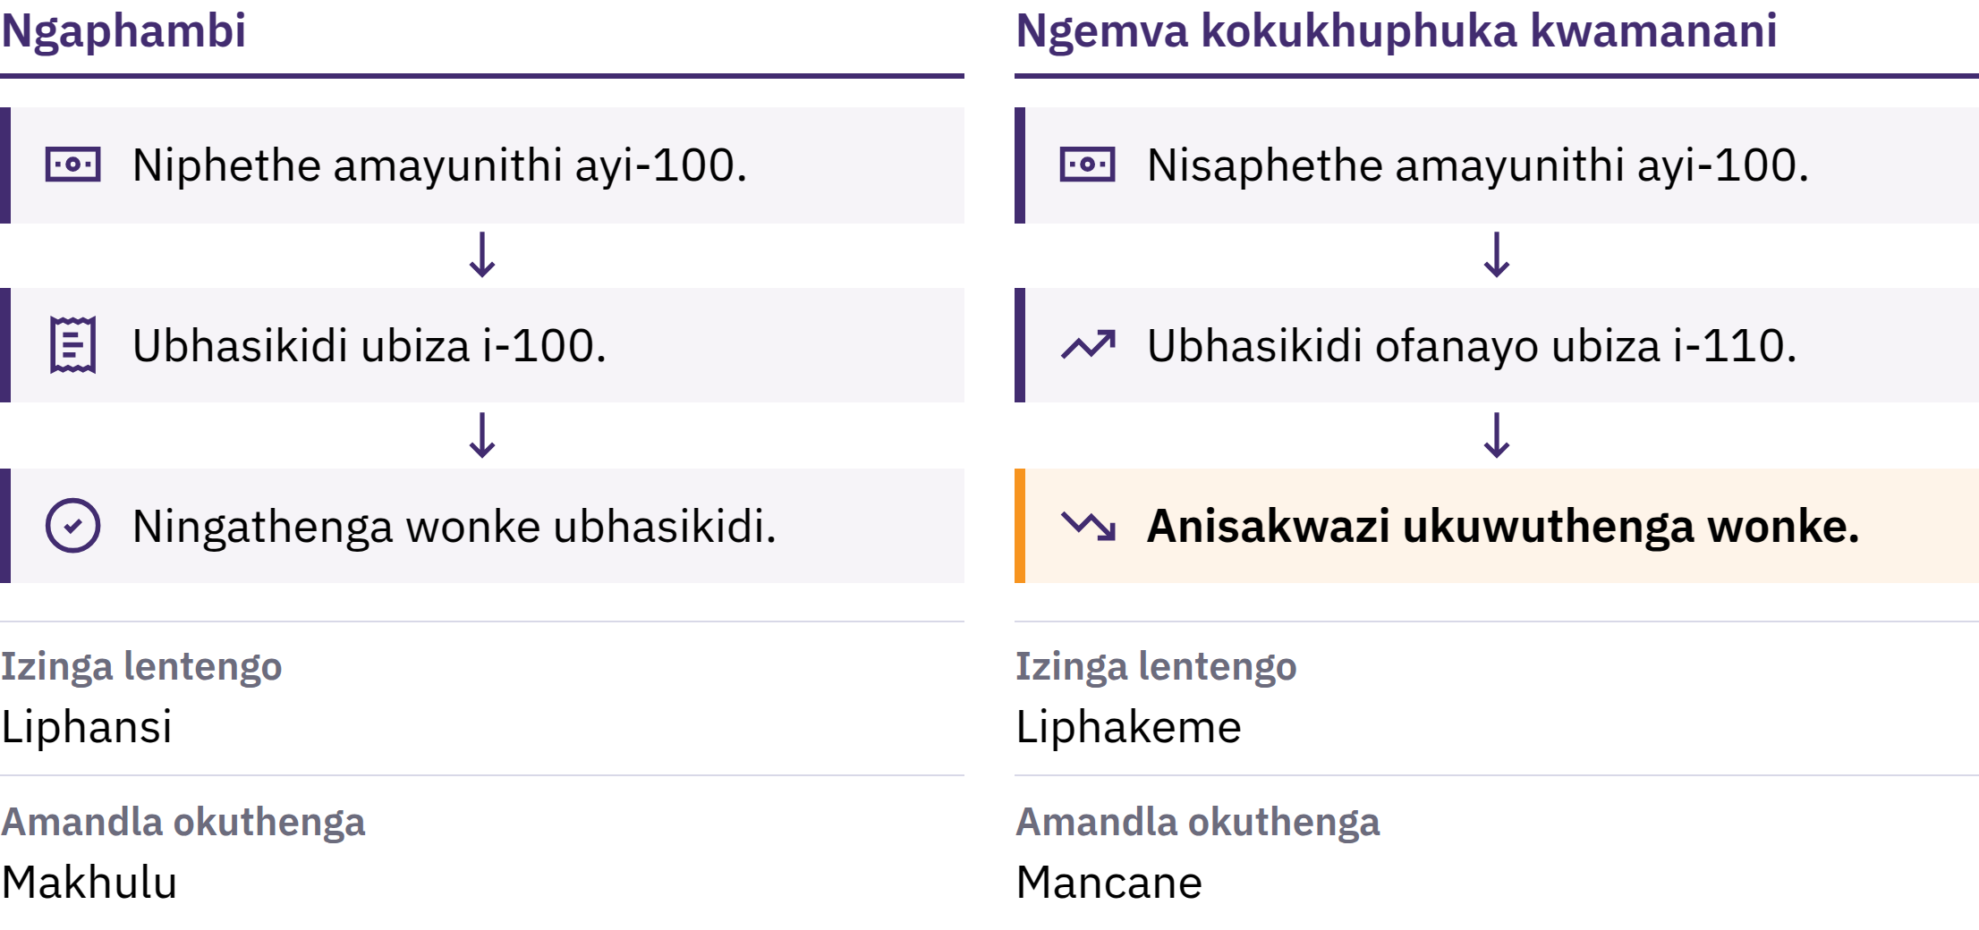
Ukwehla Kwamandla Emali Namandla Okuthenga
Isingeniso nge-Bitcoin · Yini Engahambi Kahle Ngemali Yethu?
Notes:
Ukwehla kwamandla emali kuwukukhuphuka okuqhubekayo kwezinga elivamile lamanani. Olunye uhlangothi lwakho amandla okuthenga: ukuthi iyunithi yemali ingathenga okungakanani. Uma intengo kabhasikidi wezimpahla eziyisisekelo ikhuphuka isuka kumayunithi emali ayi-100 iye kwayi-110, lawo mayunithi ayi-100 awasakwazi ukuthenga wonke ubhasikidi.

Slide 16

Ukwehla Kwamandla Emali Namandla Okuthenga
Isingeniso nge-Bitcoin · Yini Engahambi Kahle Ngemali Yethu?
Notes:
Ukwehla kwamandla emali kuwukukhuphuka okuqhubekayo kwezinga elivamile lamanani. Olunye uhlangothi lwakho amandla okuthenga: ukuthi iyunithi yemali ingathenga okungakanani. Uma intengo kabhasikidi wezimpahla eziyisisekelo ikhuphuka isuka kumayunithi emali ayi-100 iye kwayi-110, lawo mayunithi ayi-100 awasakwazi ukuthenga wonke ubhasikidi.

Slide 17

Izimbangela Eziningi,
Ukukhetha Okukodwa
Ukwandiswa kwemali nezikweletu
Ukuphazamiseka kokuhlinzekwa kwempahla nezinguquko esidingweni sayo
Uhlobo lwemali oluphelelwa amandla, izintela, izindleko zokukhiqiza
Enye imbangela iwukukhetha, hhayi into eyenzeka ngengozi: ohlelweni lwemali ye-fiat, izikhungo ezimbalwa zingandisa inani lemali nezikweletu ezitholakalayo futhi ziguqule imithetho yalo.
Isingeniso nge-Bitcoin · Yini Engahambi Kahle Ngemali Yethu?
Notes:
Izazi zezomnotho ziyaphikisana ngokuthi imbangela ngayinye ibaluleke kangakanani. Gxilani embangelweni eyodwa ewumphumela wesinqumo kunokuba ibe yinto eyenzeka ngengozi.

Slide 18
Ukuntuleka Nenani
Umdwebo wokuqala we-Mona Lisa unenani elingaphezu kwanoma iyiphi ikhophi yawo: yiwo wodwa okhona
Ukuyivelakancane kukodwa akwenzi into ibe nenani, kodwa lapho abantu beyifuna, ubuningi bayo obutholakalayo bubalulekile
Lapho imali etholakalayo yanda ngokushesha kunempahla nezinsizakalo engazithenga, iyunithi ngayinye ivame ukuthenga okuncane
Isingeniso nge-Bitcoin · Yini Engahambi Kahle Ngemali Yethu?

Slide 19
Ukwehla kwamandla emali akuthinti wonke umuntu
ngokulinganayo
Imali engukheshi nemali eyongiwe kungase kuphelelwe amandla okuthenga
Abanikazi bezimpahla ezikhuphuka ngentengo bangase bavikeleke ngokwengxenye
Amaholo nezintengo kushintsha ngesivinini esihlukene
Ibhalansi yasebhange ihlukile emalini engukheshi esesandleni senu: iyisithembiso sebhange sokunikhokhela. Leso sithembiso ngokuvamile siyagcwaliseka, kodwa lokho kuncike ebhange nasemithethweni elilawulayo.
Isingeniso nge-Bitcoin · Yini Engahambi Kahle Ngemali Yethu?

Slide 20
Kuzameni: Ukuhlola Amandla Okuthenga
Khethani into eyodwa ejwayelekile: isinkwa, ezokuthutha, noma i-airtime yocingo
Bhalani phansi intengo yayo yanamuhla
Buzani othile ukuthi yayibiza malini eminyakeni embalwa edlule, bese nihlola irekhodi elithembekile uma nikwazi
Ingabe imali engenayo yenyuka ngezinga elifanayo? Yini enye engase ichaze lolu shintsho?
Isingeniso nge-Bitcoin · Yini Engahambi Kahle Ngemali Yethu?
Notes:
Lokhu kusebenza ngaphandle kwanoma iyiphi idivayisi noma i-inthanethi. Qhathanisani izimpendulo eqenjini lonke, bese nikhumbuza abafundi ukuthi intengo eyodwa ayisona isilinganiso esiphelele sokwehla kwamandla emali.

Slide 21
Imali ye-fiat iyasebenza, kodwa inezingozi
Izinkokhelo ezilula, isikweletu esivumelana nezimo, amathuluzi okubhekana nezimo ezibucayi
Kodwa inani layo elitholakalayo nemithetho yayo kungashintsha, futhi abantu abayisebenzisayo abanalo izwi elitheni
Yingakho abantu befuna ezinye izindlela, futhi yingakho kwasungulwa i-Bitcoin.
Isingeniso nge-Bitcoin · Yini Engahambi Kahle Ngemali Yethu?

Slide 22

Iyini i-Bitcoin?
Imali yedijithali engalawulwa yisikhungo esisodwa, enomthamo olinganiselwe, futhi engathunyelwa isuka kumuntu iye komunye ngaphandle kwemvume yebhange.

Slide 23
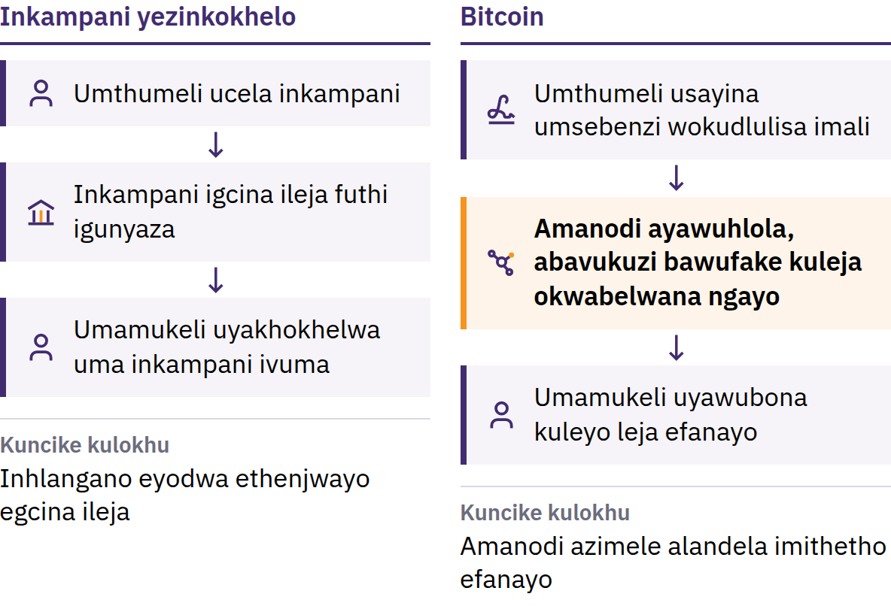
Inkinga Yokusebenzisa Imali Kabili
31 kuMfumfu 2008: Satoshi Nakamoto ushicilela Bitcoin: Uhlelo Lwemali Ye-elekthronikhi Lontanga Ngontanga. UMasingana 2009: inethiwekhi iyaqala.
Isingeniso nge-Bitcoin · Iyini i-Bitcoin?
Notes:
Ngaphambi kwe-Bitcoin, ukuthumela imali nge-inthanethi kwakuhlale kuncike enhlanganweni ethenjwayo: ibhange noma inkampani yezinkokhelo eyayigcina incwadi yamarekhodi emali, igunyaze ama-akhawunti, futhi eyayingabambezela, ivimbe noma ihoxise inkokhelo. Ulwazi lwedijithali kulula ukulukopisha: uma uhlamvu lwemali lwedijithali belungasetshenziswa kabili, belungeke lusebenze njengemali. Lena yinkinga yokusebenzisa imali efanayo kabili. U-Satoshi Nakamoto ngumuntu noma iqembu elisebenzisa lelo gama.

Slide 24
Okungalawulwa Yisikhungo Esisodwa · Inani Elilinganiselwe ·
Kusuka Kumuntu Kuya Kumuntu
Ukungabi ngaphansi kwesikhungo esisodwa: alikho ihhovisi eliyinhloko elivula ama-akhawunti, elishintsha amabhalansi, noma eligunyaza ukuthi ubani ongajoyina
Inani elilinganiselwe: ngeke kube nama-bitcoin angaphezu kwezigidi ezingu-21
Phakathi kontanga: thumelani kunoma ubani, noma kuphi, ngaphandle kokucela imvume esikhungweni esiyinhloko
Ayikho inkampani engamisa ukusetshenziswa kwe-bitcoin enizilawulela yona. Olunye uhlangothi lwaleyo nkululeko luwukuzibophezela: ngokuvamile akunakwenzeka ukuhlehlisa ukuthengiselana okuvumelekile, futhi alikho ihhovisi losizo lenethiwekhi.
Isingeniso nge-Bitcoin · Iyini i-Bitcoin?
Notes:
Ukungabi ngaphansi kokulawulwa yisikhungo esisodwa akusho ukuthi wonke umuntu unethonya elilinganayo. Kusho ukuthi akekho noyedwa obambe iqhaza ongashintsha irejista yokuthengiselana noma imithetho yezimali esebenza kubo bonke.

Slide 25
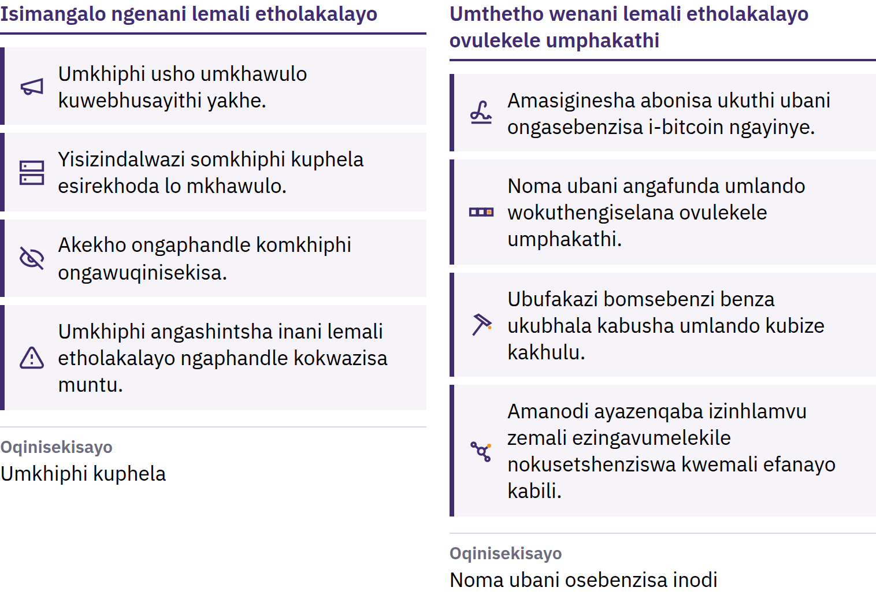
Umkhawulo Ongahlolwa Yinoma Ubani
Isingeniso nge-Bitcoin · Iyini i-Bitcoin?
Notes:
Kukhishwa ama-bitcoin amasha ngokohlelo olwaziwa umphakathi, futhi amakhompyutha azimele abizwa ngokuthi amanodi enqaba noma yiliphi ibhulokhi elephula lowo mthetho. Lo mkhawulo uyathembeka ngoba noma ubani angawuqinisekisa. Akuwona umthetho wemvelo: uyaqhubeka usebenza ngoba ababambiqhaza bayaqhubeka nokuwuphoqelela. Inani elilinganiselwe lama-bitcoin akhona aliqinisekisi ukuthi intengo izokhuphuka; intengo incike esidingweni sawo kanye nenani lawo elitholakalayo.

Slide 26
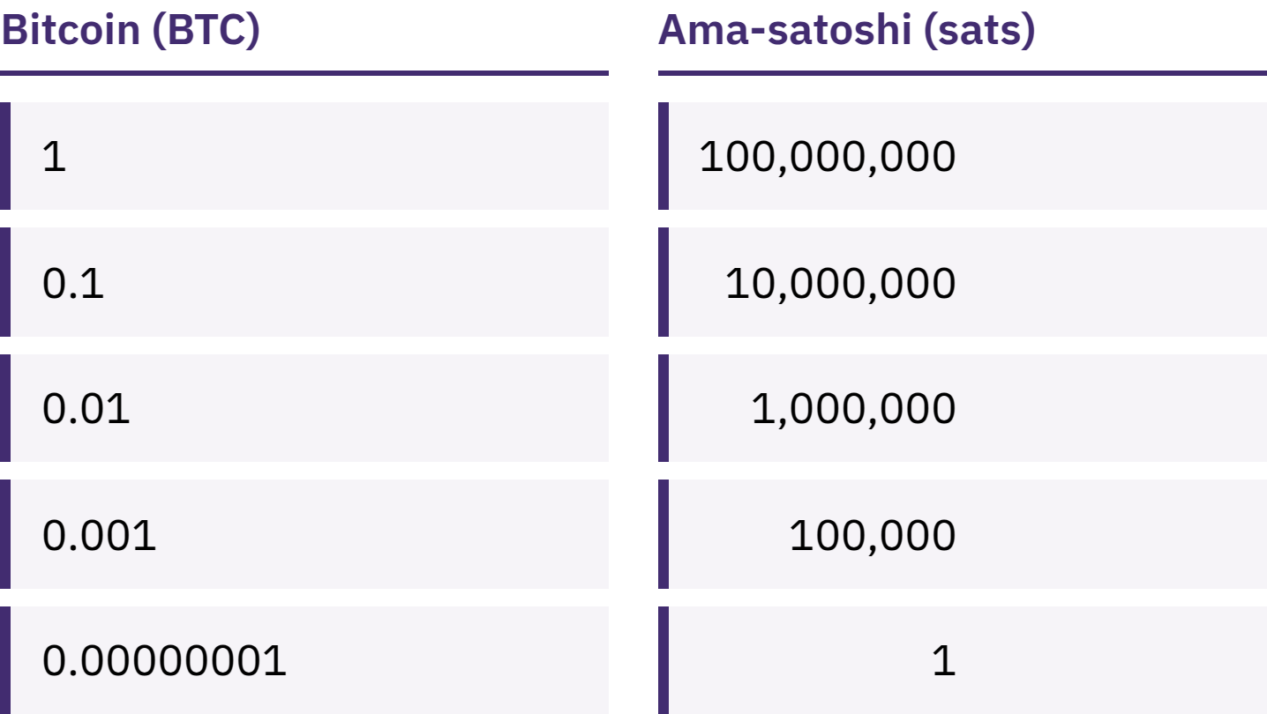
Anidingi i-Bitcoin Ephelele
I-bitcoin eyodwa ihlukaniseka ibe amayunithi amancane angu-100 000 000 abizwa ngokuthi ama-satoshi, noma ama-sats.
Isingeniso nge-Bitcoin · Iyini i-Bitcoin?
Notes:
Ukuba nama-sats angu-100 000 nokuba ne-bitcoin engu-0,001 kusho inani elifanayo. Lungisani umbono oyiphutha wokuthi i-Bitcoin ayifinyeleleki ngoba i-bitcoin eyodwa ibiza kakhulu.

Slide 27
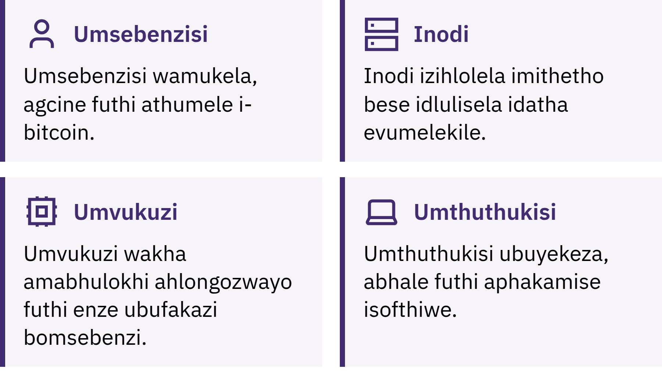
Ubani ogcina i-Bitcoin isebenza?
Isingeniso nge-Bitcoin · Iyini i-Bitcoin?
Notes:
Abasebenzisi bathumela, bamukele futhi bagcine i-bitcoin; amanodi ahlola konke ukuthengiselana nawo wonke amabhulokhi ukuze aqinisekise ukuthi kuhambisana nemithetho; abavukuzi bancintisana ukwengeza ibhulokhi elisha kurekhodi cishe njalo ngemizuzu eyishumi. Lelo rekhodi, i-blockchain, livulekele umphakathi futhi kubiza kakhulu ukulibhala kabusha. Isaziso ngesipelingi: i-Bitcoin eno-B omkhulu ngokuvamile isho inethiwekhi noma uhlelo; i-bitcoin eno-b omncane isho imali uqobo.

Slide 28

Ubani ogcina i-Bitcoin isebenza?
Isingeniso nge-Bitcoin · Iyini i-Bitcoin?
Notes:
Abasebenzisi bathumela, bamukele futhi bagcine i-bitcoin; amanodi ahlola konke ukuthengiselana nawo wonke amabhulokhi ukuze aqinisekise ukuthi kuhambisana nemithetho; abavukuzi bancintisana ukwengeza ibhulokhi elisha kurekhodi cishe njalo ngemizuzu eyishumi. Lelo rekhodi, i-blockchain, livulekele umphakathi futhi kubiza kakhulu ukulibhala kabusha. Isaziso ngesipelingi: i-Bitcoin eno-B omkhulu ngokuvamile isho inethiwekhi noma uhlelo; i-bitcoin eno-b omncane isho imali uqobo.

Slide 29
I-Bitcoin Inezinzuzo Nemikhawulo
Intengo yayo ingashintsha ngokushesha
Amaphutha ngokuvamile awakwazi ukulungiswa
Ukwamukelwa kwayo kusalinganiselwe ezindaweni eziningi
Ukuyisebenzisa ngokuphepha kudinga ukufunda okuthile
I-Bitcoin ithatha indawo yokuthembela okuthile ezikhungweni ngokuqinisekisa nangokuzibophezela komuntu siqu. Ayibuqedi ubungozi.
Isingeniso nge-Bitcoin · Iyini i-Bitcoin?

Slide 30

Niyisebenzisa Kanjani i-Bitcoin?
Umbuzo wokuqala nganoma yisiphi isikhwama semali: ubani olawula okhiye?

Slide 31
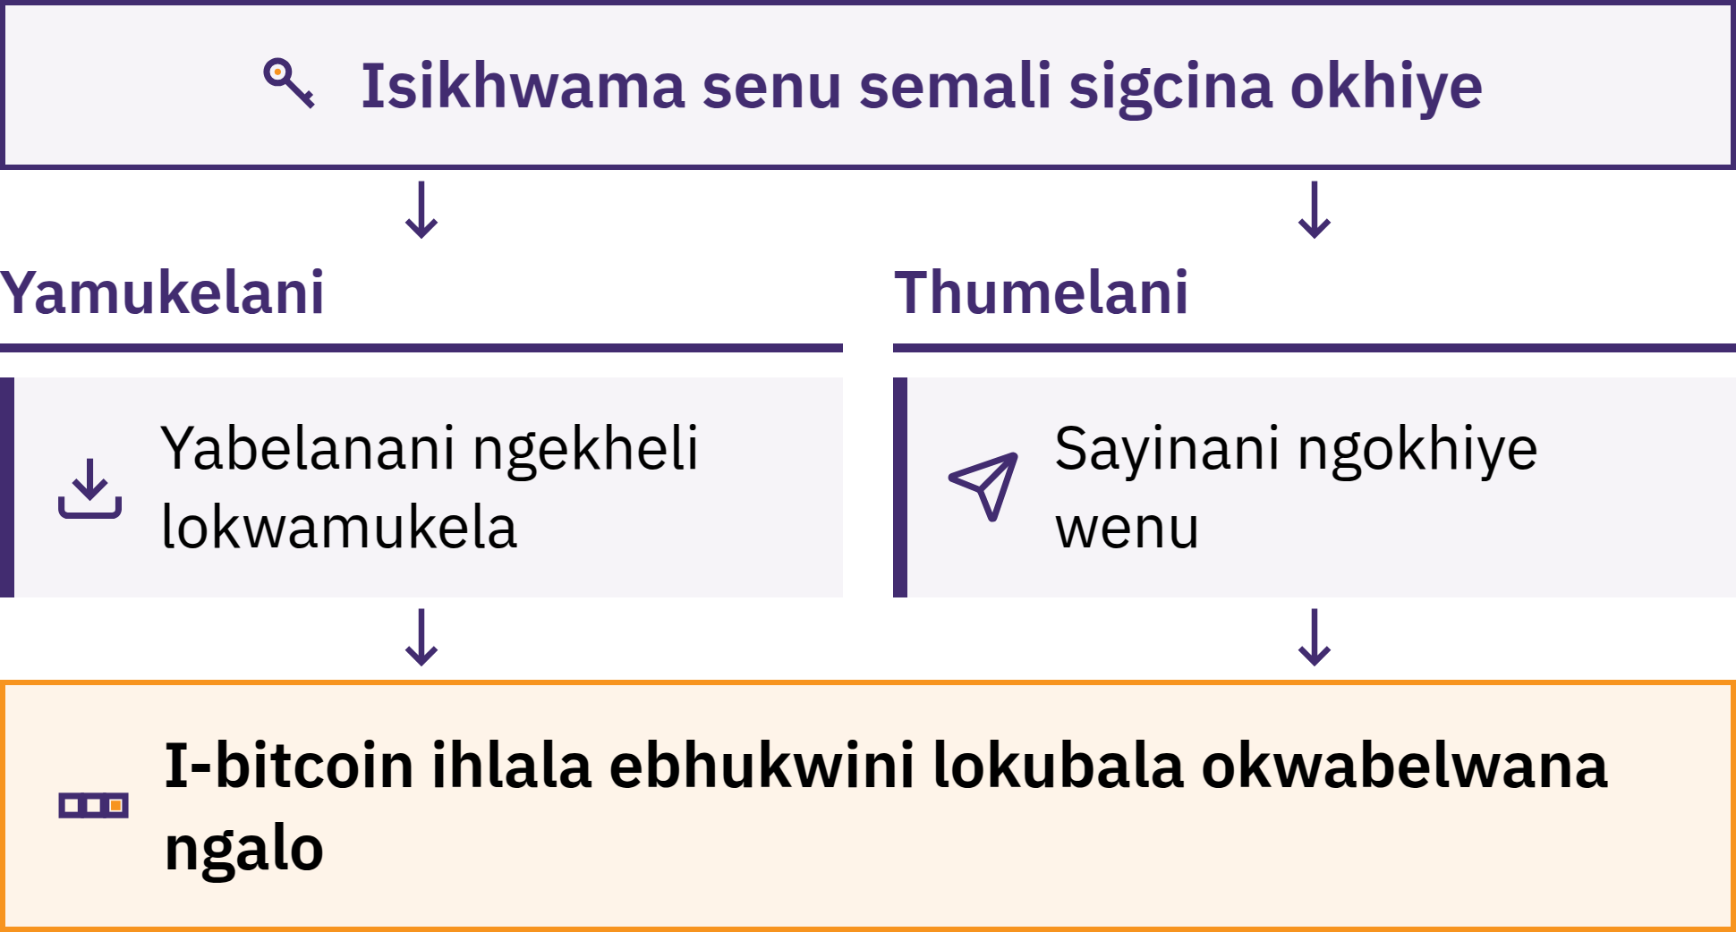
Isikhwama Siphatha Okhiye
Isingeniso nge-Bitcoin · Niyisebenzisa Kanjani i-Bitcoin?
Notes:
Isikhwama se-Bitcoin siyithuluzi, ngokuvamile eliwuhlelo lokusebenza, elinivumela ukuba namukele, nihlole futhi nithumele i-bitcoin. I-bitcoin yenu ayigcinwa ngaphakathi ocingweni lwenu: ibhalwe ku-blockchain. Isikhwama silawula okhiye abanivumela ukuba nifakazele ukuthi ingeyenu futhi nigunyaze inkokhelo.

Slide 32
Ubani Ngempela Ophethe I-Bitcoin Yenu?
Ukuzigcinela: nilawula okhiye
Akekho ongakwazi ukunibuyisela i-bitcoin yenu uma nilahlekelwa yibinzana lamagama okubuyisa kanye nedivayisi
Ukugcinelwa: inkampani igcina okhiye, kucishe kufane nebhange
Ibhalansi yenu iyisithembiso sayo sokukhokha; ingakhawulela ukukhishwa kwemali, imise ukusebenza kwe-akhawunti, ihlaselwe ngabaduni bamakhompyutha, noma ivalwe
Ukukhetha indlela yokugcinwa akusona isivivinyo sokufaneleka kwenu. Okubalulekile ukwazi ukuthi yiluphi uhlobo enilusebenzisayo nokuthi yini eniyethembayo.
Isingeniso nge-Bitcoin · Niyisebenzisa Kanjani i-Bitcoin?

Slide 33

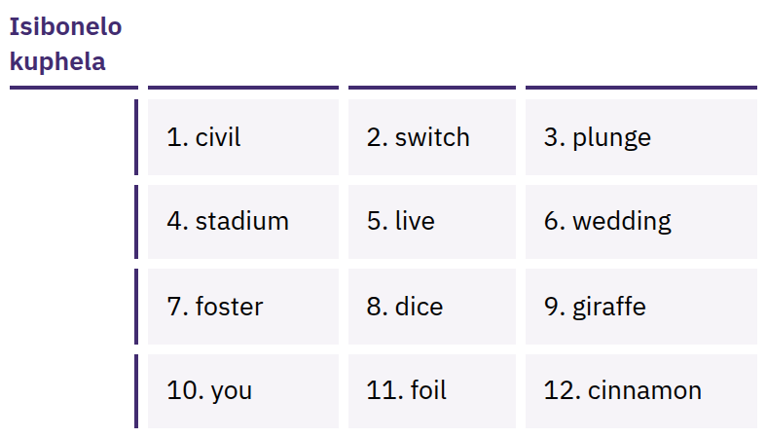
Ibinzana Lenu Lembewu
Linikeza Ukufinyelela
Okugcwele
Uhlu lwamagama ahlelwe ngokulandelana, ngokuvamile angu-12 noma angu-24, olungasetshenziswa ukwakha kabusha okhiye benu. Noma ubani onalo angathatha i-bitcoin yenu.
Isingeniso nge-Bitcoin · Niyisebenzisa Kanjani i-Bitcoin?
Notes:
Ibinzana lokubuyisela isikhwama aliyona nje indlela yokwenza ikhophi eyisipele: linikeza ukufinyelela okuphelele. Libhaleni ngokunembile ephepheni lapho nakha isikhwama; ligcineni lingaxhunyiwe ku-inthanethi, liyimfihlo, futhi lisendaweni lapho lingeke lilahleke noma lonakale khona. Ningalokothi nilithwebule, nilithumele nge-imeyili, niligcine kumanothi agcinwe efwini, nilithumele ngomyalezo, noma nilibhale kuwebhusayithi. Amagama abonisiwe ayisibonelo kuphela; ningalokothi nibonise noma niqoqe ibinzana langempela lokubuyisela isikhwama.

Slide 34

Akubona okhiye bakho, akuzona
izinhlamvu zemali zakho.
Isingeniso nge-Bitcoin · Niyisebenzisa Kanjani i-Bitcoin?

Slide 35

Ngaphambi Kokuba Nisebenzise
Noma Yisiphi Isikhwama Semali
Okhiye: ubani obalawulayo, yinina noma inkampani?
Ukubuyisela: kwenzekani uma ifoni yenu ilahleka noma inkampani inyamalala?
Umthombo: ingabe yiwebhusayithi esemthethweni noma ikhasi lohlelo lokusebenza esitolo sezinhlelo zokusebenza, hhayi isixhumanisi enisithunyelelwe othile?
Ikhodi: ingabe ikhodi yomthombo ivulelekile futhi inakekelwa ngokuqhubekayo? (Lokhu kukodwa akubona ubufakazi bokuphepha.)
Izindleko: yiziphi izimali ezikhokhwayo ngokuthumela, ukwamukela, noma ukukhipha imali?
Izinkokhelo: ku-blockchain, nge-Lightning, noma kokubili?
Isingeniso nge-Bitcoin · Niyisebenzisa Kanjani i-Bitcoin?
Notes:
I-My First Bitcoin ayincomi izikhwama ezithile. Amathuluzi, izinkokhelo nabanikazi kuyashintsha, futhi okufanele omunye umphakathi kungase kungawufaneli omunye. Qondisani abafundi kuthisha wendawo othembekile.

Slide 36
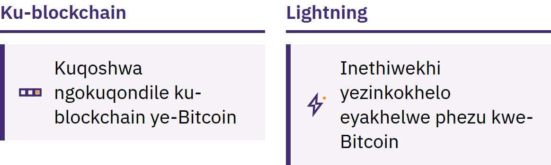
Ku-blockchain naku-Lightning
Kuchungechunge lwamabhulokhi: kuqoshwa ngokuqondile ochungechungeni lwamabhulokhi
Lightning: inethiwekhi yokukhokha eyakhelwe phezu kwe-Bitcoin ukuze kwenziwe izinkokhelo ezisheshayo, ezincane nezivamile, njengokuthenga ikhofi
Isikhwama se-Lightning naso singaphathwa umhlinzeki wesevisi noma umnikazi waso
Isingeniso nge-Bitcoin · Niyisebenzisa Kanjani i-Bitcoin?

Slide 37
Imithetho Emithathu Ngesikhathi Nifunda
Fundani kuqala. Ningathathi isinyathelo ngenxa yenjabulo, ukwesaba, noma ingcindezi.
Qalani ngokuncane. Z Alingani amathuluzi eningawajwayele ngenani lemali eningakwazi ukubekezelela ukulahlekelwa yilo.
Ningethembi, Qinisekisani. Hl olani umuntu, indlela yokukhokha, ikheli, kanye nenani lemali.
Yabelanani ngemininingwane yokwamukela imali, ningalokothi nabelane ngezimfihlo
Ikheli noma isicelo sokukhokha kungabiwa nabanye. Ibinzana lokubuyisela isikhwama semali noma ukhiye oyimfihlo akumelwe neze kwabiwe nabanye. Akekho uthisha osemthethweni, inkampani yesikhwama semali, noma umsebenzi wosizo oyoke anicele lokho.
Isingeniso nge-Bitcoin · Niyisebenzisa Kanjani i-Bitcoin?

Slide 38

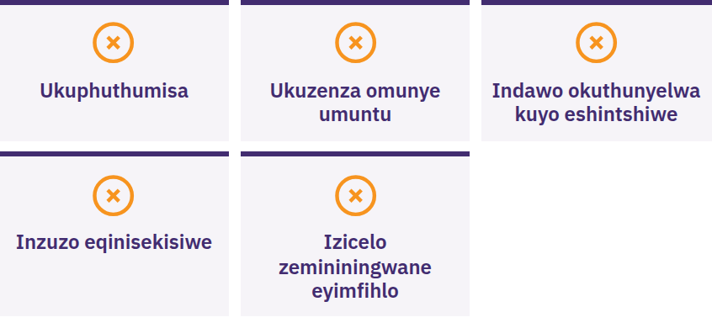
Yimani, Ningabelani Ngalutho,
Ningathumeli Lutho
Yimani uma othile eniphoqa ukuba niphuthume noma nigcine imfihlo, ethembisa inzuzo eqinisekisiwe, enicela ukuba nithumele i-bitcoin kuqala, noma ecela amagama enu okubuyisela isikhwama. Ake nithi ukuma. Ningabelani ngalutho. Ningathumeli lutho. Bese niqinisekisa ngomthombo enivele niwazi.
Isingeniso nge-Bitcoin · Niyisebenzisa Kanjani i-Bitcoin?

Slide 39

Yini Elandelayo?
Lesi kuseyisiqalo nje.

Slide 40
Amaphuzu Amane Abalulekile
Imali incike emithethweni nasekwethembaneni. Inani lemali ye-fiat nemithetho yayo kunqunywa yizikhungo ezimbalwa.
I-Bitcoin inikeza imithetho ehlukile. Inani lemali elibekwe obala, elinomkhawulo, elifinyeleleka kunoma ubani, elingaqinisekiswa esikhundleni sokumane lithenjwe.
Ukuphepha kuza kuqala. Fundani kuqala, qalani ngokuncane, qinisekisani konke, ningalokothi nabelane ngamagama enu okubuyisela isikhwama.
Lokhu kumane kuyisiqalo. Isinyathelo esisodwa esilandelayo esiphephile sanele.
Isikhathi sokuzindla
Buyelani emibuzweni emihlanu esekuqaleni. Ningaphendula nithini manje?
Isingeniso nge-Bitcoin · Yini Elandelayo?

Slide 41

Idiploma ye-Bitcoin
Isinyathelo esilandelayo. Amamojuli ayo amane aniqhubekisela phambili:
Ukuqonda imali
Indlela i-Bitcoin esebenza ngayo
Ukusebenzisa i-Bitcoin ngokuphepha
I-Bitcoin emphakathini wenu
Hlalani ninelukuluku lokwazi, qhubekani nibuza imibuzo, futhi nifunde okwengeziwe ku-myfirstbitcoin.org.
Sibheke ngabomvu ukunibona eqenjini lethu elilandelayo labafundi.
Isingeniso nge-Bitcoin · Yini Elandelayo?

Slide 42


