Slide 1

Putanga 26.10
He Kupu
Whakataki
ki Bitcoin
He Aratohu mā te Hunga Tīmata

Slide 2

He aha te take e hirahira ai te moni?
Ka whakamahi tātou i te moni i ia rā, engari he ruarua noa ngā wā ka ui tātou me pēhea tōna mahi.
Notes:
Pūtake: My First Bitcoin, He Whakatakinga ki Bitcoin, He Aratohu mā te Hunga Tīmata, putanga 26.10. He mea urutau i raro i te raihana Creative Commons Attribution-ShareAlike 4.0 International; ka whakamahia taua raihana anō mō tēnei huinga kiriata. He rauemi āwhina tēnei huinga kiriata mō te whakaaturanga e aratakina ana e te kaiwhakaako, ā, e ahu mai ana i ngā pātai e ono o te aratohu. Me urutau ngā tauira, te tere o te ako, me te āhua o te whakaako kia hāngai ki tō koutou hapori, me te pupuri tonu i te tikanga me ngā karere haumaru. Kāore e whakapaetia ana he roanga wā pūmau mō ia wāhanga ako.

Slide 3

E kore te nuinga o ngā tāngata
e āta whakaaro mō te moni
Ehara i te whiwhi i taua mea, ehara i te whakapau i taua mea, engari ko te whakaaro he aha taua mea, ā, he pēhea tōna mahi.
He Kupu Whakataki ki Bitcoin · He aha te take e hirahira ai te moni?
Notes:
Tīmata ki te whakaahua: ka whakamahi ngā tāngata katoa huri noa i a tātou i te moni, me te kore e patapatai mō taua mea. Pātai atu ki te rōpū, nōnahea te wā whakamutunga i whakaaro ai rātou mō te takenga mai o te moni.

Slide 4

E rima ngā pātai hei tīmatanga
He aha te tangata e hiahia ai ki te moni?
He aha e kīia ai tētahi mea he moni?
Mā wai e hanga, e whakahaere rānei te moni e whakamahia ana e koe?
He aha i whai wāriu ai te moni e whakamahia ana e koe?
Ka taea tonu e tō moni te hoko te rahinga o ngā mea i taea i mua?
Puritia ō whakautu
Tuhia he whakautu poto ki ia pātai. Ka hoki anō koe ki ēnei hei te mutunga.
He Kupu Whakataki ki Bitcoin · He aha te take e hirahira ai te moni?
Notes:
Hoatu he meneti ruarua ki ngā ākonga hei tuhi. Kaua e tono i tētahi kia whakapuaki i ōna taipitopito pūtea whaiaro. Ka puta anō ēnei whakautu ki te kiriata whakarāpopoto i ngā tino akoranga, “He aha ka whai ake?”

Slide 5

He meka, he whakaaro rānei?
Meka: "Ka whakaaetia tēnei moni pepa hei utu tāke." Ka taea tēnei te manatoko.
Whakaaro: "Koinei te momo moni pai rawa atu." Me whai paearu, me whai taunakitanga hoki.
Hei ako anake tēnei aratohu. Kāore e whakarato tohutohu mō te ahumoni, te haumi, te ture, te tāke rānei, kāore hoki e tohutohu i a koutou kia hoko, kia hoko atu, kia pupuri rānei i tētahi mea.
He Kupu Whakataki ki Bitcoin · He aha te take e hirahira ai te moni?
Notes:
Kia mau ki tēnei wehewehenga puta noa i te wātū. Ina puta he kerēme, pātai atu: ka taea rānei e tātou te manatoko, me whai paearu, taunakitanga rānei?

Slide 6

He Aha te Moni?
He taputapu te moni mō te whakawhitiwhiti.

Slide 7

Te Tauhokohoko Whakawhiti Taonga me te Taurite Takirua o
ngā Hiahia
Me hiahia ngā tāngata tokorua ki ngā mea kei tērā atu, i te wā kotahi, ā, kia tika hoki ngā rahinga.
He Kupu Whakataki ki Bitcoin · He Aha te Moni?
Notes:
Whakamahia te tauira o te aratohu: e whakatipu raihi ana koe, ā, me whai hū koe, engari ko tā te kaihanga hū e hiahia ana he hinu tunu kai, ehara i te raihi. Ka kīia tēnei e ngā mātanga ohaoha ko te ōritenga takirua o ngā hiahia.

Slide 8
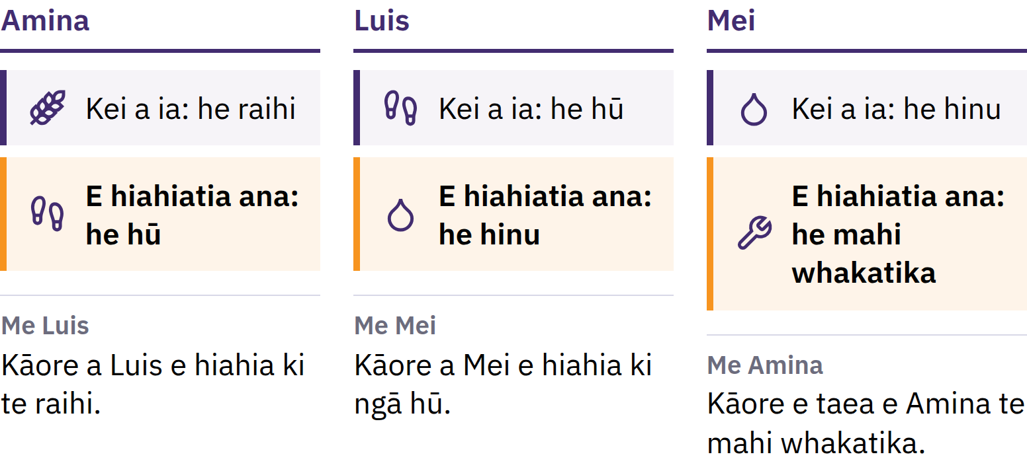
Te Tauhokohoko Whakawhiti Taonga me te Taurite Takirua o
ngā Hiahia
Me hiahia tēnā tangata, tēnā tangata ki ngā mea kei tērā atu, i te wā kotahi, ā, kia tika hoki ngā rahinga.
He Kupu Whakataki ki Bitcoin · He Aha te Moni?
Notes:
Whakamahia te tauira o te aratohu: e whakatipu raihi ana koe, ā, me whai hū koe, engari ko tā te kaihanga hū e hiahia ana he hinu tunu kai, ehara i te raihi. Ka kīia tēnei e ngā mātanga ohaoha ko te ōritenga takirua o ngā hiahia.

Slide 9

He Utauta te Moni mō te Whakawhitiwhiti
Kāore he tangata e hiahia ana ki te moni mō te moni noa iho. He whaihua te moni nā te mea ka whakaae ētahi atu ki te tango i taua moni, i runga i te tūmanako ka whakaae anō ētahi atu ki te tango ā muri ake nei.
He Kupu Whakataki ki Bitcoin · He Aha te Moni?
Notes:
He pepa noa iho te moni pepa. Ka whakatau te moni i te raruraru o te tauhokohoko whakawhiti taonga mā te wehe i te hoko atu i te hoko mai: ka hoko atu koutou i tā koutou raihi ki tētahi tangata, ā, ka hoko mai koutou i ngā hū i tētahi atu. Koinei te mea e wehe ai te moni i te tauhokohoko whakawhiti taonga.

Slide 10

Ngā Mahi e Toru a te Moni
Taputapu whakawhiti: ka whakaae te tangata ki taua mea hei utu
Waeine kaute: ka tohua ngā utu ki taua waeine
Pātaka uara: ka kawea e taua mea te uara mai i tēnei rā ki ngā rā kei te heke mai
Kāore he moni e pupuri tino pai ana i tōna uara, engari he pōturi ake te hekenga o te kaha hoko o ētahi momo moni i ētahi atu.
He Kupu Whakataki ki Bitcoin · He Aha te Moni?

Slide 11

Mai i ngā Anga ki te Pepa
Anga, tote, pirepire, kararehe, konukura, hiriwa, kōura
Ngā konganuku utu nui: he onge, he mauroa, e whakaaetia whānuitia ana
Ngā tiwhikete pepa ka taea te whakawhiti mō tētahi rahinga konganuku kua tohua
Ngā paerewa kōura: he wae moni e herea ā-ture ana ki te kōura
I rerekē ngā ture i tēnā wāhi, i tēnā wā.
He Kupu Whakataki ki Bitcoin · He Aha te Moni?

Slide 12
Moni ā-ture
1971: i whakamutua e Te Hononga o Amerika te whakawhiti ōkawa a ngā kāwanatanga o tāwāhi me ngā pēke pokapū i ngā tāra ki te koura
I ēnei rā, he moni fiat te nuinga o ngā moni ā-motu: ka whakaputaina i raro i te mana o te kāwanatanga, ā, kāore e taea te whakawhiti ki te koura, ki tētahi atu rawa tauhokohoko rānei
Fiat he kupu Rātini mō te "kia mahia", ā, ka mārama nuitia ko te "mā te whakatau mana"
Ka whakaaetia nā te mea e whakamahia ana e ngā tāngata, ngā pakihi, ngā pēke me ngā kāwanatanga; ka whakatauria e ngā ture hei moni whai mana ā-ture, ā, me whakamahi hei utu tāke
He Kupu Whakataki ki Bitcoin · He Aha te Moni?

Slide 13

I neke tātou mai i te moni i
tautokona e tētahi mea, ki te
moni i tautokona e te
whakawhirinaki ki tētahi tangata.
He Kupu Whakataki ki Bitcoin · He Aha te Moni?

Slide 14

He Aha te Raru o Ā Tātou Moni?
Ina rongo te tangata i te kupu pikinga utu, i te nuinga o te wā ka whakaaro ia ki te piki haere o ngā utu.

Slide 15
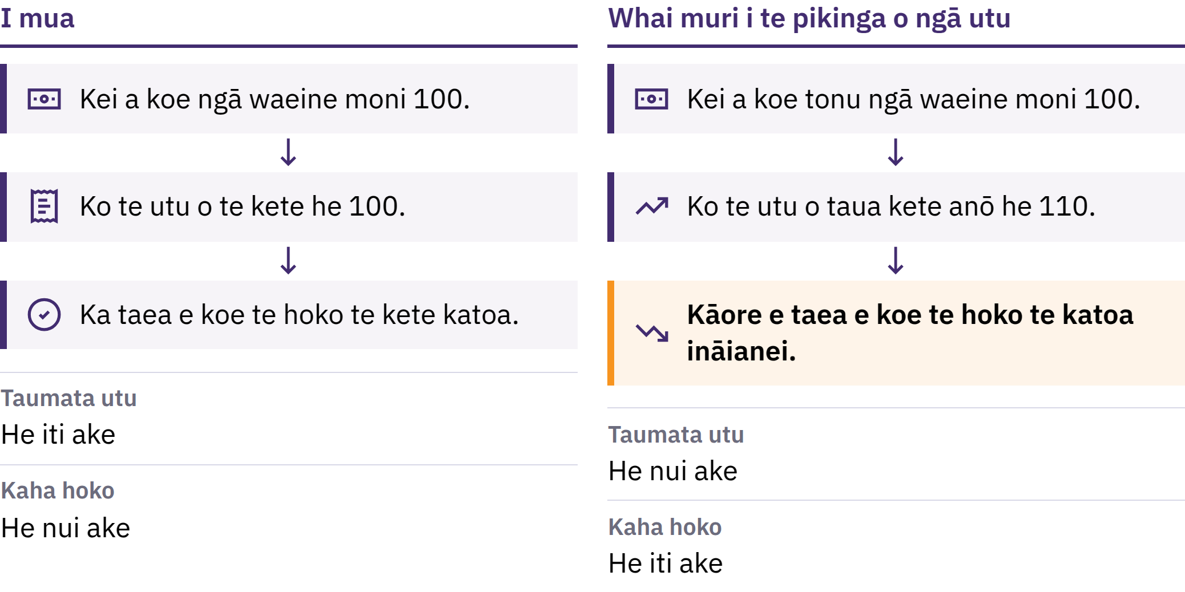
Te Pikinga Utu me te Mana Hoko
He Kupu Whakataki ki Bitcoin · He Aha te Raru o Ā Tātou Moni?
Notes:
Ko te pikinga utu he pikinga mauroa o te taumata whānui o ngā utu. Ko tērā atu taha o tēnei ko te mana hoko: arā, te nui o ngā mea ka taea te hoko ki te waeine moni kotahi. Ki te piki te utu o tētahi kete taonga taketake mai i te 100 waeine moni ki te 110, kua kore e taea te kete katoa te hoko ki aua 100 waeine moni anō.

Slide 16

Te Pikinga Utu me te Mana Hoko
He Kupu Whakataki ki Bitcoin · He Aha te Raru o Ā Tātou Moni?
Notes:
Ko te pikinga utu he pikinga mauroa o te taumata whānui o ngā utu. Ko tērā atu taha o tēnei ko te mana hoko: arā, te nui o ngā mea ka taea te hoko ki te waeine moni kotahi. Ki te piki te utu o tētahi kete taonga taketake mai i te 100 waeine moni ki te 110, kua kore e taea te kete katoa te hoko ki aua 100 waeine moni anō.

Slide 17

He maha ngā take, kotahi te
kōwhiringa
Te whakawhānuitanga o te moni me te pūtea taurewa
Ngā raruraru tuku me ngā panonitanga o te tono
He moni e ngoikore haere ana, ngā tāke, ngā utu whakaputa
Ko tētahi take he kōwhiringa, ehara i te tūpono noa: i roto i te pūnaha moni whakature, ka taea e ētahi pūtahi ruarua noa te whakapiki i te rahinga o te moni me te pūtea taurewa, me te whakarerekē i ōna ture.
He Kupu Whakataki ki Bitcoin · He Aha te Raru o Ā Tātou Moni?
Notes:
E tautohetohe ana ngā mātanga ōhanga mō te nui o te pānga o ia take. Me aro tonu ki te take kotahi i ahu mai i tētahi whakatau, ehara i te tūpono noa.

Slide 18
Te Onge me te Uara
He nui ake te uara o te Mona Lisa taketake i tō tētahi kape: kotahi anake te mea taketake
Ehara mā te onge anake e hua ai te uara, engari ina hiahia te tangata ki tētahi mea, he mea nui te nui o taua mea e wātea ana
Ina tere ake te tipu o te nui o te moni i te tipu o ngā mea ka taea te hoko ki taua moni, ko te tikanga, ka iti ake ngā mea ka taea te hoko ki ia waeine moni
He Kupu Whakataki ki Bitcoin · He Aha te Raru o Ā Tātou Moni?

Slide 19
Kāore te pikinga utu e pā ōrite ki te katoa
Ka heke pea te kaha hoko o te moni ukauka me ngā moni penapena
Ka tiakina pea, ki tētahi wāhanga, ngā kaipupuri o ngā rawa e piki ana te utu
He rerekē te tere o te panoni o ngā utu mahi me ngā utu taonga
He rerekē te toenga pūtea i te pēke i te moni ukauka kei tō ringa: he kupu taurangi nā te pēke ki te utu moni ki a koe. I te nuinga o te wā ka whakatutukihia taua kupu taurangi, engari e whakawhirinaki ana tēnei ki te pēke me ngā ture e pā ana ki a ia.
He Kupu Whakataki ki Bitcoin · He Aha te Raru o Ā Tātou Moni?

Slide 20
Whakamātauria: He arowhai i te kaha hoko
Kōwhiria tētahi mea o ia rā: te parāoa, te waka kawe, te moni waea rānei
Tuhia tōna utu i tēnei rā
Pātai atu ki tētahi tangata he aha tōna utu i ētahi tau ki muri, ā, tirohia tētahi pūkete pono mēnā ka taea
I piki ngā moni whiwhi i taua pāpātanga anō? He aha atu pea ngā take o te panonitanga?
He Kupu Whakataki ki Bitcoin · He Aha te Raru o Ā Tātou Moni?
Notes:
Ka taea tēnei me te kore pūrere, te kore ipurangi rānei. Whakatauritea ngā whakautu puta noa i te rōpū, ā, whakamaharatia ngā ākonga ehara te utu kotahi i te inenga katoa o te pikinga utu.

Slide 21
Ka mahi te moni fiat, engari he tūraru anō
He utunga māmā, he taurewa ngāwari, he taputapu hei urupare ki ngā raruraru ohotata
Engari ka taea te whakarerekē tōna rahinga me ōna ture, ā, he iti noa te mana whakatau o te hunga e whakamahi ana i taua moni
Koinei te take e rapu ai te tangata i ētahi atu kōwhiringa, ā, koinei hoki te take i waihangatia ai a Bitcoin.
He Kupu Whakataki ki Bitcoin · He Aha te Raru o Ā Tātou Moni?

Slide 22

He aha te Bitcoin?
He moni matihiko kāore e whakahaeretia ana e tētahi mana kotahi, he tepenga tō tōna rahinga, ā, ka taea te tuku tōtika mai i tētahi tangata ki tētahi atu me te kore whakaaetanga a tētahi pēke.

Slide 23
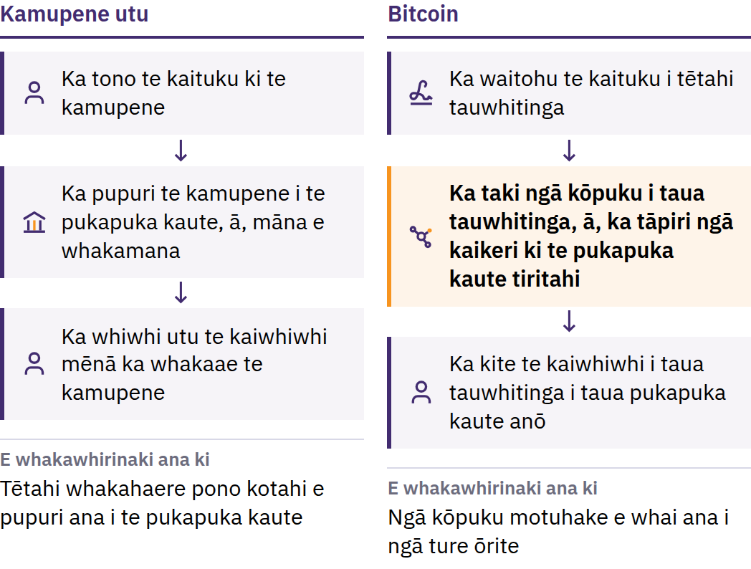
Te Raru o te Whakapau Moni Tārua
31 Whiringa-ā-nuku 2008: Ka whakaputa a Satoshi Nakamoto i Bitcoin: He Pūnaha Moni Hiko ā-Hoa ki te Hoa. Hānuere 2009: ka tīmata te whatunga.
He Kupu Whakataki ki Bitcoin · He aha te Bitcoin?
Notes:
I mua i te putanga mai o Bitcoin, i whakawhirinaki tonu te tuku moni mā te ipurangi ki tētahi whakahaere pono: arā, he pēke, he kamupene utu rānei nāna te pukapuka kaute i pupuri, ngā pūkete i whakamana, ā, i āhei hoki ki te whakaroa, ki te ārai, ki te whakahoki rānei i tētahi utu. He māmā te tārua i ngā mōhiohio matihiko: mēnā ka taea te whakapau i te moni matihiko kotahi kia rua ngā wā, e kore e pai hei moni. Koinei te raruraru whakapau rua. He tangata, he rōpū rānei a Satoshi Nakamoto e whakamahi ana i taua ingoa.

Slide 24
Mana Tohatoha · Rahinga Whāiti · Hoa ki te Hoa
He mana tuari: kāore he tari matua e waihanga pūkete ana, e whakarerekē toenga pūtea ana, e whakaae rānei ko wai ka uru mai
He rahinga whāiti: e kore rawa e neke atu i te 21 miriona bitcoin
Tangata ki te tangata: tukuna ki tētahi tangata ahakoa ko wai, ahakoa kei hea, me te kore tono whakaaetanga i tētahi mana pokapū
Kāore tētahi kamupene e āhei ki te whakatio i te bitcoin e whakahaerehia ana e koutou tonu. Ko tērā atu taha o taua herekoretanga ko te haepapa: i te nuinga o te wā, e kore e taea te whakakore i tētahi tauwhitinga whaimana, ā, kāore he tari āwhina mō te whatunga.
He Kupu Whakataki ki Bitcoin · He aha te Bitcoin?
Notes:
Ehara te tohatoha i te mana i te mea he ōrite te awe o ia tangata. Ko tōna tikanga, kāore e taea e te kaiuru kotahi te whakarerekē i te pukapuka kaute, i ngā ture moni rānei mō te katoa.

Slide 25
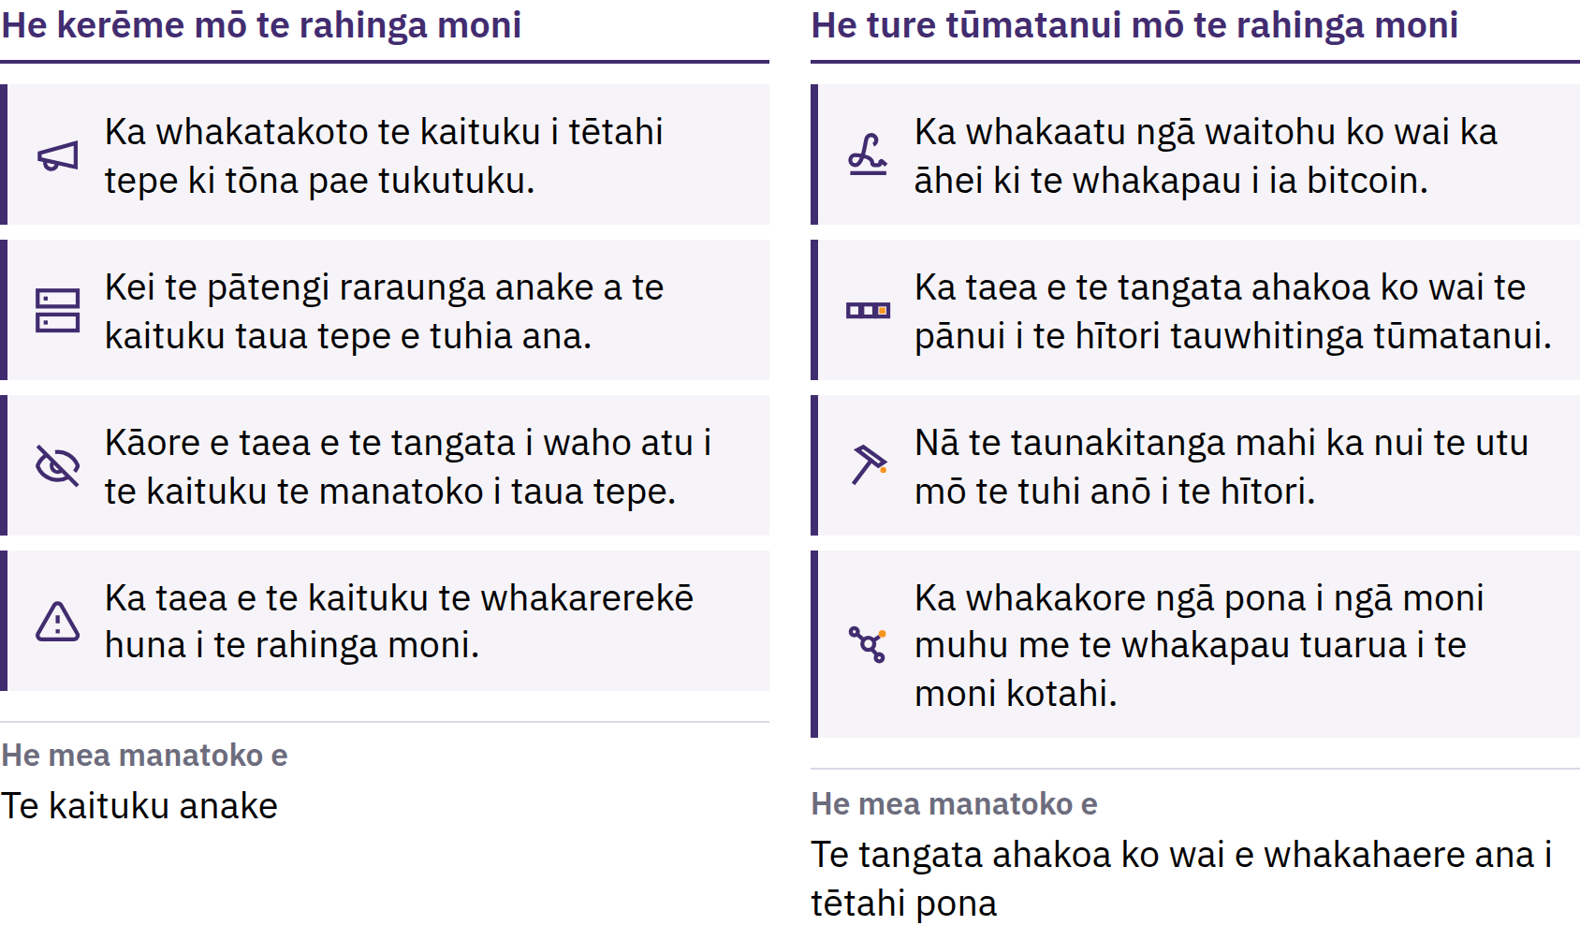
He tepe ka taea e te katoa te manatoko
He Kupu Whakataki ki Bitcoin · He aha te Bitcoin?
Notes:
Ka tukuna ngā bitcoin hou i runga i tētahi hōtaka tūmatanui, ā, ka whakakāhoretia e ngā rorohiko motuhake e kīia nei he kōpuku ngā poraka katoa e takahi ana i taua ture. He pono taua tepenga nā te mea ka taea e te tangata ahakoa ko wai te manatoko. Ehara tēnei i te ture o te taiao: ka mau tonu nā te mea ka whakaū tonu ngā kaiuru i taua ture. Ehara te whāiti o te rahinga e wātea ana i te kī taurangi ka piki te utu; ka whakawhirinaki te utu ki te hiahia hoko me te rahinga e wātea ana.

Slide 26
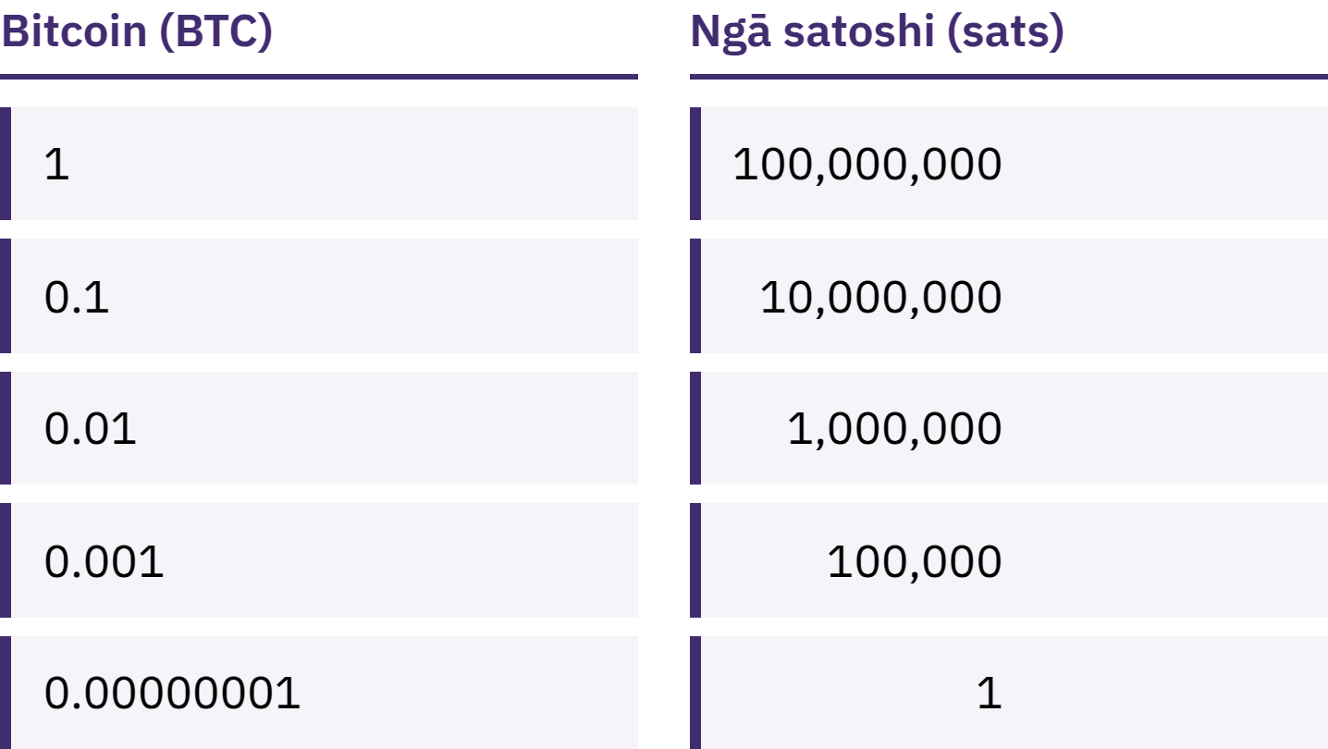
Ehara i te mea me whai koe i tētahi Bitcoin katoa
Ka wehea te bitcoin kotahi ki ngā waeine iti ake e 100,000,000, e kīia nei he satoshi, he sats rānei.
He Kupu Whakataki ki Bitcoin · He aha te Bitcoin?
Notes:
E tohu ana te whai 100,000 sats me te whai 0.001 bitcoin i te rahinga kotahi. Whakatikaina te pōhēhē kāore e taea te whai wāhi ki Bitcoin nā te nui o te utu mō te bitcoin kotahi.

Slide 27
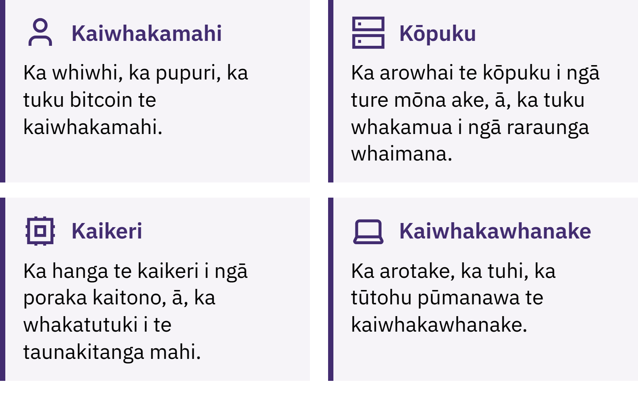
Ko wai e whakahaere tonu ana i a Bitcoin?
He Kupu Whakataki ki Bitcoin · He aha te Bitcoin?
Notes:
Ka tuku, ka whiwhi, ka pupuri ngā kaiwhakamahi i te bitcoin; ka arowhai ngā kōpuku i ia tauwhitinga me ia poraka kia ū ki ngā ture; ka whakataetae ngā kaikeri ki te tāpiri poraka hou ki te pūkete i ia tekau meneti pea. E tuwhera ana taua pūkete, arā, te mekameka poraka, ki te marea, ā, he nui rawa te utu ki te tuhi anō. He tuhipoka mō te tuhi kupu: ko te Bitcoin me te pūmatua B e tohu ana i te nuinga o te wā ki te whatunga, ki te pūnaha rānei; ko te bitcoin me te pūriki b e tohu ana ki te moni ake.

Slide 28

Ko wai e whakahaere tonu ana i a Bitcoin?
He Kupu Whakataki ki Bitcoin · He aha te Bitcoin?
Notes:
Ka tuku, ka whiwhi, ka pupuri ngā kaiwhakamahi i te bitcoin; ka arowhai ngā kōpuku i ia tauwhitinga me ia poraka kia ū ki ngā ture; ka whakataetae ngā kaikeri ki te tāpiri poraka hou ki te pūkete i ia tekau meneti pea. E tuwhera ana taua pūkete, arā, te mekameka poraka, ki te marea, ā, he nui rawa te utu ki te tuhi anō. He tuhipoka mō te tuhi kupu: ko te Bitcoin me te pūmatua B e tohu ana i te nuinga o te wā ki te whatunga, ki te pūnaha rānei; ko te bitcoin me te pūriki b e tohu ana ki te moni ake.

Slide 29
He Painga, he Huakore ō Bitcoin
Ka tere te rerekē o tōna utu
I te nuinga o te wā, kāore e taea te whakatika ngā hapa
He iti tonu te whakaaetanga ki te whakamahi i te Bitcoin i ngā wāhi maha
Me ako ētahi mea kia haumaru ai te whakamahi
Ka whakakapia e Bitcoin tētahi wāhanga o te whakawhirinaki ki ngā whakahaere ki te manatoko me te kawenga whaiaro. Kāore e whakakore i te tūraru.
He Kupu Whakataki ki Bitcoin · He aha te Bitcoin?

Slide 30

Me pēhea te whakamahi i te Bitcoin?
Te pātai tuatahi mō tētahi pūkoro moni: ko wai e whakahaere ana i ngā kī?

Slide 31
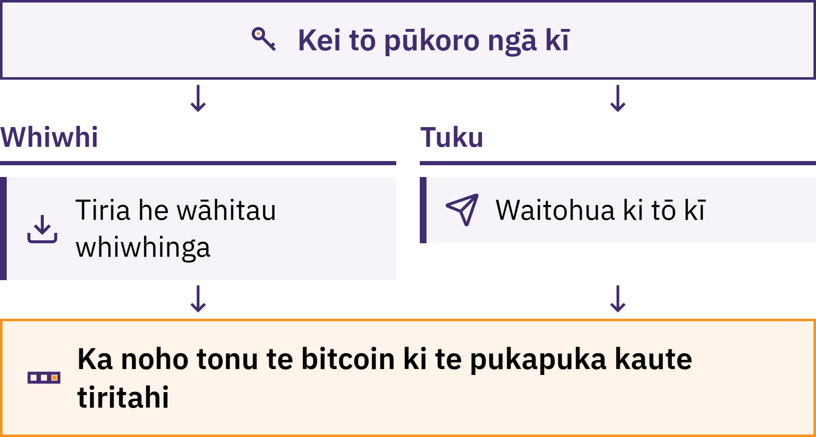
Ka whakahaere te pūkoro i ngā kī
He Kupu Whakataki ki Bitcoin · Me pēhea te whakamahi i te Bitcoin?
Notes:
He taputapu te pūkoro Bitcoin, he taupānga i te nuinga o te wā, e āhei ai koe ki te whiwhi, ki te tirotiro, ki te tuku hoki i te bitcoin. Kāore ō bitcoin e penapenahia ki roto i tō waea: ka tuhia ki te mekameka poraka. Mā te pūkoro e whakahaere ngā kī e āhei ai koe ki te whakaū nōu aua bitcoin, me te whakamana i tētahi utunga.

Slide 32
Ko wai tonu e pupuri ana i tō Bitcoin?
Te tiaki whaiaro: kei a koe te mana whakahaere i ngā kī
Kāore he tangata e āhei ki te whakahoki mai i ō bitcoin māu mēnā ka ngaro i a koe te kīanga kākano me te pūrere
Te tiaki a tētahi atu: kei tētahi kamupene ngā kī, he āhua rite ki te pēke
Ko tō toenga pūtea tāna oati ki te utu i a koe; ka taea e ia te whakawhāiti i ngā tangohanga pūtea, te whakatārewa i tētahi pūkete, ā, tērā pea ka urua pokanoatia ōna pūnaha, ka kati rānei
Ehara te kōwhiri i te momo tiaki i te whakamātautau i tō mana. Ko te mea nui kia mōhio koe ko tēhea momo e whakamahia ana e koe, ā, he aha tāu e whakawhirinaki atu ana.
He Kupu Whakataki ki Bitcoin · Me pēhea te whakamahi i te Bitcoin?

Slide 33

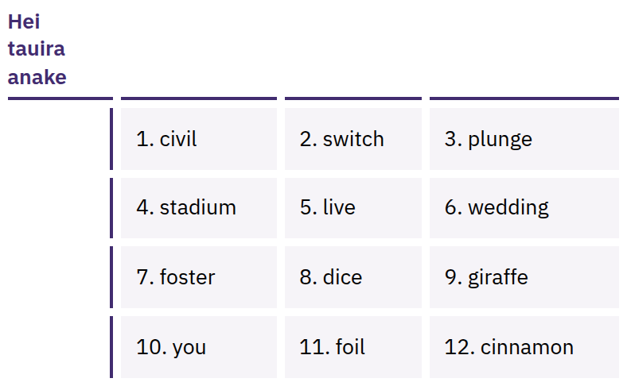
Ko tō kīanga kākano te urunga
katoa
He rārangi kupu kua whakaraupapatia, he 12, he 24 rānei ngā kupu i te nuinga o te wā, ka taea te hanga anō i ō kī mā reira. Ka taea e te tangata kei a ia taua rārangi te tango i ō bitcoin.
He Kupu Whakataki ki Bitcoin · Me pēhea te whakamahi i te Bitcoin?
Notes:
Ehara te kīanga kākano i te pūrua anake: koia tonu te mana uru katoa. Ina waihangatia te pūkoro, me tuhi tika taua kīanga ki te pepa; me pupuri ki waho i te ipurangi, kia noho matatapu, ki tētahi wāhi e kore ai e ngaro, e tūkinotia rānei. Kaua rawa e tango whakaahua o taua kīanga, e tuku mā te īmēra, e rokiroki ki ngā tuhipoka kapua, e tuku mā te karere, e pato rānei ki tētahi pae tukutuku. He tauira noa iho ngā kupu e whakaaturia ana; kaua rawa e whakaatu, e kohikohi rānei i tētahi kīanga kākano tūturu.

Slide 34

Ki te kore ngā kī i a koe, ehara
ngā moni i a koe.
He Kupu Whakataki ki Bitcoin · Me pēhea te whakamahi i te Bitcoin?

Slide 35

I mua i tō whakamahi i tētahi
pūkoro
Ngā kī: mā wai e whakahaere, māu, mā tētahi kamupene rānei?
Whakaora: ka aha mēnā ka ngaro tō waea, ka ngaro rānei te kamupene?
Pūtake: ko te paetukutuku whaimana, ko te rārangi rānei i te toa taupānga, kaua ko tētahi hononga i tukuna mai ki a koe e tētahi atu?
Waehere: he tuwhera te pūtake, ā, e tiakina tonutia ana? (Ehara tēnei anake i te taunakitanga o te haumaru.)
Ngā utu: he utu mō te tuku, te whiwhi, te tango moni rānei?
Ngā utunga: mā te mekameka, mā Lightning, mā ngā mea e rua rānei?
He Kupu Whakataki ki Bitcoin · Me pēhea te whakamahi i te Bitcoin?
Notes:
Kāore a My First Bitcoin e tūtohu ana i ētahi pūkoro motuhake. Ka huri ngā taputapu, ngā utu me ngā kaipupuri, ā, ko ngā mea e hāngai ana ki tētahi hapori, kāore pea e hāngai ki tētahi atu. Tēnā, ārahina ngā ākonga ki tētahi kaiwhakaako ā-rohe e whakaponotia ana.

Slide 36
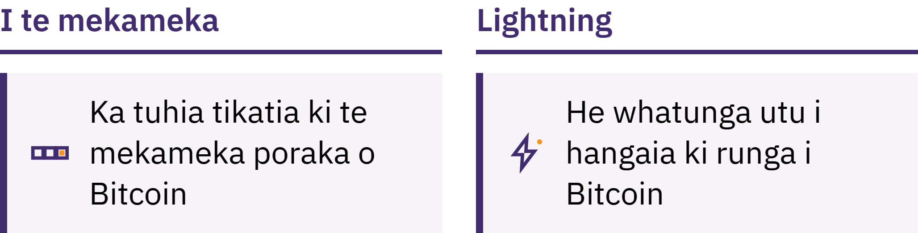
Ā-mekameka me Lightning
Ā-mekameka: ka tuhia tikatia ki te mekameka poraka
Lightning: he whatunga utu kua hangaia ki runga i a Bitcoin mō ngā utu tere, iti, auau hoki, pērā i te hoko kawhe
Ka taea hoki te pūkoro Lightning te tiaki e tētahi atu, e te kaipupuri ake rānei
He Kupu Whakataki ki Bitcoin · Me pēhea te whakamahi i te Bitcoin?

Slide 37
Ngā Ture e Toru i a Koe e Ako Ana
Me ako i te tuatahi. Kaua e mahi i runga i te hīkaka, i te mataku, i te pēhanga rānei.
Me tīmata ki te iti. Whakamātauria ngā taputapu tauhou ki tētahi rahinga moni e kore ai e raru tō noho mēnā ka ngaro.
Kaua e whakawhirinaki noa, me manatoko. Tirohia te tangata, te tikanga utu, te wāhitau, me te rahinga moni.
Tohaina ngā mōhiohio whiwhi utu, kaua rawa ngā mea huna
Ka taea te tohatoha i tētahi wāhitau, i tētahi tono utu rānei. Kaua rawa e tohatoha i tētahi kīanga kākano, i tētahi kī tūmataiti rānei. E kore rawa tētahi kaiwhakaako pono, tētahi kamupene pūkoro moni pono, tētahi kaimahi tautoko pono rānei e tono kia tukuna atu aua mea.
He Kupu Whakataki ki Bitcoin · Me pēhea te whakamahi i te Bitcoin?

Slide 38

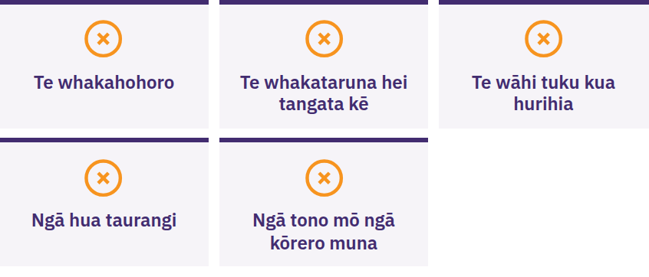
Kāti, kaua e tiritiri i tētahi mea,
kaua e tuku i tētahi mea
Me mutu mēnā ka akiaki tētahi i a koe kia mahi wawe, kia noho muna rānei, ka taurangi ka whiwhi hua koe, ka tono rānei kia tuku bitcoin koe i te tuatahi, kia hoatu rānei i tō kīanga kākano. Me whakatā. Kaua e tohatoha i tētahi mea. Kaua e tuku i tētahi mea. Kātahi ka manatoko mā tētahi puna kōrero e mōhio kē ana koe.
He Kupu Whakataki ki Bitcoin · Me pēhea te whakamahi i te Bitcoin?

Slide 39

He aha ka whai ake?
He tīmatanga noa iho tēnei.

Slide 40
Ngā Akoranga Matua e Whā
E whakawhirinaki ana te moni ki ngā ture me te whakaponotanga. Ka whakatauria te rahinga me ngā ture o te moni fiat e ētahi whakahaere ruarua.
He rerekē ngā ture ka tukuna e Bitcoin. He rahinga moni tūmatanui, he mea whakawhāiti, e wātea ana ki te katoa, ā, ka taea te manatoko, kāore e mate ki te whakawhirinaki noa.
Ko te haumaru te mea tuatahi. Me ako i te tuatahi, me tīmata ki te iti, me manatoko i ngā mea katoa, kaua rawa e tuari i tō koutou kīanga kākano.
He tīmatanga noa iho tēnei. E ranea ana kia kotahi noa te hipanga haumaru e whai ake nei.
He wā hei huritao
Hoki atu ki ngā pātai e rima i te tīmatanga. He aha ā koutou whakautu ināianei?
He Kupu Whakataki ki Bitcoin · He aha ka whai ake?

Slide 41

Te Pōkairua Bitcoin
Te hipanga e whai ake nei. Mā ōna kōwae e whā koutou e kawe whakamua:
Te mārama ki te moni
Te āhua o te mahi a Bitcoin
Te whakamahi haumaru i a Bitcoin
Ko Bitcoin i tō koutou hapori
Kia pākiki tonu, kia pātai tonu, ā, kimihia ētahi atu mātauranga i myfirstbitcoin.org.
E hīkaka ana mātou ki te kite i a koutou i tō mātou rōpū ākonga e whai ake nei.
He Kupu Whakataki ki Bitcoin · He aha ka whai ake?

Slide 42


