Slide 1

Edition 26.10
Introduction
to Bitcoin
A Beginner's Guide

Slide 2

Why Does Money Matter?
We use money every day, yet rarely ask how it works.
Notes:
Source: My First Bitcoin, Introduction to Bitcoin, A Beginner's Guide, edition 26.10. Adapted under Creative Commons Attribution-ShareAlike 4.0 International; this deck uses the same license. This deck is an educator-led presentation aid built on the guide's six questions. Adapt examples, pacing, and delivery to your community while keeping the meaning and the safety messages. No fixed session length is implied.

Slide 3

Most People Never Stop to
Think About Money
Not earning it, not spending it, but thinking about what it is and how it works.
Introduction to Bitcoin · Why Does Money Matter?
Notes:
Open with the picture: everyone around us uses money without questioning it. Ask the group when they last thought about where money comes from.

Slide 4

Five Questions to Start
Why do people need money?
What makes something money?
Who can create or control the money you use?
Why does the money you use have value?
Does your money buy the same amount as before?
Keep your answers
Write a short answer to each question. You will come back to them at the end.
Introduction to Bitcoin · Why Does Money Matter?
Notes:
Give learners a few minutes to write. Do not ask anyone to share personal financial details. These answers come back on the "What's Next?" takeaways slide.

Slide 5

Fact or Opinion?
Fact: "This note is accepted for taxes." It can be checked.
Opinion: "This is the best form of money." It needs criteria and evidence.
This guide is for education only. It does not provide financial, investment, legal, or tax advice, and it does not tell you to buy, sell, or hold anything.
Introduction to Bitcoin · Why Does Money Matter?
Notes:
Carry this distinction through the whole session. When a claim comes up, ask: can we check it, or does it need criteria and evidence?

Slide 6

What is Money?
Money is a tool for exchange.

Slide 7

Barter and the Double Coincidence of Wants
Both people must want what the other has, at the same time and in suitable amounts.
Introduction to Bitcoin · What is Money?
Notes:
Use the guide's example: you grow rice and need shoes, but the shoemaker wants cooking oil, not rice. Economists call this the double coincidence of wants.

Slide 8
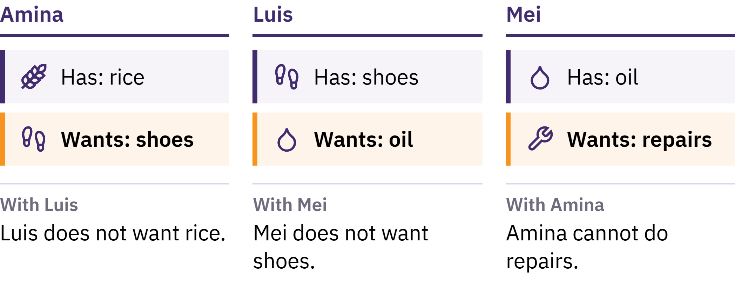
Barter and the Double Coincidence of Wants
Both people must want what the other has, at the same time and in suitable amounts.
Introduction to Bitcoin · What is Money?
Notes:
Use the guide's example: you grow rice and need shoes, but the shoemaker wants cooking oil, not rice. Economists call this the double coincidence of wants.

Slide 9

Money Is a Tool for Exchange
Nobody wants money for its own sake. It is useful because others accept it, expecting others to accept it later.
Introduction to Bitcoin · What is Money?
Notes:
A banknote is just a piece of paper. Money solves the barter problem by separating selling from buying: you sell your rice to one person and buy shoes from another. This is what separates money from barter.

Slide 10

Three Things Money Does
Medium of exchange: people accept it in payment
Unit of account: prices are expressed in it
Store of value: it moves value from today into the future
No money stores value perfectly, but some forms lose purchasing power more slowly than others.
Introduction to Bitcoin · What is Money?

Slide 11

From Shells to Paper
Shells, salt, beads, livestock, copper, silver, gold
Precious metals: scarce, durable, widely accepted
Paper claims redeemable for a stated amount of metal
Gold standards: a currency unit legally linked to gold
The rules varied by place and period.
Introduction to Bitcoin · What is Money?

Slide 12
Fiat Money
1971: the United States ended the official exchange of dollars for gold by foreign governments and central banks
Today most national currencies are fiat money: issued under government authority, not redeemable for gold or any other commodity
Fiat is Latin for "let it be done", often understood as "by decree"
Accepted because people, businesses, banks, and governments use it; laws make it legal tender and require it for taxes
Introduction to Bitcoin · What is Money?

Slide 13

We went from money backed by
something, to money backed by
trust in someone.
Introduction to Bitcoin · What is Money?

Slide 14

What's Wrong With Our Money?
When people hear the word inflation, they usually think of prices going up.

Slide 15
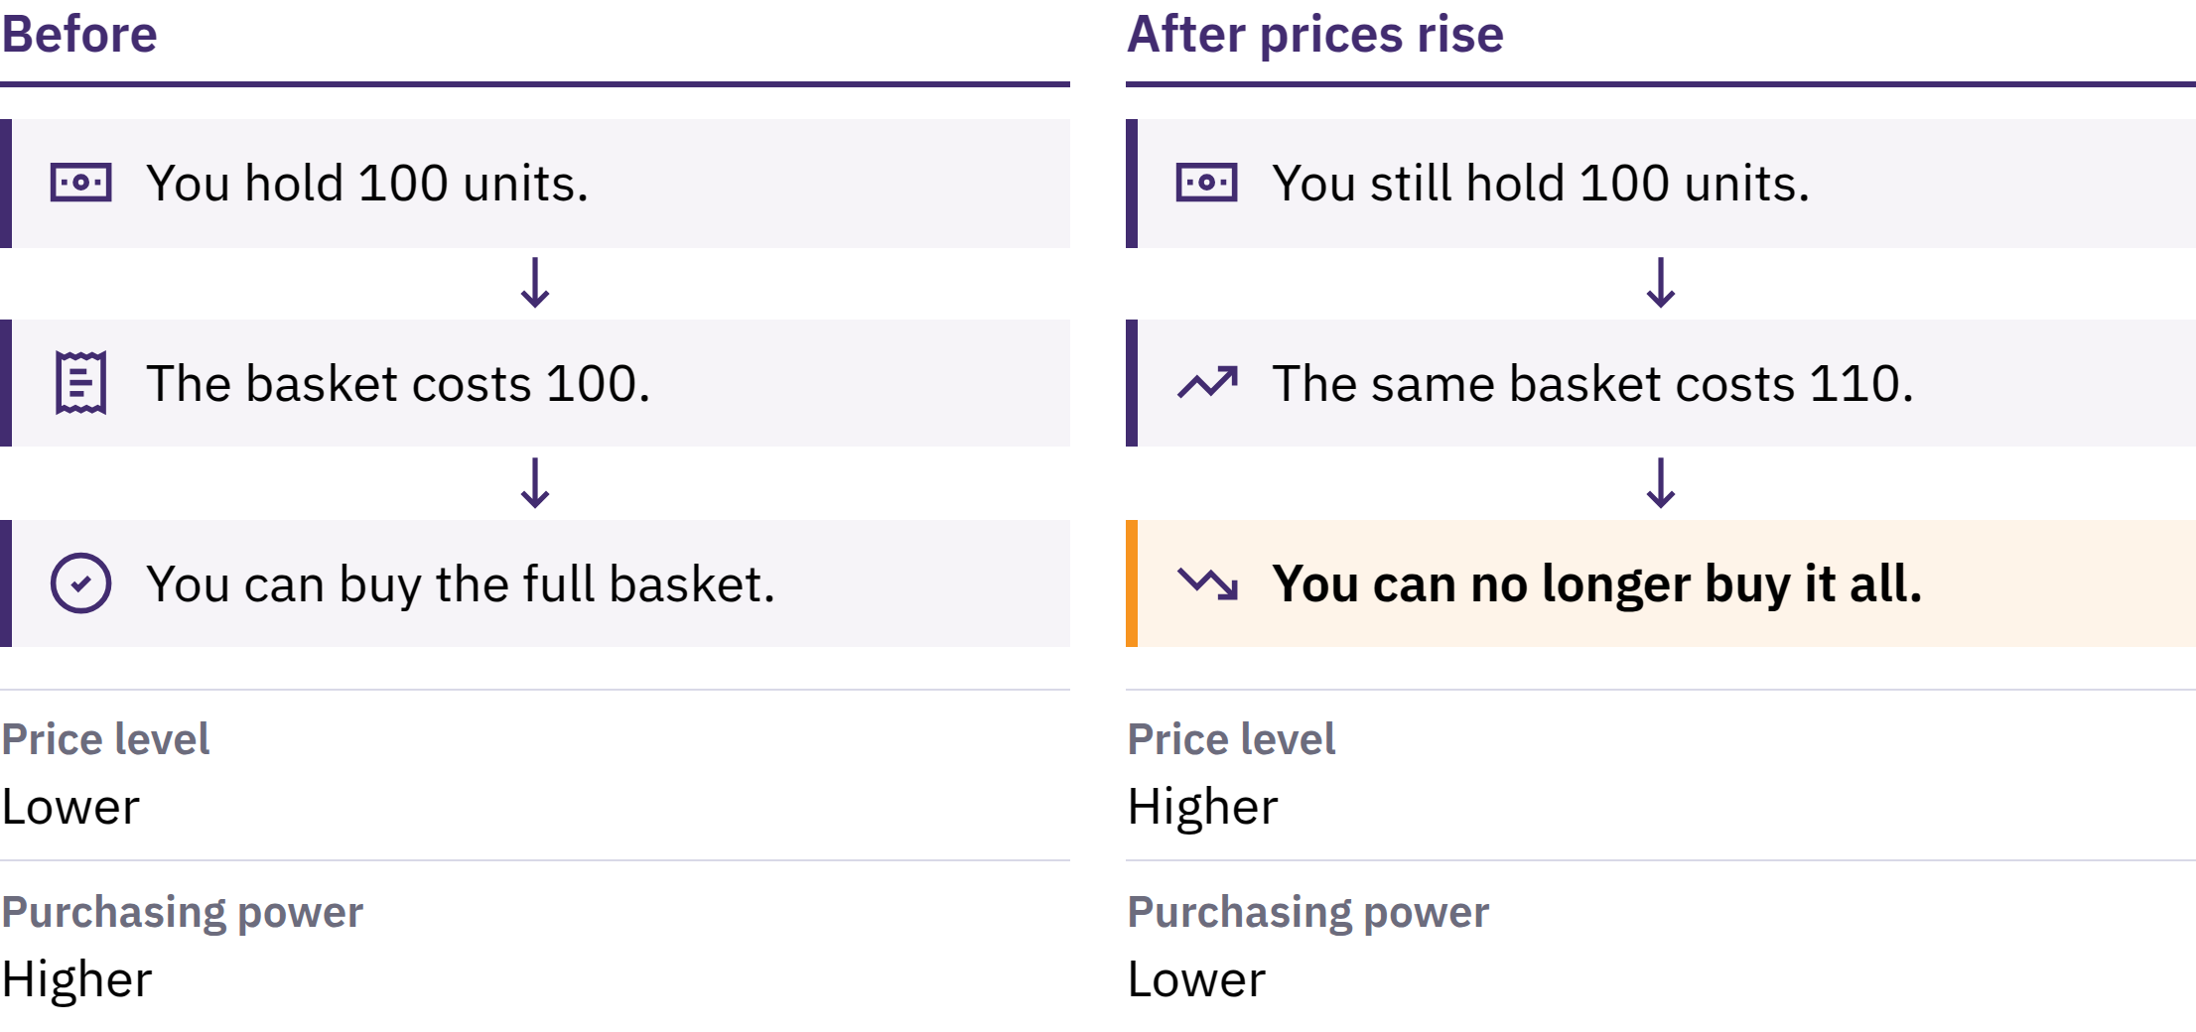
Inflation and Purchasing Power
Introduction to Bitcoin · What's Wrong With Our Money?
Notes:
Price inflation is a sustained rise in the general level of prices. Its other side is purchasing power: how much a unit of money can buy. If a basket of basic goods rises from 100 units of currency to 110, the same 100 units no longer buy the full basket.

Slide 16

Inflation and Purchasing Power
Introduction to Bitcoin · What's Wrong With Our Money?
Notes:
Price inflation is a sustained rise in the general level of prices. Its other side is purchasing power: how much a unit of money can buy. If a basket of basic goods rises from 100 units of currency to 110, the same 100 units no longer buy the full basket.

Slide 17

Many Causes, One Choice
Expansion of money and credit
Supply disruptions and changes in demand
A weakening currency, taxes, production costs
One cause is a choice, not an accident: in a fiat system, a small number of institutions can increase the supply of money and credit and change its rules.
Introduction to Bitcoin · What's Wrong With Our Money?
Notes:
Economists debate how much each cause matters. Keep the focus on the one cause that is a decision rather than an accident.

Slide 18
Scarcity and Value
The original Mona Lisa is worth more than any copy: it is the only one
Scarcity alone does not create value, but when people want something, its supply matters
When the supply of money grows faster than what it can buy, each unit tends to buy less
Introduction to Bitcoin · What's Wrong With Our Money?

Slide 19
Inflation Does Not Affect Everyone Equally
Cash and savings may lose purchasing power
Owners of assets that rise in price may be partly protected
Wages and prices adjust at different speeds
A bank balance is different from cash in your hand: it is the bank's promise to pay you. That promise usually holds, but it depends on the bank and on the rules around it.
Introduction to Bitcoin · What's Wrong With Our Money?

Slide 20
Try It: A Purchasing-Power Check
Choose one ordinary item: bread, transport, or phone credit
Write down its price today
Ask someone what it cost several years ago, and check a reliable record if you can
Did incomes rise at the same rate? What else might explain the change?
Introduction to Bitcoin · What's Wrong With Our Money?
Notes:
This works without any device or internet. Compare answers across the group, and remind learners that one price is not the whole inflation measure.

Slide 21
Fiat Money Works, With Risks
Convenient payments, flexible credit, tools for responding to crises
But its supply and rules can change, and the people who use it have little say
This is why people look for alternatives, and why Bitcoin was created.
Introduction to Bitcoin · What's Wrong With Our Money?

Slide 22

What is Bitcoin?
Digital money that is decentralized, has a limited supply, and can be sent peer to peer without a bank's permission.

Slide 23
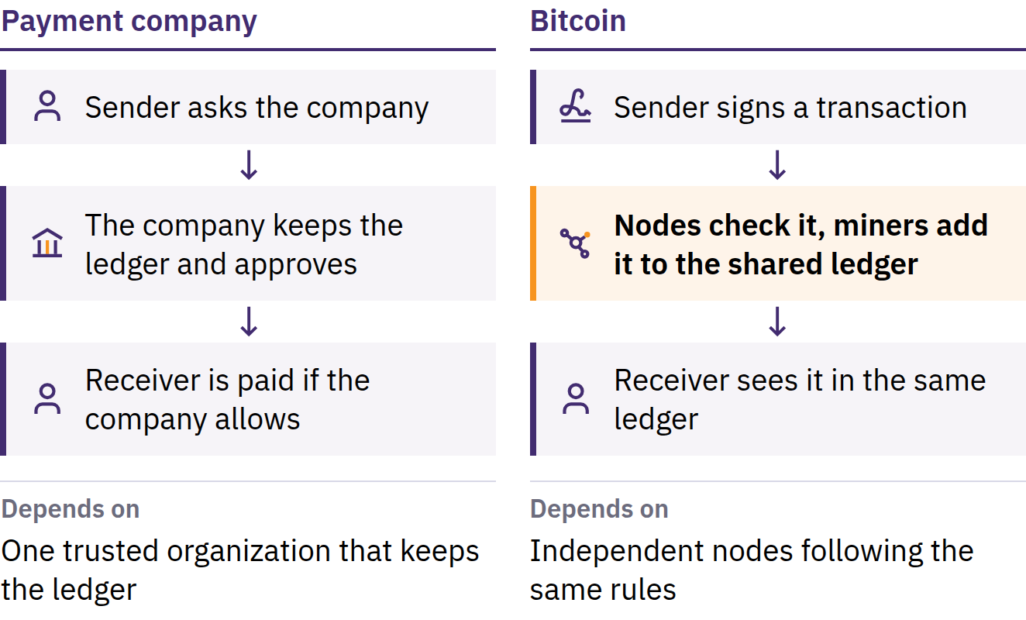
The Double-Spend Problem
31 October 2008: Satoshi Nakamoto publishes Bitcoin: A Peer-to-Peer Electronic Cash System. January 2009: the network starts.
Introduction to Bitcoin · What is Bitcoin?
Notes:
Before Bitcoin, sending money online always depended on a trusted organization: a bank or payment company that kept the ledger, approved accounts, and could delay, block, or reverse a payment. Digital information is easy to copy: if a digital coin could be spent twice, it could not work as money. This is the double-spend problem. Satoshi Nakamoto is a person or group using that name.

Slide 24
Decentralized · Limited Supply · Peer to Peer
Decentralized: no central office creates accounts, changes balances, or approves who joins
Limited supply: there will never be more than 21 million bitcoin
Peer to peer: send to anyone, anywhere, without asking a central authority
No company can freeze bitcoin that you control yourself. The other side of that freedom is responsibility: a valid transaction is usually impossible to reverse, and there is no help desk for the network.
Introduction to Bitcoin · What is Bitcoin?
Notes:
Decentralized does not mean everyone has equal influence. It means no single participant can change the ledger or the monetary rules for everyone.

Slide 25
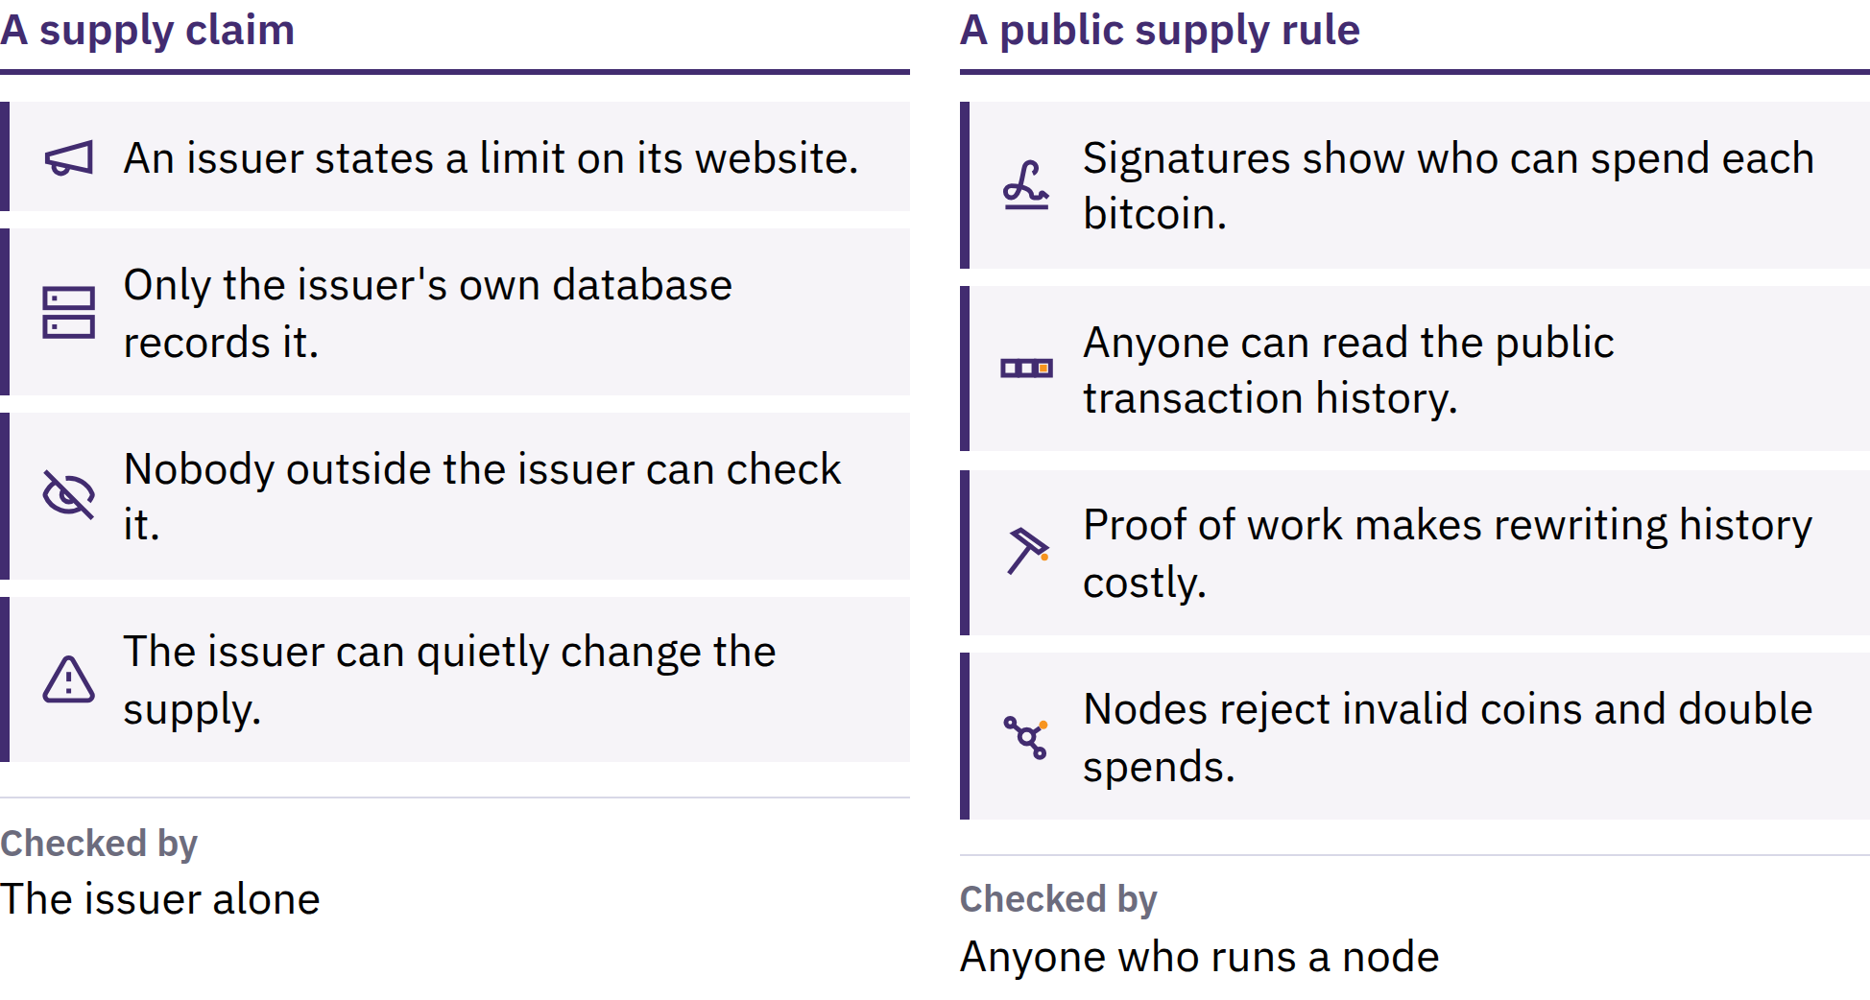
A Limit Anyone Can Check
Introduction to Bitcoin · What is Bitcoin?
Notes:
New bitcoin are released on a public schedule, and independent computers called nodes reject any block that breaks that rule. The limit is credible because anyone can check it. It is not a law of nature: it holds because participants keep enforcing it. A limited supply does not guarantee that the price will rise; price depends on demand as well as supply.

Slide 26
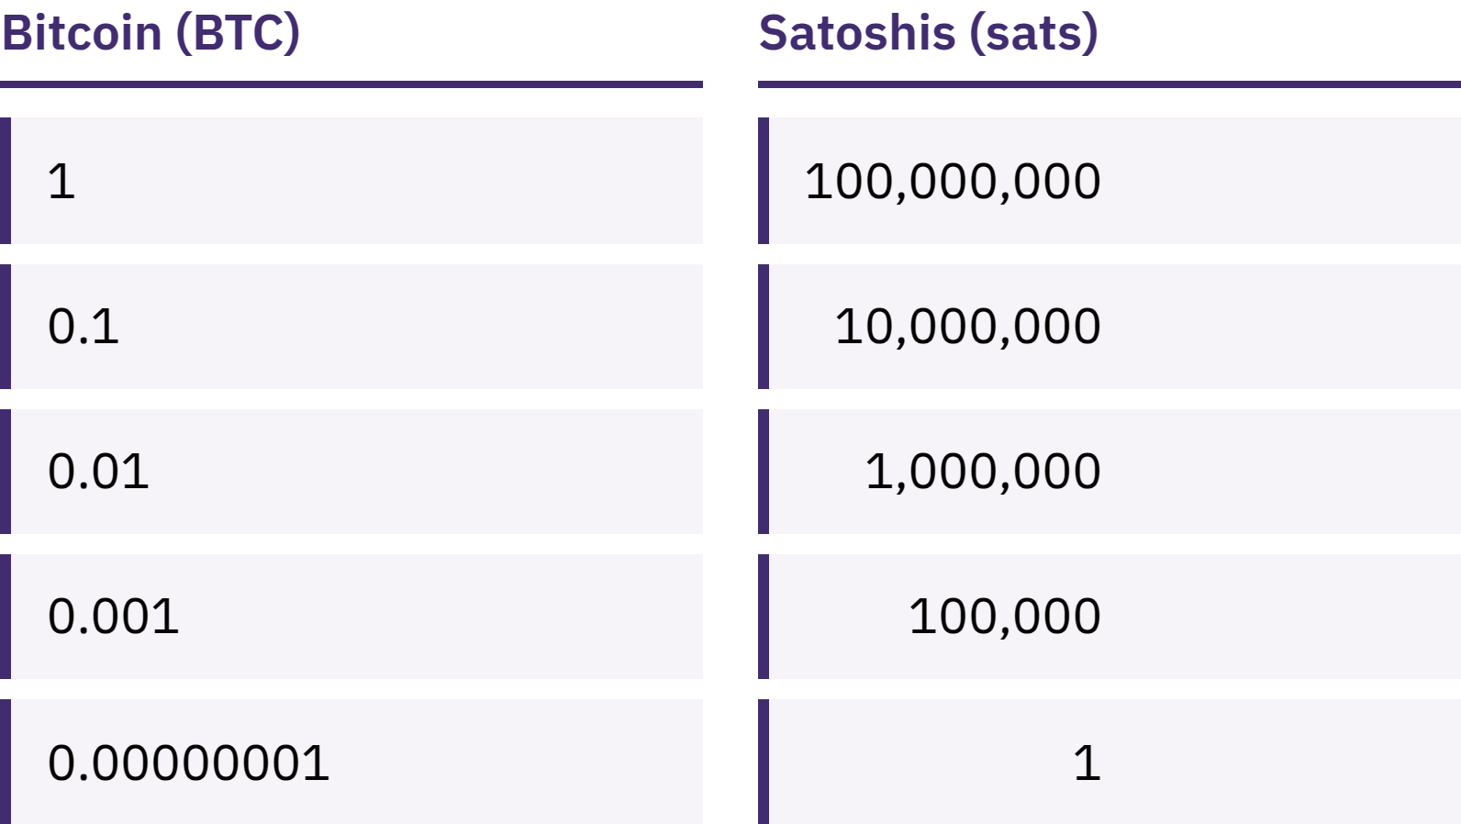
You Don't Need a Whole Bitcoin
One bitcoin divides into 100,000,000 smaller units called satoshis, or sats.
Introduction to Bitcoin · What is Bitcoin?
Notes:
Owning 100,000 sats and owning 0.001 bitcoin describe the same amount. Address the misconception that Bitcoin is out of reach because one bitcoin is expensive.

Slide 27
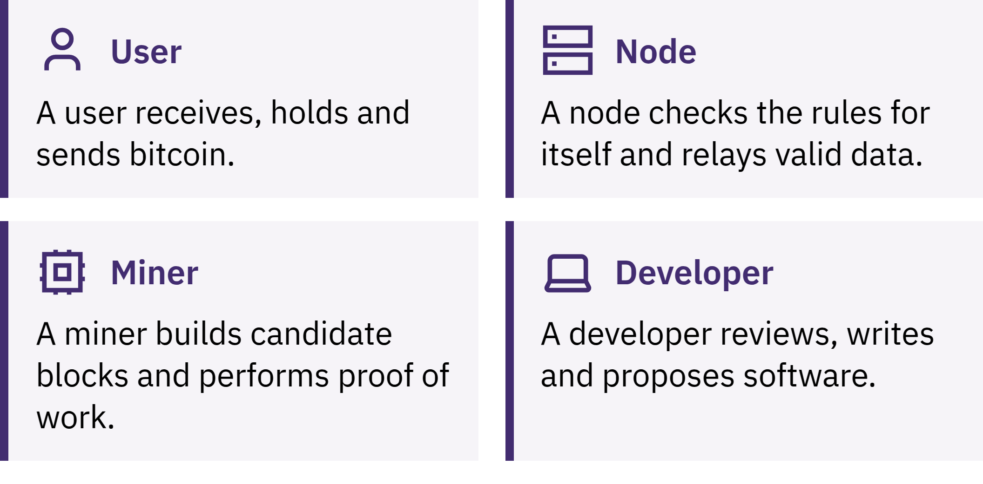
Who Keeps Bitcoin Running?
Introduction to Bitcoin · What is Bitcoin?
Notes:
Users send, receive, and hold bitcoin; nodes check every transaction and block against the rules; miners compete to add a new block to the record about every ten minutes. That record, the blockchain, is public and very costly to rewrite. A note on spelling: Bitcoin with a capital B usually means the network or the system; bitcoin with a lowercase b means the money itself.

Slide 28

Who Keeps Bitcoin Running?
Introduction to Bitcoin · What is Bitcoin?
Notes:
Users send, receive, and hold bitcoin; nodes check every transaction and block against the rules; miners compete to add a new block to the record about every ten minutes. That record, the blockchain, is public and very costly to rewrite. A note on spelling: Bitcoin with a capital B usually means the network or the system; bitcoin with a lowercase b means the money itself.

Slide 29
Bitcoin Has Trade-Offs
Its price can change quickly
Mistakes are usually permanent
Acceptance is still limited in many places
Using it safely takes some learning
Bitcoin replaces some trust in institutions with verification and personal responsibility. It does not remove risk.
Introduction to Bitcoin · What is Bitcoin?

Slide 30

How Do You Use Bitcoin?
The first question about any wallet: who controls the keys?

Slide 31
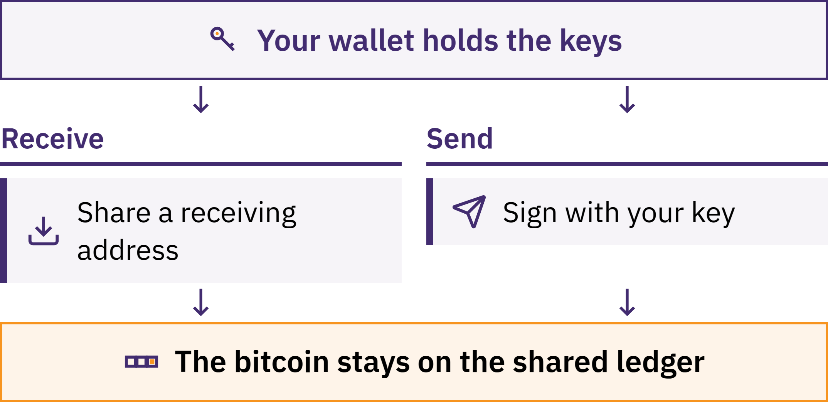
A Wallet Manages Keys
Introduction to Bitcoin · How Do You Use Bitcoin?
Notes:
A Bitcoin wallet is a tool, usually an app, that lets you receive, check, and send bitcoin. Your bitcoin is not stored inside your phone: it is recorded on the blockchain. The wallet manages the keys that let you prove it is yours and authorize a payment.

Slide 32
Who Actually Holds Your Bitcoin?
Self-custodial: you control the keys
Nobody can recover your bitcoin for you if you lose the seed phrase and the device
Custodial: a company holds the keys, a bit like a bank
Your balance is its promise to pay; it can limit withdrawals, freeze an account, be hacked, or shut down
Choosing custody is not a test of worth. What matters is knowing which kind you are using and what you are trusting.
Introduction to Bitcoin · How Do You Use Bitcoin?

Slide 33

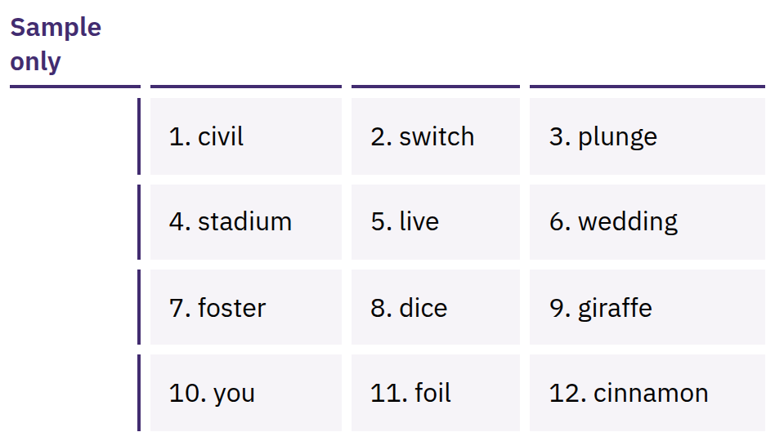
Your Seed Phrase Is Full
Access
An ordered list of words, often 12 or 24, that can recreate your keys. Anyone who has it can take your bitcoin.
Introduction to Bitcoin · How Do You Use Bitcoin?
Notes:
The seed phrase is not only a backup: it is full access. Write it down accurately on paper when you create the wallet; keep it offline, private, and somewhere it will not be lost or damaged. Never photograph it, email it, store it in cloud notes, send it in a message, or type it into a website. The words shown are a sample only; never show or collect a real seed phrase.

Slide 34

Not your keys, not your coins.
Introduction to Bitcoin · How Do You Use Bitcoin?

Slide 35

Before You Use Any Wallet
Keys: who controls them, you or a company?
Recovery: what if your phone is lost or the company disappears?
Source: official website or app store listing, not a link someone sent you?
Code: open source and actively maintained? (Not proof of safety on its own.)
Costs: fees for sending, receiving, or withdrawing?
Payments: on-chain, Lightning, or both?
Introduction to Bitcoin · How Do You Use Bitcoin?
Notes:
My First Bitcoin does not recommend specific wallets. Tools, fees, and owners change, and what suits one community may not suit another. Point learners to a trusted local educator.

Slide 36
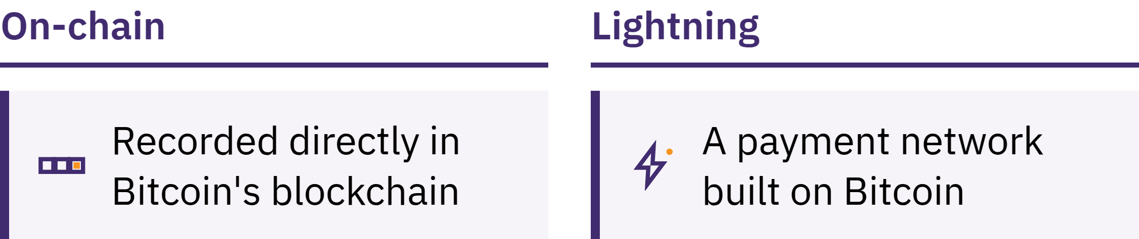
On-Chain and Lightning
On-chain: recorded directly in the blockchain
Lightning: a payment network built on top of Bitcoin for fast, small, frequent payments, such as buying a coffee
A Lightning wallet can also be custodial or self-custodial
Introduction to Bitcoin · How Do You Use Bitcoin?

Slide 37
Three Rules While You Learn
Learn first. Do not act because of excitement, fear, or pressure.
Start small. Try unfamiliar tools with an amount you can afford to lose.
Don't Trust, Verify. Check the person, the payment method, the address, and the amount.
Share receiving information, never secrets
An address or a payment request can be shared. A seed phrase or private key must never be shared. No legitimate educator, wallet company, or support worker will ever ask for it.
Introduction to Bitcoin · How Do You Use Bitcoin?

Slide 38

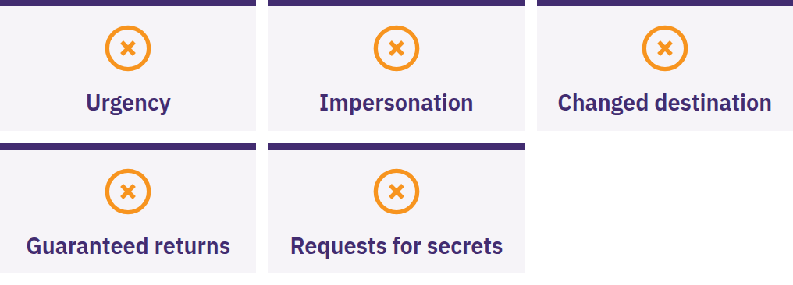
Stop, Share Nothing, Send
Nothing
Stop if someone creates urgency or secrecy, promises guaranteed returns, asks you to send bitcoin first, or asks for your seed phrase. Pause. Share nothing. Send nothing. Then check through a source you already know.
Introduction to Bitcoin · How Do You Use Bitcoin?

Slide 39

What's Next?
This is just the beginning.

Slide 40
Four Takeaways
Money depends on rules and trust. Fiat supply and rules are set by a small number of institutions.
Bitcoin offers different rules. A public, limited supply, open to anyone, that can be checked rather than trusted.
Safety comes first. Learn first, start small, verify everything, never share your seed phrase.
This is just the beginning. One safe next step is enough.
A moment to reflect
Go back to the five questions at the start. What would you answer now?
Introduction to Bitcoin · What's Next?

Slide 41

The Bitcoin Diploma
The next step. Its four modules take you further:
Understanding money
How Bitcoin works
Using Bitcoin safely
Bitcoin in your community
Stay curious, keep asking questions, and learn more at myfirstbitcoin.org.
We look forward to seeing you in our next cohort.
Introduction to Bitcoin · What's Next?

Slide 42


