Slide 1

Kope 26.10
Mawu
Oyamba
pa Bitcoin
Buku Lotsogolera Oyamba Kumene

Slide 2

N’chifukwa Chiyani Ndalama Zili Zofunika?
Timagwiritsa ntchito ndalama tsiku lililonse, koma sitimakonda kufunsa kuti zimagwira ntchito bwanji.
Notes:
Gwero: My First Bitcoin, Chiyambi cha Bitcoin, Buku Lotsogolera Oyamba, kope la 26.10. Zasinthidwa motsatira chilolezo cha Creative Commons Attribution-ShareAlike 4.0 International; zithunzi zowonetserazi zimagwiritsa ntchito chilolezo chomwechi. Zithunzi zowonetserazi ndi chida chothandizira mphunzitsi pofotokoza, chozikidwa pa mafunso asanu ndi limodzi a m’bukuli. Sinthani zitsanzo, liwiro la kuphunzitsa, ndi njira yofotokozera kuti zigwirizane ndi anthu a m’dera lanu, koma musasinthe tanthauzo ndi mauthenga oteteza anthu. Palibe nthawi yokhazikika yophunzirira yomwe ikunenedwa.

Slide 3

Anthu Ambiri Saimapo Kuti
Aganizire za Ndalama
Osati kuipeza, osati kuigwiritsa ntchito, koma kuganizira kuti ndi chiyani komanso mmene imagwirira ntchito.
Mawu Oyamba pa Bitcoin · N’chifukwa Chiyani Ndalama Zili Zofunika?
Notes:
Yambani ndi chithunzichi: aliyense wotizungulira amagwiritsa ntchito ndalama popanda kudzifunsa za izo. Funsani gulu kuti ndi liti pamene anaganizirapo komaliza za kumene ndalama zimachokera.

Slide 4

Mafunso Asanu Oyambira
N’chifukwa chiyani anthu amafunika ndalama?
N’chiyani chimapangitsa chinthu kukhala ndalama?
Ndani angathe kupanga kapena kulamulira ndalama zimene mumagwiritsa ntchito?
N’chifukwa chiyani ndalama zimene mumagwiritsa ntchito zili ndi mtengo?
Kodi ndalama zanu zimagulabe zinthu zochuluka mofanana ndi kale?
Sungani mayankho anu
Lembani yankho lalifupi pa funso lililonse. Mudzabwereranso ku mayankhowo pamapeto pake.
Mawu Oyamba pa Bitcoin · N’chifukwa Chiyani Ndalama Zili Zofunika?
Notes:
Apatseni ophunzira mphindi zochepa kuti alembe. Musapemphe aliyense kuti afotokoze za chuma chake. Mayankho amenewa adzabweranso pa silaidi ya mfundo zofunika kukumbukira yakuti “Chotsatira N’chiyani?”

Slide 5

Zoona Kapena Maganizo?
Mfundo yotsimikizika: "Ndalama ya pepala iyi imalandiridwa polipira misonkho." Izi zikhoza kufufuzidwa kuti zitsimikizidwe.
Maganizo: "Uwu ndi mtundu wabwino kwambiri wa ndalama." Izi zimafunika miyezo yoweruzira ndi umboni.
Bukuli ndi lophunzitsira kokha. Silipereka upangiri pa nkhani za zachuma, kuika ndalama, zamalamulo, kapena zamisonkho, ndipo silikuuzani kugula, kugulitsa, kapena kusunga chilichonse.
Mawu Oyamba pa Bitcoin · N’chifukwa Chiyani Ndalama Zili Zofunika?
Notes:
Pitirizani kusiyanitsa zimenezi pa phunziro lonseli. Pakabuka mfundo inayake, funsani kuti: kodi tingaitsikizire, kapena ikufunika miyezo ndi umboni?

Slide 6

Kodi Ndalama N’chiyani?
Ndalama ndi chida chosinthanitsira zinthu.

Slide 7

Kusinthanitsa Katundu ndi Kugwirizana kwa Zofuna za Mbali
Ziwiri
Anthu onse awiri ayenera kufuna chimene winayo ali nacho, pa nthawi imodzi komanso pa kuchuluka koyenera.
Mawu Oyamba pa Bitcoin · Kodi Ndalama N’chiyani?
Notes:
Gwiritsani ntchito chitsanzo cha m’bukhu lophunzitsira: mumalima mpunga ndipo mukufuna nsapato, koma wopanga nsapato akufuna mafuta ophikira, osati mpunga. Akatswiri a zachuma amatcha zimenezi kugwirizana kwa zofuna za anthu awiri, pamene aliyense akufuna chimene mnzakeyo ali nacho.

Slide 8
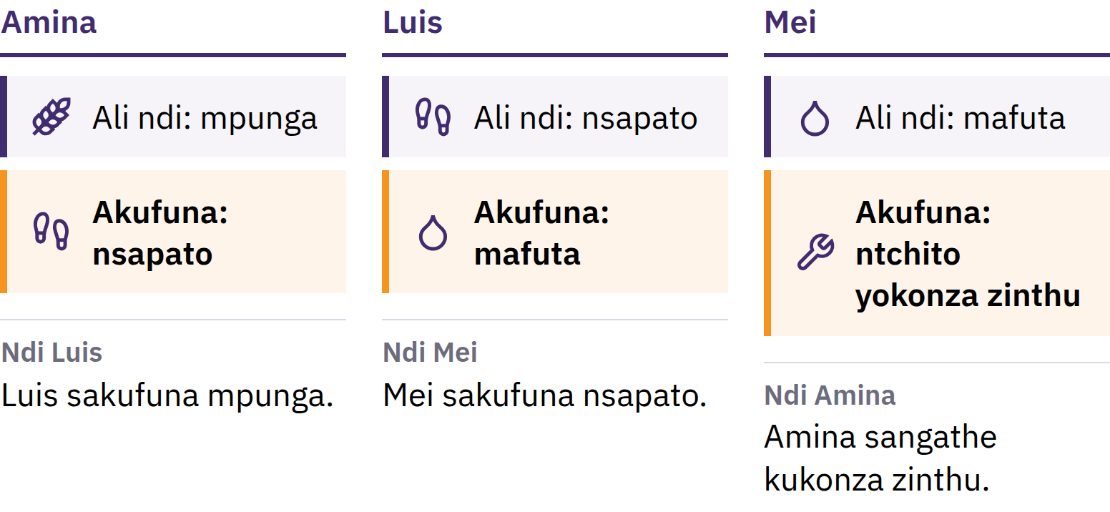
Kusinthanitsa Katundu ndi Kugwirizana kwa Zofuna za Mbali
Ziwiri
Anthu onse awiri ayenera kufuna zimene winayo ali nazo, pa nthawi yomweyo komanso m'miyeso yoyenera.
Mawu Oyamba pa Bitcoin · Kodi Ndalama N’chiyani?
Notes:
Gwiritsani ntchito chitsanzo cha m’bukhu lophunzitsira: mumalima mpunga ndipo mukufuna nsapato, koma wopanga nsapato akufuna mafuta ophikira, osati mpunga. Akatswiri a zachuma amatcha zimenezi kugwirizana kwa zofuna za anthu awiri, pamene aliyense akufuna chimene mnzakeyo ali nacho.

Slide 9

Ndalama Ndi Chida Chosinthanitsira Zinthu
Palibe amene amafuna ndalama chifukwa cha ndalamazo zokha. Ndalama n’zothandiza chifukwa anthu ena amazilandira, poyembekezera kuti enanso adzazilandira m’tsogolo.
Mawu Oyamba pa Bitcoin · Kodi Ndalama N’chiyani?
Notes:
Ndalama ya pepala ndi pepala chabe. Ndalama zimathetsa vuto la kusinthanitsa katundu ndi katundu polekanitsa kugulitsa ndi kugula: mumagulitsa mpunga wanu kwa munthu mmodzi n’kugula nsapato kwa munthu wina. Izi n’zimene zimasiyanitsa kugwiritsa ntchito ndalama ndi kusinthanitsa katundu ndi katundu.

Slide 10

Zinthu Zitatu Zimene Ndalama
Zimachita
Njira yosinthanitsira zinthu: anthu amazilandira ngati malipiro
Muyeso wowerengera mtengo: mitengo imafotokozedwa pogwiritsa ntchito ndalamazo
Njira yosungira mtengo: imasamutsa mtengo kuchokera lero kupita m'tsogolo
Palibe ndalama zomwe zimasunga mtengo wake mosasinthika, koma mitundu ina ya ndalama imataya mphamvu yogulira zinthu pang'onopang'ono kuposa ina.
Mawu Oyamba pa Bitcoin · Kodi Ndalama N’chiyani?

Slide 11

Kuchokera ku Zigoba za
Nkhono Kupita ku Pepala
Zigoba za nkhono, mchere, mikanda, ziweto, mkuwa, siliva, golide
Zitsulo zamtengo wapatali: zosowa, zokhalitsa, zovomerezeka m'madera ambiri
Mapepala otsimikizira ufulu wolandira kuchuluka kwa chitsulo kotchulidwa
Miyezo ya golide: gawo la ndalama lolumikizidwa ndi golide mwalamulo
Malamulowo ankasiyana malinga ndi malo ndi nthawi.
Mawu Oyamba pa Bitcoin · Kodi Ndalama N’chiyani?

Slide 12
Ndalama za Fiat
1971: dziko la United States linathetsa kusinthanitsa mwalamulo madola ndi golide kwa maboma akunja ndi mabanki akuluakulu a mayikowo
Masiku ano ndalama za mayiko ambiri ndi ndalama za fiat: zimaperekedwa ndi chilolezo cha boma, ndipo sizingawomboledwe ndi golide kapena chinthu china chilichonse chogulitsidwa
Fiat ndi liwu la Chilatini lotanthauza kuti "zichitike", ndipo nthawi zambiri limamveka ngati "mwa lamulo"
Zimavomerezedwa chifukwa anthu, mabizinesi, mabanki, ndi maboma amazigwiritsa ntchito; malamulo amazipatsa udindo wa ndalama zovomerezeka zolipirira ngongole ndipo amafuna kuti zigwiritsidwe ntchito polipira misonkho
Mawu Oyamba pa Bitcoin · Kodi Ndalama N’chiyani?

Slide 13

Tinachoka pa ndalama
zochirikizidwa ndi chinthu china,
n’kupita pa ndalama
zochirikizidwa ndi kukhulupirira
munthu wina.
Mawu Oyamba pa Bitcoin · Kodi Ndalama N’chiyani?

Slide 14

Kodi Ndalama Zathu Zili ndi Vuto Lanji?
Anthu akamva mawu akuti kukwera kwa mitengo, nthawi zambiri amaganiza za mitengo ya zinthu ikukwera.

Slide 15
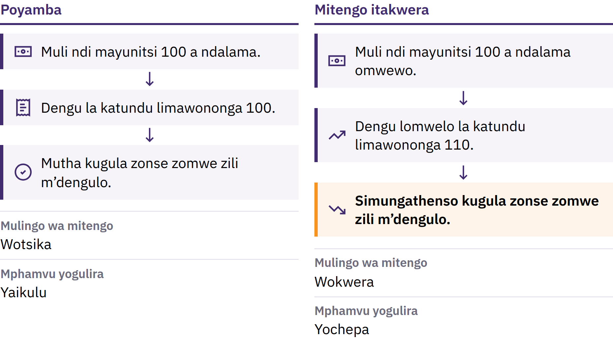
Kukwera kwa Mitengo ndi Mphamvu Yogulira
Mawu Oyamba pa Bitcoin · Kodi Ndalama Zathu Zili ndi Vuto Lanji?
Notes:
Kukwera kwa mitengo ndi kuwonjezeka kosalekeza kwa mitengo ya katundu ndi ntchito pa mlingo wamba. Mbali yake ina ndi mphamvu yogulira: kuchuluka kwa zinthu zimene gawo limodzi la ndalama lingagule. Ngati mtengo wa dengu la zinthu zofunika pa moyo ukwera kuchokera pa magawo 100 a ndalama kufika pa 110, magawo 100 omwewo sangathenso kugula zonse za m’dengulo.

Slide 16

Kukwera kwa Mitengo ndi Mphamvu Yogulira
Mawu Oyamba pa Bitcoin · Kodi Ndalama Zathu Zili ndi Vuto Lanji?
Notes:
Kukwera kwa mitengo ndi kuwonjezeka kosalekeza kwa mitengo ya katundu ndi ntchito pa mlingo wamba. Mbali yake ina ndi mphamvu yogulira: kuchuluka kwa zinthu zimene gawo limodzi la ndalama lingagule. Ngati mtengo wa dengu la zinthu zofunika pa moyo ukwera kuchokera pa magawo 100 a ndalama kufika pa 110, magawo 100 omwewo sangathenso kugula zonse za m’dengulo.

Slide 17

Zifukwa Zambiri, Chisankho
Chimodzi
Kuwonjezeka kwa ndalama ndi ngongole
Kusokonekera kwa kaperekedwe ka katundu ndi kusintha kwa kufunika kwake
Ndalama zomwe zikuchepa mphamvu yogulira, misonkho, ndalama zopangira katundu
Chifukwa chimodzi chimachokera pa chisankho, osati mwangozi: m’dongosolo la ndalama za fiat, mabungwe ochepa angathe kuwonjezera kuchuluka kwa ndalama ndi ngongole komanso kusintha malamulo a dongosololi.
Mawu Oyamba pa Bitcoin · Kodi Ndalama Zathu Zili ndi Vuto Lanji?
Notes:
Akatswiri a zachuma amakambirana za kufunika kwa chifukwa chilichonse. Ikani chidwi chanu pa chifukwa chimodzi chimene chimachokera pa chisankho, osati pa zinthu zongochitika mwangozi.

Slide 18
Kuchepa ndi Mtengo
Chojambula choyambirira cha Mona Lisa chili ndi mtengo woposa wa kope lililonse: ndi chokhacho
Kuchepa kwa chinthu pakokha sikuchipatsa mtengo, koma anthu akamafuna chinthucho, kuchuluka kwake kumakhala kofunika
Ndalama zikachuluka mofulumira kuposa zinthu zimene zingagulidwe nazo, nthawi zambiri gawo lililonse la ndalamazo limagula zinthu zochepa
Mawu Oyamba pa Bitcoin · Kodi Ndalama Zathu Zili ndi Vuto Lanji?

Slide 19
Kukwera kwa Mitengo Sikukhudza Aliyense Mofanana
Ndalama za m'manja ndi zosungidwa zingachepe mphamvu yogulira zinthu
Eni katundu amene mtengo wake ukukwera angatetezeke pang'ono
Malipiro ndi mitengo zimasintha pa liwiro losiyanasiyana
Ndalama zimene zili mu akaunti yanu ya kubanki n'zosiyana ndi ndalama zimene muli nazo m'manja: ndi lonjezo la banki lakuti idzakulipirani. Nthawi zambiri lonjezo limeneli limakwaniritsidwa, koma zimadalira bankiyo ndi malamulo amene imatsatira.
Mawu Oyamba pa Bitcoin · Kodi Ndalama Zathu Zili ndi Vuto Lanji?

Slide 20
Yesani: Kuwunika Mphamvu Yogula
Sankhani chinthu chimodzi cha tsiku ndi tsiku: buledi, mayendedwe, kapena mayunitsi a foni
Lembani mtengo wake wa lero
Funsani munthu wina kuti chinkagula ndalama zingati zaka zingapo zapitazo, ndipo onani zolemba zodalirika ngati mungathe
Kodi ndalama zimene anthu amapeza zinakwera pamlingo womwewo? Nanga ndi chiyani china chimene chingafotokoze kusinthaku?
Mawu Oyamba pa Bitcoin · Kodi Ndalama Zathu Zili ndi Vuto Lanji?
Notes:
Izi zimagwira ntchito popanda chipangizo chilichonse kapena intaneti. Yerekezerani mayankho a anthu onse m’gululo, ndipo akumbutseni ophunzira kuti mtengo wa chinthu chimodzi si muyeso wonse wa kukwera kwa mitengo.

Slide 21
Ndalama za fiat zimagwira ntchito, koma zili ndi zoopsa zake
Kulipira mosavuta, ngongole zosinthika mogwirizana ndi zosowa, njira zothanirana ndi mavuto aakulu
Koma kuchuluka kwake ndi malamulo ake zingasinthe, ndipo anthu amene amaigwiritsa ntchito alibe mphamvu zambiri pa zisankho zake
N’chifukwa chake anthu amafunafuna njira zina, komanso chifukwa chake Bitcoin inapangidwa.
Mawu Oyamba pa Bitcoin · Kodi Ndalama Zathu Zili ndi Vuto Lanji?

Slide 22

Kodi Bitcoin ndi chiyani?
Ndalama za digito zomwe sizilamulidwa ndi bungwe limodzi, zili ndi malire pa kuchuluka kwake, ndipo zingatumizidwe kuchokera kwa munthu wina kupita kwa wina popanda chilolezo cha banki.

Slide 23
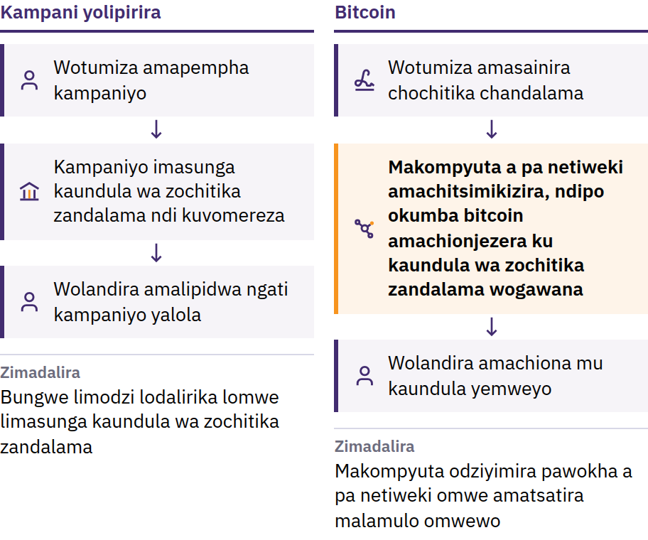
Vuto la Kugwiritsa Ntchito Ndalama Zomwezo Kawiri
31 Okutobala 2008: Satoshi Nakamoto amasindikiza Bitcoin: Dongosolo la Ndalama Zamagetsi Lochokera kwa Munthu Kupita kwa Munthu. Januwale 2009: netiweki imayamba kugwira ntchito.
Mawu Oyamba pa Bitcoin · Kodi Bitcoin ndi chiyani?
Notes:
Bitcoin isanabwere, kutumiza ndalama pa intaneti nthawi zonse kunkadalira bungwe lodalirika: banki kapena kampani yoyendetsa malipiro imene inkasunga buku la zolemba za ndalama, kuvomereza maakaunti, ndipo inkatha kuchedwetsa, kuletsa, kapena kubweza malipiro. Uthenga wa digito ndi wosavuta kukopera: ngati khobidi la digito likanatha kugwiritsidwa ntchito kawiri, silikanatha kugwira ntchito ngati ndalama. Ili ndi vuto la kugwiritsa ntchito ndalama zomwezo kawiri. Satoshi Nakamoto ndi munthu kapena gulu limene limagwiritsa ntchito dzinali.

Slide 24
Yopanda Ulamuliro Wapakati · Kuchuluka Kwake Kuli ndi
Malire · Munthu kwa Munthu
Zopanda ulamuliro wapakati: palibe ofesi yapakati imene imatsegula maakaunti, kusintha ndalama zotsala m'maakaunti, kapena kuvomereza amene angalowe
Kuchuluka kuli ndi malire: sipadzakhala bitcoin zoposa 21 miliyoni
Munthu ndi munthu: tumizani kwa aliyense, kulikonse, popanda kupempha chilolezo ku ulamuliro wapakati
Palibe kampani imene ingaletse kugwiritsa ntchito bitcoin zimene mukuzilamulira nokha. Ufulu umenewu umabweranso ndi udindo: kutumiza ndalama kovomerezeka nthawi zambiri sikungabwezedwe, ndipo netiwekiyi ilibe malo opempherako thandizo.
Mawu Oyamba pa Bitcoin · Kodi Bitcoin ndi chiyani?
Notes:
Kusakhala ndi ulamuliro wapakati sikutanthauza kuti aliyense ali ndi mphamvu zofanana zokhudza zisankho. Kumatanthauza kuti palibe wotenga nawo mbali mmodzi amene angasinthe kaundula wa zochitika za ndalama kapena malamulo a ndalama kwa aliyense.

Slide 25
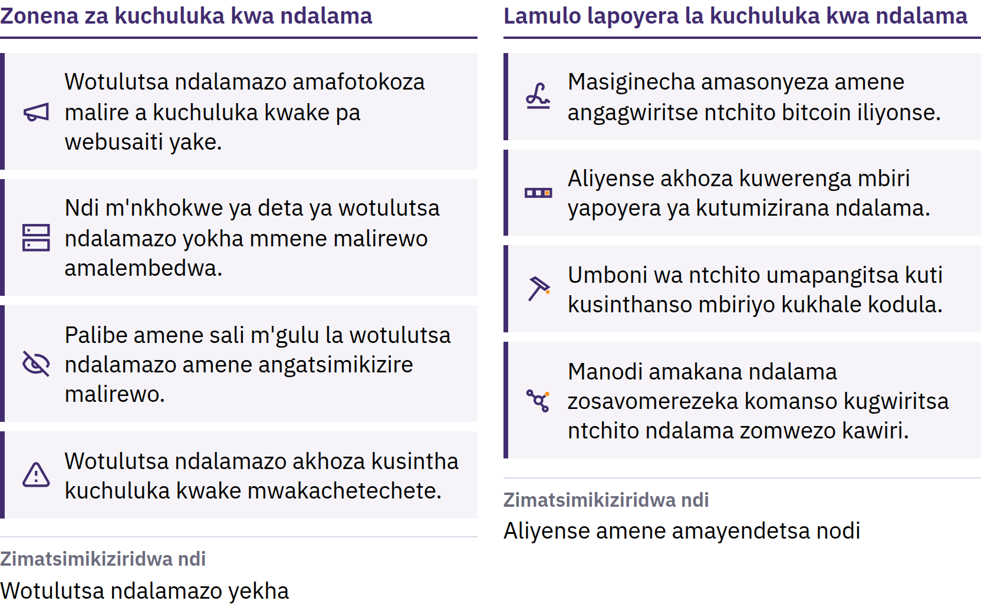
Malire Omwe Aliyense Angathe Kutsimikizira
Mawu Oyamba pa Bitcoin · Kodi Bitcoin ndi chiyani?
Notes:
Ma bitcoin atsopano amatulutsidwa motsatira ndondomeko yodziwika kwa anthu onse, ndipo makompyuta odziyimira pawokha otchedwa ma node amakana buloko iliyonse yophwanya lamulolo. Malirewa ndi odalirika chifukwa aliyense akhoza kuwatsimikizira. Si lamulo la chilengedwe: amatsatiridwa chifukwa otenga nawo mbali amapitiriza kuonetsetsa kuti akutsatiridwa. Kuchuluka kochepa kwa bitcoin sikutsimikizira kuti mtengo udzakwera; mtengo umadalira kuchuluka kwa zimene anthu akufuna kugula komanso kuchuluka kwa zimene zilipo.

Slide 26
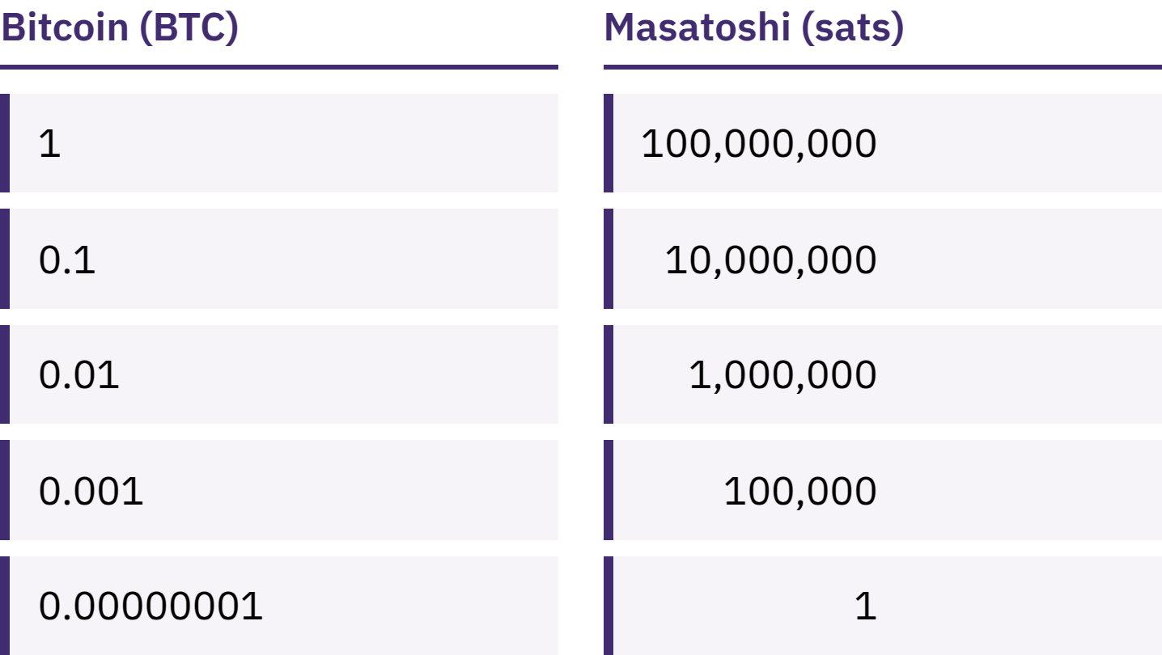
Simufunikira Bitcoin Yathunthu
bitcoin imodzi imagawika m'magawo ang'onoang'ono 100,000,000 otchedwa satoshis, kapena sats.
Mawu Oyamba pa Bitcoin · Kodi Bitcoin ndi chiyani?
Notes:
Kukhala ndi 100,000 sats ndi kukhala ndi 0.001 bitcoin kumatanthauza kukhala ndi ndalama zofanana. Fotokozani kuti maganizo akuti Bitcoin ndi yosatheka kuipeza chifukwa bitcoin imodzi ndi yokwera mtengo ndi olakwika.

Slide 27
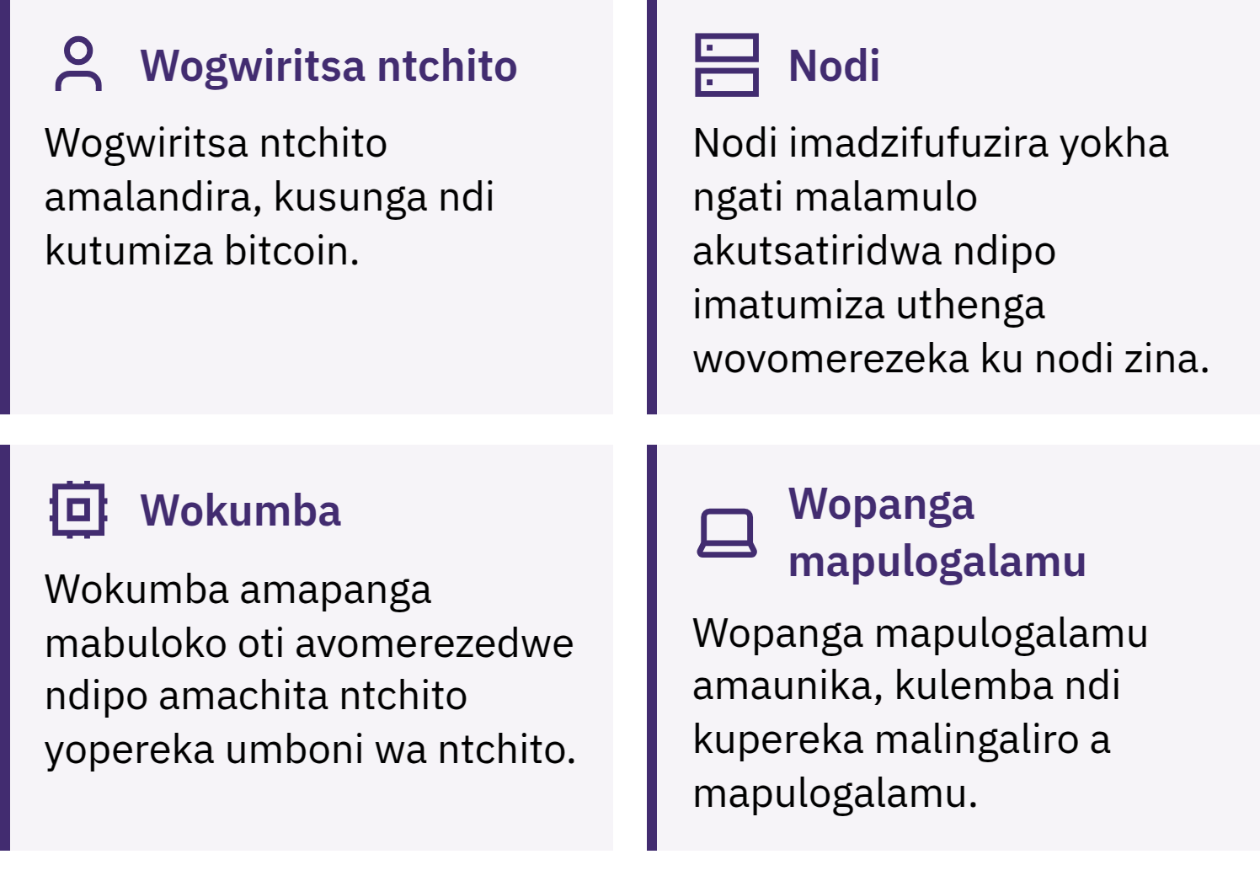
Ndani Amaonetsetsa Kuti Bitcoin Ikugwira Ntchito?
Mawu Oyamba pa Bitcoin · Kodi Bitcoin ndi chiyani?
Notes:
Ogwiritsa ntchito amatumiza, kulandira ndi kusunga bitcoin; ma node amaonetsetsa kuti kutumizirana kulikonse ndi buloko lililonse zikutsatira malamulo; okumba amapikisana kuti awonjezere buloko latsopano pa mbiri pafupifupi mphindi khumi zilizonse. Mbiri imeneyo, yotchedwa blockchain, ndi yoonekera kwa aliyense ndipo kuilembanso kumawononga ndalama zambiri. Mfundo yokhudza kalembedwe: Bitcoin yokhala ndi B wamkulu nthawi zambiri imatanthauza netiweki kapena dongosolo; bitcoin yokhala ndi b wamng’ono imatanthauza ndalamazo zokha.

Slide 28

Ndani Amaonetsetsa Kuti Bitcoin Ikugwira Ntchito?
Mawu Oyamba pa Bitcoin · Kodi Bitcoin ndi chiyani?
Notes:
Ogwiritsa ntchito amatumiza, kulandira ndi kusunga bitcoin; ma node amaonetsetsa kuti kutumizirana kulikonse ndi buloko lililonse zikutsatira malamulo; okumba amapikisana kuti awonjezere buloko latsopano pa mbiri pafupifupi mphindi khumi zilizonse. Mbiri imeneyo, yotchedwa blockchain, ndi yoonekera kwa aliyense ndipo kuilembanso kumawononga ndalama zambiri. Mfundo yokhudza kalembedwe: Bitcoin yokhala ndi B wamkulu nthawi zambiri imatanthauza netiweki kapena dongosolo; bitcoin yokhala ndi b wamng’ono imatanthauza ndalamazo zokha.

Slide 29
Bitcoin Ili ndi Ubwino ndi Zovuta Zake
Mtengo wake ukhoza kusintha mofulumira
Zolakwa nthawi zambiri sizingakonzedwenso
Kuvomerezedwa kwake kudakali kochepa m'malo ambiri
Kuigwiritsa ntchito mosamala kumafuna kuphunzira pang'ono
Bitcoin imalowetsa kutsimikizira ndi udindo wa munthu payekha m'malo mwa kudalira mabungwe pa zinthu zina. Sichotsa chiopsezo.
Mawu Oyamba pa Bitcoin · Kodi Bitcoin ndi chiyani?

Slide 30

Kodi mumagwiritsa ntchito Bitcoin
motani?
Funso loyamba lokhudza waleti iliyonse: ndani amalamulira makiyi?

Slide 31
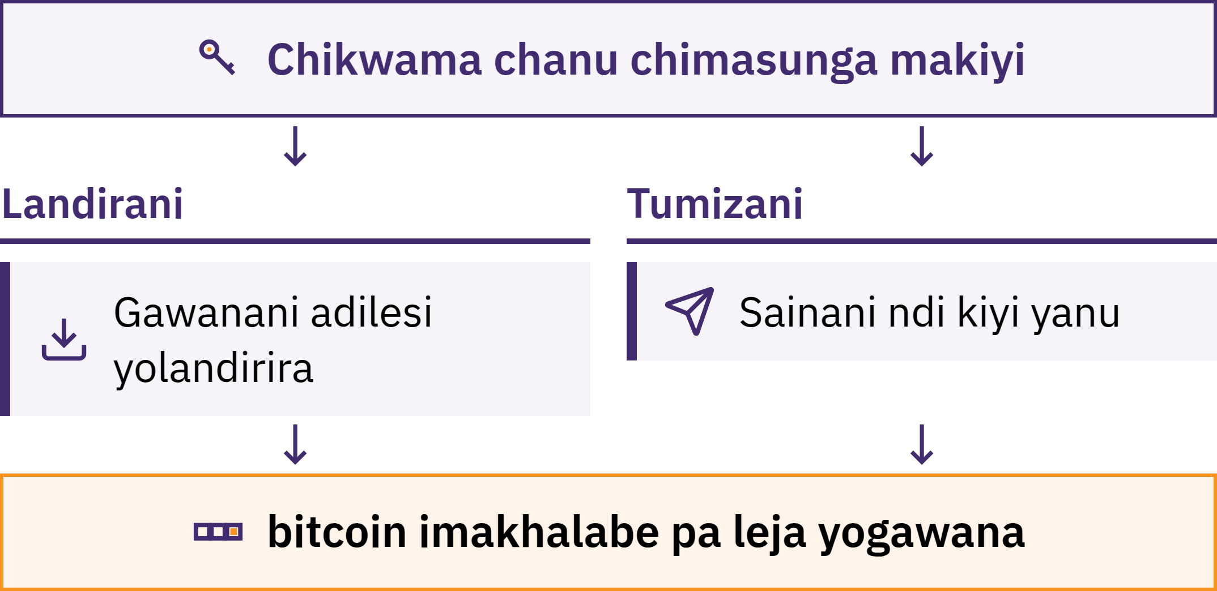
Chikwama Chimasamalira Makiyi
Mawu Oyamba pa Bitcoin · Kodi mumagwiritsa ntchito Bitcoin motani?
Notes:
Chikwama cha Bitcoin ndi chida, nthawi zambiri pulogalamu, chomwe chimakulolani kulandira, kuona kuchuluka kwa bitcoin yanu, ndi kutumiza bitcoin. Bitcoin yanu sisungidwa mkati mwa foni yanu: imalembedwa pa blockchain. Chikwamacho chimasamalira makiyi omwe amakuthandizani kutsimikizira kuti bitcoin ndi yanu komanso kuvomereza kuti malipiro achitike.

Slide 32
Kodi Ndani Kwenikweni Amasunga Bitcoin Yanu?
Kudzisungira nokha: mumayang'anira makiyi nokha
Palibe amene angakubwezeretsereni bitcoin yanu ngati mwataya mawu obwezeretsera ndi chipangizocho
Kusungiridwa ndi kampani: kampani imasunga makiyi, mofanana pang'ono ndi banki
Ndalama zomwe zikuoneka mu akaunti yanu ndi lonjezo la kampaniyo loti idzakulipirani; kampaniyo ingachepetse kuchuluka kwa ndalama zomwe mungatulutse, kuimitsa akaunti, kulowereredwa ndi anthu osaloledwa, kapena kutsekedwa
Kusankha njira yosungira si mayeso a kufunika kwanu. Chofunika ndi kudziwa njira yomwe mukugwiritsa ntchito ndi zimene mukudalira.
Mawu Oyamba pa Bitcoin · Kodi mumagwiritsa ntchito Bitcoin motani?

Slide 33

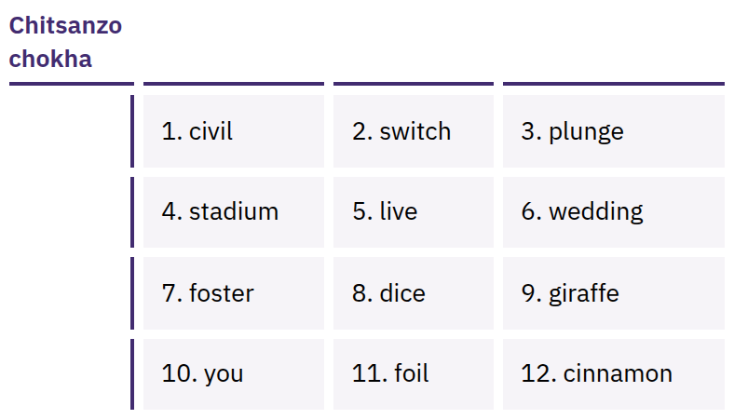
Mawu Anu Obwezeretsera
Amapereka Mwayi Wonse
Wolowera
Mndandanda wa mawu otsatizana mwadongosolo, nthawi zambiri 12 kapena 24, womwe ungagwiritsidwe ntchito kupanganso makiyi anu. Aliyense amene ali ndi mndandandawu angatenge bitcoin yanu.
Mawu Oyamba pa Bitcoin · Kodi mumagwiritsa ntchito Bitcoin motani?
Notes:
Mawu obwezeretsera chikwama si ongokuthandizani kubwezeretsa chikwama chokha: amapereka mwayi wonse wochigwiritsa ntchito. Mukamapanga chikwama, lembani mawuwo molondola papepala; asungeni popanda intaneti, mwachinsinsi, ndiponso pamalo amene sangatayike kapena kuwonongeka. Musawajambule chithunzi, kuwatumiza pa imelo, kuwasunga m’zolemba za pa mtambo, kuwatumiza mu uthenga, kapena kuwalemba pa webusaiti. Mawu amene asonyezedwa ndi chitsanzo chokha; musasonyeze kapena kusonkhanitsa mawu enieni obwezeretsera chikwama.

Slide 34

Makiyi si anu, ndalama si zanu.
Mawu Oyamba pa Bitcoin · Kodi mumagwiritsa ntchito Bitcoin motani?

Slide 35

Musanagwiritse Ntchito
Chikwama Chilichonse
Makiyi: ndani amawalamulira, inuyo kapena kampani?
Kubwezeretsa: bwanji ngati foni yanu itatayika kapena kampaniyo itasowa?
Gwero: ndi webusaiti yovomerezeka kapena tsamba la pulogalamuyo m’sitolo ya mapulogalamu, osati ulalo umene munthu wina anakutumizirani?
Khodi: ndi yotseguka kwa aliyense ndipo ikusamalidwa mosalekeza? (Izi zokha si umboni wakuti ndi yotetezeka.)
Ndalama zolipira: pali zolipiritsa potumiza, polandira, kapena pochotsa ndalama?
Malipiro: pa blockchain, pa Lightning, kapena zonse ziwiri?
Mawu Oyamba pa Bitcoin · Kodi mumagwiritsa ntchito Bitcoin motani?
Notes:
My First Bitcoin simalimbikitsa zikwama zinazake. Zida, zolipiritsa, ndi eni ake zimasintha, ndipo zimene zili zoyenera kwa gulu lina sizingakhale zoyenera kwa gulu lina. Auzeni ophunzira kuti afunse mphunzitsi wodalirika wa m’dera lawo.

Slide 36
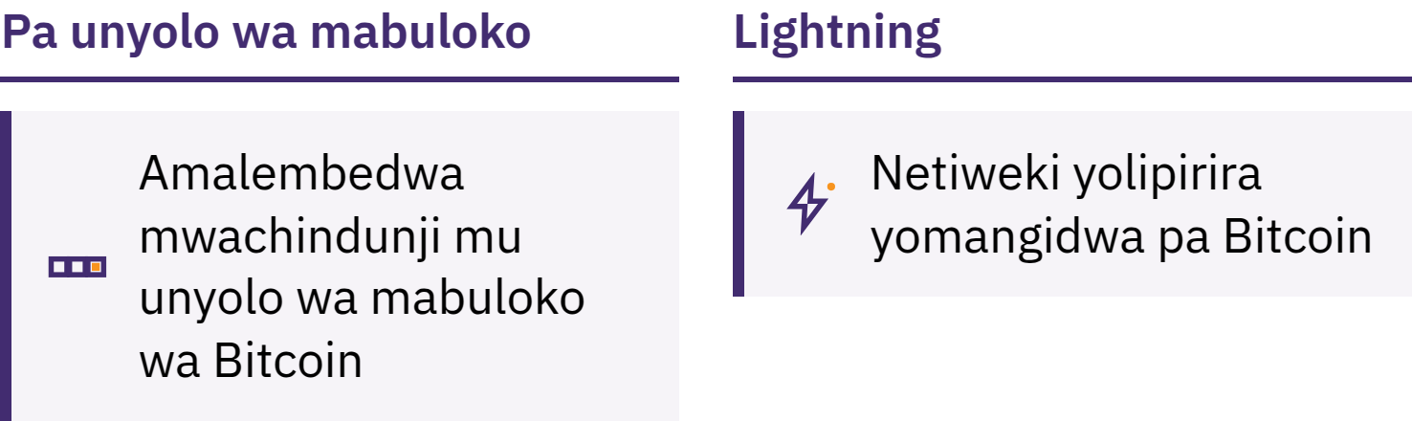
Pa Blockchain ndi Lightning
Pa Blockchain: zolembedwa mwachindunji mu Blockchain
Lightning: netiweki yolipirira yomangidwa pamwamba pa Bitcoin kuti malipiro ang'onoang'ono komanso obwerezabwereza azichitika mofulumira, monga pogula khofi
Chikwama cha Lightning chingakhalenso choyang'aniridwa ndi wopereka chithandizo kapena ndi mwiniwake
Mawu Oyamba pa Bitcoin · Kodi mumagwiritsa ntchito Bitcoin motani?

Slide 37
Malamulo Atatu Pamene Mukuphunzira
Phunzirani kaye. Musachite zinthu chifukwa cha chisangalalo, mantha, kapena kukakamizidwa.
Yambani ndi zochepa. Yesani zida zomwe simunazolowere ndi ndalama zomwe kutaya kwake sikungakuvutitseni.
Musangokhulupirira, Tsimikizirani. Yang'anani munthuyo, njira yolipirira, adiresi, ndi kuchuluka kwa ndalama.
Gawani uthenga wolandirira ndalama, osagawana zinsinsi
Adiresi kapena pempho lolipira zingagawidwe. Mawu obwezeretsera chikwama kapena kiyi wachinsinsi siziyenera kugawidwa konse. Palibe mphunzitsi wovomerezeka, kampani ya zikwama zadijito, kapena wothandiza makasitomala amene angakufunseni zimenezi.
Mawu Oyamba pa Bitcoin · Kodi mumagwiritsa ntchito Bitcoin motani?

Slide 38

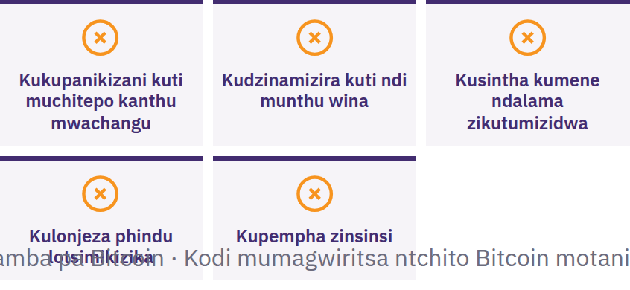
Imani, Musagawane
Chilichonse, Musatumize
Chilichonse
Imani ngati wina akukukakamizani kuchita zinthu mwachangu kapena mwachinsinsi, akulonjeza phindu lotsimikizika, akukupemphani kuti mutumize bitcoin kaye, kapena akupempha mawu anu obwezeretsera chikwama. Dikirani kaye. Musagawane chilichonse. Musatumize chilichonse. Kenako tsimikizirani kudzera ku gwero limene mumalidziwa kale.
Mawu Oyamba pa Bitcoin · Kodi mumagwiritsa ntchito Bitcoin motani?

Slide 39

Chotsatira N’chiyani?
Ichi ndi chiyambi chabe.

Slide 40
Mfundo Zinayi Zofunika Kukumbukira
Ndalama zimadalira malamulo ndi kukhulupirirana. Kuchuluka kwa ndalama za fiat ndi malamulo ake zimakhazikitsidwa ndi mabungwe ochepa.
Bitcoin imapereka malamulo osiyana. Kuchuluka kwa ndalama kodziwika kwa anthu onse, kokhala ndi malire, komwe aliyense angagwiritse ntchito ndipo kungatsimikizidwe m'malo mongokukhulupirira.
Chitetezo chimabwera poyamba. Phunzirani kaye, yambani ndi zochepa, tsimikizirani chilichonse, ndipo musauze aliyense mawu anu obwezeretsera chikwama.
Ichi ndi chiyambi chabe. Sitepe imodzi yotsatira yotetezeka ndi yokwanira.
Nthawi yosinkhasinkha
Bwererani ku mafunso asanu oyambirira aja. Kodi mungayankhe bwanji tsopano?
Mawu Oyamba pa Bitcoin · Chotsatira N’chiyani?

Slide 41

Dipuloma ya Bitcoin
Gawo lotsatira. Magawo ake anayi akukuthandizani kupita patsogolo:
Kumvetsetsa ndalama
Mmene Bitcoin imagwirira ntchito
Kugwiritsa ntchito Bitcoin mosamala
Bitcoin m’dera lanu
Pitirizani kukhala ndi chidwi chofuna kudziwa, kufunsa mafunso, ndi kuphunzira zambiri pa myfirstbitcoin.org.
Tikuyembekezera kukuonani m’gulu lathu lotsatira la ophunzira.
Mawu Oyamba pa Bitcoin · Chotsatira N’chiyani?

Slide 42


