Slide 1

Integuro 26.10
Intangamarara
kuri
Bitcoin
Imfashanyigisho y’abatangura

Slide 2

Kubera iki amahera ahambaye?
Dukoresha amahera buri musi, yamara ni gake twibaza ingene akora.
Notes:
Inkomoko: My First Bitcoin, Intangamarara kuri Bitcoin, Igitabu c’abatangura, integuro ya 26.10. Vyahinduwe hisunzwe uruhusha rwa Creative Commons Attribution-ShareAlike 4.0 International; izi mpapuro zo kwerekana zikoresha urwo ruhusha nyene. Izi mpapuro ni igikoresho gifasha umwigisha gushikiriza icigwa, zishingiye ku bibazo bitandatu biri muri ico gitabu. Nimuhuze uburorero, umuvuduko w’inyigisho n’uburyo bwo kuzishikiriza n’abo mwigisha, ariko mugumye insobanuro n’ubutumwa bwerekeye umutekano. Nta kiringo ntakuka c’icigwa gitegekanijwe.

Slide 3

Abantu benshi ntibigera
bafata akanya ko kwiyumvira
ku mafaranga
Si ukuyikorera, si ukuyikoresha mu kugura, ahubwo ni ukwiyumvira ico ari co n'ingene ikora.
Intangamarara kuri Bitcoin · Kubera iki amahera ahambaye?
Notes:
Mutangure n’ishusho: abantu bose badukikuje bakoresha amahera ata co bayibazako. Mubaze abagize umugwi igihe baheruka kwiyumvira aho amahera ava.

Slide 4

Ibibazo bitanu vyo gutangura
Kubera iki abantu bakeneye amahera?
Ni igiki gituma ikintu kiba amahera?
Ni nde ashobora kurema canke kugenzura amahera mukoresha?
Kubera iki amahera mukoresha afise agaciro?
Amahera yanyu arashobora kugura ibintu bingana n'ivyo yagura mbere?
Nimubike inyishu zanyu
Nimwandike inyishu ngufi kuri buri kibazo. Muzosubira kuri izo nyishu mu mpera.
Intangamarara kuri Bitcoin · Kubera iki amahera ahambaye?
Notes:
Muhe abiga iminota mikeyi yo kwandika. Ntimusabe umuntu n’umwe gutanga amakuru y’ido n’ido yerekeye ivy’amafaranga yiwe bwite. Izi nyishu zizogaruka ku gicapo c’ivyiyumviro nyamukuru citwa «Ni igiki gikurikira?».

Slide 5

Ukuri canke iciyumviro?
Ukuri: "Iyi noti iremewe mu kuriha amakori." Ivyo birashobora kugenzurwa.
Iciyumviro: "Ubu ni bwo buryo bwiza kuruta ubundi bwose bw’amahera." Ivyo bisaba ibipimo n’ivyemezo.
Iyi mfashanyigisho igenewe inyigisho gusa. Ntitanga impanuro zijanye n’imari, ishoramari, amategeko canke amakori, kandi ntivuga ko mukwiye kugura, kugurisha canke kubika ikintu na kimwe.
Intangamarara kuri Bitcoin · Kubera iki amahera ahambaye?
Notes:
Mugume mwisunga iryo tandukaniro mu kiringo cose c’iki cigwa. Igihe hagize ikivugwa, mwibaze muti: twoshobora kugisuzuma, canke gisaba ingingo ngenderwako n’ibimenyamenya?

Slide 6

Amafaranga ni iki?
Amahera ni igikoresho co guhanahana.

Slide 7

Uguhanahana ibidandazwa n’uguhurirana kw’ivyo impande
zompi zikeneye
Umwe wese muri abo bantu babiri ategerezwa kuba ashaka ivyo uwundi afise, mu mwanya umwe kandi mu bwinshi bubereye.
Intangamarara kuri Bitcoin · Amafaranga ni iki?
Notes:
Nimukoreshe akarorero kari mu gitabu c’ubuyobozi: murima umuceri kandi mukeneye ibirato, ariko uwukora ibirato ashaka amavuta yo guteka, ntashaka umuceri. Abahinga mu vy’ubutunzi ivyo bavyita uguhurirana kw’ivyo abantu bipfuza ku mpande zompi.

Slide 8
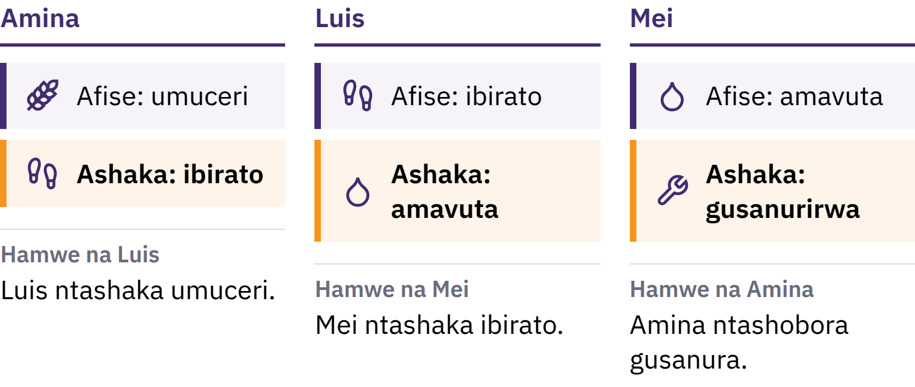
Uguhanahana ibidandazwa n’uguhurirana kw’ivyo impande
zompi zikeneye
Abo bantu bompi bategerezwa kuba bashaka ivyo uwundi afise, mu gihe kimwe kandi ku rugero rubereye.
Intangamarara kuri Bitcoin · Amafaranga ni iki?
Notes:
Nimukoreshe akarorero kari mu gitabu c’ubuyobozi: murima umuceri kandi mukeneye ibirato, ariko uwukora ibirato ashaka amavuta yo guteka, ntashaka umuceri. Abahinga mu vy’ubutunzi ivyo bavyita uguhurirana kw’ivyo abantu bipfuza ku mpande zompi.

Slide 9

Amahera ni igikoresho co guhanahana
Nta muntu yipfuza amahera kugira gusa ayatunge. Afise akamaro kuko abandi bayemera, biteze ko n'abandi bazoyemera mu nyuma.
Intangamarara kuri Bitcoin · Amafaranga ni iki?
Notes:
Inoti y’amahera ni urupapuro gusa. Amahera atorera umuti ingorane zo guhanahana ibidandazwa ku bindi mu gutandukanya kugurisha no kugura: mugurisha umuceri wanyu umuntu umwe, mukagura ibirato ku wundi. Ico ni co gitandukanya amahera n’uguhanahana ibidandazwa ku bindi.

Slide 10

Ibintu Bitatu Amahera Akora
Uburyo bwo guhanahana: abantu barayemera mu kwishura
Igipimo co guharura: ibiciro bigaragazwa muri yo
Uburyo bwo kuzigama agaciro: atwara agaciro kuva uno musi gushika muri kazoza
Nta mafaranga azigama agaciro bimwe bitagira agahaze, ariko ubwoko bumwebumwe bw'amafaranga butakaza ubushobozi bwo kugura buhorobuhoro kuruta ubundi.
Intangamarara kuri Bitcoin · Amafaranga ni iki?

Slide 11

Kuva ku bikonoshwa gushika
ku mpapuro
Ibikonoshwa, umunyu, ubunigi, ibitungwa, umuringa, ifeza, inzahabu
Ivyuma vy'agaciro: biboneka gake, biramba, vyemerwa henshi
Impapuro ziha uwuzifise uburenganzira bwo guhabwa urugero rw'icuma rwanditsweko
Uburyo bwo gushingira amafaranga ku nzahabu: igice c'ifaranga gifitaniye isano n'inzahabu hisunzwe amategeko
Amategeko yarahinduka bivanye n'ahantu be n'ikiringo.
Intangamarara kuri Bitcoin · Amafaranga ni iki?

Slide 12
Amafaranga ashingiye kw’itegeko rya Leta
1971: Leta Zunze Ubumwe za Amerika zahagaritse uburyo bwemewe bwo kuvunjisha amadolari mu nzahabu bwakoreshwa na za Leta z'amahanga n'amabanki nkuru
Muri iki gihe, amafaranga y'ibihugu vyinshi ni amafaranga ya fiat: asohorwa ku bubasha bwa Leta, ntashobora kuvunjishwa mu nzahabu canke mu kindi kidandazwa ico ari co cose
Fiat ni ijambo ry'ikilatini risobanura ngo "nibikorwe", akenshi rigatahuzwa n'insobanuro ngo "biciye kw'itegeko"
Aremerwa kuko abantu, amashirahamwe y'ubudandaji, amabanki na za Leta bayakoresha; amategeko arayemeza nk'uburyo bwo kuriha kandi agasaba ko akoreshwa mu kuriha amakori
Intangamarara kuri Bitcoin · Amafaranga ni iki?

Slide 13

Twavuye ku mahera ashigikiwe
n’ikintu, tuja ku mahera
ashigikiwe n’icizere dufitiye
umuntu.
Intangamarara kuri Bitcoin · Amafaranga ni iki?

Slide 14

Ni igiki kitagenda neza mu mafaranga
yacu?
Iyo abantu bumvise ijambo ugutakaza agaciro kw'amahera, akenshi baca biyumvira iduga ry'ibiciro.

Slide 15
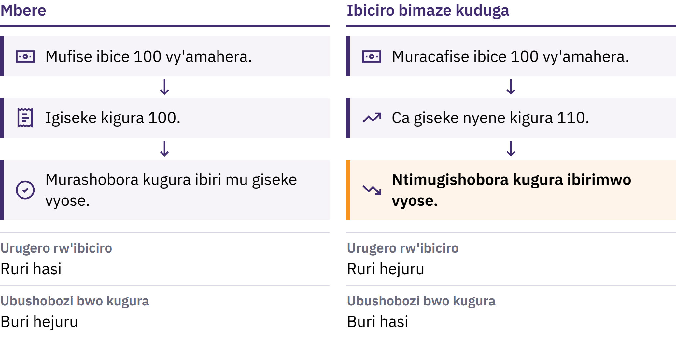
Iduga ry’ibiciro n’ubushobozi bwo kugura
Intangamarara kuri Bitcoin · Ni igiki kitagenda neza mu mafaranga yacu?
Notes:
Iduga ry’ibiciro ni ukwiyongera kubandanya kw’urugero rusangi rw’ibiciro. Urundi ruhande rwaryo ni ubushobozi bwo kugura: ivyo igipimo kimwe c’amahera gishobora kugura. Iyo ikiguzi c’igiseke c’ibintu vy’ishimikiro kiduze kiva ku bipimo 100 vy’amahera kikaja kuri 110, vya bipimo 100 nyene ntibiba bigishobora kugura ico giseke cose.

Slide 16

Iduga ry’ibiciro n’ubushobozi bwo kugura
Intangamarara kuri Bitcoin · Ni igiki kitagenda neza mu mafaranga yacu?
Notes:
Iduga ry’ibiciro ni ukwiyongera kubandanya kw’urugero rusangi rw’ibiciro. Urundi ruhande rwaryo ni ubushobozi bwo kugura: ivyo igipimo kimwe c’amahera gishobora kugura. Iyo ikiguzi c’igiseke c’ibintu vy’ishimikiro kiduze kiva ku bipimo 100 vy’amahera kikaja kuri 110, vya bipimo 100 nyene ntibiba bigishobora kugura ico giseke cose.

Slide 17

Imvo Nyinshi, Ihitamwo
Rimwe
Iyongerekana ry’amahera n’inguzanyo
Ihungabana ry’itangwa ry’ibidandazwa n’amahinduka mu vyo abaguzi basaba
Ifaranga ritakaza agaciro, amakori, amafaranga akoreshwa mu guhingura
Imwe mu mvo ni ingingo ifashwe, si ikintu gipfuye kwizana: mu buryo bw’amahera ashingiye ku ngingo ya Leta, inzego nke zirashobora kwongera amahera n’inguzanyo biriho no guhindura amategeko abigenga.
Intangamarara kuri Bitcoin · Ni igiki kitagenda neza mu mafaranga yacu?
Notes:
Abahinga mu vy’ubutunzi baraharira ku rugero igituma kimwekimwe cose kigira uruhara. Nimushimike kuri ca gituma kimwe kiva ku ngingo yafashwe aho kuva ku kintu cashitse giturumbuka.

Slide 18
Ubukeyi n’agaciro
Igicapo c'umwimerere ca Mona Lisa gifise agaciro karuta ak'ikopi iyo ari yo yose: ni co conyene kiriho
Ubuke bw'ikintu bwonyene ntibugiha agaciro, ariko iyo abantu bagishaka, ingano yaco iboneka irahambaye
Iyo ingano y'amahera ariho yiyongera ningoga kuruta ingano y'ivyo ashobora kugura, ifaranga rimwe ryose rikunda kugura ibintu bike kuruta
Intangamarara kuri Bitcoin · Ni igiki kitagenda neza mu mafaranga yacu?

Slide 19
Iduga ry’ibiciro ntirigira ingaruka zimwe kuri bose
Amafaranga y'inoti n'ibiceri hamwe n'ayo mwaziganije arashobora gutakaza ubushobozi bwo kugura
Abafise amatungo aduga mu giciro barashobora gukingirwa ku rugero runaka
Imishahara n'ibiciro bihinduka ku muvuduko utandukanye
Amafaranga mufise kuri konti muri banki aratandukanye n'amafaranga mufise mu ntoke: ni umuhango banki ibaha wo kubaha ayo mafaranga. Uwo muhango akenshi urashitswa, ariko bivana na banki hamwe n'amategeko ayigenga.
Intangamarara kuri Bitcoin · Ni igiki kitagenda neza mu mafaranga yacu?

Slide 20
Nimubigerageze: Isuzuma ry’ubushobozi bwo kugura
Nimuhitemwo ikintu kimwe gisanzwe: umukate, kwiyunguruza, canke amafaranga yo guhamagara kuri telefone
Nimwandike igiciro caco c'uyu musi
Nimubaze umuntu igiciro caco mu myaka iheze, mwongere musuzume inyandiko yo kwizigirwa nimba mubishoboye
Amafaranga abantu binjiza yoba yiyongereye ku rugero rumwe? Ni ikindi ikihe cosigura iryo hinduka?
Intangamarara kuri Bitcoin · Ni igiki kitagenda neza mu mafaranga yacu?
Notes:
Ibi birashoboka ata gikoresho na kimwe canke interineti. Mugereranye inyishu zatanzwe mu mugwi, mwongere mwibutse abiga ko igiciro kimwe conyene kiterekana igipimo cose c’iduga ry’ibiciro.

Slide 21
Amafaranga ya fiat arakora, ariko arimwo ingorane
Ukwishura mu buryo bworoshe, ingurane zishobora guhindurwa hisunzwe ibikenewe, ibikoresho vyo guhangana n'ibihe vy'ingorane
Ariko igitigiri c'amahera n'amategeko ayagenga birashobora guhinduka, kandi abayakoresha nta jambo rinini babifisemwo
Ni co gituma abantu barondera ubundi buryo, kandi ni co catumye Bitcoin iremwa.
Intangamarara kuri Bitcoin · Ni igiki kitagenda neza mu mafaranga yacu?

Slide 22

Bitcoin ni iki?
Amafaranga yo mu buhinga bwa none atagenzurwa n’urwego rumwe, afise igitigiri ntarengwa, kandi ashobora kurungikwa ava ku muntu aja ku wundi ata ruhusha rwa banki.

Slide 23
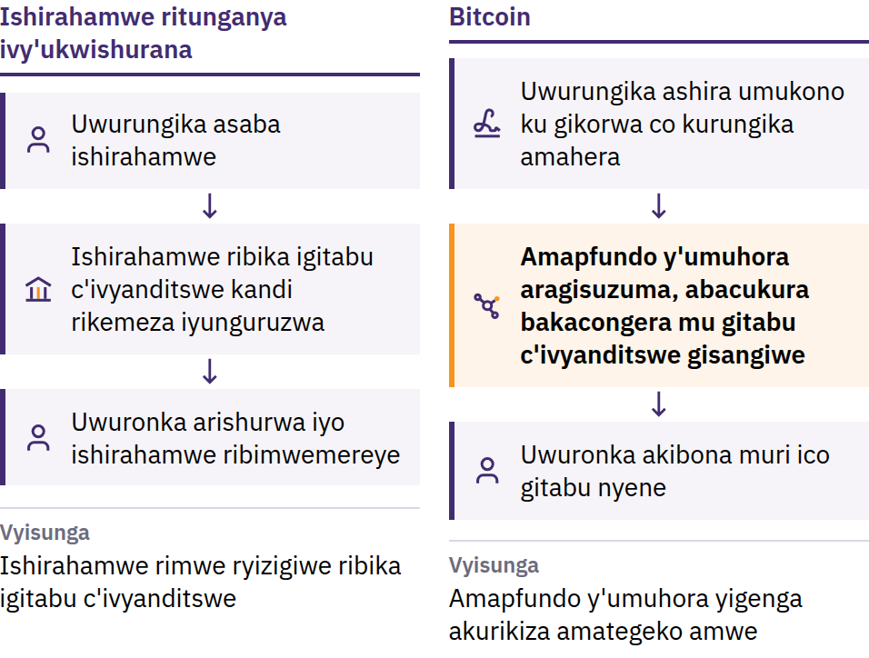
Ingorane yo gukoresha amahera amwe kabiri
31 Gitugutu 2008: Satoshi Nakamoto asohora Bitcoin: Uburyo bwo guhanahana amafaranga yo mu buhinga bwa elegitoronike hagati y’abakoresha ata muhuza. Nzero 2009: umuhora utangura gukora.
Intangamarara kuri Bitcoin · Bitcoin ni iki?
Notes:
Imbere y’uko Bitcoin ibaho, kurungika amafaranga kuri internet vyama bisaba kwizigira ikigo: ibanki canke ishirahamwe ryo kwishurana ryabika igitabu c’amakonte, rikemeza amakonte, kandi ryashobora guteba, guhagarika canke gusubiza inyuma ukwishura. Amakuru yo mu buhinga bwa none aroroshe gukoporora: iyo igiceri co mu buhinga bwa none gishobora gukoreshwa mu kwishura incuro zibiri, nticoshoboye gukora nk’amafaranga. Iyo ni yo ngorane yo gukoresha amafaranga amwe incuro zibiri. Satoshi Nakamoto ni umuntu canke umugwi ukoresha iryo zina.

Slide 24
Bidashingiye ku buyobozi bumwe · Igitigiri ntarengwa ·
Umuntu ku wundi
Bidatwarwa n'urwego rumwe: nta biro bikuru vyugurura amakonti, bihindura amafaranga ari kuri yo, canke vyemeza abemerewe kwinjira
Igitigiri ntarengwa: ntihazokwigera habaho bitcoin zirenga imiliyoni 21
Umuntu ku wundi: murashobora kurungikira uwo ari we wese, aho ari hose, mutarinze gusaba uruhusha urwego rukuru
Nta shirahamwe rishobora guhagarika ikoreshwa rya bitcoin mwigenzurira ubwanyu. Uwo mwidegemvyo ujana n'ukubazwa ivyo mukora: ihanahanwa ryemewe akenshi ntirishobora gusubizwa inyuma, kandi nta biro vyo gufasha abakoresha uwo muhora biriho.
Intangamarara kuri Bitcoin · Bitcoin ni iki?
Notes:
Kutagira ubuyobozi bumwe bugenzura vyose ntibisigura ko bose bafise ijambo ringana. Bisigura ko ata n’umwe mu babigiramwo uruhara ashobora guhindura igitabu c’inyandiko z’ibikorwa vy’amahera canke amategeko agenga amahera ku bwa bose.

Slide 25
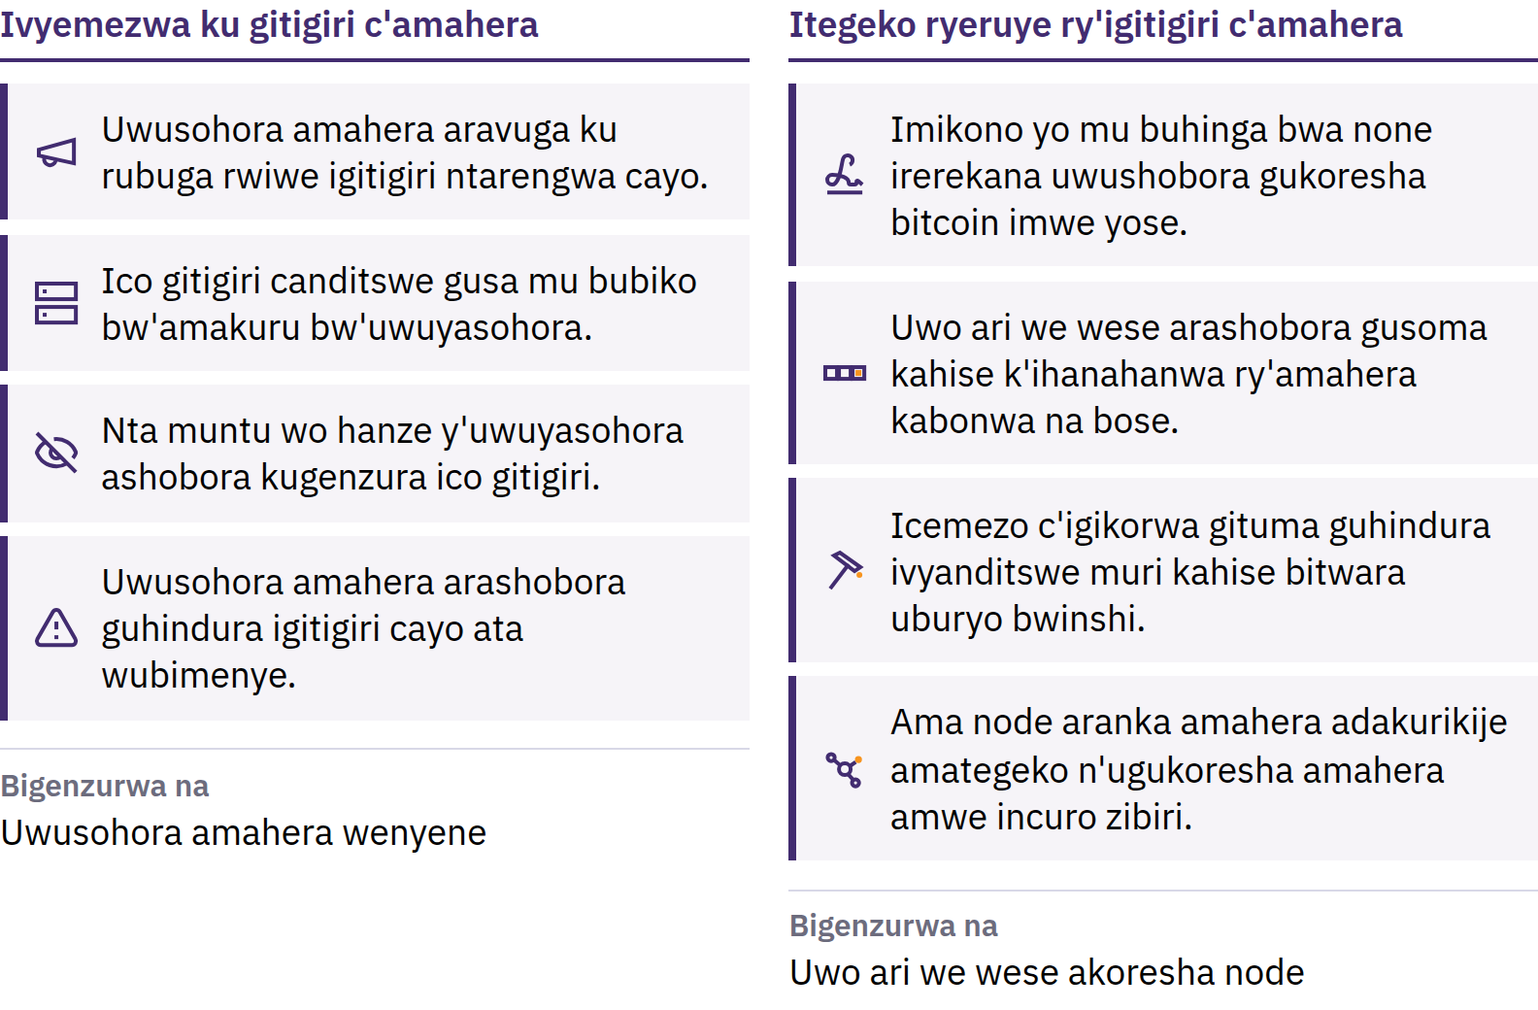
Urugero ntarengwa umuntu wese ashobora kugenzura
Intangamarara kuri Bitcoin · Bitcoin ni iki?
Notes:
bitcoin nshasha zirekurwa hakurikijwe ingengabihe izwi na bose, kandi inyabwonko zigenga zitwa amapfundo ziranka ibarabara ryose ridakurikiza iryo tegeko. Ico gitigiri ntarengwa kirizigirwa kuko uwo ari we wese ashobora kugisuzuma. Si itegeko ry’ivyaremwe: riguma ryubahirizwa kuko abari muri uwo muhora babandanya kurishira mu ngiro. Kuba igitigiri ca bitcoin gifise aho kigarukira ntivyemeza ko igiciro kizoduga; igiciro kivana n’ubwinshi bw’izikenewe hamwe n’ubwinshi bw’izitangwa.

Slide 26
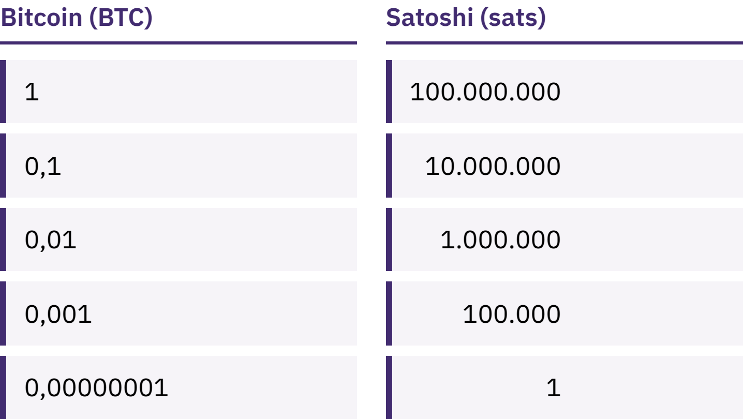
Ntimukeneye Bitcoin imwe yuzuye
bitcoin imwe igaburamwo uduce dutoduto 100 000 000 twitwa satoshis, canke sats.
Intangamarara kuri Bitcoin · Bitcoin ni iki?
Notes:
Gutunga 100 000 sats no gutunga 0,001 bitcoin bisigura urugero rumwe rw’amahera. Nimukosore iciyumviro kitari co c’uko Bitcoin idashobora kugurwa kubera ko bitcoin imwe izimvye.

Slide 27
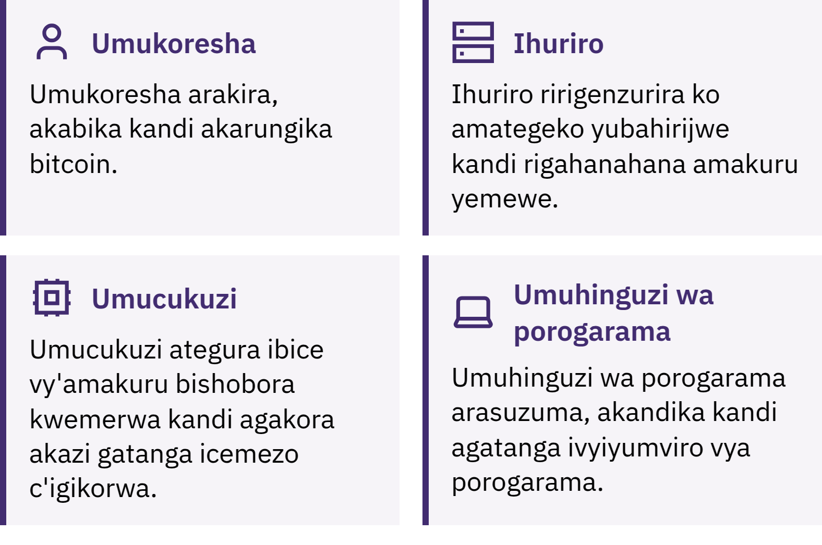
Ni nde atuma Bitcoin ibandanya gukora?
Intangamarara kuri Bitcoin · Bitcoin ni iki?
Notes:
Abakoresha bararungika, bakakira kandi bakabika bitcoin; ibikoresho bihurikiye ku rubuga birasuzuma ko irungikwa ryose n’igice cose c’amakuru vyubahiriza amategeko; abacukuzi barahiganwa kugira bongere igice gishasha c’amakuru ku rutonde rw’ivyanditswe, hafi buri minota cumi. Urwo rutonde, ari rwo ruhererekane rw’ibice vy’amakuru rwitwa blockchain, rurashobora kubonwa na bose kandi kurusubira kwandika bisaba uburyo bwinshi cane. Icitonderwa ku nyandiko: Bitcoin itangurwa na B nkuru akenshi isobanura urubuga canke uburyo bukora; bitcoin itangurwa na b ntoya isobanura amahera ubwayo.

Slide 28

Ni nde atuma Bitcoin ibandanya gukora?
Intangamarara kuri Bitcoin · Bitcoin ni iki?
Notes:
Abakoresha bararungika, bakakira kandi bakabika bitcoin; ibikoresho bihurikiye ku rubuga birasuzuma ko irungikwa ryose n’igice cose c’amakuru vyubahiriza amategeko; abacukuzi barahiganwa kugira bongere igice gishasha c’amakuru ku rutonde rw’ivyanditswe, hafi buri minota cumi. Urwo rutonde, ari rwo ruhererekane rw’ibice vy’amakuru rwitwa blockchain, rurashobora kubonwa na bose kandi kurusubira kwandika bisaba uburyo bwinshi cane. Icitonderwa ku nyandiko: Bitcoin itangurwa na B nkuru akenshi isobanura urubuga canke uburyo bukora; bitcoin itangurwa na b ntoya isobanura amahera ubwayo.

Slide 29
Bitcoin Ifise Ivyiza n’Ibibi
Igiciro cayo kirashobora guhinduka ningoga
Amakosa akenshi ntashobora gukosorwa
Ukwemerwa kwayo kuracari guke mu bibanza vyinshi
Kuyikoresha mu buryo butekanye bisaba kubanza kwiga bimwe
Bitcoin ituma ukwizigira inzego mu bintu bimwebimwe gusubirirwa n'ugusuzuma hamwe n'ukwiyemeza inshingano z'umuntu ku giti ciwe. Ntikuraho ingorane.
Intangamarara kuri Bitcoin · Bitcoin ni iki?

Slide 30

Mukoresha Bitcoin gute?
Ikibazo ca mbere ku bijanye n’agasakoshi ako ari ko kose: ni nde agenzura impfunguruzo?

Slide 31
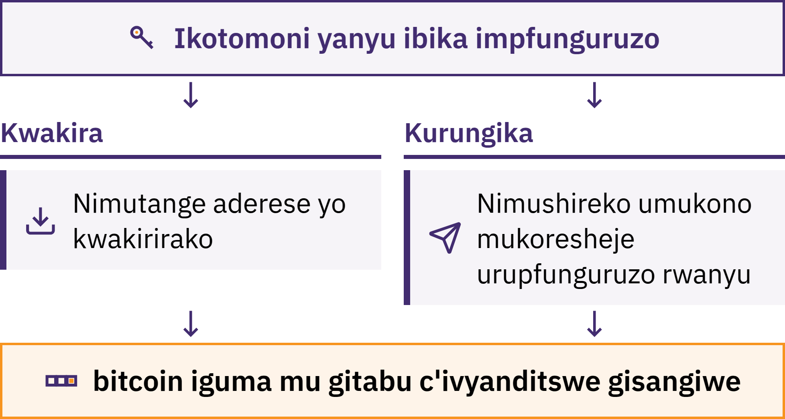
Ikofi icungera imfunguruzo
Intangamarara kuri Bitcoin · Mukoresha Bitcoin gute?
Notes:
Agasakoshi ka Bitcoin ni igikoresho, akenshi kikaba ari porogarama, kibafasha kwakira, kugenzura no kurungika bitcoin. Bitcoin zanyu ntizibikwa muri telefone yanyu: zandikwa kuri blockchain. Ako gasakoshi gacungera imfunguruzo zibafasha kwemeza ko izo bitcoin ari izanyu no gutanga uruhusha rwo kuriha.

Slide 32
Ni nde mu vy’ukuri abitse Bitcoin zanyu?
Kwibikira: ni mwebwe mugenzura impfunguruzo
Nta n'umwe ashobora kubagarurira bitcoin zanyu mutakaje urukurikirane rw'amajambo yo kugaruza ikotomoni n'igikoresho
Kubikizwa: ishirahamwe ni ryo ribika impfunguruzo, nk'uko ibanki ibigenza
Amafaranga mufise kuri konti ni isezerano iryo shirahamwe ribaha ryo kuzobariha; rirashobora kugabanya ayo mushobora kubikuza, guhagarika ibikorwa kuri konti, kwinjirirwa n'abasuma bo kuri internet, canke kwugara
Guhitamwo uburyo bwo kubika si ikigeragezo c'agaciro kanyu. Igihambaye ni ukumenya uburyo muriko murakoresha n'ico muriko murizigira.
Intangamarara kuri Bitcoin · Mukoresha Bitcoin gute?

Slide 33

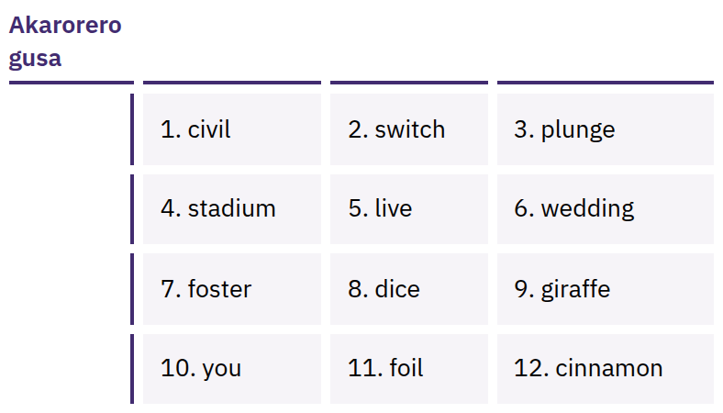
Amajambo yanyu yo kugarura
atanga uburenganzira bwose
bwo kwinjira
Urutonde rw'amajambo ashizwe ku murongo, akenshi aba 12 canke 24, rushobora gukoreshwa mu gusubira kurema impfunguzo zanyu. Uwo wese arufise arashobora gutwara bitcoin zanyu.
Intangamarara kuri Bitcoin · Mukoresha Bitcoin gute?
Notes:
Urukurikirane rw’amajambo yo gusubizaho isakoshi si uburyo bwo kuyigarukana gusa: rutanga uburenganzira bwose bwo kuyikoresha. Mwandike ayo majambo neza ku rupapuro igihe murema isakoshi; muyabike ahatari kuri internet, mw’ibanga, kandi ahantu atazotakara canke ngo yononekare. Ntimukigere muyafotora, muyarungika kuri imeyili, muyabika mu nyandiko zo mu bubiko bwo kuri internet, muyarungika mu butumwa, canke muyandika ku rubuga rwa internet. Amajambo yerekanwa ni akarorero gusa; ntimukigere mwerekana canke mukusanya urukurikirane rw’amajambo yo gusubizaho isakoshi ikoreshwa vy’ukuri.

Slide 34

Si imfunguruzo zanyu, si ibiceri
vyanyu.
Intangamarara kuri Bitcoin · Mukoresha Bitcoin gute?

Slide 35

Imbere y’uko mukoresha
ikotomoni iyo ari yo yose
Impfunguruzo: ni nde azigenzura, ni mwebwe canke ishirahamwe?
Gusubirana: bigenda gute iyo telefone yanyu itakaye canke ishirahamwe ritakiriho?
Inkomoko: ni ku rubuga rwemewe canke mu bubiko bw'amaporogarama, aho kuba kw'ihuriro umuntu yabarungikiye?
Kode: iruguruye ku bantu bose kandi yoba yama ibungabungwa? (Ivyo vyonyene ntivyemeza ko itekanye.)
Amafaranga asabwa: hari amafaranga asabwa mu kurungika, mu kwakira canke mu kubikuza?
Ukwishura: kuri blockchain, kuri Lightning, canke kuri vyompi?
Intangamarara kuri Bitcoin · Mukoresha Bitcoin gute?
Notes:
My First Bitcoin ntihanura gukoresha amasakoshi kanaka yo kubikamwo bitcoin. Ibikoresho, amafaranga asabwa be na ba nyenevyo birahinduka, kandi ikibereye ikibano kimwe gishobora kutabera ikindi. Murangire abiga umwigisha wo mu karere kabo yizigirwa.

Slide 36
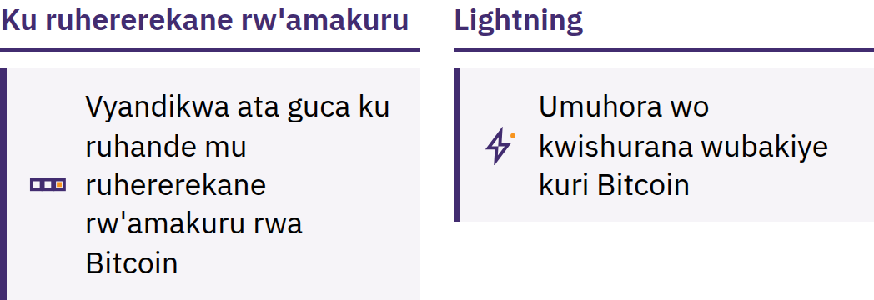
Ku ruhererekane rw’amakuru na Lightning
Ku ruhererekane rw’amakuru: vyandikwa ata guca ku ruhande mu ruhererekane rw’amakuru
Lightning: umuhora wo kwishurana wubakiye kuri Bitcoin kugira ngo umuntu ashobore kwishura ningoga, amahera make kandi kenshi, nko kugura ikawa
Isakoshi ya Lightning na yo nyene irashobora kuba icungiwe n’uwundi muntu canke iyo mwicungira
Intangamarara kuri Bitcoin · Mukoresha Bitcoin gute?

Slide 37
Amategeko atatu mu gihe mwiga
Nimubanze mwige. Ntimukore kubera ugushwashwanuka, ubwoba canke uguhatirwa.
Nimutangure n'amahera make. Nimugerageze ibikoresho mutamenyereye mukoresheje amahera mwoshobora kwihanganira gutakaza.
Ntimupfe kwizera, nimusuzume. Nimusuzume uwo muntu, uburyo bwo kuriha, aderese n'igitigiri c'amahera.
Nimutange amakuru yo kwakira amahera, ntimukigere mutanga amabanga
Aderese canke ubusabe bwo kuriha birashobora gutangwa. Amajambo yo kugarukana ikotomoni canke urufunguruzo rw'ibanga ntibitegerezwa kwigera bitangwa. Nta mwigisha wemewe, ishirahamwe ritanga amakotomoni canke umukozi ajejwe gufasha abakoresha azokwigera abibasaba.
Intangamarara kuri Bitcoin · Mukoresha Bitcoin gute?

Slide 38

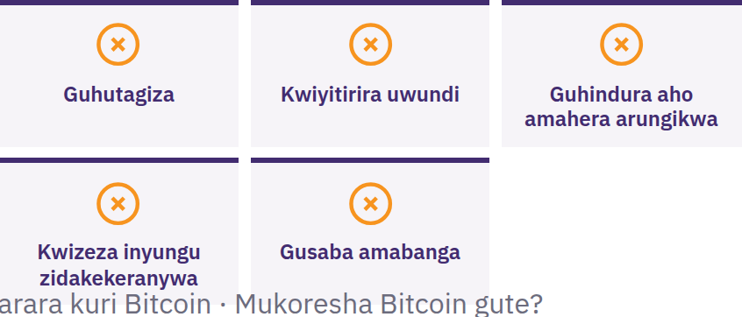
Nimuhagarare, ntimusangize
ikintu na kimwe, ntimurungike
ikintu na kimwe
Nimuhagarare nimba hari umuntu atuma ibintu bisa n’ivyihutirwa canke abasaba kubigira ibanga, abizeza inyungu ata kabuza, abasaba kubanza kurungika bitcoin, canke abasaba amajambo yanyu yo kugarura ikotomoni. Nimufate akanya. Ntihagire ico musangiza abandi. Ntihagire ico murungika. Hanyuma mugenzure mwifashishije isoko ry’amakuru musanzwe muzi.
Intangamarara kuri Bitcoin · Mukoresha Bitcoin gute?

Slide 39

Ni igiki gikurikira?
Iyi ni intango gusa.

Slide 40
Ivyigwa bine nyamukuru
Amahera ashingiye ku mategeko no ku kwizigirana. Igitigiri c'amahera ashingiye ku ngingo ya Leta n'amategeko ayagenga bishingwa n'inzego nkeyi.
Bitcoin itanga amategeko atandukanye. Igitigiri c'amahera kizwi na bose kandi gifise aho kigarukira, ashobora gukoreshwa na bose, kandi ico gitigiri gishobora kugenzurwa aho kucizigira gusa.
Umutekano uza imbere ya vyose. Nimubanze mwige, mutangure n'udukeyi, mugenzure vyose, kandi ntimukigere musangiza abandi amajambo yo kugarukana ikotomoni yanyu.
Iyi ni intango gusa. Intambwe imwe ikurikira itekanye irahagije.
Akanya ko kuzirikana
Nimusubire kuri vya bibazo bitanu vyo mu ntango. Ubu mwovyishura gute?
Intangamarara kuri Bitcoin · Ni igiki gikurikira?

Slide 41

Impamyabumenyi ya Bitcoin
Intambwe ikurikira. Ibice vyayo bine bibafasha gutera iyindi ntambwe:
Gutahura amafaranga
Ingene Bitcoin ikora
Gukoresha Bitcoin mu mutekano
Bitcoin mu kibano canyu
Mugume mufise inyota yo kumenya, mubandanye kubaza ibibazo, kandi mwige vyinshi kuri myfirstbitcoin.org.
Turashashaye kuzobabona mu mugwi wacu ukurikira w'abanyeshure.
Intangamarara kuri Bitcoin · Ni igiki gikurikira?

Slide 42


